Slide 1
Presence Detection/Location Tracking from WiFi Sniffing of Smart Phones
Chris Berry-Porter
Supervisor: Mark Schulz

Slide 2
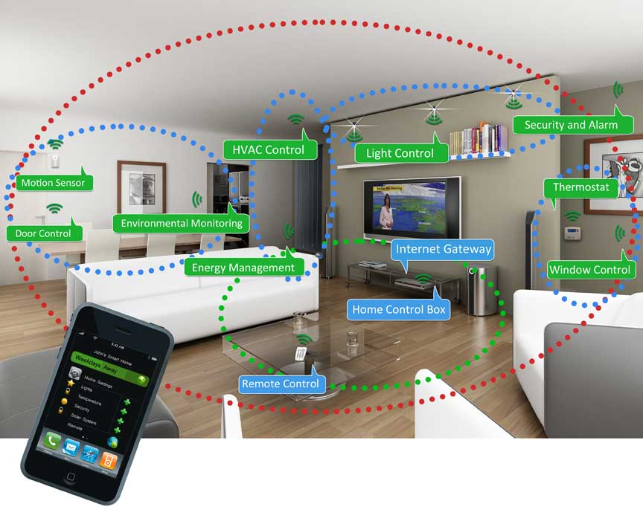
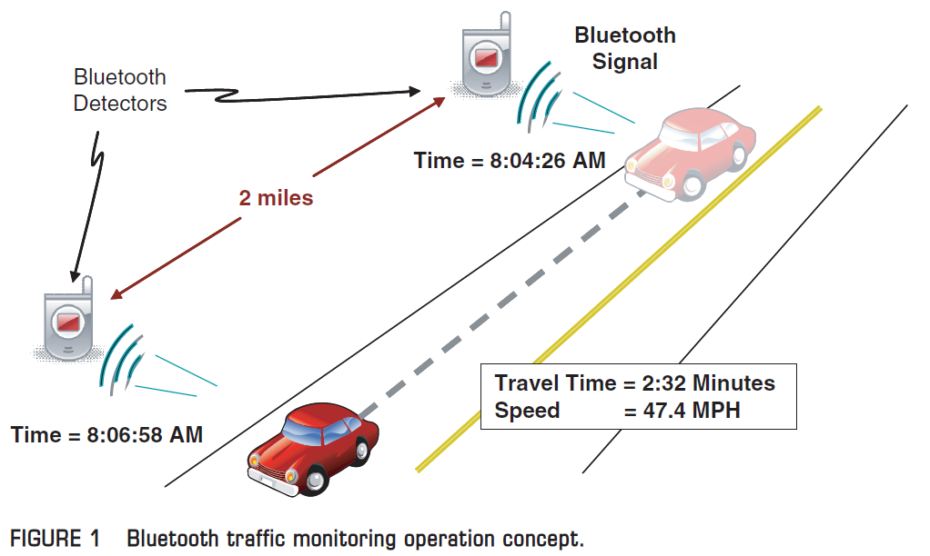
Why is Localisation Important?
Smart Homes
Traffic Monitoring
Notes:
Gives some context to apps
Automation
Office detection/energy control
Lost – map for airport/shopping centre
Navigation for robots

Slide 3
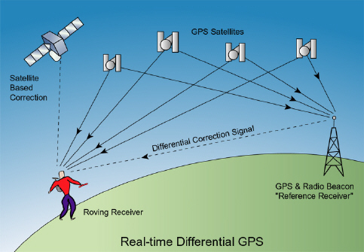
Common Localisation Methods
GPS
Bluetooth and/or Wireless
Notes:
GPS – good but doesn’t work indoors although getting better
Mobile Network (GSM/3G) – coarse grain location, not great for indoors
Bluetooth – low power but noisy
Wireless – common on many devices but noisy

Slide 4
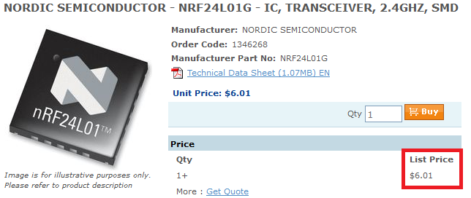
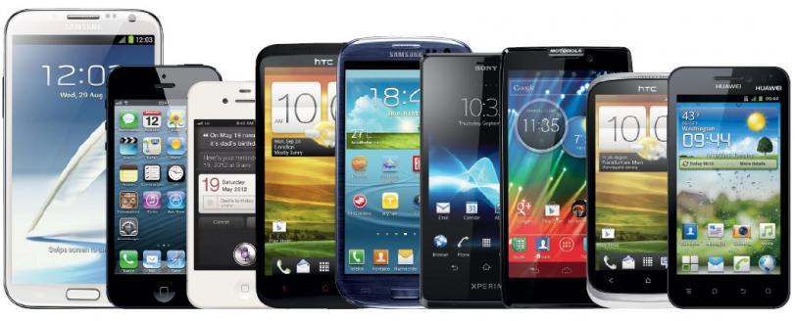
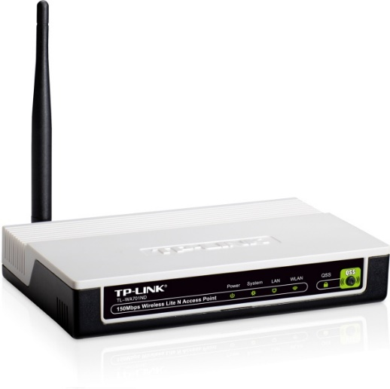
Wireless Advantages
Cheap
Found in all smart phones
Existing infrastructure could be reused
Notes:
Cheap – GPS costs triple
All smart devices have it
Commonly left on unlike Bluetooth
Can be passive or active
Has other purposes aside from localisation
Can use existing infrastructure (APs become sensor nodes)

Slide 5
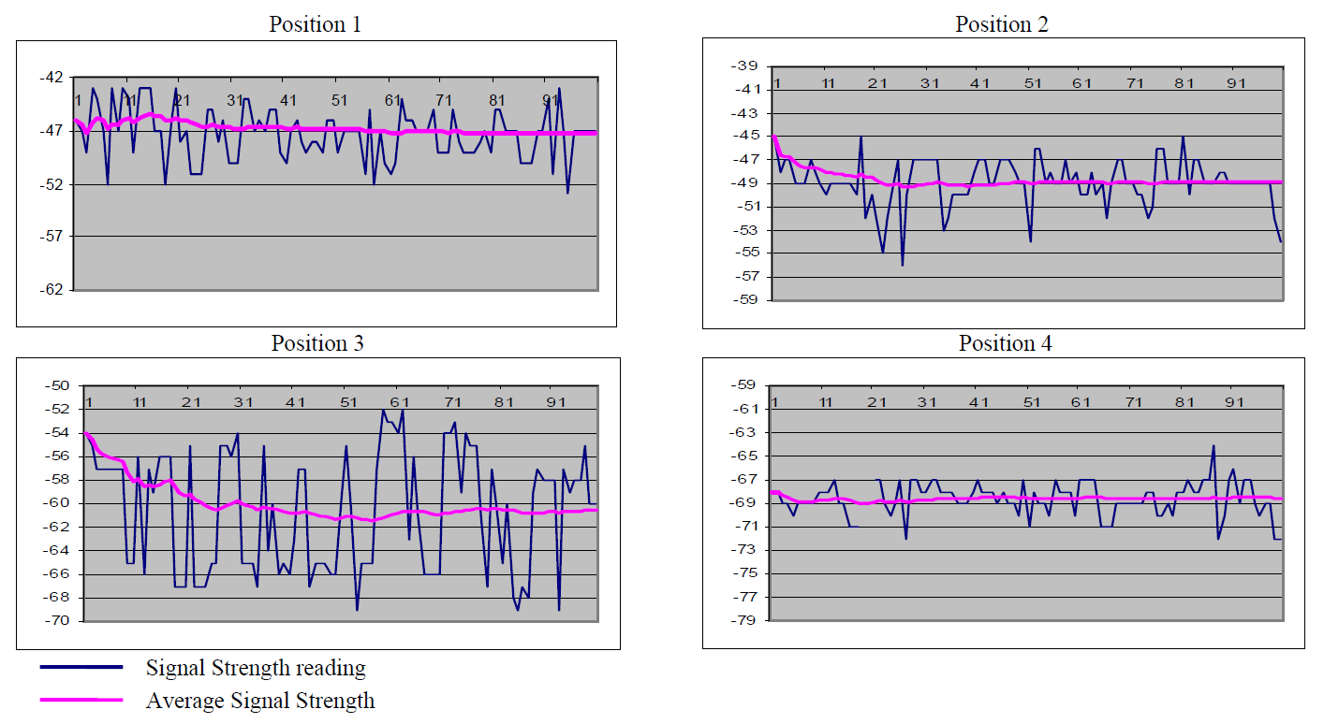
Wireless Disadvantages - Noise
Notes:
Reflections, constructive/destructive interference from other wifi
This affects accuracy – best case generally ~2m
Means lots of averaging – slow to react

Slide 6
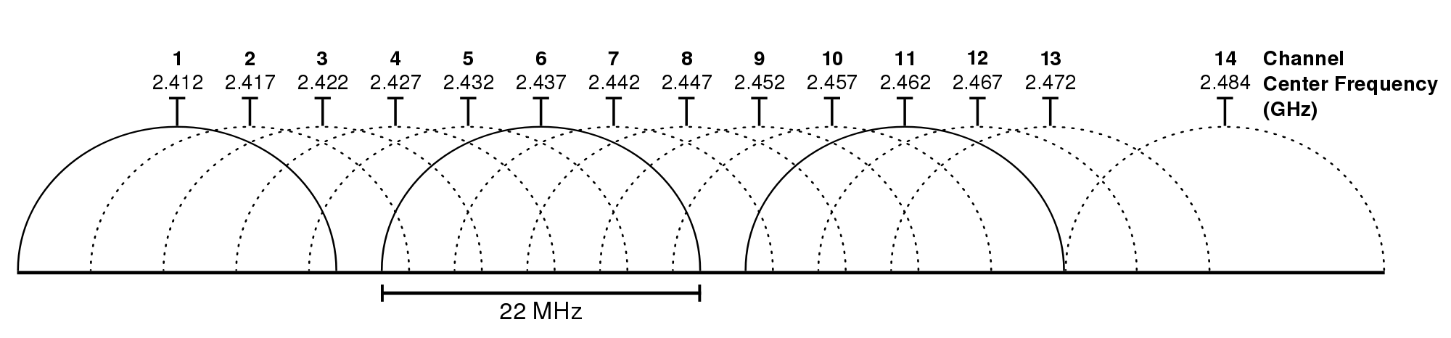
Wireless Disadvantages
Which channel/frequency?
Notes:
Which channel should you listen on? – scan?
Channels overlap – can get traffic from multiple channels

Slide 7
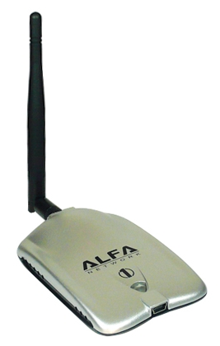
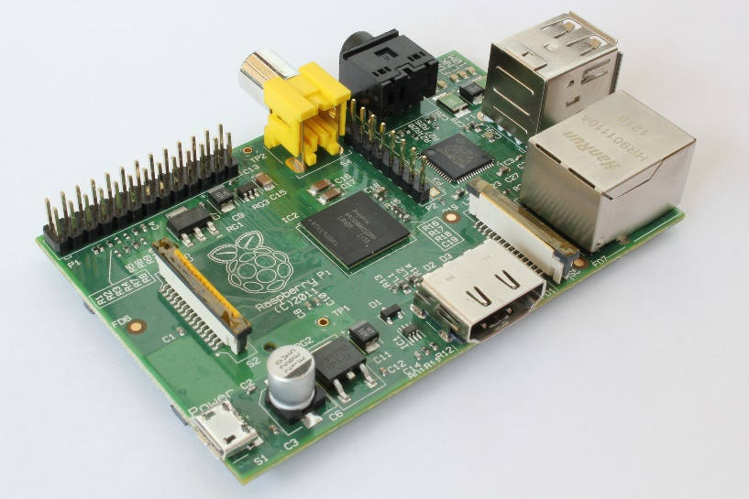
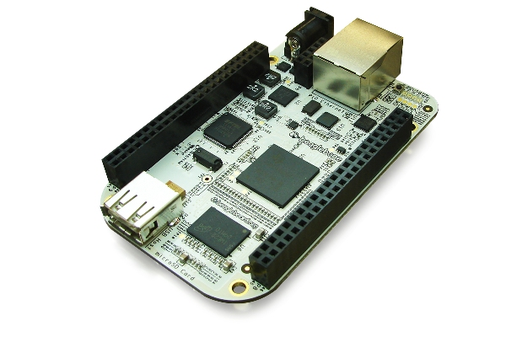
How does Localisation using wireless work?
Step 1: Sensor nodes
+
or
Wireless receiver
Raspberry Pi
BeagleBone
Notes:
Wireless adapter picked for receive sensitivity
Need USB
Need Ethernet/connectivity to server
Need Linux

Slide 8
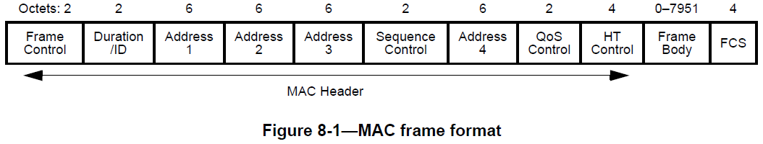
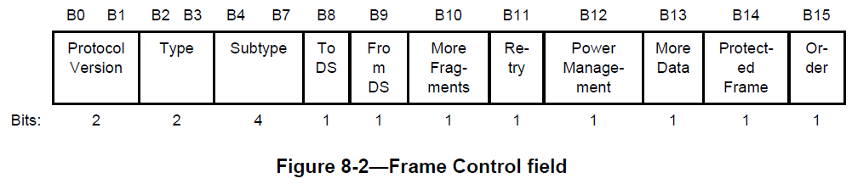
How does Localisation using wireless work?
Step 2: Capture packets
Notes:
FC: Type and subtype define packet type
FC: DS defines who transmitted/received
Ignore beacon packets
Address 2 is normally transmitter MAC address
Send packets to server for collection and processing

Slide 9
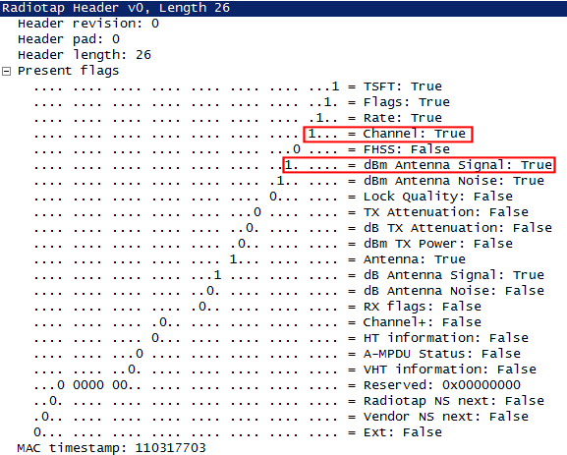
How does Localisation using wireless work?
Step 3: RSSI ranging
Radiotap Header
Notes:
RSSI given in radiotap header – variable length
Radiotap contents depends on driver and radio
Calibration for distance
Error from reflections, constructive/destructive interference
Different devices have different power levels
Some devices alter their power level

Slide 10
How does Localisation using wireless work?
Step 4: Multilateration
Notes:
Almost never get ideal case
Use least squares to minimise error
Need 3 nodes for 2D, 4 nodes for 3D
Best accuracy = use as many nodes as possible

Slide 11
How does Localisation using wireless work?
Step 5: Identify
40:78:6A:32:A0:2E
David
32:58:2C:32:16:9A
42:59:E3:B8:29:81
Tim
88:38:F3:2B:81:01
Steve
Media Access Control (MAC) Address
Identifiers
Notes:
MAC is unique for every network interface
Identifier can be name/person/object
Map MAC address to identifier
Identifiers can have multiple MACs but not vice versa
Opt-in, done through website

Slide 12
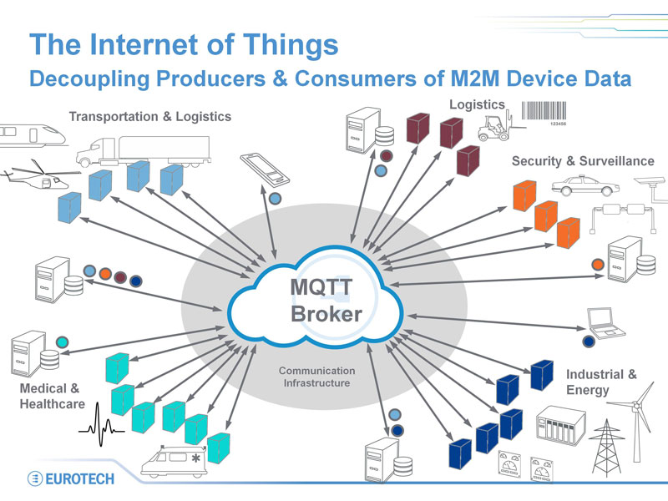
Sensor Node – Server Communications
Message Queue Telemetry Transport (MQTT)
Three main parts:
Broker
Publishers
Subscribers
Notes:
MQTT publisher-subscribe protocol
Lightweight, reliable, scalable
Topics, hierarchy, subscribe multiple topics

Slide 13
Core Tasks
Sensor Nodes
Capture packets
Read and filter packet headers – mac, channel, rssi
Send packet data to server
Server
Receive packet data from nodes
Calibrate RSSI to distance conversion
Process data to get position data
Notes:
Essential tasks that need to be (mostly) done by semester 1

Slide 14
Additional Tasks
Improve capture of packets
API for external access to position data
Opt-in system for users
Interface for users to be able to visualise position data
Tweak distance calculation for better accuracy
Notes:
Improve channel scanning
Opt-in for privacy

Slide 15
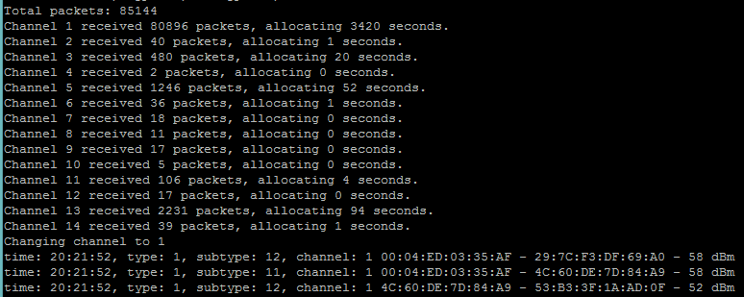
Sensor Node Output
Channel scanning
Packets captured
Timestamp
Packet type
Channel
MAC 1
MAC 2
RSSI
Notes:
MAC 1 is generally receiver
MAC 2 is generally transmitter

Slide 16
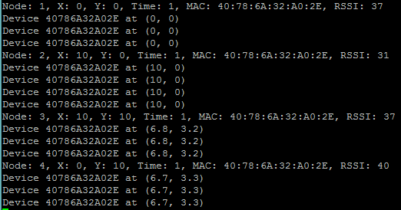
Server Output
Node 4
Node 3
Packet received
Packet received
40 dBm
37 dBm
10 m
Packet received
Packet received
37 dBm
Phone
31 dBm
Node 1
Node 2
Actual position of phone at (7, 3)
10 m
Notes:
Explain how position is calculated for only 1 or 2 nodes
Overlap 2 circles – there are 2 intersections, which is right?

Slide 17
Questions?

