Slide 1

Classification Project – American Trends Chris Byrnes May 14, 2021

Slide 2
Data
Pew Research Center
Nonprofit and nonpartisan
Publish facts for dialogue and decision making
American Trends Panel
Wave 67
April 29 – May 5, 2020

Slide 3
Data
Wave 67
Covid
Climate change
US Government responsibilities
Data for 9,955 respondents out of 10,957 was used
Missing values for difference

Slide 4

Project
Predict response to survey question: Do you think a year from now, May 2021, will be better or worse for you than May 2020?

Slide 5
Issues / Objectives
Imbalance
Total population – 13.6% w/ positive target
Test data – 12.8% w/ positive target
Low Correlation between target and features
Preferred metric – Recall
Interpretable model

Slide 6
Baseline - Simple KNN with K = 1
Confusion Matrix
Predicted
 | Better | Worse
Better | 1,548 | 189
Worse | 208 | 46
Actual
Accuracy | .801
Precision | .196
Recall | .181

Slide 7
Final Model – Logistic Reg., Class Weight = Balanced
Confusion Matrix
Predicted
 | Better | Worse
Better | 809 | 928
Worse | 69 | 185
Actual
Accuracy | .499
Precision | .166
Recall | .728

Slide 8
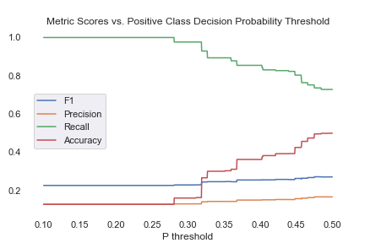
Final Tweak – P = .45
Best F1 score is at .475 Threshold. Lowering P to .45 does not impact precision significantly and raises recall to .803
Metric
Score

Slide 9
Feature Importance
Feature Coefficient (abs. value)

Slide 10
Appendix – Survey questions used in final model
- In general, would you say scientific experts are usually __________ at making policy decisions about scientific issues than other people.
- How much of a threat is, if any, is the coronavirus outbreak for the health of the US population as a whole?
- How would you rate the job the following is doing responding to the coronavirus outbreak: the president?
-Thinking about the year ahead, that is in the next 12 months, do you think there will be a vaccine to prevent the coronavirus disease?
- Also used was political party tendency which was not part of the survey but provided with the data.

