Slide 1
BERKELEY DATA ANALYTICS 2019
PROJECT 1
By Chris Catolico, Andrew Desa, and John Palalia.

Slide 2







When buying a home, there are many variables that people look at, for example. The size of the house, crime ratings, the proximity to grocery stores, good jobs around, the neighborhood, and for many parents the academic performance of the students in the area.

Slide 3
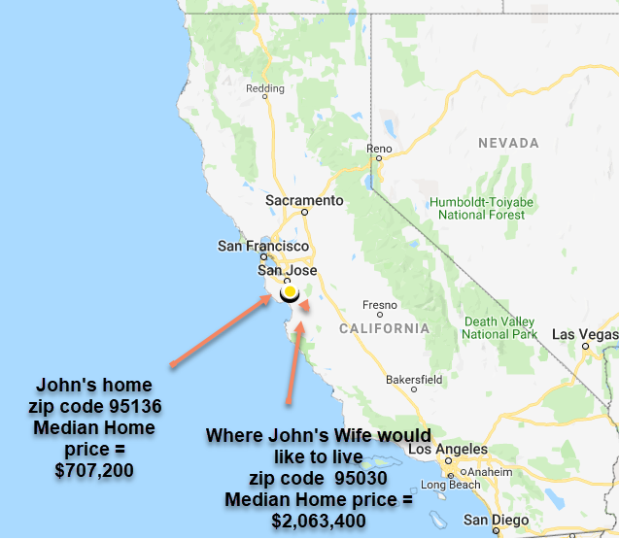
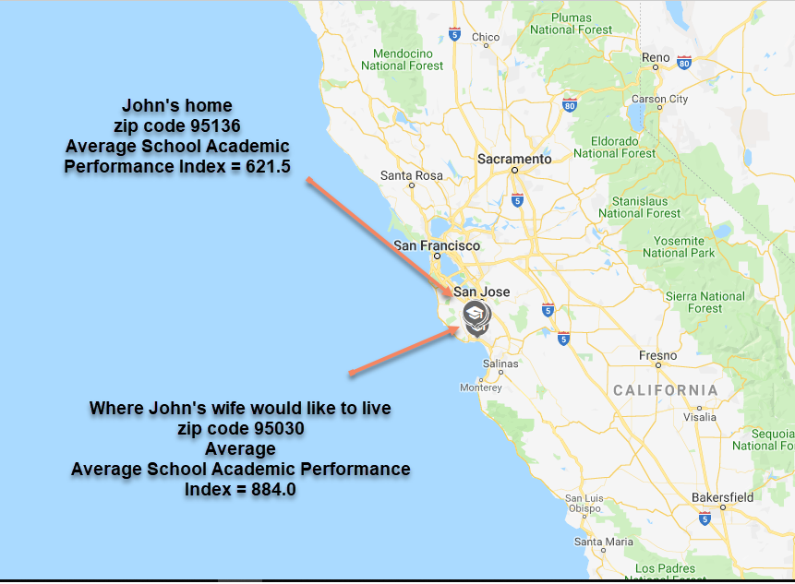


Question:
Is there a correlation between housing prices and academic school performance in California?

Slide 4


Hypothesis:
Null Hypothesis: There is no correlation between CA academic performance and local housing prices.
Alternative Hypothesis: There is a correlation between high school academic performance and the housing prices in California.

Slide 5
Methodology:
Obtained average California academic performance index for public high schools
Data file available through CA Department of Education .gov site
Weighed, 3 year average
Academic performance was based on
Standardized Testing and Reporting (STAR) Program
California High School Exit Examination (CAHSEE)
California Alternate Performance Assessment (CAPA)
Limitation – didn’t have zip code (used Google Geolocation API)
Obtained median housing prices from Zillow API
Median house price per zip code

Slide 6
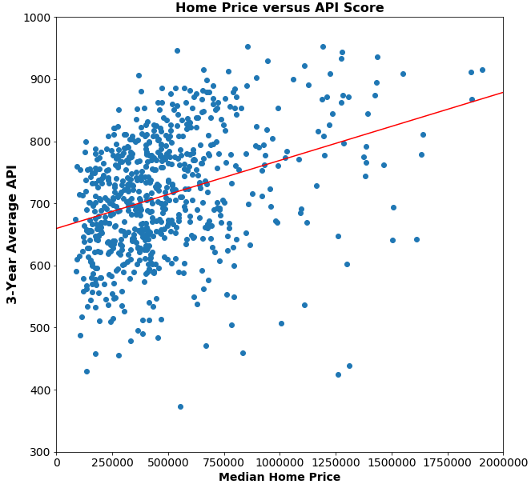
House Market data vs School data
Linear Regression:
Intercept: 659.53
Slope: 0.000109566
R: 0.3874
P-value: 6.51e-28
reject null hypothesis
3-Year Avg Academic Performance Index (max 1000)
Mean: 715
Median: 713
Std Dev: 99
Home Price
Mean: $505,177
Median: $416,850
Std Dev: $350,237
Notes:
R: 39% variation in the data. Looking at only high school data helped reduce the variation and improved the model.
P: <.05, statistically significant

Slide 7
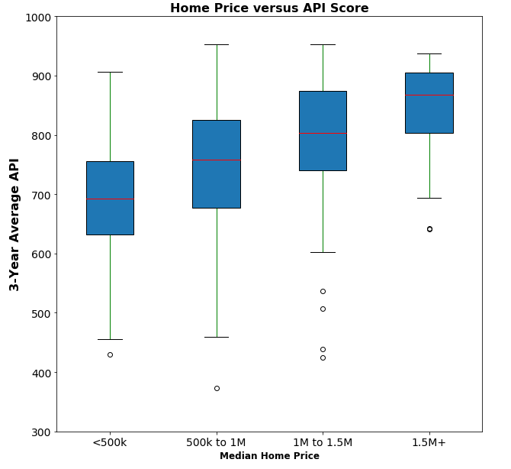
House Market data vs School data
ANOVA Test:
F-statistic: 35.395
P-value: 2.54e-21
Notes:
F-stat is greater than critical F value in an .05 alpha table
p value is smaller than .05
reject null hypothesis

Slide 8
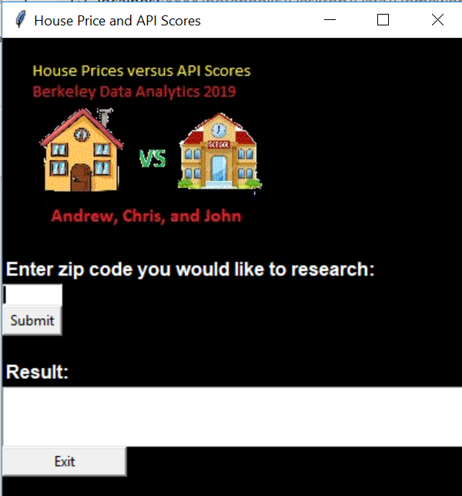
House Price and API Scores App
Allows user to enter a zip code and check what the average API score and housing price is in that area

Slide 9
Conclusion:
Based on the data collected, we can conclude that there is a correlation between housing prices and high school academic performance in California
There is also less variance in school performance as housing prices increase.
API scores of less than 700 are extremely rare in areas where housing prices average $1.5M or higher
However, it is not uncommon for API scores to be as low as 450 in areas where housing prices average $500k or less

