Slide 1
Groupon Travel Package
Fuchun Chai - N01210879 & Henrique R Belotto - N01245990

Slide 2
Design the features
a.Webpage for the customer to create an account;
b. During the account creation, the user selects an interest and date from two dynamically created drop-down list. After an account is created, the registrationID, which will be a 6-digit random number, will be displayed for the user. The user must use email/registrationID to login in the webpage next time to check the group;
c.Webpage for the customer to login in the system using email/registrationID;
d.Webpage for an admin account to login in the system, using the hardcoded account in the database;
e.Webpage for the admin to manage the groups and import data from a file;

Slide 3
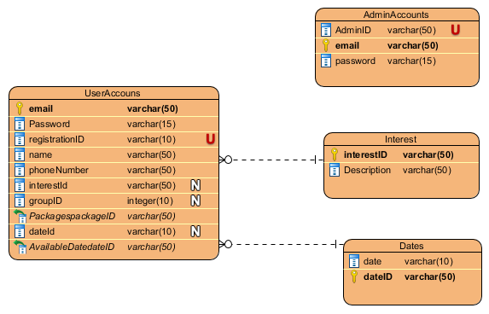
Database Design

Slide 4
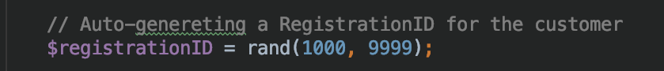
How to Generate Registration ID

Slide 5
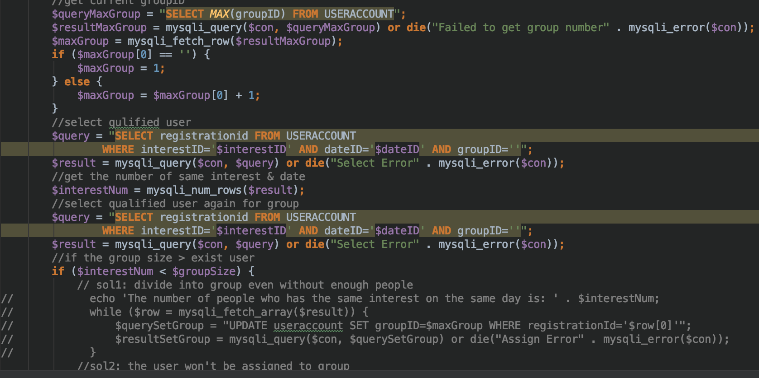
How to form the group

Slide 6
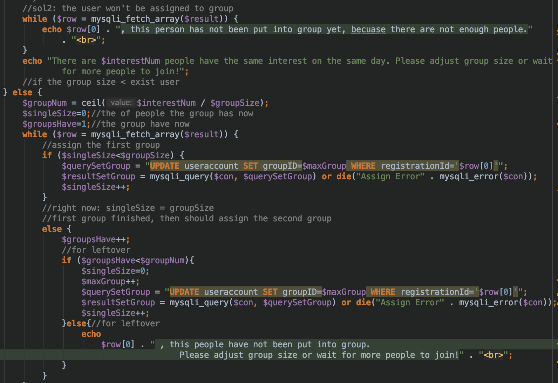

Slide 7
Things Learned
This project allowed us to work together using a repository on Git Hub, this helped us to share our code and keep updated with the latest version of whatever the other member has just finished.

Slide 8
Moreover, during this project, we faced multiple challenges regarding the implementation of full web pages using PHP or Python, also to create an algorithm to read a file and automatically selects the groups only based on the group size. It was a challenge to come up with something that looks as efficient as possible and reliable.

Slide 9
Time management was a big issue for our group because both members work during the week and weekend, also, other assignments from other courses required a lot of our time. Despite that, I believe that we used our time efficiently to provide a well-designed and developed project.

