Slide 1

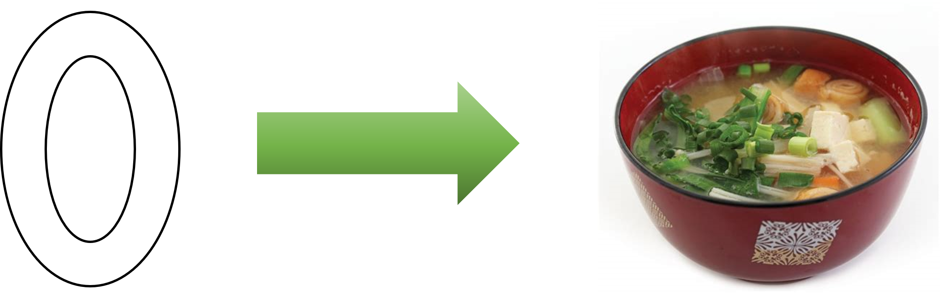
02_Orders and Iterations
ISS-ESG.COM

Slide 2


02_Order and Iteration
Putting data in place
Ways of holding data
The Road towards a DataFrame

Slide 3
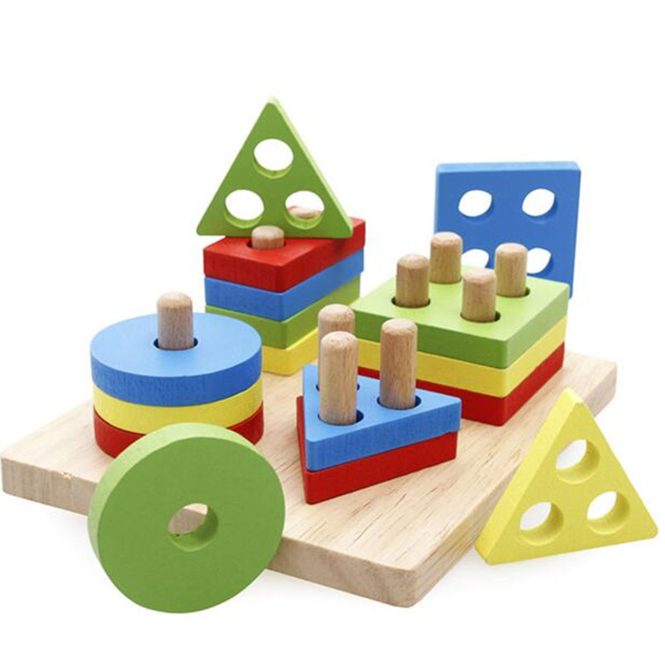
We know what Data is…
Putting order into data
List
Arrays
Dictionary
Matrixes
DataFrames

Slide 4
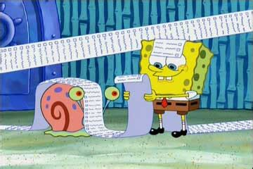
List and Arrays
List and arrays can hold multiple data within it
List_A = [1, “two”, 3]
List_B = list((“Cuatro”, 5, “Sechs”))
Array_A = np.array([1, 2, 3])
Array_B = np.array([4, 5, 6])
However, List and Arrays are used differently
Generally arrays hold numerical data (int, float)
Arrays can be easily transformed into matrixes and perform matrixes based calculations
np.array([3, 4, 5])
np.zeros((4, 4))
np.ones(5)
np.random.rand(row, column)
np.random.randint(limit, size = (layer, row, column))

Slide 5
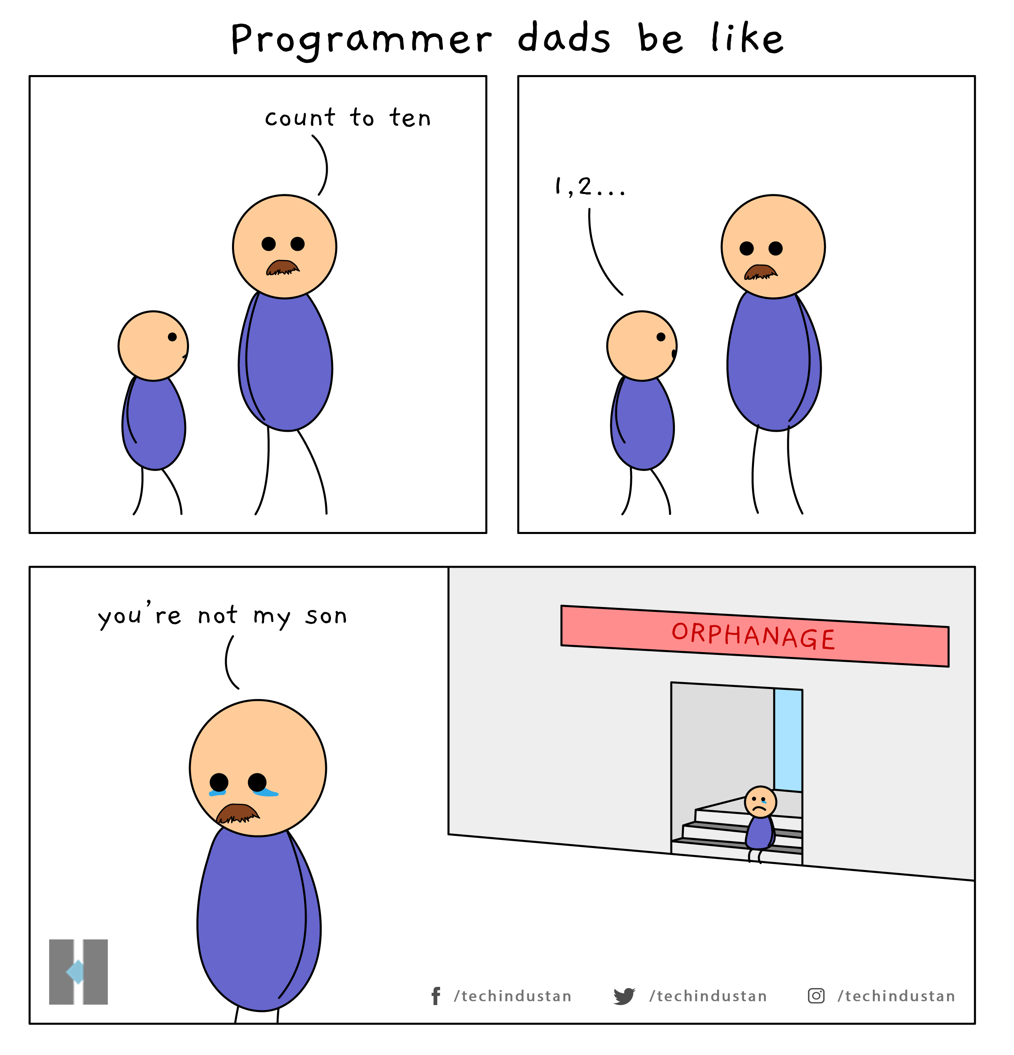
Indexing
Recall that python counts from 0
What is List_A[1]?
What is List_B[-1]
What happens with List_A[1:3]
Wait………
List_A[3] is error
BUT List_A[1:3] is possible?

Slide 6
Indexing List and Arrays
Indexing Lists
print(List_C[3])
print(List_A[0:2])
Indexing Arrays
print(array_C[-2])
print(random_array[3, 3])
print(ThreeD_RandArray[1, 4, 0])
Print(np.where(array_C == 29))
print(np.where(ThreeD_RandArray == 0))
print(ThreeD_RandArray[:, 3, ])

Slide 7


Slide 8
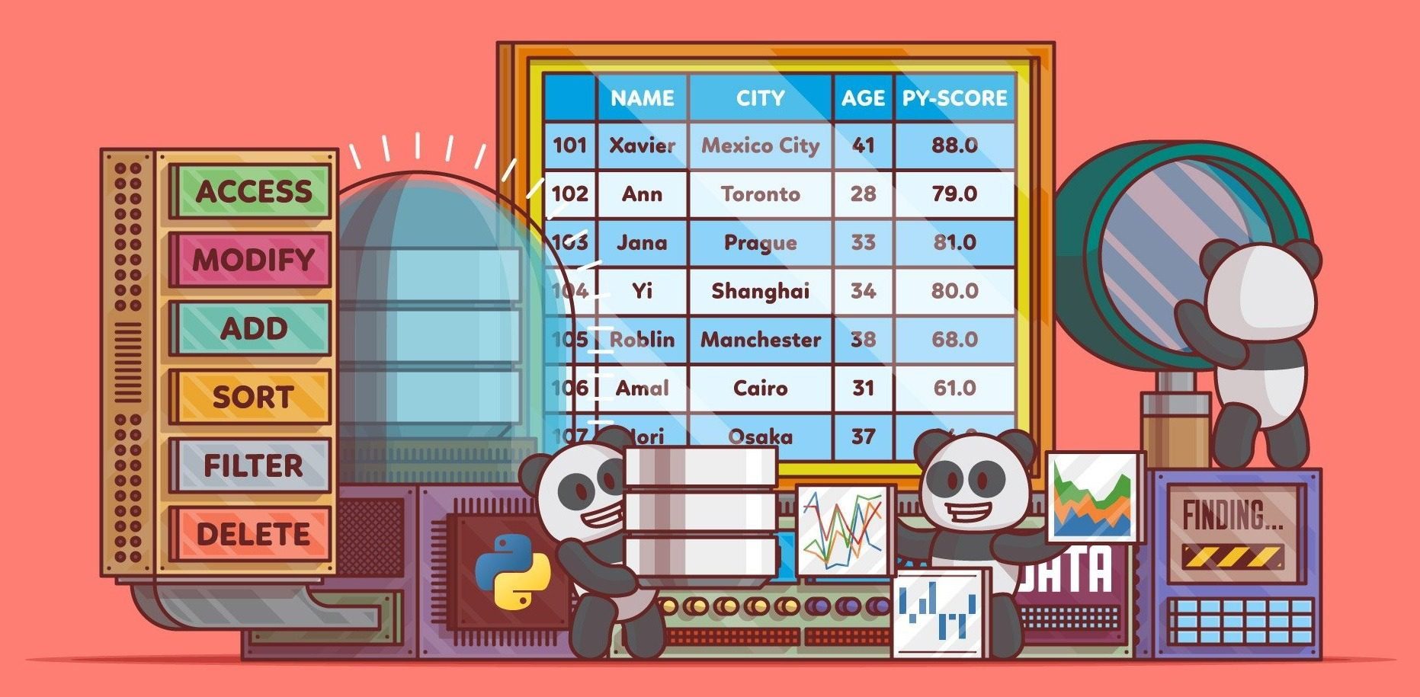
Pandas (Panel Data)
Now it really gets fun!
Spreadsheets, Excels, CSVs, are all known as DataFrames
DataFrames are really just matrixes (2D-arrays) with names
All DataFrames have Index and Column Names
Pandas is the library to access it
df = pd.DataFrame(array_AB)

Slide 9

pd.DataFrame
We can turn numeric 2-Dimensional array we just created to a pandas dataframe
Table = pd.DataFrame(twoD_array)
We can create a DataFrame from scratch
Note that we can specify the data type for each columns available.

Slide 10

ISS-ESG.COM

