Slide 1


02_Orders and Iterations
ISS-ESG.COM

Slide 2


03_DataFrame
Read and Write DataFrame
Exploring types in DataFrames
Indexing and subsetting DataFrames
Joins, Merge, Pivot

Slide 3


Slide 4
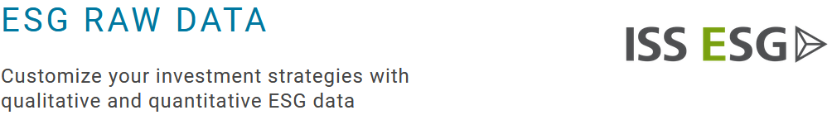
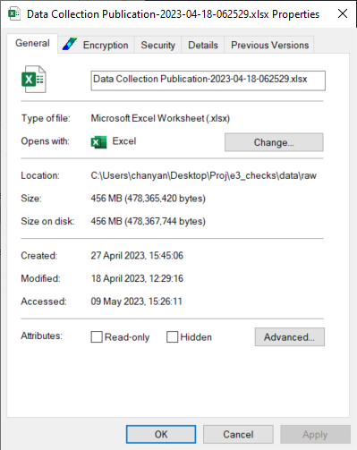
E&S Data
What’s the point?
E&S Raw Data as of 2023-04-18 cycle:
0.456 Gb.
169,999,983 rows by 17 columns
706 Questions
996 Agents
Full data takes at least 5 minutes to load?

Slide 5
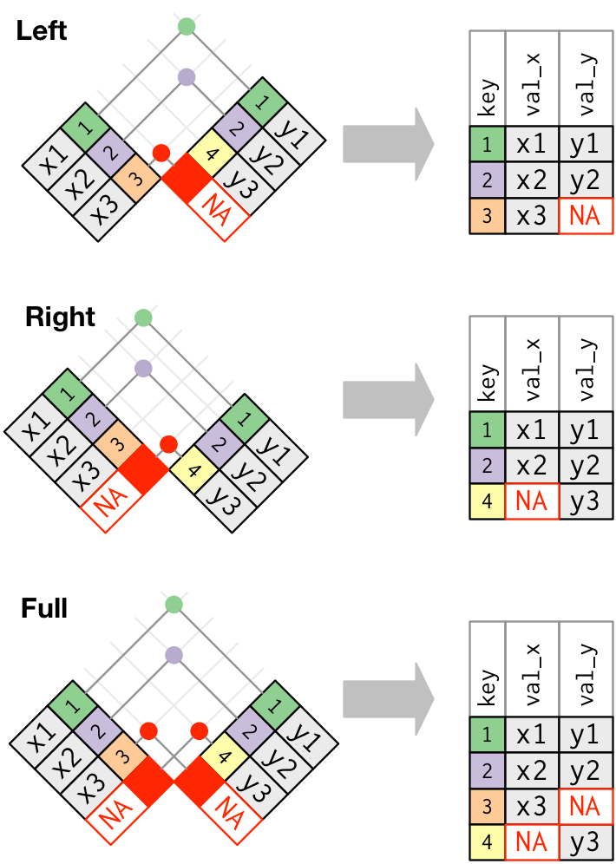
E&S Raw Data sample
We will play with a 50,000 row subset
Too big to understand with excel
Small enough to get a grip on data manipulation
df = pd.read_csv(“f{data_raw}/ESData_sample.csv”, sep = “;”)

Slide 6
Querying
Viewing
df.head()
df.tail()
df.sample(n = 34)
df[“Question”]
df[[“AgentId”, “AgentName”]]
df[[“AgentId”, “AgentName”]].sample(n = 3)
Indexing and subsetting
loc (location)
Name based
df.loc[row, “Question”]
df.loc[2:3, “FactorId”:”Answer”]
Iloc (integer location)
Counts from 0
df.iloc[ : , 1:3]
df.iloc[row, col]

