Slide 1


03_DataFrame
ISS-ESG.COM

Slide 2


03_DataFrame
Read and Write DataFrame
Exploring types in DataFrames
Indexing and subsetting DataFrames
Joins, Merge, Pivot

Slide 3


Slide 4

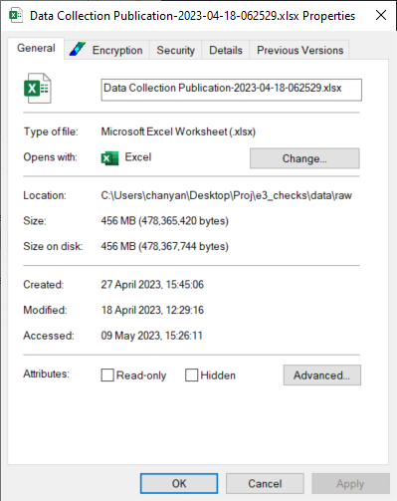
E&S Data
What’s the point?
E&S Raw Data as of 2023-04-18 cycle:
0.456 Gb.
169,999,983 rows by 17 columns
706 Questions
996 Agents
Full data takes at least 5 minutes to load?

Slide 5
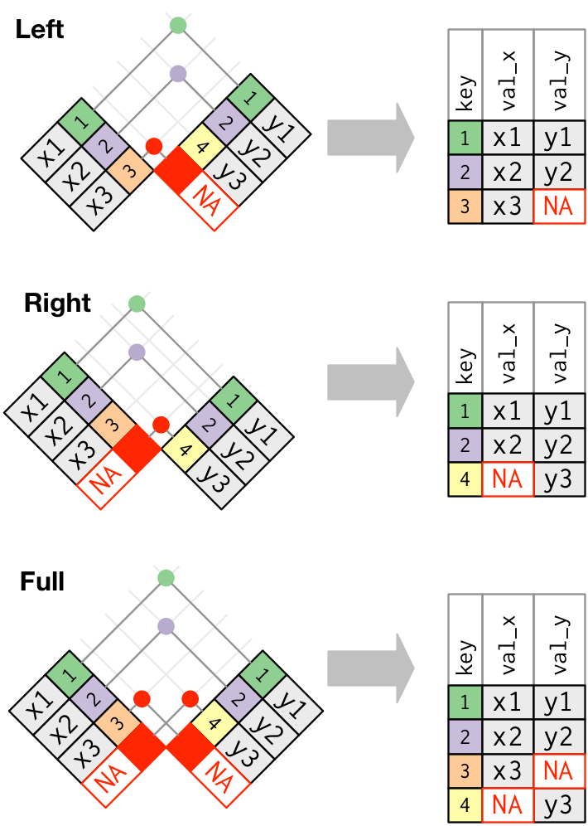
E&S Raw Data sample
We will play with a 50,000 row subset
Too big to understand with excel
Small enough to get a grip on data manipulation
df = pd.read_csv(“f{data_raw}/ESData_sample.csv”, sep = “;”)

Slide 6
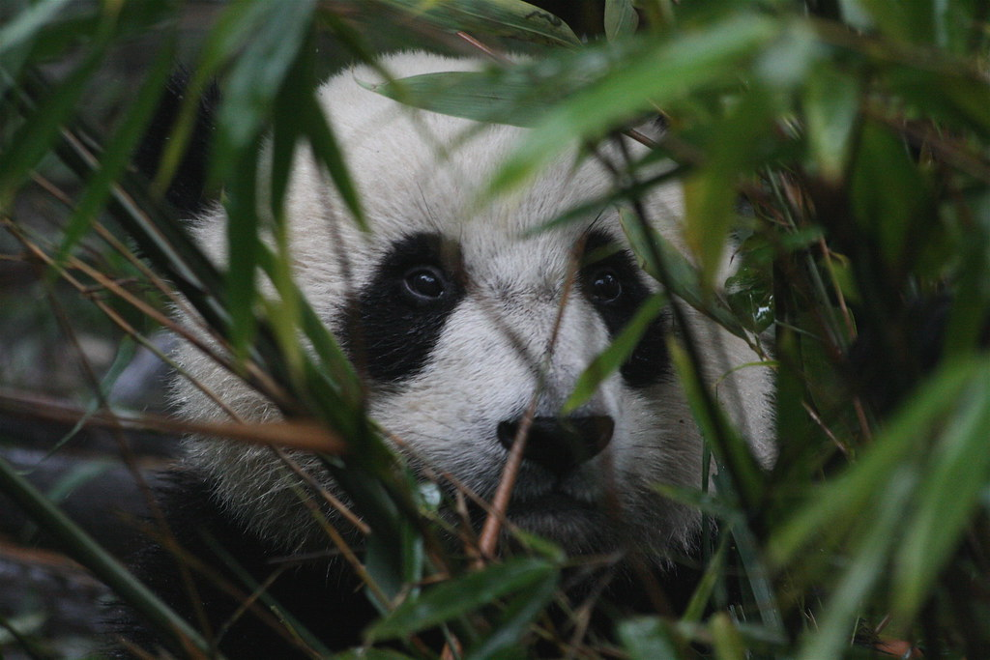
ALWAYS INSPECT THE DATA!
print(DataFrame.shape)
Check for size (row, col), is it abnormal?
print(DataFrame.describe())
Quick stats for quantitative columns
print(DataFrame.info())
Check for data types, are FactorId column an integers? Are URL strings? Are datetime datetime?
Print(DataFrame.sample(n = x))
Randomly sample the data!

Slide 7
Querying
Viewing
df.head()
df.tail()
df.sample(n = 34)
df[“Question”]
df[[“AgentId”, “AgentName”]]
df[[“AgentId”, “AgentName”]].sample(n = 3)
Indexing and subsetting
loc (location)
Name based
df.loc[row, “Question”]
df.loc[2:3, “FactorId”:”Answer”]
Iloc (integer location)
Counts from 0
df.iloc[ : , 1:3]
df.iloc[row, col]

Slide 8
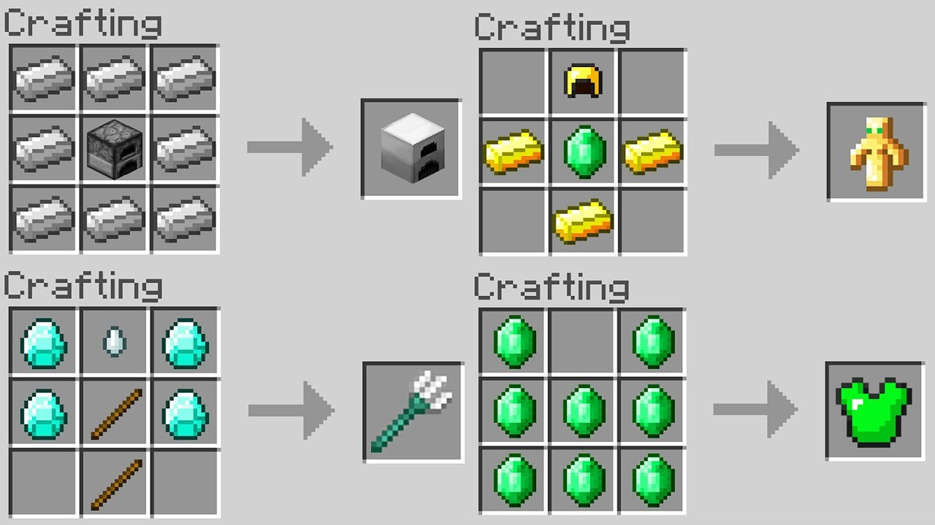
We can also stack logical queries
What if I just want the Question, AgentName and Excerpt for FactorID (4907)
What if I just want the Question, Date, and Answer for FactorID (4990)
I want Answers that are all null?

Slide 9

Let’s look at a specific company?
Mercedes-Benz (AgentId == 540)
Mercedes_df = ESData[ESData[“AgentId”] == 540]

Slide 10

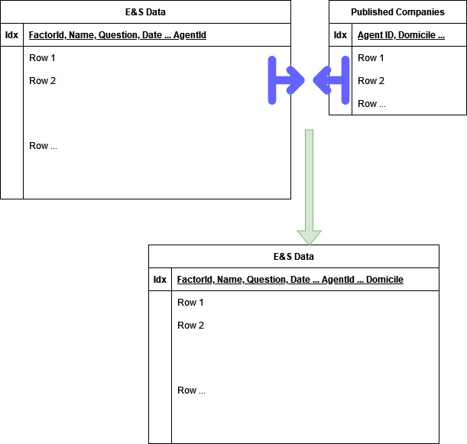
Join and Merges

Slide 11
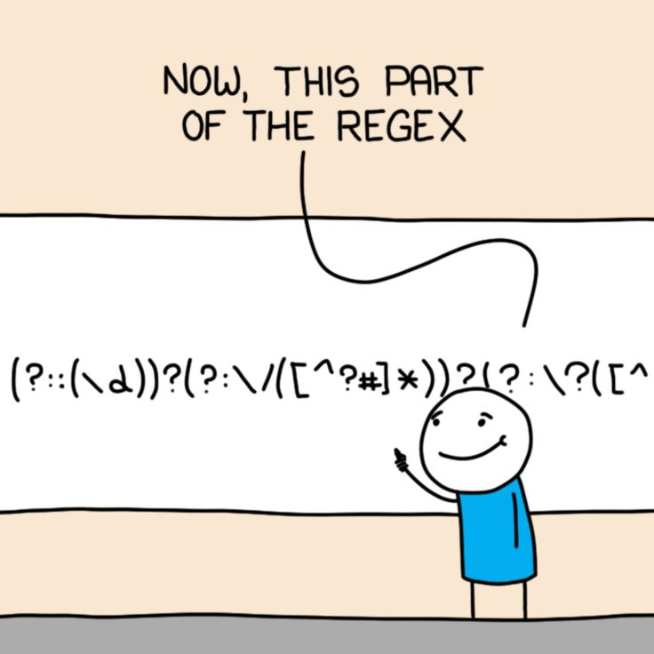
Regular Expressions (Regex)
How can we parse qualitative data?
Regular expression is used everywhere but little known
System of pattern match invented by mathematician in the 1950s
Once mastered, it’s a superpower

Slide 12
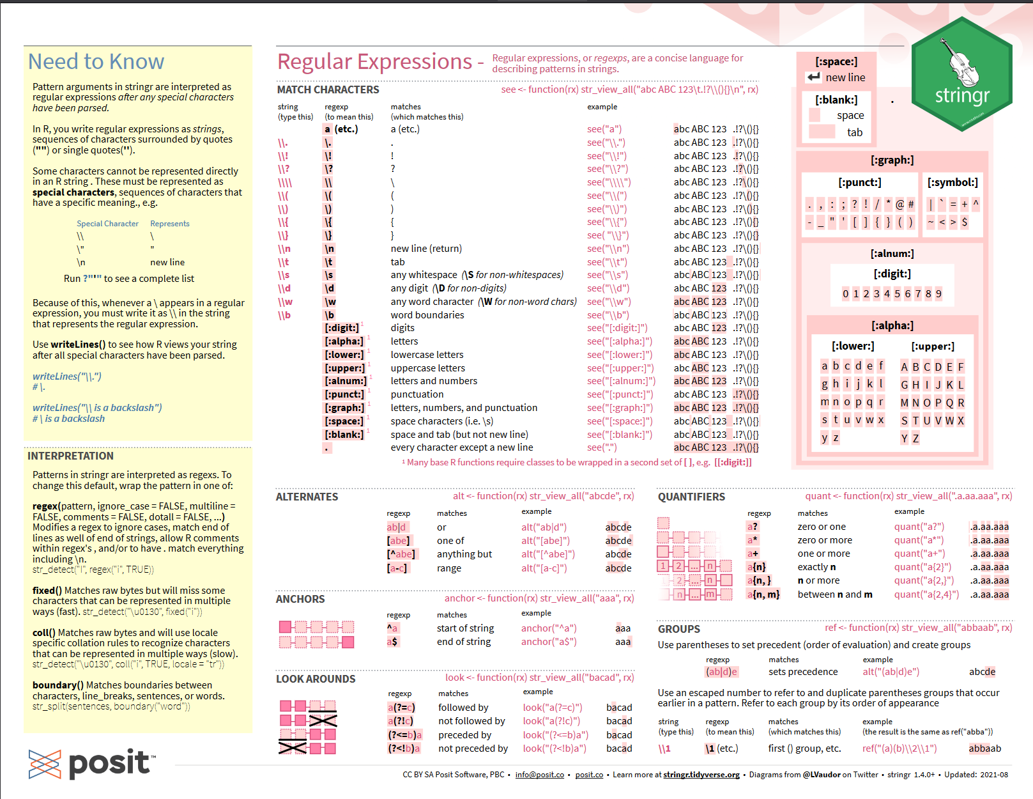
Regex cheatsheet
https://rstudio.github.io/cheatsheets/html/strings.html

Slide 13

Operations to explore
Pivoting
Regex pattern match
Subsetting my datetime objects
Datetime comparison
Check out pandas documentation for available operations:
https://pandas.pydata.org/pandas-docs/stable/index.html

