Slide 1


00_SETUP 2023-04-06
ISS-ESG.COM

Slide 2


Content
Anaconda & Project Files (easier)
Miniconda3 & Project Files (harder)
Source Code Editor (IDE)
Troubleshooting

Slide 3
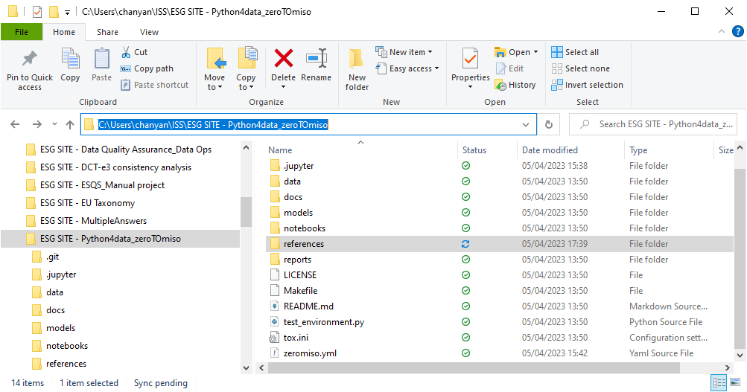
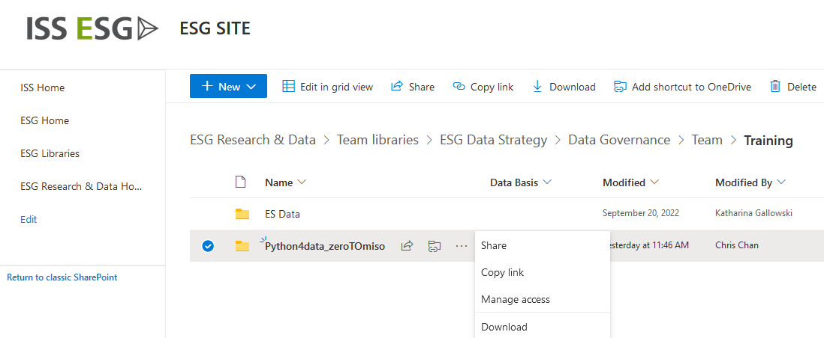
Project Files
Project Files for this course are located on sharepoint (Please MAKE A COPY, don’t sync)
https://issgovernance.sharepoint.com/:f:/s/isshome/ESG/Ev-i17GYVVVOqwGf0_ahHmQBi03CmC8-SrwLep6Ql7DR_w?e=vaCe8x
Download this to your desired location

Slide 4
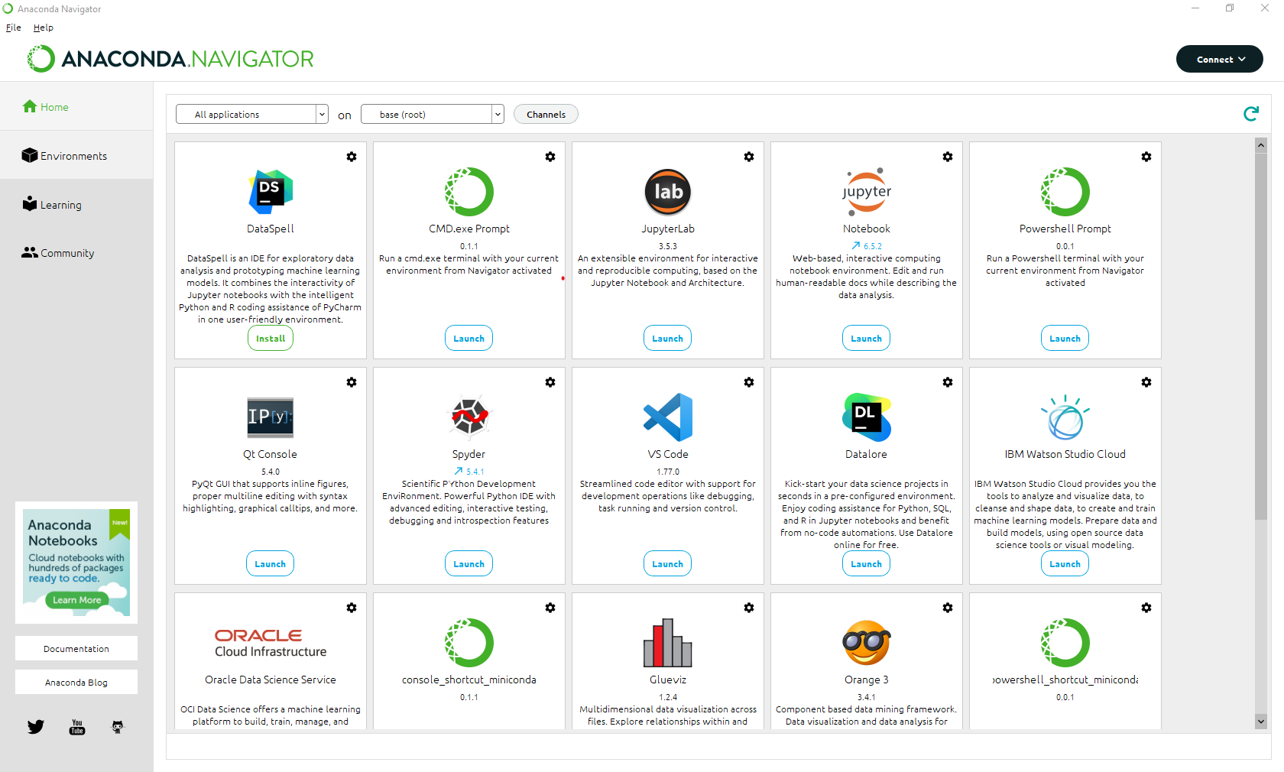
Miniconda3 & Project Files
First, try anaconda
https://www.anaconda.com/
Please select the latest correct distribution for you computer Operating System and run the .exe or installer file.
Once installation is complete
Open it

Slide 5
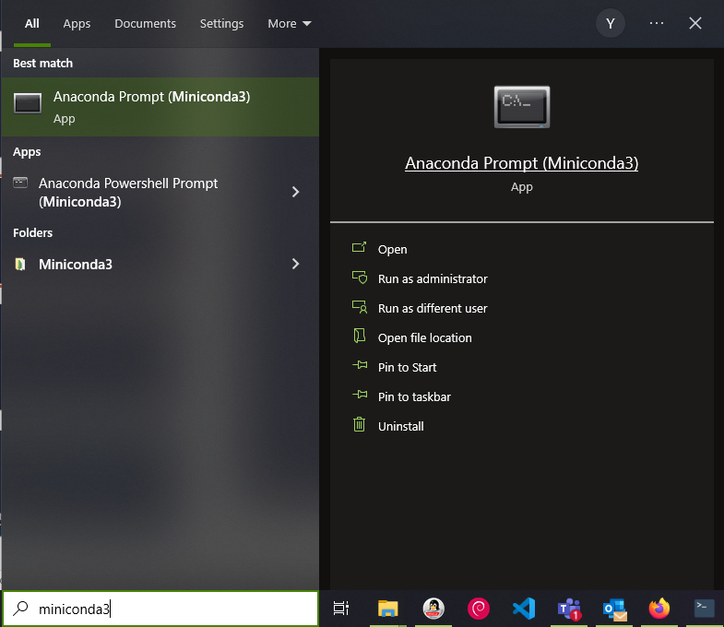
Miniconda3 & Project Files
Alternatively you can use miniconda3 which contains the python program for this course
https://docs.conda.io/en/latest/miniconda.html#latest-miniconda-installer-links
Please select the latest correct distribution for you computer Operating System and run the .exe or installer file.
Once installation is complete
You can find the application here

Slide 6
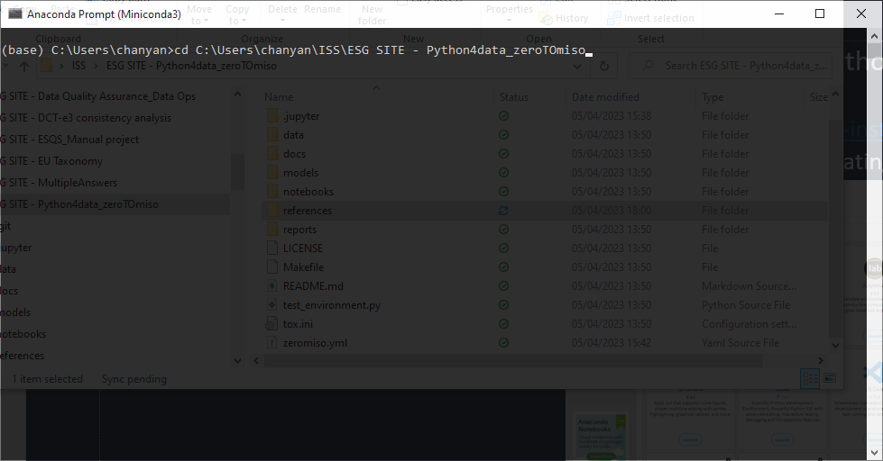
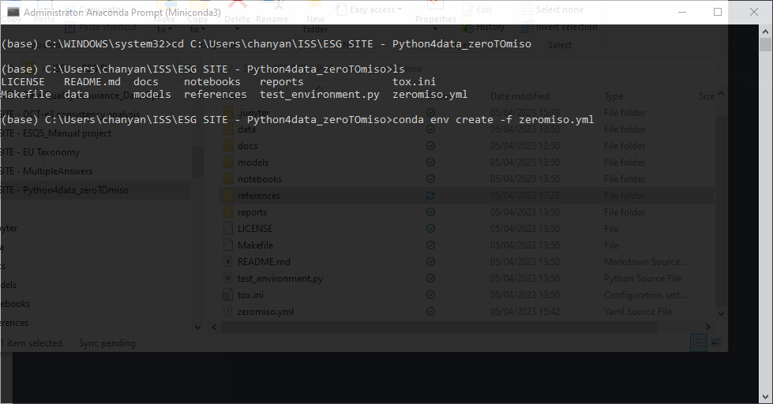
Miniconda3 & Project Files
In you miniconda prompt change your directory to your downloaded project folder

Slide 7
Miniconda3 & Project Files
Now installed your desired Source Code Editor
I recommend VS Code or Jupyter Lab
VS Code
https://code.visualstudio.com/
Jupyter Lab

Slide 8
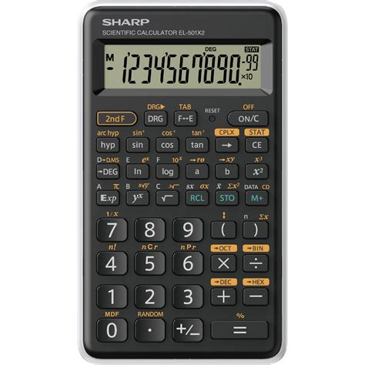
Miniconda3 & Project Files
Python is a calculator, a programmable calculator
To make our life easier, packages written in python contains pre-built calculation
Packages are like your sin or Exp button here
Miniconda is a package manager that makes everything compatible

Slide 9
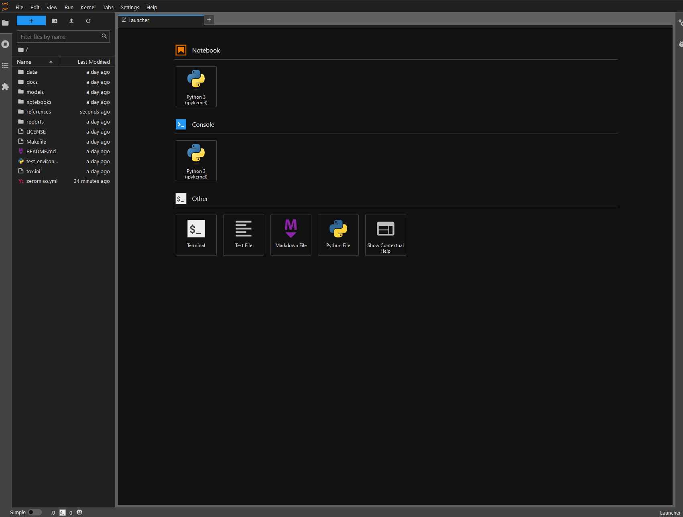
Source Code Editor / IDE

Slide 10
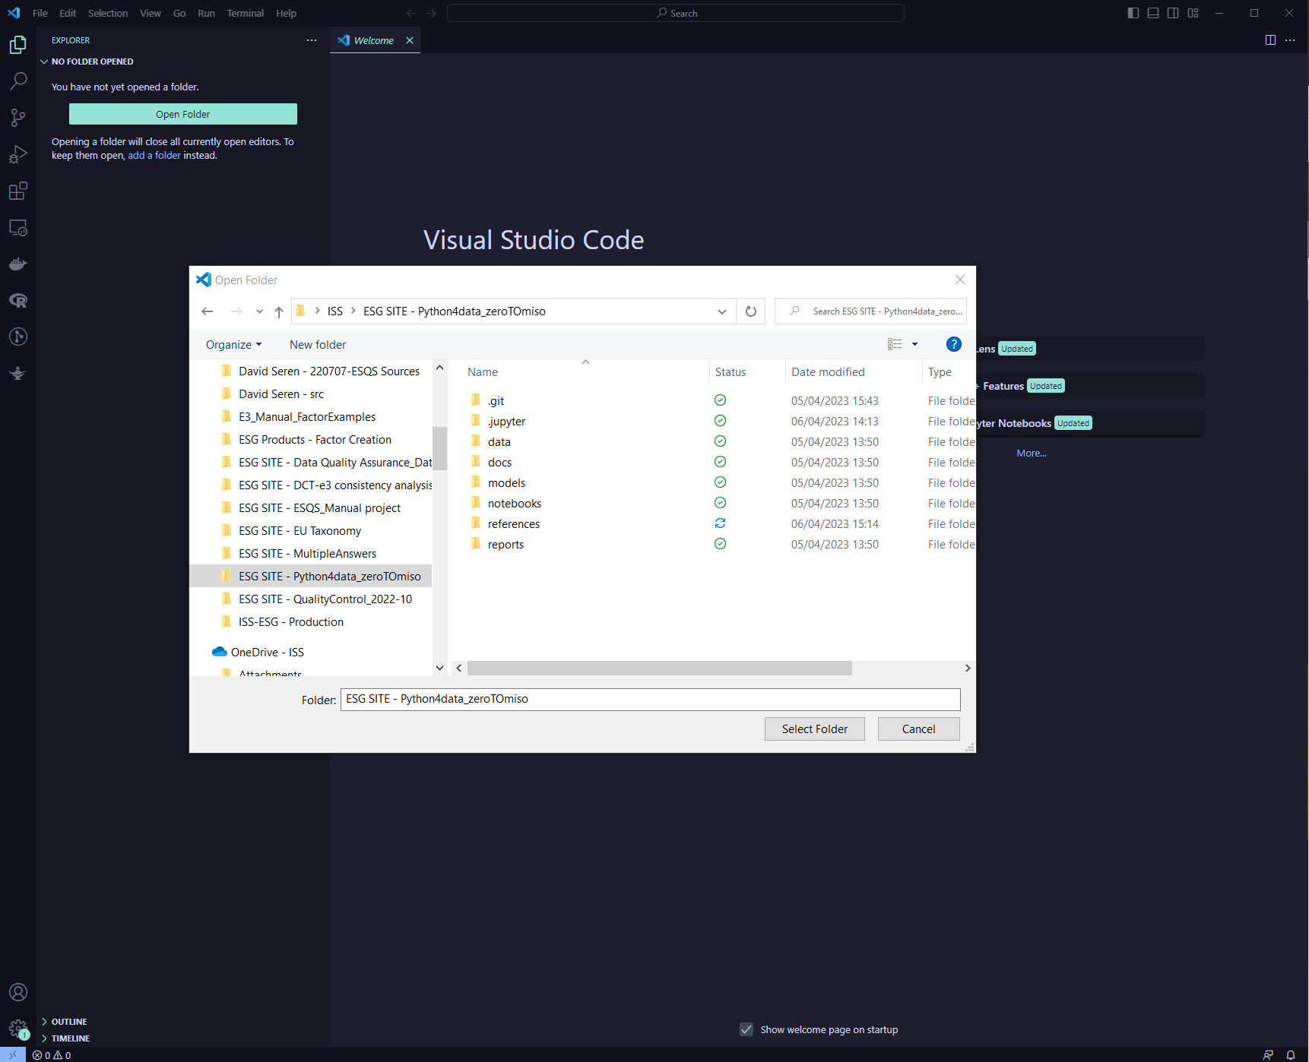
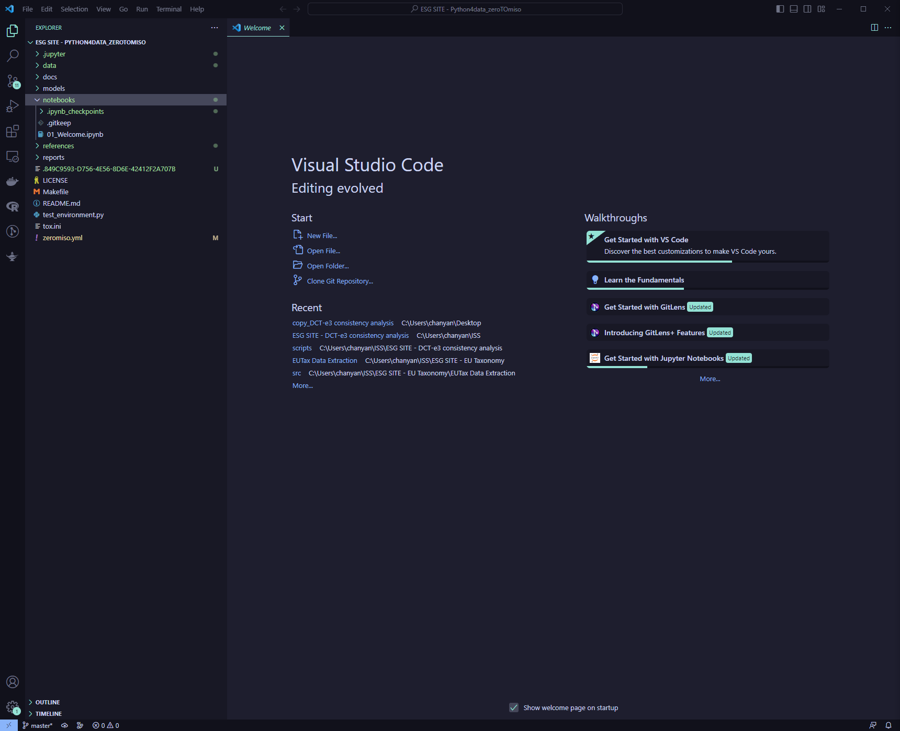
Source Code Editor / IDE

Slide 11
00_SETUP
THANK YOU
2023-04-06
ISS-ESG.COM

