Slide 1

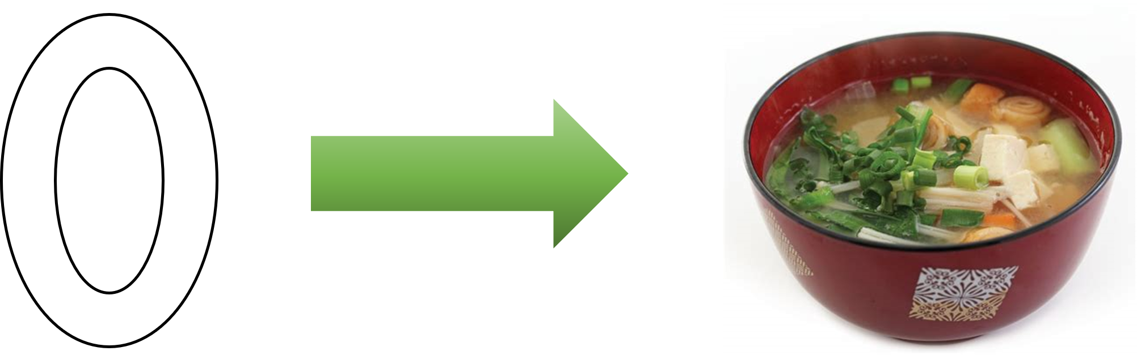
01_Welcome
ISS-ESG.COM

Slide 2


Course Objectives
Establish the reasons for python (or scripting) in Data Governance
Transfer basic and extendable skills
Syntax
Data Wrangling
Plotting
Establish good scripting etiquette and practices
Explore potentials

Slide 3
01_Welcome goal
Why python
Basic syntax
Look at some data

Slide 4
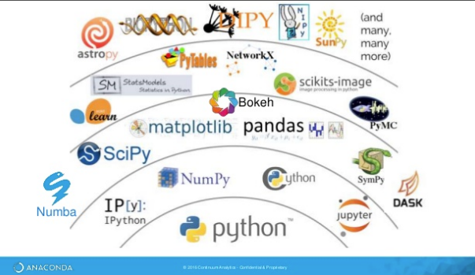
Why Python and why write scripts
Popular and full of resources online
Fine control, and complex reproducible results
Super powerful libraries for data wrangling and data science
e.g. pandas, numpy, scipy, statsmodels,
re, matplotlib… PyTorch, TensorFlow…
General purpose programming language
Web-building, machine learning, image manipulation, sound engineering, Artificial Intelligence
We have too much data (Excel have a 1,048,576 row limit)

Slide 5
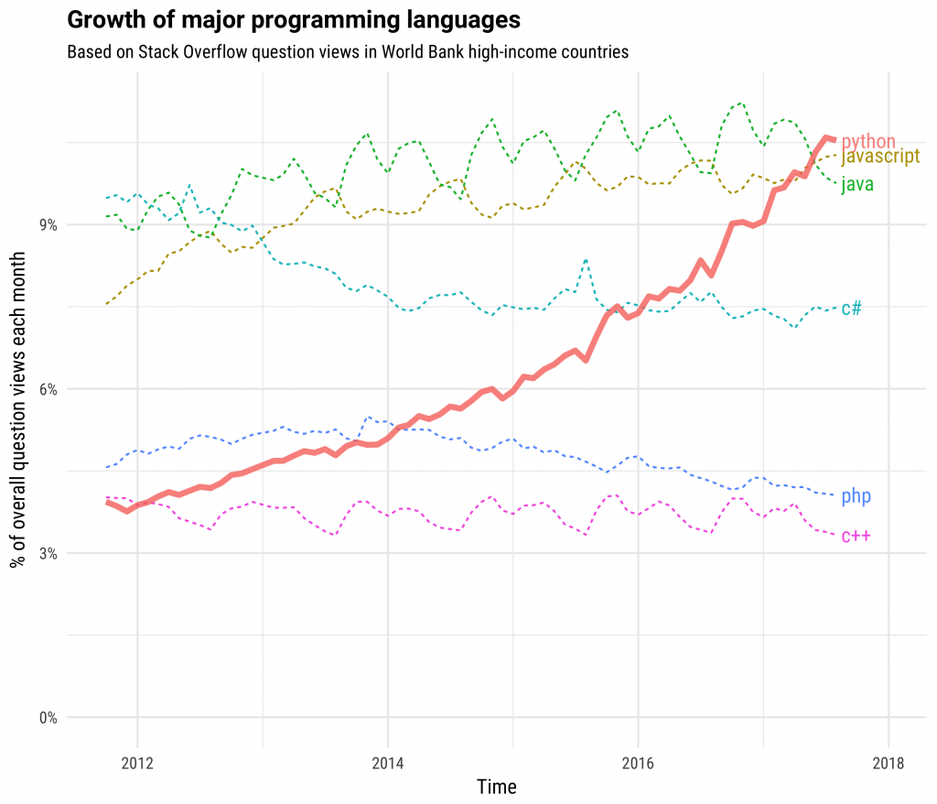
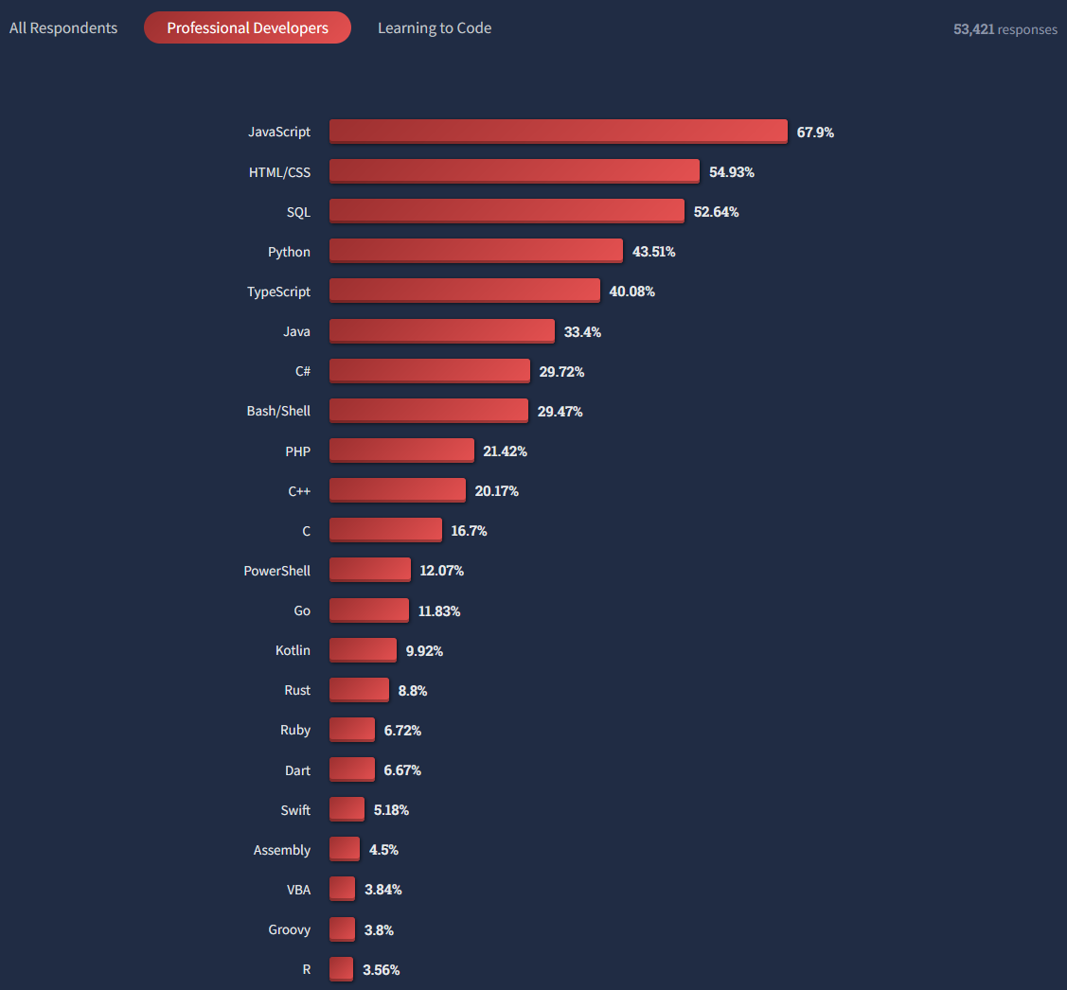
Why Python and why write scripts

Slide 6
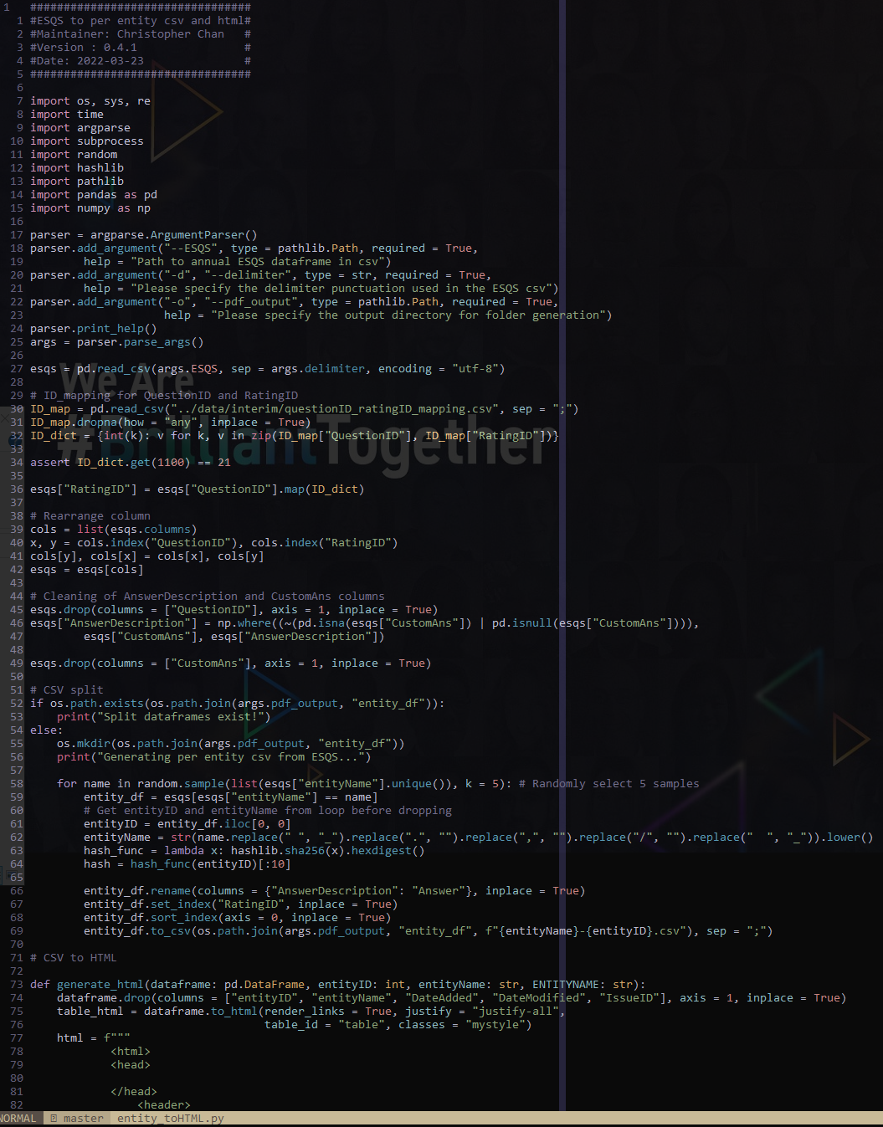

What is a script
A sequence of python (or other language) commands which executes a set of command
The script and the packages can be transported across machines and computer
Write once, run
Versioned and extendable in the future

Slide 7
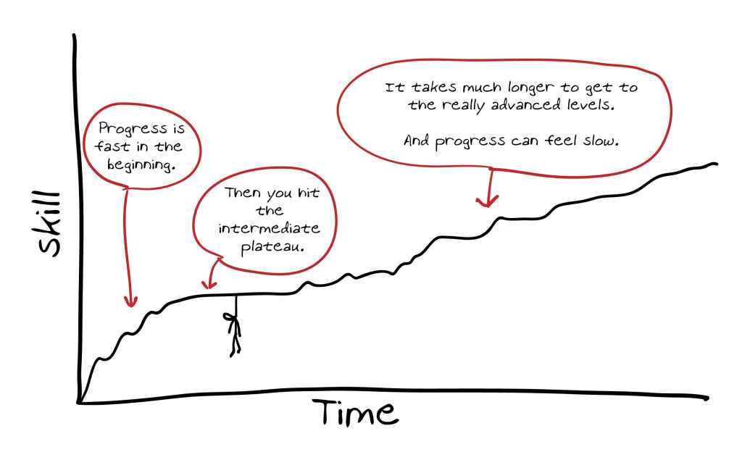

Slide 8


Slide 9
Basic data type
int
Integers: 1, 2, 3, 4, 99, 10000, 34905, 999999, -4444, -68598, -9999999
Use integer when decimals or ratios are not involved
Signed integer (negative numbers allowed) and Unsigned integer (Only positive numbers)
float
Floating-point numbers: 1.0, 3.0, -34.0, 934.32, 22.454, -13513.999
Approximated in scientific notation
Less accurate in the very precise calculation than integer
String
Words and symbols: “Sorry that this is the boring thing we need to learn!”
Can be parsed qualitatively using regular expressions (regex)
Very common in E&S Answers, we have more qualitative than quantitative answers

Slide 10
Special data type
datetime
ISO date: 2023-04-12 %Y-%m-%d
date.year(), date.month(), date.day()
boolean
True / False
print(4 == 3 + 5)
print(True == False)
print(True + False == True)
NULL / NaN
Not 0, Null types are null types
Be careful, python have multiple null types (None, numpy nan)
Allow for checks (.isnull(), .notnull(), .isna(), .notna())

Slide 11
Syntax and grammar of python
Python counts from 0!
Properties and functions are accessed with .
dataframe.describe() ; np.mean([1, 2, 3, 4, 5])
list.append(3)
Python indentation matters!
VAR_NAME = 5452
LIST_NAME = [“List”, “of”, “word”]
= sign in python is assignment, not equal!
== sign in python is equal!
Do not use spaces when defining variables or filenames. Computers don’t like that

Slide 12
Syntax and grammar of python
Basic arithmetic:
+ plus
- minus
== equal
/ divide
// divide (but only keep whole integer)
* multiply
** power
np.sqrt() square root
Basic Logic
A > B A is bigger than B
A < B A is smaller than B
A == B A equal B
A >= B A is larger than OR equal to B
A <= B A is smaller than OR equal to B
& AND
| OR
^ Exclusive OR (XOR)
not not(True == False) == True

Slide 13
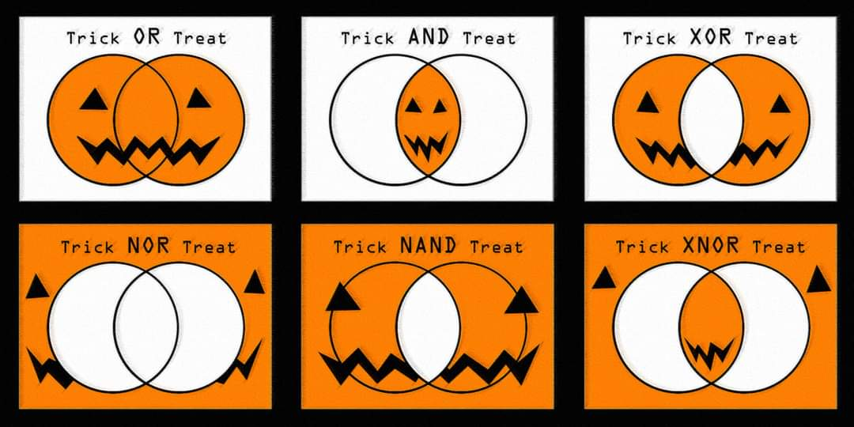
Logic is actually pretty confusing

Slide 14

Programming is not about the language, it’s a way of thinking
ISS-ESG.COM

