Slide 1
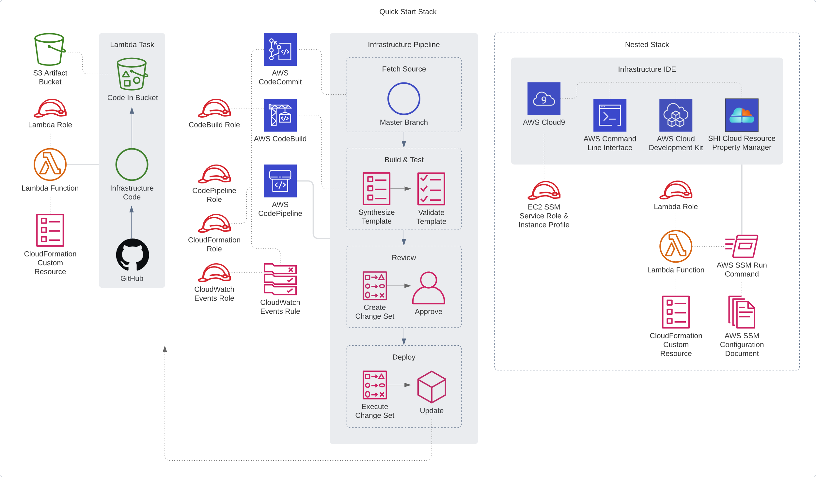

Slide 2




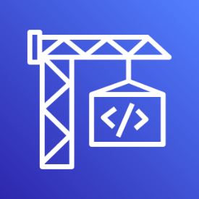




AWS Cloud
Infrastructure pipeline
AWS CodeCommit
Amazon EventBridge
Amazon S3 bucket
AWS CodeBuild
AWS Cloud9
IAM roles
AWS CodePipeline
AWS Lambda

