Slide 1

NutritionFacts.org
https://nutritionfacts.org

Slide 2
Architecting a Search Feature
(in Rails)
Chris Cressman
https://chriscressman.com

Slide 3
“Elastic makes the power of search—the ability to instantly find relevant information and insights from large amounts of data—available for a diverse set of applications and use cases.”
“Developers build on top of the Elastic Stack to apply the power of search to their data and solve business problems.”

Slide 4
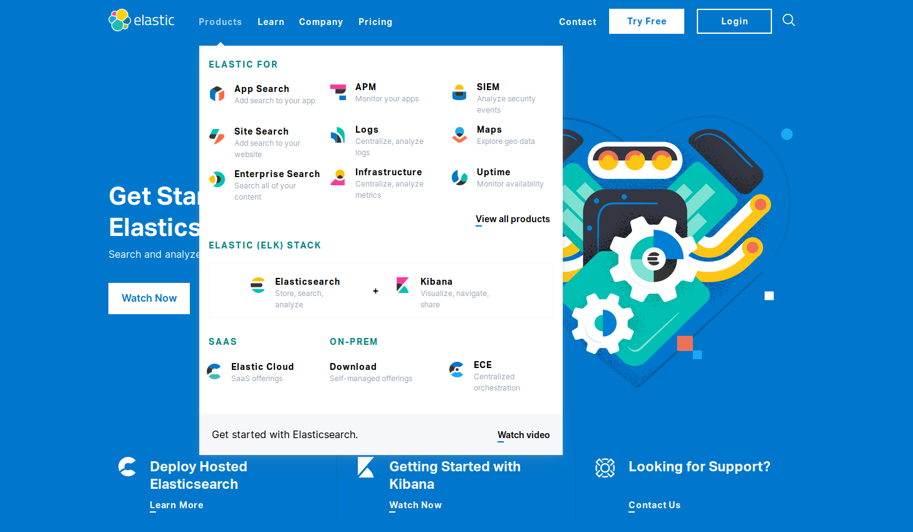

Slide 5
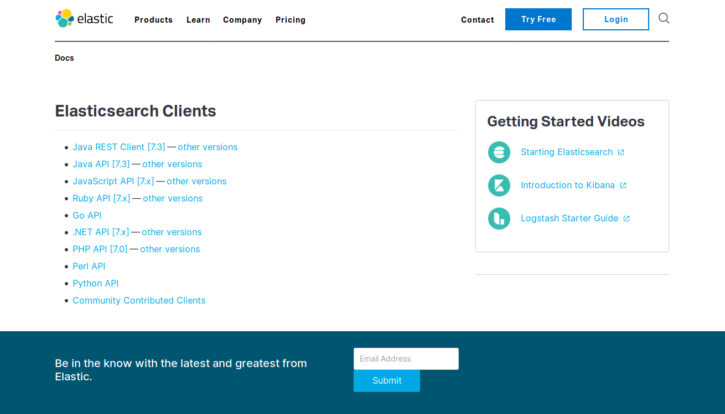

Slide 6
Open Source
Programming-Language-Specific
APIs
SDKs
Clients
Libraries
Integrations

Slide 7
Excellent Reference Documentation

Slide 8
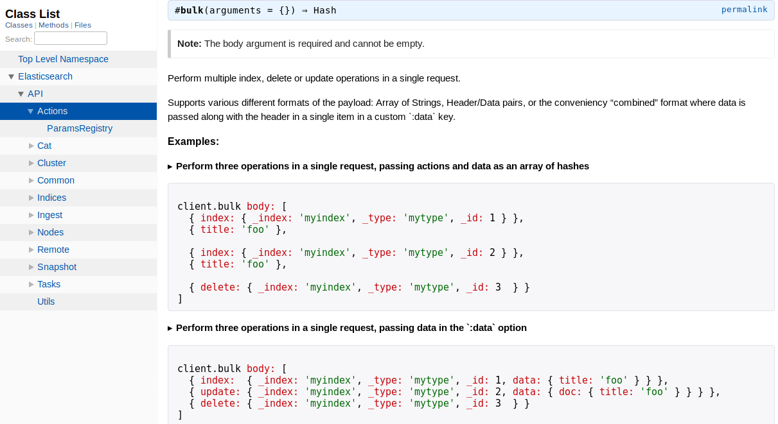

Slide 9
But how do you design a search feature
with these tools?

Slide 10
App Search
Domain Model Integration
Ruby on Rails
Make “Books” Searchable

Slide 11
Public
Domain
Paperbacks
Books
Authors
Genres
Filters
Search Books
Sort
Authors
Foo (3)
Filters
Sort
Best Match
Bar (3)
Date Published
Name of the Book
Genres
By Author
Title
Foo (3)
Published on December 12, 2018
Bar (3)
Years Published
Name of the Book
Foo (3)
By Author
Bar (3)
Published on December 12, 2018
Prev
Next

Slide 12
Communication
Cluster
Client
Indexing
Search Document Design
Search Document Serialization
Index Configuration
Index Creation
Initial Indexing
Systematic Indexing
Querying
Search Definition
Search Results
Pagination
Sorting
Filtering

Slide 13
Solution “Framework”
Language/Tool Agnostic

Slide 14
Communication
Cluster
Client
Indexing
Search Document Design
Search Document Serialization
Index Configuration
Index Creation
Initial Indexing
Systematic Indexing
Querying
Search Definition
Search Results
Pagination
Sorting
Filtering

Slide 15
docker-compose.yml
version: '3'
services:
elasticsearch:
image: docker.elastic.co/elasticsearch/elasticsearch:7.3.0
environment:
- discovery.type=single-node
volumes:
- elasticsearch:/usr/share/elasticsearch/data
ports:
- 9200:9200
kibana:
image: docker.elastic.co/kibana/kibana:7.3.0
ports:
- 5601:5601
volumes:
elasticsearch:

Slide 16
$ curl localhost:9200
{
"name" : "c4fabad24d76",
"cluster_name" : "docker-cluster",
"cluster_uuid" : "GH_xFJ_aTuSDA9MZTRgMbQ",
"version" : {
"number" : "7.3.0",
"build_flavor" : "default",
"build_type" : "docker",
"build_hash" : "de777fa",
"build_date" : "2019-07-24T18:30:11.767338Z",
"build_snapshot" : false,
"lucene_version" : "8.1.0",
"minimum_wire_compatibility_version" : "6.8.0",
"minimum_index_compatibility_version" : "6.0.0-beta1"
},
"tagline" : "You Know, for Search"
}

Slide 17
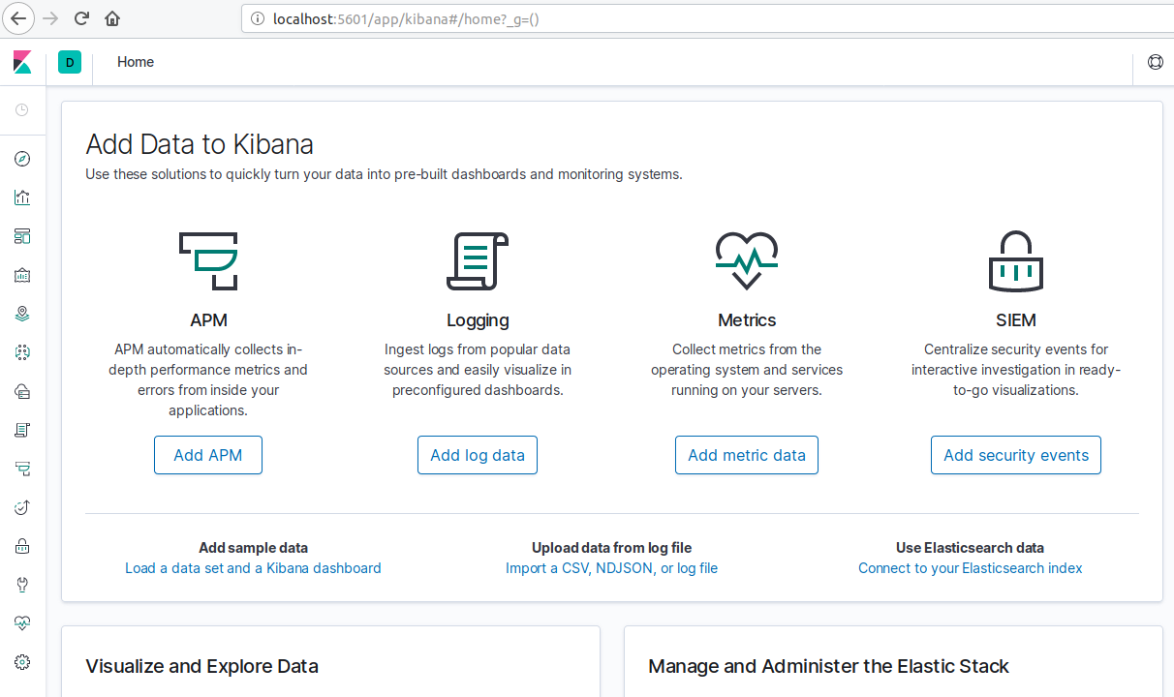

Slide 18
Communication
Cluster
Client
Indexing
Search Document Design
Search Document Serialization
Index Configuration
Index Creation
Initial Indexing
Systematic Indexing
Querying
Search Definition
Search Results
Pagination
Sorting
Filtering

Slide 19
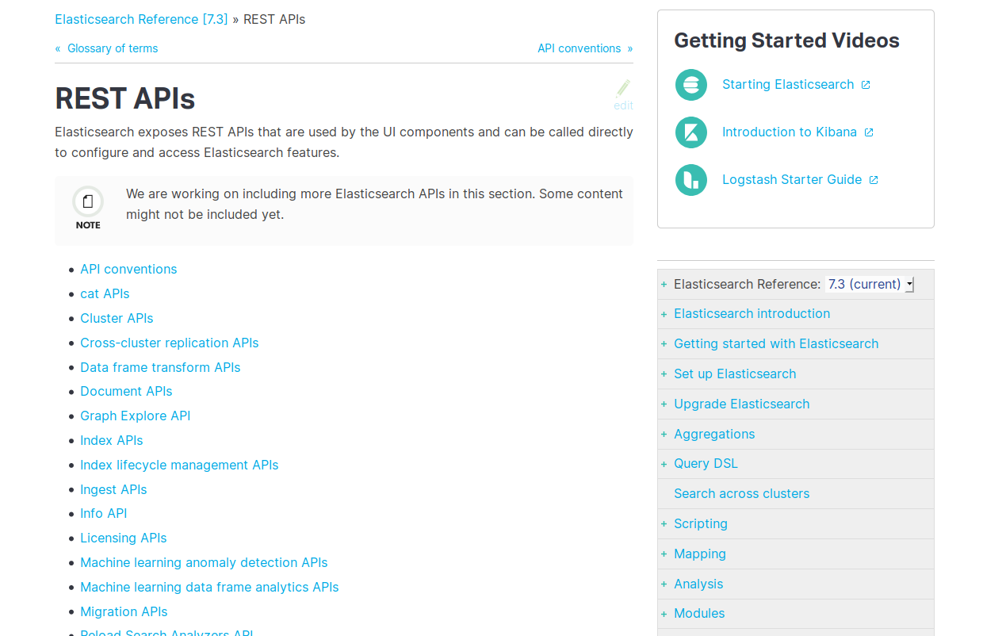

Slide 20
Elasticsearch REST APIs
So Any HTTP Client/Library Should Do?

Slide 21
Construct every request
Parse every response
Set up logging/tracing
Manage connections with the nodes in the cluster
Handle retries and errors

Slide 23
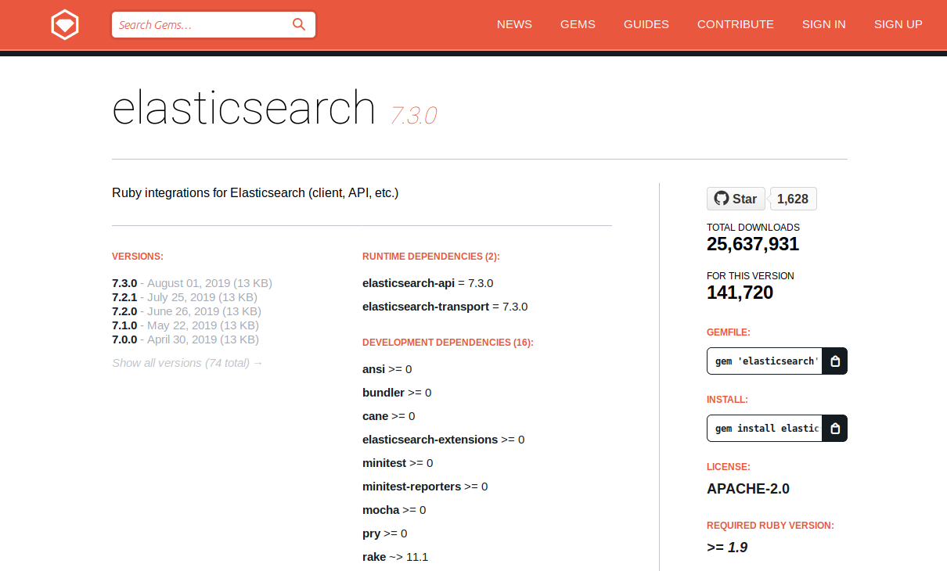

Slide 24
$ bundle add elasticsearch --version='~> 7.3.0'

Slide 25
elasticsearch = Elasticsearch::Client.new
cluster_health = elasticsearch.cluster.health
puts JSON.pretty_generate(cluster_health)
{
"cluster_name": "docker-cluster",
"status": "green",
"timed_out": false,
"number_of_nodes": 1,
...
}
elasticsearch.index(...)
elasticsearch.delete(...)
elasticsearch.bulk(...)
elasticsearch.get(...)
elasticsearch.search(...)

Slide 26
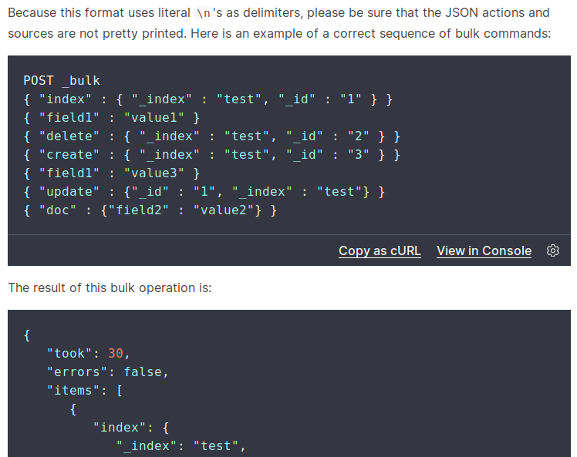
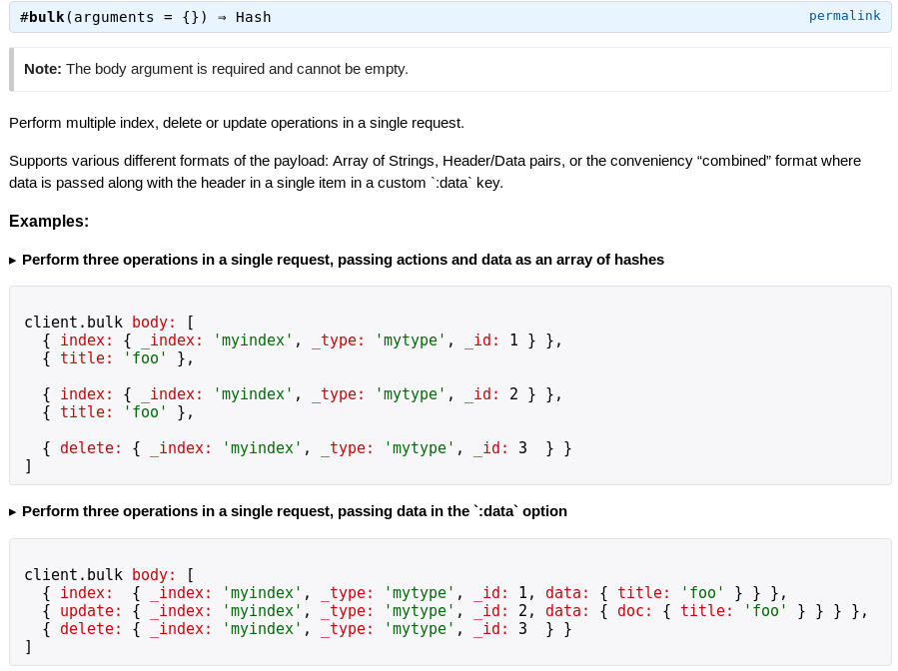
REST API
Ruby API

Slide 27
Idiomatic, Programmatic Access to Your Elasticsearch Cluster
Foundation on Which Deeper Integrations
Are Built

Slide 28
Communication
Cluster
Client
Indexing
Search Document Design
Search Document Serialization
Index Configuration
Index Creation
Initial Indexing
Systematic Indexing
Querying
Search Definition
Search Results
Pagination
Sorting
Filtering

Slide 29
The app allows us to browse books

Slide 30
Public
Domain
Paperbacks
Books
Authors
Genres
Filters
Search Books
Sort
Authors
Foo (3)
Filters
Sort
Best Match
Bar (3)
Date Published
Name of the Book
Genres
By Author
Title
Foo (3)
Published on December 12, 2018
Bar (3)
Years Published
Name of the Book
Foo (3)
By Author
Bar (3)
Published on December 12, 2018
Prev
Next

Slide 31
But we want to search books

Slide 32
Public
Domain
Paperbacks
Books
Authors
Genres
Filters
Search Books
Sort
Authors
Foo (3)
Filters
Sort
Best Match
Bar (3)
Date Published
Name of the Book
Genres
By Author
Title
Foo (3)
Published on December 12, 2018
Bar (3)
Years Published
Name of the Book
Foo (3)
By Author
Bar (3)
Published on December 12, 2018
Prev
Next

Slide 33
Ruby on Rails (Web application framework)
ActiveRecord (ORM)

Slide 34
4 Tables:
books
authors
genres
books_genres

Slide 35
ActiveRecord::Schema.define do
create_table "books" do |t|
t.string "name"
t.string "image"
t.text "description"
t.string "isbn"
t.date "published_at"
t.integer "author_id"
t.datetime "created_at"
t.datetime "updated_at"
end
end
ActiveRecord::Schema.define do
create_table "authors" do |t|
t.string "name"
t.string "image"
t.text "description"
t.datetime "created_at"
t.datetime "updated_at"
end
end
ActiveRecord::Schema.define do
create_table "genres" do |t|
t.string "name"
t.string "image"
t.text "description"
t.datetime "created_at"
t.datetime "updated_at"
end
end
ActiveRecord::Schema.define do
create_table "books_genres" do |t|
t.integer "book_id"
t.integer "genre_id"
end
end

Slide 36
3 Models:
Book
Author
Genre

Slide 37
class Book < ApplicationRecord
belongs_to :author
has_and_belongs_to_many :genres
end
class Author < ApplicationRecord
has_many :books
end
class Genre < ApplicationRecord
has_and_belongs_to_many :books
end

Slide 38
We want to search books
Views of a book

Slide 39
Tabular view of a book
authors (1 row)
"id": 2,
"name": "Robert Louis Stevenson",
"image": "robert-louis-stevenson.jpg",
"description": "Robert Louis Stevenson was a Scottish novelist...",
"created_at": "2019-08-20T19:12:55.322Z",
"updated_at": "2019-08-20T19:12:55.322Z"
books (1 row)
"id": 2,
"author_id": 2,
"name": "Strange Case of Dr Jekyll and Mr Hyde",
"image": "dr-jekyll-and-mr-hyde.jpg",
"description": "Strange Case of Dr Jekyll and Mr Hyde is a gothic novella by..."
"isbn": "284998401-9",
"published_at": "2018-01-01",
"created_at": "2019-08-20T19:12:56.078Z",
"updated_at": "2019-08-20T19:12:56.078Z"
books_genres (2 rows)
book_id 2
genre_id 1
book_id 2
genre_id 2
genres (2 rows)
"id": 1,
"name": "Horror",
"image": "horror.jpg",
"description": "Horror is a genre of speculative fiction...",
"created_at": "2019-08-20T19:12:55.345Z",
"updated_at": "2019-08-20T19:12:55.345Z"
"id": 2,
"name": "Science Fiction",
"image": "science-fiction.jpg",
"description": "Science fiction (sometimes called Sci-Fi) is a...",
"created_at": "2019-08-20T19:12:55.351Z",
"updated_at": "2019-08-20T19:12:55.351Z"

Slide 40
Author.create(name: 'Robert Louis Stevenson', ...)
Genre.create(name: 'Horror', ...)
Genre.create(name: 'Science Fiction', ...)
author = Author.find_by(name: 'Robert Louis Stevenson')
genres = Genre.where(name: ['Horror', 'Science Fiction'])
Book.create(
author: author,
genres: genres,
name: 'Strange Case of Dr Jekyll and Mr Hyde',
image: 'dr-jekyll-and-mr-hyde.jpg',
description: 'Strange Case of Dr Jekyll and Mr Hyde is a ...'
isbn: '284998401-9',
published_at: '2018-01-01'
)

Slide 41
book = Book.find_by(
name: 'Strange Case of Dr Jekyll and Mr Hyde'
)
book.isbn
"284998401-9"
book.author.id
2
book.author.name
"Robert Louis Stevenson"
book.genres.map(&:id)
[1, 2]
book.genres.map(&:name)
["Horror", "Science Fiction"]

Slide 42
What we think of as a book is a view
that involves multiple models/tables
and must be constructed

Slide 43
We must design an additional
view of a book that's suitable for searching
A search document

Slide 44
Considerations:
Filters
Query
Sorts
Aggregations
Results

Slide 45
Public
Domain
Paperbacks
Books
Authors
Genres
Filters
Search Books
Sort
Authors
Foo (3)
Filters
Sort
Best Match
Bar (3)
Date Published
Name of the Book
Genres
By Author
Title
Foo (3)
Published on December 12, 2018
Bar (3)
Years Published
Name of the Book
Foo (3)
By Author
Bar (3)
Published on December 12, 2018
Prev
Next

Slide 46
Public
Domain
Paperbacks
Books
Authors
Genres
Filters
Search Books
Sort
Authors
Foo (3)
Filters
Sort
Best Match
Bar (3)
Date Published
Name of the Book
Genres
By Author
Title
Foo (3)
Published on December 12, 2018
Bar (3)
Years Published
Name of the Book
Foo (3)
By Author
Bar (3)
Published on December 12, 2018
Prev
Next

Slide 47
id
name
image
description
isbn
published_at
author_id
published_at_year
author_name
genre_ids
genre_names

Slide 48
id
name
image
description
isbn
published_at
author_id
published_at_year
author_name
genre_ids
genre_names

Slide 49
class Book < ApplicationRecord
def published_at_year
published_at.year
end
def author_name
author.name
end
def genre_ids
genres.map(&:id)
end
def genre_names
genres.map(&:name)
end
end

Slide 50
book = Book.second
book.id
2
book.name
"Strange Case of Dr Jekyll and Mr Hyde"
book.author_id
2
book.author_name
"Robert Louis Stevenson"
book.genre_ids
[1, 2]
book.genre_names
["Horror", "Science Fiction"]
book.published_at
Mon, 01 Jan 2018
book.published_at_year
2018
book.description
"Strange Case of Dr Jekyll and Mr Hyde is a gothic novella..."
book.image
"dr-jekyll-and-mr-hyde.jpg"
book.isbn
"398742348-X"

Slide 51
Communication
Cluster
Client
Indexing
Search Document Design
Search Document Serialization
Index Configuration
Index Creation
Initial Indexing
Systematic Indexing
Querying
Search Definition
Search Results
Pagination
Sorting
Filtering

Slide 52
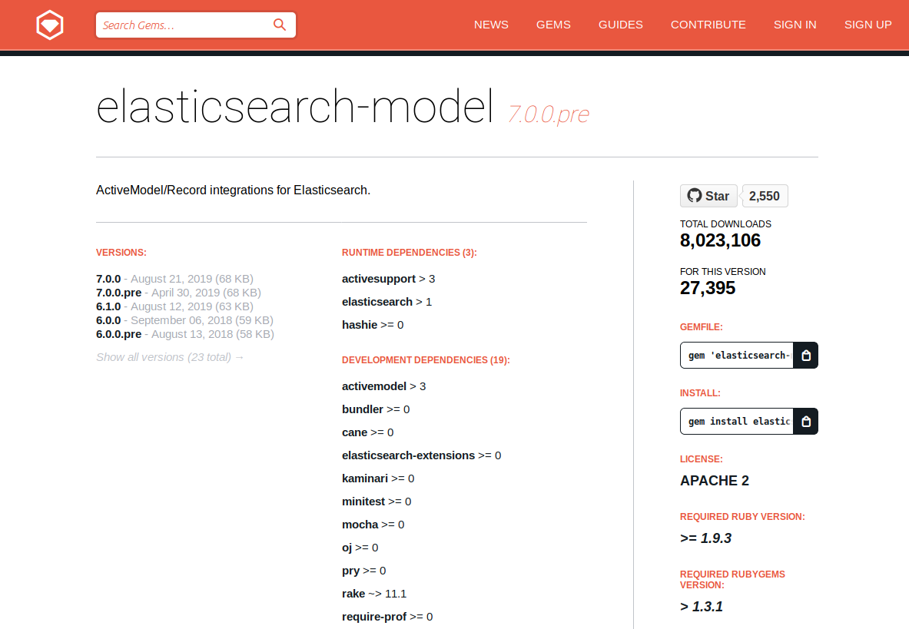

Slide 53
$ bundle add elasticsearch-model --version='~> 7.0.0.pre'

Slide 54
class Book < ApplicationRecord
include Elasticsearch::Model
end
Book.import(...)
Book.search(...)
Book.__elasticsearch__
Book.__elasticsearch__.client
Book.__elasticsearch__.client.cluster.health
book = Book.first
book.__elasticsearch__.client.cluster.health
book.as_indexed_json

Slide 55
{
"id": 2,
"name": "Strange Case of Dr Jekyll and Mr Hyde",
"image": "dr-jekyll-and-mr-hyde.jpg",
"description": "Strange Case of Dr Jekyll and Mr Hyde...",
"isbn": "284998401-9",
"published_at": "2018-01-01",
"author_id": 2,
"created_at": "2019-08-20T19:12:56.078Z",
"updated_at": "2019-08-20T19:12:56.078Z"
}

Slide 56
{
"id": 2,
"name": "Strange Case of Dr Jekyll and Mr Hyde",
"image": "dr-jekyll-and-mr-hyde.jpg",
"description": "Strange Case of Dr Jekyll and Mr Hyde...",
"isbn": "284998401-9",
"published_at": "2018-01-01",
"author_id": 2,
-"created_at": "2019-08-20T19:12:56.078Z",
-"updated_at": "2019-08-20T19:12:56.078Z"
}

Slide 57
{
"id": 2,
"name": "Strange Case of Dr Jekyll and Mr Hyde",
"image": "dr-jekyll-and-mr-hyde.jpg",
"description": "Strange Case of Dr Jekyll and Mr Hyde...",
"isbn": "284998401-9",
"published_at": "2018-01-01",
"author_id": 2,
"published_at_year": 2018,
"author_name": "Robert Louis Stevenson",
"genre_ids": [
1,
2
],
"genre_names": [
"Horror",
"Science Fiction"
]
}

Slide 58
class Book < ApplicationRecord
def as_indexed_json(options={})
as_json(
except: [
:created_at,
:updated_at
],
methods: [
:published_at_year,
:author_name,
:genre_ids,
:genre_names
]
)
end
end

Slide 59
{
"id": 2,
"name": "Strange Case of Dr Jekyll and Mr Hyde",
"image": "dr-jekyll-and-mr-hyde.jpg",
"description": "Strange Case of Dr Jekyll and Mr Hyde...",
"isbn": "284998401-9",
"published_at": "2018-01-01",
"author_id": 2,
"published_at_year": 2018,
"author_name": "Robert Louis Stevenson",
"genre_ids": [
1,
2
],
"genre_names": [
"Horror",
"Science Fiction"
]
}

Slide 60
Views of a book
tables -> object -> search document
books
id
2
name
String Case...
author_id
2
authors
id
2
name
Robert Louis...
book = Book.find(2)
book.name
'String Case...'
book.author_name
'Robert Louis...'
book.as_indexed_json
'{"name":"Strange Case...","author_name":"Robert Louis..."}'

Slide 61
Indexing, Index Configuration
now we can create search documents
but we need a place to put them
since our app has dev and test databases
we'll create dev and test indexes for books
configure:
index name
index settings
index mapping

Slide 62
Communication
Cluster
Client
Indexing
Search Document Design
Search Document Serialization
Index Configuration
Index Creation
Initial Indexing
Systematic Indexing
Querying
Search Definition
Search Results
Pagination
Sorting
Filtering

Slide 63
class Book < ApplicationRecord
index_name "#{Rails.env}-books"
settings number_of_replicas: 0 do
mapping dynamic: 'false' do
...
end
end
end

Slide 64
[reuse: overlay the application UI with 4 boxes, each with field names]

Slide 65
mapping dynamic: 'false' do
indexes :name, type: 'text' do
indexes :raw, type: 'keyword'
end
indexes :image, type: 'keyword', index: false
indexes :description, type: 'text'
indexes :isbn, type: 'keyword'
indexes :published_at, type: 'date'
indexes :author_id, type: 'integer'
indexes :published_at_year, type: 'integer'
indexes :author_name, type: 'text'
indexes :genre_ids, type: 'integer'
indexes :genre_names, type: 'text'
end

Slide 66
[trying to use kibana to show "internal representation" 1/2]

Slide 67
[trying to use kibana to show "internal representation" 2/2]

Slide 68
Indexing, Index Creation

Slide 69
Communication
Cluster
Client
Indexing
Search Document Design
Search Document Serialization
Index Configuration
Index Creation
Initial Indexing
Systematic Indexing
Querying
Search Definition
Search Results
Pagination
Sorting
Filtering

Slide 70
[using REST API to create an index]

Slide 71
[using Ruby API to create an index]

Slide 72
using model integration library to create the indexes
$ RAILS_ENV=development bin/rails runner 'Book.create_index!'
$ RAILS_ENV=test bin/rails runner 'Book.create_index!'
irb> puts Book.__elasticsearch__.client.cat.indices(h: 'i').split.sort
.kibana_1
.kibana_task_manager
development-books
test-books

Slide 73
Indexing, Initial Indexing
irb> Book.import

Slide 74
Communication
Cluster
Client
Indexing
Search Document Design
Search Document Serialization
Index Configuration
Index Creation
Initial Indexing
Systematic Indexing
Querying
Search Definition
Search Results
Pagination
Sorting
Filtering

Slide 75
[documents indexed]

Slide 76
will come back to Indexing, Systematic Indexing
let's search!

Slide 77
Communication
Cluster
Client
Indexing
Search Document Design
Search Document Serialization
Index Configuration
Index Creation
Initial Indexing
Systematic Indexing
Querying
Search Definition
Search Results
Pagination
Sorting
Filtering

Slide 78
Querying, Search Definition
search with a query string
Book.search('horror')
or with a search definition
Book.search({...})
we want to redefine Book#search
to always use the same search definition

Slide 79
Communication
Cluster
Client
Indexing
Search Document Design
Search Document Serialization
Index Configuration
Index Creation
Initial Indexing
Systematic Indexing
Querying
Search Definition
Search Results
Pagination
Sorting
Filtering

Slide 80
[elasticsearch-dsl rubygem]

Slide 81
$ bundle add 'elasticsearch-dsl' --version='~> 0.1.8'

Slide 82
class Book < ApplicationRecord
def self.search(q, options={})
search_definition = Elasticsearch::DSL::Search.search do
...
end
__elasticsearch__.search(search_definition)
end
end
q and options come from the UI
we'll get to options later

Slide 83
search_definition = Elasticsearch::DSL::Search.search do
query do
if q.present?
multi_match do
query q
fields [
'isbn^10',
'name^9',
'author_name^5',
'genre_names^1',
'description'
]
end
else
match_all
end
end
end

Slide 84
No query string: Book.search(nil)
{
"index": "development-books",
"type": null,
"body": {
"query": {
"match_all": {}
}
}
}

Slide 85
With query string: Book.search('romantic horror')
{
"index": "development-books",
"type": null,
"body": {
"query": {
"multi_match": {
"query": "romantic horror",
"fields": [
"isbn^10",
"name^9",
"author_name^5",
"genre_names^1",
"description"
]
}
}
}
}

Slide 86
Querying, Search Results
Book.search('romantic horror').class
Elasticsearch::Model::Response::Response
Book.search('romantic horror').results.class
Elasticsearch::Model::Response::Results
Book.search('romantic horror').records.class
Elasticsearch::Model::Response::Records
Book.search('romantic horror').response.class
Elasticsearch::Model::HashWrapper
Book.search('romantic horror').raw_response.class
Hash

Slide 87
Communication
Cluster
Client
Indexing
Search Document Design
Search Document Serialization
Index Configuration
Index Creation
Initial Indexing
Systematic Indexing
Querying
Search Definition
Search Results
Pagination
Sorting
Filtering

Slide 88
response.results.each do |result|
puts
puts result.name
puts result.author_name
end
Frankenstein
Mary Shelley
Strange Case of Dr Jekyll and Mr Hyde
Robert Louis Stevenson

Slide 89
[image of the UI or just a result or the results in the UI]

Slide 90
Book.search('romantic horror').results.first.class
Elasticsearch::Model::Response::Result
Book.search('romantic horror').records.first.class
Book
(additional books query)

Slide 91
Book.search('romantic horror').results.first.<search_document_field>
Book.search('romantic horror').results.first.author_name
'Mary Shelley'
Book.search('romantic horror').records.first.<active_record_model_field>
Book.search('romantic horror').records.first.author_name
'Mary Shelley'
(additional author query)

Slide 92
if you design your search document well
you can display the page using only the results
and don't need the records
the tradeoff of using the data from the search documents
is that is is potentially stale
if an admin updated the author name
e.g. fix a typo
and that change hasn't propogated to elasticsearch yet
you still see the typo
but that is mitigated by having good systematic indexing
which we'll cover soon

Slide 93
Querying, Pagination

Slide 94
Communication
Cluster
Client
Indexing
Search Document Design
Search Document Serialization
Index Configuration
Index Creation
Initial Indexing
Systematic Indexing
Querying
Search Definition
Search Results
Pagination
Sorting
Filtering

Slide 95
[kaminari rubygem]

Slide 96
have to require it before elasticsearch
gem "kaminari", "~> 1.1.1"
gem "elasticsearch", "~> 7.3.0"
gem "elasticsearch-model", "~> 7.0.0.pre"
gem "elasticsearch-dsl", "~> 0.1.8"

Slide 97
Book.search(nil).results.count
4
Book.search(nil).page(1).per(3).results.count
3
Book.search(nil).page(2).per(3).results.count
1
Book.search(nil).page(2).per(3).first_page?
false
Book.search(nil).page(2).per(3).last_page?
true
Book.search(nil).page(2).per(3).total_pages
2
Book.search(nil).page(2).per(3).current_page
2
Book.search(nil).page(2).per(3).next_page
nil
Book.search(nil).page(2).per(3).prev_page
1

Slide 98
Querying, Sorting

Slide 99
Communication
Cluster
Client
Indexing
Search Document Design
Search Document Serialization
Index Configuration
Index Creation
Initial Indexing
Systematic Indexing
Querying
Search Definition
Search Results
Pagination
Sorting
Filtering

Slide 100
class Book < ApplicationRecord
def self.available_sorts
{
best: {
display_name: 'Best Match',
field: '_score',
order: 'desc'
},
date: {
display_name: 'Date Published',
field: 'published_at',
order: 'desc'
},
title: {
display_name: 'Title',
field: 'name.raw',
order: 'asc'
}
}
end
end

Slide 101
Book.available_sorts.each do |id, sort|
puts;
puts "* #{sort[:display_name]}"
puts " (#{sort[:field]}, #{sort[:order]})"
end
* Best Match
(_score, desc)
* Date Published
(published_at, desc)
* Title
(name.raw, asc)

Slide 102
Book.search(nil, sort: :title).results.first.name
"Frankenstein"
Book.search(nil, sort: :date).results.first.name
"The Time Machine"

Slide 103
class Book < ApplicationRecord
def self.search(q, options={})
selected_sort = available_sorts[options.fetch(:sort, :best)]
search_definition = Elasticsearch::DSL::Search.search do
query do
...
end
sort do
by selected_sort[:field], order: selected_sort[:order]
end
end
end
end

Slide 104
{
"index": "development-books",
"type": null,
"body": {
"query": {...},
"sort": [
{
"published_at": {
"order": "desc"
}
}
]
}
}

Slide 105
Querying, Filtering

Slide 106
Communication
Cluster
Client
Indexing
Search Document Design
Search Document Serialization
Index Configuration
Index Creation
Initial Indexing
Systematic Indexing
Querying
Search Definition
Search Results
Pagination
Sorting
Filtering

Slide 107
Book.search(nil).response.aggregations.each do |term, values|
type = term.singularize.titleize
puts
values.buckets.each do |bucket|
puts "#{type} #{bucket['key']} (#{bucket['doc_count']})"
end
end
Genre 1 (2)
Genre 2 (2)
Genre 3 (1)
Year 2018 (2)
Year 2019 (2)
Author 2 (2)
Author 1 (1)
Author 3 (1)

Slide 108
search_definition = Elasticsearch::DSL::Search.search do
query do
...
end
sort do
...
end
aggregation :authors do
terms field: 'author_id'
end
aggregation :genres do
terms field: 'genre_ids'
end
aggregation :years do
terms field: 'published_at_year'
end
end

Slide 109
{
"index": "development-books",
"type": null,
"body": {
"query": {...},
"sort": [...],
"aggregations": {
"authors": {
"terms": {
"field": "author_id"
}
},
"genres": {
"terms": {
"field": "genre_ids"
}
},
"years": {
"terms": {
"field": "published_at_year"
}
}
}
}
}

Slide 110
Book.search(nil).results.count
4
Book.search(nil, author: 2).results.count
2
Book.search(nil, genre: 3).results.count
1
Book.search(nil, year: 2019).results.count
2
Book.search('time travel', year: 2019).results.count
1

Slide 111
def self.search(q, options={})
selected_author = options[:author]
selected_genre = options[:genre]
selected_year = options[:year]
selected_sort = available_sorts[options.fetch(:sort, :best)]
search_definition = Elasticsearch::DSL::Search.search do
query do
bool do
filter { term author_id: selected_author } if selected_author
filter { term genre_ids: selected_genre } if selected_genre
filter { term published_at_year: selected_year } if selected_year
must do
if q.present?
...
else
match_all
end
end
end
end
end
end

Slide 112
{
"index": "development-books",
"type": null,
"body": {
"query": {
"bool": {
"filter": [
{
"term": {
"author_id": 2
}
}
],
"must": [
{
"multi_match": {...}
}
]
}
},
"sort": [...],
"aggregations": {...}
}
}

Slide 113
Indexing, Systematic Indexing

Slide 114
Communication
Cluster
Client
Indexing
Search Document Design
Search Document Serialization
Index Configuration
Index Creation
Initial Indexing
Systematic Indexing
Querying
Search Definition
Search Results
Pagination
Sorting
Filtering

Slide 115
book_1 = Book.find(1)
search_book_1 = Book.__elasticsearch__.client.get(
index: Book.index_name,
id: 1
)
book_1.name
"Frankensteen"
search_book_1.dig('_source', 'name')
"Frankensteen"

Slide 116
Book
.find(1)
.update_attribute(:name, 'Frankenstein')

Slide 117
book_1 = Book.find(1)
search_book_1 = Book.__elasticsearch__.client.get(
index: 'development-books',
id: 1
)
book_1.name
"Frankenstein"
search_book_1['_source']['name']
"Frankensteen"

Slide 118
goes beyond fixing typo
create, update, or delete a book
and those changes make it into Elasticsearch

Slide 119
class Book < ApplicationRecord
after_save :save_search_book
after_destroy :destroy_search_book
def save_search_book(*args)
SaveSearchBookJob.perform_later(id)
end
def destroy_search_book(*args)
DestroySearchBookJob.perform_later(id)
end
end

Slide 120
class SaveSearchBookJob < ApplicationJob
queue_as :default
def perform(book_id)
book = Book.find(book_id)
book.__elasticsearch__.index_document
end
end

Slide 121
class DestroySearchBookJob < ApplicationJob
queue_as :default
def perform(book_id)
client = Book.__elasticsearch__.client
index = Book.index_name
client.delete(index: index, id: book_id)
end
end

Slide 122
but still a problem
because you can assign genres to a book without saving the book
the RDBMS is updated as soon as you assign genres
so have to add some more callbacks on book
and you can also relate books and genres in the opposite direction
from the genre, you can assign books
so genre also needs callbacks

Slide 123
class Book < ApplicationRecord
has_and_belongs_to_many :genres,
after_add: :save_search_book,
after_remove: :save_search_book
after_save :save_search_book
after_destroy :destroy_search_book
end

Slide 124
class Genre < ApplicationRecord
has_and_belongs_to_many :books,
after_add: :save_search_book,
after_remove: :save_search_book
def save_search_book(book)
SaveSearchBookJob.perform_later(book.id)
end
end

Slide 125
And Beyond!

Slide 126
those are the fundamentals
but app search can be so much more
some ideas:

Slide 127
improve filtering
conjunctive facets
ranges/sliders
improve querying
typo tolerance
spelling correction
bigram matching
phrase matching
improve results handling
highlighting
add search as you type, query suggestions and autocomplete
add dashboards to
promote, hide, or otherwise manage results for specific queries
manage synonyms
view analytics for searches and clicks
manage relevance (e.g. field boosting)

Slide 128
many of these inspired by prebuilt solutions
such as Elastic App Search
[elastic app search image]
reach for those when you need these features
but don't want to build them all yourself

Slide 129
but if you want to build it all yourself
there are tools for that too
for many languages and frameworks
it may have been a little difficult to get started
or design your app search / domain model integration solution
in response to that I presented
the following design steps/framework

Slide 130
all the steps again

Slide 131
Thank You
Architecting a Search Feature (in Rails)
Chris Cressman
https://chriscressman.com

