Slide 1
Comp4611 Tutorial 4
Pipelining and Control Hazards
Oct. 7 2013

Slide 2
Outline
Branch Hazard
  Modified Pipelined MIPS Datapath
  4 Reducing Branch Penalty Alternatives
  Dynamic Branch Prediction
Exercise on Pipeline Time Chart

Slide 3
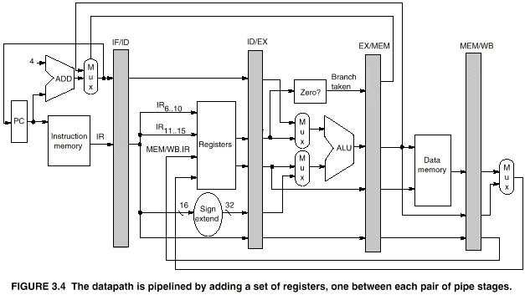
Pipelined MIPS Datapath
Conditional Branches:
beq R1,R2,100 if (R1 == R2) go to PC+4+100

Slide 4
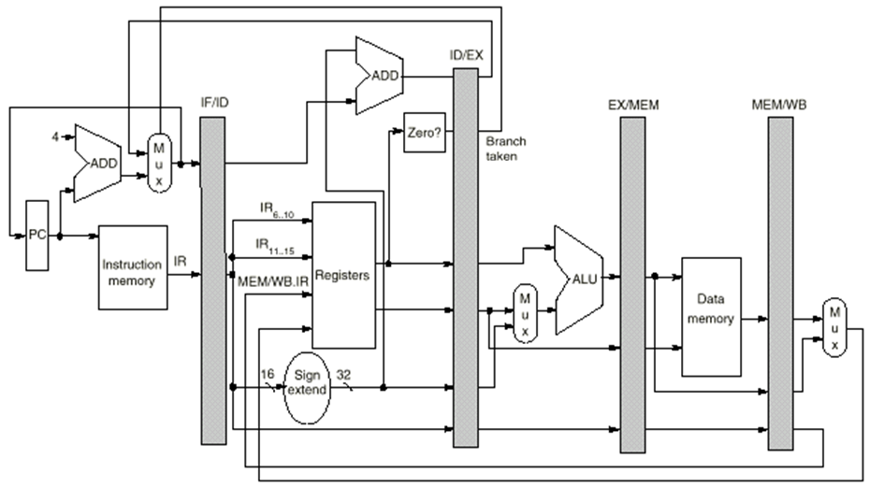
Modified Pipelined MIPS Datapath with Early Branch Determination
Conditional Branches
Completed in ID Stage

Slide 5
Reducing Branch Penalty
Stall until branch direction is clear
  Move Zero test to ID stage
  Adder to calculate new PC in ID stage
  Less wasted clock cycles
  ➔ Modified pipelined MIPS still need one stall
Branch | IF | ID | EX | MEM | WB
Next |  | IF(stall) | IF | ID | EX | MEM | WB

Slide 6
Reducing Branch Penalty
Predict Branch Not Taken
  Immediately execute the next instruction
  Execute successor instructions in sequence
  “Squash” instructions in pipeline if branch actually taken
  Advantage of late pipeline state update
  PC+4 already calculated, so use it to get next instruction (each instruction take 4 bytes)
  0 clock cycle wasted when branch not taken
  1 clock cycle wasted when branch taken

Slide 7
Reducing Branch Penalty
Predict Branch Taken
  But haven’t calculated branch target address in MIPS
  ➔ MIPS still incurs 1 cycle branch penalty
  Predict-taken scheme makes sense only in some machines where the target address of branch is known before the branch outcome

Slide 8
Reducing Branch Penalty
Delayed Branch
  The first instruction following the branch is ALWAYS executed
  Compiler can figure out what to put there
  Where to get instructions to fill branch delay slot?
    Before branch instruction
    From the target address: only valuable when branch taken
    From fall through: only valuable when branch not taken
target
before
Blt R1,L1
fallthru

Slide 9
Dynamic Branch Prediction
Builds on the premise that history matters
  Observe the behavior of branches in previous instances and try to predict future branch behavior
  Try to predict the outcome of a branch early on in order to avoid stalls
  Branch prediction is critical for multiple issue processors
    In an n-issue processor, branches will come n times faster than a single issue processor

Slide 10
1-Bit Branch Prediction
Branch History Table (BHT): Lower bits of PC address index table of 1-bit values
  Says whether or not the branch was taken last time
  No address check (saves HW, but may not be the right branch)
  If prediction is wrong, invert prediction bit
  1 = branch was last taken
  0 = branch was last not taken
1
prediction bit
0
a₃₁a₃₀…a₁₁…a₂a₁a₀
branch instruction
1K-entry BHT
10-bit index
1
Instruction memory
Hypothesis: branch will do the same again.

Slide 11
1-Bit Branch Prediction
  Example:
Consider a loop branch that is taken 9 times in a row and then not taken once. What is the prediction accuracy of the 1-bit predictor for this branch assuming only this branch ever changes its corresponding prediction bit?
  Answer:
  80%. Because there are two mis-predictions;
  one on the first iteration and one on the last iteration.

Slide 12
2-bit Predictors
2-bit scheme ➔ 2 mis-predictions change the prediction
Greatly improve the prediction performance
T
NT
Predict Taken
11
10
T
T
NT
NT
Predict Not Taken
01
00
T
NT

Slide 13
2-bit Prediction Buffer
How to implement it?
  A separate memory (cache)
  Bits attached to each instruction cache line
Do we need address tags?
Size of storage needed?
11
00
10
…
01
11
000
004
008
ff8
ffc
PC=1a305ff8: bnz r3, label
1024-entry 2-bit prediction buffer indexed by 10 bits (12th — 3rd least significant bits)

Slide 14
Pipeline Time Chart Exercise
Loop: LD R1, 0(R2)
DADDI R1, R1, #1
SD 0(R2), R1
DADDI R2, R2, #4 ; R2 = R2 + 4
DSUB R4, R3, R2 ; R4 = R3 - R2
BNEZ R4, Loop
Given: 1. Initially R3 = R2 + 396, all stages take 1 cycle each.
2. Register can perform read/write in same cycle.
3. With Modified MIPS Datapath
Draw pipeline timing chart without forwarding. Branch handled by stalling pipeline. How many cycles does the loop take?
Draw pipeline timing chart with forwarding. Branch handled by predicted not taken. How many cycles does the loop take?

Slide 15
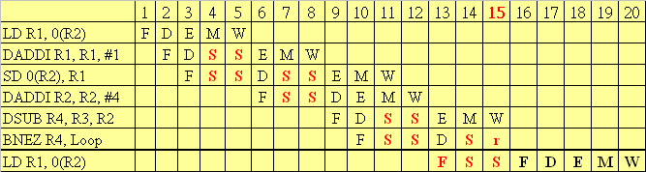
Answer
For Modified MIPS Pipeline, Conditional Branch will be resolved in ID stage. (S - Stall, r - branch result ready)
Total No. of Loops = 396/4 = 99
(a)
Total cycles = 15 x 99 = 1485
Notes:
SD 0(R2),R1 must stall 2 cycles before execute ID, otherwise it will flush the ID/EX registers, thus affect the EX stage of DADDI R1,R1,#1

Slide 16
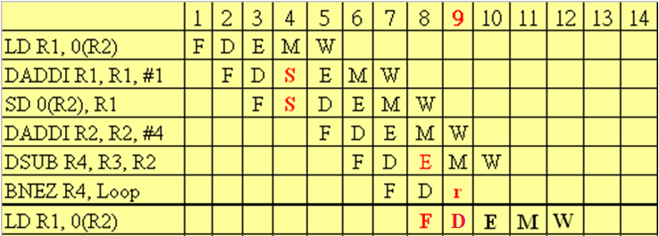
Answer (cont.)
(b)
Total cycles = 9 x 98 + 10 = 892
Prediction
Correct
Prediction
incorrect
Notes:
9*98+10 is because DSUB R4,R3,R2 finish at 10.

