Slide 1
SimpleScalar Tutorial
COMP4611 Tutorial 4
Sept 29, 2013

Slide 2
Outline
Introduction to SimpleScalar
SimpleScalar Installation and Usage
Installing Cygwin
Installing SimpleScalar for PISA
SimpleScalar Usage
Exercises
Installing SimpleScalar for Alpha
Benchmark on SimpleScalar
PISA gcc and objdump
Installing gcc cross-compiler & objdump for PISA
Objdump demo
Instruction count and CPI calculation

Slide 3
What is SimpleScalar
A tool set for users to build applications that simulate real programs running on a range of modern processors and systems
SimpleScalar tool set includes a set of sample simulators to simulate different operations of processors (i.e. branch prediction)

Slide 4
The SimpleScalar Suite
sim-fast – fastest, least detailed functional simulator
sim-safe – functional simulator with checks
sim-outorder – most complicated and detailer simulator
sim-cache – functional cache simulator
sim-bpred – branch prediction simulator
sim-profile – functional simulator that generates detailed profile information
Notes:
Functional Simulator:
Perform real execution
Implement what programmers see

Slide 5
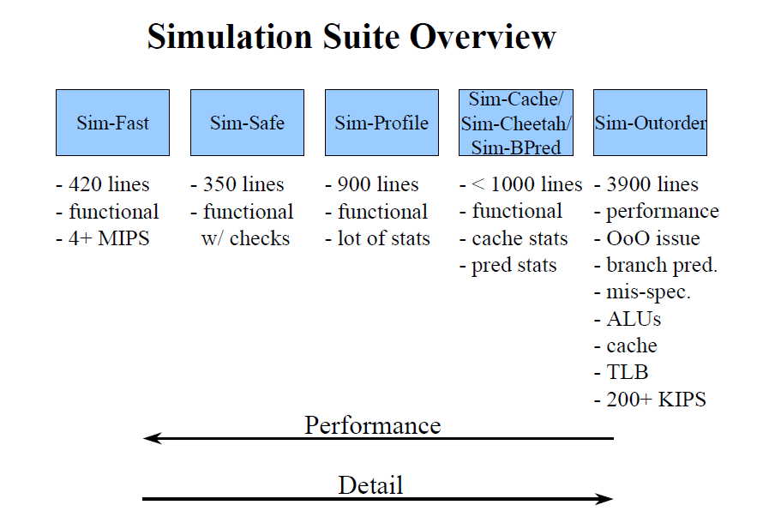
Overview of the SimpleScalar Suite
Figure from SimpleScalar version 2.0 tutorial presentation

Slide 6
Outline
Introduction to SimpleScalar
SimpleScalar Installation and Usage
Installing Cygwin
Installing SimpleScalar for PISA
SimpleScalar Usage
Exercises
Installing SimpleScalar for Alpha
Benchmark on SimpleScalar
PISA gcc and objdump
Instruction count and CPI calculation

Slide 7
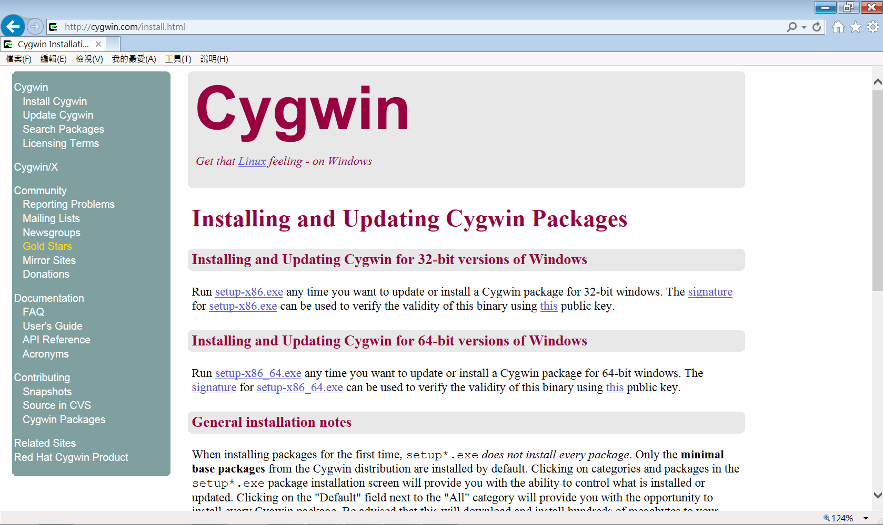
Installing Cygwin
We will run SimpleScalar on Cygwin
Go to http://cygwin.com/install.html to install Cygwin
Download and Run the corresponding package:
setup-x86.exe for 32-bit versions of Windows
setup-x86_64.exe for 64-bit versions of Windows
Note: If you do not have a computer with Windows environment to install Cygwin:
You can apply for an account on a virtual machine in Linux environment (network connection required during programming) for your group
Please send a request email to Prof. Gu (lingu@ust.hk)
With subject “COMP4611: Apply for an account on virtual machine”
With names and UST email addresses of all group members

Slide 8
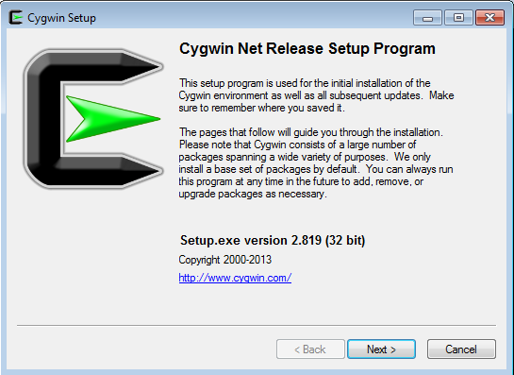
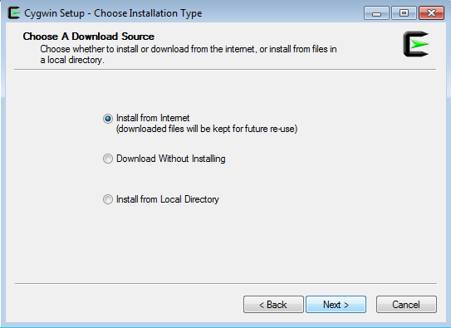
Installing Cygwin
Run the package:
Click next for the following window:
Choose Install from Internet option and click “Next” button from following window

Slide 9
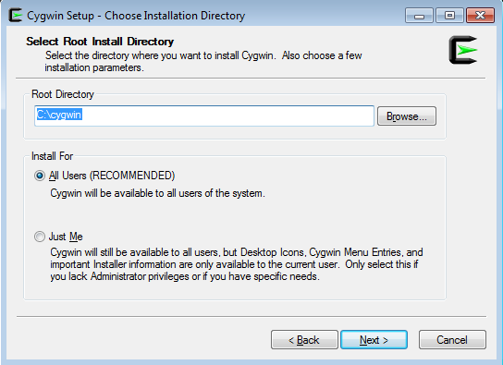
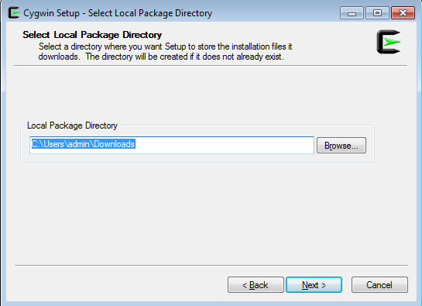
Installing Cygwin
Enter the PATH for Cygwin software and click “Next” to continue

Slide 10
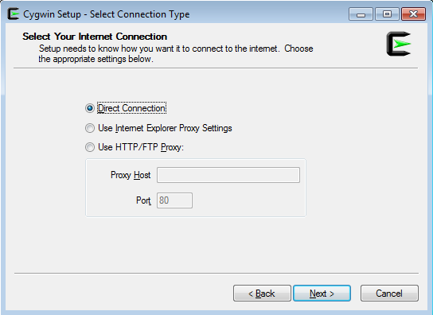
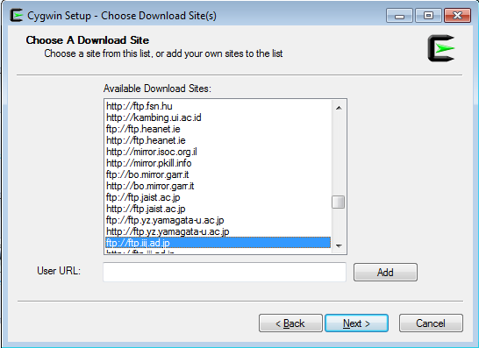
Installing Cygwin
Choose your connection type, then “Next”
Using ftp.iij.ad.jp(ftp) as a recommended mirror site, then “Next”

Slide 11
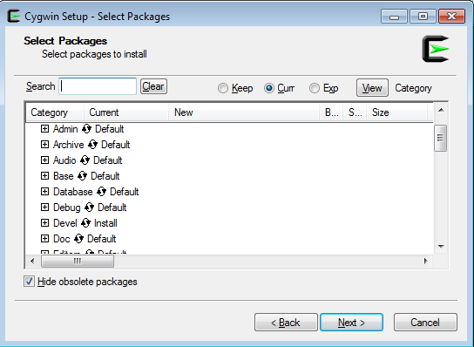
Installing Cygwin
By default Cygwin installation will not contain some of the additional utilities which we need to use:
E.g. gcc, make, wget, tar
To install these extra utilities:
for “Devel”
click once to change it from default to install

Slide 12
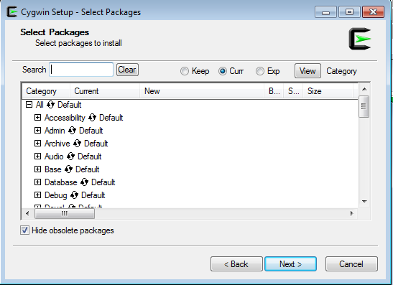
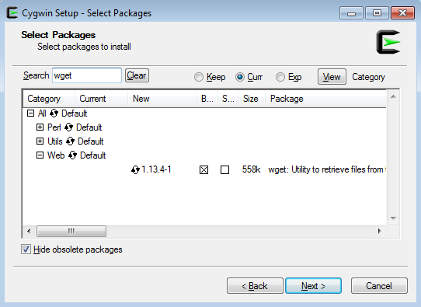
Installing Cygwin
Or another way to install the utilities:
select Category (the default) package installation option
search for the tool and click to change from “skip” to install it

Slide 13
Outline
Introduction to SimpleScalar
SimpleScalar Installation and Usage
Installing Cygwin
Installing SimpleScalar for PISA
SimpleScalar Usage
Exercises
Installing SimpleScalar for Alpha
Benchmark on SimpleScalar
PISA gcc and objdump
Instruction count and CPI calculation

Slide 14
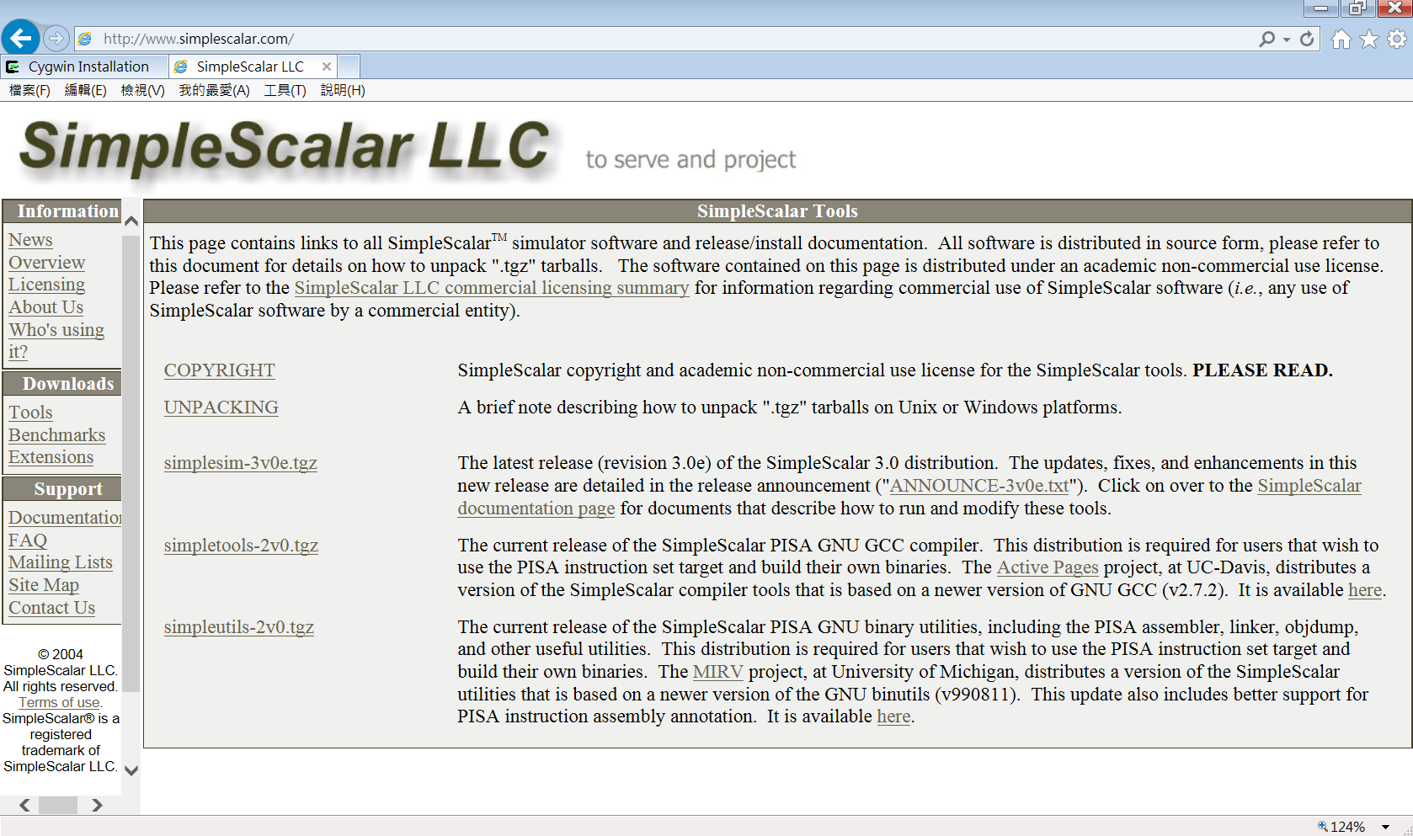
Where to get SimpleScalar
Go to http://www.simplescalar.com
Go to Tools in the Downloads section to the left and download simplesim-3v0d.tgz.
Download the package directly into Cygwin’s root directory (c:\cygwin) or your home directory (c:\cygwin\home\<user>\)

Slide 15
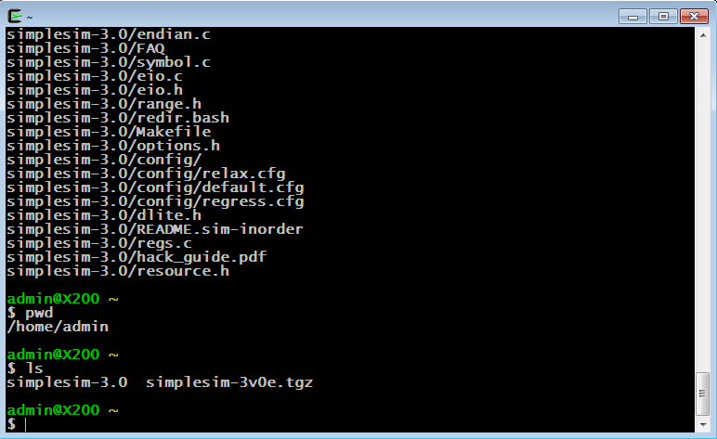
Installing SimpleScalar
Open the Cygwin and go to the directory where the SimpleScalar is downloaded at
Extract the SimpleScalar package:
$ tar –xzvf simplesim-3v0e.tgz

Slide 16
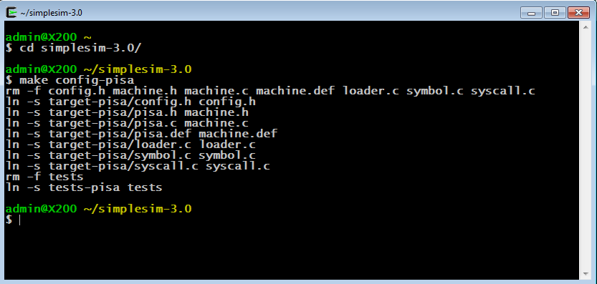
Installing SimpleScalar for PISA binary
Configure the installation target:
$ cd simplesim-3.0/
$ make config-pisa
This step will set up the files for building the PISA target. The other alternative is an Alpha target.

Slide 17
What is PISA and Alpha
SimpleScalar can simulate programs in Alpha or PISA binary
PISA (Portable ISA) instruction set is a simple MIPS-like instruction set. A GNU GCC-based cross-compiler and pre-built libraries are also available for this target.
Alpha ISA is a 64-bit RISC ISA

Slide 18
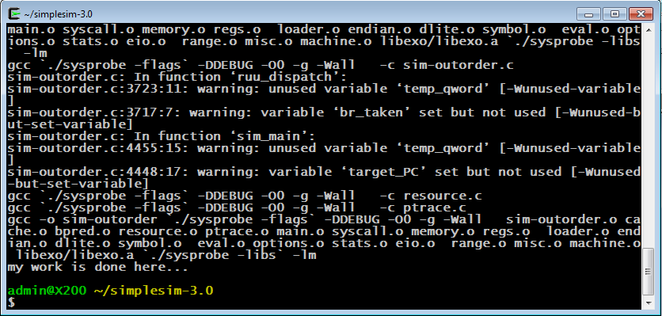
Installing SimpleScalar
Compile the source code of SimpleScalar:
$ make

Slide 19
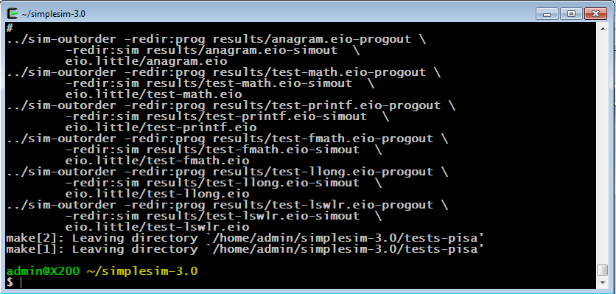
How to verify SimpleScalar works
Verify if the installation is successful:
$ make sim-tests

Slide 20
Outline
Introduction to SimpleScalar
SimpleScalar Installation and Usage
Installing Cygwin
Installing SimpleScalar for PISA
SimpleScalar Usage
Exercises
Installing SimpleScalar for Alpha
Benchmark on SimpleScalar
PISA gcc and objdump
Instruction count and CPI calculation

Slide 21
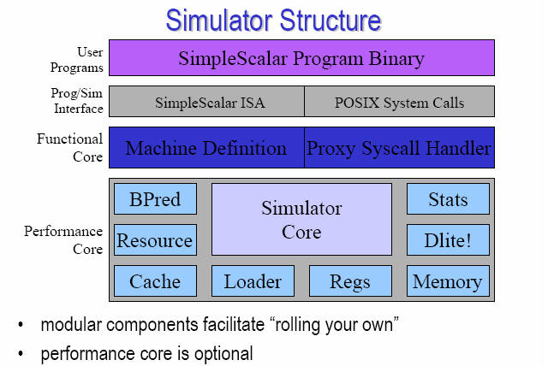
Structure of SimpleScalar
Figure from SimpleScalar version 2.0 tutorial presentation
Where to get SimpleScalar program binary?

Slide 22
SimpleScalar Usage
Global options which are supported on all SimpleScalar simulators:
-h print simulator help message
-d enable debug message
-i start up in Dlite! Debugger
-q quit immediately (use with –dumpconfig)
-config <file> read config parameters from <file>
-dumpconfig <file> save config parameters to <file>

Slide 23
SimpleScalar Usage
For example, running the test-math benchmark
(in simplesim-3.0/tests/bin.little/test-math) :
sim-safe
$ ./sim-safe -v tests/bin.little/test-math
$ ./sim-safe -redir:sim result.simout -redir:prog result.progout tests/bin.little/test-math
-v → verbose operation: reporting the progress
-redir:sim <file>
→ redirects simulator output to the file <file>, i.e. “result.simout”
-redir:prog <file>
→ redirects simulated program output to the file <file>, i.e. “result.progout”

Slide 24
Outline
Introduction to SimpleScalar
SimpleScalar Installation and Usage
Installing Cygwin
Installing SimpleScalar for PISA
SimpleScalar Usage
Exercises
Installing SimpleScalar for Alpha
Benchmark on SimpleScalar
PISA gcc and objdump
Instruction count and CPI calculation

Slide 25
Exercise
How to install SimpleScalar for Alpha binary?
Clean the previous installation for PISA binary
$ cd simplesim-3.0
$ make clean
Configure the installation target:
$ make config-alpha
Compile the source code
Verify the installation

Slide 26
Exercise – Benchmark on SimpleScalar
Download some benchmark programs at http://www.eecs.umich.edu/~taustin/eecs573_public/instruct-progs.tar.gz
For example (in your home directory, e.g. /home/<user>/ )
$ wget http://www.eecs.umich.edu/~taustin/eecs573_public/instruct-progs.tar.gz
Extract the benchmark package:
$ tar –xzvf instruct-progs.tar.gz
$ mv benchmarks simplesim-3.0/
$ cd simplesim-3.0
$ ls benchmarks/

Slide 27
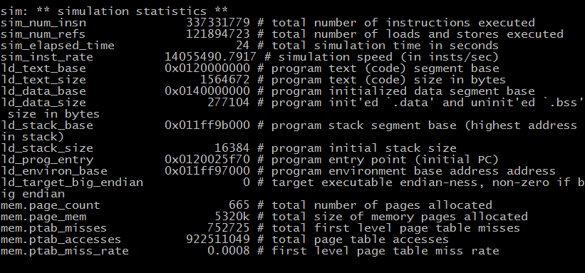
Exercise – Benchmark on SimpleScalar
Run GCC Alpha binary on SimpleScalar
$ cd benchmarks
$ ../sim-safe cc1.alpha -O 1stmt.i
Compare the simulation result:
$ diff 1stmt.s 1stmt.s.ref
simulator program
Alpha binary
Input file

Slide 28
Exercise – Benchmark on SimpleScalar
Run GO Alpha binary on SimpleScalar
$ cd benchmarks
$ ../sim-safe go.alpha 50 9 2stone9.in > OUT
Compare the simulation result:
$ diff OUT go.out

Slide 29
Outline
Introduction to SimpleScalar
SimpleScalar Installation and Usage
Installing Cygwin
Installing SimpleScalar for PISA
SimpleScalar Usage
Exercises
Installing SimpleScalar for Alpha
Benchmark on SimpleScalar
PISA gcc and objdump
Instruction count and CPI calculation

Slide 30
Install gcc cross-compiler and objdump for PISA
In order to be able to compile programs to run on the simulator, you need a port of cross-compiler and libraries for Cygwin:
Download gcc cross-compiler and objdump for PISA to your root directory (i.e. C:\cgywin) at http://www.eecg.toronto.edu/~moshovos/ACA07/files/ss-gcc.usrlocal.tar.bz
Installation steps:
$ cd /
$ tar –xvjf ss-gcc.usrlocal.tar.bz
$ cd usr/loca/bin
$ ls ss-gcc ss-objdump

Slide 31
Introduction to PISA objdump
A tool for disassembling PISA binary code into PISA assembly code
Manual of objdump available at http://sourceware.org/binutils/docs/binutils/objdump.html

Slide 32
PISA objdump Demo
A simple C program – hello.c
int main()
{
int i, a;
a = 2;
for (i = 0; i < 1000; i++)
a++;
}
Compile hello.c into PISA binary code – hello
$ ss-gcc -o hello hello.c
Disassemble hello into PISA assembly code – hello.asm
$ ss-objdump -d hello > hello.asm
$ less hello.asm

Slide 33
PISA assembly of main()
004001f0 <main> addiu/00 $sp[29],$sp[29],-32
004001f8 <main+8> sw/00 $ra[31],28($sp[29])
00400200 <main+10> sw/00 $s8[30],24($sp[29])
00400208 <main+18> addu/00 $s8[30],$zero[0],$sp[29]
00400210 <main+20> jal/00 00400468 <__main>
00400218 <main+28> addiu/00 $v0[2],$zero[0],2
00400220 <main+30> sw/00 $v0[2],20($s8[30])
00400228 <main+38> sw/00 $zero[0],16($s8[30])
00400230 <main+40> lw/00 $v0[2],16($s8[30])
00400238 <main+48> slti/00 $v1[3],$v0[2],1000
00400240 <main+50> bne/00 $v1[3],$zero[0],00400250 <main+60>
00400248 <main+58> j/00 00400298 <main+a8>
00400250 <main+60> lw/00 $v1[3],20($s8[30])

Slide 34
PISA assembly of main()
00400258 <main+68> addiu/00 $v0[2],$v1[3],1
00400260 <main+70> addu/00 $v1[3],$zero[0],$v0[2]
00400268 <main+78> sw/00 $v1[3],20($s8[30])
00400270 <main+80> lw/00 $v1[3],16($s8[30])
00400278 <main+88> addiu/00 $v0[2],$v1[3],1
00400280 <main+90> addu/00 $v1[3],$zero[0],$v0[2]
00400288 <main+98> sw/00 $v1[3],16($s8[30])
00400290 <main+a0> j/00 00400230 <main+40>
00400298 <main+a8> addu/00 $sp[29],$zero[0],$s8[30]
004002a0 <main+b0> lw/00 $ra[31],28($sp[29])
004002a8 <main+b8> lw/00 $s8[30],24($sp[29])
004002b0 <main+c0> addiu/00 $sp[29],$sp[29],32
004002b8 <main+c8> jr/00 $ra[31]

Slide 35
hello on SimpleScalar
Simulate hello binary on SimpleScalar
$ cp hello ~/simplesim-3.0
$ cd ~/simplesim-3.0
$ ./sim-safe –v hello &> hello.ss
$ less hello.ss
$ cat hello.ss | grep ‘bne’ | wc
$ cat hello.ss | grep ‘j/’ | wc

Slide 36
Outline
Introduction to SimpleScalar
SimpleScalar Installation and Usage
Installing Cygwin
Installing SimpleScalar for PISA
SimpleScalar Usage
Exercises
Installing SimpleScalar for Alpha
Benchmark on SimpleScalar
PISA gcc and objdump
Instruction count and CPI calculation

Slide 37
Instruction Statistics
Static instruction statistics is the statistics about the program’s binary code (i.e. how many instructions are there in the program)
Dynamic instruction statistics is the statistics of the dynamic instruction flow fetched and executed by the processor
About hello
What is the static instruction count in main() of hello?
What is one instruction that is executed most frequently by processors in main() of hello?

Slide 38
Calculate CPI of hello
For a given program, CPI
= total program execution cycles / instruction count
Is instruction count equal to static or dynamic instruction count?
How to get instruction count?
How to get total program execution cycles?
(Hint: try different SimpleScalar simuators, and read the SimpleScalar summaries)

Slide 39
References
SimpleScalar LLC: www.simplescalar.com
Setting up Cygwin: cygwin.com/cygwin-ug-net/setup-net.html
Introduction to SimpleScalar: www.ecs.umass.edu/ece/koren/architecture/Simplescalar/SimpleScalar_introduction.htm
GCC port for SimpleScalar: www.eecg.toronto.edu/~moshovos/ACA07
GNU objdump: sourceware.org/binutils/docs/binutils/objdump.html

