Slide 1
Project Tutorial
COMP4611 Tutorial 7
Oct 28th , 2013

Slide 2
Outline
Objectives
Background Information
Project Task I
Task description
Project Task II
Task description
Skeleton code
Project Task III
Task description
Deliverables
Submission & Grading

Slide 3
Objectives
To have hands-on experiments with the branch prediction using SimpleScalar
To design your own branch predictor for higher prediction accuracy

Slide 4
Background
Branch predictor types in SimpleScalar
Taken or not-taken
2-bit saturating counter predictor
2-level adaptive predictor (correlating predictor)
Combined predictor (2-bit and 2-level adaptive)

Slide 5
Background
Specifying the branch predictor type
Option: -bpred <type>
<type>
nottaken always predict not taken
taken always predict taken
bimod bimodal predictor, using a branch target buffer (BTB) with 2-bit saturating counters
2lev 2-level adaptive predictor
comb combined predictor (bimodal and 2-level adaptive, the technique uses bimod and 2-level adaptive predictors and selects the one which is performing best for each branch)
Default is a bimodal predictor with 2048 entries

Slide 6
Background – static predictors
Configuring taken/nottaken predictor
Option: -bpred taken, -bpred nottaken
Command line example for “-bpred taken”:
./sim-bpred -bpred taken benchmarks/cc1.alpha -O benchmarks/1stmt.1
Command line example for “-bpred nottaken”:
./sim-bpred -bpred nottaken benchmarks/cc1.alpha -O benchmarks/1stmt.i

Slide 7
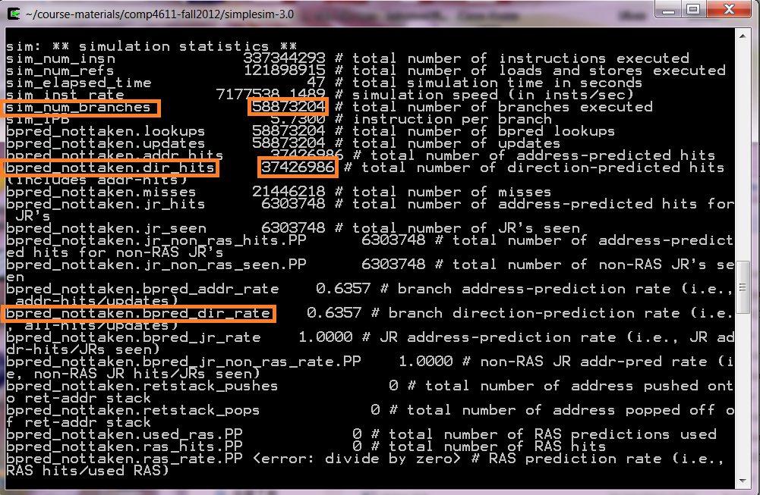

Simulating Not-Taken Predictor
Branch prediction accuracy:
bpred_dir_rate = $\frac{\text{total} \text{number} \text{of} \text{direction} \text{predicted} \text{hits}}{\text{total} \text{number} \text{of} \text{branches} \text{executed} }$

Slide 8
Background – Bimodal predictor
Configuring the bimodal predictor
-bpred:bimod <size>
<size>: the size of direct-mapped branch target buffer (BTB)
Command line example:
./sim-bpred -bpred:bimod 2048 benchmarks/cc1.alpha -O benchmarks/1stmt.i
T
NT
Predict: Taken
11
10
T
NT
T
NT
01
Predict: Not Taken
00
T
NT

Slide 9
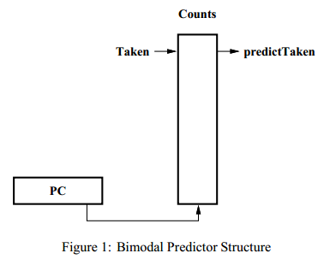
Background – Bimodal Predictor Approach
The ﬁgure shows a table of counters indexed by the low order address bits in the program counter.
Each counter is two bits long.
For each taken branch, the appropriate counter is incremented.
Likewise for each not-taken branch, the appropriate counter is decremented.
In addition, the counter is saturating:
the counter is not decremented past zero,
nor is it incremented past three.
The most signiﬁcant bit determines the prediction.

Slide 10
Background – 2-level adaptive predictor
Configuring 2-level adaptive predictor
-bpred:2lev <l1size> <l2size> <hist_size> <xor>
<l1size>: the number of entries in the first-level table
<l2size>: the number of entries in the second-level table
<hist_size>: the history width
<xor>: xor the history and the address in the second level of the predictor
Command line example: ./sim-bpred –bpred 2lev -bpred:2lev 1 1024 8 0 benchmarks/cc1.alpha -O benchmarks/1stmt.i
pattern history
2-bit predictors
branch address
l1size
l2size
hist_size

Slide 11
Background – Combined predictor
Configuring combined predictor
-bpred:comb <size>
<size>: the number of entries in the first-level table
Command line example: ./sim-bpred –bpred comb -bpred:comb 1024 benchmarks/cc1.alpha -O benchmarks/1stmt.i
P1c (2level) | P2c (bimod) | P1c-P2c
0 | 0 | 0 | (no change)
0 | 1 | -1 | (decrement counter)
1 | 0 | 1 | (increment counter)
1 | 1 | 0 | (no change)

Slide 12
Benchmark for the Project
compress – SPEC95 integer benchmark
http://www.spec.org/cpu95/CINT95/129.compress/
compress:
This benchmark generates an larger in-memory buffer of data, then compresses it to another in-memory buffer, and then checks the results and decompresses it back to an in-memory buffer.
It uses the compression algorithm from an old UNIX utility of the same name.
Its input file specifies how large a random buffer to generate and seeds the generation process.
Usage: compress95.ss < <inputfile>

Slide 13
compress on SimpleScalar
Download and Install the SimpleScalar if you haven’t (refer to tutorial 5 for details)
Install SimpleScalar for PISA binary
Clean the previous installation
$ cd simplesim-3.0
$ make clean
Configure the installation target:
$ make config-pisa
Compile the source code:
$ make
Download the compress95 benchmark
http://course.cse.ust.hk/comp4611/project/benchmarks.tar.gz
Unzip and extract
$ cd simplesim-3.0
$ tar xvzf benchmarks.tar.gz

Slide 14
compress on SimpleScalar
Run compress PISA binary on SimpleScalar
$ cd simplesim3.0/
$ ./sim-bpred –bpred taken benchmarks/compress95.ss < benchmarks/compress_proj.in > benchmarks/OUT
Compare the simulation result:
$ diff benchmarks/compress_proj.out benchmarks/OUT

Slide 15
Project Task I
Evaluation of bimodal branch predictor
Varied number of table entries (32, 64, 256, 1024)
Benchmark: compress95 (PISA)
Input file for compress95: compress_proj.in
Branch prediction accuracy (bpred_dir_rate) and command lines to be included in the project report
Command line example:
$./sim-bpred -redir:prog results/compress-2bit-512.progout -redir:sim results/compress-2bit-512.simout -bpred:bimod 512 benchmarks/compress95.ss < benchmarks/compress_proj.in
Note: You can use the standard SimpleScalar (www.simplescalar.com) or the skeleton code provided.

Slide 16
Project Task II
Write a 3-bit branch predictor on SimpleScalar
Implementation
Evaluation
Guideline
Skeleton code at http://course.cse.ust.hk/comp4611/project/comp4611_proj.tar.gz
Extract the package and compile it by typing “make config-pisa” and then “make”
Fill in the missing code in “bpred.c ” and recompile

Slide 17
Code Glimpse
Source code that implements the branch predictor is in simplesim-3.0/
sim-bpred.c: simulating a program with configured branch prediction instance
bpred.c: implementing the logic of several branch predictors
bpred.h: defining the structure of several branch predictors
main.c: simulating a program on SimpleScalar

Slide 18
Code Glimpse
Workflow of branch prediction
main()
sim_check_options()
bpred_create()
bpred_dir_create()
allocate BTB
sim_main()
bpred_lookup()
bpred_update()
pred->dir_hits
*(dir_update_ptr->pdir1)

Slide 19
Code Glimpse – important data structures
bpred.h
bpred_class: branch predictor types (enumeration)
enum bpred_class {
BPredComb, /* combined predictor (McFarling) */
BPred2Level, /* 2-level correlating pred w/2-bit counters */
BPred2bit, /* 2-bit saturating cntr pred (dir mapped) */
BPredTaken, /* static predict taken */
BPredNotTaken, /* static predict not taken */
BPred_NUM
};
bpred_t: branch predictor structure
bpred_dir_t: branch direction structure
bpred_update_t: branch state update structure (containing predictor state counter)
bpred_btb_ent_t: entry structure in a BTB

Slide 20
Code Glimpse
Predictor’s state counter
struct bpred_update_t {
char *pdir1; /* direction-1 predictor counter */
char *pdir2; /* direction-2 predictor counter */
char *pmeta; /* meta predictor counter */
struct { /* predicted directions */
unsigned int ras : 1; /* RAS used */
unsigned int bimod : 1; /* bimodal predictor */
unsigned int twolev : 1; /* 2-level predictor */
unsigned int meta : 1; /* meta predictor (0..bimod / 1..2lev) */
} dir;
};

Slide 21
Code Glimpse – Important Interfaces
bpred.c
bpred_create(): create a new branch predictor instance
bpred_dir_create(): create a branch direction instance
bpred_lookup(): predict a branch target
bpred_dir_lookup(): predict a branch direction
bpred_update(): update an entry in BTB

Slide 22
3-bit Branch Predictor
A 3-bit branch predictor has 8 states in total
T
NT
NT
NT
111
110
101
100
T
T
T
T
Predict Taken
NT
NT
NT
NT
NT
000
001
010
011
T
T
T
Predict Not Taken

Slide 23
Implementation
Configuring 3-bit predictor
-bpred:tribit <size>
<size>: the size of direct-mapped BTB
Command line example:
$./sim-bpred -v -redir:prog results/compress-3bit-1024.progout -redir:sim results/compress-3bit-1024.simout -bpred:tribit 1024 benchmarks/compress95.ss < benchmarks/compress_proj.in
Command must include verbose option –v

Slide 24
Skeleton Code
branch_lookup() in bpred.c
/* comp4611 3-bit predict saturating cntr pred (dir mapped) */
if (pbtb == NULL) {
if (pred->class != BPred3bit) {
return ((*(dir_update_ptr->pdir1) >= 2)? /* taken */ 1 : /* not taken */ 0);
}
else {
// code to be filled in here
}
}
else {
……
}
/************************************************************/

Slide 25
Skeleton Code
branch_update() in bpred.c
/* comp4611 3-bit predict saturating cntr pred (dir mapped) */
if (dir_update_ptr->pdir1) {
if (pred->class != BPred3bit) {
…….
}
else {
if (taken) {
// code to be filled in here
}
else { /* not taken */
// code to be filled in here
}
}
}
/****************************************************/

Slide 26
Evaluation
3-bit predictor with the table size as 1024
Benchmark: compress95 (PISA)
Input file for compress95: compress_proj.in
Branch prediction accuracy and command line to be included in the project report
Output trace files (using the verbose option: –v)
are the redirected program and simulation output
should be saved in the “results” directory
can be larger than 10 GBs and make sure you have sufficient disk storage for them in your PC

Slide 27
Project Task III
Design and implement your own predictor
Use existing predictors (e.g. 2-level) or create your own predictor to achieve higher accuracy than the 2-bit predictor
Evaluate your predictor using compress95 (PISA)
Input file for compress95: compress_proj.in
Branch prediction accuracy and command line to be included in the project report
Output trace files (using option –v)
the redirected program (“compress-own.progout”) and simulation output (“compress-own.simout”)
should be saved in the “results” directory
can be larger than 10 GBs and make sure you have sufficient disk storage for them in your PC

Slide 28
Deliverables
Put the following into a directory that is created using your group ID:
comp4611_proj_<groupID>/
Project report (no longer than 2 pages)
Evaluation result (2-bit, 3-bit, your own predictor)
Description of your own predictor
Source code
Code for 3-bit predictor: bpred.c, saved as “3bit/bpred.c”
Code for your own predictor: including bpred.h, bpred.c, sim-bpred.c , readme (specify your command line format) and other relevant files, saved under “own/”
Zip the folder into “comp4611_proj_<groupID>.zip”
Submit the zip file to CASS
Output trace files
Output trace files for 3-bit predictor
Output trace files for your own predictor
To be submitted separately (not CASS)

Slide 29
Deliverables
Sample List of files to be submitted to CASS(comp4611_proj_<groupID>.zip) :
comp4611_proj_<groupID>/report.doc
comp4611_proj_<groupID>/3bit/bpred.c
comp4611_proj_<groupID>/own/bpred.c
comp4611_proj_<groupID>/own/bpred.h
comp4611_proj_<groupID>/own/sim-bpred.c
comp4611_proj_<groupID>/own/readme
comp4611_proj_<groupID>/own/…
Sample List of output trace files to be submitted separately (Not to CASS):
compress-3bit-1024.simout
compress-3bit-1024.progout
compress-own.simout
compress-own.progout

Slide 30
Grading Scheme
2-bit predictor (20%)
Correctness
3-bit predictor (30%)
Correctness
Your own predictor (40%)
If correct, score = max{0, (prediction accuracy – 0.90) * 400}
Project report (10%)
Completeness
Correctness
Clarity

Slide 31
Submission Guideline
Submit your source code and report to CASS
Report should contain your group ID, each group member’s name, UST ID, email on the first page
Package the code and report files in one zip file as “comp4611_proj_groupID.zip”
Deadline: Nov 25, 2013
Submit the hardcopy of your report to the homework box
On the first page of your report , there should be
your group ID, and
each group member’s
name, UST ID, email
Deadline: Nov 25, 2013
Submission of your output trace files will be informed later

Slide 32
References
SimpleScalar LLC: www.simplescalar.com
Introduction to SimpleScalar: www.ecs.umass.edu/ece/koren/architecture/Simplescalar/SimpleScalar_introduction.htm
SimpleScalar Tool Set: http://www.ece.uah.edu/~lacasa/tutorials/ss/ss.htm

Slide 33
Appendix
Branch direction structure
struct bpred_dir_t {
enum bpred_class class; /* type of predictor */
union {
struct {
unsigned int size; /* number of entries in direct-mapped table */
unsigned char *table; /* prediction state table */
} bimod;
……
} config;
};

Slide 34
Appendix
sim-bpred.c
sim_main: execute each conditional branch instruction
sim_reg_options: register command options
sim_check_options: determine branch predictor type and create a branch predictor instance
pred_type: define the type of branch predictor
*_nelt & *_config[]: configure the parameters for each branch predictor

Slide 35
Appendix
sim_main() in sim-bpred.c
if (MD_OP_FLAGS(op) & F_CTRL) {
if (pred) {
pred_PC = bpred_lookup(pred, …, &update_rec, …);
if (!pred_PC) {
pred_PC = regs.regs_PC + sizeof(md_inst_t);
}
bpred_update(pred, …, &update_rec, …);
}
}
……
regs.regs_PC = regs.regs_NPC;
regs.regs_NPC += sizeof(md_inst_t);

Slide 36
Appendix
main() in main.c
sim_odb = opt_new(orphan_fn);
opt_reg_flag(sim_odb, …);
……
sim_reg_options(sim_odb);
opt_process_options(sim_odb, argc, argv);
……
sim_check_options(sim_odb, argc, argv);
……
sim_reg_stats(sim_sdb);
……
sim_main();
……

