Slide 1
I/O & RAID
COMP4611
Tutorial 10
18, Nov,2013
Notes:
Gl: please specify the year as well.

Slide 2
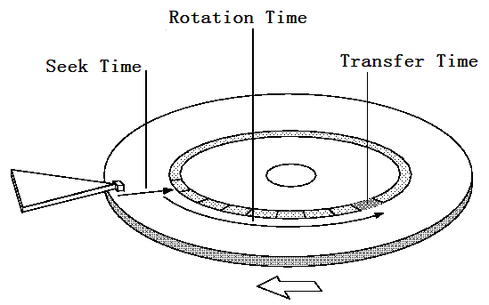
I/O Performance
Disk Latency = Seek Time + Rotation Time + Transfer Time + Controller Overhead
  Seek Time depends on the number of tracks and mechanical characteristics of the arm
  Rotation Time depends on how fast the disk rotates and how far the sector is from the head
  Transfer Time depends on data rate (bandwidth) of disk and size of request

Slide 3
I/O Performance – Example 1
Compare the time to read and write a 64KB block to Flash memory and magnetic disk.
For Flash, assume it takes 65ns to read 1 byte, 1.5us to write 1 byte, and 5ms to erase 4KB.
For disk, average seek time = 12ms, rotation speed = 3600rpm and data transfer rate = 2.6-4.2MB/s.
Assume the measured seek time is one-third of the calculated average, the controller overhead is 0.1ms, and the data are stored in the outer-most track (the disk rotates in one direction).

Slide 4
Example 1 - Analysis
File to transfer: 64 KB
Magnetic Disk
  average seek time = 12ms
  rotation speed = 3600rpm
  data transfer rate = 2.6-4.2MB/s
  controller overhead = 0.1ms
Flash
  65ns to read 1 byte
  1.5us to write 1 byte
  5ms to erase 4KB
Some Key points
  Data are stored in the outer-most track
  We want to use the average rotational delay in order to find the time to read to or write from the disk

Slide 5
Example 1 - Solution
Average disk access is equal to measured seek time + average rotational delay + transfer time + controller overhead. The average time to read or write 64KB for the disk is
12 / 3ms + 0.5 / 3600RPM + 64KB / (4.2MB/s) + 0.1ms = 19.3ms
Flash read time = 64KB / (1B / 65ns) = 4.3ms
Flash write time = erase time + write time
= 64KB / (4KB / 5ms) + 64KB / (1B / 1.5us) = 178.3ms
Thus, Flash memory is about 4.5 times faster than disk for reading 64KB, and disk is about 9 times faster than Flash memory for writing 64KB.

Slide 6
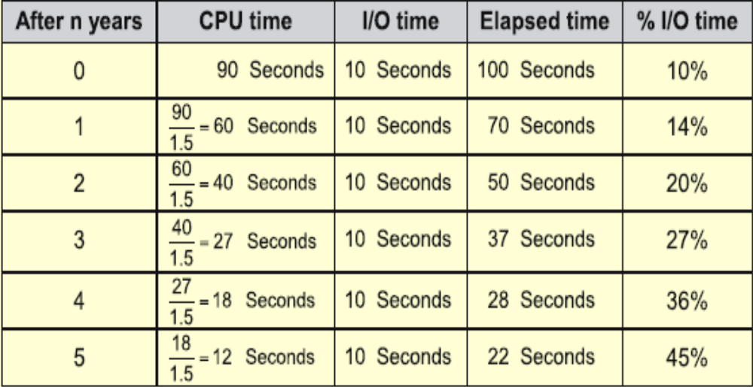
Impact of I/O on System Performance
Suppose we have a benchmark that executes in 100 seconds of elapsed time, where 90 seconds is CPU time and the rest is I/O time. If the CPU time improves by 50% per year for the next five years but I/O time does not improve, how much faster will our program run at the end of the five years?
Answer: Elapsed Time = CPU time + I/O time
Over five years:
CPU improvement = 90/12 = 7.5 BUT System improvement = 100/22 = 4.5

Slide 7
I/O System Performance
I/O system performance depends on many aspects of the system:
  CPU
  Memory system (internal and external caches, main memory)
  Underlying interconnection ( typically buses)
  I/O controller
  I/O device
  Speed of I/O software (operating system)
  Efficiency of the software’s use of the I/O devices

Slide 8
I/O Performance Metrics
Throughput:
  The throughput of an I/O interface is a measure of the data that can be transferred per unit time.
Response time: latency
  The latency of an I/O interface is a measure of the time required to perform a transfer.

Slide 9
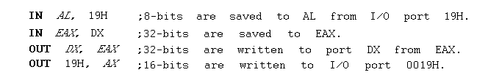
Basic I/O Instructions
We discussed IN, OUT as instructions for the transfer of data to and from an I/O device.
IN and OUT transfer data between an I/O device and the microprocessor's accumulator (AL, AX or EAX).
The I/O address is stored in:
  Register DX as a 16-bit I/O address (variable addressing).

Slide 10
I/O Performance – Example 2
A disk workload consisting of 64KB reads and writes where the user program executes 200,000 instructions per disk I/O operation and
  a processor that sustains 3 billion instr/s and averages 100,000 OS instructions to handle a disk I/O operation (the device I/O operation’s latency is close to 0)
  a memory-I/O bus that sustains a transfer rate of 1000 MB/s
The maximum disk I/O rate (# I/O’s/s) of the processor is
Each disk I/O reads/writes 64 KB so the maximum I/O rate of the bus is

Slide 11
Example 2 – Solution
A disk workload consisting of 64KB reads and writes where the user program executes 200,000 instructions per disk I/O operation and
  a processor that sustains 3 billion instr/s and averages 100,000 OS instructions to handle a disk I/O operation (the device I/O operation’s latency is close to 0)
  a memory-I/O bus that sustains a transfer rate of 1000 MB/s
The maximum disk I/O rate (# I/O’s/s) of the processor is
Instr execution rate 3 x 10⁹
-------------------------- = ------------------------ = 10,000 I/O’s/s
Instr per I/O (200 + 100) x 10³
Each disk I/O reads/writes 64 KB so the maximum I/O rate of the bus is
Bus bandwidth 1000 x 10⁶
---------------------- = ----------------- = 15,625 I/O’s/s
Bytes per I/O 64 x 10³

Slide 12
Example 2 (con’t)
A disk workload consisting of 64KB reads and writes where the user program executes 200,000 instructions per disk I/O operation and
  SCSI disk I/O controllers with a DMA transfer rate of 320 MB/s that can accommodate up to 7 disks per controller
  disk drives with a read/write bandwidth of 75 MB/s and an average seek plus rotational latency of 6 ms
  What is the maximum sustainable I/O rate and what is the number of disks and SCSI controllers required to achieve that rate?

Slide 13
Example 2 – Solution
So the processor is the bottleneck, not the bus
Disk I/O read/write time = seek + rotational time + transfer time = 6ms + 64KB/(75MB/s) = 6.9ms
Thus each disk can complete 1000ms/6.9ms or 146 I/O’s per second. To saturate the processor requires 10,000 I/O’s per second or 10,000/146 = 69 disks
To calculate the number of SCSI disk controllers, we need to know the average transfer rate per disk to ensure we can put the maximum of 7 disks per SCSI controller and that a disk controller won’t saturate the memory-I/O bus during a DMA transfer
Disk transfer rate = (transfer size)/(transfer time) = 64KB/6.9ms = 9.56 MB/s
Thus 7 disks won’t saturate either the SCSI controller (with a maximum transfer rate of 320 MB/s) or the memory-I/O bus (1000 MB/s). This means we will need 69/7 or 10 SCSI controllers.

Slide 14
Motivation for RAID
Capacity
  More disks allows us to store more data
Performance
  Access multiple disks in parallel
  Each disk can be working on independent read or write
  Overlap seek and rotational positioning time for all
Reliability
  Recover from disk (or single sector) failures
  Will need to store multiple copies of data to recover
RAID: Redundant Array of Inexpensive Disks

Slide 15
RAID Techniques: (RAID 1)
Introduce redundancy through mirroring
Expensive
Performance Issues
  -- No data loss if either drive fails
  – Good read performance
  – Reasonable write performance
1
0
0
1
0
0
1
1
1
0
0
1
0
0
1
1

Slide 16
RAID Techniques: (RAID 3)
known as Bit-Interleaved Parity
Disk Controllers can detect whether sector has been read correctly.
Storage overhead is reduced – only 1 parity disk
Expense of computing and writing parity
Need to include a dedicated parity hardware
1
0
0
1
0
0
1
1
1
1
0
0
1
1
0
1
1
0
0
1
0
0
1
1
0
0
1
1
0
0
1
0

Slide 17
RAID Techniques: (RAID 5)
Block-interleaved Distributed parity
Spreads data and parity among all N+1 disks, rather than storing data in N disks and parity in 1 disk
Avoids potential overuse of a single parity disk
Most common parity RAID system

Slide 18
Example 3
Suppose we have a RAID 5 system with 5 disks. A disk has failed and is being replaced. Assume the remaining disks are error-free. Reconstruct the data for the new disk.
0111
1010
0100
0101
0000
1100
1111
1101
1111
1001
0110
0011
1011
1001
1110
1101
0001
0011
1010
1111

Slide 19
Example 3 - Solution
0111
1010
0100
0101
0000
1100
1111
1101
1111
1001
0000
0111
0001
1001
1000
0110
0011
1011
1001
1110
1101
0001
0011
1010
1111

Slide 20
Example 4
Suppose we want to build a RAID 0 system with 4000GB storage capacity. There are two options available:
SysA: 100 x 40GB and $400 per disk
SysB: 50 x 80GB and $1000 per disk
Assume the MTTF for every disk is 1,000,000 hours.
(MTTF: the mean time to failure)
What is the cost and MTTF of the each option?

Slide 21
Example 4 - Solution
Cost of SysA = 100 x $400 = $40000
Cost of SysB = 50 x $1000 = $50000
MTTF of SysA = 1000000 / 100 = 1000hrs
MTTF of SysB = 1000000 / 50 = 2000hrs
SysA has a lower cost while SysB has a better MTTF value

