Slide 1
Vector, SIMD Extensions and GPU
COMP 4611
Tutorial 11
Nov. 25 2013

Slide 2
Abbreviation
Single instruction stream, multiple data streams (SIMD)
Multiple instruction streams, multiple data streams (MIMD)
Graphics Processor Units (GPUs)

Slide 3
Introduction
Introduction
SIMD architectures can exploit significant data-level parallelism for:
Matrix-oriented scientific computing
Media-oriented image and sound processors
SIMD can be more energy efficient than MIMD
Only needs to fetch one instruction per data operation
Makes SIMD attractive for personal mobile devices
SIMD allows programmer to continue to think sequentially

Slide 4
SIMD Parallelism
Introduction
Vector architectures
SIMD extensions
Graphics Processor Units (GPUs)
For x86 processors:
In the previous decade, roughly
Two additional cores per chip per year
SIMD width doubles every four years
If the rates are the similar in the next decade
Potential speedup from SIMD to be twice that from MIMD

Slide 5
Vector Architectures
Vector Architectures
Basic idea:
Read sets of data elements into “vector registers”
Operate on those registers
A single instruction -> dozens of operations on independent data elements
Disperse the results back into memory
Registers are controlled by compiler
Used to hide memory latency
Leverage memory bandwidth

Slide 6
VMIPS
Vector Architectures
Example architecture: VMIPS
Loosely based on Cray-1
Vector registers
Each register holds a 64-element, 64 bits/element vector
Register file has 16 read ports and 8 write ports
Vector functional units
Fully pipelined
Data and control hazards are detected
Vector load-store unit
Fully pipelined
One word per clock cycle after initial latency
Scalar registers
32 general-purpose registers
32 floating-point registers

Slide 7
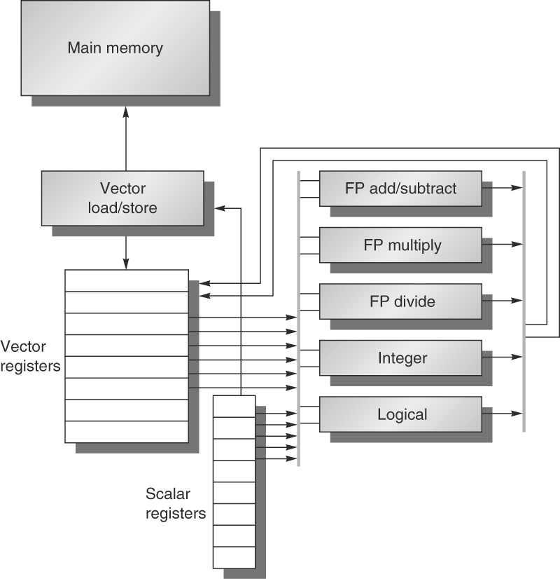
The basic structure of a vector architecture, VMIPS.
This processor has a scalar architecture just like MIPS. There are also eight 64-element vector registers, and all the functional units are vector functional units.

Slide 8
VMIPS Instructions
Vector Architectures
ADDVV.D: add two vectors
MULVS.D: multiply each element of a vector by a scalar
LV/SV: vector load and vector store from address
Example: DAXPY
Y = a x X + Y, X and Y are vectors, a is a scalar
L.D F0,a ; load scalar a
LV V1,Rx ; load vector X
MULVS.D V2,V1,F0 ; vector-scalar multiply
LV V3,Ry ; load vector Y
ADDVV V4,V2,V3 ; add
SV Ry,V4 ; store the result
Requires 6 instructions

Slide 9
DAXPY in MIPS Instructions
Example: DAXPY (double precision a*X+Y)
L.D F0,a ; load scalar a
DADDIU R4,Rx,#512 ; last address to load
Loop: L.D F2,0(Rx ) ; load X[i]
MUL.D F2,F2,F0 ; a x X[i]
L.D F4,0(Ry) ; load Y[i]
ADD.D F4,F2,F2 ; a x X[i] + Y[i]
S.D F4,9(Ry) ; store into Y[i]
DADDIU Rx,Rx,#8 ; increment index to X
DADDIU Ry,Ry,#8 ; increment index to Y
SUBBU R20,R4,Rx ; compute bound
BNEZ R20,Loop ; check if done
Requires almost 600 MIPS instructions
Vector Architectures

Slide 10
SIMD Extensions
Media applications operate on data types narrower than the native word size
Example: “partition” 64-bit adder --> eight 8-bit elements
Limitations, compared to vector instructions:
Number of data operands encoded into op code
No sophisticated addressing modes
No mask registers
SIMD Instruction Set Extensions for Multimedia

Slide 11
Example SIMD Code
Example DAXPY:
L.D F0,a ;load scalar a
MOV F1, F0 ;copy a into F1 for SIMD MUL
MOV F2, F0 ;copy a into F2 for SIMD MUL
MOV F3, F0 ;copy a into F3 for SIMD MUL
DADDIU R4,Rx,#512 ;last address to load
Loop: L.4D F4,0[Rx] ;load X[i], X[i+1], X[i+2], X[i+3]
MUL.4D F4,F4,F0 ;a*X[i],a*X[i+1],a*X[i+2],a*X[i+3]
L.4D F8,0[Ry] ;load Y[i], Y[i+1], Y[i+2], Y[i+3]
ADD.4D F8,F8,F4 ;a*X[i]+Y[i], ..., a*X[i+3]+Y[i+3]
S.4D F8,0[Ry] ;store into Y[i], Y[i+1], Y[i+2], Y[i+3]
DADDIU Rx,Rx,#32 ;increment index to X
DADDIU Ry,Ry,#32 ;increment index to Y
DSUBU R20,R4,Rx ;compute bound
BNEZ R20,Loop ;check if done

Slide 12
SIMD Implementations
Implementations:
Intel MMX (1996)
Eight 8-bit integer ops or four 16-bit integer ops
Streaming SIMD Extensions (SSE) (1999)
Eight 16-bit integer ops
Four 32-bit integer/fp ops or two 64-bit integer/fp ops
Advanced Vector Extensions (2010)
Four 64-bit integer/fp ops
SIMD Instruction Set Extensions for Multimedia

Slide 13
Graphical Processing Units
Graphical Processing Units
Given the hardware invested to do graphics well,
how can we supplement it to improve performance of a wider range of applications?

Slide 14
GPU Accelerated or Many-core Computation
NVIDIA GPU
Reliable performance, communication between CPU and GPU using the PCIE channels
Tesla M2090
512 CUDA cores (16 Streaming Multiprocessor x 32 cores/SM )
1331 GFLOPs (single precision)
GFLOPs: Floating-point operations per second
6GB memory with 177GB/sec bandwidth
Notes:
http://www.nvidia.com/object/tesla-servers.html

Slide 15
GPU Accelerated or Many-core Computation (cont.)
APU (Accelerated Processing Unit) – AMD
CPU and GPU functionality on a single chip
AMD FirePro A320
4 CPU cores and 384 GPU processors
736 GFLOPs (single precision) @ 100W
Up to 2GB dedicated memory
Notes:
http://www.amd.com/us/products/workstation/graphics/ati-firepro-3d/APU/Pages/APU.aspx#4

Slide 16
Programming the NVIDIA GPU
We use NVIDIA GPU as the example for discussion
Graphical Processing Units
Heterogeneous execution model
CPU is the host, GPU is the device
Develop a programming language (CUDA) for GPU
Unify all forms of GPU parallelism as CUDA thread
Programming model is “Single Instruction Multiple Thread”

Slide 17
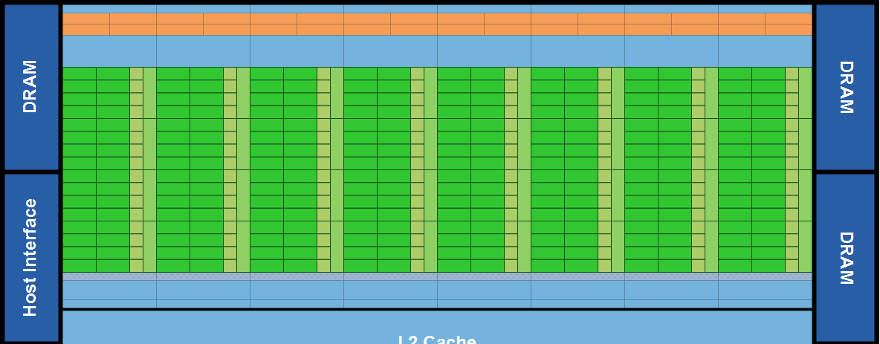
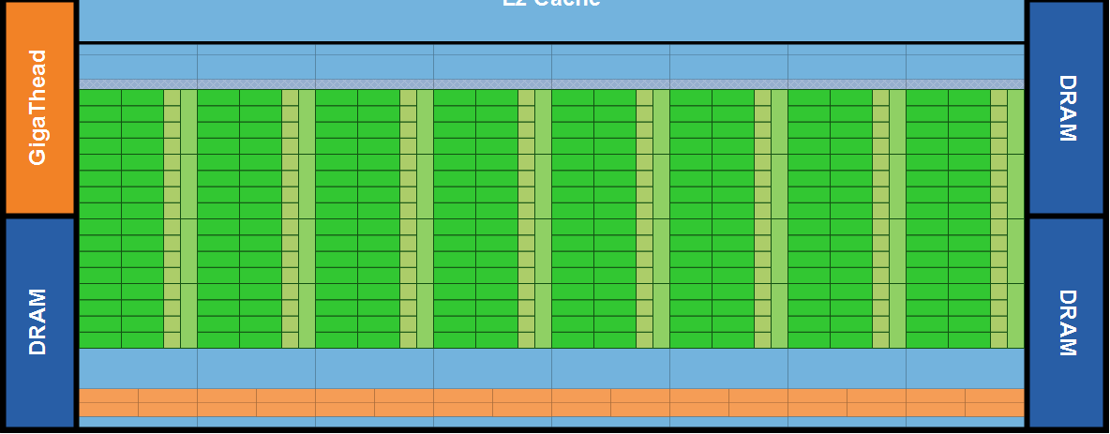
Fermi GPU
One Stream Processor (SM)
Notes:
Fermi’s 16 SM are positioned around a common L2 cache. Each SM is a vertical rectangular strip that contain an orange portion (scheduler and dispatch), a green portion (execution units), and light blue portions (register file and L1 cache).
Figure from: http://www.nvidia.com/content/PDF/fermi_white_papers/NVIDIA_Fermi_Compute_Architecture_Whitepaper.pdf

Slide 18
NVIDIA GPU Memory Structures
Each SIMD Lane has private section of off-chip DRAM
“Private memory”
Each multithreaded SIMD processor also has local memory
Shared by SIMD lanes
Memory shared by SIMD processors is GPU Memory
Host can read and write GPU memory
Graphical Processing Units

Slide 19
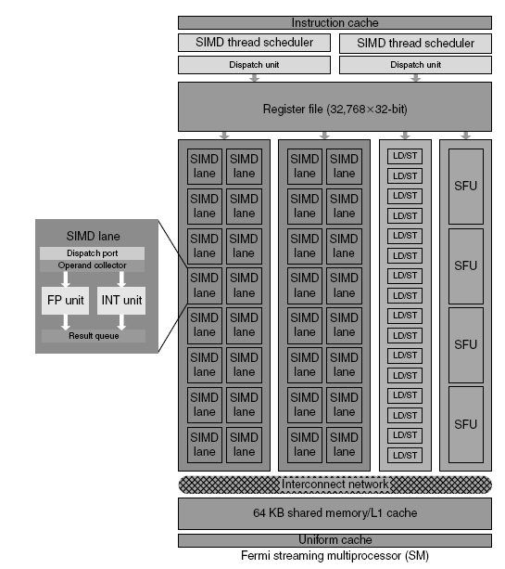
Fermi Multithreaded SIMD Proc.
Each Streaming Processor (SM)
32 SIMD lanes
16 load/store units
32,768 registers
Each SIMD thread has up to
64 vector registers of 32 32-bit elements
Graphical Processing Units

Slide 20
GPU Compared to Vector
Similarities to vector machines:
Works well with data-level parallel problems
Mask registers
Large register files
Differences:
No scalar processor
Uses multithreading to hide memory latency
Has many functional units, as opposed to a few deeply pipelined units like a vector processor
Graphical Processing Units

