Slide 1
Comp4611 Tutorial 8
Memory System
Nov. 4 2013

Slide 2
Levels in Memory Hierarchy
cheap technology available memory
fast technology access speed
Upper
Lower
Disk
Storage
Main
Memory
CPU
L1
I-Cache
L2
Cache
L1
D-Cache

Slide 3
Memory Hierarchy
Level | 1 | 2 | 3 | 4
Name | Registers | Cache | Main Memory | Disk Storage
Typical size | <1KB | <16MB | <64GB | >1TB
Access time (ns) | 0.25-0.5 | 0.5-25 | 50-250 | 5,000,000
Managed by | Compiler | Hardware | Operating System | Operating System/ Operator
Speed | Fastest Slowest
Capacity | Smallest Biggest
Cost/bit | Highest Lowest

Slide 4
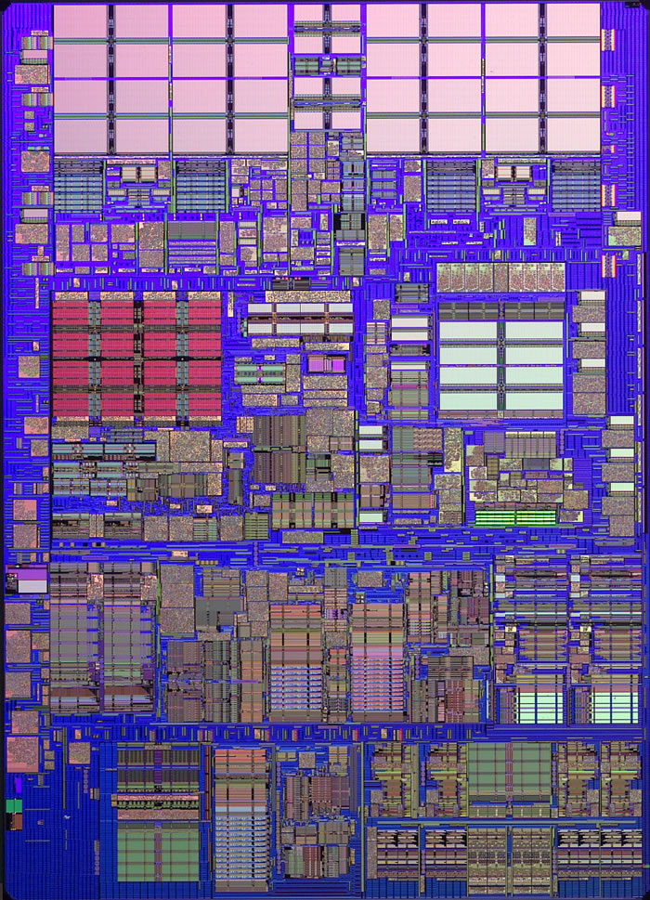
iMac’s PowerPC 970
L1 (64K Instruction)
Registers
(1K)
512K
L2
L1 (32K Data)
Notes:
64-bit Power Architecture processors from IBM introduced in 2002

Slide 5
Design Issues
Various factors affect the cache design
  Cache size
    Larger cache vs. shorter latencies
  Cache latency
  Associativity
    one-way(direct mapped cache), two-way, four-way or eight-way
  Cost
Factors are inter-related -> Difficult to achieve the “best cache”
Fast and large caches are expensive

Slide 6
Cache Concepts
Cache Hit
  Data requested by the CPU is present in the cache
Cache Miss
  Data requested by the CPU is not present in the cache
  On a cache miss, a block brought from the main memory
  may replace an existing cache block
Hit Rate
  The percentage of accesses that result in cache hits
Cache Replacement Policies
  FIFO (First In First Out)
  LRU (Least Recently Used)
  LFU (Least Frequently Used)
  Random

Slide 7
Cache Concepts (cont.)
Cache Write Policies
  Write Through
  Data is written to both the cache block and to a block of main memory
  Write Back
  Data is written only to the cache block ;
  Modified cache block is written to main memory when it has to be replaced
Cache Write Miss Policies
  Write Allocate
  The cache block is allocated on a write miss, followed by write hit actions
  No Write Allocate
  Write misses do not affect the cache;
  The block is only modified in the main memory
Notes:
Cache allocate c11

Slide 8
Cache Miss Operation
Assume: 1. Write-Back Cache with Write-Allocate
2. Block to be replaced is clean
Set Modified/Dirty bit to 1 if this is a write
CPU reads or writes to block in cache
Cache
Memory
Need not write the replaced block to main memory since it’s clean (Dirty bit = 0)
0
Read missed block from memory
Penalty = M
Total Miss Penalty=M

Slide 9
Cache Miss Operation
Assume: 1. Write-Back Cache with Write-Allocate
2. Block to be replaced is dirty
Set Modified/Dirty bit to 1 if this is a write
CPU reads or writes to block in cache
Cache
Memory
Write replaced modified block to memory
Penalty = M
1
Read missed block from memory
Penalty = M
Total Miss Penalty=M+M=2M
Notes:
Why 2M?

Slide 10
Example 1
  Suppose a computer's address size is 64 bits (using byte
  addressing), the cache size is 64 Kbytes (1 K = 2¹⁰ bytes), the
  block size is 64 bytes and the cache is 8-way set-associative.
  Compute the following quantities:
  (i) the number of sets in the cache
  (ii) the number of index bits
  (iii) the number of tag address bits in a block

Slide 11
Example 1 - Solution
This is an 8-way set associative cache, the size of each set is
8 * Block_size = 512 bytes
Thus, # Sets = Cache_size / Set_size = 64KB / 512 B = 128 Sets
(ii) The number of index bits is determined by the number of sets.
Since there are 128 sets, 7 bits are needed as the index bits (2⁷ = 128).
(iii) The number of tag address bits is determined by the total address
size, the number of index bits and the number of offset bits.
# (Tag address bits) = # (Address Bits) – # (index bits) - # (offset bits)
# (offset bits) = 6 (block size is 64 bytes and 2⁶ = 64)
Thus, # (Tag address bits) = 64 – 7 – 6 = 51

Slide 12
Average Memory Access Time (AMAT)
AMAT can be expressed by Hit time, Miss rate and Miss penalty on different cache levels.
For example,
AMAT = Hit time + Miss rate x Miss penalty (1-level)
AMAT = Hit time_{L1} + Miss rate_{L1} x (Hit time_{L2} + Miss rate_{L2}
x Miss penalty_{L2}) (2-level)
FYI: Not all the cases are included. e.g., 3-level cache

Slide 13
Example 2
Suppose that in 1000 memory references there are 40 misses in the first level cache and 20 misses in the second level cache. What are the various miss rate?
Assume the miss penalty from the L2 cache to memory is 100 clock cycles, the hit time of the L2 cache is 10 clock cycles, the hit time of L1 is 1 clock cycle, and there are 1.5 memory references per instruction. What is the average memory access time and average stall cycles per instruction? Ignore the impact of writes.

Slide 14
Example 2 - Solution
1. Miss rate for L1 (either Local or Global ) = 40/1000 = 4%
Local miss rate for L2 = 20/40 = 50%
Global miss rate for L2 = 20/1000 = 2%
2. AMAT = Hit time_{L1} + Miss rate_{L1} x (Hit time_{L2} + Miss rate_{L2}
x Miss penalty_{L2})
= 1 + 4% x (10 + 50% x 100)
= 3.4 clock cycles
Average memory stalls per instruction
= (AMAT – 1) x 1.5
= (3.4 – 1) x 1.5
= 3.6
AMAT = 1 + Stall Cycles Per Memory Access

Slide 15
Virtual Memory
Definition
  It gives an application program the impression that it has contiguous working memory, while in fact it may be physically fragmented and may even overflow on to disk storage
Motivations
  Allows the same program to run in any location in physical memory
  Allows the program to use a memory space larger than the capacity of the physical memory
Different terminology comparing with cache
  Virtual memory block is called a page
  A virtual memory miss is called a page fault

Slide 16
Virtual & physical address
Physical address
  Instruction or data address in main memory
  256 MB main memory -> 28-bit physical address
Virtual address
  Decided by ISA
Virtual address = virtual page # and page offset
  Page # identifies a particular page
  Page offset identifies a byte within that page
Physical address = physical page # and page offset
Address translation
  Virtual address issued by the processor needs to be translated into the physical address

Slide 17
Example 3 & Solution
The page size on a byte-addressed machine is 16 KB. The machine has 1 GB of main memory. The virtual address of the machine has 32 bits. What are the sizes of the virtual page #, physical page #, and page offset fields?
Main memory size = 2³⁰ bytes,
so physical address is 30 bits.
Page size = 2¹⁴ bytes,
so page offset is 14 bits.
Virtual page # size = 32 - 14 = 18 bits.
Physical page # size = 30 - 14 = 16 bits.

Slide 18
Paging
Each process has its own page table
Use page number as an index into the page table
Each page table entry contains the physical page number of the corresponding page in main memory
A valid bit to indicate whether the page is in main memory or not
A modify bit to indicate whether the page has been altered or not
  If no change, the page does not have to be written to the disk when it needs to be swapped out
Replacement policies
Notes:
Replacement policies

Slide 19
Page Table
Virtual page number 20 bits: 1 Million
31
12
11
0
Virtual page number
Page offset
Page offset
12 bits: 4096 bytes
V
Physical page number
0x00000
0x00001
0x00002
0x00003
0x00004
0x00005
0x00006
0x00007
.
.
.
.
.
.
.
.
.
0xFFFFF
24
12
11
0
Physical address

Slide 20
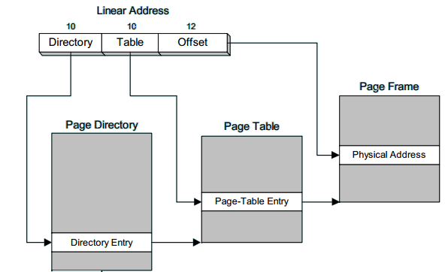
X86 Page Translation
A linear address is divided into a page directory field, page table field, and page frame offset. The processor uses the three numbers to calculate the physical address.

Slide 21
TLB
TLB - translation lookaside buffer
  Improve the speed of virtual address translation
A TLB entry is like a cache entry where the tag holds portions of the virtual address and the data portion holds the physical page number, protection field, valid bit, and dirty bit.
Size: 8 - 4,096 entries
Hit time: 0.5 - 1 clock cycle
Miss penalty: 10 - 30 clock cycles
Miss rate: 0.01% - 1%
Notes:
C-44

Slide 22
TLB (cont.)
If the requested address is present in the TLB, the physical address can be used to access memory.
If the requested address is not in the TLB, the translation proceeds using the page table, which is slower to access.

Slide 23
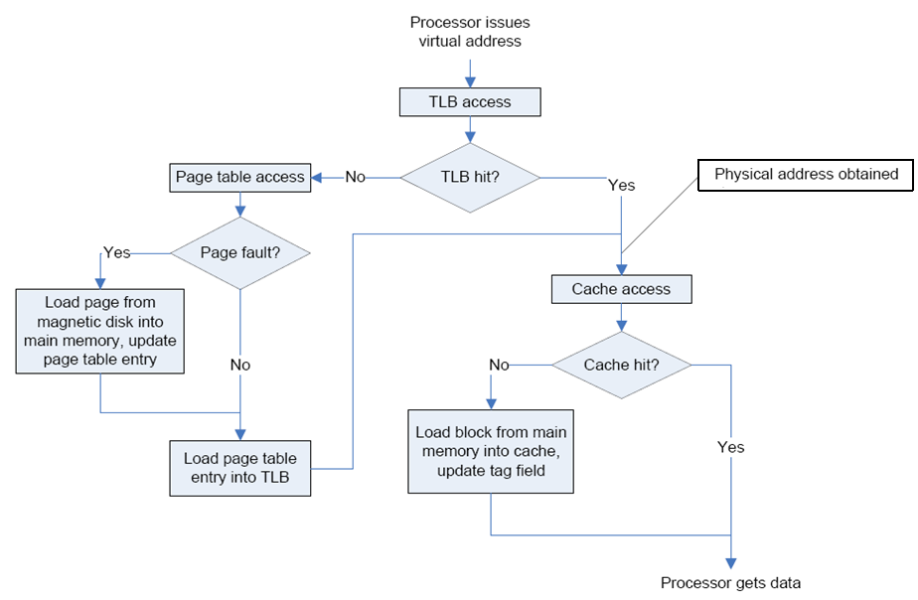
Overall operation of memory hierarchy

