Slide 1
COMP4611: Design and Analysis of Computer Architectures
Input/Output I/O Devices, RAID and Network Storage Lin Gu CSE, HKUST

Slide 2
Motivation: Who Cares About I/O?
CPU Performance: 60% improvement per year
I/O system performance: < 10% improvement per year
sometimes limited by mechanical delays (disk I/O)
10% IO & 10x CPU => 5x Performance (lose 50%)
10% IO & 100x CPU => 10x Performance (lose 90%)
I/O bottleneck:
Diminishing value of faster CPUs

Slide 3
Input and Output Devices
I/O devices are diverse with respect to
Behavior – input, output or storage
User – human or machine
Data rate – the rate at which data are transferred between the I/O device and the main memory or processor
Device | Behavior | User | Data rate (Mb/s)
Keyboard | input | human | 0.0001
Mouse | input | human | 0.0038
Laser printer | output | human | 3.2000
Graphics display | output | human | 800.0000-8000.0000
Network/LAN | input or output | machine | 10.0000-10000.0000
Magnetic disk | storage | machine | 240.0000-2560.0000
9 orders of magnitude range

Slide 4
I/O Performance Measures
I/O bandwidth (throughput) – amount of information that can be input (output) and communicated across an interconnect (e.g., a bus) to the processor/memory (I/O device) per unit time
How much data can we move through the system in a certain time?
How many I/O operations can we do per unit time?
I/O response time (latency) – the total elapsed time to accomplish an input or output operation
An especially important performance metric in real-time systems
Many applications require both high throughput and short response times

Slide 5
A Simpe System with I/O
interrupts
Processor
Cache
Memory - I/O Bus
Main
Memory
I/O
Controller
I/O
Controller
I/O
Controller
Disk
Disk
Graphics
Network

Slide 6
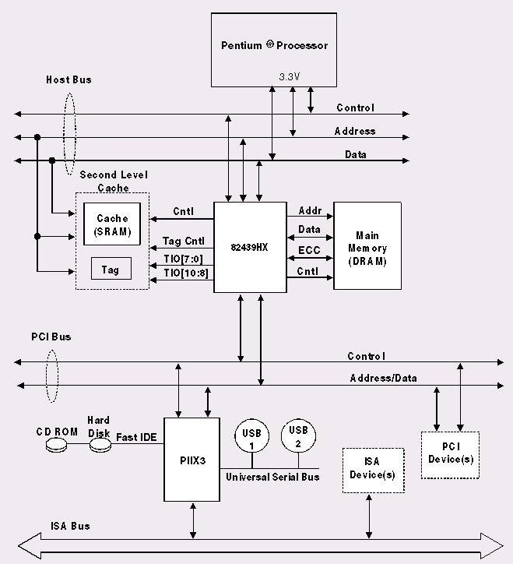
A More Recent System
Processor/Memory
Bus
I/O Bus (PCI)
I/O Buses (ISA)

Slide 7
Introduction to I/O
Most of the I/O devices are very slow compared to the cycle time of a CPU.
The architecture of I/O systems is an active area of R&D.
I/O systems can define the performance of a system.
Computer architects strive to design systems that do not tie up the CPU waiting for slow I/O systems (too many applications running simultaneously on processor).

Slide 8
Hard Disk
Spindle
Arm
Head
Actuator
{
Platters (12)

Slide 9
Hard Disk Performance
Outer
Track
Inner
Track
Sector
Head
Arm
Controller
Spindle
Platter
Actuator
Disk Latency = Seek Time + Rotation Time + Transfer Time + Controller Overhead
Seek Time depends on the moving distance and moving speed of arms
Rotation Time depends on how fast the disk rotates and how far sector is from head
Transfer Time depends on data rate (bandwidth) of disk and size of request

Slide 10
Disk Access Time
I want
block X
block x
in memory
Disk platter
Disk access time =
Disk head
Seek time
+ Rotational delay
+ Transfer time
Disk arm
+ Other delays

Slide 11
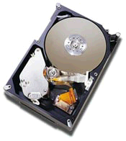
Example: Barracuda 180
181.6 GB, 3.5 inch disk
12 platters, 24 surfaces
24,247 cylinders
7,200 RPM; (4.2 ms avg. latency)
7.4/8.2 ms avg. seek (r/w)
65 to 35 MB/s (internal)
0.1 ms controller time
Latency =
Queuing Time +
Controller time +
Seek Time + Rotation Time +
Size / Bandwidth
{
per access
+
per byte
source: www.seagate.com

Slide 12
Disk Performance Example
Calculate time to read 64 KB (128 sectors) for Barracuda 180 X using advertised performance; sector is on outer track
Disk latency = average seek time + average rotational delay + transfer time + controller overhead
= 7.4 ms + 0.5 * 1/(7200 RPM) + 64 KB / (65 MB/s) + 0.1 ms
= 7.4 ms + 0.5 /(7200 RPM/(60000ms/M)) + 64 KB / (65 KB/ms) + 0.1 ms
= 7.4 + 4.2 + 1.0 + 0.1 ms = 12.7 ms

Slide 13
Communication of I/O Devices and Processor
How does the processor command the I/O devices?
Special I/O instructions
Must specify both the device (port number) and the command
For example:
inp reg, port ; register←port
out port, reg ; port→register
Physical
address space
I/O address space
each device gets
one or more
addresses

Slide 14
Communication of I/O Devices and Processor
How does the processor command the I/O devices?
Memory-mapped I/O
Portions of the memory address space are assigned to I/O devices
Read and writes to those memory addresses are interpreted as commands to the I/O devices
Load/stores to the I/O address space can only be done by the OS
Physical address space
each device gets
one or more
addresses

Slide 15
Communication of I/O Devices and Processor
How does the I/O device communicate with the processor?
Polling – the processor periodically checks the status of an I/O device to determine its need for service
Processor is totally in control – it also does all the work
Can waste a lot of processor time due to speed differences
Interrupt-driven I/O – the I/O device issues an interrupt to the processor to indicate that it needs attention

Slide 16
Interrupt-Driven Input
1. input interrupt
Processor
add
sub
and
or
beq
user
program
Memory
Receiver
Keyboard
lbu
sb
...
jr
input
interrupt
service
routine
:
memory
Notes:
For class handout

Slide 17
Interrupt-Driven Input
1. input interrupt
Processor
add
sub
and
or
beq
user
program
2.1 save state
Memory
Receiver
2.3 service interrupt
2.2 jump to interrupt
service routine
Keyboard
lbu
sb
...
jr
input
interrupt
service
routine
2.4 return
to user code
memory

Slide 18
Interrupt-Driven Output
1.output interrupt
Processor
add
sub
and
or
beq
user
program
2.1 save state
Memory
Trnsmttr
2.3 service interrupt
2.2 jump to interrupt
service routine
Display
lbu
sb
...
jr
output
interrupt
service
routine
2.4 return
to user code
memory

Slide 19
Direct-Memory Access (DMA)
Interrupt-driven IO relieves the CPU from waiting for every IO event
But the CPU can still be bogged down if it is used in transferring IO data.
Typically blocks of bytes.
For high-bandwidth devices (like disks) interrupt-driven I/O would consume a lot of processor cycles

Slide 20
DMA
DMA – the I/O controller has the ability to transfer data directly to/from the memory without involving the processor

Slide 21
DMA
Consider printing a 60-line by 80-character page
With no DMA:
CPU will be interrupted 4800 times, once for each character printed.
With DMA:
OS sets up an I/O buffer and CPU writes the characters into the buffer.
DMA is commanded (includes the beginning address of the buffer and its size) to print the buffer.
DMA will take items from the buffer one-at-a-time and performs everything requested.
Once the operation is complete, the DMA sends a single interrupt signal to the CPU.

Slide 22
I/O Communication Protocols
Typically one I/O channel controls multiple I/O devices.
We need a two-way communication between the channel and the I/O devices.
The channel needs to send the command/data to the I/O devices.
The I/O devices need to send the data/status information to the channel whenever they are ready.

Slide 23
Channel to I/O Device Communication
Channel sends the address of the device on the bus.
All devices compare their addresses against this address.
Optionally, the device which has matched its address places its own address on the bus again.
First, it is an acknowledgement signal to the channel;
Second, it is a check of validity of the address.
The channel then places the I/O command/data on the bus received by the correct I/O device.
The command/data is queued at the I/O device and is processed whenever the device is ready.

Slide 24
I/O Devices to Channel Communication
The I/O devices-to-channel communication is more complicated, since now several devices may require simultaneous access to the channel.
Need arbitration among multiple devices (bus master?)
May prefer a priority scheme
Three methods for providing I/O devices-to-channel communication

Slide 25
Daisy Chaining
Two schemes
Centralized control (priority scheme)
Grant
I/O
I/O
I/O
1
2
n
Request
Channel
Busy
Bus
Data/Address/Control lines

Slide 26
Daisy Chaining
The I/O devices activate the request line for bus access.
If the bus is not busy (indicated by no signal on busy line), the channel sends a Grant signal to the first I/O device (closest to the channel).
If the device is not the one that requested the access, it propagates the Grant signal to the next device.
If the device is the one that requested an access, it then sends a busy signal on the busy line and begins access to the bus.
Only a device that holds the Grant signal can access the bus.
When the device is finished, it resets the busy line.
The channel honors the requests only if the bus is not busy.
Obviously, devices closest to the channel have a higher priority and block access requests by lower priority devices.

Slide 27
Daisy Chaining
Decentralized control (Round-robin Scheme)
Grant
I/O
I/O
I/O
1
2
n
Request
Channel
Bus
Data/Address/Control lines

Slide 28
Daisy Chaining
The I/O devices send their request.
The channel activates the Grant line.
The first I/O device which requested access accepts the Grant signal and has control over the bus.
Only the devices that have received the grant signal can have access to the bus.
When a device is finished with an access, it checks to see if the request line is activated or not.
If it is activated, the current device sends the Grant signal to the next I/O device (Round-Robin) and the process continues.
Otherwise, the Grant signal is deactivated.

Slide 29
Polling
The channel interrogates (polls) the devices to find out which one requested access:
I/O
1
I/O
2
I/O
n
Request
Channel
Busy
Count
lines
Data/Address/Control lines

Slide 30
Polling
Any device requesting access places a signal on request line.
If the busy signal is off, the channel begins polling the devices to see which one is requesting access.
It does this by sequentially sending a count from 1 to n on log₂n lines to the devices.
Whenever a requesting device matches the count against its own number (address), it activates the busy line.
The channel stops the count (polling) and the device has access over the bus.
When access is over, the busy line is deactivated and the channel can either continue the count from the last device (Round-Robin) or start from the beginning (priority).

Slide 31
Independent Requests

Slide 32
Independent Requests
Each device has its own Request-Grant lines:
Again, a device sends in its request, the channel responds by granting access
Only the device that holds the grant signal can access the bus
When a device finishes access, it lowers it request signal.
The channel can use either a Priority scheme or Round-Robin scheme to grant the access.

Slide 33
I/O Buses
Connect I/O devices (channels) to memory.
Many types of devices are connected to a bus.
Have a wide range of bandwidth requirements for the devices connected to a bus.
Typically follow a bus standard, e.g., PCI, SCSI.
Clocking schemes:
Synchronous: The bus includes a clock signal in the control lines and a fixed protocol for address and data relative to the clock
Asynchronous: The bus is self-timed and uses a handshaking protocol between the sender and receiver

Slide 34
I/O Buses
Synchronous buses are fast and inexpensive, but
All devices on the bus must run at the same clock rate.
Due to clock-skew problems, buses cannot be long.
CPU-Memory buses are typically implemented as synchronous buses.
The front side bus (FSB) clock rate typically determines the clock speed of the memory you must install.

Slide 35
I/O Buses
Asynchronous buses are self-timed and use a handshaking protocol between the sender and receiver.
This allows the bus to accommodate a wide variety of devices and to lengthen the bus.
I/O buses are typically asynchronous.
A master (e.g., an I/O channel writing into memory) asserts address, data, and control and begins the handshaking process.

Slide 36
I/O Buses
Asynchronous write: master asserts address, data, write buses.

Slide 37
I/O Buses
Asynchronous write: master asserts request, expecting acknowledgement later.

Slide 38
I/O Buses
Asynchronous write: slave (memory) asserts acknowledgment, expecting request to be deasserted later.

Slide 39
I/O Buses
Asynchronous write: master deasserts request and expects the acknowledgement to be deasserted later.

Slide 40
I/O Buses
Asynchronous write: slave deasserts acknowledgement and operation completes.

Slide 41
I/O Bus Examples
Multiple master I/O buses:

Slide 42
I/O Bus Examples
Multiple master CPU-memory buses:

Slide 43
RAID (Redundant Array of Inexpensive Disks)

Slide 44
Disk Latency & Bandwidth Improvements
Disk latency is one average seek time plus the rotational latency
Disk bandwidth is the peak transfer rate of formatted data
In the time that the disk bandwidth doubles the latency improves by a factor of only 1.2 to 1.4

Slide 45
Media Bandwidth/Latency Demands
Bandwidth requirements
High quality video
Digital data = (30 frames/s) × (640 x 480 pixels) × (24-b color/pixel) = 221 Mb/s (27.625 MB/s)
High quality audio
Digital data = (44,100 audio samples/s) × (16-b audio samples) × (2 audio channels for stereo) = 1.4 Mb/s (0.175 MB/s)
Latency issues
How sensitive is your eye (ear) to variations in video (audio) rates?
How can you ensure a constant rate of delivery?
How important is synchronizing the audio and video streams?
15 to 20 ms early to 30 to 40 ms late is tolerable

Slide 46
Storage Pressures
Storage capacity growth estimates: 60-100% per year
Growth of e-business, e-commerce, and e-mail ⇨ now common for organizations to manage hundreds of TB of data
Mission critical data must be continuously available
Regulations require long-term archiving
More storage-intensive applications on market
Storage and Security are leading pain points for the IT community
Managing storage growth effectively is a challenge

Slide 47
Data Growth Trends
(in Terabytes)
7,000,000
From 2002 to 2006
Storage shipped grew
at 83% CAGR
6,000,000
5,000,000
From 1999 to 2001
Storage Shipped grew
at 78% CAGR
4,000,000
3,000,000
2,000,000
1,000,000
-
1999
2000
2001
2002
2003
2004
2005
2006

Slide 48
Storage Cost
Storage cost as proportion of total IT spending as compared to server cost
Availability/Reliability and Performance are EXTREMLY important

Slide 49
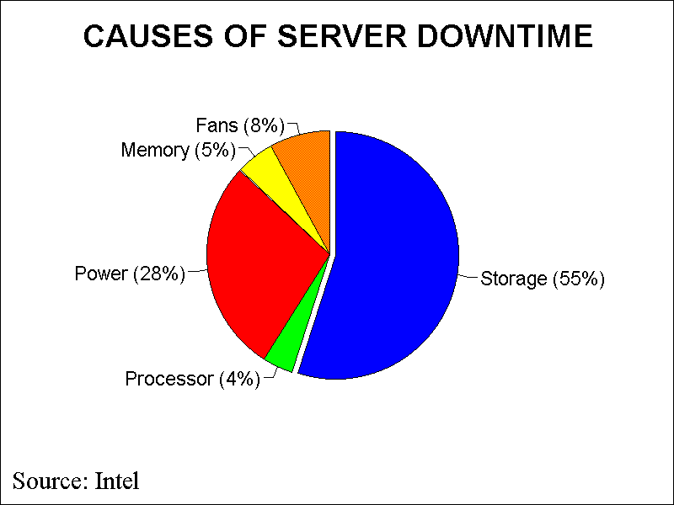
Importance of Storage Reliability

Slide 50
RAID
To increase the availability and the performance (bandwidth) of a storage system, instead of a single disk, a set of disks (disk arrays) can be used.
Similar to memory interleaving, data can be spread among multiple disks (striping), allowing simultaneous access to the data and thus improving the throughput.
However, the reliability of the system drops (n devices have 1/n the reliability of a single device).

Slide 51
Dependability Measures
Reliability: mean time to failure (MTTF)
Service interruption: mean time to repair (MTTR)
Mean time between failures
MTBF = MTTF + MTTR
Availability = MTTF / (MTTF + MTTR)
Improving Availability
Increase MTTF: fault avoidance, fault tolerance, fault forecasting
Reduce MTTR: improved tools and processes for diagnosis and repair

Slide 52
Array Reliability
Reliability of N disks = Reliability of 1 Disk ÷N
50,000 Hours ÷ 70 disks = 700 hours
Disk system Mean Time To Failure (MTTF): Drops from 6 years to 1 month!
Arrays without redundancy too unreliable to be useful!

Slide 53
RAID
A disk array’s availability can be improved by adding redundant disks:
If a single disk in the array fails, the lost information can be reconstructed from redundant information.
These systems have become known as RAID - Redundant Array of Inexpensive Disks.
Depending on the number of redundant disks and the redundancy scheme used, RAIDs are classified into levels.
6 levels of RAID (0-5) are accepted by the industry.
Level 2 and 4 are not commercially available, they are included for clarity

Slide 54
RAID-0
stripe 0
stripe 1
stripe 2
stripe 3
stripe 4
stripe 5
stripe 6
stripe 7
stripe 8
stripe 9
stripe 10
stripe 11
stripe 12
stripe 13
stripe 14
stripe 15
Striped, non-redundant
Parallel access to multiple disks
Excellent data transfer rate
Excellent I/O request processing rate (for large stripes) if the controller supports independent Reads/Writes
Not fault tolerant (AID)
Typically used for applications requiring high performance for non-critical data (e.g., video streaming and editing)

Slide 55
RAID-1 - Mirroring
stripe 0
stripe 0
stripe 1
stripe 1
stripe 2
stripe 2
stripe 3
stripe 3
Called mirroring or shadowing, uses an extra disk for each disk in the array (most costly form of redundancy)
Whenever data is written to one disk, that data is also written to a redundant disk: good for reads, fair for writes
If a disk fails, the system just goes to the mirror and gets the desired data.
Fast, but very expensive.
Typically used in system drives and critical files
Banking, insurance data
Web (e-commerce) servers

Slide 56
RAID-2: Memory-Style ECC
b₀
b₁
b₂
b₃
f₀(b)
f₁(b)
P(b)
Data Disks
Multiple ECC Disks and a Parity Disk
Multiple disks record the (error correcting code) ECC information to determine which disk is in fault
A parity disk is then used to reconstruct corrupted or lost data
Needs log₂(number of disks) redundancy disks
Least used since ECC is irrelevant because most new Hard drives support built-in error correction

Slide 57
RAID-3 - Bit-interleaved Parity
10010011
11001101
10010011
. . .
P
Striped physical
records
1 0 0 1 0 0 1 1 0
1 1 0 0 1 1 0 1 1
1 0 0 1 0 0 1 1 0
Logical record
Physical record
Use 1 extra disk for each array of n disks.
Reads or writes go to all disks in the array, with the extra disk to hold the parity information in case there is a failure.
The parity is carried out at bit level:
A parity bit is kept for each bit position across the disk array and stored in the redundant disk.
Parity: sum modulo 2.
parity of 1010 is 0
parity of 1110 is 1
Or use XOR of bits

Slide 58
RAID-3 - Bit-interleaved Parity
If one of the disks fails, the data for the failed disk must be recovered from the parity information:
This is achieved by subtracting the parity of good data from the original parity information:
Recovering from failures takes longer than in mirroring, but failures are rare, so is okay
Examples:

Slide 59
RAID-4 - Block-interleaved Parity
In RAID 3, every read or write needs to go to all disks since bits are interleaved among the disks.
Performance of RAID 3:
Only one request can be serviced at a time
Poor I/O request rate
Excellent data transfer rate
Typically used in large I/O request size applications, such as imaging or CAD
RAID 4: If we distribute the information block-interleaved, where a disk sector is a block, then for normal reads different reads can access different segments in parallel. Only if a disk fails we will need to access all the disks to recover the data.

Slide 60
RAID-4: Block Interleaved Parity
block 0
block 1
block 2
block 3
P(0-3)
block 4
block 5
block 6
block 7
P(4-7)
block 8
block 9
block 10
block 11
P(8-11)
block 12
block 13
block 14
block 15
P(12-15)
Allow for parallel access by multiple I/O requests
Doing multiple small reads is now faster than before.
A write, however, is a different story since we need to update the parity information for the block.
Large writes (full stripe), update the parity:
P’ = d0’ ⊕ d1’ ⊕ d2’ ⊕ d3’;
Small writes (eg. write on d0), update the parity:
P = d0 ⊕ d1 ⊕ d2 ⊕ d3
P’ = d0’ ⊕ d1 ⊕ d2 ⊕ d3 = d0’ ⊕ d0 ⊕ P;
However, writes are still very slow since parity disk is the bottleneck.

Slide 61
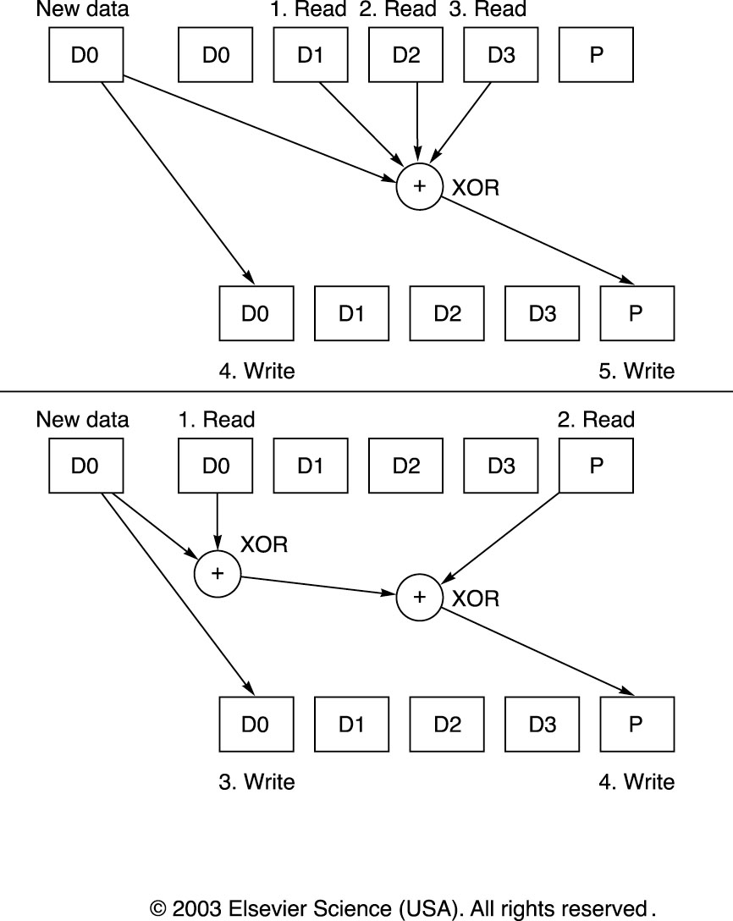
RAID-4: Small Writes

Slide 62
RAID-5 - Block-interleaved Distributed Parity
To address the write deficiency of RAID 4, RAID 5 distributes the parity blocks among all the disks.
0
1
2
3
P0
4
5
6
P1
7
8
9
P2
10
11
12
P3
13
14
15
P4
16
17
18
19
20
21
22
23
P5
. . .
. . .
. . .
. . .
. . .
RAID 5

Slide 63
RAID-5 - Block-interleaved Distributed Parity
This allows some writes to proceed in parallel
For example, writes to blocks 8 and 5 can occur simultaneously.

Slide 64
RAID-5 - Block-interleaved Distributed Parity
However, writes to blocks 8 and 11 cannot proceed in parallel.

Slide 65
Performance of RAID-5 - Block-interleaved Distributed Parity
Performance of RAID-5
I/O request rate: excellent for reads, good for writes
Data transfer rate: good for reads, good for writes
Typically used for high request rate, read-intensive data lookup
File and Application servers, Database servers, WWW, E-mail, and News servers, Intranet servers
The most versatile and widely used RAID.

Slide 66
RAID-6 – Row-Diagonal Parity
To handle 2 disk errors
In practice, another disk error can occur before the first problem disk is repaired
Use p-1 data disks, 1 row-parity disk, 1 diagonal-parity disk
If any two of the p+1 disks fail, data can still be recovered
Data Disk 0 | Data Disk 1 | Dada Disk 2 | Dada Disk 3 | Row Parity Disk | Diagonal Parity Disk
0 | 1 | 2 | 3 | 4 | 0
1 | 2 | 3 | 4 | 0 | 1
2 | 3 | 4 | 0 | 1 | 2
3 | 4 | 0 | 1 | 2 | 3

Slide 67
Dependability
Notes:
67

Slide 68
Definitions
Examples on why precise definitions so important for reliability
Is a programming mistake a fault, error, or failure?
Are we talking about the time it was designed or the time the program is run?
If the running program doesn’t exercise the mistake, is it still a fault/error/failure?
If an alpha particle hits a DRAM memory cell, is it a fault/error/failure if it doesn’t change the value?
Is it a fault/error/failure if the memory doesn’t access the changed bit?
Did a fault/error/failure still occur if the memory had error correction and delivered the corrected value to the CPU?

Slide 69
IFIP Standard terminology
Computer system dependability: quality of delivered service such that reliance can be justifiably placed on the service
Service is observed actual behavior as perceived by other system(s) interacting with this system’s users
Each module has ideal specified behavior, where service specification is agreed description of expected behavior
A system failure occurs when the actual behavior deviates from the specified behavior
failure occurred because an error, a defect in module
The cause of an error is a fault
When a fault occurs it creates a latent error, which becomes effective when it is activated
When error actually affects the delivered service, a failure occurs (time from error to failure is error latency)

Slide 70
Fault v. (Latent) Error v. Failure
An error is manifestation in the system of a fault, a failure is manifestation on the service of an error
If an alpha particle hits a DRAM memory cell, is it a fault/error/failure if it doesn’t change the value?
Is it a fault/error/failure if the memory doesn’t access the changed bit?
Did a fault/error/failure still occur if the memory had error correction and delivered the corrected value to the CPU?
An alpha particle hitting a DRAM can be a fault
If it changes the memory, it creates an error
Error remains latent until affected memory word is read
If the effected word error affects the delivered service, a failure occurs

Slide 71
Fault Categories
Hardware faults: Devices that fail, such alpha particle hitting a memory cell
Design faults: Faults in software (usually) and hardware design (occasionally)
Operation faults: Mistakes by operations and maintenance personnel
Environmental faults: Fire, flood, earthquake, power failure, and sabotage
Also by duration:
Transient faults exist for limited time and not recurring
Intermittent faults cause a system to oscillate between faulty and fault-free operation
Permanent faults do not correct themselves over time

Slide 72

Fault Tolerance vs Disaster Tolerance
Fault-Tolerance (or more properly, Error-Tolerance): mask local faults (prevent errors from becoming failures)
RAID disks
Uninterruptible Power Supplies
Cluster Failover
Disaster Tolerance: masks site errors (prevent site errors from causing service failures)
Protects against fire, flood, sabotage,..
Redundant system and service at remote site.
Use design diversity
From Jim Gray’s “Talk at UC Berkeley on Fault Tolerance " 11/9/00

Slide 73
Case Studies - Tandem Trends Reported MTTF by Component
1985 1987 1990
SOFTWARE 2 53 33 Years
HARDWARE 29 91 310 Years
MAINTENANCE 45 162 409 Years
OPERATIONS 99 171 136 Years
ENVIRONMENT 142 214 346 Years
SYSTEM 8 20 21 Years
Problem: Systematic Under-reporting
From Jim Gray’s “Talk at UC Berkeley on Fault Tolerance " 11/9/00

Slide 74
HW Failures in Real Systems: Tertiary Disks
A cluster of 20 PCs in seven 7-foot high, 19-inch wide racks with 368 8.4 GB, 7200 RPM, 3.5-inch IBM disks. The PCs are P6-200MHz with 96 MB of DRAM each. They run FreeBSD 3.0 and the hosts are connected via switched 100 Mbit/second Ethernet. Data collected during 18 months of operation.

Slide 75
How Realistic is "5 Nines"?
HP claims HP-9000 server HW and HP-UX OS can deliver 99.999% availability guarantee “in certain pre-defined, pre-tested customer environments”
Application faults?
Operator faults?
Environmental faults?
Collocation sites (lots of computers in 1 building on Internet) have
1 network outage per year (~1 day)
1 power failure per year (~1 day)
Microsoft Network unavailable recently for a day due to problem in Domain Name Server: if only outage per year, 99.7% or 2 Nines

Slide 76
Data Processing for Today’s Web-Scale Services
Application tasks | Data size | Computation | Network
Web crawl | 800TB | Highly parallel | High bandwidth
Data analytics | 200TB | Intensive | High bandwidth, low latency
Orkut (social network) | 9TB | Parallelizable | Low latency
Youtube | Estimated multi-petabytes | Intensive, parallelizable | Very high bandwidth, low latency
e-business (e.g., Amazon) | Estimated multi-petabytes | Intensive | High bandwidth, very low latency
Petabytes of data and demanding computation
Network performance is essential!
Chang, F et al. Bigtable: a distributed storage system for structured data. In Proceedings of the 7th Symposium on Operating Systems Design and Implementation (Seattle, Washington, November 06 - 08, 2006). 205-218. http://baijia.info/showthread.php?tid=4

Slide 77
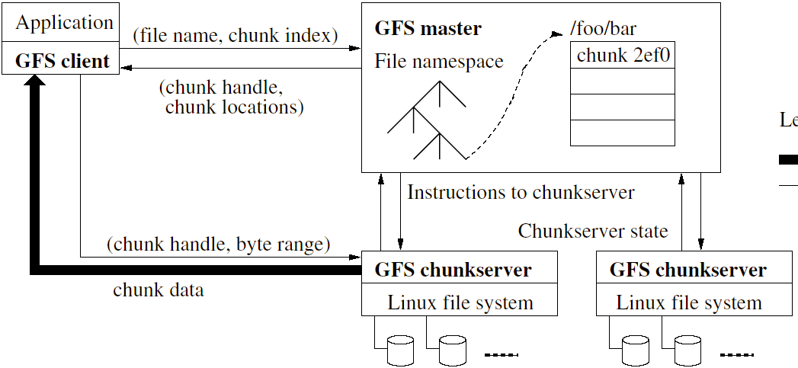
Large-Scale Fault Tolerant File System
A distributed file system at work (GFS)
Single master and numerous slaves communicate with each other
File data unit, “chunk”, is up to 64MB. Chunks are replicated.
Requires extremely high network bandwidth, very low network latency

Slide 78
Network Storage Systems
Notes:
78

Slide 79
Which Storage Architecture?
DAS - Directly-Attached Storage
NAS - Network Attached Storage
SAN - Storage Area Network

Slide 80
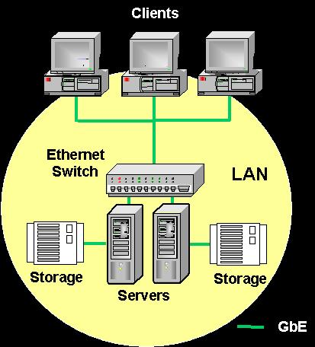
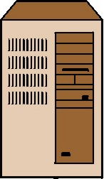
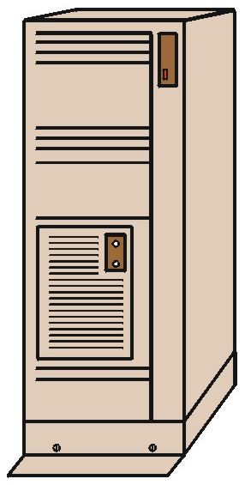
Storage Architectures (Direct Attached Storage (DAS))
Unix
NT/W2K
Netware
Virtual Drive 3
NT Server
Storage
Unix Server
Storage
NetWare Server
Storage

Slide 81
DAS
MS Windows
NIC
Memory
CPUs
Bus
SCSI Adaptor
Block
I/O
SCSI protocol
SCSI Adaptor
SCSI Disk Drive
Traditional Server

Slide 82

Storage Architectures (Direct Attached Storage (DAS))
File Server
Exchange Server
ERP Server
Disk A
Disk B
Disk C

Slide 83


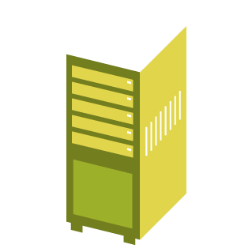
The Problem with DAS
Direct Attached Storage (DAS)
Data is bound to the server hosting the disk
Expanding the storage may mean purchasing and managing another server
In heterogeneous environments, management is complicated
Netware
Windows NT/2K
Linux/Unix

Slide 84
Storage Architectures (Direct Attached Storage (DAS))
Advantages
Low cost
Simple to use
Easy to install
Disadvantages
No shared resources
Difficult to backup
Limited distance
Limited high-availability options
Complex maintenance
Solution for small organizations only

Slide 85
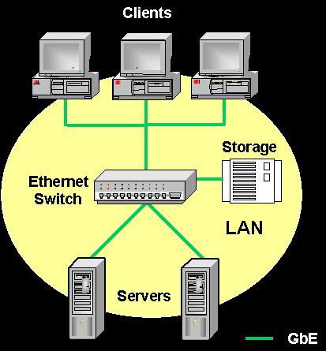
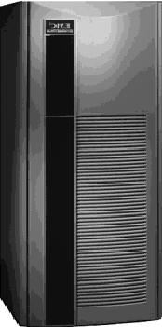
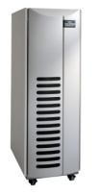
Storage Architectures (Network Attached Storage (NAS))
Hosts
Disk subsystem
NAS Controller
IP Network
Shared
Information

Slide 86
NAS (Network Attached Storage)
What is it?
NAS devices contain embedded processors that run specialized OS or micro kernel that understands networking protocols and is optimized for particular tasks, such as file service. NAS devices usually deploy some level of RAID storage.

Slide 87
NAS
File protocol (CIFS, NFS)
IP network
MS Windows
Optimized OS
NIC
Memory
NIC
Memory
CPUs
CPUs
Bus
Bus
SCSI Adaptor
SCSI Adaptor
Block
I/O
SCSI protocol
SCSI Adaptor
SCSI Adaptor
SCSI Disk Drive
SCSI Disk Drive
“Diskless” App Server
(or rather a “Less Disk” server)
NAS appliance

Slide 88
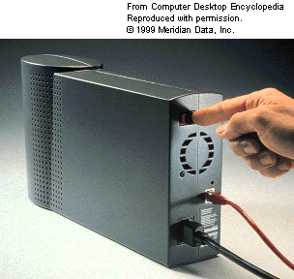
The NAS Network
IP network
App Server
App Server
NAS Appliance
App Server
NAS - truly an appliance

Slide 89
More on NAS
NAS Devices can easily and quickly attach to a LAN
NAS is platform and OS independent and appears to machines as another server
NAS Devices provide storage that can be addressed via standard file system (e.g., NFS, CIFS) protocols

Slide 90
Storage Architectures (Network Attached Storage (NAS))
Advantages
Easy to install
Easy to maintain
Shared information
Unix, Windows file sharing
Remote access
Disadvantages
Not suitable for databases
Storage islands
Not-very-scalable solution
NAS controller is a bottle neck
Vendor-dependable
Suitable for file based application

Slide 91



Some NAS Problems
Network Attached Storage (NAS)
Each appliance represents a larger island of storage
Data is bound to the NAS device hosting the disk and cannot be accessed if the system hosting the drive fails
Storage is labor-intensive and thus expensive
Network is bottleneck
Netware
Windows NT/2K
Linux/Unix
NAS

Slide 92
Some Benefits of NAS
Files are easily shared among users at high demand and performance
Files are easily accessible by the same user from different locations
Demand for local storage at the desktop is reduced
Storage can be added more economically and partitioned among users— reasonably scalable
Data can be backed up from the common repository more efficiently than from desktops
Multiple file servers can be consolidated into a single managed storage pool

Slide 93
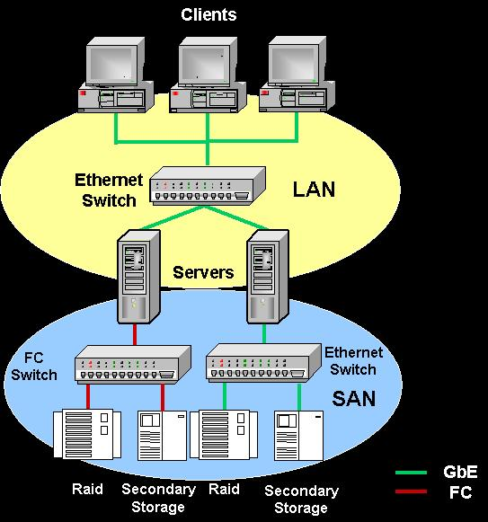

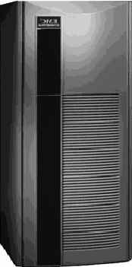
Storage Architectures (Storage Area Networks (SAN))
Clients
Hosts
IP
Network
Storage
Network
Shared
Storage

Slide 94
SAN (Storage Area Network)
what is it?
In short, SAN is essentially just another type of network, consisting of storage components (instead of computers), one or more interfaces, and interface extension technologies. The storage units communicate in much the same form and function as computers communicate on a LAN.

Slide 95
Advantages of SANs
Superior Performance
Reduces Network bottlenecks
Highly Scalable
Allows backup of storage devices with minimal impact on production operations
Flexibility in configuration

Slide 96

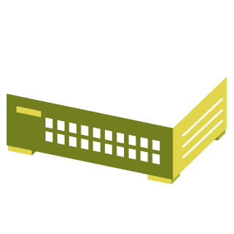
Additional Benefits of SANs
Storage Area Network (SAN)
Server Consolidation
Storage Consolidation
Storage Flexibility and Management
LAN Free backup and archive
Modern data protection (change from traditional tape backup to snap-shot, archive, geographically separate mirrored storage)
Windows NT/2K
Netware
SAN Switch
Linux/Unix

Slide 97
Additional Benefits of SANs
Disks appear to be directly attached to each host
Provides potential of direct attached performance over Fibre Channel distances (Uses block level I/O)
Provides flexibility of multiple host access
Storage can be partitioned, with each partition dedicated to a particular host computer
Storage can be shared among a heterogeneous set of host computers
Economies of scale can reduce management costs by allowing administration of a centralized pool of storage and allocating storage to projects on an as-needed basis
SAN can be implemented within a single computer room environment, across a campus network, or across a wide area network

