Slide 1
COMP4611: Design and Analysis of Computer Architectures
Memory System Cache Lin Gu CSE, HKUST

Slide 2
Memory Hierarchy: Motivation The Principle Of Locality
Programs usually access a relatively small portion of their address space (instructions/data) at any instant of time (loops, data arrays).
Two Types of locality:
Temporal Locality: If an item is referenced, it will tend to be referenced again soon.
Spatial locality: If an item is referenced, items whose addresses are close by will tend to be referenced soon .
The presence of locality in program behavior (e.g., loops, data arrays), makes it possible to satisfy a large percentage of program access needs (both instructions and operands) using memory levels with much less capacity than the program address space.

Slide 3
Locality Example
Locality Example:
Data
Reference array elements in succession (stride-1 reference pattern):
Reference sum each iteration:
Instructions
Reference instructions in sequence:
Cycle through loop repeatedly:
sum = 0;
for (i = 0; i < n; i++)
sum += a[i];
return sum;
Spatial locality
Temporal locality
Spatial locality
Temporal locality

Slide 4
Memory Hierarchy: Terminology
A Block: The smallest unit of information transferred between two levels.
Hit: Item is found in some block in the upper level (example: Block X)
Hit Rate: The fraction of memory accesses found in the upper level.
Hit Time: Time to access the upper level which consists of
memory access time + time to determine hit/miss
Miss: Item needs to be retrieved from a block in the lower level (Block Y)
Miss Rate = 1 - (Hit Rate)
Miss Penalty: Time to replace a block in the upper level +
Time to deliver the block to the processor
Hit Time << Miss Penalty
Lower Level
Memory
Upper Level
Memory
From Processor
Blk X
Blk Y
To Processor

Slide 5
Caching in a Memory Hierarchy
Smaller, faster, more expensive
device at level k caches a
subset of the blocks from level k+1
8
Level k:
4
9
14
3
10
Data is copied between
levels in block-sized transfer units
10
4
0
1
2
3
4
Larger, slower, cheaper storage
device at level k+1 is partitioned
into blocks.
Level k+1:
4
5
6
7
8
9
10
10
11
12
13
14
15

Slide 6
General Caching Concepts
Program needs object d, which is stored in some block b.
Cache hit
Program finds b in the cache at level k. E.g., block 14.
Cache miss
b is not at level k, so level k cache must fetch it from level k+1. E.g., block 12.
If level k cache is full, then some current block must be replaced (evicted). Which one is the “victim”?
Placement policy: where can the new block go? E.g., b mod 4
Replacement policy: which block should be evicted? E.g., LRU
Request
12
14
Request
14
12
0
1
2
3
Level
k:
4*
9
14
12
14
3
4*
12
Request
12
4*
0
1
2
3
Level
k+1:
4
5
6
7
4*
8
9
10
11
12
13
14
15
12

Slide 7
Cache Design & Operation Issues
Q1: Where can a block be placed in cache? (Block placement strategy & Cache organization)
Fully Associative, Set Associative, Direct Mapped.
Q2: How is a block found if it is in cache? (Block identification)
Tag/Block.
Q3: Which block should be replaced on a miss? (Block replacement)
Random, LRU.
Q4: What happens on a write? (Cache write policy)
Write through, write back.

Slide 8
Types of Caches: Organization
Type of cache | Mapping of data from memory to cache | Complexity of searching the cache
Direct mapped (DM) | A memory value can be placed at a single corresponding location in the cache | Easy search mechanism
Set-associative (SA) | A memory value can be placed in any of a set of locations in the cache | Slightly more involved search mechanism
Fully-associative (FA) | A memory value can be placed in any location in the cache | Extensive hardware resources required to search (CAM)
DM and FA can be thought as special cases of SA
DM → 1-way SA
FA → All-way SA

Slide 9
Cache Organization & Placement Strategies
Placement strategies or mapping of a main memory data block onto cache block frame addresses divide cache into three organizations:
Direct mapped cache: A block can be placed in one location only, given by:
(Block address) MOD (Number of blocks in cache)
Advantage: It is easy to locate blocks in the cache (only one possibility)
Disadvantage: Certain blocks cannot be simultaneously present in the cache (they can only have the same location)

Slide 10
Cache Organization: Direct Mapped Cache
A block can be placed in one location only, given by:
(Block address) MOD (Number of blocks in cache)
In this case: (Block address) MOD (8)
C
a
c
h
e
0
1
0
1
0
1
0
1
8 cache block
frames
0
0
1
1
0
0
1
1
0
0
0
0
1
1
1
1
(11101) MOD (1000) = 101
32 memory
blocks
cacheable
0
0
0
0
1
0
0
1
0
1
0
1
0
0
1
0
1
1
0
1
1
0
0
0
1
1
0
1
0
1
1
1
0
0
1
1
1
1
0
1
M
e
m
o
r
y

Slide 11
Direct Mapping
Tag
Index
Data
00000
0
00000
0
0x55
0x55
0x0F
00000
0x0F
1
00000
1
00001
0
Direct mapping:
A memory value can only be placed at a single corresponding location in the cache
11111
11111
0
0xAA
0xAA
0xF0
11111
0xF0
11111
1

Slide 12
Cache Organization & Placement Strategies
Fully associative cache: A block can be placed anywhere in cache.
Advantage: No restriction on the placement of blocks. Any combination of blocks can be simultaneously present in the cache.
Disadvantage: Costly (hardware and time) to search for a block in the cache
Set associative cache: A block can be placed in a restricted set of places, or cache block frames. A set is a group of block frames in the cache. A block is first mapped onto the set and then it can be placed anywhere within the set. The set in this case is chosen by:
(Block address) MOD (Number of sets in cache)
If there are n blocks in a set the cache placement is called n-way set-associative, or n-associative.
A good compromise between direct mapped and fully associative caches (most processors use this method).

Slide 13
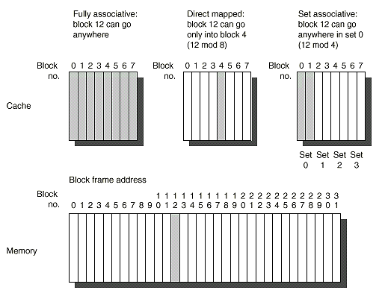
Cache Organization Example

Slide 14
Set Associative Mapping (2-Way)
Way 0
Way 1
Tag
Index
Data
0000
0
0000
00
0x55
0x55
0x0F
0000
0x0F
1
0000
01
0001
10
Set-associative mapping:
A memory value can be placed in any block frame of a set corresponding to the block address
1111
1111
10
0xAA
0xAA
0xF0
1111
0xF0
1111
11

Slide 15
Fully Associative Mapping
Tag
Data
000000
0000
0x55
000000
0x55
0000
0x55
0x55
0x0F
0x0F
0x0F
000001
0x0F
0000
000001
0000
000110
000110
Fully-associative mapping:
A block can be stored anywhere in the cache
111110
1111
111110
1111
0xAA
0xAA
0xAA
0xAA
0xF0
0xF0
0xF0
111111
0xF0
1111
111111
1111

Slide 16
Cache Organization Tradeoff
For a given cache size, there is a tradeoff between hit rate and complexity
If L = number of lines (blocks) in the cache, L = Cache Size / Block Size
How many places Name of Number of Sets for a block to go cache type
1 Direct Mapped L
n n-way associative L/n
L Fully Associative 1
Number of comparators needed to compare tags

Slide 17
An Example
Assume a direct mapped cache with 4-word blocks and a total size of 16 words.
Consider the following string of address references given as word addresses:
1, 4, 8, 5, 20, 17, 19, 56, 9, 11, 4, 43, 5, 6, 9, 17
Show the hits and misses and final cache contents.

Slide 19
Main memory
block no in
cache
0
1, 4, 8, 5, 20, 17, 19, 56, 9, 11, 4, 43, 5, 6, 9, 17

Slide 20
Main memory
block no in
cache
0
1
1, 4, 8, 5, 20, 17, 19, 56, 9, 11, 4, 43, 5, 6, 9, 17

Slide 21
Main memory
block no in
cache
0
1
2
1, 4, 8, 5, 20, 17, 19, 56, 9, 11, 4, 43, 5, 6, 9, 17

Slide 22
Main memory
block no in
cache
0
1
2
Address 5: Hit, access block 1 of cache
Block #
Cache
Memory
Block #
0
0
0
1
1
0
2
2
3
3
4
4
1
5
5
1
6
6
7
7
8
8
2
9
9
2
10
10
11
11
0
12
3
1
13
3
2
14
3
15
16
17
4
18
19
20
1, 4, 8, 5, 20, 17, 19, 56, 9, 11, 4, 43, 5, 6, 9, 17
21

Slide 23
Main memory
block no in
cache
0
5
2
1, 4, 8, 5, 20, 17, 19, 56, 9, 11, 4, 43, 5, 6, 9, 17

Slide 24
Main memory
block no in
cache
4
5
2
1, 4, 8, 5, 20, 17, 19, 56, 9, 11, 4, 43, 5, 6, 9, 17

Slide 25
Main memory
block no in
cache
4
5
2
1, 4, 8, 5, 20, 17, 19, 56, 9, 11, 4, 43, 5, 6, 9, 17

Slide 26
Main memory
block no in
cache
4
5
14
1, 4, 8, 5, 20, 17, 19, 56, 9, 11, 4, 43, 5, 6, 9, 17

Slide 27
Main memory
block no in
cache
4
5
2
1, 4, 8, 5, 20, 17, 19, 56, 9, 11, 4, 43, 5, 6, 9, 17

Slide 28
Main memory
block no in
cache
4
5
2
1, 4, 8, 5, 20, 17, 19, 56, 9, 11, 4, 43, 5, 6, 9, 17

Slide 29
Main memory
block no in
cache
4
1
2
1, 4, 8, 5, 20, 17, 19, 56, 9, 11, 4, 43, 5, 6, 9, 17

Slide 30
Main memory
block no in
cache
4
1
10
1, 4, 8, 5, 20, 17, 19, 56, 9, 11, 4, 43, 5, 6, 9, 17

Slide 31
Main memory
block no in
cache
4
1
10
1, 4, 8, 5, 20, 17, 19, 56, 9, 11, 4, 43, 5, 6, 9, 17

Slide 32
Main memory
block no in
cache
4
1
10
1, 4, 8, 5, 20, 17, 19, 56, 9, 11, 4, 43, 5, 6, 9, 17

Slide 33
Main memory
block no in
cache
4
1
2
1, 4, 8, 5, 20, 17, 19, 56, 9, 11, 4, 43, 5, 6, 9, 17

Slide 34
Main memory
block no in
cache
4
1
2
1, 4, 8, 5, 20, 17, 19, 56, 9, 11, 4, 43, 5, 6, 9, 17

Slide 35
Summary
Number of Hits = 6
Number of Misses = 10
Hit Ratio: 6/16 =
37.5% ⬇ Unacceptable
Typical Hit ratio:
> 90%

Slide 36
Locating A Data Block in Cache
Each block in the cache has an address tag.
The tags of every cache block that might contain the required data are checked in parallel.
A valid bit is added to the tag to indicate whether this cache entry is valid or not.
The address from the CPU to the cache is divided into:
A block address, further divided into:
An index field to choose a block set in the cache.
(no index field when fully associative).
A tag field to search and match addresses in the selected set.
A block offset to select the data from the block.
Block Address
Block
Offset
Tag
Index

Slide 37
Address Field Sizes
Physical Address Generated by CPU
Block Address
Block
Offset
Tag
Index
Block offset size = log2(block size)
Index size = log2(Total number of blocks/associativity)
Tag size = address size - index size - offset size
Number of Sets
Mapping function:
Cache set or block frame number = Index =
= (Block Address) MOD (Number of Sets)

Slide 38
Locating A Data Block in Cache
Increasing associativity shrinks index, expands tag
Block index not needed for fully associative cache
Block Address
Block
Offset, m bits
Tag – r bits
Index – k bits
Tag to identify a unique block
2^{k} addressable blocks in the cache
2^{m} bytes in a block

Slide 39
Direct-Mapped Cache Example
Suppose we have a 16KB of data in a direct-mapped cache with 4 word blocks
Determine the size of the tag, index and offset fields if we’re using a 32-bit architecture
Offset
need to specify correct byte within a block
block contains 4 words = 16 bytes = 2⁴ bytes
need 4 bits to specify correct byte

Slide 40
Direct-Mapped Cache Example
Index: (~index into an “array of blocks”)
need to specify correct row in cache
cache contains 16 KB = 2¹⁴ bytes
block contains 2⁴ bytes (4 words)
# rows/cache =# blocks/cache (since there’s one block/row)
= bytes/cache bytes/row
= 2¹⁴ bytes/cache 2⁴ bytes/row
= 2¹⁰ rows/cache
need 10 bits to specify this many rows

Slide 41
Direct-Mapped Cache Example
Tag: use remaining bits as tag
tag length = mem addr length - offset - index = 32 - 4 - 10 bits = 18 bits
so tag is leftmost 18 bits of memory address

Slide 42
4KB Direct Mapped Cache Example
A
d
d
r
e
s
s
(
s
h
o
w
i
n
g
b
i
t
p
o
s
i
t
i
o
n
s
)
Index field
Tag field
3
1
3
0
1
3
1
2
1
1
2
1
0
o
B
y
t
e
f
f
s
e
t
H
i
t
2
0
1
0
D
a
t
a
T
a
g
1K = 1024 Blocks
Each block = one word
Can cache up to
2³² bytes = 4 GB
of memory
Mapping function:
Cache Block frame number =
(Block address) MOD (1024)
I
n
d
e
x
I
n
d
e
x
V
a
l
i
d
T
a
g
D
a
t
a
0
1
2
1
0
2
1
1
0
2
2
1
0
2
3
2
0
3
2
Block Address = 30 bits
Block offset
= 2 bits
Tag = 20 bits
Index = 10 bits

Slide 43
64KB Direct Mapped Cache Example
Tag field
A
d
d
r
e
s
s
(
s
h
o
w
i
n
g
b
i
t
p
o
s
i
t
i
o
n
s
)
4K= 4096 blocks
Each block = four words = 16 bytes
Can cache up to
2³² bytes = 4 GB
of memory
Index field
3
1
1
6
1
5
4
3
2
1
0
H
i
t
1
6
1
2
2
B
y
t
e
Word select
D
a
t
a
T
a
g
o
f
f
s
e
t
I
n
d
e
x
B
l
o
c
k
o
f
f
s
e
t
1
6
b
i
t
s
1
2
8
b
i
t
s
V
T
a
g
D
a
t
a
4
K
e
n
t
r
i
e
s
1
6
3
2
3
2
3
2
3
2
M
u
x
3
2
Block Address = 28 bits
Block offset
= 4 bits
Tag = 16 bits
Index = 12 bits
Mapping Function: Cache Block frame number = (Block address) MOD (4096)
Larger blocks take better advantage of spatial locality

Slide 44
Cache Organization: Set Associative Cache
O
n
e
-
w
a
y
s
e
t
a
s
s
o
c
i
a
t
i
v
e
(
d
i
r
e
c
t
m
a
p
p
e
d
)
B
l
o
c
k
T
a
g
D
a
t
a
0
T
w
o
-
w
a
y
s
e
t
a
s
s
o
c
i
a
t
i
v
e
1
2
S
e
t
T
a
g
D
a
t
a
T
a
g
D
a
t
a
3
0
4
1
5
2
6
3
7
F
o
u
r
-
w
a
y
s
e
t
a
s
s
o
c
i
a
t
i
v
e
S
e
t
T
a
g
D
a
t
a
T
a
g
D
a
t
a
T
a
g
D
a
t
a
T
a
g
D
a
t
a
0
1
E
i
g
h
t
-
w
a
y
s
e
t
a
s
s
o
c
i
a
t
i
v
e
(
f
u
l
l
y
a
s
s
o
c
i
a
t
i
v
e
)
T
a
g
D
a
t
a
T
a
g
D
a
t
a
T
a
g
D
a
t
a
T
a
g
D
a
t
a
T
a
g
D
a
t
a
T
a
g
D
a
t
a
T
a
g
D
a
t
a
T
a
g
D
a
t
a

Slide 45
Direct-Mapped Cache Design
32-bit architecture, 32-bit blocks, 8 blocks
ADDRESS
Block Address
Byte Offset (2-bit)
Block
Offset
Cache
Index (3-bit)
DATA
HIT
=1
Tag (27-bit)
Tag
Index
0x0000000
3
0
ADDR
CACHE SRAM
V
Tag
Data
1
0x00001C0
0xff083c2d
0
1
0x0000000
0x00000021
1
0x0000000
0x00000103
0
0
1
0
0x23F0210
0x00000009
DATA[59]
DATA[58:32]
DATA[31:0]
=
45

Slide 46
4K Four-Way Set Associative Cache: MIPS Implementation Example
Tag
Field
A
d
d
r
e
s
s
3
1
3
0
1
2
1
1
1
0
9
8
3
2
1
0
Index
Field
1024 block frames
1 block = one word (32 bits)
4-way set associative
256 sets
Can cache up to
2³² bytes = 4 GB
of memory
2
2
8
I
n
d
e
x
V
T
a
g
D
a
t
a
V
T
a
g
D
a
t
a
V
T
a
g
D
a
t
a
V
T
a
g
D
a
t
a
0
1
2
2
5
3
2
5
4
2
5
5
2
2
3
2
Block Address = 30 bits
Block offset
= 2 bits
Tag = 22 bits
Index = 8 bits
4
-
t
o
-
1
m
u
l
t
i
p
l
e
x
o
r
H
i
t
D
a
t
a
Mapping Function: Cache Set Number = (Block address) MOD (256)
46

Slide 47
Fully Associative Cache Design
Key idea: set size of one block
1 comparator required for each block
No address decoding
Practical only for small caches due to hardware demands
tag in 11110111
data out 1111000011110000101011
=
tag 00011100
data 0000111100001111111101
=
=
tag 11110111
data 1111000011110000101011
tag 11110111
data 1111000011110000101011
=
tag 11111110
data 0000000000001111111100
=
tag 00000011
data 1110111100001110000001
=
tag 11100110
data 1111111111111111111111
47

Slide 48
Fully Associative
Fully Associative Cache
0 bit for cache index
Compare the Cache Tags of all cache entries in parallel
Example: Block Size = 32 B blocks, we need N 27-bit comparators
31
4
0
Cache Tag (27 bits long)
Byte Select
Ex: 0x01
Cache Tag
Valid Bit
Cache Data
X
Byte 31
:
Byte 1
Byte 0
X
Byte 63
:
Byte 33
Byte 32
X
X
:
:
:
X
48
Notes:
48

Slide 49
Unified vs.Separate Level 1 Cache
Unified Level 1 Cache
A single level 1 cache is used for both instructions and data.
Separate instruction/data Level 1 caches (Harvard Memory Architecture):
The level 1 (L₁) cache is split into two caches, one for instructions (instruction cache, L₁ I-cache) and the other for data (data cache, L₁ D-cache).
Processor
Processor
Control
Control
Unified
Level
One
Cache
L₁
Datapath
L₁
I-cache
Registers
Datapath
Registers
L₁
D-cache
Unified Level 1 Cache
Separate Level 1 Caches
(Harvard Memory Architecture)
49

Slide 50
Cache Replacement Policy
When a cache miss occurs the cache controller may have to select a block of cache data to be removed from a cache block frame and replaced with the requested data, such a block is selected by one of two methods (for direct mapped cache, there is only one choice):
Random:
Any block is randomly selected for replacement providing uniform allocation.
Simple to build in hardware.
The most widely used cache replacement strategy.
Least-recently used (LRU):
Accesses to blocks are recorded and the block replaced is the one that was not used for the longest period of time.
LRU is expensive to implement, as the number of blocks to be tracked increases, and is usually approximated.

Slide 51
LRU Policy
MRU
MRU-1
LRU+1
LRU
A
B
C
D
Access C
C
A
B
D
Access D
D
C
A
B
Access E
MISS, replacement
needed
E
D
C
A
Access C
C
E
D
A
Access G
MISS, replacement
needed
G
C
E
D
51
Notes:
51

Slide 52
Miss Rates for Caches with Different Size, Associativity & Replacement Algorithm Sample Data
Associativity: 2-way 4-way 8-way
Size LRU Random LRU Random LRU Random
16 KB 5.18% 5.69% 4.67% 5.29% 4.39% 4.96%
64 KB 1.88% 2.01% 1.54% 1.66% 1.39% 1.53%
256 KB 1.15% 1.17% 1.13% 1.13% 1.12% 1.12%

Slide 53
Cache and Memory Performance Average Memory Access Time (AMAT), Memory Stall cycles
The Average Memory Access Time (AMAT): The average number of cycles required to complete a memory access request by the CPU.
Memory stall cycles per memory access: The number of stall cycles added to CPU execution cycles for one memory access.
For an ideal memory: AMAT = 1 cycle, this results in zero memory stall cycles.
Memory stall cycles per memory access = AMAT -1
Memory stall cycles per instruction =
Memory stall cycles per memory access
x Number of memory accesses per instruction
= (AMAT -1 ) x ( 1 + fraction of loads/stores)
Instruction Fetch

Slide 54
Cache Performance Unified Memory Architecture
For a CPU with a single level (L1) of cache for both instructions and data and no stalls for cache hits:
Total CPU time = (CPU execution clock cycles +
Memory stall clock cycles) x clock cycle time
Memory stall clock cycles =
(Reads x Read miss rate x Read miss penalty) +
(Writes x Write miss rate x Write miss penalty)
If write and read miss penalties are the same:
Memory stall clock cycles = Memory accesses x Miss rate x Miss penalty
With ideal memory

Slide 55
Cache Performance Unified Memory Architecture
CPUtime = Instruction count x CPI x Clock cycle time
CPI_{execution} = CPI with ideal memory
CPI = CPI_{execution} + MEM Stall cycles per instruction
CPUtime = Instruction Count x (CPI_{execution} +
MEM Stall cycles per instruction) x Clock cycle time
MEM Stall cycles per instruction =
MEM accesses per instruction x Miss rate x Miss penalty
CPUtime = IC x (CPI_{execution} + MEM accesses per instruction x
Miss rate x Miss penalty) x Clock cycle time
Misses per instruction = Memory accesses per instruction x Miss rate
CPUtime = IC x (CPI_{execution} + Misses per instruction x Miss penalty) x
Clock cycle time

Slide 56
Memory Access Tree For Unified Level 1 Cache
CPU Memory Access
L1 Hit:
% = Hit Rate = H1
Access Time = 1
Stalls= H1 x 0 = 0
( No Stall)
L1 Miss:
% = (1- Hit rate) = (1-H1)
Access time = M + 1
Stall cycles per access = M x (1-H1)
L₁
AMAT = H1 x 1 + (1 -H1 ) x (M+ 1) = 1 + M x ( 1 -H1)
Stall Cycles Per Access = AMAT - 1 = M x (1 -H1)
M = Miss Penalty
H1 = Level 1 Hit Rate
1- H1 = Level 1 Miss Rate

Slide 57
Cache Impact On Performance: An Example
Assuming the following execution and cache parameters:
Cache miss penalty = 50 cycles
Normal instruction execution CPI ignoring memory stalls = 2.0 cycles
Miss rate = 2%
Average memory references/instruction = 1.33
CPU time = IC x [CPI _{execution} + Memory accesses/instruction x Miss rate x
Miss penalty ] x Clock cycle time
CPUtime _{with cache} = IC x (2.0 + (1.33 x 2% x 50)) x clock cycle time
= IC x 3.33 x Clock cycle time
Lower CPI _{execution} increases the impact of cache miss clock cycles

Slide 58
Cache Performance Example
Suppose a CPU executes at Clock Rate = 200 MHz (5 ns per cycle) with a single level of cache.
CPI_{execution} = 1.1
Instruction mix: 50% arith/logic, 30% load/store, 20% control
Assume a cache miss rate of 1.5% and a miss penalty of 50 cycles.
CPI = CPI_{execution} + mem stalls per instruction
Mem Stalls per instruction = Mem accesses per instruction x Miss rate x Miss penalty
Mem accesses per instruction = 1 + .3 = 1.3
Mem Stalls per instruction = 1.3 x .015 x 50 = 0.975
CPI = 1.1 + .975 = 2.075
The ideal memory CPU with no misses is 2.075/1.1 = 1.88 times faster
Instruction fetch
Load/store

Slide 59
Cache Performance Example
Suppose for the previous example we double the clock rate to 400 MHZ, how much faster is this machine, assuming similar miss rate, instruction mix?
Since memory speed is not changed, the miss penalty takes more CPU cycles:
Miss penalty = 50 x 2 = 100 cycles.
CPI = 1.1 + 1.3 x .015 x 100 = 1.1 + 1.95 = 3.05
Speedup = (CPI_{old} x C_{old})/ (CPI_{new} x C_{new})
= 2.075 x 2 / 3.05 = 1.36
The new machine is only 1.36 times faster rather than 2 times faster due to the increased effect of cache misses.
CPUs with higher clock rate, have more cycles per cache miss and more memory impact on CPI.

Slide 60
Cache Performance Harvard Memory Architecture
For a CPU with separate or split level one (L1) caches for
instructions and data (Harvard memory architecture) and no
stalls for cache hits:
CPUtime = Instruction count x CPI x Clock cycle time
CPI = CPI_{execution} + Mem Stall cycles per instruction
CPUtime = Instruction Count x (CPI_{execution} +
Mem Stall cycles per instruction) x Clock cycle time
Mem Stall cycles per instruction = Instruction Fetch Miss rate x Miss Penalty + Data Memory Accesses Per Instruction x Data Miss Rate x Miss Penalty

Slide 61
Memory Access Tree For Separate Level 1 Caches
CPU Memory Access
Instruction
Data
L₁
Instruction L1 Hit:
Access Time = 1
Stalls = 0
Instruction L1 Miss:
Access Time = M + 1
Stalls Per access:
%instructions x (1 - Instruction H1 ) x M
Data L1 Hit:
Access Time: 1
Stalls = 0
Data L1 Miss:
Access Time : M + 1
Stalls per access:
% data x (1 - Data H1 ) x M
Stall Cycles Per Access = % Instructions x ( 1 - Instruction H1 ) x M + % data x (1 - Data H1 ) x M
AMAT = 1 + Stall Cycles per access

Slide 62
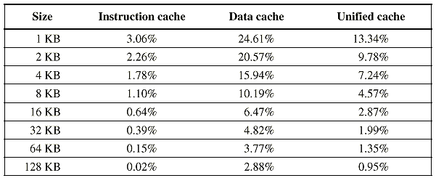
Typical Cache Performance Data Using SPEC92

Slide 63
Cache Performance Example
To compare the performance of either using a 16-KB instruction cache and a 16-KB data cache as opposed to using a unified 32-KB cache, we assume a hit to take one clock cycle and a miss to take 50 clock cycles, and a load or store to take one extra clock cycle on a unified cache, and that 75% of memory accesses are instruction references. Using the miss rates for SPEC92 we get:
Overall miss rate for a split cache = (75% x 0.64%) + (25% x 6.47%) = 2.1%
From SPEC92 data a unified cache would have a miss rate of 1.99%
Average memory access time = 1 + stall cycles per access
= 1 + % instructions x (Instruction miss rate x Miss penalty)
+ % data x ( Data miss rate x Miss penalty)
For split cache:
Average memory access time_{split}
= 1 + 75% x ( 0.64% x 50) + 25% x (6.47%x50) = 2.05 cycles
For unified cache:
Average memory access time_{unified}
= 1 + 75% x ( 1.99%) x 50) + 25% x ( 1 + 1.99% x 50) = 2.24 cycles

Slide 64
Cache Write Strategies

Slide 65
Cache Read/Write Operations
Statistical data suggest that reads (including instruction fetches) dominate processor cache accesses (writes account for 25% of data cache traffic).
In cache reads, a block is read at the same time while the tag is being compared with the block address (searching). If the read is a hit the data is passed to the CPU, if a miss it ignores it.
In cache writes, modifying the block cannot begin until the tag is checked to see if the address is a hit.
Thus for cache writes, tag checking cannot take place in parallel, and only the specific data requested by the CPU can be modified.
Cache is classified according to the write and memory update strategy in place: write through, or write back.
65

Slide 66
Write-through Policy
0x1234
0x1234
0x5678
0x1234
0x5678
0x1234
Processor
Cache
Memory
66
Notes:
66

Slide 67
Cache Write Strategies
Write Though: Data is written to both the cache block and the main memory.
The lower level always has the most updated data; an important feature for I/O and multiprocessing.
Easier to implement than write back.
A write buffer is often used to reduce CPU write stall while data is written to memory.
Cache
Processor
DRAM
Write Buffer
67

Slide 68
Write Buffer for Write Through
Cache
Processor
DRAM
Write Buffer
A Write Buffer is needed between the Cache and Memory
Processor: writes data into the cache and the write buffer
Memory controller: write contents of the buffer to memory
Write buffer is just a FIFO queue:
Typical number of entries: 4
Works fine if: Store frequency (w.r.t. time) << 1 / DRAM write cycle
68
Notes:
68

Slide 69
Write-back Policy
0x1234
0x1234
0x5678
0x1234
0x9ABC
0x5678
0x1234
0x5678
Processor
Cache
Memory
69
Notes:
69

Slide 70
Cache Write Strategies
Write back: Data is written or updated only to the cache block.
Writes occur at the speed of cache
The modified or dirty cache block is written to main memory later (e.g., when it’s being replaced from cache)
A status bit called a dirty bit, is used to indicate whether the block was modified while in cache; if not the block is not written to main memory.
Uses less memory bandwidth than write through.
70

Slide 71
Write misses
Index
V
Tag
Data
Address
Data
...
110
...
...
1101 0110
...
1
00010
123456
6378
71
If we try to write to an address that is not already contained in the cache; this is called a write miss.
Let’s say we want to store 21763 into Mem[1101 0110] but we find that address is not currently in the cache.
When we update Mem[1101 0110], should we also load it into the cache?

Slide 72
No write-allocate
With a no-write allocate policy, the write operation goes directly to main memory without affecting the cache.
This is good when data is written but not immediately used again, in which case there’s no point to load it into the cache yet.
Mem[1101 0110] = 21763
Index
V
Tag
Data
Address
Data
...
110
...
...
1101 0110
...
1
00010
123456
21763
72

Slide 73
Write Allocate
Mem[214] = 21763
Index
V
Tag
Data
Address
Data
...
110
...
...
1101 0110
...
1
11010
21763
21763
73
A write allocate strategy would instead load the newly written data into the cache.
If that data is needed again soon, it will be available in the cache.

Slide 74
Memory Access Tree, Unified L₁ Write Through, No Write Allocate, No Write Buffer
CPU Memory Access
Read
Write
L₁
L1 Read Hit:
Access Time = 1
Stalls = 0
L1 Read Miss:
Access Time = M + 1
Stalls Per access
% reads x (1 - H1 ) x M
L1 Write Hit:
Access Time: M +1
Stalls Per access:
% write x (H1 ) x M
L1 Write Miss:
Access Time : M + 1
Stalls per access:
% write x (1 - H1 ) x M
Stall Cycles Per Memory Access = % reads x (1 - H1 ) x M + % write x M
AMAT = 1 + % reads x (1 - H1 ) x M + % write x M
74

Slide 75
Memory Access Tree Unified L₁ Write Back, With Write Allocate
CPU Memory Access
Read
Write
L₁
L1 Hit:
% read x H1
Access Time = 1
Stalls = 0
L1 Read Miss
L1 Write Hit:
% write x H1
Access Time = 1
Stalls = 0
L1 Write Miss
Clean
Access Time = M +1
Stall cycles = M x (1-H1 ) x
% reads x % clean
Dirty
Access Time = 2M +1
Stall cycles = 2M x (1-H1) x
%read x % dirty
Clean
Access Time = M +1
Stall cycles = M x (1 -H1) x
% write x % clean
Dirty
Access Time = 2M +1
Stall cycles = 2M x (1-H1) x
%write x % dirty
Stall Cycles Per Memory Access = (1-H1) x ( M x % clean + 2M x % dirty )
AMAT = 1 + Stall Cycles Per Memory Access
75

Slide 76
Write Through Cache Performance Example
A CPU with CPI_{execution} = 1.1 uses a unified L1 Write Through, No Write Allocate and no write buffer.
Instruction mix: 50% arith/logic, 15% load, 15% store, 20% control
Assume a cache miss rate of 1.5% and a miss penalty of 50 cycles.
CPI = CPI_{execution} + MEM stalls per instruction
MEM Stalls per instruction = MEM accesses per instruction x Stalls per access
MEM accesses per instruction = 1 + .3 = 1.3
Stalls per access = % reads x miss rate x Miss penalty + % write x Miss penalty
% reads = 1.15/1.3 = 88.5% % writes = .15/1.3 = 11.5%
Stalls per access = 50 x (88.5% x 1.5% + 11.5%) = 6.4 cycles
Mem Stalls per instruction = 1.3 x 6.4 = 8.33 cycles
AMAT = 1 + 6.4 = 7.4 cycles
CPI = 1.1 + 8.33 = 9.43
The ideal memory CPU with no misses is 9.43/1.1 = 8.57 times faster
76

Slide 77
Write Back Cache Performance Example
A CPU with CPI_{execution} = 1.1 uses a unified L1 with write back , write allocate, and the probability a cache block is dirty = 10%
Instruction mix: 50% arith/logic, 15% load, 15% store, 20% control
Assume a cache miss rate of 1.5% and a miss penalty of 50 cycles.
CPI = CPI_{execution} + mem stalls per instruction
MEM Stalls per instruction =
MEM accesses per instruction x Stalls per access
MEM accesses per instruction = 1 + .3 = 1.3
Stalls per access = (1-H1) x ( M x % clean + 2M x % dirty )
Stalls per access = 1.5% x (50 x 90% + 100 x 10%) = .825 cycles
Mem Stalls per instruction = 1.3 x .825 = 1.07 cycles
AMAT = 1 + .825 = 1.825 cycles
CPI = 1.1 + 1.07 = 2.17
The ideal CPU with no misses is 2.17/1.1 = 1.97 times faster
77

Slide 78
Impact of Cache Organization: An Example
Given:
A CPI with ideal memory = 2.0 Clock cycle = 2 ns
1.3 memory references/instruction Cache size = 64 KB with
Cache miss penalty = 70 ns, no stall on a cache hit
Compare two caches
One cache is direct mapped with miss rate = 1.4%
The other cache is two-way set-associative, where:
CPU clock cycle time increases 1.1 times to account for the cache selection multiplexor
Miss rate = 1.0%
78

Slide 79
Impact of Cache Organization: An Example
Average memory access time = Hit time + Miss rate x Miss penalty
Average memory access time _{1-way} = 2.0 + (.014 x 70) = 2.98 ns
Average memory access time _{2-way} = 2.0 x 1.1 + (.010 x 70) = 2.90 ns
CPU time = IC x [CPI _{execution} + Memory accesses/instruction x Miss rate x
Miss penalty ] x Clock cycle time
CPUtime _{1-way} = IC x (2.0 x 2 + (1.3 x .014 x 70) = 5.27 x IC
CPUtime _{2-way} = IC x (2.0 x 2 x 1.10 + (1.3 x 0.01 x 70)) = 5.31 x IC
In this example, 1-way cache offers slightly better performance with less complex hardware.
79

Slide 80
2 Levels of Cache: L₁, L₂
CPU
L₁ Cache
Hit Rate= H₁, Hit time = 1 cycle
(No Stall)
L₂ Cache
Hit Rate= H₂, Hit time = T₂ cycles
Main Memory
Memory access penalty, M
80

Slide 81
Miss Rates For Multi-Level Caches
Local Miss Rate: This rate is the number of misses in a cache level divided by the number of memory accesses to this level. Local Hit Rate = 1 - Local Miss Rate
Global Miss Rate: The number of misses in a cache level divided by the total number of memory accesses generated by the CPU.
Since level 1 receives all CPU memory accesses, for level 1:
Local Miss Rate = Global Miss Rate = 1 - H1
For level 2 since it only receives those accesses missed in level 1:
Local Miss Rate = Miss rate_{L2}= 1- H2
Global Miss Rate = Miss rate_{L1} x Miss rate_{L2}
= (1- H1) x (1 - H2)
81

Slide 82
2-Level Cache Performance Memory Access Tree
CPU Memory Access
L₁
L1 Hit:
Stalls= H1 x 0 = 0
(No Stall)
L1 Miss:
% = (1-H1)
L₂
L2 Hit:
(1-H1) x H2 x T2
L2 Miss:
Stalls= (1-H1)(1-H2) x M
Stall cycles per memory access = (1-H1) x H2 x T2 + (1-H1)(1-H2) x M
AMAT = 1 + (1-H1) x H2 x T2 + (1-H1)(1-H2) x M
T2: L2 cache hit time in cycle
82

Slide 83
2-Level Cache Performance
CPUtime = IC x (CPI_{execution} + Mem Stall cycles per instruction) x C
Mem Stall cycles per instruction = Mem accesses per instruction x Stall cycles per access
For a system with 2 levels of cache, assuming no penalty when found in L₁ cache:
Stall cycles per memory access =
[miss rate L₁] x [ Hit rate L₂ x Hit time L₂
+ Miss rate L₂ x Memory access penalty) ] =
(1-H1) x H2 x T2 + (1-H1)(1-H2) x M
L1 Miss, L2 Hit
L1 Miss, L2 Miss:
Must Access Main Memory
83

Slide 84
Two-Level Cache Example
CPU with CPI_{execution} = 1.1 running at clock rate = 500 MHZ
1.3 memory accesses per instruction.
L₁ cache operates at 500 MHZ with a miss rate of 5%
L₂ cache operates at 250 MHZ with local miss rate 40%, (T₂ = 2 cycles)
Memory access penalty, M = 100 cycles. Find CPI.
CPI = CPI_{execution} + MEM Stall cycles per instruction
With No Cache, CPI = 1.1 + 1.3 x 100 = 131.1
With single L₁, CPI = 1.1 + 1.3 x .05 x 100 = 7.6
With L1 and L2 caches:
MEM Stall cycles per instruction =
MEM accesses per instruction x Stall cycles per access
Stall cycles per memory access = (1-H1) x H2 x T2 + (1-H1)(1-H2) x M
= .05 x .6 x 2 + .05 x .4 x 100
= .06 + 2 = 2.06
MEM Stall cycles per instruction =
MEM accesses per instruction x Stall cycles per access
= 2.06 x 1.3 = 2.678
CPI = 1.1 + 2.678 = 3.778 Speedup = 7.6/3.778 = 2
84

Slide 85
3 Levels of Cache
CPU
L1 Cache
Hit Rate= H₁, Hit time = 1 cycle
L2 Cache
Hit Rate= H₂, Hit time = T₂ cycles
L3 Cache
Hit Rate= H₃, Hit time = T₃
Main Memory
Memory access penalty, M
85

Slide 86
3-Level Cache Performance Memory Access Tree CPU Stall Cycles Per Memory Access
CPU Memory Access
L1 Hit:
Stalls= H1 x 0 = 0
( No Stall)
L1 Miss:
% = (1-H1)
L₁
L2 Hit:
(1-H1) x H2 x T2
L2 Miss:
% = (1-H1)(1-H2)
L₂
L₃
L3 Hit:
(1-H1) x (1-H2) x H3 x T3
L3 Miss:
(1-H1)(1-H2)(1-H3) x M
Stall cycles per memory access = (1-H1) x H2 x T2 + (1-H1) x (1-H2) x H3 x T3 + (1-H1)(1-H2) (1-H3)x M
AMAT = 1 + Stall cycles per memory access
86

Slide 87
3-Level Cache Performance
CPUtime = IC x (CPI_{execution} + Mem Stall cycles per instruction) x C
Mem Stall cycles per instruction = Mem accesses per instruction x Stall cycles per access
For a system with 3 levels of cache, assuming no penalty when found in L₁ cache:
Stall cycles per memory access =
[miss rate L₁] x [ Hit rate L₂ x Hit time L₂
+ Miss rate L₂ x (Hit rate L3 x Hit time L₃
+ Miss rate L₃ x Memory access penalty) ] =
(1-H1) x H2 x T2 + (1-H1) x (1-H2) x H3 x T3
+ (1-H1)(1-H2) (1-H3)x M
L1 Miss, L2 Hit
L2 Miss, L3 Hit
L1 Miss, L2 Miss:
Must Access Main Memory
87

Slide 88
Three-Level Cache Example
CPU with CPI_{execution} = 1.1 running at clock rate = 500 MHZ
1.3 memory accesses per instruction.
L₁ cache operates at 500 MHZ with a miss rate of 5%
L₂ cache operates at 250 MHZ with a local miss rate 40%, (T₂ = 2 cycles)
L₃ cache operates at 100 MHZ with a local miss rate 50%, (T₃ = 5 cycles)
Memory access penalty, M= 100 cycles. Find CPI.
88

Slide 89
Three-Level Cache Example
Memory access penalty, M= 100 cycles. Find CPI.
With No Cache, CPI = 1.1 + 1.3 x 100 = 131.1
With single L₁, CPI = 1.1 + 1.3 x .05 x 100 = 7.6
With L1, L2 CPI = 1.1 + 1.3 x (.05 x .6 x 2 + .05 x .4 x 100) = 3.778
CPI = CPI_{execution} + Mem Stall cycles per instruction
Mem Stall cycles per instruction = Mem accesses per instruction x Stall cycles per access
Stall cycles per memory access = (1-H1) x H2 x T2 + (1-H1) x (1-H2) x H3 x T3 + (1-H1)(1-H2) (1-H3)x M
= .05 x .6 x 2 + .05 x .4 x .5 x 5 + .05 x .4 x .5 x 100
= .06 + .05 + 1 = 1.11
CPI = 1.1 + 1.3 x 1.11 = 2.54
Speedup compared to L1 only = 7.6/2.54 = 3
Speedup compared to L1, L2 = 3.778/2.54 = 1.49
89

Slide 90
Cache on Multicore
90
Notes:
90

Slide 91
Multi-Core and caches coherence
C O R E 1
C O R E 0
C O R E 1
C O R E 0
L1 cache
L1 cache
L1 cache
L1 cache
L2 cache
L2 cache
L2 cache
L2 cache
L3 cache
L3 cache
memory
memory
Both L1 and L2 are private
Examples: AMD Opteron, AMD Athlon, Intel Pentium D
A design with L3 caches Example: Intel Itanium 2
91
Notes:
91

Slide 92
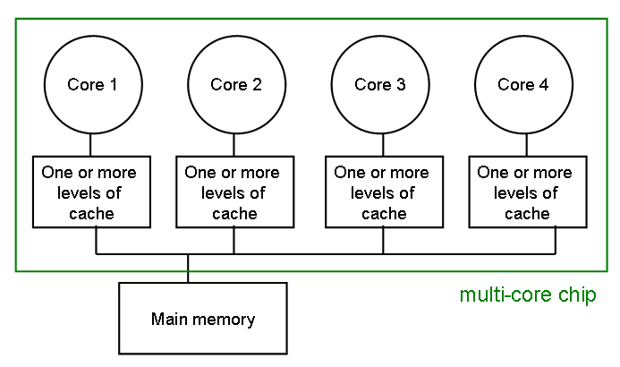
The cache coherence problem
Since we have private caches: How to keep the data consistent across caches?
Each core should perceive the memory as a monolithic array, shared by all the cores
92
Notes:
92

Slide 93
The cache coherence problem
Suppose variable x initially contains 15213
Core 1
Core 2
Core 3
Core 4
One or more levels of cache
One or more levels of cache
One or more levels of cache
One or more levels of cache
multi-core chip
Main memory
x=15213
93
Notes:
93

Slide 94
The cache coherence problem
Core 1 reads x
Core 1
Core 2
Core 3
Core 4
One or more levels of cache
x=15213
One or more levels of cache
One or more levels of cache
One or more levels of cache
multi-core chip
Main memory
x=15213
94
Notes:
94

Slide 95
The cache coherence problem
Core 2 reads x
Core 1
Core 2
Core 3
Core 4
One or more levels of cache
x=15213
One or more levels of cache
x=15213
One or more levels of cache
One or more levels of cache
multi-core chip
Main memory
x=15213
95
Notes:
95

Slide 96
The cache coherence problem
Core 1 writes to x, setting it to 21660
Core 1
Core 2
Core 3
Core 4
One or more levels of cache
x=21660
One or more levels of cache
x=15213
One or more levels of cache
One or more levels of cache
multi-core chip
Main memory
x=21660
assuming write-through caches
96
Notes:
96

Slide 97
The cache coherence problem
Core 2 attempts to read x… gets a stale copy
Core 1
Core 2
Core 3
Core 4
One or more levels of cache
x=21660
One or more levels of cache
x=15213
One or more levels of cache
One or more levels of cache
multi-core chip
Main memory
x=21660
97
Notes:
97

Slide 98
Reduce Miss Rate
98
Notes:
98

Slide 99
Reducing Misses (3 Cs)
Classifying Misses: 3 Cs
Compulsory—The first access to a block is not in the cache, so the block must be brought into the cache. These are also called cold start misses or first reference misses. (Misses even in infinite size cache)
Capacity—If the cache cannot contain all the blocks needed during the execution of a program, capacity misses will occur due to blocks being discarded and later retrieved. (Misses due to size of cache)
Conflict—If the block-placement strategy is not fully associative, conflict misses (in addition to compulsory and capacity misses) will occur because a block can be discarded and later retrieved if too many blocks map to its set. These are also called collision misses or interference misses. (Misses due to associativity and size of cache)
99
Notes:
99

Slide 100
3Cs Absolute Miss Rates
2:1 cache rule: The miss rate of a direct mapped cache of size N is about the same as a 2-way set associative cache of size N/2.
0.14
1-way
0.12
Conflict
2-way
0.1
4-way
0.08
Miss Rate per Type
8-way
0.06
Capacity
0.04
0.02
0
1
2
4
8
16
32
64
128
2:1 cache rule
Cache Size (KB)
Compulsory
100

Slide 101
3Cs Relative Miss Rate
100%
1-way
80%
Conflict
2-way
4-way
60%
8-way
Miss Rate per Type
40%
Capacity
20%
0%
1
2
4
8
16
32
64
128
Compulsory
Cache Size (KB)
101
Notes:
101

Slide 102
How to Reduce the 3 Cs Cache Misses?
Increase Block Size
Increase Associativity
Use a Victim Cache
Use a Pseudo Associative Cache
Hardware Prefetching
102
Notes:
102

Slide 103
1. Increase Block Size
One way to reduce the miss rate is to increase the block size
Take advantage of spatial locality
Reduce compulsory misses
However, larger blocks have disadvantages
May increase the miss penalty (need to get more data)
May increase hit time
May increase conflict misses (smaller number of block frames)
Increasing the block size can help, but don’t overdo it.
103

Slide 104
1. Reduce Misses via Larger Block Size
Cache Size (bytes)
25%
20%
1K
4K
15%
Miss
16K
Rate
10%
64K
5%
256K
0%
16
32
64
128
256
Block Size (bytes)
104
Notes:
104

Slide 105
2. Reduce Misses via Higher Associativity
105
Increasing associativity helps reduce conflict misses (8-way should be good enough)
2:1 Cache Rule:
The miss rate of a direct mapped cache of size N is about equal to the miss rate of a 2-way set associative cache of size N/2
Disadvantages of higher associativity
Need to do large number of comparisons
Need n-to-1 multiplexor for n-way set associative
Could increase hit time
Hit time for 2-way vs. 1-way external cache +10%, internal + 2%
Notes:
105

Slide 106
Example: Avg. Memory Access Time vs. Associativity
Example: assume CCT = 1.10 for 2-way, 1.12 for 4-way, 1.14 for 8-way vs. CCT=1 of direct mapped.
Cache Size Associativity
(KB) 1-way 2-way 4-way 8-way
1 7.65 6.60 6.22 5.44
2 5.90 4.90 4.62 4.09
4 4.60 3.95 3.57 3.19
8 3.30 3.00 2.87 2.59
16 2.45 2.20 2.12 2.04
32 2.00 1.80 1.77 1.79
64 1.70 1.60 1.57 1.59
128 1.50 1.45 1.42 1.44
(Red means memory access time not improved by higher associativity)
Does not take into account effect of slower clock on rest of program
106
Notes:
106

Slide 107
3. Reducing Misses via Victim Cache
Add a small fully associative victim cache to hold data discarded from the regular cache
When data not found in cache, check victim cache
4-entry victim cache removed 20% to 95% of conflicts for a 4 KB direct mapped data cache
Get access time of direct mapped with reduced miss rate
107
Notes:
107

Slide 108
3. Victim Cache
CPU
Address
Data Data
in out
=?
Tag
Data
Victim Cache
=?
Write buffer
Fully associative, small cache reduces conflict misses without impairing clock rate
Lower level memory
108

Slide 109
4. Reducing Misses via Pseudo-Associativity
How to combine fast hit time of direct mapped cache and the lower conflict misses of 2-way SA cache?
Divide cache: on a miss, check other half of cache to see if there, if so have a pseudo-hit (slow hit).
Usually check other half of cache by flipping the MSB of the index.
Drawbacks
CPU pipeline is hard if hit takes 1 or 2 cycles
Slightly more complex design
Hit Time
Pseudo Hit Time
Miss Penalty
109
Notes:
109

Slide 110
Pseudo Associative Cache
CPU
Address
Data Data
in out
Data
1
1
Tag
=?
3
2
2
=?
Write buffer
Lower level memory
110

Slide 111
5. Hardware Prefetching
Instruction Prefetching
Alpha 21064 fetches 2 blocks on a miss
Extra block placed in stream buffer
On miss check stream buffer
Works with data blocks too:
1 data stream buffer gets 25% misses from 4KB DM cache; 4 streams get 43%
For scientific programs: 8 streams got 50% to 70% of misses from 2 64KB, 4-way set associative caches
Prefetching relies on having extra memory bandwidth that can be used without penalty
111

Slide 112
Summary
3 Cs: Compulsory, Capacity, Conflict Misses
Reducing Miss Rate
1. Larger Block Size
2. Higher Associativity
3. Victim Cache
4. Pseudo-Associativity
5. HW Prefetching Instr, Data
112

Slide 113
Pros and cons – Re-visit cache design choices
Larger cache block size
Pros
Reduces miss rate
Cons
Increases miss penalty
Important factors deciding cache performance: hit time, miss rate, miss penalty
113

Slide 114
Pros and cons – Re-visit cache design choices
Bigger cache
Pros
Reduces miss rate
Cons
May increases hit time
My increase cost and power consumption
114

Slide 115
Pros and cons – Re-visit cache design choices
Higher associativity
Pros
Reduces miss rate
Cons
Increases hit time
115

Slide 116
Pros and cons – Re-visit cache design choices
Multiple levels of caches
Pros
Reduces miss penalty
Cons
Increases cost and power consumption
116

Slide 117
Multilevel Cache Design Considerations
Design considerations for L1 and L2 caches are very different
Primary cache should focus on minimizing hit time in support of a shorter clock cycle
Smaller cache with smaller block sizes
Secondary cache (s) should focus on reducing miss rate to reduce the penalty of long main memory access times
Larger cache with larger block sizes and/or higher associativity

Slide 118
Key Cache Design Parameters
 | L1 typical | L2 typical
Total size (blocks) | 250 to 2000 | 4000 to 250,000
Total size (KB) | 16 to 64 | 500 to 8000
Block size (B) | 32 to 64 | 32 to 128
Miss penalty (clocks) | 10 to 25 | 100 to 1000
Miss rates (global for L2) | 2% to 5% | 0.1% to 2%

Slide 119
Reducing Miss rate with programming
Examples:
cold cache, 4-byte words, 4-word cache blocks
j=0
i=0
int sumarraycols(int a[M][N])
{
int i, j, sum = 0;
for (j = 0; j < N; j++)
for (i = 0; i < M; i++)
sum += a[i][j];
return sum;
}
Miss rate =
～ 100%
j=0
i=0
int sumarrayrows(int a[M][N])
{
int i, j, sum = 0;
for (i = 0; i < M; i++)
for (j = 0; j < N; j++)
sum += a[i][j];
return sum;
}
Miss rate =
～1/N

Slide 120
Reducing Miss Penalty
120
Notes:
120

Slide 121
The cost of a cache miss
For a memory access, assume:
1 clock cycle to send address to memory
25 clock cycles for each DRAM access (clock cycle 2ns, 50 ns access time)
1 clock cycle to send each resulting data word
This actually depends on the bus speed
Miss access time (4-word block)
4 x (Address + access + sending data word)
4 x (1 + 25 + 1) = 108 = 108 cycles for each miss
121
Notes:
121

Slide 122
Memory Interleaving
4 bytes
4 bytes
Interleaving
Default
CPU
CPU
Begin accessing one word, and while waiting, start accessing other three words (pipelining)
Bus
Must finish accessing one word before starting the next access
Bus
Cache
Cache
Bus
(1+25+1)x4 = 108 cycles
1
25
1
1
25
1
1
25
1
Memory
1
25
1
30 cycles
Bus
Bus
Bus
Bus
Requires 4 separate memories, each 1/4 size
Memory₃
Memory₂
Memory₁
Memory₀
Interleaving works perfectly with caches
Spread out addresses among the memories
Sophisticated DRAMs provide support for this
122
Notes:
122

Slide 123
Memory Interleaving: An Example
Given the following system parameters with single cache level L₁:
Block size=1 word Memory bus width=1 word Miss rate =3% Miss penalty=27 cycles
(1 cycle to send address 25 cycles access time/word, 1 cycle to send a word)
Memory access/instruction = 1.2 Ideal CPI (ignoring cache misses) = 2
Miss rate (block size=2 words) = 2% Miss rate (block size=4 words) =1%
The CPI of the base machine with 1-word blocks = 2+(1.2 x 0.03 x 27) = 2.97
Increasing the block size to two words gives the following CPI:
32-bit bus and memory, no interleaving = 2 + (1.2 x .02 x 2 x 27) = 3.29
32-bit bus and memory, interleaved = 2 + (1.2 x .02 x (28)) = 2.67
Increasing the block size to four words; resulting CPI:
32-bit bus and memory, no interleaving = 2 + (1.2 x 0.01 x 4 x 27) = 3.29
32-bit bus and memory, interleaved = 2 + (1.2 x 0.01 x (30)) = 2.36
123

Slide 124
Summary
Interleaving
Multiple levels of caches
Other advanced techniques…
124

Slide 125
Cache Optimization
Six basic cache optimizations:
Larger block size
Reduces compulsory misses
Increases capacity and conflict misses, increases miss penalty
Larger total cache capacity to reduce miss rate
Increases hit time, increases power consumption
Higher associativity
Reduces conflict misses
Increases hit time, increases power consumption
Higher number of cache levels
Reduces overall memory access time
Giving priority to read misses over writes
Reduces miss penalty
Avoiding address translation in cache indexing
Reduces hit time

Slide 126
Ten Advanced Optimizations
Small and simple first level caches
Critical timing path:
addressing tag memory, then
comparing tags, then
selecting correct set
Direct-mapped caches can overlap tag compare and transmission of data
Lower associativity reduces power because fewer cache lines are accessed

Slide 127
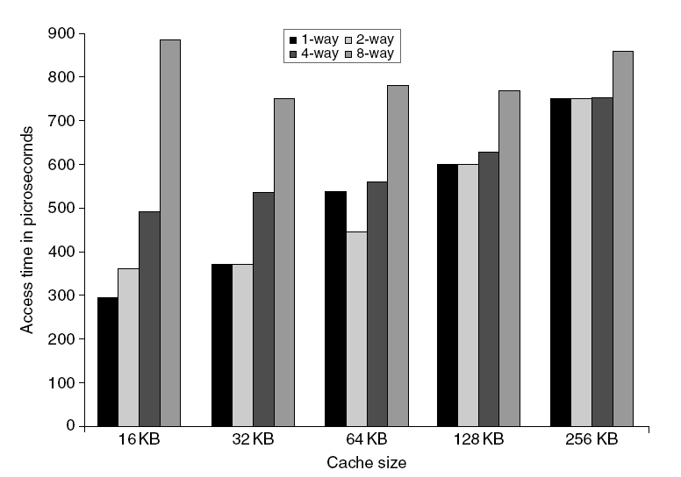
L1 Size and Associativity
Access time vs. size and associativity

Slide 128
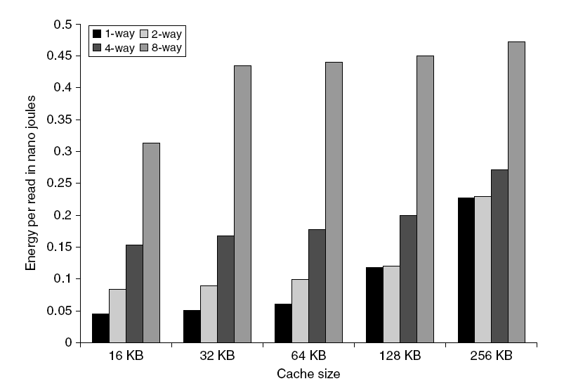
L1 Size and Associativity
Energy per read vs. size and associativity

Slide 129
Way Prediction
To improve hit time, predict the way to pre-set mux
Mis-prediction gives longer hit time
Prediction accuracy
> 90% for two-way
> 80% for four-way
I-cache has better accuracy than D-cache
First used on MIPS R10000 in mid-90s
Used on ARM Cortex-A8
Extend to predict block as well
“Way selection”
Increases mis-prediction penalty

Slide 130
Pipelining Cache
Pipeline cache access to improve bandwidth
Examples:
Pentium: 1 cycle
Pentium Pro – Pentium III: 2 cycles
Pentium 4 – Core i7: 4 cycles
Increases branch mis-prediction penalty
Makes it easier to increase associativity

Slide 131
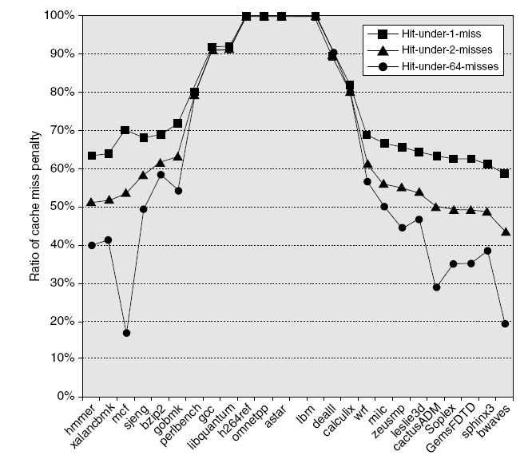
Nonblocking Caches
Allow hits before previous misses complete
“Hit under miss”
“Hit under multiple miss”
L2 must support this
In general, processors can hide L1 miss penalty but not L2 miss penalty

Slide 132
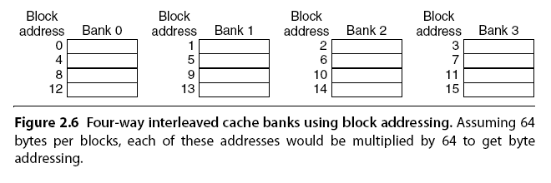
Multibanked Caches
Organize cache as independent banks to support simultaneous access
ARM Cortex-A8 supports 1-4 banks for L2
Intel i7 supports 4 banks for L1 and 8 banks for L2
Interleave banks according to block address

Slide 133
Critical Word First, Early Restart
Critical word first
Request missed word from memory first
Send it to the processor as soon as it arrives
Early restart
Request words in normal order
Send missed work to the processor as soon as it arrives
Effectiveness of these strategies depends on block size and likelihood of another access to the portion of the block that has not yet been fetched

Slide 134
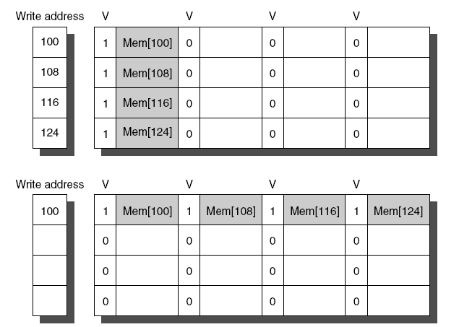
Merging Write Buffer
When storing to a block that is already pending in the write buffer, update write buffer
Reduces stalls due to full write buffer
Do not apply to I/O addresses
No write buffering
Write buffering

Slide 135
Compiler Optimizations
Loop Interchange
Swap nested loops to access memory in sequential order
Blocking
Instead of accessing entire rows or columns, subdivide matrices into blocks
Requires more memory accesses but improves locality of accesses

Slide 136
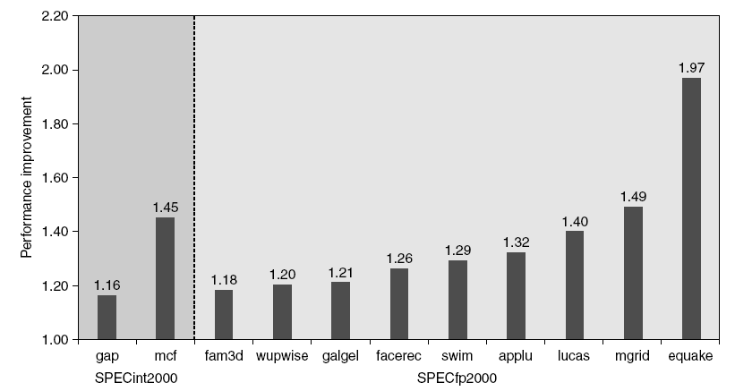
Hardware Prefetching
Fetch two blocks on miss (include next sequential block)
Pentium 4 Pre-fetching

Slide 137
Compiler Prefetching
Insert prefetch instructions before data is needed
Non-faulting: prefetch doesn’t cause exceptions
Register prefetch
Loads data into register
Cache prefetch
Loads data into cache
Combine with loop unrolling and software pipelining

Slide 138
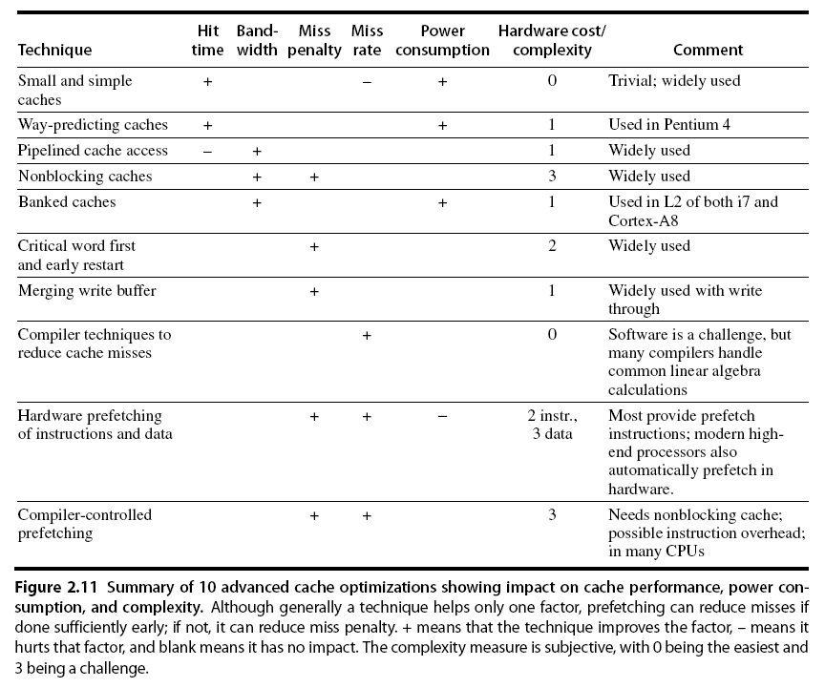
Summary

