Slide 1
Instruction Set Architecture
IA-64 and Compiler Support for Computer Architectures

Slide 2
Modern RISC processors
Complexity has nonetheless increased significantly
Superscalar execution (where CPU has multiple functional units of the same type e.g. two add units) require complex circuitry to control scheduling of operations
What if we could remove the scheduling complexity by using a smart compiler…?

Slide 3
EPIC and IA-64

Slide 4
VLIW & EPIC
VLIW – very long instruction word
Idea: pack a number of non- interdependent operations into one long instruction
Strong emphasis on compilers to schedule instructions
Natural successor to RISC – designed to avoid the need for complex scheduling in RISC designs
Example: IA-64
Instr 1
Instr 2
Instr 3
3 instructions scheduled
into one long instruction word

Slide 5
IA- 64: The Itanium Processor
A radical departure from the traditional paradigms.
Intel and Hewlett-Packard Co. designed a new architecture, IA-64, that they expected to be much more effective at executing instructions in parallel
IA-64 is brand new ISA, derived from EPIC (Explicitly Parallel Instruction Computing)

Slide 6
IA - 64
64-bit ISA
Instructions are scheduled by the compiler, not by the hardware
Much of the logic that groups, schedules, and tracks instructions is not needed thus simplifying the circuitry and promising to improve performance

Slide 7
Intel IA-64
Massive resources
  128 GPRs (64-bit not including the NaT/Not a Thing bit)
  128 FPRs (82-bit)
  64 predicate registers
  Also has branch registers for indirect branches
Contrast to:
  RISC: 32 int, 32 FP, handful of control regs
  x86: 8 int, 8 fp, handful of control regs
    x86-64 bumps this to 16, SSE adds 8/16 MM regs

Slide 8
IA-64 Registers

Slide 9
IA-64 Groups
Compiler assembles groups of instructions
  No register data dependencies between instructions in the same group
    Memory dependence may exist
  Compiler explicitly inserts “stops” to mark the end of a group
  Group can be arbitrarily long

Slide 10
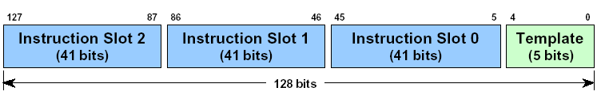
IA-64 Bundles
Bundle == The “VLIW” Instruction
  5-bit template encoding
    also encodes “stops”
  Three 41-bit instructions
  Bundles can be connected together and executed simultaneously
128 bits per bundle
  average of 5.33 bytes per instruction
    x86 only needs 3 bytes on average

Slide 11
Instruction Types
Instructions are divided into different types
  the type determines which functional units the instruction operates on
  templates are based on these types

Slide 12
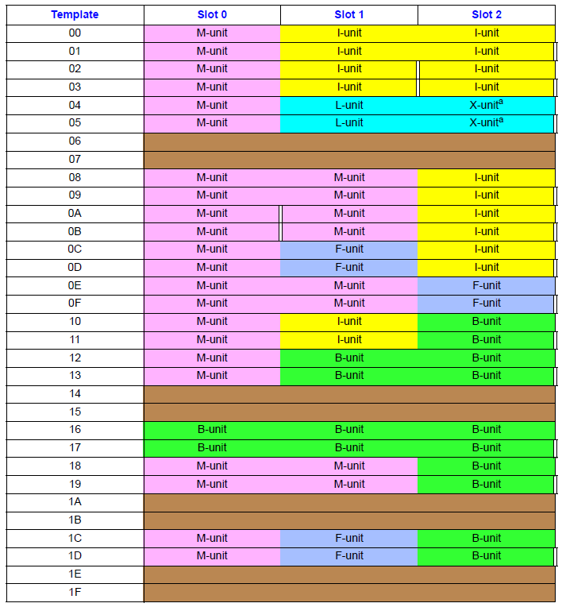
Bundle Templates
Not all combinations of A, I, M, F, B, L and X are permitted
Group “stops” are explicitly encoded as part of the template
  can’t stop just anywhere
Some bundles identical
except for group stop

Slide 13
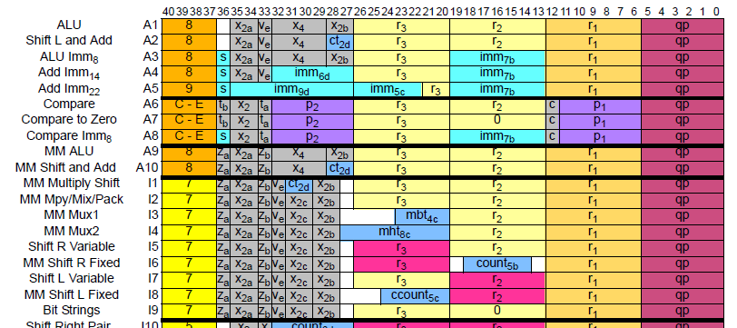
Individual Instruction Formats
Fairly RISC-like like
  easy to decode, fields tend to stay put

Slide 14
Explicitly Parallel Instruction Computing (EPIC)
S2
S1
S0
T
128-bit instruction bundles from I-cache
Fetch one or more bundles for execution
(Implementation, Itanium® takes two.)
Processor
Try to execute all instructions in
parallel, depending on available units.
functional units
MEM
MEM
MEM
MEM
INT
INT
INT
INT
FP
FP
FP
FP
B
B
B
B
B
B
Retired instruction bundles
Notes:
How are instructions executed by the machine.
The goal is to schedule bundles so that most of the excution units have work to do.
Itanium(Merced) pulls in 2 bundles at a time and tries to execute them.
Subsequent implementation will have more execution units

Slide 15
The Role of Compilers

Slide 16
Compiler and ISA
ISA decisions are no longer just for programming in assembly languages (AL) easily
With HLLs, ISA is a compiler target today
Performance of a computer will be significantly affected by compilers
Understanding the compiler technology today is critical to designing and efficiently implementing an instruction set
Architectural choices affect the code quality and the complexity of building a compiler for it

Slide 17
Goal of the Compiler
Primary goal is correctness
Second goal is speed of the object code
Others:
  Speed of the compilation
  Ease of providing debug support
  Inter-operability among languages
  Flexibility of the implementation - languages may not change much but they do evolve - e. g. Fortran 66 ===> HPF
Make the common cases fast and the rare cases correct

Slide 18
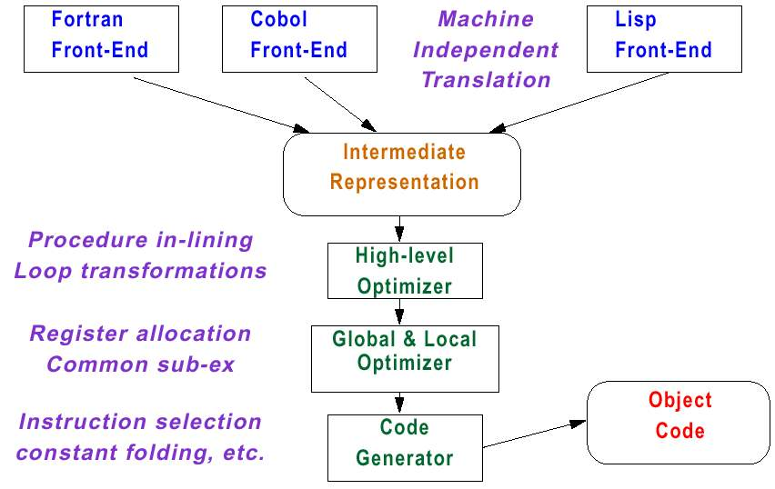
Typical Modern Compiler Structure
Common Intermediate Representation
Somewhat language dependent
Largely machine independent
Moderately language dependent
Slightly machine dependent
Language independent
Highly machine dependent

Slide 19
Optimization Types
High level - done at source code level
  E.g., procedure called only once - so put it in-line and save CALL
Local - done on a basic block (straight-line code)
  Common sub-expressions produce same value
  Constant propagation - replace constant valued variable with the constant - saves multiple variable accesses with same value
Global - same as local but done across branches
  Code motion - remove code from loops that compute same value on each pass and put it before the loop
  Simplify or eliminate array addressing calculations in loop

Slide 20
Optimization Types (Cont.)
Register allocation
  Use graph coloring (graph theory) to allocate registers
    NP-complete
    Heuristic algorithm works best when there are at least 16 (and preferably more) registers
Processor-dependent optimization
  Strength reduction: replace multiply with shift and add sequence
  Pipeline scheduling: reorder instructions to minimize pipeline stalls
  Branch offset optimization: Reorder code to minimize branch offsets

Slide 21
Strength reduction
Example:
for (j = 0; j = n; ++j)
A[j] = 2*j;
for (i = 0; 4*i <= n; ++i)
A[4*i] = 0;
An optimizing compiler can replace multiplication by 4 by addition of 4.

Slide 22
Constant propagation
a:= 5;
...
// no change to a so far.
if (a > b)
{
. . .
}
The statement (a > b) can be replaced by (5 > b). This could free a register when the comparison is executed.
When applied systematically, constant propagation can improve the code significantly.

Slide 23
Register Allocation
One the most important optimizations
Based on graph coloring techniques
  Construct graph based on the liveness of registers
    Use a vertex to represent a variable,
    Add an edge between two vertices if the two corresponding variables are live at the same time
  If there are k registers, use k-coloring to allocate registers
  Goal is to achieve 100% register allocation for all active variables.
  Graph coloring works best when there are at least 16 general-purpose registers available for integers and more for floating-point variables.

Slide 24
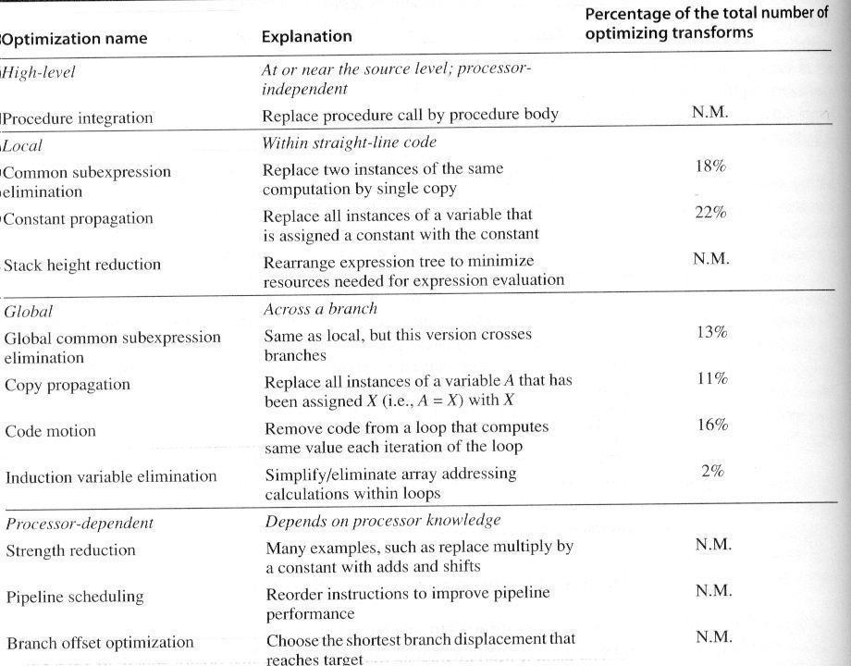
Major Types of Optimizations and Examples

Slide 25
Practice Makes Perfection
gcc optimization flags “-O1, -O2, -O3”
  “-O0” turns off optimization
  Example: gcc –O3 –o <out_file> <in_file>
Examine the binary
  objdump –D <executable or obj file>
  View the output: “less <file>”
Write a program, and see the difference with different optimization flags

Slide 26
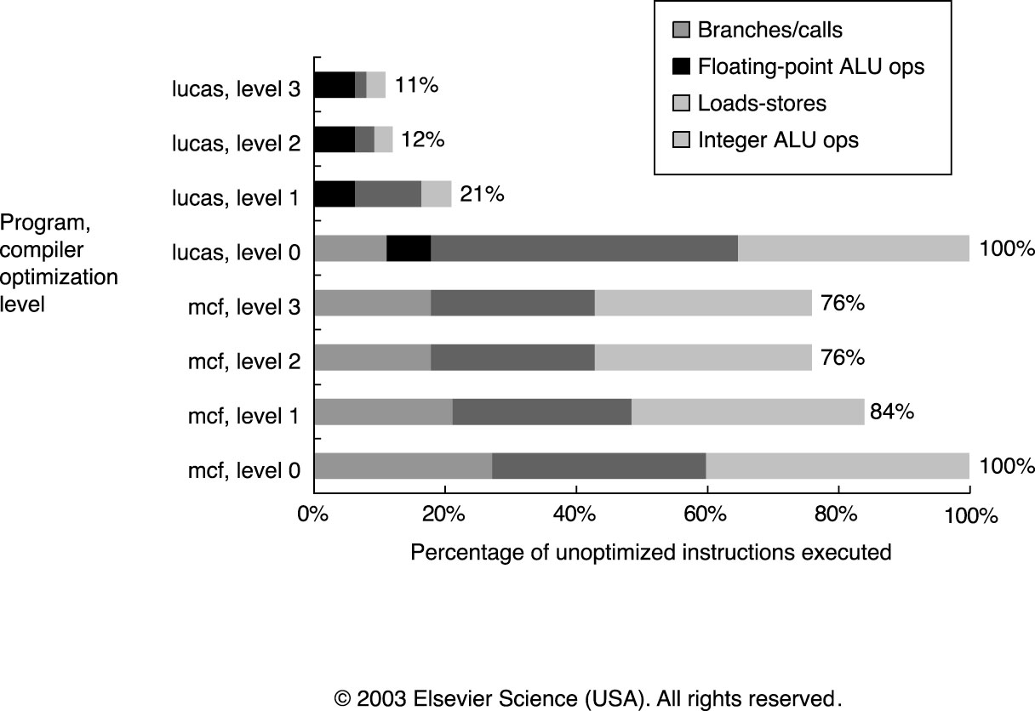
Change in IC Due to Optimization
Level 1: local optimizations, code scheduling, and local register allocation
Level 2: global optimization, loop transformation (software pipelining), global register allocation
Level 3: + procedure integration

Slide 27
How can Architects Help Compiler Writers
Provide Regularity
  Addressing modes, operations, and data types should be orthogonal (independent) of each other
    Simplify code generation especially multi-pass
    Counterexample: restrict what registers can be used for a certain class of instructions
Provide primitives - not solutions
  Special features that match an HLL construct are often un-usable
  What works in one language may be detrimental to others

Slide 28
How can Architects Help Compiler Writers (Cont.)
Simplify trade-offs among alternatives
  How to write good code? What is a good code?
    Metric: IC or code size (no longer true) →caches and pipeline…
  Anything that makes code’s performance easier to estimate
    How many times a variable should be referenced before it is cheaper to load it into a register
Provide instructions that bind the quantities known at compile time as constants
  Don’t hide compile time constants
    Instructions which work off of something that the compiler thinks could be a run-time determined value hand-cuff the optimizer

Slide 29
Short Summary -- Compilers
ISA has at least 16 GPRs (not counting FP registers) to simplify allocation of registers using graph coloring
Orthogonality suggests all supported addressing modes apply to all instructions that transfer data
Simplicity – understand that less is more in ISA design
  Provide primitives instead of solutions
  Simplify trade-offs between alternatives
  Don’t bind constants at runtime

