Slide 1
Pipeline Hazards

Slide 2
Register File/Structural Hazards
Time (clock cycles)
Cycle 1
Cycle 2
Cycle 3
Cycle 4
Cycle 5
Cycle 6
Cycle 7
Operation on register set
by 2 different instructions
in the same clock cycle
I
n
s
t
r.
O
r
d
e
r
Load
Ifetch
Reg
ALU
DMem
Reg
Instr 1
Ifetch
Reg
ALU
DMem
Reg
Instr 2
Ifetch
Reg
ALU
DMem
Reg
Instr 3
Ifetch
Reg
ALU
DMem
Reg
Instr 4
Ifetch
Reg
ALU
DMem
Reg

Slide 3
Register File/Structural Hazards
Time (clock cycles)
Cycle 1
Cycle 2
Cycle 3
Cycle 4
Cycle 5
Cycle 6
Cycle 7
I
n
s
t
r.
O
r
d
e
r
Load
Ifetch
Reg
ALU
DMem
Reg
Instr 1
Ifetch
Reg
ALU
DMem
Reg
Instr 2
Ifetch
Reg
ALU
DMem
Reg
Instr 3
Ifetch
Reg
ALU
DMem
Reg
3 stalls cycles
We need 3 stall cycles
In order to solve this hazard
Instr 4
Ifetch
Reg
ALU
DMem
Reg

Slide 4
Pipelining is Not That Easy for Computers
Limits to pipelining: Hazards prevent next instruction from executing during its designated clock cycle
Structural hazards: Arise from hardware resource conflicts when the available hardware cannot support all possible combinations of instructions.
Data hazards: Arise when an instruction depends on the results of a previous instruction in a way that is exposed by the overlapping of instructions in the pipeline
Control hazards: Arise from the pipelining of conditional branches and other instructions that change the PC
A possible solution is to “stall” the pipeline until the hazard is resolved, inserting one or more “bubbles” in the pipeline
You can always resolve pipeline hazards by waiting

Slide 5
Stalling for Data Hazards
Operation
First instruction progresses unimpeded
Second waits in ID until first hits WB (2 stall cycles)
Third waits in IF until second allowed to progress
IF
ID
EX
M
WB
add r1, 63, r0
r1
add r2, 0, r1
r2
IF
ID
ID
ID
EX
M
WB
r3
IF
IF
IF
ID
EX
M
WB
add r3, 0, r1
r4
IF
ID
EX
M
WB
add r4, 0, r1
r5
IF
ID
EX
M
WB
add r5, 0, r1
r1 written
Time

Slide 6
Structural Hazards
In pipelined processors, overlapped instruction execution requires pipelining of functional units and duplication of resources to allow all possible combinations of instructions in the pipeline.
If a resource conflict arises due to a hardware resource being required by more than one instruction in a single cycle, and one or more such instructions cannot be accommodated, a structural hazard has occurred, for example:
when a machine has only one register file write port
or when a pipelined machine has a shared single-memory pipeline for data and instructions.

Slide 7
Register File/Structural Hazards
Allow writing registers in first ½ of cycle and reading in 2nd ½ of cycle
Time (clock cycles)
Cycle 1
Cycle 2
Cycle 3
Cycle 4
Cycle 5
Cycle 6
Cycle 7
No stalls are required
I
n
s
t
r.
O
r
d
e
r
Load
Ifetch
Reg
ALU
DMem
Reg
Instr 1
Ifetch
Reg
ALU
DMem
Reg
Instr 2
Ifetch
Reg
ALU
DMem
Reg
Instr 3
Ifetch
Reg
ALU
DMem
Reg
Instr 4
Ifetch
Reg
ALU
DMem
Reg

Slide 8
1 Memory Port/Structural Hazards
Time (in Cycles)
Operation on Memory
by 2 different instructions
in the same clock cycle
Load
Mem
Reg
ALU
Mem
Reg
Instruction Order
Instruction1
Mem
Reg
ALU
Mem
Reg
Instruction2
Mem
ALU
Mem
Reg
Reg
Instruction3
Mem
ALU
Mem
Reg
Reg
Instruction4
Mem
Mem
Reg
ALU
Reg

Slide 9
Inserting Bubbles (Stalls)
Time (in Cycles)
Load
Mem
Reg
ALU
Mem
Reg
3 stall cycles
with 1-port memory
Instruction1
Mem
Reg
ALU
Mem
Reg
Instruction2
Mem
ALU
Mem
Reg
Reg
Stall
Bubble
Bubble
Bubble
Bubble
Bubble
Stall
Bubble
Bubble
Bubble
Bubble
Bubble
Stall
Bubble
Bubble
Bubble
Bubble
Bubble
Instruction3
Mem
Mem
Reg
ALU
Reg

Slide 10
2 Memory Port/Structural Hazards (Read & Write at the same time)
Time (in Cycles)
Load
Mem
ALU
Mem
No stall with 2-memory
ports
Reg
Reg
Instruction Order
Instruction1
Mem
Reg
ALU
Mem
Reg
Instruction2
Mem
ALU
Mem
Reg
Reg
Instruction3
Mem
ALU
Mem
Reg
Reg
Instruction4
Mem
Mem
Reg
ALU
Reg

Slide 11
Performance of Pipelines with Stalls
Hazards in pipelines may make it necessary to stall the pipeline by one or more cycles, thus degrading performance from the ideal CPI of 1.
CPI pipelined = Ideal CPI + Pipeline stall clock cycles per instruction
If pipelining overhead is ignored and we assume that the stages are perfectly balanced then:
Speedup = CPI unpipelined/(1+Pipeline stall cycles per instruction)
When all instructions take the same number of cycles and is equal to the number of pipeline stages then:
Speedup = Pipeline depth/(1+ Pipeline stall cycles per instruction)

Slide 12
Performance of Pipelines with Stalls
If we think of pipelining as improving the effective clock cycle time, then given the the CPI for the unpipelined machine and the CPI of the ideal pipelined machine = 1, then effective speedup of a pipeline with stalls over the unpipelind case is given by:
Speedup = 1 Clock cycles unpiplined
1 + Pipeline stall cycles per instruction Clock cycle pipelined
When pipe stages are balanced with no overhead, the clock cycle for the pipelined machine is smaller by a factor equal to the pipelined depth:
Clock cycle pipelined = clock cycle unpipelined / pipeline depth
Pipeline depth = Clock cycle unpipelined / clock cycle pipelined
Speedup = 1 pipeline depth
1 + pipeline stall cycles per instruction
×
×

Slide 13
Speed Up Equation for Pipelining
Viewpoint: Improving clock cycle time (CPI_{unpipelined} =1).
Pipeline stall cycles per instruction

Slide 14
Speed Up Equation for Pipelining
Viewpoint: Decreasing CPI (ignoring the cycle time overhead of pipelining).

Slide 15
Example: Dual-port vs. Single-port Memory
Machine A: Dual ported memory (0 stalls)
Machine B: Single ported memory (1 stall), but its pipelined implementation has a 1.05 times faster clock rate
Ideal CPI = 1 for both
Loads/stores are 40% of instructions executed
SpeedUp_{A} = (Pipeline Depth/(1 + 0)) x (CycleTime_{unpipe}/CycleTime_{pipe})
= Pipeline Depth
SpeedUp_{B} = Pipeline Depth/(1 + 0.4 x 1) x (CycleTime_{unpipe}/(CycleTime_{unpipe} / 1.05)
= (Pipeline Depth/1.4) x 1.05
= 0.75 x Pipeline Depth
SpeedUp_{A} / SpeedUp_{B} = Pipeline Depth/(0.48 x Pipeline Depth) = 1.33
Machine A is 1.33 times faster

Slide 16
Pipeline Hazards
Hazards reduce the ideal speedup gained from pipelining and are classified into three classes:
Structural hazards: Arise from hardware resource conflicts when the available hardware cannot support all possible combinations of instructions.
Data hazards: Arise when an instruction depends on the results of a previous instruction in a way that is exposed by the overlapping of instructions in the pipeline
Control hazards: Arise from the pipelining of conditional branches and other instructions that change the PC
We can always resolve hazards by waiting

Slide 17
Data Hazard on R1
Time (clock cycles)
IF
ID/RF
EX
MEM
WB
I
n
s
t
r.
O
r
d
e
r
add r1,r2,r3
Reg
Ifetch
Reg
ALU
DMem
sub r4,r1,r3
Ifetch
Reg
ALU
DMem
Reg
and r6,r1,r7
Ifetch
Reg
ALU
DMem
Reg
or r8,r1,r9
Ifetch
Reg
ALU
DMem
Reg
xor r10,r1,r11
Ifetch
Reg
ALU
DMem
Reg

Slide 18
Data Hazard Classification
Given two instructions I, J, with I occurring before J in an instruction stream:
RAW (read after write): A true data dependence
J tried to read a source before I writes to it, so J incorrectly gets the old value.
WAW (write after write): A name dependence
J tries to write an operand before it is written by I
The writes end up being performed in the wrong order.
WAR (write after read): A name dependence
J tries to write to a destination before it is read by I,
so I incorrectly gets the new value.
RAR (read after read): (Usually) not a hazard

Slide 19
Data Hazard Classification
I (Write)
I (Read)
Shared
Operand
Shared
Operand
J (Read)
J (Write)
Read after Write (RAW)
Write after Read (WAR)
I (Write)
I (Read)
Shared
Operand
Shared
Operand
J (Write)
J (Read)
Write after Write (WAW)
Read after Read (RAR) not a hazard

Slide 20
Data Hazards Present in Current MIPS Pipeline
Read after Write (RAW) Hazards: Possible?
Caused by a “Dependence” (in compiler nomenclature). This hazard results from an actual need for communication.
Yes possible, when an instruction requires an operand generated by a preceding instruction with distance less than four.
Resolved by:
Forwarding or Stalling.
I: add r1,r2,r3
J: sub r4,r1,r3
Write
Inst i
1
2
3
4
5
Inst j
1
2
3
4
5
Read
read the old data.

Slide 21
Data Hazards Present in Current MIPS Pipeline
Write After Read (WAR) – not possible Error if Instr_{J} tries to write operand before Instr_{I} reads it
Called an “anti-dependence” by compiler writers. This results from reuse of the name “r1”.
I: sub r4,r1,r3
J: add r1,r2,r3
K: mul r6,r1,r7
Read
Always read the correct data.
Inst i
1
2
3
4
5
Write
Inst j
1
2
3
4
5

Slide 22
Data Hazards Present in Current MIPS Pipeline
Write After Write (WAW) - not possible
Error if Instr_{J} tries to write operand before Instr_{I} writes it.
Called an “output dependence” by compiler writers This also results from the reuse of name “r1”.
I: sub r1,r4,r3
J: add r1,r2,r3
K: mul r6,r1,r7
Write
Inst i
1
2
3
4
5
Inst j
1
2
3
4
5
Write

Slide 23
Data Hazards
Solutions for Data Hazards
Stalling
Forwarding:
connect new value directly to next stage
Reordering, renaming, …

Slide 24
Minimizing Data Hazard Stalls by Forwarding
Forwarding is a hardware-based technique (also called register bypassing or short-circuiting) used to eliminate or minimize data hazard stalls.
Using forwarding hardware, the result of an instruction is copied directly from where it is produced (ALU, memory read port etc.), to where subsequent instructions need it (ALU, input register, memory write port etc.)
Zero?
D/A Buffer
A/M Buffer
M/W Buffer
MUX MUX
ALU
Data
Memory

Slide 25
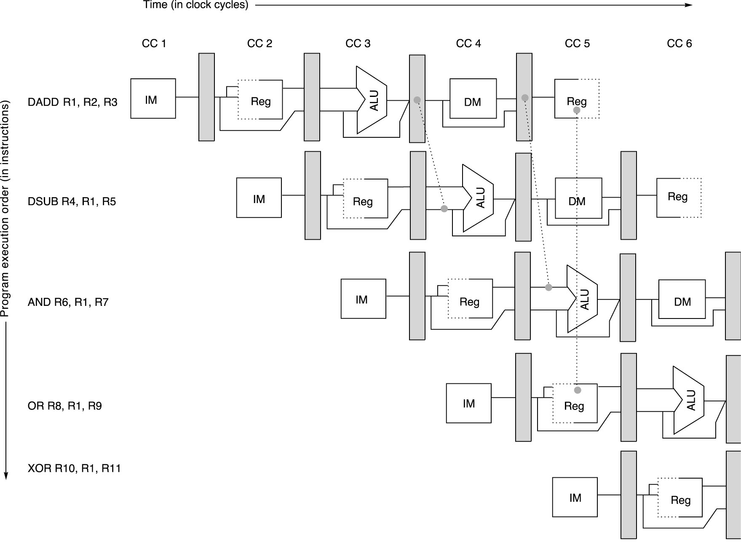
Pipeline with Forwarding:
Could avoid stalls
A set of instructions that depend on the DADD result uses forwarding paths to avoid the data hazard

Slide 26
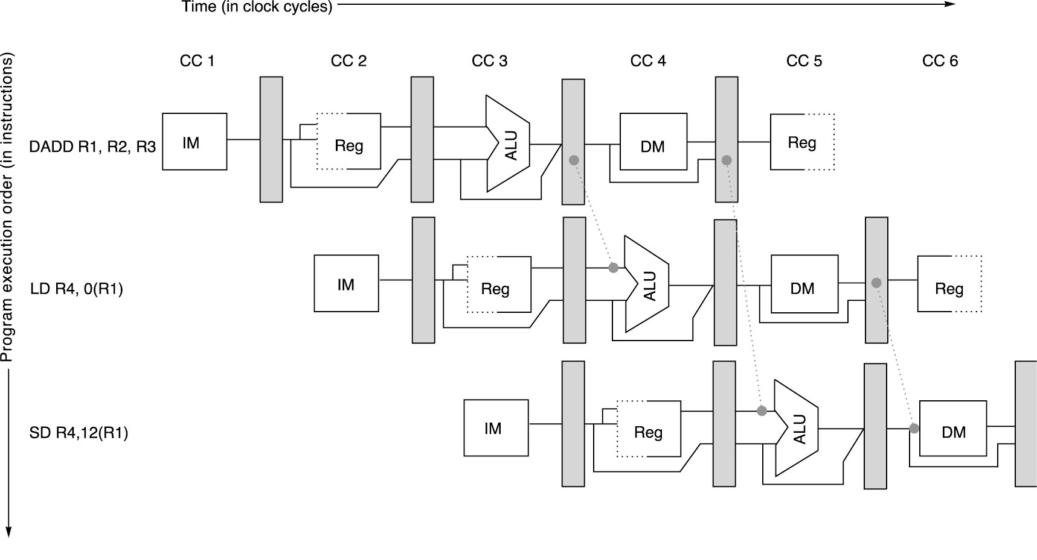
Load/Store Forwarding Example
Forwarding of operand required by stores during MEM

Slide 27
Data Hazards Requiring Stall Cycles
In some code sequence cases, potential data hazards cannot be handled by bypassing. For example:
L.D R1, 0 (R2)
DSUB R4, R1, R5
AND R6, R1, R7
OR R8, R1, R9
The L.D (load double word) instruction has the data in clock cycle 4 (MEM cycle).
The DSUB instruction needs the data of R1 in the beginning of that cycle.
Hazard prevented by hardware pipeline interlock causing a stall cycle.

Slide 28
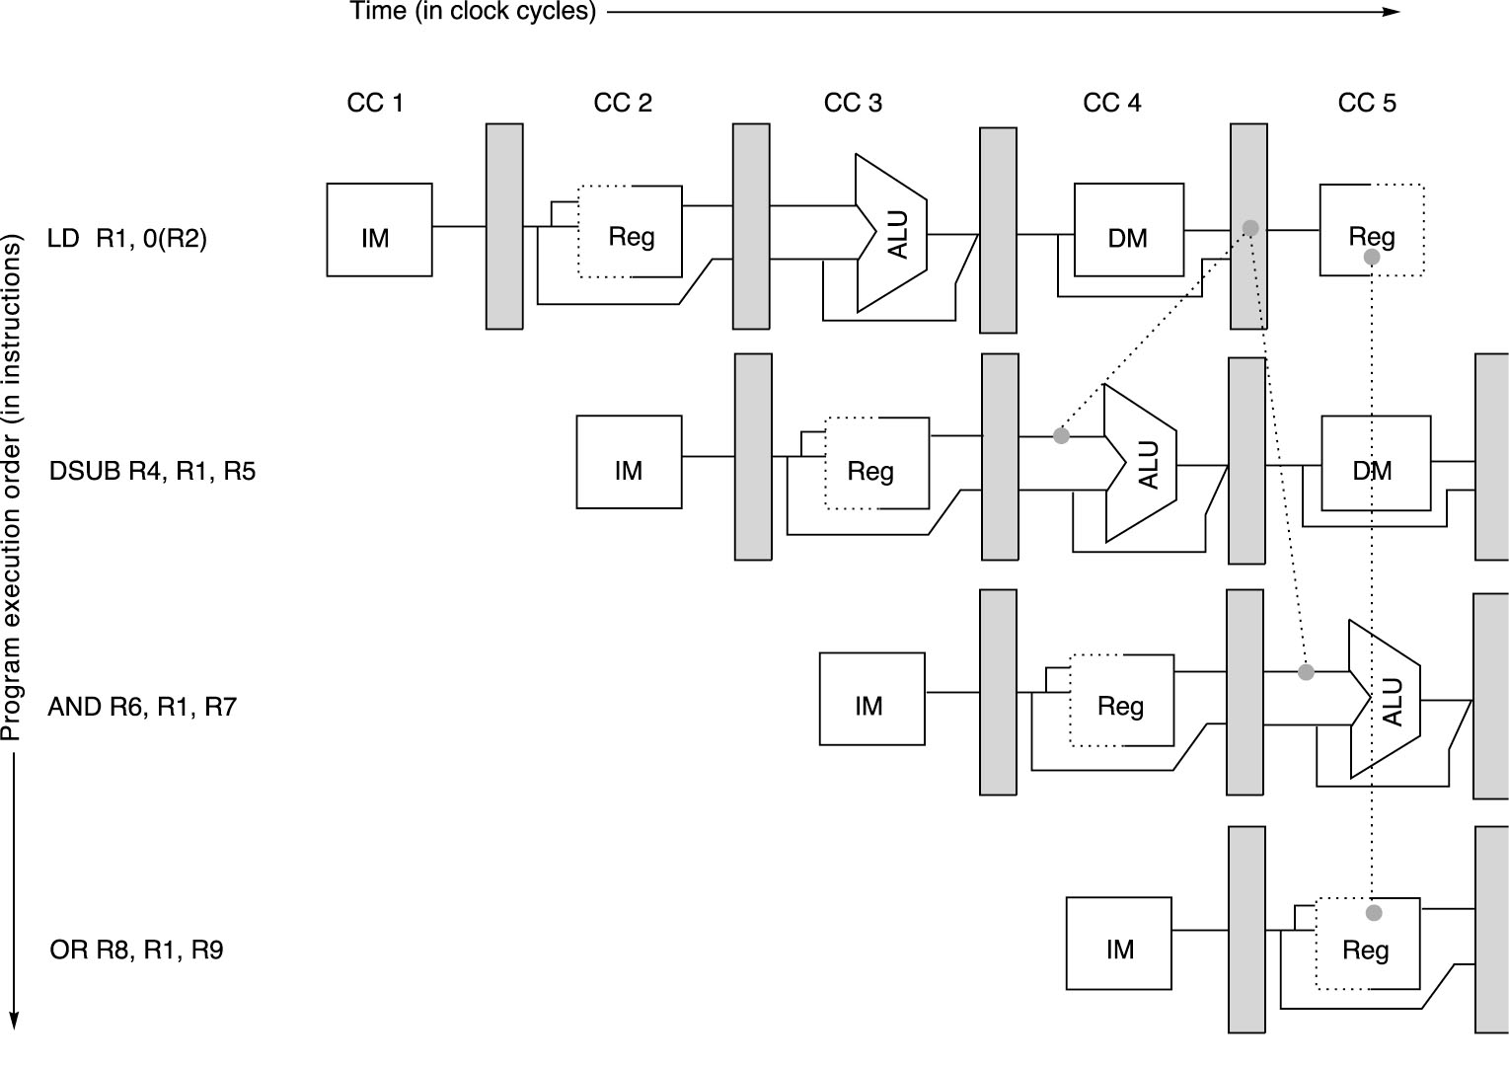
The load instruction can bypass its result to the AND and OR instructions without stalls. But it cannot bypass the result to DSUB without a stall. We cannot forward to “negetive time”.

Slide 29
Data Hazard Even with Forwarding
Time (clock cycles)
I
n
s
t
r.
O
r
d
e
r
lw r1, 0(r2)
IF
Reg
ALU
Mem
Reg
sub r4,r1,r6
Bubble
IF
Reg
ALU
Mem
Reg
Bubble
ALU
and r6,r1,r7
IF
Reg
Mem
Reg
or r8,r1,r9
Bubble
Reg
ALU
Reg
IF
Mem
Notes:
MIPS actutally didn’t interlecok: MPU without Interlocked Pipelined Stages

Slide 30
Compiler Instruction Scheduling Example
For the code sequence:
a = b + c
d = e - f
Assuming a load require a delay of one extra clock cycle before its result is available for the next instruction’s ALU input, the following code or pipeline compiler schedule eliminates stalls:
a, b, c, d ,e, and f
are in memory
Original code with stalls:
LD Rb,b
LD Rc,c
DADD Ra,Rb,Rc
SD Ra,a
LD Re,e
LD Rf,f
DSUB Rd,Re,Rf
SD Rd,d
Scheduled code with no stalls:
LD Rb,b
LD Rc,c
LD Re,e
DADD Ra,Rb,Rc
LD Rf,f
SD Ra,a
DSUB Rd,Re,Rf
SD Rd,d
Stall
Stall

Slide 31
Pipeline Hazards
Hazards reduce the ideal speedup gained from pipelining and are classified into three classes:
Structural hazards: Arise from hardware resource conflicts when the available hardware cannot support all possible combinations of instructions.
Data hazards: Arise when an instruction depends on the results of a previous instruction in a way that is exposed by the overlapping of instructions in the pipeline
Control hazards: Arise from the pipelining of conditional branches and other instructions that change the PC
Can always resolve hazards by waiting

Slide 32
Control Hazards
A control hazard is when we need to find the destination of a branch, and can’t fetch any new instructions until we know that destination.
A branch is either
Taken: PC <= PC + 4 + Immediate
Not Taken: PC <= PC + 4
if (cond) PC ← ALUOutput else PC ← NPC

Slide 33
Control Hazards
When a conditional branch is executed it may change the PC and, without any special measures, leads to stalling the pipeline for a number of cycles until the branch condition is known.
In current MIPS pipeline, the conditional branch is resolved in the MEM stage resulting in three stall cycles as shown below:
Branch instruction IF ID EX MEM WB
Branch successor IF stall stall IF ID EX MEM WB
Branch successor + 1 IF ID EX MEM WB
Branch successor + 2 IF ID EX MEM
Branch successor + 3 IF ID EX
Branch successor + 4 IF ID
Branch successor + 5 IF
Three clock cycles are wasted for every branch for current MIPS pipeline

Slide 34
Control Hazard on Branches: Three-Cycle Stall
If CPI = 1, 30% branch, Stall 3 cycles ==> new CPI = 1.9!
12: beq r1,r3,36
Ifetch
Reg
ALU
DMem
Reg
16: and r2,r3,r5
Ifetch
Reg
ALU
DMem
Reg
20: or r6,r1,r7
Ifetch
Reg
ALU
DMem
Reg
24: add r8,r1,r9
Ifetch
Reg
ALU
DMem
Reg
36: xor r10,r1,r11
Ifetch
Reg
ALU
DMem
Reg

Slide 35
Reducing Branch Stall Cycles
Pipeline hardware measures to reduce branch stall cycles:
1- Find out whether a branch is taken earlier in the pipeline.
2- Compute the taken PC earlier in the pipeline.
In MIPS:
In MIPS branch instructions BEQZ, BNZ, test a register for equality to zero.
This can be completed in the ID cycle by moving the zero test into that cycle.
Both PCs (taken and not taken) must be computed early.
Requires an additional adder because the current ALU is not useable until EX cycle.
This results in just a single cycle stall on branches.

Slide 36
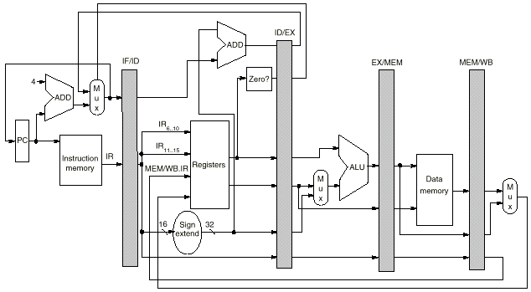
Modified MIPS Pipeline:
Conditional Branches
Completed in ID Stage

Slide 37
Control Hazard - Stall
beq
writes PC
here
new PC
used here

Slide 38
Reducing Branch Penalties
One scheme is to flush or freeze the pipeline whenever a conditional branch is decoded by deleting or holding any instructions in the pipeline until the branch destination is known (zero pipeline registers, control lines).
Another method is to predict that the branch is not taken where the state of the machine is not changed until the branch outcome is definitely known. Execution here continues with the next instruction; stall occurs here when the branch is taken.
Another method is to predict that the branch is taken and begin fetching and executing at the target; stalls occur here if the branch is not taken.

Slide 39
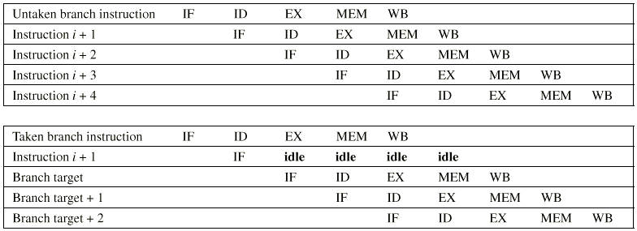
Predict Not-Taken Scheme

Slide 40
Control Hazard - Correct Predict-Taken
Fetch assuming
branch taken

Slide 41
Control Hazard - Incorrect Predict-Taken
“Squashed”
instruction

Slide 42
Canceling Branches
When the branch goes as predicted, the instruction in the branch delay slot is executed normally.
When the branch does not go as predicted the instruction is turned into a no-op.
The effectiveness of this method depends on whether we predict the branch correctly.

Slide 43
Static Compiler Branch Prediction
Two basic methods exist to statically predict branches at compile time:
By examination of program behavior and the use of information collected from earlier runs of the program.
For example, a program profile may show that most branches are taken. The simplest scheme in this case is to just predict the branch as taken
Different branch instructions may have different behavior
To predict branches on the basis of branch direction, choosing backward branches (loop) as taken and forward branches (if) as not taken.

Slide 44
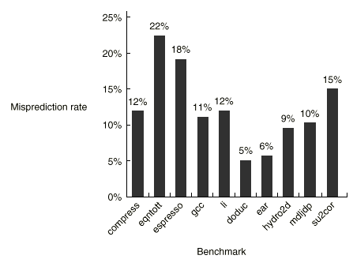

Profile-Based Compiler Branch
Misprediction Rates for SPEC92
FIGURE 2.3

Slide 45
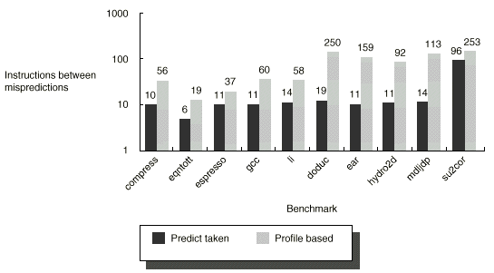
Accuracy of a predict-taken strategy and a profile-based predictor as measured by the number of instructions executed between mispredicted branches and shown on log scale

Slide 46
Pipeline Performance Example
Assume the following MIPS instruction mix:
What is the resulting CPI for the pipelined MIPS with forwarding and branch address calculation in ID stage when using a predict branch not-taken scheme?
CPI = Ideal CPI + Pipeline stall clock cycles per instruction
= 1 + stalls by loads + stalls by branches
= 1 + .3 x .25 x 1 + .2 x .45 x 1
= 1 + .075 + .09
= 1.165
Type Frequency
Arith/Logic 40%
Load 30% of which 25% are followed immediately by
an ALU instruction using the loaded value
Store 10%
branch 20% of which 45% are taken

Slide 47
Dynamic Branch Prediction

Slide 48
Dynamic Branch Prediction
Builds on the premise that history matters
Observe the behavior of branches in previous instances and try to predict future branch behavior
Try to predict the outcome of a branch early on in order to avoid stalls
Branch prediction is critical for multiple issue processors
In an n-issue processor, branches will come n times faster than a single issue processor

Slide 49
Basic Branch Predictor
1-bit predictor: use a 1-bit branch predictor buffer or branch history table
1 bit of memory stating whether the branch was recently taken or not
Bit entry updated each time the branch instruction is executed
T
NT
NT
State 1
Predict
Taken
State 0
Predict
Not Taken
T

Slide 50
Branch-Prediction Buffer
A small (fast) memory indexed by the lower portion of the address of the branch instructions
Essentially a cache with every access being a hit
Maintained by the processor
000
1
0
0
…
1
1
004
008
ff8
PC=1a305ff8: bnz r3, label
ffc
1024-entry branch-prediction buffer indexed by 10 bits bits (12th — 3rd least significant bits)

Slide 51
1-bit Branch Prediction Buffer
Problem – even simplest branches are mispredicted twice
LD R3, #10
Outer_loop:
LD R1, #5
Loop: LD R2, 0(R5)
ADD R2, R2, R4
STORE R2, 0(R5)
ADD R5, R5, #4
SUB R1, R1, #1
BNEZ R1, Loop
SUB R3, R3, #1
BNEZ R3, Outer_loop
First time: prediction = 0 but the branch is taken ⇒ change prediction to 1 miss
Time 2, 3, 4: prediction = 1 and the branch is taken
Time 5: prediction = 1 but the branch is not taken ⇒ change prediction to 0 miss

Slide 52
Limitations of 1-bit Predictors
1 mis-prediction changes the prediction
Only considers the taken/not-taken (T/NT) of the last time
No consideration of the biased distribution of T/NT for branches
Braches are highly biased on T/NT, e.g., one braches prefer T and another prefer NT
Every change of branch outcome is likely to generate two mis-predictions
High mis-prediction rate!
Notes:
52

Slide 53
2-bit Predictors
2-bit scheme ➔ 2 mis-predictions change the prediction
Greatly improve the prediction performance
T
NT
Predict Taken
11
10
T
T
NT
NT
Predict :Not Taken
01
00
T
NT

Slide 54
2-bit Prediction Buffer
How to implement it?
A separate memory (cache)
Bits attached to each instruction cache line
Do we need address tags?
Size of storage needed?
000
11
00
10
…
01
11
004
008
ff8
ffc
PC=1a305ff8: bnz r3, label
1024-entry 2-bit prediction buffer indexed by 10 bits (12th — 3rd least significant bits)

Slide 55
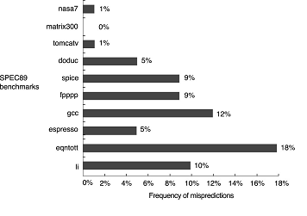
Performance of 2-bit Predictor
4096-entry 2-bit prediction buffer on SPEC89
Misprediction rates average 11% for integer programs and 4% for FP programs.

Slide 56
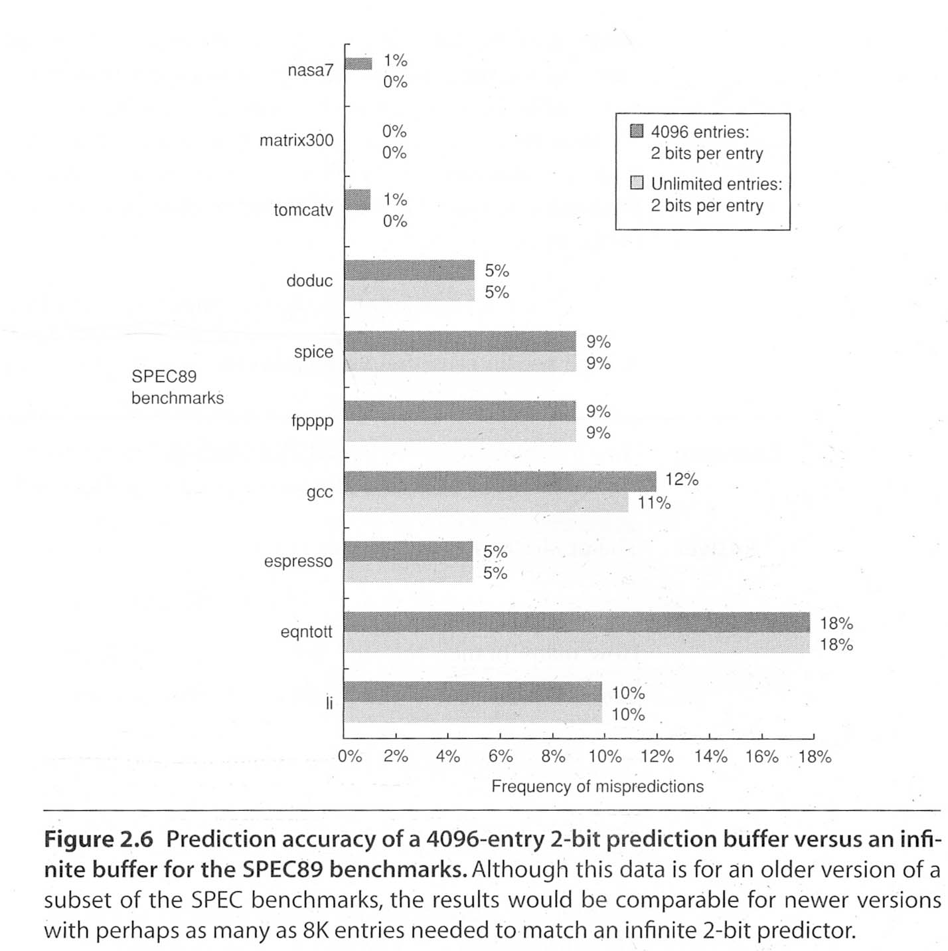
Further improvements?
2-bit to more-bits?
No much help because 2-bit predictor already captures the biased preferences of branches
More entries (unlimited?)
No much help because in run-time there are not so many concurrent branches

Slide 57


Correlating Branch Predictors
You jump, I jump !
--- Jack in Titanic
You jump, I laugh
-- Cartoons
Friends mean a lot.
U cry,
I cry.
U laugh,
I laugh.
U jump,
I laugh, again!
Haha!

Slide 58
Correlating Branch Predictors
Correlated branches
if (a==8) b = 5;
if (a==9) b = 22;
…
if (a==3) a = 0;
if (b==9) b = 0;
if (a!=b) c = 0;
…
We may predict the branch directions based on the outcome of the last few branches

Slide 59
Correlating Branch Predictors
Consider last m branches’ decisions (T or NT)
E.g., m=3
For each pattern of these m prior branches, construct an n-bit predictor
n bits (e.g., 2 bits) for each predictor
Based on the state of the last m branches, and the state of the predictor, make the prediction for the current branch
Current branch’s direction (taken or not taken) will affect the prediction of the next branch
(m,n) pridictor: “To see the last m branches, each predictor has n-bit” (e.g.,m=3,n=2)

Slide 60
Example: m=3, n=2
B1 (0=NT | B2 1=T) | B3
0 | 0 | 0
0 | 0 | 1
0 | 1 | 0
… | … | …
1 | 1 | 0
1 | 1 | 1
2-bit predictor
B1: ...
…
…
...
B2: ...
…
B3: …
…
B4: …
…
NT
T
…
PC=1a305ff8: bnz r3, label

Slide 61
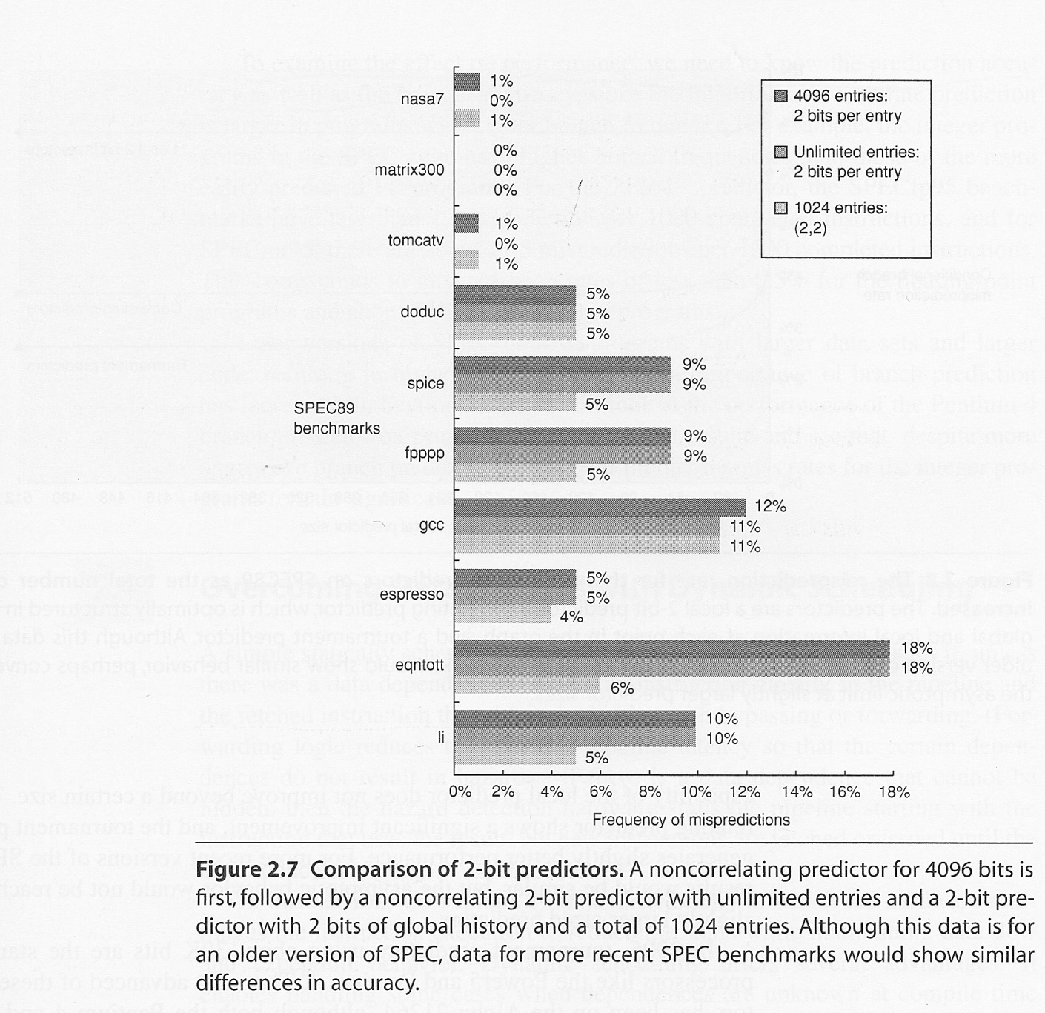
Comparison
(m,n) predictor
It is called global predictor
Original 2-bit predictor is actually (0,2) predictor
It is called local predictor

Slide 62
Storage Size
Given a (m,n) predictor
Each entry has 2^{m} predictors
Each predictor has n-bit
To carry E entries we need, 2^{m}∙n∙E bits

Slide 63
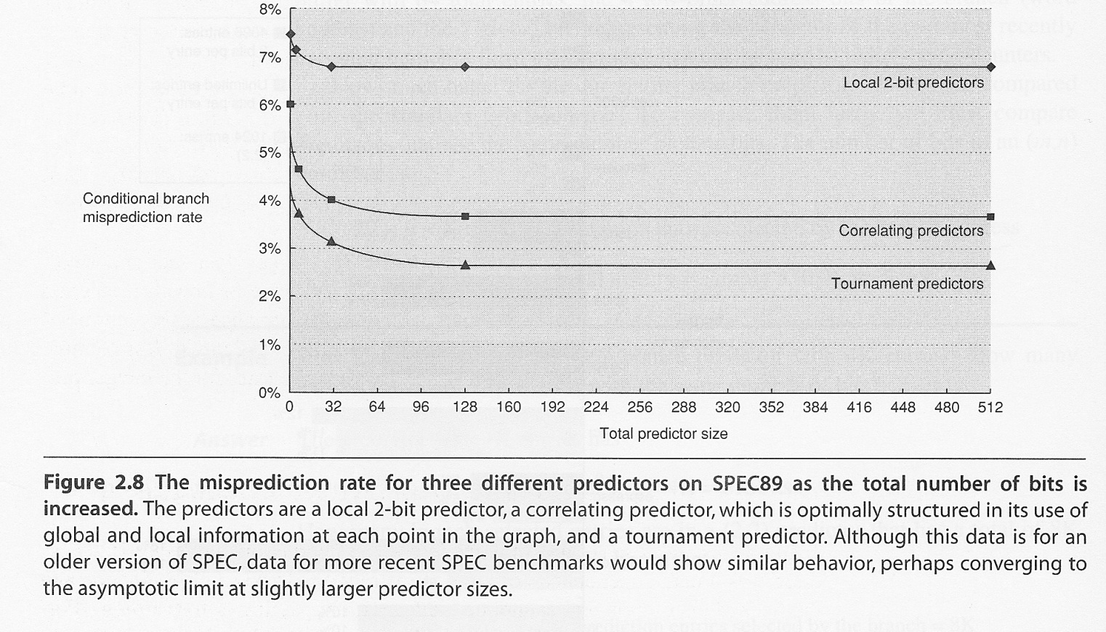
Tournament Predictor
A combination of the local and global predictor
Select the predictor with the best prediction rate
Slightly better
How to implement a tournament predictor?

Slide 64
Tackle Branch Hazards
#1: Stall until branch direction is clear
#2: Determine branch outcome and target earlier
#3: Predict the branch outcome and target
Static branch prediction
Predict Branch Not Taken
Execute successor instructions in sequence
“Squash” instructions in pipeline if branch actually taken
Advantage of late pipeline state update
47% MIPS branches not taken on average
PC+4 already calculated, so use it to get next instruction
Predict Branch Taken
53% MIPS branches taken on average
But haven’t calculated branch target address in MIPS
MIPS still incurs 1 cycle branch penalty
Other machines: branch target known before outcome
Dynamic branch prediction
1-bit predictor, 2-bit predictor
Correlating branch predictor
tournament predictor
#4: Delayed Branch

Slide 65
Reduction of Branch Penalties: Delayed Branch
Define branch to take place AFTER one or more following instruction(s)
branch instruction sequential successor₁ sequential successor₂ ........ sequential successor_{n}
branch target if taken
1 slot delay allows proper decision and branch target address in the 5-stage MIPS pipeline
Requires compiler help
Branch delay of length n

Slide 66
Reduction of Branch Penalties: Delayed Branch
When delayed branch is used, the branch is delayed by n cycles, following this execution pattern:
conditional branch instruction
sequential successor₁
sequential successor₂
……..
sequential successor_{n}
branch target if taken
The sequential successor instruction are said to be in the branch delay slots. These instructions are executed whether or not the branch is taken.

Slide 67
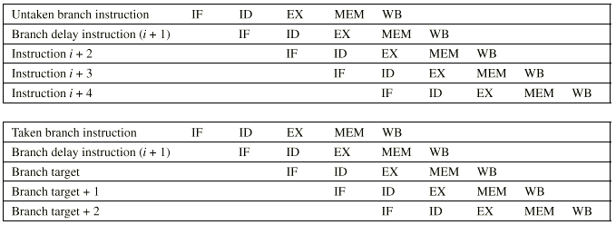
Delayed Branch Example (1-slot)

Slide 68
Reduction of Branch Penalties: Delayed Branch
In practice, almost all machines that utilize delayed branches have a single instruction delay slot.
The job of the compiler is to make the successor instructions valid and useful instructions.
Fills about 60% of branch delay slots
About 80% of instructions executed in branch delay slots useful in computation
About 50% (60% x 80%) of slots usefully filled

Slide 69
Delayed Branch-delay Slot Scheduling Strategies
The branch-delay slot instruction can be chosen from three cases:
An independent instruction from before the branch:
Always improves performance when used. The branch
must not depend on the rescheduled instruction.
An instruction from the target of the branch:
Improves performance if the branch is taken and may require instruction duplication. This instruction must be safe to execute if the branch is not taken.
An instruction from the fall through instruction stream:
Improves performance when the branch is not taken. The instruction must be safe to execute when the branch is taken.

Slide 70
Delayed Branch
Instruction in branch delay slot is always executed
Compiler (tries to) move a useful instruction into delay slot.
From before the Branch: Always helpful when possible
ADD R1, R2, R3
BEQZ R2, L1 BEQZ R2, L1
DELAY SLOT ADD R1, R2, R3
- -
L1: L1:
If the ADD instruction were: ADD R2, R1, R3 the move would not be possible

Slide 71
Delayed Branch
(b) From the Target: Helps when branch is taken. May duplicate instructions
ADD R2, R1, R3 ADD R2, R1, R3
BEQZ R2, L1 BEQZ R2, L2
DELAY SLOT SUB R4, R5, R6
- -
L1: SUB R4, R5, R6 L1: SUB R4, R5, R6
L2: L2:
Instructions between BEQZ and SUB (in fall through) must not use R4.

Slide 72
Delayed Branch
( c ) From Fall Through: Helps when branch is not taken.
ADD R2, R1, R3 ADD R2, R1, R3
BEQZ R2, L1 BEQZ R2, L1
DELAY SLOT SUB R4, R5, R6
SUB R4, R5, R6 -
-
L1: L1:
Instructions at target (L1 and after) must not use R4 till set again.
Cancelling (Nullifying) Branch:
Branch instruction indicates direction of prediction.
If mispredicted the instruction in the delay slot is cancelled.
Greater flexibility for compiler to schedule instructions.

Slide 73
Branch-delay Slot: Canceling Branches
In a canceling branch, a static compiler branch direction prediction is included with the branch-delay slot instruction.
When the branch goes as the compiler expects, the instruction in the branch delay slot is executed normally.
When the branch does not go as expected the instruction is turned into a no-op.
Canceling branches eliminate the conditions on instruction selection in delay instruction strategies B, C
The effectiveness of this method depends on whether we predict the branch correctly.
In practice 50% of time, we have no stalls (nop).

Slide 74
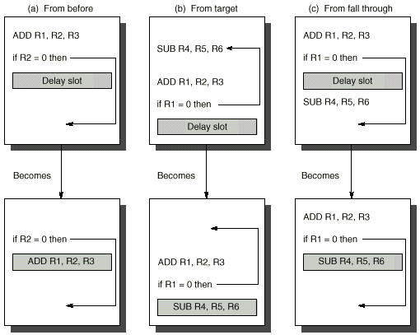
(A)
(B)
(C)

Slide 75
Performance of Branch Schemes
The effective pipeline speedup with branch penalties: (assuming an ideal pipeline CPI of 1)
Pipeline speedup = Pipeline depth
1 + Pipeline stall cycles from branches
Pipeline stall cycles from branches = Branch frequency X branch penalty
Pipeline speedup = Pipeline Depth
1 + Branch frequency X Branch penalty

Slide 76
Evaluating Branch Alternatives (MIPS)
Scheduling Branch CPI speedup v. scheme penalty unpipelined
Stall pipeline 1 1.14 4.4
Predict taken 1 1.14 4.4
Predict not taken 1 1.09 4.5
Delayed branch 0.5 1.07 4.6
Conditional & Unconditional = 14%, 65% change PC (taken)

Slide 77
Delayed Branch
Limitations of delayed branch
Compiler may not find appropriate instructions to fill delay slots. Then it fills delay slots with no-ops.
Visible architectural feature – likely to change with new implementations
Pipeline structure is exposed to compiler. Need to know how many delay slots.

Slide 78
Delayed Branch
Compiler effectiveness for single branch delay slot:
Fills about 60% of branch delay slots
About 80% of instructions executed in branch delay slots useful in computation
About 50% (60% x 80%) of slots usefully filled
Delayed Branch downside: As processor go to deeper pipelines and multiple issue, the branch delay grows and need more than one delay slot
Delayed branching has lost popularity compared to more expensive but more flexible dynamic approaches
Growth in available transistors has made dynamic approaches relatively cheaper

