Slide 1
COMP4611: Design and Analysis of Computer Architectures
Memory System Memory Hierarchy Lin Gu CSE, HKUST

Slide 2
Memory System
Main memory generally uses Dynamic RAM (DRAM),
which uses a single transistor to store a bit, but requires a periodic data refresh (~every 8 msec).
Cache uses SRAM: Static Random Access Memory
No refresh (6 transistors/bit vs. 1 transistor/bit for DRAM)
Size: DRAM/SRAM ­ 4-8, Cost & Cycle time: SRAM/DRAM ­ 8-16
Performance metrics
Latency is concern of cache
Access time: The time it takes between a memory access request and the time the requested information is available to cache/CPU.
Cycle time: The minimum time between unrelated requests to memory (greater than access time in DRAM to allow address lines to be stable)‏
Memory bandwidth: The maximum sustained data transfer rate between main memory and cache/CPU.

Slide 3
Memory Technology
SRAM
Requires low power to retain bit
Requires 6 transistors/bit
DRAM
Must be re-written after being read
Must also be periodically refeshed
Every ~ 8 ms
Each row can be refreshed simultaneously
One transistor/bit
Address lines are multiplexed:
Upper half of address: row access strobe (RAS)
Lower half of address: column access strobe (CAS)

Slide 4
Conventional DRAM Organization
d x w DRAM:
dw total bits organized as d supercells of size w bits
16 x 8 DRAM chip
cols
memory
controller
0
1
2
3
2 bits
/
0
addr
1
rows
2
supercell
(2,1)
(to CPU)
3
8 bits
/
data
internal row buffer

Slide 5
Reading DRAM Supercell (2,1)
Step 1(a): Row access strobe (RAS) selects row 2.
Step 1(b): Row 2 copied from DRAM array to row buffer.
16 x 8 DRAM chip
cols
memory
controller
RAS = 2
0
1
2
3
2
/
0
addr
1
rows
2
8
/
3
data
internal row buffer

Slide 6
Reading DRAM Supercell (2,1)
Step 2(a): Column access strobe (CAS) selects column 1.
Step 2(b): Supercell (2,1) copied from buffer to data lines, and eventually back to the CPU.
16 x 8 DRAM chip
cols
memory
controller
CAS = 1
0
1
2
3
2
/
0
To CPU
addr
1
rows
2
supercell
(2,1)
3
8
/
data
supercell
(2,1)
internal row buffer

Slide 7
Memory Modules
addr (row = i, col = j)
: supercell (i,j)
DRAM 0
64 MB
memory module
consisting of
eight 8Mx8 DRAMs
DRAM 7
bits
56-63
bits
48-55
bits
40-47
bits
32-39
bits
24-31
bits
16-23
bits
8-15
bits
0-7
63
63
56
56
55
55
48
48
47
47
40
40
39
39
32
32
31
31
24
24
23
23
16
16
15
15
8
8
7
7
0
0
Memory
controller
64-bit doubleword at main memory address A
64-bit double word at main memory address A
64-bit doubleword

Slide 8
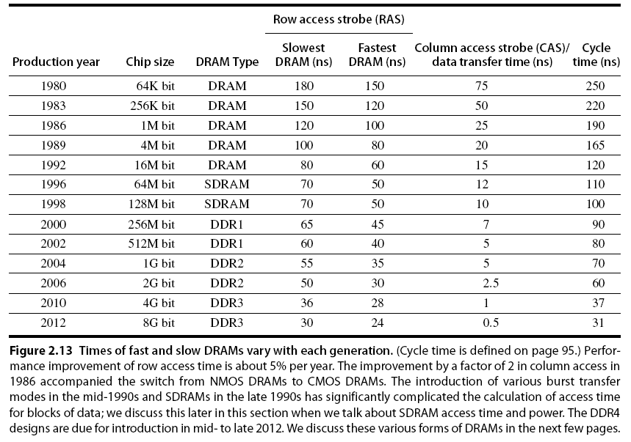
Memory Optimizations

Slide 9
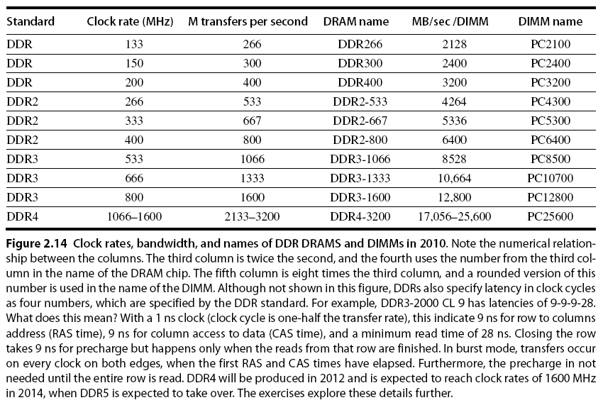
Memory Optimizations

Slide 10
Memory Optimizations
DDR:
DDR2
Lower power (2.5 V -> 1.8 V)
Higher clock rates (266 MHz, 333 MHz, 400 MHz)
DDR3
1.5 V
800 MHz
DDR4
1-1.2 V
1600 MHz
GDDR5 is graphics memory based on DDR3

Slide 11
Memory Optimizations
Graphics memory:
Achieve 2-5 X bandwidth per DRAM vs. DDR3
Wider interfaces (32 vs. 16 bit)
Higher clock rate
Possible because they are attached via soldering instead of socketted DIMM modules
Reducing power in SDRAMs:
Lower voltage
Low power mode (ignores clock, continues to refresh)

Slide 12
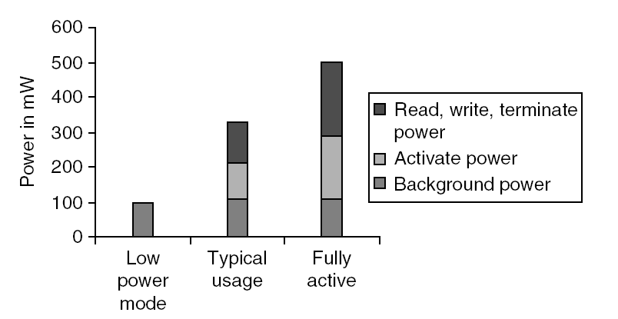
Memory Power Consumption

Slide 13
Flash Memory
Type of EEPROM
Must be erased (in blocks) before being overwritten
Non volatile
Limited number of write cycles
Cheaper than SDRAM, more expensive than disk
Slower than SRAM, faster than disk

Slide 14
Memory Dependability
Memory is susceptible to cosmic rays
Soft errors: dynamic errors
Detected and fixed by error correcting codes (ECC)
Hard errors: permanent errors
Use sparse rows to replace defective rows
Chipkill: a RAID-like error recovery technique

Slide 15
Impact on Performance
Suppose a processor executes at
Clock Rate = 200 MHz (5 ns per cycle)
CPI = 1.1
50% arith/logic, 30% ld/st, 20% control
Suppose that 10% of memory operations get 50 cycle miss penalty
CPI = ideal CPI + average stalls per instruction = 1.1(cyc) +( 0.30 (datamops/ins) x 0.10 (miss/datamop) x 50 (cycle/miss) ) = 1.1 cycle + 1.5 cycle = 2.6
58 % of the time the processor is stalled waiting for memory!
a 1% instruction miss rate would add an additional 0.5 cycles to the CPI!

Slide 16
Memory Technology
Amdahl:
Memory capacity should grow linearly with processor speed
Unfortunately, memory capacity and speed has not kept pace with processors
Some optimizations:
Multiple accesses to same row
Synchronous DRAM
Added clock to DRAM interface
Burst mode with critical word first
Wider interfaces
Double data rate (DDR)
Multiple banks on each DRAM device

Slide 17
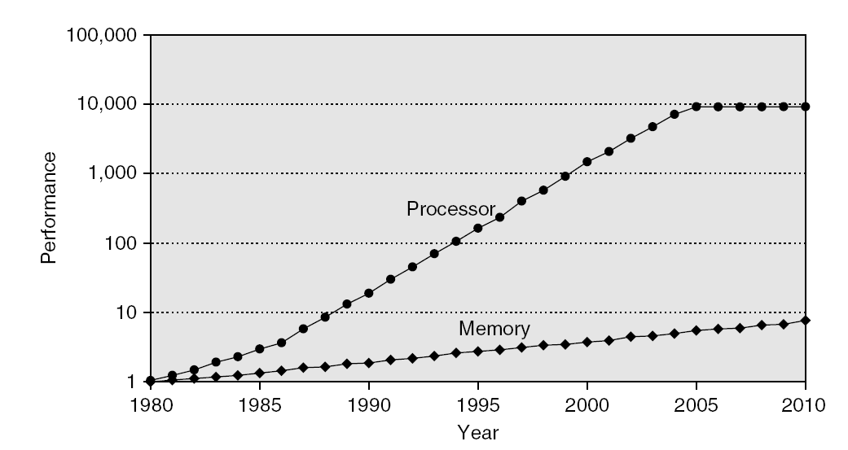
Memory Performance Gap

Slide 18
Latency in a Single PC
Ratio
Memory Access Time
CPU Time
THE WALL

Slide 19
Technology Trends
Capacity Speed (latency)
Logic: 2x in 3 years 2x in 3 years
DRAM: 4x in 3 years 2x in 10 years
Disk: 4x in 3 years 2x in 10 years
DRAM Generations
Year Size Cycle Time
1980 64 Kb 250 ns
1983 256 Kb 220 ns
1986 1 Mb 190 ns
1989 4 Mb 165 ns
1992 16 Mb 120 ns
1996 64 Mb 110 ns
1998 128 Mb 100 ns
2000 256 Mb 90 ns
2002 512 Mb 80 ns
2006 1024 Mb 60ns
16000:1 4:1
(Capacity) (Latency)

Slide 20
Processor-DRAM Performance Gap Impact: Example
To illustrate the performance impact, assume a single-issue pipelined CPU with CPI = 1 using non-ideal memory.
The minimum cost of a full memory access in terms of number of wasted CPU cycles:
CPU CPU Memory Minimum CPU cycles or
Year speed cycle Access instructions wasted
MHZ ns ns
1986: 8 125 190 190/125 - 1 = 0.5
1989: 33 30 165 165/30 -1 = 4.5
1992: 60 16.6 120 120/16.6 -1 = 6.2
1996: 200 5 110 110/5 -1 = 21
1998: 300 3.33 100 100/3.33 -1 = 29
2000: 1000 1 90 90/1 - 1 = 89
2003: 2000 .5 80 80/.5 - 1 = 159
2006: 3700 0.27 60 60/.27 – 1 = 221

Slide 21
How to make memory system better?
Programmers want unlimited amounts of memory with low latency
Fast memory technology is more expensive per bit than slower memory
Solution: organize memory system into a hierarchy
Entire addressable memory space available in largest, slowest memory
Incrementally smaller and faster memories, each containing a subset of the memory below it, proceed in steps up toward the processor
Temporal and spatial locality insures that nearly all references can be found in smaller memories
Gives the allusion of a large, fast memory being presented to the processor

Slide 22
Memory Hierarchy Design
Memory hierarchy design becomes more crucial with recent multi-core processors:
Aggregate peak bandwidth grows with # cores:
Intel Core i7 can generate two references per core per clock
Four cores and 3.2 GHz clock
25.6 billion 64-bit data references/second +
12.8 billion 128-bit instruction references
= 409.6 GB/s!
DRAM bandwidth is only 6% of this (25 GB/s)
Requires:
Multi-port, pipelined caches
Two levels of cache per core
Shared third-level cache on chip
High-end microprocessors have >10 MB on-chip cache
Consumes large amount of area and power budget

Slide 23
Memory Hierarchy
The idea is to build a memory subsystem that consists of:
Very small, very fast, very expensive memory “close” to the processor.
Larger, slower, but more affordable memory “further away” from the processor.
Hence, provide the appearance of virtually unlimited memory while minimizing delays to the processor.
The memory hierarchy is organized into levels of memory with the smaller, more expensive, and faster memory levels closer to the CPU: registers, then primary Cache Level (L₁), then additional secondary cache levels (L₂, L₃…), then main memory, then mass storage (virtual memory).

Slide 24
Levels of The Memory Hierarchy
Part of The On-chip CPU Datapath
16-256 Registers
Farther away from
The CPU
Lower Cost/Bit
Higher Capacity
Increased Access
Time/Latency
Lower Throughput
One or more levels (Static RAM):
Level 1: On-chip 16-64K
Level 2: On or Off-chip 128-512K
Level 3: Off-chip 1M-64M
Registers
Cache
DRAM, RDRAM
16M-16G
Main Memory
Interface:
SCSI, RAID,
IDE, 1394
4G-100G
Magnetic Disc
Optical Disk or Magnetic Tape

Slide 25
A Typical Memory Hierarchy (With Two Levels of Cache)
Faster
Larger Capacity
Processor
Control
Virtual
Memory,
Secondary
Storage
(Disk)
Tertiary
Storage
(Tape)
Second
Level
Cache
(SRAM)
L₂
Main
Memory
(DRAM)
On-Chip
Level
One
Cache
L₁
Datapath
Registers
Speed (ns):
1s
10s
100s
10,000,000s
(10s ms)
10,000,000,000s
(10s sec)
Size (bytes):
100s
Ks
Ms
Gs
Ts

Slide 26
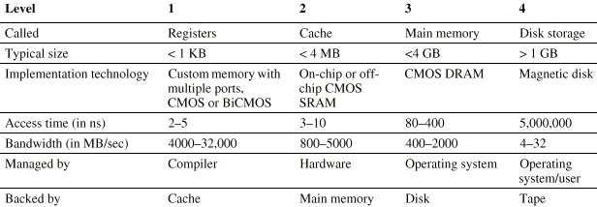
Levels of The Memory Hierarchy

Slide 27
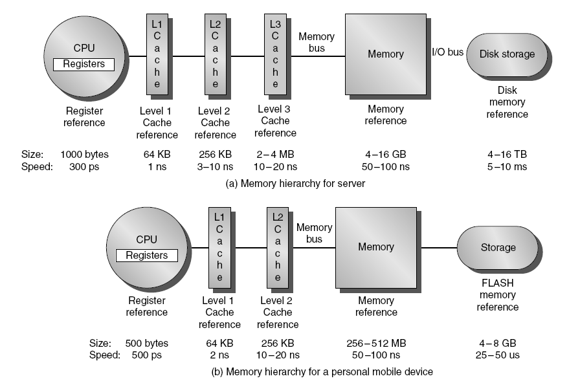
Recently Typical Configurations

Slide 28
Memory Hierarchy: Apple iMac G5
Managed
by compiler
Managed
by hardware
Managed by OS,
hardware,
application
07 | Reg | L1 Inst | L1 Data | L2 | DRAM | Disk
Size | 1K | 64K | 32K | 512K | 256M | 80G
Latency Cycles, Time | 1, 0.6 ns | 3, 1.9 ns | 3, 1.9 ns | 11, 6.9 ns | 88, 55 ns | 10⁷, 12 ms
Goal: Illusion of large, fast, cheap memory
Let programs address a memory space that scales to the disk size, at a speed that is usually as fast as register access

Slide 29
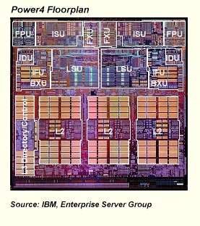
Memory on the CPU Chip
Architects Use Transistors to Tolerate Slow Memory
Cache
Small, Fast Memory
Holds information (expected) to be used soon
Mostly Successful
Apply Recursively
Level-one cache(s)
Level-two cache
Most of microprocessor die area is cache!

Slide 30
Pentium 4 Cache hierarchy (Gallatin)
Processor
L1 I (12Ki)
L1 D (8KiB)
Cycles: 2
Cycles: 19
L2 cache (512 KiB)
Cycles: 43
L3 cache (2 MiB)
Cycles: 206
Memory

Slide 31
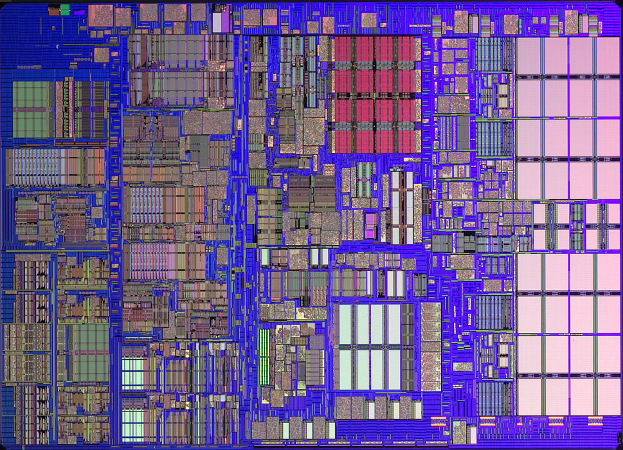
iMac’s PowerPC 970: All caches on-chip
L1 (64K Instruction)
Registers
512K
L2
(1K)
L1 (32K Data)

Slide 32
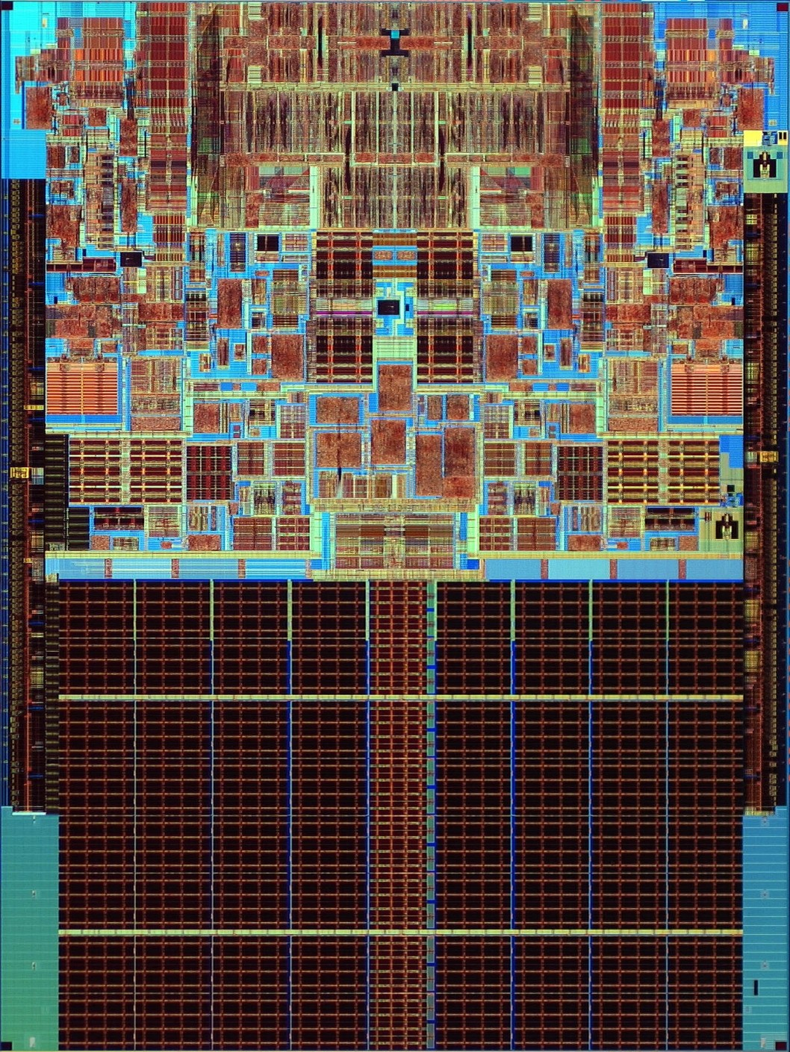
Case study: Intel Core2 Duo
L1 | 32 KB, 8-Way, 64 Byte/Line, LRU, WB 3 Cycle Latency
L2 | 4.0 MB, 16-Way, 64 Byte/Line, LRU, WB 14 Cycle Latency
Core0
Core1
L2 Cache
Source: http://www.sandpile.org

Slide 33
Memory Hierarchy Basics
When a word is not found in the higher level, a miss occurs:
Fetch word from lower level in hierarchy, requiring a higher latency reference
Also fetch the other words contained within the block
Takes advantage of spatial locality
Place block into cache in any location within its set, determined by address
block address MOD number of sets

Slide 34
Memory Hierarchy Operation
If an instruction or operand is required by the CPU, the levels of the memory hierarchy are searched for the item starting with the level closest to the CPU (Level 1 cache):
If the item is found, it’s delivered to the CPU resulting in a cache hit.
If the item is missing from an upper level, resulting in a miss, the level just below is searched.
For systems with several levels of cache, the search continues with cache level 2, 3 etc.
If all levels of cache report a miss then main memory is accessed.
CPU ↔ cache ↔ memory: Managed by hardware.
If the item is not found in main memory resulting in a page fault, then disk (virtual memory), is accessed for the item.
Memory ↔ disk: Managed by hardware and the operating system.

Slide 35
Memory Hierarchy Basics
n sets => n-way set associative
Direct-mapped cache => one block per set
Fully associative => one set
Writing to cache: two strategies
Write-through
Immediately update lower levels of hierarchy
Write-back
Only update lower levels of hierarchy when an updated block is replaced
Both strategies use write buffer to make writes asynchronous

Slide 36
Memory Hierarchy Basics
Miss rate
Fraction of cache access that result in a miss
Causes of misses
Compulsory
First reference to a block
Capacity
Blocks discarded and later retrieved
Conflict
Program makes repeated references to multiple addresses from different blocks that map to the same location in the cache

Slide 37
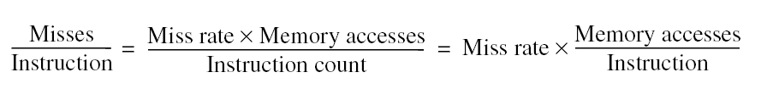
Memory Hierarchy Basics
Note that speculative and multithreaded processors may execute other instructions during a miss
Reduces performance impact of misses

