Slide 1
Comp4611 Tutorial 1
Computer Processor History
Die Cost Calculation
Performance Measuring & Evaluation
Sept. 17, 19, 21 2012

Slide 2



Advances Come from Design
4004 (1971)
Intel's first microprocessor
8008 (1972)
twice as powerful as the 4004
8080 (1974)
brains of the first personal computer
~US$ 400
8086 – 8088 (1978)
brains of IBM's new hit product -- the IBM PC
The 8088's success propelled Intel into the ranks of the Fortune 500, and Fortune magazine named the company one of the "Business Triumphs of the Seventies."
Notes:
Gl: comes → come

Slide 3



Advances Come from Design
80286 (1982)
first Intel processor that could run all the software written for its predecessor
Within 6 years of its release, an estimated 15 million 286-based personal computers were installed around the world.
80386 (1985)
275,000 transistors--more than 100times as many as the original 4004
32-bit chip
"multi tasking"
80486 (1989)
32 bit chip
built-in math coprocessor
packaged together with cache memory chip
command-level computer → point-and-click computing
color computer
Notes:
Find more on:
http://www.intel.com/intel/intelis/museum/online/hist_micro/hof/index.htm
http://article.pchome.net/2003/06/25/10429.htm

Slide 4




Advances Come from Design
Pentium (1993)
incorporate "real world" data such as speech, sound, handwriting and photographic images
Pentium Pro (1995)
5.5 million transistors
packaged together with a second speed-enhancing cache memory chip,
pipelining
enabling fast computer-aided design, mechanical engineering and scientific computation
Pentium II (1997)
7.5 million-transistor
MMX technology, designed specifically to process video, audio and graphics data efficiently
high-speed cache memory chip
Celeron (1999)
excellent performance in gaming

Slide 5

Advances Come from Design
Pentium III (1999)
9.5 million transistors, 0.25-micron technology
70 new SSE (Streaming SIMD Extension) instructions
dramatically enhance the performance of advanced imaging, 3-D, streaming audio, video and speech recognition applications, Internet experiences
Pentium 4 (2000)
42 million transistors and circuit lines of 0.18 microns
1.5 gigahertz (4004 ran at 108 kilohertz )
SSE2 instructions, more pipeline stages, higher successful prediction rate
can create professional-quality movies; deliver TV-like video via the Internet; communicate with real-time video and voice; render 3D graphics in real time; quickly encode music for MP3 players; and simultaneously run several multimedia applications while connected to the Internet.
Notes:
Gl: 4004, ran → 4004 ran

Slide 6
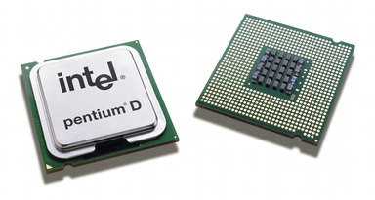
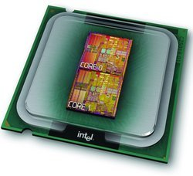
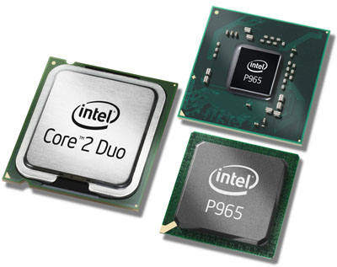

Advances Come from Design
Pentium D
Dual-core processing technology
  → high-end entertainment: multimedia entertainment, digital photo editing, multiple users and multitasking
Pentium Dual-Core
High-value performance for multitasking (CPU executes more instructions in less time)
Smart Cache: smarter, more efficient cache and bus design
→ enhanced performance, responsiveness and power savings
Core 2 Duo
A dual-core CPU
A new microarchitecture to replace Netburst
Memory Hierarchy System
Low power consumption
Core™2 Quad
Four execution cores
More intensive entertainment and more media multitasking
Notes:
Gl: fix indentation of “digital photo editing”
Gl: what’s “high-value performance”?
Gl: introduction to Core 2 Duo is too commercial and over-excited

Slide 7



Advances Come from Technology
Processor | Intel® Pentium® D Processor | Intel® Pentium® Dual-Core Processor | Intel® Core™2 Duo Processor | Intel® Core™2 Quad Processor
Process Technology | 65 nm - 90 nm | 65 nm | 65 nm | 65 nm
L2 Cache | 1MB - 2MB for each core | 1MB | 2M - 4M | 8M
Clock Speed | 2.80 - 3.60 GHz | 1.6 - 2 GHz | 1.86 – 3.0 GHz | 2.4 - 2.66 GHz
Chipset | Intel® 945P, 945G, 955X, 975X chipsets | N/A | Intel® Q965, Q963, G965, P965, 975X | Intel® P965, 975X
Increase in processor performance due to the growth in CPU Transistor Count
Notes:
Gl: Architecture → Process technology
Gl: why these indicate progress enabled by technology?

Slide 8


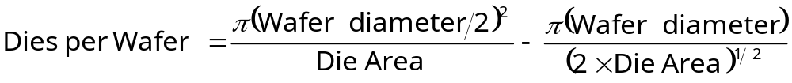
Cost Formula Summary
wafer
die
Where α is a parameter inversely proportional to the number of mask
Levels, which is a measure of the manufacturing complexity.
For today’s CMOS process, good estimate is α = 3.0 – 4.0
Yield: the percentage of manufactured devices that survives the testing procedure

Slide 9
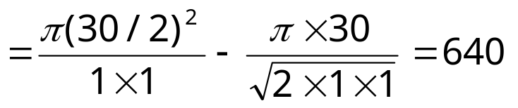
Example: Die Cost
Given:
wafer 30cm, die 1cm, defect density 0.6 per cm² , α=4.0
30-cm-diameter wafer with 3-4 metal layers : $3500
wafer yield is 100%
Calculate:
die cost
Step 1: dies per wafer

Slide 10
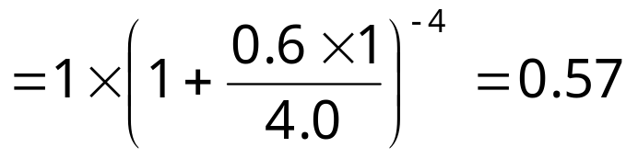
Example: Die Cost
Given:
wafer 30cm, die 1cm, defect density 0.6 per cm² , α=4.0
30-cm-diameter wafer with 3-4 metal layers : $3500
wafer yield is 100%
Calculate:
die cost
Step 2: die yield

Slide 11
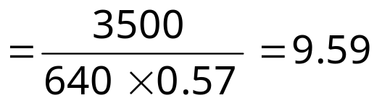
Example: Die Cost
Given:
wafer 30cm, die 1cm, defect density 0.6 per cm² , α=4.0
30-cm-diameter wafer with 3-4 metal layers : $3500
wafer yield is 100%
Calculate:
die cost
Step 3: die cost

Slide 12
How to Measure Performance ?
Performance Rating
  CPU Time
  Benchmark programs
    Integer programs and floating point programs
      Compression
      Compiler
      Artificial Intelligence
      Physics / Quantum Computing
      Video Compression
      Path-finding Algorithms
  Amdahl’s Law

Slide 13
Measuring Performance
Performance = 1 / Execution Time
CPU time = Seconds = Instructions x Cycles x Seconds
Program Program Instruction Cycle
Instruction
count
CPI
Clock cycle
= 1 / Clock rate

Slide 14
Measuring Performance
CPU time = Instruction count x CPI x (1/clock rate)
Example 1:
A SPEC CPU2006 integer benchmark (464.h264ref, a video compression program written in C) is run on a Pentium D processor:
Total instruction count: 3731 billion
Average CPI for the program: 2.5 cycles/instruction.
CPU clock rate: 2.1 GHz
  CPU time = 3731 x 10⁹ x 2.5 / (2.1 x 10⁹)
  = 4442 seconds
Source: Analysis of Redundancy and Application Balance in the SPEC CPU2006 Benchmark Suite

Slide 15
Measuring Performance
Speedup = Old Execution Time = I_{old} x CPI_{old} x Clock cycle_{old}
New Execution Time I_{new} x CPI_{new} x Clock Cycle_{new}
Example 2:
Suppose SPEC CPU2006 integer benchmark (464.h264ref) is run on a faster processor, with a new compiler:
New total instruction count: 2000 billion
New average CPI for the program: 4 cycles/instruction.
New CPU clock rate: 3.6 GHz
  New CPU time = 2000 x 10⁹ x 4 / (3.6 x 10⁹)
  = 2222 seconds
  Speedup = Old CPU time = 4442 = 1.999
  New CPU time 2222

Slide 16
Measuring Performance
Speedup = Old Execution Time = I_{old} x CPI_{old} x Clock cycle_{old}
New Execution Time I_{new} x CPI_{new} x Clock Cycle_{new}
Example 3:
Should this be implemented?
Old CPI
= 0.40 x 3 + 0.2 x 1 + 0.2 x 1 + 0.2 x 2
= 2
Speedup
= I_{old} x 2 x Clock cycle_{old}
I_{new} x 2.2 x Clock cycle_{new}
Instruction Class | Frequency | Old CPI | New CPI
ALU | 40% | 3 | 2
Load | 20% | 1 | 2
Store | 20% | 1 | 2
Branch | 20% | 2 | 3
New CPI
= 0.4 x 2 + 0.2 x 2 + 0.2 x 2 + 0.2 x 3
= 2.2
Shouldn’t be implemented
= 0.91

Slide 17
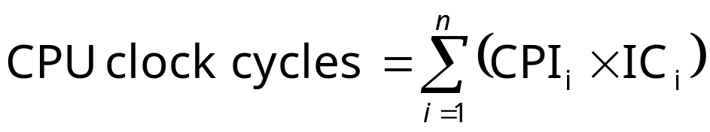
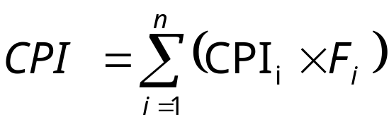
Metrics for Performance
CPU time: most accurate and fair measure
CPU Time = Instruction Count x CPI x Clock Cycle Time
a priori frequency of the instruction set

Slide 18
Example 4: Performance
Suppose we have made the following measurements:
  Frequency of FP operations (other than FPSQR) = 23%
  Average CPI of FP operations (other than FPSQR) = 4.0
  Frequency of FPSQR = 2%, CPI of FPSQR = 20
  Average CPI of other instructions = 1.33
Assume that the two design alternatives
  decrease the CPI of FPSQR to 3
  decrease the average CPI of FP operations (other than FPSQR) to 2.
Compare these two design alternatives using the CPU performance equation.

Slide 19
Solution
Step 1: Original CPI without enhancement:
CPI original = 4×23% + 20x2% +1.33×75% = 2.3175
Step 2: compute the CPI for the enhanced FPSQR by subtracting the cycles saved from the original CPI:
CPI with new FPSQR = CPI original - 2%×(CPI old FPSQR – CPI new FPSQR only)
= 2.3175 - 0.02x(20-3) = 1.9775
Step 3: compute the CPI for the enhancement of all FP instructions:
CPI with new FP = CPI original - 23%×(CPI old FP – CPI new FP)
= 2.3175 - 0.23x(4-2) = 1.8575
Step 4: the speedup for the FP enhancement over FPSQR enhancement is:
Speedup = CPU time with new FPSQR / CPU time with new FP
= I × CPI with new FPSQR × C / I × CPI with new FP × C
= 1.9775 / 1.8575 = 1.065
Notes:
An example of making common case faster.

Slide 20
Comparing Performance
Total execution time
 | Machine A | Machine B
Program 1 | 1 | 10
Program 2 | 1000 | 100
Total | 1001 | 110
How much faster is Machine B than Machine A?
9.1 times?
Machine A is faster in running Program 1.
Machine B is faster in running Program 2.
UNCLEAR

Slide 21
Comparing Performance
1
n
n
Execution Time_{i}
i=1
Arithmetic Mean:
 | Machine A | Machine B
Program 1 | 1 | 10
Program 2 | 1000 | 100
Total | 1001 | 110
AM | 500.5 | 55
 | Machine A | Machine B
Program 1 | 200 | 400
Program 2 | 250 | 400
Program 3 | 450 | 100
AM | 300 | 300
Can be
misleading
Valid only if
programs run equally

Slide 22
Comparing Performance
n
Weight_{i} x Execution Time_{i}
i=1
Weighted Arithmetic Mean:
 | Machine A | Machine B | W (1)
Program 1 | 200 | 400 | 0.4
Program 2 | 250 | 500 | 0.4
Program 3 | 550 | 100 | 0.2
AM | 300 | 300
WAM (1) | 200 x 0.4 + 250 x 0.4 + 550 x 0.2 = 290 | 400 x 0.4 + 500 x 0.4 + 100 x 0.2 = 380
Machine A is better

Slide 23
Comparing Performance
n
Weight_{i} x Execution Time_{i}
i=1
Weighted Arithmetic Mean:
 | Machine A | Machine B | W (2)
Program 1 | 200 | 400 | 0.2
Program 2 | 250 | 500 | 0.2
Program 3 | 550 | 100 | 0.6
AM | 300 | 300
WAM (2) | 200 x 0.2 + 250 x 0.2 + 550 x 0.6 = 420 | 400 x 0.2 + 500 x 0.2 + 100 x 0.6 = 240
Machine B is better
Depend very much on how to weigh each testing item

Slide 24
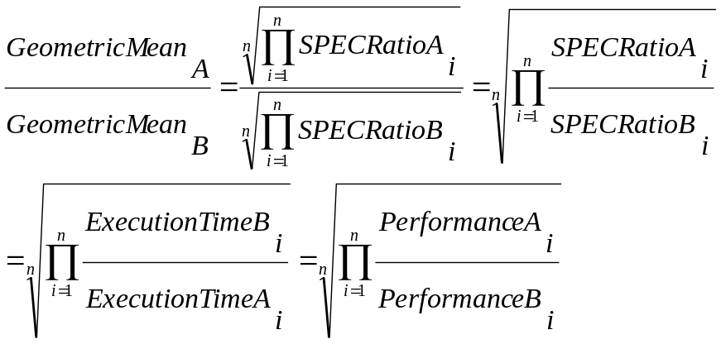
Comparing Performance
Geometric Mean: n
n
Execution time ratio_{i}
I=1
 | Machine A | Machine B
Program 1 | 1 | 10
Program 2 | 1000 | 100
Total | 1001 | 110
Same GM
≠
same execution time or same performance
Normalized Execution Time to a
reference machine
 | Normalized to A
 | Machine A | Machine B
Program 1 | 1 | 10
Program 2 | 1 | 0.1
GM | 1 | 1

Slide 25
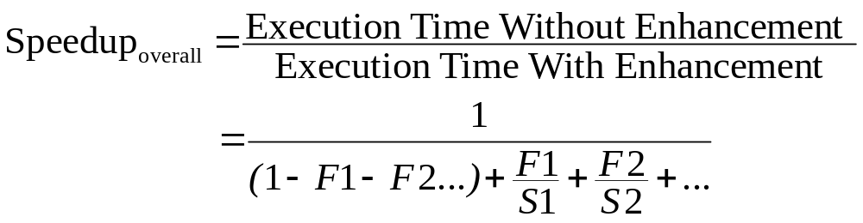
Amdahl’s Law
Amdahl’s Law – law of diminishing returns
In general case, assume several enhancements has been taken for the system, the speedup for whole system is,
where Fi is the fraction of enhancement i and Si is the speedup of the corresponding enhancement
The new execution time is

Slide 26
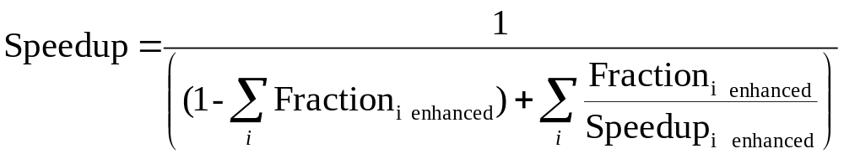
Example on Amdahl’s Law
Float instruction:
  Fraction: 50%
  Speedup: 2.0x
Integer instruction:
  Fraction: 30%
  Speedup: 3.0x
Others keep the same.
= 1 / ((1-0.5-0.3)+(0.5/2+0.3/3))=1.818

Slide 27

Intuition – make the common case fast
I have two processors, which can help accelerate one of the below parts by parallel processing. Two parts occupy the total time percentage of 95% and 5%.
Fraction_{enhanced} = 95%, Speedup_{enhanced} = 2.0x
Speedup_{overall} = 1/((1-0.95)+0.95/2) = 1.905
Fraction_{enhanced} = 5%, Speedup_{enhanced} = 2.0x
Speedup_{overall} = 1/((1-0.05)+0.05/2) = 1.026
1.905 vs. 1.026
Make the common case faster!!
Fraction_{enhanced} = 5%, Speedup_{enhanced} -> infinity
Speedup_{overall} = 1/(1-0.05) = 1.052
1.052 is still much smaller than 1.905.

Slide 28
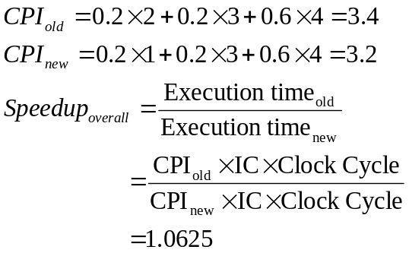
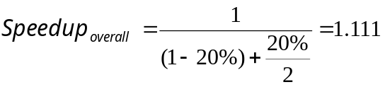
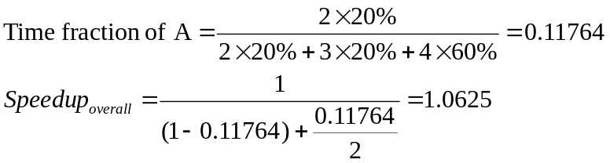
A Common Confusion: CPI vs. Amdahl’s Law
Assume a program consists of three classes of instructions A,B and C, as shown below.
An enhancement is made by doubling the speed of instruction class A
Assume instruction count for the program and CPU clock cycle is not influenced
What is the overall speedup achieved for the program
Method 1: CPI
Method 2: Amdahl’s Law
Instruction Class | Frequency | Old CPI | New CPI
A | 20% | 2 | 1
B | 20% | 3 | 3
C | 60% | 4 | 4
The fraction in Amdahl’s law is time fraction
Method 2: Amdahl’s Law
Notes:
Gl: by double → by doubling

