Slide 1
I/O & RAID
COMP4611
Tutorial 10
19-23, Nov

Slide 2
I/O Performance
Disk Latency = Seek Time + Rotation Time + Transfer Time + Controller Overhead
  Seek Time depends on the number of tracks and mechanical characteristics of arm
  Rotation Time depends on how fast the disk rotates and how far sector is from head
  Transfer Time depends on data rate (bandwidth) of disk and size of request

Slide 3
I/O Performance – Example 1
Compare the time to read and write a 64KB block to Flash memory and magnetic disk.
For Flash, assume it takes 65ns to read 1 byte, 1.5us to write 1 byte, and 5ms to erase 4KB.
For disk, average seek time = 12ms, rotation speed = 3600rpm and data transfer rate = 2.6-4.2MB/s.
Assume the measured seek time is one-third of the calculated average, the controller overhead is 0.1ms, and the data are stored in the outer-most track (the disk rotates in one direction).

Slide 4
Example 1 - Analysis
File to transfer: 64 KB
Magnetic Disk
  average seek time = 12ms
  rotation speed = 3600rpm
  data transfer rate = 2.6-4.2MB/s
  controller overhead = 0.1ms
Flash
  65ns to read 1 byte
  1.5us to write 1 byte
  5ms to erase 4KB
Some Key points
  Data are stored in the outer-most track
  We want to use the average rotational delay in order to find the time to read to or write from the disk

Slide 5
Example 1 - Solution
Average disk access is equal to measured seek time + average rotational delay + transfer time + controller overhead. The average time to read or write 64KB for the disk is
12 / 3ms + 0.5 / 3600RPM + 64KB / (4.2MB/s) + 0.1ms = 19.3ms
Flash read time = 64KB / (1B / 65ns) = 4.3ms
Flash write time = erase time + write time
= 64KB / (4KB / 5ms) + 64KB / (1B / 1.5us) = 178.3ms
Thus, Flash memory is about 4.5 times faster than disk for reading 64KB, and disk is about 9 times faster than Flash memory for writing 64KB.
!
!

Slide 6
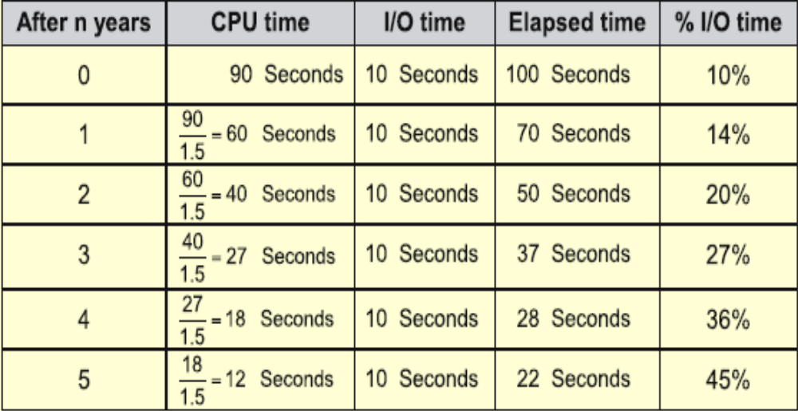
Impact of I/O on System Performance
Suppose we have a benchmark that executes in 100 seconds of elapsed time, where 90 seconds is CPU time and the rest is I/O time. If the CPU time improves by 50% per year for the next five years but I/O time does not improve, how much faster will our program run at the end of the five years?
Answer: Elapsed Time = CPU time + I/O time
Over five years:
CPU improvement = 90/12 = 7.5 BUT System improvement = 100/22 = 4.5

Slide 7
I/O System Performance
I/O system performance depends on many aspects of the system (limited by weakest link in the chain):
  CPU
  Memory system (internal and external caches, main memory)
  Underlying interconnection (buses)
  I/O controller
  I/O device
  Speed of I/O software (operating system)
  Efficiency of the software’s use of the I/O devices

Slide 8
I/O Performance Metrics
Throughput: I/O bandwidth
  The number of bytes received by the server in unit time
  In order to get the highest possible throughput
    The server should never be idle
    The bus should never be empty
Response time: latency
  Begins when a byte is transmitted by the server
  Ends when it is received by another server
  In order to minimize the response time
    The bus should be empty
    The server will be idle

Slide 9
I/O Performance – Example 2
A disk workload consisting of 64KB reads and writes where the user program executes 200,000 instructions per disk I/O operation and
  a processor that sustains 3 billion instr/s and averages 100,000 OS instructions to handle a disk I/O operation (the device I/O operation’s latency is close to 0)
  a memory-I/O bus that sustains a transfer rate of 1000 MB/s
The maximum disk I/O rate (# I/O’s/s) of the processor is
Each disk I/O reads/writes 64 KB so the maximum I/O rate of the bus is

Slide 10
Example 2 – Solution
A disk workload consisting of 64KB reads and writes where the user program executes 200,000 instructions per disk I/O operation and
  a processor that sustains 3 billion instr/s and averages 100,000 OS instructions to handle a disk I/O operation (the device I/O operation’s latency is close to 0)
  a memory-I/O bus that sustains a transfer rate of 1000 MB/s
The maximum disk I/O rate (# I/O’s/s) of the processor is
Instr execution rate 3 x 10⁹
-------------------------- = ------------------------ = 10,000 I/O’s/s
Instr per I/O (200 + 100) x 10³
Each disk I/O reads/writes 64 KB so the maximum I/O rate of the bus is
Bus bandwidth 1000 x 10⁶
---------------------- = ----------------- = 15,625 I/O’s/s
Bytes per I/O 64 x 10³

Slide 11
Example 2 (con’t)
A disk workload consisting of 64KB reads and writes where the user program executes 200,000 instructions per disk I/O operation and
  SCSI disk I/O controllers with a DMA transfer rate of 320 MB/s that can accommodate up to 7 disks per controller
  disk drives with a read/write bandwidth of 75 MB/s and an average seek plus rotational latency of 6 ms
  What is the maximum sustainable I/O rate and what is the number of disks and SCSI controllers required to achieve that rate?

Slide 12
Example 2 – Solution
So the processor is the bottleneck, not the bus
Disk I/O read/write time = seek + rotational time + transfer time = 6ms + 64KB/(75MB/s) = 6.9ms
Thus each disk can complete 1000ms/6.9ms or 146 I/O’s per second. To saturate the processor requires 10,000 I/O’s per second or 10,000/146 = 69 disks
To calculate the number of SCSI disk controllers, we need to know the average transfer rate per disk to ensure we can put the maximum of 7 disks per SCSI controller and that a disk controller won’t saturate the memory-I/O bus during a DMA transfer
Disk transfer rate = (transfer size)/(transfer time) = 64KB/6.9ms = 9.56 MB/s
Thus 7 disks won’t saturate either the SCSI controller (with a maximum transfer rate of 320 MB/s) or the memory-I/O bus (1000 MB/s). This means we will need 69/7 or 10 SCSI controllers.

Slide 13
Reliability and Availability
Reliability: Is anything broken?
  Reliability can be improved by:
    Enhancing environmental conditions
    Building more reliable components
    Building with fewer components
      Improve ability may come at the cost of lower reliability
Availability: Is the system still available to the user?
  Availability can be improved by adding hardware:
    Example: adding error-correcting code on memory

Slide 14
Motivation for RAID
As a first solution to increase disk performance we could use Disk Arrays
Reliability of N disks = Reliability of 1 Disk ÷ N
  1,200,000 Hours ÷ 100 disks = 12,000 hours
  1 year = 365 * 24 = 8700 hours
Disk system MTTF: Drops from 140 years to about 1.5 years!
Problem: No redundancy between the disks – failed data cannot be retrieved

Slide 15
RAID Techniques:
Goal was Performance, Popularity due to Reliability
• Disk Mirroring, Shadowing (RAID 1)
1
0
0
1
0
0
1
1
1
0
0
1
0
0
1
1
Each disk is fully duplicated onto its "shadow"
Logical write = two physical writes
100% capacity overhead
• Parity Data Bandwidth Array (RAID 3)
1
0
0
1
0
0
1
1
1
1
0
0
1
1
0
1
1
0
0
1
0
0
1
1
0
0
1
1
0
0
1
0
Parity computed horizontally
Logically a single high data bw disk
• High I/O Rate Parity Array (RAID 5)
Interleaved parity blocks
Independent reads and writes
Logical write = 2 reads + 2 writes

Slide 16
Example 3
Suppose we have a RAID 5 system with 5 disks. A disk has failed and is being replaced. Assume the remaining disks are error-free. Reconstruct the data for the new disk.
0111
1010
0100
0101
0000
1100
1111
1101
1111
1001
0110
0011
1011
1001
1110
1101
0001
0011
1010
1111

Slide 17
Example 3 - Solution
0111
1010
0100
0101
0000
1100
1111
1101
1111
1001
0000
0111
0001
1001
1000
0110
0011
1011
1001
1110
1101
0001
0011
1010
1111

Slide 18
Example 4
Suppose we want to build a RAID 0 system with 4000GB storage capacity. There are two options available:
SysA: 100 x 40GB and $400 per disk
SysB: 50 x 80GB and $1000 per disk
Assume the MTTF for every disk is 1,000,000 hours.
What is the cost and MTTF of the each option?

Slide 19
Example 4 - Solution
Cost of SysA = 100 x $400 = $40000
Cost of SysB = 50 x $1000 = $50000
MTTF of SysA = 1000000 / 100 = 1000hrs
MTTF of SysB = 1000000 / 50 = 2000hrs
SysA has a lower cost while SysB has a better MTTF value

Slide 20
Well Known Storage
Hard drive: random access, magnetic, various density and speed
Tape: sequential access, huge storage capacity, cheap
Helical scan tapes: diagonal storage of bits to allow high speed tape rotation
  Used also for VCR and camcorders
Optical disk: high density, mostly read-only
Flash memory: much faster than hard drive, expensive and limited in capacity
Notes:
Gl: Optical disks now are not necessarily read only
Gl: little slower… do you mean it is almost not slower? I think flash’s much slower than RAM. What’s flash DRAM anyway?

Slide 21
Storage Example: Internet Archive
Goal of making a historical record of the Internet
  Internet Archive began in 1996
  Wayback Machine interface performs time travel to see what a web page looked like in the past
Contains over a petabyte (10¹⁵ bytes)
  Growing by 20 terabytes (10¹² bytes) of new data per month
Besides storing historical record, same hardware crawls Web to get new snapshots

Slide 22
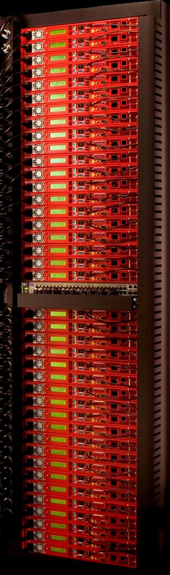
Internet Archive Cluster
1U storage node PetaBox GB2000 from Capricorn Technologies
Has 4 500-GB Parallel ATA (PATA) drives, 512 MB of DDR266 DRAM, G-bit Ethernet, and 1 GHz C3 processor from VIA (80x86)
Node dissipates ≈ 80 watts
40GB2000s in a standard VME rack,
⇒ 80 TB raw storage capacity
40 nodes connected with 48-port Ethernet switch
Rack dissipates about 3 KW
1 Petabyte = 12 racks

Slide 23
Estimated Cost
VIA processor, 512 MB of DDR266 DRAM, ATA disk controller, power supply, fans, and enclosure = $500
7200 RPM 500-GB PATA drive = $375 (in 2006)
48-port 10/100/1000 Ethernet switch and all cables for a rack = $3000
Total cost $84,500 for a 80-TB rack
160 Disks are ≈ 60% of total

Slide 24
Estimated Performance
7200 RPM drive
  Average seek time = 8.5 ms
  Transfer bandwidth 50 MB/second
  PATA link can handle 133 MB/second
  ATA controller overhead is 0.1 ms per I/O
VIA processor is 1000 MIPS
  OS needs 50K CPU instructions for a disk I/O
  Network stack uses 100K instructions per data block
Average I/O size
  16 KB for archive fetches
  50 KB when crawling Web
Disks are limit
  ≈ 75 I/Os/s per disk, thus 300/s per node, 12000/s per rack
  About 200-600 MB/sec bandwidth per rack
Switches must achieve 1.6-3.8 Gbps over 40 Gbps links

Slide 25
Estimated Reliability
CPU/memory/enclosure MTTF is 1,000,000 hours (x 40)
Disk MTTF 125,000 hours (x 160)
PATA controller MTTF 500,000 hours (x 40)
PATA cable MTTF 1,000,000 hours (x 40)
Ethernet switch MTTF 500,000 hours (x 1)
Power supply MTTF 200,000 hours (x 40)
Fan MTTF 200,000 hours (x 40)
MTTF for system works out to 531 hours (≈ 3 weeks)
70% of failures in time are disks
20% of failures in time are fans or power supplies

