Slide 1
Multiprocessor
COMP4611
Tutorial 11
Nov. 26 – 30, 2012

Slide 2
Outline
Why Multiprocessor?
Performance Potential
New Problems
Cache Coherence Problem & Solution
Challenges of Parallel Processing

Slide 3
The Bottleneck of Single Processor
Even various ways of increasing a single processor performance have been introduced, the performance of a single processor still has its bottleneck.
The figures above demonstrate the limitation of ILP.

Slide 4
We Need High Performance
Less time for a time-consuming operation
More operations in a period of time
1 TB
100 GB
vehicle dynamics
structural biology
10 GB
pharmaceutical design
1 GB
48-hour
weather
72-hour
weather
Storage Requirements
chemical dynamics
100 MB
3D plasma modelling
2D airfoil
oil reservoir
modelling
10 MB
100 MFLOPS
1 GFLOPS
10 GFLOPS
100 GFLOPS
1 TFLOPS
Computational Performance Requirements

Slide 5
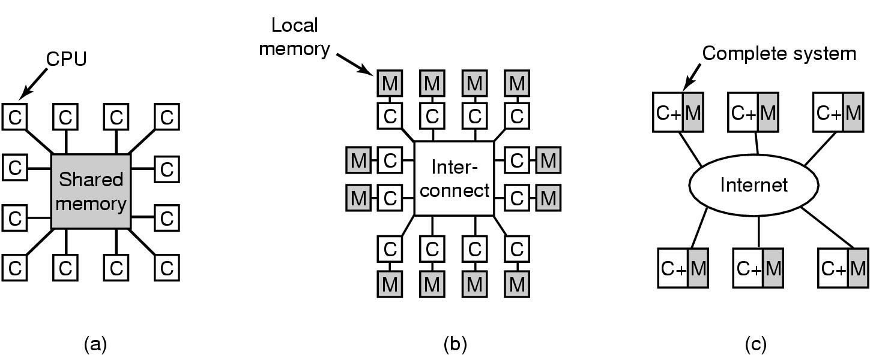
Multiprocessing
Concurrent execution of tasks (programs) using multiple computing, memory and interconnection resources
Provide alternative to faster processors
Use multiple processors to solve a problem

Slide 6
Outline
Why Multiprocessor?
Performance Potential
New Problems
Cache Coherence Problem & Solution
Challenges in Using Multiprocessors

Slide 7
Performance Potential Using Multiprocessor
Amdahl’s Law
Using multiple processors to solve the same problems as the single processor
Pessimistic, limited speedup factor
Gustafson’s View
Using multiple processors to solve larger or more complex problems
Parallel portion increases as the problem size increases
Speedup factor can be increased by deploying more processors

Slide 8
Amdahl’s Law
A parallel program has sequential parts and parallel parts, the proportion for both of them are β and (1-β)
The total execution time for a single processer is
T₁ = βT₁ + (1-β)T₁
The total execution time for p processors would be
T_{p} = βT₁ + (1-β)T₁ / p
Speedup(p) = 1 / (β + (1-β)/p) ≤ 1 / β

Slide 9
Amdahl’s Law
S is the serial part
P is the part that can be parallelized in 6 ways
Serial: SSPPPPPP
6 processors: SSP
P
P
P
P
P
Speedup = 8/3 = 2.67
Speedup(p) = 1 / (β + (1- β)/p)
As p → ∞, Speedup(p) → 1/ β

Slide 10
Amdahl’s Law
Speedup
25
20
15
1000 CPUs
16 CPUs
4 CPUs
10
5
Limited speedup factor!!!
0
10%
20%
30%
40%
50%
60%
70%
80%
90%
99%
% Serial

Slide 11
Gustafson’s View
Parallel portion increases as the problem size increases
Old Serial: SSPPPPPP
Hypothetical Serial: SSPPPPPP PPPPPP PPPPPP PPPPPP PPPPPP PPPPPP
6 processors: SSPPPPPP
PPPPPP
PPPPPP
PPPPPP
PPPPPP
PPPPPP
Speedup(6) = (8+5*6)/8 = 4.75
Speedup(p) = p(1- β) + β; Speedup(p) _{p → ∞} → ∞

Slide 12
Amdahl vs. Gustafson
Speedup
100
80
Gustafson
60
Amdhal
40
20
0
10%
20%
30%
40%
50%
60%
70%
80%
90%
99%
% Serial

Slide 13
Example 1. To achieve a speedup of 80 with 100 processors, the fraction of the original computation can be sequential
Amdahl’s law
1 / (β + (1- β)/100) = 80
β = 0.25%
Gustafson’s view
100(1- β) + β = 80
β =20%
To achieve high speedup, only a very small fraction of a program can be sequential
In practice, programs usually have much more sequential fraction

Slide 14
Outline
Why Multiprocessor?
Performance Potential
New Problems
Cache Coherence Problem & Solution
Challenges in Using Multiprocessors

Slide 15
Programming with Shared Memory
Virtual address spaces for a collection of processes communicating via shared addresses
Machine physical address space
Processor
Memory
System
Load
Pn private
Process
Process
Common physical addresses
Store
Shared portion of address space
load(X)
store(X)
P2 private
X
Shared variable
P1 private
Private portion of address space
P0 private

Slide 16
Cache Coherence Problem
W: X = 17
R: X
P1
R: X
P2
P3
P4
$
X:17
$
$
$
X:42
X:42
MEM
X:42
Processor P4 does not see the value written by processor P1
16

Slide 17
Write Through Does Not Help
W: X = 17
R: X
P1
R: X
P2
P3
P4
R: X
$
X:17
$
$
$
X:17
X:42
X:42
MEM
X:42
Processor P4 sees 42 in cache and does not get the value (17) from memory.
17

Slide 18
Some Solutions to Cache Coherence Problem
Shared Cache
Cache placement identical to single cache
Only one copy of any cached block which results in limited bandwidth
Snoopy Cache-Coherence Protocols for Distributed Cache

Slide 19
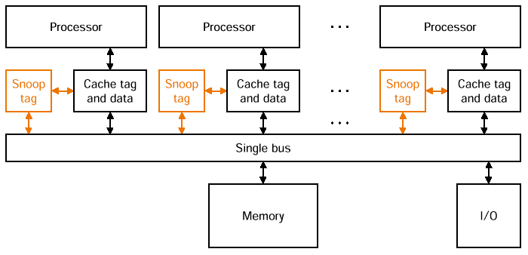

Snooping Cache Coherency
Bus snoop
Cache-memory
transaction
Cache Controller “snoops” all transactions on the shared bus and takes action to ensure coherence (invalidate, update, or supply value)
A transaction is a relevant transaction if it involves a cache block currently contained in this cache
19

Slide 20
Hardware Cache Coherence Demonstration
write-invalidate
invalidate -->
memory
X -> X’
X -> Inv
X -> Inv
. . . . .
write-update (also called distributed write)
memory
update -->
X -> X’
X -> X’
X -> X’
. . . . .

Slide 21
Outline
Why Multiprocessor?
Performance Potential
New Problems
Cache Coherence Problem & Solution
Challenges in Using Multiprocessors

Slide 22
Challenges in Using Multiprocessors
Limited parallelism available in programs
Example 1
Relatively high cost of communications
Example 2

Slide 23
Example 2
We have a 32-processor multiprocessor
Clock rate is 3.3 GHz
Base CPI is 0.5 (no remote request)
Shared memory - nonuniform memory access
200 ns to handle a remote memory reference
A processor is stalled when it invokes a remote memory access
How much slower if 0.2% of the instructions involve remote requests?

Slide 24
Effective CPI
= Base CPI + Remote req. rate x Remote req. cost
= 0.5 + 0.2% x Remote req. cost
Remote req. cost
= Remote access cost / cycle time
= 200 ns / (1/3.3) ns = 660 cycles
CPI = 0.5 + 0.2% x 660 = 1.8
CPI / Base CPI = 1.8 / 0.5 = 3.6
0.2% remote requests make the program 3.6 times slower

Slide 25
Questions?

