Slide 1
Vector, SIMD Extensions and GPU
COMP 4611
Tutorial 12

Slide 2
Introduction
Introduction
SIMD architectures can exploit significant data-level parallelism for:
Matrix-oriented scientific computing
Media-oriented image and sound processors
SIMD can be more energy efficient than MIMD
Only needs to fetch one instruction per data operation
Makes SIMD attractive for personal mobile devices
SIMD allows programmer to continue to think sequentially

Slide 3
SIMD Parallelism
Introduction
Vector architectures
SIMD extensions
Graphics Processor Units (GPUs)
For x86 processors:
In the previous decade, roughly
Two additional cores per chip per year
SIMD width doubles every four years
If the rates are the similar in the next decade
Potential speedup from SIMD to be twice that from MIMD
Notes:
12 years:
MIMD: 16 -> 16+2*12 = 40 (2.5)
SIMD: 8 - > 8 * 2 * 2 * 2 = 64 (8)

Slide 4
Vector Architectures
Vector Architectures
Basic idea:
Read sets of data elements into “vector registers”
Operate on those registers
A single instruction -> dozens of operations on independent data elements
Disperse the results back into memory
Registers are controlled by compiler
Used to hide memory latency
Leverage memory bandwidth

Slide 5
VMIPS
Vector Architectures
Example architecture: VMIPS
Loosely based on Cray-1
Vector registers
Each register holds a 64-element, 64 bits/element vector
Register file has 16 read ports and 8 write ports
Vector functional units
Fully pipelined
Data and control hazards are detected
Vector load-store unit
Fully pipelined
One word per clock cycle after initial latency
Scalar registers
32 general-purpose registers
32 floating-point registers

Slide 6
VMIPS Instructions
Vector Architectures
ADDVV.D: add two vectors
MULVS.D: multiply each element of a vector by a scalar
LV/SV: vector load and vector store from address
Example: DAXPY
Y = a x X + Y, X and Y are vectors, a is a scalar
L.D F0,a ; load scalar a
LV V1,Rx ; load vector X
MULVS.D V2,V1,F0 ; vector-scalar multiply
LV V3,Ry ; load vector Y
ADDVV V4,V2,V3 ; add
SV Ry,V4 ; store the result
Requires 6 instructions vs. almost 600 for MIPS

Slide 7
Vector Execution Time
Vector Architectures
Execution time depends on three factors:
Length of operand vectors
Structural hazards
Data dependencies
VMIPS functional units consume one element per clock cycle
Execution time is approximately the vector length
Convoy
Set of vector instructions that could potentially execute together

Slide 8
Chimes
Vector Architectures
Sequences with read-after-write dependency hazards can be in the same convoy via chaining
Chaining
Allows a vector operation to start as soon as the individual elements of its vector source operand become available
Chime
Unit of time to execute one convoy
m convoys executes in m chimes
For vector length of n, requires m x n clock cycles

Slide 9
Example
LV V1,Rx ;load vector X
MULVS.D V2,V1,F0 ;vector-scalar multiply
LV V3,Ry ;load vector Y
ADDVV.D V4,V2,V3 ;add two vectors
SV Ry,V4 ;store the sum
Convoys:
1 LV MULVS.D
2 LV ADDVV.D
3 SV
3 chimes, 2 FP ops per result, cycles per FLOP = 1.5
For 64 element vectors, requires 64 x 3 = 192 clock cycles
Vector Architectures

Slide 10
Challenges
Start up time
Latency of vector functional unit
Assume the same as Cray-1
Floating-point add => 6 clock cycles
Floating-point multiply => 7 clock cycles
Floating-point divide => 20 clock cycles
Vector load => 12 clock cycles
Improvements:
> 1 element per clock cycle
IF statements in vector code
Non-64 wide vectors
Memory system optimizations to support vector processors
Multiple dimensional matrices
Sparse matrices
Programming a vector computer
Vector Architectures

Slide 11
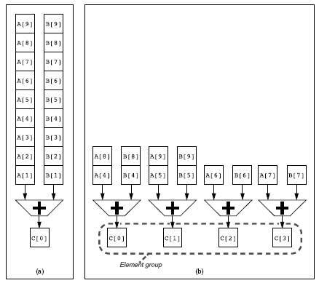
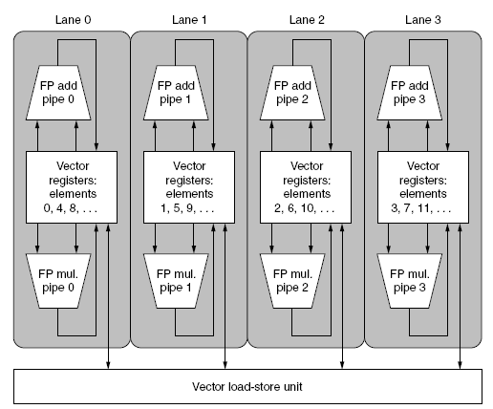
Multiple Lanes
Element n of vector register A is “hardwired” to element n of vector register B
Allows for multiple hardware lanes
Vector Architectures

Slide 12
Vector Mask Registers
Vector Architectures
Consider:
for (i = 0; i < 64; i=i+1)
if (X[i] != 0)
X[i] = X[i] – Y[i];
Use vector mask register to “disable” elements:
LV V1,Rx ;load vector X into V1
LV V2,Ry ;load vector Y
L.D F0,#0 ;load FP zero into F0
SNEVS.D V1,F0 ;sets VM(i) to 1 if V1(i)!=F0
SUBVV.D V1,V1,V2 ;subtract under vector mask
SV Rx,V1 ;store the result in X
Compilers manipulate mask registers explicitly

Slide 13
SIMD Extensions
Media applications operate on data types narrower than the native word size
Example: disconnect carry chains to “partition” 64-bit adder --> eight 8-bit elements
Limitations, compared to vector instructions:
Number of data operands encoded into op code
No sophisticated addressing modes
No mask registers
SIMD Instruction Set Extensions for Multimedia

Slide 14
SIMD Implementations
Implementations:
Intel MMX (1996)
Eight 8-bit integer ops or four 16-bit integer ops
Streaming SIMD Extensions (SSE) (1999)
Eight 16-bit integer ops
Four 32-bit integer/fp ops or two 64-bit integer/fp ops
Advanced Vector Extensions (2010)
Four 64-bit integer/fp ops
SIMD Instruction Set Extensions for Multimedia

Slide 15
Graphical Processing Units
Graphical Processing Units
Given the hardware invested to do graphics well,
how can we supplement it to improve performance of a wider range of applications?

Slide 16
GPU Accelerated or Many-core Computation
NVIDIA GPU
Reliable performance, communication between CPU and GPU using the PCIE channels
Tesla M2090
512 CUDA cores (16 Streaming Multiprocessor x 32 cores/SM )
1331 GFLOPs (single precision)
6GB memory with 177GB/sec bandwidth
Notes:
http://www.nvidia.com/object/tesla-servers.html

Slide 17
GPU Accelerated or Many-core Computation (cont.)
APU (Accelerated Processing Unit) – AMD
CPU and GPU functionality on a single chip
AMD FirePro A320
4 CPU cores and 384 GPU processors
736 GFLOPs (single precision) @ 100W
Up to 2GB dedicated memory
Notes:
http://www.amd.com/us/products/workstation/graphics/ati-firepro-3d/APU/Pages/APU.aspx#4

Slide 18
GPU Accelerated or Many-core Computation (cont.)
MIC (Many Integrated Core) – Intel
Many CPU cores on a single chip
Intel Xeon Phi Coprocessor 5110P
60 cores/1.053 GHz/240 threads
8 GB memory and 320 GB/s bandwidth
829 GFLOPs (double precision) @ 195W (Intel Xeon Phi coprocessor SE10P)
Easier programming, lower power consumption, and better integration of the CPU and GPU capabilities
Notes:
http://www.intel.com/content/www/us/en/processors/xeon/xeon-phi-detail.html

Slide 19
Programming the NVIDIA GPU
We use NVIDIA GPU as the example for discussion
Graphical Processing Units
Heterogeneous execution model
CPU is the host, GPU is the device
Develop a programming language (CUDA) for GPU
Unify all forms of GPU parallelism as CUDA thread
Programming model is “Single Instruction Multiple Thread”

Slide 20
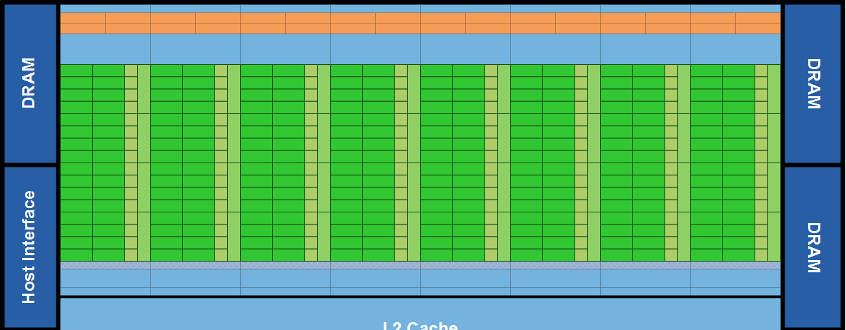
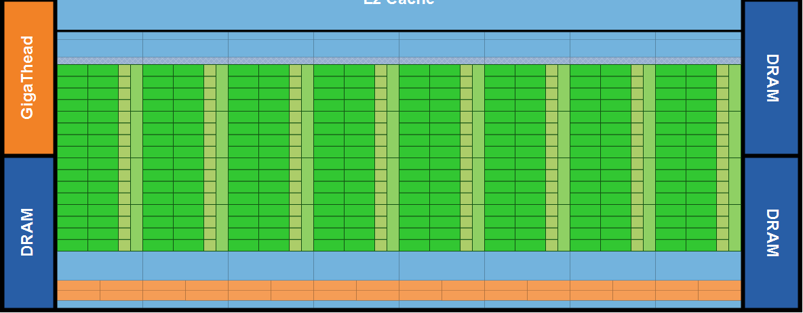
Fermi GPU
One Stream Processor (SM)
Notes:
Fermi’s 16 SM are positioned around a common L2 cache. Each SM is a vertical rectangular strip that contain an orange portion (scheduler and dispatch), a green portion (execution units), and light blue portions (register file and L1 cache).
Figure from: http://www.nvidia.com/content/PDF/fermi_white_papers/NVIDIA_Fermi_Compute_Architecture_Whitepaper.pdf

Slide 21
NVIDIA GPU Memory Structures
Each SIMD Lane has private section of off-chip DRAM
“Private memory”
Each multithreaded SIMD processor also has local memory
Shared by SIMD lanes
Memory shared by SIMD processors is GPU Memory
Host can read and write GPU memory
Graphical Processing Units

Slide 22
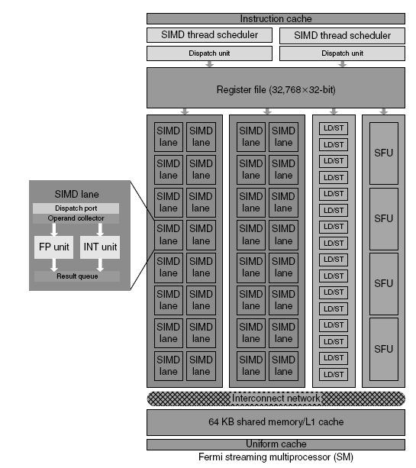
Fermi Multithreaded SIMD Proc.
Each Streaming Processor (SM)
32 SIMD lanes
16 load/store units
32,768 registers
Each SIMD thread has up to
64 vector registers of 32 32-bit elements
Graphical Processing Units

Slide 23
GPU Compared to Vector
Similarities to vector machines:
Works well with data-level parallel problems
Mask registers
Large register files
Differences:
No scalar processor
Uses multithreading to hide memory latency
Has many functional units, as opposed to a few deeply pipelined units like a vector processor
Graphical Processing Units

Slide 24
http://www.nvidia.com/object/fermi-architecture.html
Introduction to Fermi from NVIDIA

Slide 25
Questions?

