Slide 1
Project Tutorial
COMP4611 Tutorial 7
Oct 29th-Nov 2nd

Slide 2
Outline
Objectives
Project Task I
Task description
Project Task II
Task description
Skeleton code
Project Task III
Task description
Deliverables
Submission & Grading

Slide 3
Objectives
To have hands-on experiments with the branch prediction using SimpleScalar
To design your own branch predictor for higher prediction accuracy

Slide 4
Background
Branch predictor types in SimpleScalar (alpha)
Taken or not-taken
Perfect predictor
2-bit predictor
2-level adaptive predictor
Specifying the branch predictor type
Option: -bpred <type>
<type>: nottaken, taken, perfect, bimod, 2lev

Slide 5
Background
Configuring taken/nottaken predictor
Option: -bpred taken, -bpred nottaken
Command line example for “-bpred taken”:
./sim-bpred -bpred taken benchmarks/cc1.alpha -O benchmarks/1stmt.1
Command line example for “-bpred nottaken”:
./sim-bpred -bpred nottaken benchmarks/cc1.alpha -O benchmarks/1stmt.i

Slide 6
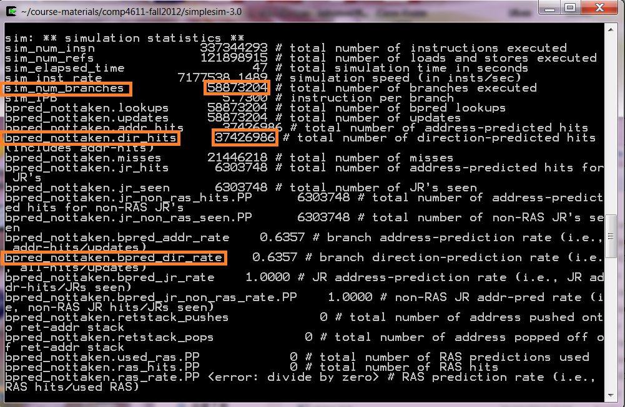

Simulating Not-Taken Predictor
Branch prediction accuracy:
bpred_dir_rate = $\frac{\text{total} \text{number} \text{of} \text{direction}\text{−}\text{predicted} \text{hits}}{\text{total} \text{number} \text{of} \text{branches} \text{executed} }$

Slide 7
Background
Configuring 2-bit predictor
-bpred:bimod <size>
<size>: the size of direct-mapped branch target buffer (BTB)
Command line example:
./sim-bpred -bpred:bimod 2048 benchmarks/cc1.alpha -O benchmarks/1stmt.i
T
NT
Predict: Taken
11
10
T
NT
T
NT
01
Predict: Not Taken
00
T
NT

Slide 8
Project Task I
Evaluation of 2-bit dynamic branch predictor
Varied number of table entries (512, 1024, 2048)
Benchmark: Go (Alpha)
Configuration parameters for Go: 2 17
Input file for Go: 2stone9.in
Branch prediction accuracy (bpred_dir_rate) and command lines to be included in the project report
Command line example:
./sim-bpred -redir:prog results/go-2bit-512-2-17.progout -redir:sim results/go-2bit-512-2-17.simout -bpred:bimod 512 benchmarks/go.alpha 2 17 benchmarks/2stone9.in

Slide 9
Project Task II
Write a 3-bit branch predictor on SimpleScalar
Implementation
Evaluation
Guideline
Skeleton code at http://course.cse.ust.hk/comp4611/comp4611_project.tar.gz
Extract the package and compile it by typing “make config-alpha” and then “make”
Fill in the missing code in bpred.c and recompile

Slide 10
Code Glimpse
Source code that implements the branch predictor is in simplesim-3.0/
sim-bpred.c: simulating a program with configured branch prediction instance
brpred.c: implementing the logic of several branch predictors
brpred.h: defining the structure of several branch predictors
main.c: simulating a program on SimpleScalar

Slide 11
Code Glimpse
bpred.h
bpred_class: branch predictor types
bpred_t: branch predictor structure
bpred_dir_t: branch direction structure
bpred_update_t: branch state update structure (containing predictor state counter)
bpred_btb_ent_t: entry structure in a BTB

Slide 12
Code Glimpse
Predictor’s state counter
struct bpred_update_t {
char *pdir1; /* direction-1 predictor counter */
char *pdir2; /* direction-2 predictor counter */
char *pmeta; /* meta predictor counter */
struct { /* predicted directions */
unsigned int ras : 1; /* RAS used */
unsigned int bimod : 1; /* bimodal predictor */
unsigned int twolev : 1; /* 2-level predictor */
unsigned int meta : 1; /* meta predictor (0..bimod / 1..2lev) */
} dir;
};

Slide 13
Code Glimpse
bpred.c
bpred_create: create a new branch predictor instance
bpred_dir_create: create a branch direction instance
bpred_lookup: predict a branch target
bpred_dir_lookup: predict a branch direction
bpred_update: update an entry in BTB

Slide 14
Code Glimpse
Workflow of branch prediction
main
sim_check_options
bpred_create
bpred_dir_create
allocate BTB
sim_main
bpred_lookup
bpred_update
pred->dir_hits
*dir_update_ptr->pdir1

Slide 15
3-bit Branch Predictor
A 3-bit branch predictor has 8 states in total
T
NT
NT
NT
111
110
101
100
T
T
T
T
Predict Taken
NT
NT
NT
NT
NT
000
001
010
011
T
T
T
Predict Not Taken

Slide 16
Implementation
Configuring 3-bit predictor
-bpred:tribit <size>
<size>: the size of direct-mapped BTB
Command line example:
./sim-bpred -v -redir:prog results/go-3bit-2048-2-17.progout -redir:sim results/go-3bit-2048-2-17.simout -bpred:tribit 2048 benchmarks/go.alpha 2 17 benchmarks/5stone21.in
Command must include verbose option –v

Slide 17
Skeleton Code
branch_lookup() in bpred.c
/* comp4611 3-bit predict saturating cntr pred (dir mapped) */
if (pbtb == NULL) {
if (pred->class != BPred3bit) {
return ((*(dir_update_ptr->pdir1) >= 2)? /* taken */ 1 : /* not taken */ 0);
}
else {
// code to be filled in here
}
}
else {
……
}
/************************************************************/

Slide 18
Skeleton Code
branch_update() in bpred.c
/* comp4611 3-bit predict saturating cntr pred (dir mapped) */
if (dir_update_ptr->pdir1) {
if (pred->class != BPred3bit) {
…….
}
else {
if (taken) {
// code to be filled in here
}
else { /* not taken */
// code to be filled in here
}
}
}
/****************************************************/

Slide 19
Evaluation
3-bit predictor with the table size as 2048
Benchmark: Go (Alpha)
Parameters for Go: 2 17
Input file for Go: 2stone9.in
Branch prediction accuracy and command line to be included in the project report
Output trace files (include option –v)
are the redirected program and simulation output
should be saved in the “results” directory
are as large as a few GBs and make sure you have sufficient disk storage for them in your PC

Slide 20
Project Task III
Design and implement your own predictor
Use existing predictors (e.g. 2-level) or create your own predictor to achieve higher accuracy than the 2-bit predictor
Evaluate your predictor using Go (Alpha)
Parameters for Go: 2 17
Input file for Go: 2stone9.in
Branch prediction accuracy and command line to be included in the project report
Output trace files (include option –v)
are the redirected program and simulation output
should be saved in the “results” directory
are as large as a few GBs and make sure you have sufficient disk storage for them in your PC

Slide 21
Deliverables
Source code
Code for 3-bit predictor: bpred.c, saved as “3bit/bpred.c”
Code for your own predictor: including bpred.h, bpred.c, sim-bpred.c, readme (specify your command line format) and other relevant files, saved under “own/”
To be submitted to CASS
Output trace files
Output trace files for 3-bit predictor
Output trace files for your own predictor
To be submitted separately (not CASS)
Project report (no longer than 2 pages)
Evaluation result (2-bit, 3-bit, your own predictor)
Description of your own predictor
To be submitted to CASS

Slide 22
Grading Scheme
2-bit predictor (20%)
Correctness
3-bit predictor (40%)
Correctness
Your own predictor (30%)
If correct, score = max{0, (prediction accuracy – 0.85) * 200}
Project report (10%)
Completeness
Correctness
Clarity

Slide 23
Submission Guideline
Submit your source code and report to CASS
Report should contain your group ID, each group member’s name, UST ID, email on the first page
Package the code and report files in one zip file as “comp4611_project_groupID.zip”
Deadline: Nov 30, 2012
Submit the hardcopy of your report to the homework box
Report should contain your group ID, each group member’s name, UST ID, email on the first page
Deadline: Nov 30, 2012
Submission of your output trace files will be informed later

Slide 24
References
SimpleScalar LLC: www.simplescalar.com
Introduction to SimpleScalar: www.ecs.umass.edu/ece/koren/architecture/Simplescalar/SimpleScalar_introduction.htm
SimpleScalar Tool Set: http://www.ece.uah.edu/~lacasa/tutorials/ss/ss.htm

Slide 25
Appendix
Branch direction structure
struct bpred_dir_t {
enum bpred_class class; /* type of predictor */
union {
struct {
unsigned int size; /* number of entries in direct-mapped table */
unsigned char *table; /* prediction state table */
} bimod;
……
} config;
};

Slide 26
Appendix
sim-bpred.c
sim_main: execute each conditional branch instruction
sim_reg_options: register command options
sim_check_options: determine branch predictor type and create a branch predictor instance
pred_type: define the type of branch predictor
*_nelt & *_config[]: configure the parameters for each branch predictor

Slide 27
Appendix
sim_main() in sim-bpred.c
if (MD_OP_FLAGS(op) & F_CTRL) {
if (pred) {
pred_PC = bpred_lookup(pred, …, &update_rec, …);
if (!pred_PC) {
pred_PC = regs.regs_PC + sizeof(md_inst_t);
}
bpred_update(pred, …, &update_rec, …);
}
}
……
regs.regs_PC = regs.regs_NPC;
regs.regs_NPC += sizeof(md_inst_t);

Slide 28
Appendix
main() in main.c
sim_odb = opt_new(orphan_fn);
opt_reg_flag(sim_odb, …);
……
sim_reg_options(sim_odb);
opt_process_options(sim_odb, argc, argv);
……
sim_check_options(sim_odb, argc, argv);
……
sim_reg_stats(sim_sdb);
……
sim_main();
……

