Slide 1
COMP4611: Design and Analysis of Computer Architectures Instruction Set Architectures

Slide 2
Instruction Set Architecture (ISA)
In order to use the hardware of a computer, we must speak its language.
The words of a computer language are called instructions, and its vocabulary is called an instruction set.
Instruction set of a computer: the portion of the computer visible to the assembly level programmer or to the compiler writer.
software
instruction set
hardware

Slide 3
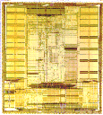
Instruction Set Architecture
Application
Instruction Set Architecture
…SPARC MIPS ARM x86 HP-PA IA-64…
Intel Pentium X, Core 2
AMD K6, Athlon, Opteron
Transmeta Crusoe TM5x00
Implementation

Slide 4
Interface Design
A good interface
lasts through many implementations (portability, compatibility)
is used in many different ways (generality)
provides convenient functionality to higher levels
permits an efficient implementation at lower levels
use
imp 1
time
Interface
use
imp 2
use
imp 3

Slide 5
Instruction Set Architecture
Strong influence on cost/performance
Remember the Execution Time equation?
ISA has a huge impact on programs and their performance!
New ISAs are rare, but new (extended) versions are not
16-bit, 32-bit and 64-bit X86 versions
Longevity is a strong function of marketing prowess
CPU time = Seconds = Instructions x Cycles x Seconds
Program Program Instruction Cycle

Slide 6
Instruction Set Architecture
What is an instruction set architecture?
Specification of a set of instructions
Each instruction is directly executed by the CPU hardware.
How is it represented?
By a binary format, typically bits, bytes, words.
Word size is typically 16, 32, 64 bits today.
Length format options:
Fixed – each instruction encoded in same size field
Variable – half-word, whole word, multiple word instructions are possible

Slide 7
Instruction Formats
VAX-11: 1—53 bytes
Alpha (fixed length)
opcode
TRAP
x86 (variable length)
opcode
RA
Branch
opcode
RA
RB
Mem
prefixes
opcode
addr mode
displ
imm
opcode
RA
RB
RC
Operate
0 to 8 bytes
6 bits
32 bits
0 to 2 bytes (ModR/M and SIB)
1 or 2 bytes of opcode
0 to 4 bytes of prefix

Slide 8
Evolution of Instruction Sets
Single Accumulator (EDSAC 1950)
Accumulator + Index Registers
(Manchester Mark I, IBM 700 series 1953)
Separation of Programming Model
from Implementation
High-level Language Based
Concept of a Family
(B5000 1963)
(IBM 360 1964)
General Purpose Register Machines
Complex Instruction Sets
Load/Store Architecture
(Vax, Intel 432 1977-80)
(CDC 6600, Cray 1 1963-76)
CISC
RISC
(Intel x86 1980-199x)
(MIPS,Sparc,HP-PA,IBM RS6000,PowerPC 1987,AVR)
Mixed CISC & RISC?
(IA-64. . .1999)

Slide 9
Basic ISA Classes
Accumulator:
1 Address: add A (acc ← acc + Mem[A]).
Stack:
0 address: add (tos ← tos + second of stack).
General Purpose Register (GPR):
A fast register file (collection of registers)
Operands of arithmetic operations are explicitly specified
Operands can be memory locations or registers
2 addresses: add A, B EA(A) ←EA(A)+EA(B)
3 addresses: add A, B, C EA(A) ←EA(B)+EA(C)

Slide 10
Basic ISA Classes
Classes of GPR computers
Register-register, register-memory, memory-memory
Load/Store (register-register):
ALU operations : No memory reference.
3 addresses: add R1, R2, R3 R1 ← R2 + R3
load R1, R2 R1 ←Mem[R2]
store R1, R2 Mem[R1] ← R2
Comparison: Bytes per Instruction? Number of Instructions? Cycles per instruction?

Slide 11
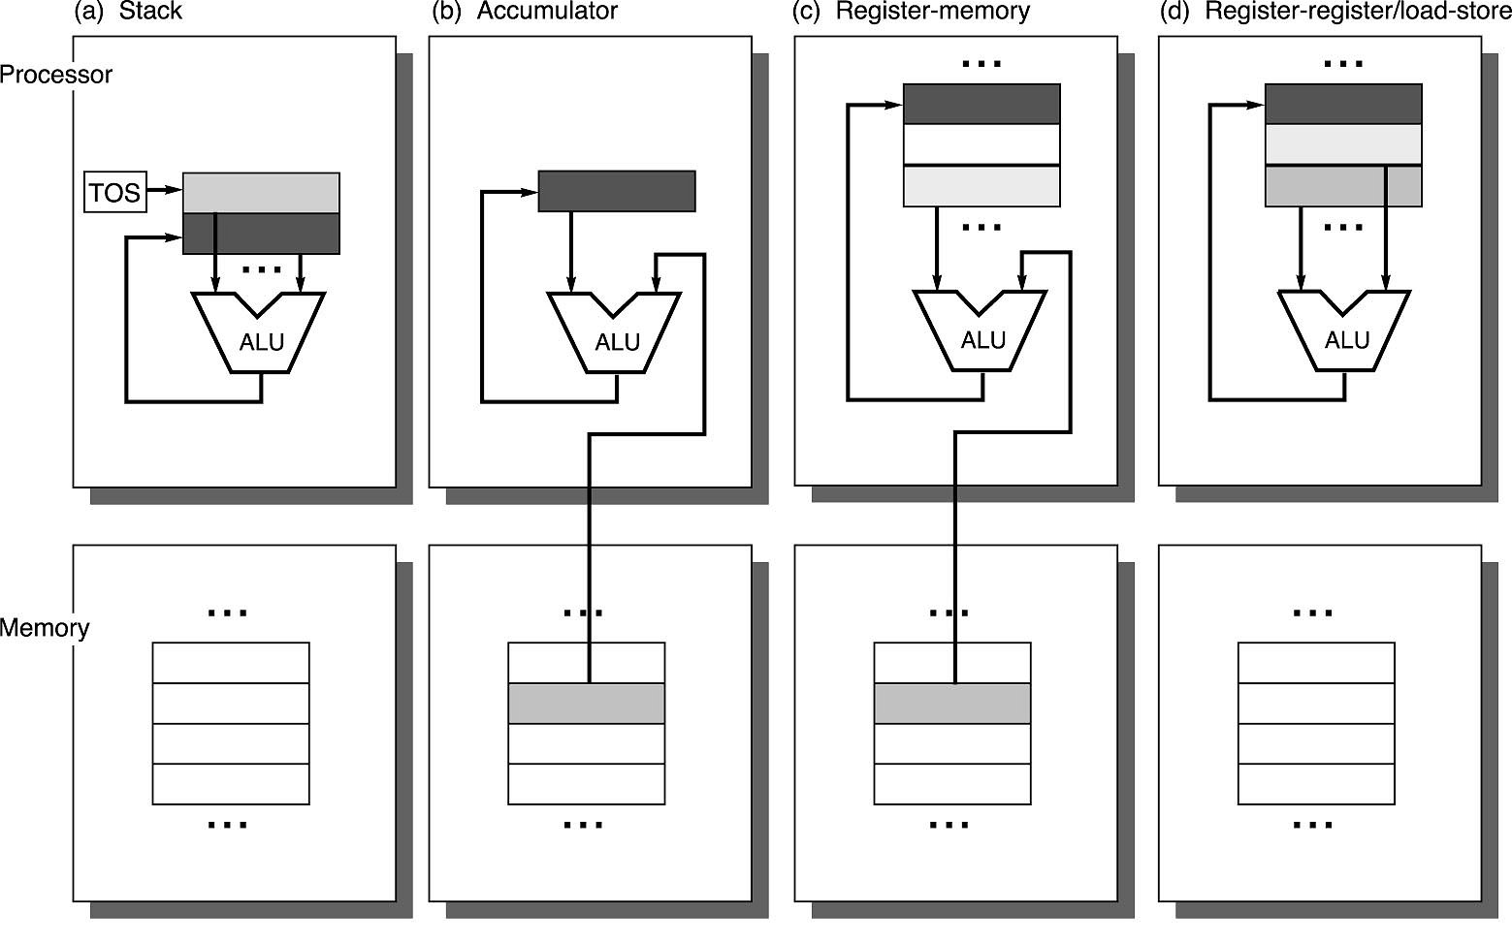
Operand Locations in Four ISA Classes

Slide 12
Comparison of ISA Classes
Code Sequence for C = A+B
A, B, and C are variables stored in memory
Memory efficiency? Instruction access? Data access?
What’s the minimum number of instructions we need for a computer?

Slide 13
What may an ISA want to provide?
Computers should use general purpose registers
Computer should use a load-store architecture
The number of instructions is not a limitation any more

Slide 14
Addressing Modes
An important aspect of ISA design
Has major impact on both the HW complexity and the instruction count
HW complexity affects the CPI and the cycle time
Basically a set of mappings
From address specified to address used
Address used = effective address
Effective address may go to memory or to register file
Effective address generation is an important focus

Slide 15
Typical Memory Addressing Modes
Addressing Sample
Mode Instruction Meaning
Register
Immediate
Displacement
Indirect
Indexed
Absolute
Memory indirect
Autoincrement
Autodecrement
Scaled
Add R4, R3
Add R4, #3
Add R4, 10 (R1)
Add R4, (R1)
Add R3, (R1 + R2)
Add R1, (1001)
Add R1, @ (R3)
Add R1, (R2) +
Add R1, - (R2)
Add R1, 100 (R2) [R3]
Regs [R4] ←Regs[R4] + Regs[R3]
Regs[R4] ←Regs[R4] + 3
Regs[R4] ←Regs[R4]+Mem[10+Regs[R1]]
Regs[R4] ←Regs[R4]+ Mem[Regs[R1]]
Regs [R3] ←Regs[R3]+Mem[Regs[R1]+Regs[R2]]
Regs[R1] ←Regs[R1] + Mem[1001]
Regs[R1] ←Regs[R1] + Mem[Mem[Regs[R3]]]
Regs[R1] ←Regs[R1] + Mem[Regs[R2]]
Regs[R2] ←Regs[R2] + d
Regs [R2] ←Regs[R2] -d
Regs{R1] ←Regs[Regs[R1] +Mem[Regs[R2]]
Regs[R1] ←Regs[R1] +
Mem[100+Regs[R2]+Regs[R3]*d]

Slide 16
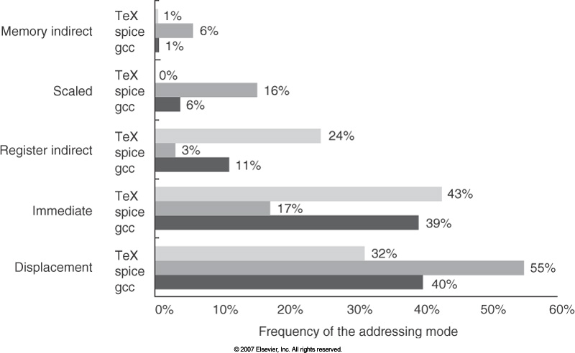
Utilization of Memory Addressing Modes

Slide 17
Addressing Modes Usage Example
For 3 programs running on VAX ignoring direct register mode:
Displacement 42% avg, 32% to 55%
Immediate: 33% avg, 17% to 43%
Register deferred (indirect): 13% avg, 3% to 24%
Scaled: 7% avg, 0% to 16%
Memory indirect: 3% avg, 1% to 6%
Misc: 2% avg, 0% to 3%
75% displacement & immediate
88% displacement, immediate & register indirect.
Observation: In addition to Register direct, Displacement, Immediate, Register Indirect addressing modes are important.
75%
88%

Slide 18
Displacement Address Size Example
Avg. of 5 SPECint programs vs. avg. 5 SPECfp programs
Displacement Address Bits Needed
1% of addresses > 16-bits
12 - 16 bits of displacement needed

Slide 19
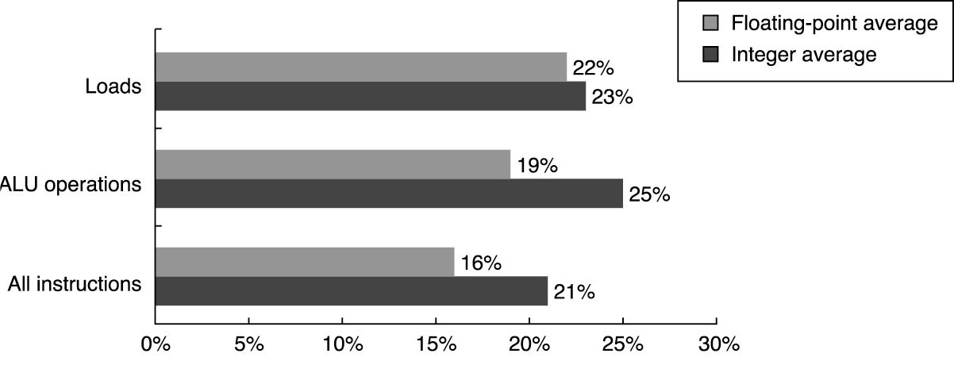
Immediate Addressing Mode
About one quarter of data transfers and ALU operations
have an immediate operand for SPEC CPU2000 programs.

Slide 20
Immediate Addressing Mode
50% to 60% fit within 8 bits
75% to 80% fit within 16 bits
gcc
spice
Tex

Slide 21
Addressing Mode Summary
Important data addressing modes
Displacement
Immediate
Register Indirect
Displacement size should be 12 to 16 bits.
Immediate size should be 8 to 16 bits.

Slide 22
Instruction Operations
Arithmetic and Logical:
add, subtract, and , or, etc.
Data transfer:
Load, Store, etc.
Control
Jump, branch, call, return, trap, etc.
Synchronization:
Test & Set.
String:
string move, compare, search.

Slide 23
Instruction Usage Example: Top 10 Intel X86 Instructions
Rank
instruction
Integer Average Percent total executed
1
load
22%
2
conditional branch
20%
3
compare
16%
4
store
12%
5
add
8%
6
and
6%
7
sub
5%
8
move register-register
4%
9
call
1%
10
return
1%
Total
96%
Observation: Simple instructions dominate instruction usage frequency.

Slide 24
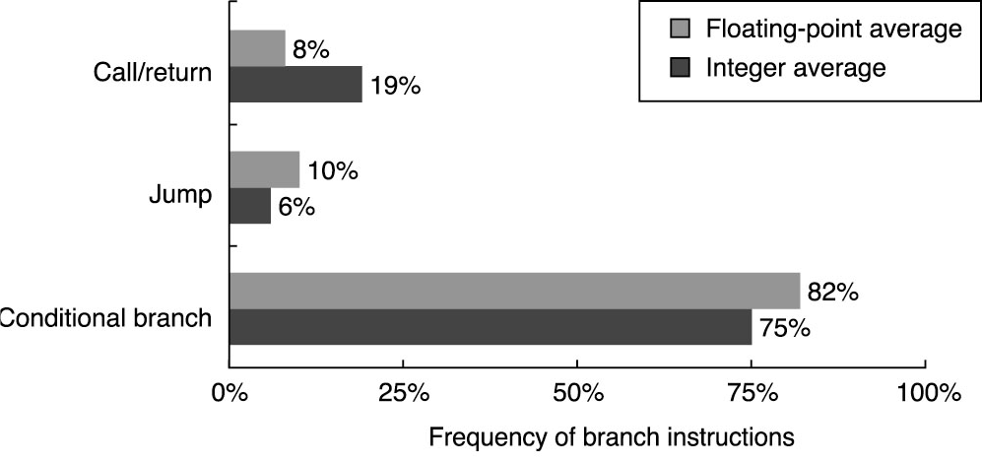
Instructions for Control Flow
Breakdown of control flow instructions into three classes: calls or returns,
jumps and conditional branches for SPEC CPU2000 programs.

Slide 25
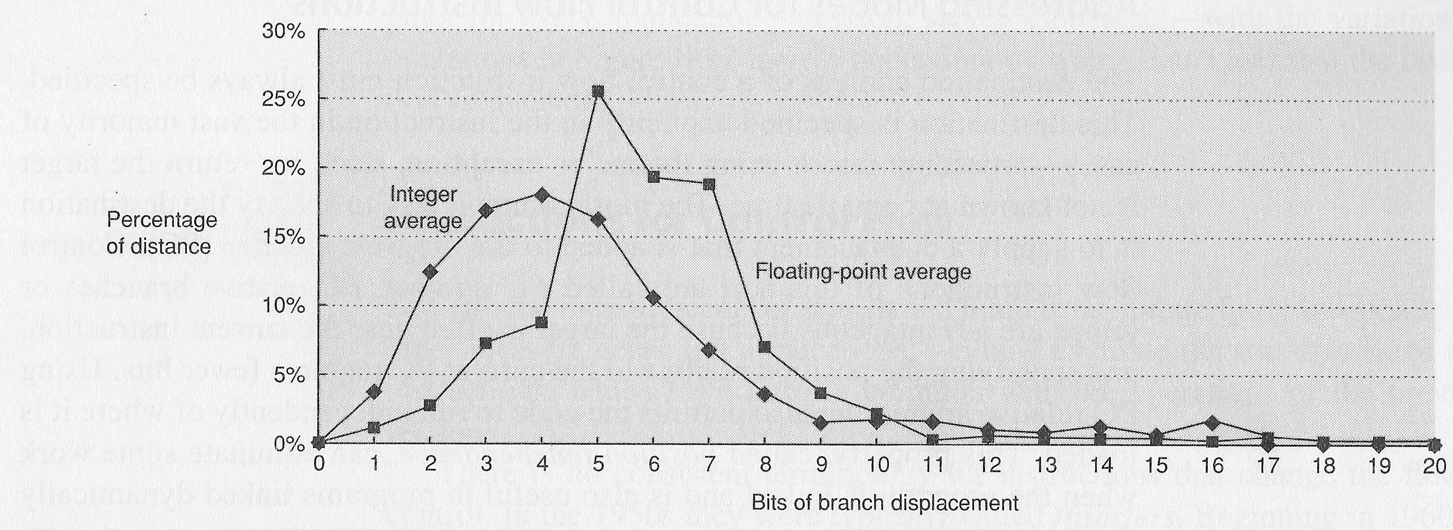
Conditional Branch Distance
Short displacement fields often sufficient for branch
PC-relative, since most branches from current PC address
At least 8 bits.

Slide 26
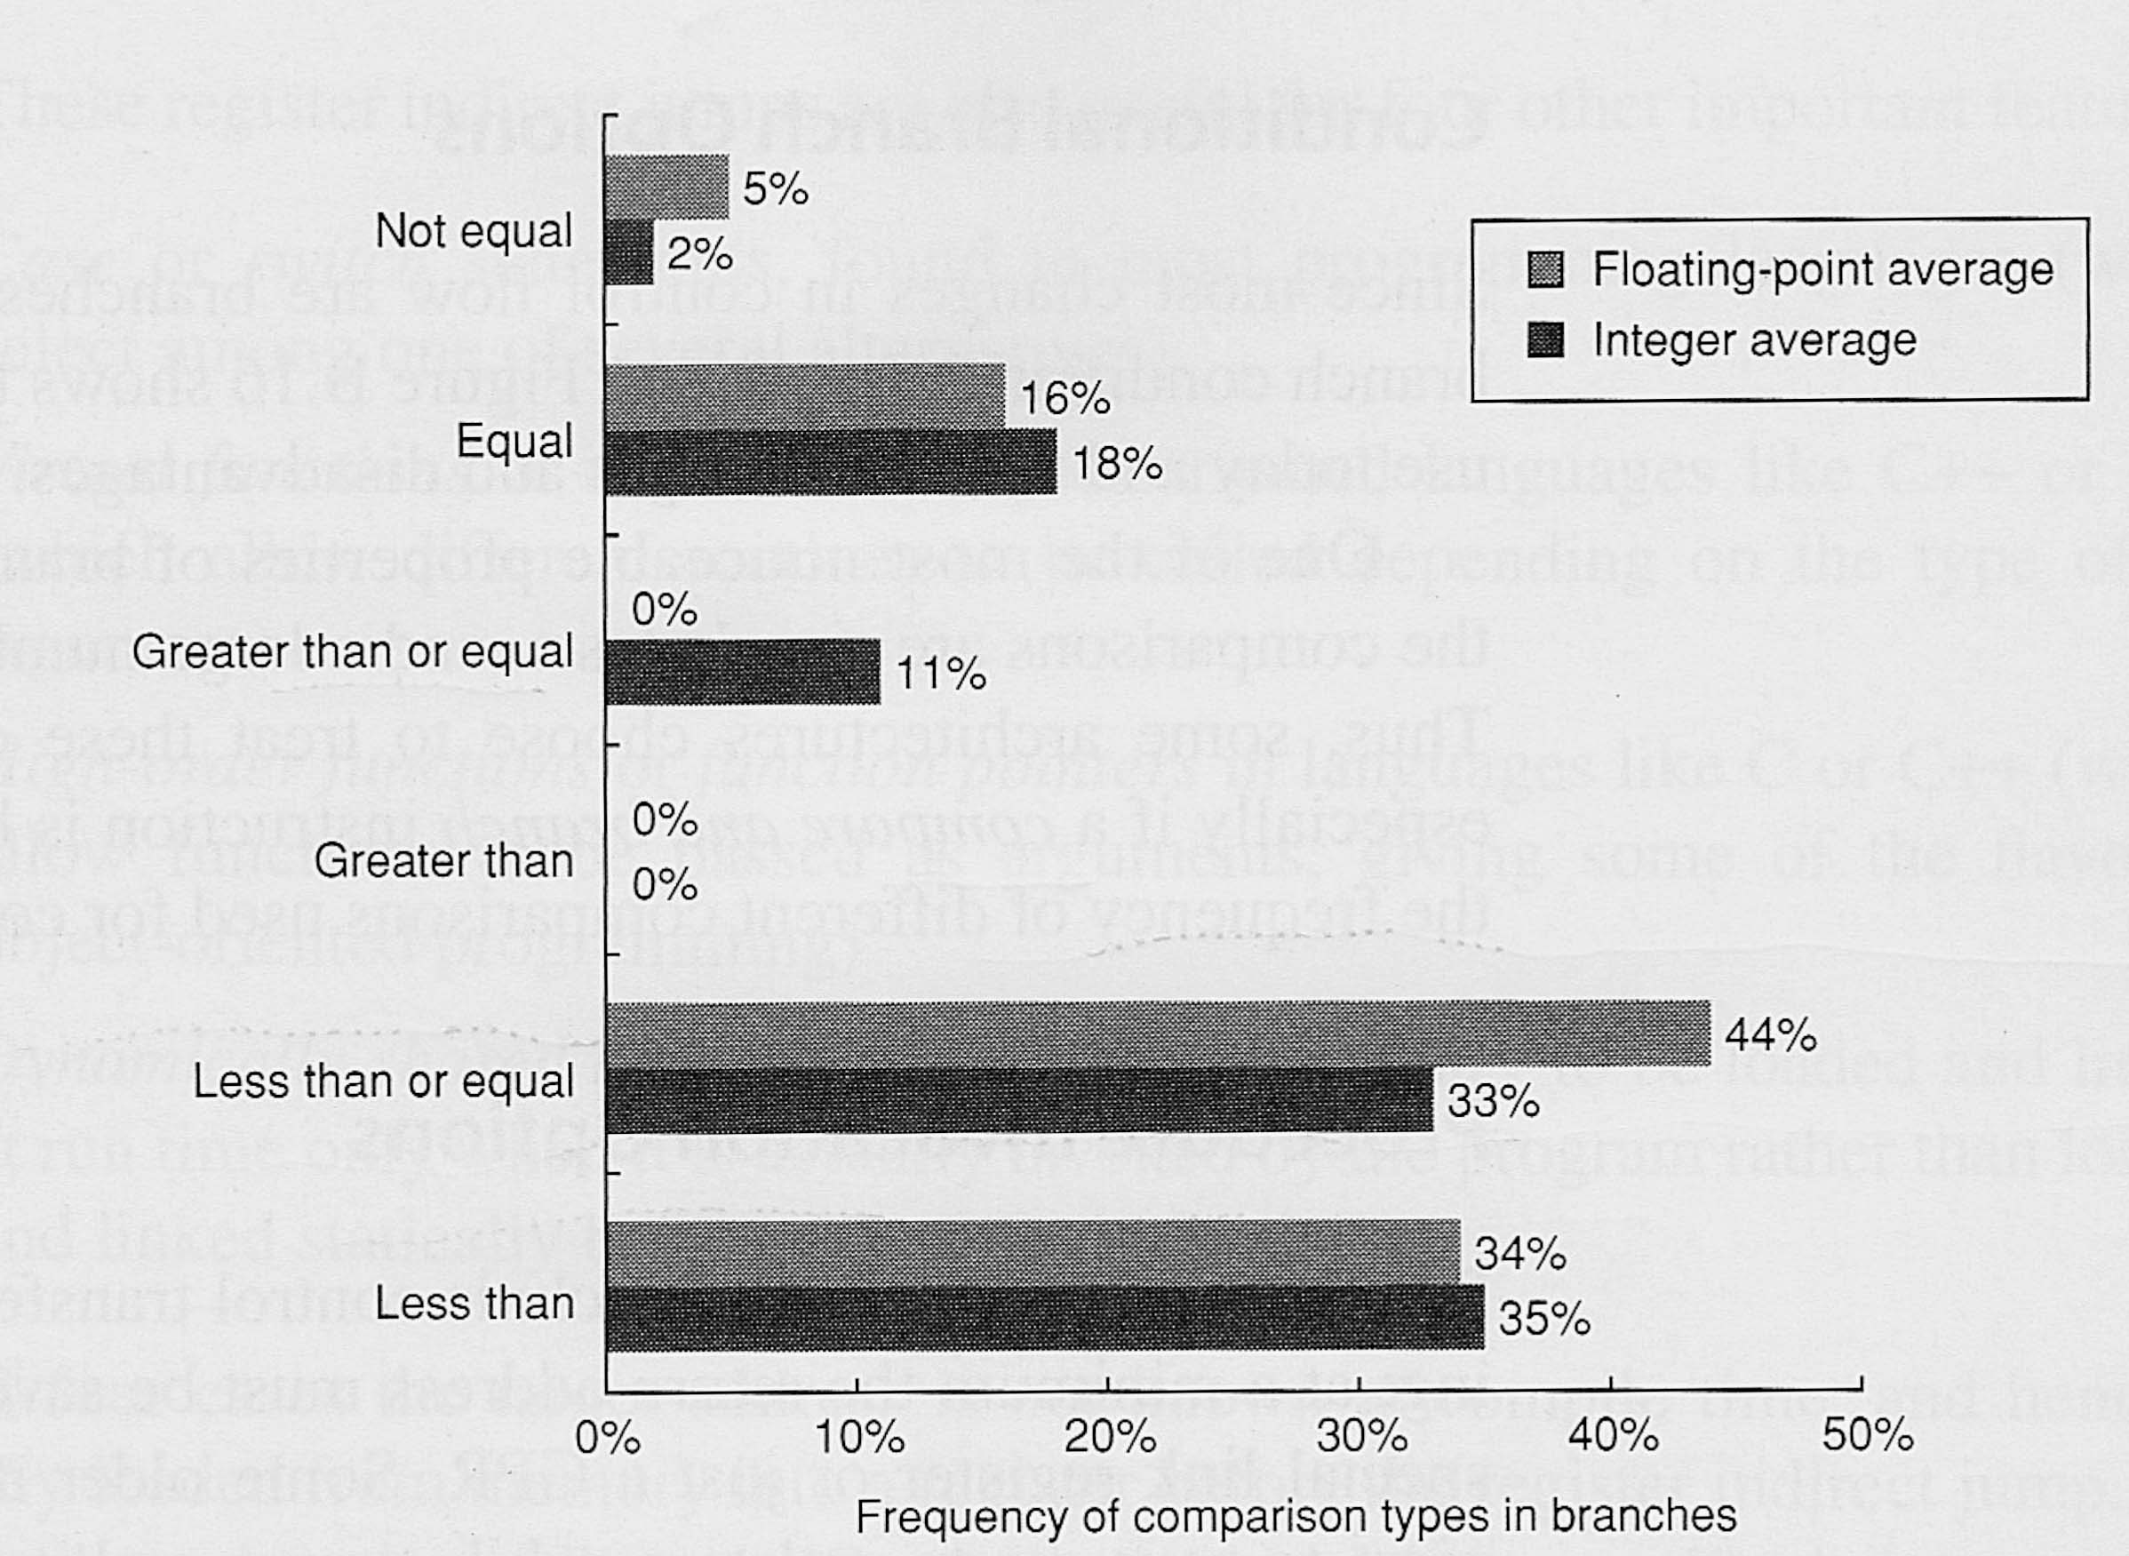
Conditional Branch Addressing
Compare Equal/Not Equal/Less than (or Equal) are important

Slide 27
Data Type and Size of Operands
Byte, half word (16 bits), word (32 bits), double word (64 bits).
Arithmetic:
Decimal: 4bit per digit.
Integers: 2’s complement
8 bits (C char), 16 bits (C int16_t, sometimes int, short), 32 bits (C int32_t, sometimes long), 64 bits (C int64_t, sometimes long long)
Floating-point: IEEE standard
Single precision: 32 bits (C float)
Double precision: 64 bits (C double)
Quadruple precision: 128 bits
Extended precision: e.g., 80 bits

Slide 28
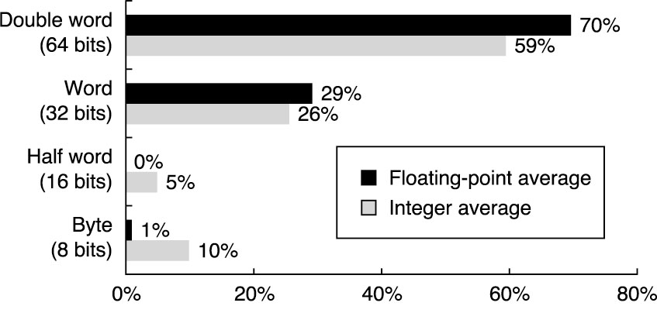
Type and Size of Operands
Distribution of data accesses by size for SPEC CPU2000
benchmark programs

Slide 29
Instruction Set Encoding
Considerations affecting instruction set encoding:
To support registers and addressing modes provided
The impact of the size of the register and addressing mode fields on the average instruction size and on the average program.
To encode instructions into lengths that will be easy to handle in the implementation.
Usually, the instruction length should be a multiple of bytes.

Slide 30
Instruction Format
Fixed
Operation, address specifier 1, address specifier 2, address specifier 3.
MIPS, SPARC, Power PC.
Variable
Operation & # of operands, address specifier1, …, specifier n.
VAX
Hybrid
Intel x86
operation, address specifier, address field.
operation, address specifier 1, address specifier 2, address field.
operation, address field, address specifier 1, address specifier 2.
Summary:
If code size is most important, use variable format.
If performance is most important, use fixed format.

Slide 31
Three Examples of Instruction Set Encoding
Operations &
no of operands
Address
specifier 1
Address
field 1
Address
specifier n
Address
field n
Variable: VAX (1-53 bytes)
Operation
Address
field 1
Address
field 2
Address
field3
Fixed: DLX, MIPS, PowerPC, SPARC
Operation
Address
Specifier
Address
field
Operation
Address
Specifier 1
Address
Specifier 2
Address field
Address
Specifier
Address
field 2
Operation
Address
field 1
Hybrid : IBM 360/370, Intel 80x86

Slide 32
Instruction Format
Endian-ness: byte ordering in multibyte data
Little Endian vs. Big Endian
To know how important this issue is, read to “Gulliver's Travels”
 | Byte 0 | Byte 1 | Byte 2 | Byte 3
Most Significant Byte (MSB) |  |  |  |  | Least Significant Byte (LSB)
Memory Address | +0 | +1 | +2 | +3
Big Endian | Byte 0 | Byte 1 | Byte 2 | Byte 3 | MSB in the lowest (first) memory address
Little Endian | Byte 3 | Byte 2 | Byte 1 | Byte 0 | LSB in the lowest (first) memory address

Slide 33
What should an ISA want to provide?
Use general purpose registers with a load-store architecture.
Support these addressing modes: displacement, immediate, register indirect.
Support these simple instructions: load, store, add, subtract, move register, shift, compare equal, compare not equal, branch, jump, call, return.
Support these data size: 8-,16-,32-bit integer, IEEE FP standard.
Provide at least 16 general purpose registers plus separate FP registers and aim for a minimal instruction set.

Slide 34
64-Bit Processors
Notes:
Please if anyone has additional comments please speak up

Slide 35
32-bit Computing
In computer architecture, a word is defined as a unit of data that can be addressed and moved between the computer processor and the storage area.
In 32-bit computing a word is 32 bits.
Usually, the defined bit-length of a word is equivalent to the width of the computer's data bus (and registers) so that a word can be moved in a single operation from the storage to the processor registers

Slide 36
32-bit Computing
In a 32-bit microprocessor;
There are 32-bit general-purpose registers in the processor.
There are 2³² = 4GB memory to be addressed.

Slide 37
64-bit Computing
The best and simple definition is enhancing the processing word in the architecture to 64 bits.
The addressable memory increases from 4 GB to up to 2⁶⁴ = 18 billion GB
Many implementations support less than this
Size of registers extended to 64 bits
Integer and address data up to 64 bits in length can now be operated on
2⁶⁴ = 1.8 x 10¹⁹ integers can be represented with 64 bits vs. 4.3 x 10⁹ with 32 bits
Dynamic range has increased by a factor of 4.3 billion!

Slide 38
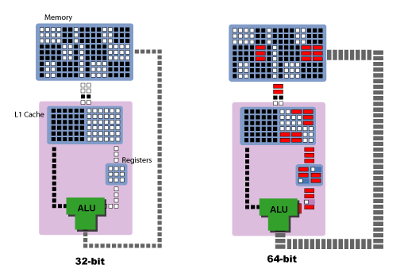
64-bit Computing
Stepping up from 32 to 64 bits does not mean doubling performance
Certain applications will benefit, others may not
What Applications Can Benefit Most From 64-bit?
Large databases
Business and scientific simulation and modeling programs
Highly graphics-intensive software (CAD, 3-D games)
Cryptography
Etc.

