Slide 1
COMP4611: Design and Analysis of Computer Architectures Basic Pipelining Lin Gu CSE, HKUST

Slide 2
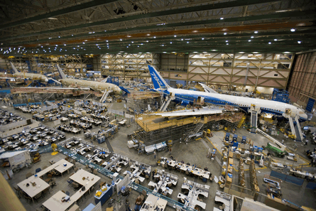

Introduction to Pipelining – Boeing Everett
Courtesy photos by Boeing

Slide 3
Introduction to Pipelining
Pipelining: An implementation technique that overlaps the execution of multiple instructions. It is a key technique in achieving high-performance
Laundry Example
Ann, Brian, Cathy, Dave each has one load of clothes to wash, dry, and fold
Washing takes 30 minutes
Drying takes 40 minutes
“Folding” takes 20 minutes
A
B
C
D
washer
dryer
folding

Slide 4
Sequential Laundry
6 PM
7
8
9
10
11
Midnight
Time
30
40
20
30
40
20
30
40
20
30
40
20
T
a
s
k
O
r
d
e
r
A
B
C
D
Sequential laundry takes 6 hours for 4 loads

Slide 5
Pipelined Laundry: start work ASAP
6 PM
7
8
9
10
11
Midnight
Time
30
40
40
40
40
20
T
a
s
k
O
r
d
e
r
A
B
C
D
Pipelined laundry takes 3.5 hours for 4 loads
Speedup = 6/3.5 = 1.7

Slide 6
Pipelining Lessons
Latency vs. Throughput
Question
What is the latency in both cases ?
What is the throughput in both cases ?
30
40
40
40
40
20
Pipelining doesn’t reduce latency of single task,
It increases throughput of entire workload
A
B
C
D

Slide 7
Pipelining Lessons [cont’d…]
Question
What is the fastest operation in the example ?
What is the slowest operation in the example
Pipeline rate limited by slowest pipeline stage
30
40
40
40
40
20
A
B
C
D

Slide 8
Pipelining Lessons [cont’d…]
Washing takes 30 minutes
Drying takes 40 minutes
“Folding” takes 20 minutes
Question
Would it matter if “folding” also took 40 minutes
Unbalanced lengths of pipe stages reduce speedup

Slide 9
Pipelining Lessons [cont’d…]
30
40
40
40
40
20
Multiple tasks operating simultaneously using different resources
A
B
C
D

Slide 10
Pipelining Lessons [contd…]
Question
Would the speedup increase if we had more steps ?
30
40
40
40
40
20
A
Potential Speedup = Number of pipe stages
B
C
D
More steps = Deeper pipeline

Slide 11
Pipelining Lessons [cont’d…]
30
40
40
40
40
20
A
B
C
D
Time to “fill” pipeline and time to “drain” it reduce speedup

Slide 12
Pipelining in Computation
30ns
3ns
Comp.
R
E
G
Delay = 33ns
Throughput = 30MHz
Unpipelined
System
Clock
Op1
Op2
Op3
Time
One operation must complete before next can begin
Operations spaced 33ns apart

Slide 13
3 Stage Pipelining
10ns
3ns
10ns
3ns
10ns
3ns
Comp.
R
E
G
Comp.
R
E
G
Comp.
R
E
G
Delay = 39ns
Throughput = 77MHz
Clock
Op1
Op2
Space operations 13ns apart
3 operations occur simultaneously
Op3
Op4
Time

Slide 14
Limitation: Non-uniform Pipelining
5ns
3ns
15ns
3ns
10ns
3ns
Comp.
R
E
G
Comp.
R
E
G
Comp.
R
E
G
Delay = 18 * 3 = 54 ns
Throughput = 55MHz
Clock
Throughput limited by slowest stage
Delay determined by clock period * number of stages
Must attempt to balance stages

Slide 15
Limitation: Deep Pipelines
5ns
3ns
5ns
3ns
5ns
3ns
5ns
3ns
5ns
3ns
5ns
3ns
Comp.
R
E
G
Comp.
R
E
G
Comp
R
E
G
Comp.
R
E
G
Comp.
R
E
G
Comp.
R
E
G
Clock
Delay = 48ns, Throughput = 128MHz
Diminishing returns as add more pipeline stages
Register delays become limiting factor
Increased latency
Small throughput gains
More hazards

Slide 16
Computer (Processor) Pipelining
It is one KEY method of achieving High-Performance in modern microprocessors
A major advantage of pipelining over “parallel processing” is that it is not visible to the programmer
An instruction execution pipeline involves a number of steps, where each step completes a part of an instruction.
Each step is called a pipe stage or a pipe segment.

Slide 17
Pipelining
Multiple instructions overlapped in execution
Throughput increased
Doesn’t reduce time for individual instructions
Instr 2
Instr 1
Stage 1
Stage 2
Stage 3
Stage 4
Stage 5
Stage 6
Stage 7
Instr 7
Instr 6
Instr 5
Instr 4
Instr 3
Instr 2
Instr 1
Stage 1
Stage 2
Stage 3
Stage 4
Stage 5
Stage 6
Stage 7

Slide 18
Computer Pipelining
The stages or steps are connected one to the next to form a pipe -- instructions enter at one end and progress through the stage and exit at the other end.
Throughput of an instruction pipeline is determined by how often an instruction exits the pipeline.
An instruction moves one step down the pipeline after every time interval C, where C equals to the cycle time or machine cycle (1/Clock Rate) and is determined by the stage with the longest processing delay (slowest pipeline stage).

Slide 19
Pipelining: Design Goals
An important pipeline design consideration is to balance the length of each pipeline stage.
If all stages are perfectly balanced, then the time per instruction on a pipelined machine (assuming ideal conditions with no stalls):
Time per instruction on unpipelined machine
Number of pipe stages

Slide 20
Pipelining: Design Goals
Under these ideal conditions:
Speedup from pipelining equals the number of pipeline stages: n
One instruction is completed every cycle, CPI = 1 .
This is an asymptote of course, but +10% is commonly achieved
Difference is due to difficulty in achieving balanced stage design
Two ways to view the performance mechanism
Reduced CPI (i.e. non-piped to piped change)
Close to 1 instruction/cycle if you’re lucky
Reduced cycle-time (i.e. increasing pipeline depth)
Work split into more stages
Simpler stages result in faster clock cycles

Slide 21
Implementation of MIPS
We use the MIPS processor as an example to demonstrate the concepts of computer pipelining.
MIPS ISA design reflects careful measurements and informed architectural decisions.
The design of its pipeline needs to answer the following questions
How are instructions executed?
How to pipeline them?

Slide 22

How to Execute an Instruction?
“Vēnī, vīdī, vīcī ”
– “I came, I saw, I conquered”
Bring the instruction to the processor – “Fetch”
Do the work – “Execute, Memory-Access, Writeback”
Examine the instruction – “Decode”
IF, ID, EX, MEM, WB

Slide 23
A Basic Multi-Cycle Implementation of MIPS
Instruction fetch cycle (IF):
IR ← Mem[PC]
NPC ← PC + 4
Note: IR (instruction register), NPC (next sequential program counter register)
6
5
5
16
Opcode
rs
rt
Immediate
I - type instruction
0 5 6 10 11 15 16 31
6
5
5
5
5
6
Opcode
rs
rt
rd
shamt
func
R - type instruction
0 5 6 10 11 15 16 20 21 25 26 31
6
26
J - Type instruction
Opcode
Offset added to PC
0 5 6 31

Slide 24
A Basic Multi-Cycle Implementation of MIPS
Instruction decode/register fetch cycle (ID):
Parse instruction
Read:
A ← Regs[rs];
B ← Regs[rt];
Imm ← ((IR₁₆)¹⁶##IR _{16..31}) sign-extended immediate field of IR
Note: A, B, Imm are temporary registers
6
5
5
16
Opcode
rs
rt
Immediate
I - type instruction
6
5
5
5
5
6
Opcode
rs
rt
rd
shamt
func
R - type instruction
0 5 6 10 11 15 16 20 21 25 26 31
6
26

Slide 25
A Basic Implementation of MIPS (continued)
Execution/Effective address cycle (EX):
Memory reference:
ALUOutput ← A + Imm;
Register-Register ALU instruction:
ALUOutput ← A op B;
Register-Immediate ALU instruction:
ALUOutput ← A op Imm;
Branch (simplification – only consider BEQZ):
ALUOutput ← NPC + Imm;
cond ← (A == 0)

Slide 26
A Basic Implementation of MIPS (continued)
Memory access/branch completion cycle (MEM):
Memory reference:
LMD ← Mem[ALUOutput] or
Mem[ALUOutput] ← B;
Branch:
if (cond) PC ← ALUOutput else PC ← NPC
Note: LMD (load memory data) register

Slide 27
A Basic Implementation of MIPS (continued)
Write-back cycle (WB):
Register-Register ALU instruction:
Regs[rd] ← ALUOutput;
Register-Immediate ALU instruction:
Regs[rt] ← ALUOutput;
Load instruction:
Regs[rt] ← LMD;
Note: LMD (load memory data) register

Slide 28
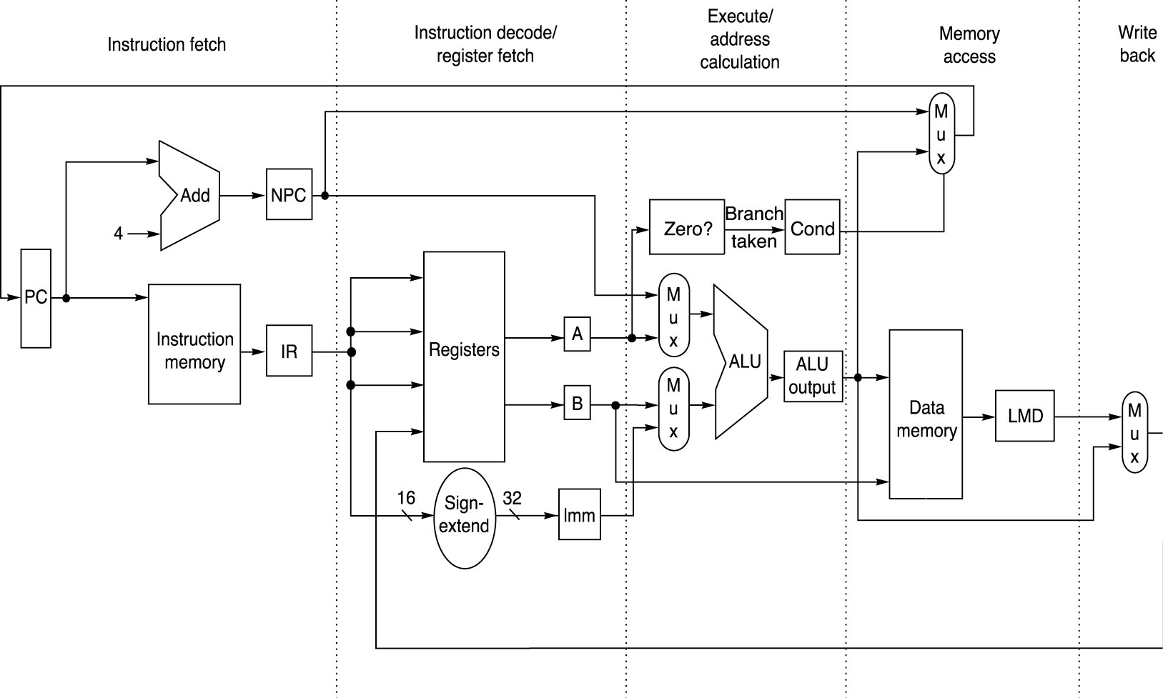
Basic MIPS Integer Datapath Implementation

Slide 29
Datapath for Instruction Fetch
IR <- MEM[PC]
PC <- PC + 4
ADD
4
PC
ADDR
Memory
RD
IR

Slide 30
Datapath for R-Type Instructions
add rd, rs, rt
R[rd] <- R[rs] + R[rt];

Slide 31
Datapath for Load/Store Instructions
lw rt, offset(rs)
R[rt] <- MEM[R[rs] + s_extend(offset)];

Slide 32
Datapath for Load/Store Instructions
sw rt, offset(rs)
MEM[R[rs] + sign_extend(offset)] <- R[rt]

Slide 33
Datapath for Branch Instructions
beq rs, r0, offset
if (R[rs] == 0) then PC <- PC+4 + s_extend(offset<<2)

Slide 34
Basic MIPS Processor (More Details)
ADD
4
ADD
PC
<<2
ADDR
RD
Instruction
I
Instruction
32
16
32
5
5
5
Memory
RN1
RN2
WN
Register File
RD1
ALU
Taken?
WD
RD2
M
U
ADDR
X
Data
E
Memory
RD
M
16
X
32
U
T
WD
X
N
D
IF
Instruction Fetch
ID
Instruction Decode
EX
Execute/ Address Calc.
MEM
Memory Access
WB
Write Back

Slide 35
Pipelining - Key Idea
Question: What happens if we break execution into multiple cycles?
Answer: in the best case, we can start executing a new instruction on each clock cycle - this is pipelining
Pipelining stages:
IF - Instruction Fetch
ID - Instruction Decode
EX - Execute / Address Calculation
MEM - Memory Access (read / write)
WB - Write Back (results into register file)

Slide 36
Simple MIPS Pipelined Integer Instruction Processing
Clock Number Time in clock cycles →
Instruction Number 1 2 3 4 5 6 7 8 9
Instruction I IF ID EX MEM WB
Instruction I+1 IF ID EX MEM WB
Instruction I+2 IF ID EX MEM WB
Instruction I+3 IF ID EX MEM WB
Instruction I +4 IF ID EX MEM WB
Time to fill the pipeline
MIPS Pipeline Stages:
IF = Instruction Fetch
ID = Instruction Decode
EX = Execution
MEM = Memory Access
WB = Write Back
Last instruction,
I+4 completed
First instruction, I
Completed
How to design the datapaths to support pipelining?

Slide 37
Basic MIPS Processor (More Details)
ADD
4
ADD
PC
<<2
ADDR
RD
Instruction
I
Instruction
32
16
32
5
5
5
Memory
RN1
RN2
WN
Register File
RD1
ALU
Taken?
WD
RD2
M
U
ADDR
X
Data
E
Memory
RD
M
16
X
32
U
T
WD
X
N
D
IF
Instruction Fetch
ID
Instruction Decode
EX
Execute/ Address Calc.
MEM
Memory Access
WB
Write Back

Slide 38
Pipeline Registers
Need pipeline registers (latches) between stages to hold data for instructions
Pipeline registers are named with 2 stages (the stages that the register is “between.”)
ANY information needed in a later pipeline stage MUST be passed via a pipeline register
Example:IF/ID register gets
instruction
PC+4
No register is needed after WB. Results from the WB stage are already stored in the register file.

Slide 39
Basic Pipelined Processor
Pipeline Registers
ADD
4
ADD
PC
<<2
ADDR
RD
Instruction
I
Instruction
32
16
32
5
5
5
Memory
RN1
RN2
WN
Register File
RD1
ALU
Taken?
WD
RD2
M
U
ADDR
X
Data
E
Memory
RD
M
16
X
32
U
T
WD
X
N
D
IF
ID
EX
MEM
WB
IF/ID
ID/EX
EX/MEM
MEM/WB

Slide 40
Non-Pipelined vs. Pipelined Execution
Non-Pipelined
Pipelined

Slide 41
Pipelined Example - Executing Multiple Instructions
Consider the following instruction sequence:
lw $r0, 10($r1)
sw $sr3, 20($r4)
add $r5, $r6, $r7
sub $r8, $r9, $r10

Slide 42
Executing Multiple Instructions Clock Cycle 1
LW

Slide 43
Executing Multiple Instructions Clock Cycle 2
SW
LW

Slide 44
Executing Multiple Instructions Clock Cycle 3
ADD
SW
LW
IF/ID
ID/EX
EX/MEM
MEM/WB
ADD
ADD
4
<<2
PC
ADDR
RD
32
5
RN1
RD1
Zero
Instruction
RN2
ALU
Memory
5
Register
5
WN
File
RD2
WD
M
ADDR
U
X
Data
E
Memory
RD
M
16
X
32
U
T
WD
X
N
5
D

Slide 45
Executing Multiple Instructions Clock Cycle 4
SUB
ADD
SW
LW

Slide 46
Executing Multiple Instructions Clock Cycle 5
SUB
ADD
SW
LW

Slide 47
Executing Multiple Instructions Clock Cycle 6
SUB
ADD
SW

Slide 48
Executing Multiple Instructions Clock Cycle 7
SUB
ADD

Slide 49
Executing Multiple Instructions Clock Cycle 8
SUB

Slide 50
Alternative View - Multicycle Diagram
Cycle 1
Cycle 2
Cycle 3
Cycle 4
Cycle 5
Cycle 6
Cycle 7
Cycle 8
lw $r0, 10($r1)
IM
REG
ALU
DM
REG
sw $r3, 20($r4)
IM
REG
ALU
DM
REG
add $r5, $r6, $r7
IM
REG
ALU
DM
REG
sub
$r8, $r9, $r10
IM
REG
ALU
DM
REG

Slide 51
Pipeline Performance
Throughput, latency, hazards
How much does pipelining improve the performance? How to calculate throughput and latency of a pipelined processor?
How to design the pipeline to increase speedup?
…

Slide 52
Pipelining Performance Example
Example: For an unpipelined CPU:
Clock cycle = 1ns, 4 cycles for ALU operations and branches and 5 cycles for memory operations with instruction frequencies of 40%, 20% and 40%, respectively.
If pipelining adds 0.2 ns to the machine clock cycle then the speedup in instruction execution from pipelining is:
Non-pipelined Average instruction execution time = Clock cycle x Average CPI
= 1 ns x ((40% + 20%) x 4 + 40%x 5) = 1 ns x 4.4 = 4.4 ns
In the 5-stage pipelined implementation, the latency is 6ns, but the average instruction execution time is: 1 ns + 0.2 ns = 1.2 ns
Speedup from pipelining = Instruction time unpipelined
Instruction time pipelined
= 4.4 ns / 1.2 ns = 3.7 times faster

Slide 53
Pipeline Throughput and Latency: A More realistic Examples
IF
ID
EX
MEM
WB
5 ns
4 ns
5 ns
10 ns
4 ns
Consider the pipeline above with the indicated
delays. We want to know what the pipeline
throughput and the pipeline latency are.
Pipeline throughput: instructions completed per second.
Pipeline latency: how long does it take to execute a
single instruction in the pipeline.

Slide 54
Pipeline Throughput and Latency
IF
ID
EX
MEM
WB
5 ns
4 ns
5 ns
10 ns
4 ns
Pipeline latency: how long does it take to execute an
instruction in the pipeline.
?

Slide 55
Pipeline Throughput and Latency
IF
ID
EX
MEM
WB
5 ns
4 ns
5 ns
10 ns
4 ns
Simply adding the latencies to compute the pipeline
latency only would work for an isolated instruction
I1
IF
ID
EX
MEM
WB
L(I1) = 28ns
I2
IF
ID
EX
MEM
WB
L(I2) = 33ns
I3
IF
ID
EX
MEM
WB
L(I3) = 38ns
I4
IF
ID
EX
MEM
WB
L(I5) = 43ns
We are in trouble! The latency is not constant.
This happens because this is an unbalanced
pipeline. The solution is to make every state
the same length as the longest one.

Slide 56
Synchronous Pipeline Throughput and Latency
IF
ID
EX
MEM
WB
5 ns
4 ns
5 ns
10 ns
4 ns
The slowest pipeline stage also limits the latency!!
I1
IF
ID
EX
MEM
WB
I2
IF
ID
EX
MEM
WB
L(I2) = 50ns
I3
IF
ID
EX
MEM
WB
I4
IF
ID
EX
MEM
0
10
20
30
40
50
60
L(I1) = L(I2) = L(I3) = L(I4) = 50ns

Slide 57
Pipeline Throughput and Latency
IF
ID
EX
MEM
WB
5 ns
4 ns
5 ns
10 ns
4 ns
IF
ID
EX
MEM
WB
10 ns
10 ns
10 ns
10 ns
10 ns
Pipeline throughput: how often an instruction is completed.

Slide 58
Pipeline Throughput and Latency
IF
ID
EX
MEM
WB
5 ns
4 ns
5 ns
10 ns
4 ns
IF
ID
EX
MEM
WB
10 ns
10 ns
10 ns
10 ns
10 ns
How long does it take to execute (issue) 20000 instructions
in this pipeline? (disregard latency, bubbles caused by
branches, cache misses, hazards, fill, drain)
How long would it take using the same modules
without pipelining?

Slide 59
Pipeline Throughput and Latency
IF
ID
EX
MEM
WB
5 ns
4 ns
5 ns
10 ns
4 ns
Thus the speedup that we got from the pipeline is:
How can we improve this pipeline design?
We need to reduce the unbalance to increase
the clock speed.

Slide 60
Pipeline Throughput and Latency
IF
ID
EX
MEM1
MEM2
WB
5 ns
4 ns
5 ns
5 ns
5 ns
4 ns
Now we have one more pipeline stage, but the
maximum latency of a single stage is reduced in half.
The new latency for a single instruction is:

Slide 61
Pipeline Throughput and Latency
IF
ID
EX
MEM1
MEM2
WB
5 ns
4 ns
5 ns
5 ns
5 ns
4 ns
I1
IF
ID
EX
MEM1
MEM2
WB
I2
IF
ID
EX
MEM1
MEM2
WB
I3
IF
ID
EX
MEM1
MEM2
WB
I4
IF
ID
EX
MEM1
MEM2
WB
I5
IF
ID
EX
MEM1
MEM2
WB
I6
IF
ID
EX
MEM1
MEM2
WB
I7
IF
ID
EX
MEM1
MEM2
WB

Slide 62
Pipeline Throughput and Latency
IF
ID
EX
MEM1
MEM2
WB
5 ns
4 ns
5 ns
5 ns
5 ns
4 ns
How long does it take to execute 20000 instructions
in this pipeline? (disregard bubbles caused by
branches, cache misses, etc, for now)
Thus the speedup that we get from the pipeline is:

Slide 63
Pipeline Throughput and Latency
IF
ID
EX
MEM1
MEM2
WB
5 ns
4 ns
5 ns
5 ns
5 ns
4 ns
What have we learned from this example?
1. It is important to balance the delays in the
stages of the pipeline
2. The throughput of a pipeline is 1/max(stage_delay).
3. The latency is N×max(stage_delay), where N is the
number of stages in the pipeline.

