Slide 1
Warehouse-Scale Computers to Exploit Request-Level and Data-Level Parallelism
COMP4611: Design and Analysis of Computer Architectures
Lin Gu CSE, HKUST

Slide 2
Server Computers
Applications are increasingly run on servers
Web search, office apps, virtual worlds, …
Requires large data center servers
Multiple processors, networks connections, massive storage
Space and power constraints
Rack server equipment often in units of 1.75” (1U).
E.g., a 1U switch, a 2U server

Slide 3
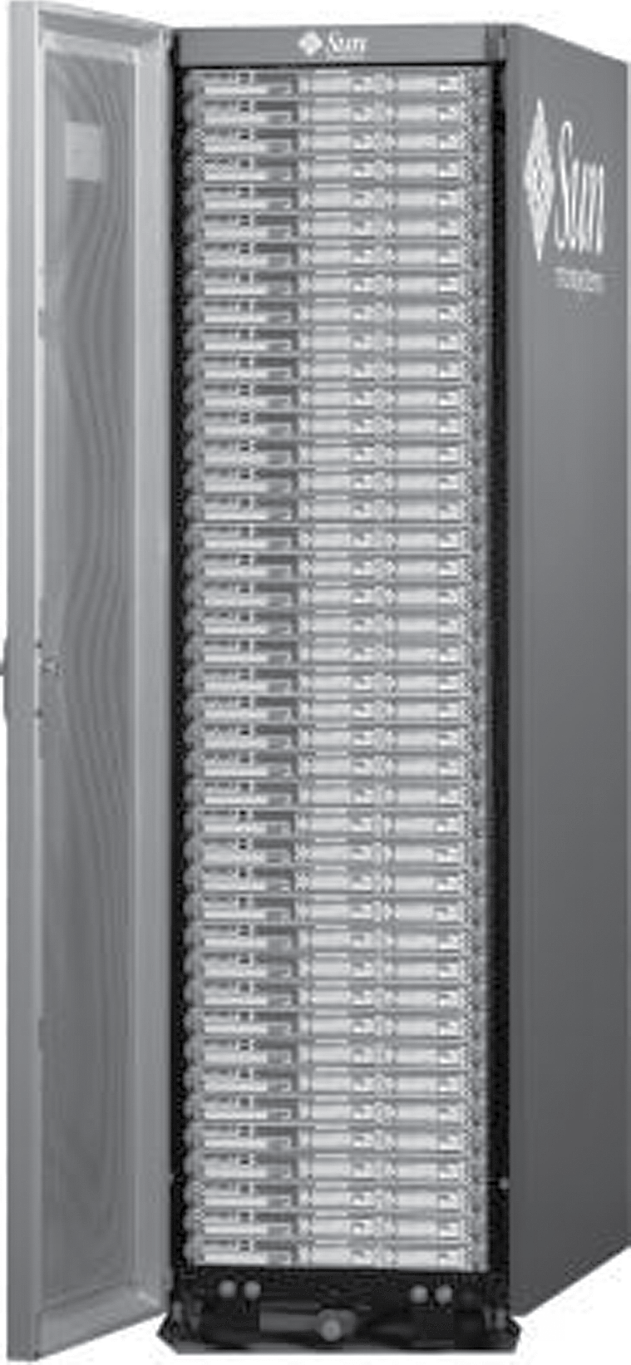
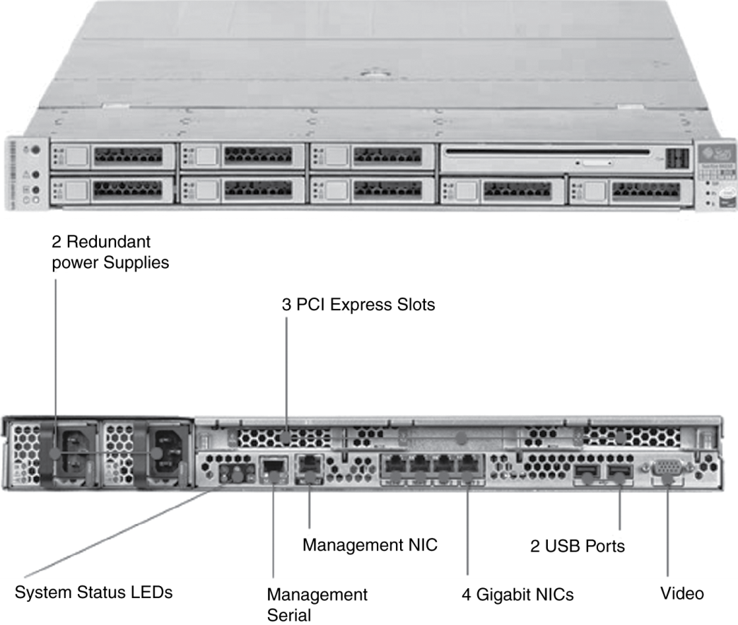
Rack-Mounted Servers
Sun Fire x4150 1U server

Slide 4
Scalability Vs. Cost
MPP
SMP
Super Server
Departmental
Cluster
of PCs
Server
Personal
System

Slide 5
Motivations of using Clusters over Specialized Parallel Computers
Individual PCs are becoming increasingly powerful
Communication bandwidth between PCs is increasing and latency is decreasing (Gigabit Ethernet, Myrinet)
PC clusters are easier to integrate into existing networks
Typical low user utilization of PCs (<10%)
Development tools for workstations and PCs are mature
PC clusters are a cheap and readily available
Clusters can be easily grown

Slide 6
Cluster Architecture
Parallel Applications
Parallel Applications
Parallel Applications
Sequential Applications
Sequential Applications
Sequential Applications
Parallel Programming Environment
Cluster Middleware
(Single System Image and Availability Infrastructure)
PC/Workstation
PC/Workstation
PC/Workstation
PC/Workstation
Communications
Software
Communications
Software
Communications
Software
Communications
Software
Network Interface Hardware
Network Interface Hardware
Network Interface Hardware
Network Interface Hardware
Cluster Interconnection Network/Switch

Slide 7
How Can we Benefit From Clusters?
Given a certain user application
Phase 1
If the application can be run fast enough on a single PC, there is no need to do anything else
Otherwise go to Phase 2
Phase 2
Try to put the whole application on the DRAM to avoid going to the disk.
If that is not possible, use the DRAM of the other idle workstations
Network DRAM is 5 to 10 times faster than local disk

Slide 8
Remote Memory Paging
Background
Application’s working sets have increased dramatically
Applications require more memory than a single workstation can provide.
Solution
Inserts the Network DRAM in the memory hierarchy between local memory and the disk
Swaps the page to remote memory
Cache
Cache
Main Memory
Main Memory
Disk
Network RAM
Disk

Slide 9
How Can we Benefit From Clusters?
In this case, the DRAM of the networked PCs behave like a huge cache system for the disk
Otherwise go to Phase 3
Time
512 MB + Disk
Networked DRAM
All DRAM
512 MB
Problem size

Slide 10
How Can we Benefit From Clusters?
Phase 3
If the network DRAM is not large enough, try using all the disks in the network in parallel for reading and writing data and program code (e.g., RAID) to speedup the I/O
Or, go to Phase 4
Communication Network
Cluster
Caching
Local
Cache
P
P
P
P
P
P
P
P
File
Cache
File
Cache
File
Cache
File
Cache
File
Cache
File
Cache
File
Cache
File
Cache
Network RAID striping

Slide 11
How Can we Benefit From Clusters?
Phase 4
Execute the program on a multiple number of workstations (PCs) at the same time – Parallel processing
Tools
There are many tools that do all these phases in a transparent way (except parallelizing the program) as well as load-balancing and scheduling.
Beowulf (CalTech and NASA) - USA
Condor - Wisconsin State University, USA
MPI (MPI Forum, MPICH is one of the popular implementations)
NOW (Network of Workstations) - Berkeley, USA
PVM - Oak Ridge National Lab./UTK/Emory, USA

Slide 12
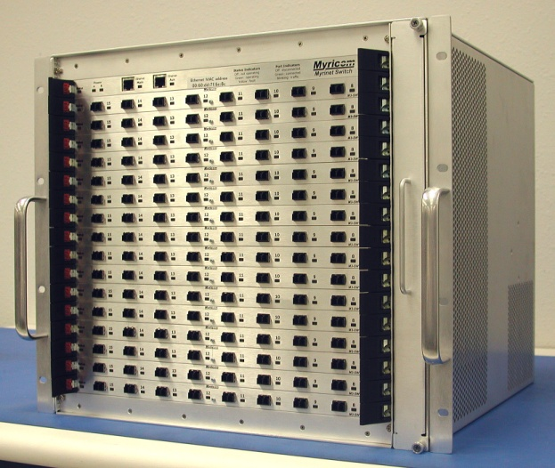
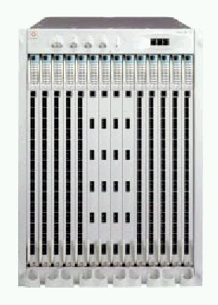
What network should be used?
 | Fast Ethernet | Gigabit Ethernet | Myrinet | 10GbE
Latency | ~120μs | ~120 μs | ~7 μs | 10s of μs’s
Bandwidth | ~100Mbps peak | ~1Gbps peak | ~1.98Gbps real | 10Gbps peak

Slide 13
2007 Top500 List
Clusters are the fastest growing category of supercomputers in the TOP500 List.
406 clusters (81%) in November 2007 list
130 clusters (23%) in the June 2003 list
80 clusters (16%) in the June 2002 list
33 clusters (6.6%) in the June 2001 list
4% of the supercomputers in the November 2007 TOP500 list use Myrinet technology!
54% of the supercomputers in the November 2007 TOP500 list Gigabit Ethernet technology!

Slide 14
Introduction
Warehouse-scale computer (WSC)
Provides Internet services
Search, social networking, online maps, video sharing, online shopping, email, cloud computing, etc.
Differences with HPC “clusters”:
Clusters have higher performance processors and network
Clusters emphasize thread-level parallelism, WSCs emphasize request-level parallelism
Differences with datacenters:
Datacenters consolidate different machines and software into one location
Datacenters emphasize virtual machines and hardware heterogeneity in order to serve varied customers

Slide 15
Introduction
Important design factors for WSC:
Cost-performance
Small savings add up
Energy efficiency
Affects power distribution and cooling
Work per joule
Dependability via redundancy
Network I/O
Interactive and batch processing workloads
Ample computational parallelism is not important
Most jobs are totally independent
“Request-level parallelism”
Operational costs count
Power consumption is a primary, not secondary, constraint when designing system
Scale and its opportunities and problems
Can afford to build customized systems since WSC require volume purchase

Slide 16
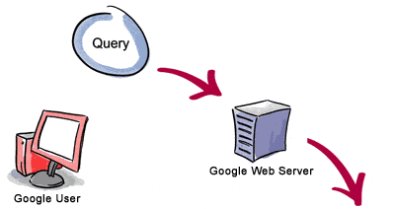


Google
2. The web server sends the query to the Index Server cluster, which matches the query to documents.
1. The user enters a query on a web form sent to the Google web server.
4. The list, with abstracts, is displayed by the web server to the user, sorted (using a secret formula involving PageRank).
3. The match is sent to the Doc Server cluster, which retrieves the documents to generate abstracts and cached copies.

Slide 17
Google Requirements
Google: search engine that scales at Internet growth rates
Search engines: 24x7 availability
Google : 600M queries/day, or AVERAGE of 7500 queries/s all day (old data)
Google crawls WWW and puts up new index every 2 weeks (old data)
Storage: 5.3 billion web pages, 950 million newsgroup messages, and 925 million images indexed, Millions of videos (very old data)
Response time goal: < 0.5 s per search (old data)

Slide 18
Google (Based on old data)
Require high amounts of computation per request
A single query on Google (on average)
reads hundreds of megabytes of data
consumes tens of billions of CPU cycles
A peak request stream on Google
requires an infrastructure comparable in size to largest supercomputer installations
Typical google Data center: 15000 PCs (Linux), 30000 disks: almost 3 petabyte!
Google application affords easy parallelization
Different queries can run on different processors
A single query can use multiple processors
because the overall index is partitioned

Slide 19
Prgrm’g Models and Workloads
Batch processing framework: MapReduce
Map: applies a programmer-supplied function to each logical input record
Runs on thousands of computers
Provides new set of key-value pairs as intermediate values
Reduce: collapses values using another programmer-supplied function

Slide 20
Prgrm’g Models and Workloads
Example:
map (String key, String value):
// key: document name
// value: document contents
for each word w in value
EmitIntermediate(w,”1”); // Produce list of all words
reduce (String key, Iterator values):
// key: a word
// value: a list of counts
int result = 0;
for each v in values:
result += ParseInt(v); // get integer from key-value pair
Emit(AsString(result));

Slide 21
Prgrm’g Models and Workloads
MapReduce runtime environment schedules map and reduce task to WSC nodes
Availability:
Use replicas of data across different servers
Use relaxed consistency:
No need for all replicas to always agree
Workload demands
Often vary considerably

Slide 22
Computer Architecture of WSC
WSC often use a hierarchy of networks for interconnection
Each rack holds dozens of servers connected to a rack switch
Rack switches are uplinked to switch higher in hierarchy
Uplink has 48 / n times lower bandwidth, where n = # of uplink ports
“Oversubscription”
Goal is to maximize locality of communication relative to the rack

Slide 23
Storage
Storage options:
Use disks inside the servers, or
Network attached storage through Infiniband
WSCs generally rely on local disks
Google File System (GFS) uses local disks and maintains at least three replicas

Slide 24
Array Switch
Switch that connects an array of racks
Array switch should have 10 X the bisection bandwidth of rack switch
Cost of n-port switch grows as n²
Often utilize content addressible memory chips and FPGAs

Slide 25
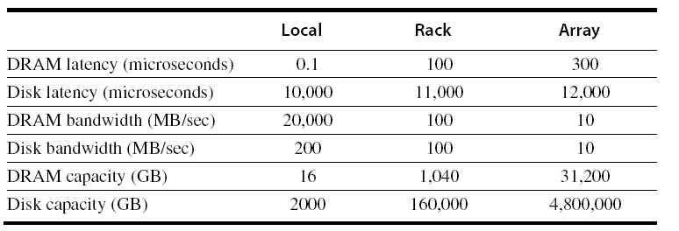
WSC Memory Hierarchy
Servers can access DRAM and disks on other servers using a NUMA-style interface

Slide 26
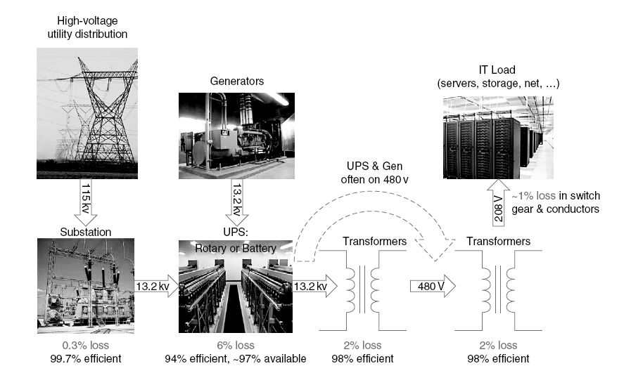
Infrastructure and Costs of WSC
Location of WSC
Proximity to Internet backbones, electricity cost, property tax rates, low risk from earthquakes, floods, and hurricanes
Power distribution

Slide 27
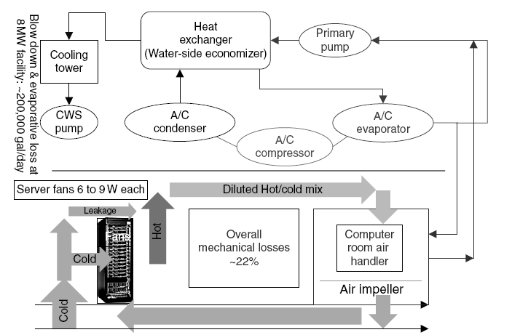
Infrastructure and Costs of WSC
Cooling
Air conditioning used to cool server room
64 F – 71 F
Keep temperature higher (closer to 71 F)
Cooling towers can also be used
Minimum temperature is “wet bulb temperature”

Slide 28
Infrastructure and Costs of WSC
Cooling system also uses water (evaporation and spills)
E.g. 70,000 to 200,000 gallons per day for an 8 MW facility
Power cost breakdown:
Chillers: 30-50% of the power used by the IT equipment
Air conditioning: 10-20% of the IT power, mostly due to fans
How man servers can a WSC support?
Each server:
“Nameplate power rating” gives maximum power consumption
To get actual, measure power under actual workloads
Oversubscribe cumulative server power by 40%, but monitor power closely

Slide 29
Measuring Efficiency of a WSC
Power Utilization Effectiveness (PEU)
= Total facility power / IT equipment power
Median PUE on 2006 study was 1.69
Performance
Latency is important metric because it is seen by users
Bing study: users will use search less as response time increases
Service Level Objectives (SLOs)/Service Level Agreements (SLAs)
E.g. 99% of requests be below 100 ms

Slide 30
Cost of a WSC
Capital expenditures (CAPEX)
Cost to build a WSC
Operational expenditures (OPEX)
Cost to operate a WSC

Slide 31
Cloud Computing
WSCs offer economies of scale that cannot be achieved with a datacenter:
5.7 times reduction in storage costs
7.1 times reduction in administrative costs
7.3 times reduction in networking costs
This has given rise to cloud services such as Amazon Web Services
“Utility Computing”
Based on using open source virtual machine and operating system software

