Slide 1
COMP 4611 Design and Analysis of Computer Architectures Final Exam Review
Notes:
Please if anyone has additional comments please speak up

Slide 2
Memory System
Main memory generally uses Dynamic RAM (DRAM),
which uses a single transistor to store a bit, but requires a periodic data refresh (~every 8 ms).
Cache uses SRAM: Static Random Access Memory
No refresh (6 transistors/bit vs. 1 transistor/bit for DRAM)
Size: DRAM/SRAM ­ 4-8, Cost & Performance: SRAM/DRAM ­ 8-16
Performance metrics
Latency is concern of cache
Access time: The time it takes between a memory access request and the time the requested information is available to cache/CPU.
Cycle time: The minimum time between unrelated requests to memory (greater than access time in DRAM to allow address lines to be stable)‏
Memory bandwidth: The maximum sustained data transfer rate between main memory and cache/CPU.

Slide 3
Memory Technology
SRAM
Requires lower power to retain bit than DRAM
Requires 6 transistors/bit
DRAM
Must be re-written after being read
Must also be periodically refeshed
Every ~ 8 ms
Each row can be refreshed simultaneously
One transistor/bit
Address lines are multiplexed:
Upper half of address: row access strobe (RAS)
Lower half of address: column access strobe (CAS)

Slide 4
Conventional DRAM Organization
d x w DRAM:
dw total bits organized as d supercells of size w bits
16 x 8 DRAM chip
cols
memory
controller
0
1
2
3
2 bits
/
0
addr
1
rows
2
supercell
(2,1)
(to CPU)
3
8 bits
/
data
internal row buffer

Slide 5
Reading DRAM Supercell (2,1)
Step 1(a): Row access strobe (RAS) selects row 2.
Step 1(b): Row 2 copied from DRAM array to row buffer.
16 x 8 DRAM chip
cols
memory
controller
RAS = 2
0
1
2
3
2
/
0
addr
1
rows
2
8
/
3
data
internal row buffer

Slide 6
Reading DRAM Supercell (2,1)
Step 2(a): Column access strobe (CAS) selects column 1.
Step 2(b): Supercell (2,1) copied from buffer to data lines, and eventually back to the CPU.
16 x 8 DRAM chip
cols
memory
controller
CAS = 1
0
1
2
3
2
/
0
To CPU
addr
1
rows
2
supercell
(2,1)
3
8
/
data
supercell
(2,1)
internal row buffer

Slide 7
Memory Modules
addr (row = i, col = j)
: supercell (i,j)
DRAM 0
64 MB
memory module
consisting of
eight 8Mx8 DRAMs
DRAM 7
bits
56-63
bits
48-55
bits
40-47
bits
32-39
bits
24-31
bits
16-23
bits
8-15
bits
0-7
63
63
56
56
55
55
48
48
47
47
40
40
39
39
32
32
31
31
24
24
23
23
16
16
15
15
8
8
7
7
0
0
Memory
controller
64-bit doubleword at main memory address A
64-bit double word at main memory address A
64-bit doubleword

Slide 8
Memory Optimizations
DDR (Double Data Rate):
DDR2
Lower power (2.5 V -> 1.8 V)
Higher clock rates (266 MHz, 333 MHz, 400 MHz)
DDR3
1.5 V
800 MHz
DDR4
1-1.2 V
1600 MHz
GDDR5 is graphics memory based on DDR3

Slide 9
Memory Optimizations
Graphics memory:
Achieve 2-5 X bandwidth per DRAM vs. DDR3
Wider interfaces (32 vs. 16 bit)
Higher clock rate
Possible because they are attached via soldering instead of socketted DIMM modules
Reducing power in SDRAMs:
Lower voltage
Low power mode (ignores clock, continues to refresh)

Slide 10
Flash Memory
Type of EEPROM
Must be erased (in blocks) before being overwritten
Non-volatile
Limited number of write cycles
Cheaper than SDRAM, more expensive than disk
Slower than SRAM, faster than disk

Slide 11
Memory Technology
Amdahl:
Memory capacity should grow linearly with processor speed
Unfortunately, memory capacity and speed has not kept pace with processors
Some optimizations:
Multiple accesses to same row
Synchronous DRAM
Added clock to DRAM interface
Burst mode with critical word first
Wider interfaces
Double data rate (DDR)
Multiple banks on each DRAM device

Slide 12
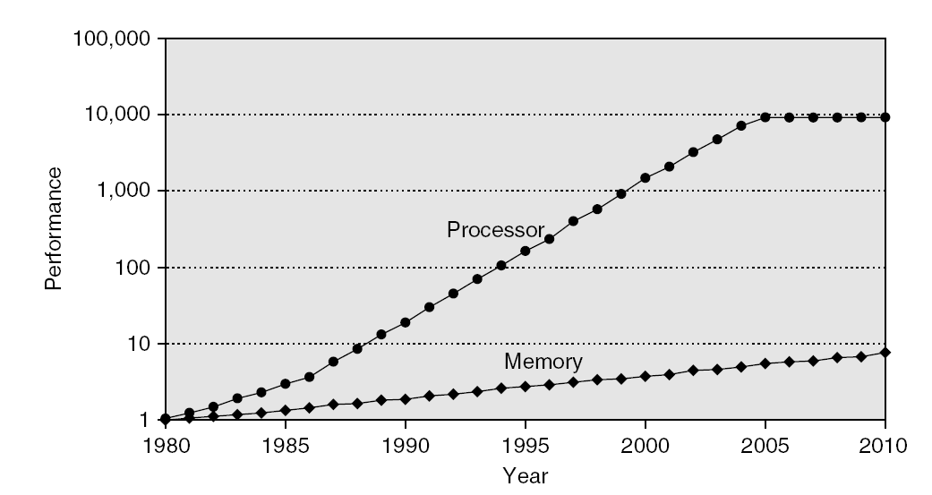
Memory Performance Gap

Slide 13
How to make memory system better?
Programmers want unlimited amounts of memory with low latency
Fast memory technology is more expensive per bit than slower memory
Solution: organize memory system into a hierarchy
Entire addressable memory space available in largest, slowest memory
Incrementally smaller and faster memories, each containing a subset of the memory below it, proceed in steps up toward the processor
Temporal and spatial locality insures that nearly all references can be found in smaller memories
Gives the illusion of a large, fast memory being presented to the processor

Slide 14
Memory Hierarchy Design
Memory hierarchy design becomes more crucial with recent multi-core processors:
Aggregate peak bandwidth grows with # cores:
Intel Core i7 can generate two references per core per clock
Four cores and 3.2 GHz clock
25.6 billion 64-bit data references/second +
12.8 billion 128-bit instruction references
= 409.6 GB/s!
DRAM bandwidth is only 6% of this (25 GB/s)
Requires:
Multi-port, pipelined caches
Two levels of cache per core
Shared third-level cache on chip
High-end microprocessors have >10 MB on-chip cache
Consumes large amount of area and power budget

Slide 15
Memory Hierarchy
The idea is to build a memory subsystem that consists of:
Very small, very fast, very expensive memory “close” to the processor.
Larger, slower, but more affordable memory “further away” from the processor.
Hence, provide the appearance of virtually unlimited memory while minimizing delays to the processor.
The memory hierarchy is organized into levels of memory with the smaller, more expensive, and faster memory levels closer to the CPU: registers, then primary Cache Level (L₁), then additional secondary cache levels (L₂, L₃…), then main memory, then mass storage (virtual memory).

Slide 16
Levels of The Memory Hierarchy
Part of The On-chip CPU Datapath
16-256 Registers
Farther away from
The CPU
Lower Cost/Bit
Higher Capacity
Increased Access
Time/Latency
Lower Throughput
One or more levels (Static RAM):
Level 1: On-chip 16-64K
Level 2: On or Off-chip 128-512K
Level 3: Off-chip 1M-64M
Registers
Cache
DRAM, RDRAM
16M-16G
Main Memory
Interface:
SCSI, RAID,
IDE, 1394
4GB-2TB
Magnetic Disc
Optical Disk or Magnetic Tape

Slide 17
A Typical Memory Hierarchy (With Two Levels of Cache)
Faster
Larger Capacity
Processor
Control
Virtual
Memory,
Secondary
Storage
(Disk)
Tertiary
Storage
(Tape)
Second
Level
Cache
(SRAM)
L₂
Main
Memory
(DRAM)
On-Chip
Level
One
Cache
L₁
Datapath
Registers
Speed (ns):
1s
10s
100s
10,000,000s
(10s ms)
10,000,000,000s
(10s sec)
Size (bytes):
100s
Ks
Ms/Gs
Gs/Ts
Ts

Slide 18
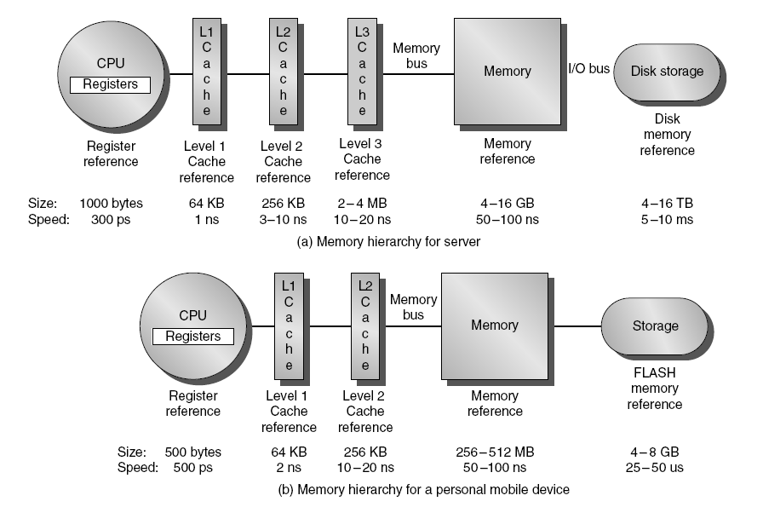
Recent Typical Configurations

Slide 19
Pentium 4 Cache hierarchy (Gallatin)
Processor
L1 I (12Ki)
L1 D (8KiB)
Cycles: 2
Cycles: 19
L2 cache (512 KiB)
Cycles: 43
L3 cache (2 MiB)
Cycles: 206
Memory

Slide 20
Memory Hierarchy Basics
When a word is not found in the higher level, a miss occurs:
Fetch word from lower level in hierarchy, requiring a higher latency reference
Also fetch the other words contained within the block
Takes advantage of spatial locality
Place block into cache in any location within its set, determined by address
block address MOD number of sets

Slide 21
Memory Hierarchy Operation
If an instruction or operand is required by the CPU, the levels of the memory hierarchy are searched for the item starting with the level closest to the CPU (Level 1 cache):
If the item is found, it’s delivered to the CPU resulting in a cache hit.
If the item is missing from an upper level, resulting in a miss, the level just below is searched.
For systems with several levels of cache, the search continues with cache level 2, 3 etc.
If all levels of cache report a miss then main memory is accessed.
CPU ↔ cache ↔ memory: Managed by hardware.
If the item is not found in main memory resulting in a page fault, then disk (virtual memory), is accessed for the item.
Memory ↔ disk: Managed by hardware and the operating system.

Slide 22
Memory Hierarchy Basics
n sets => n-way set associative
Direct-mapped cache => one block per set
Fully associative => one set
Writing to cache: two strategies
Write-through
Immediately update lower levels of hierarchy
Write-back
Only update lower levels of hierarchy when an updated block is replaced
Both strategies use write buffer to make writes asynchronous

Slide 23
Memory Hierarchy Basics
Miss rate
Fraction of cache access that result in a miss
Causes of misses
Compulsory
First reference to a block
Capacity
Blocks discarded and later retrieved
Conflict
Program makes repeated references to multiple addresses from different blocks that map to the same location in the cache

Slide 24
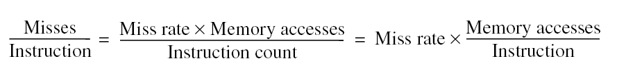
Memory Hierarchy Basics
Note that speculative and multithreaded processors may execute other instructions during a miss
Reduces performance impact of misses

Slide 25
Impact on Performance
Suppose a processor executes at
Clock Rate = 200 MHz (5 ns per cycle)
CPI = 1.1
50% arith/logic, 30% ld/st, 20% control
Suppose that 10% of memory operations get 50 cycle miss penalty
CPI = ideal CPI + average stalls per instruction = 1.1(cyc) +( 0.30 (datamops/ins) x 0.10 (miss/datamop) x 50 (cycle/miss) ) = 1.1 cycle + 1.5 cycle = 2.6
58 % of the time the processor is stalled waiting for memory!
a 1% instruction miss rate would add an additional 0.5 cycles to the CPI!

Slide 26
Memory Hierarchy: Motivation The Principle Of Locality
Programs usually access a relatively small portion of their address space (instructions/data) at any instant of time (loops, data arrays).
Two types of locality:
Temporal Locality: If an item is referenced, it will tend to be referenced again soon.
Spatial locality: If an item is referenced, items whose addresses are close by will tend to be referenced soon .
The presence of locality in program behavior (e.g., loops, data arrays), makes it possible to satisfy a large percentage of the program’s data accesses (both instructions and operands) using memory levels closer to the CPU.
Probability
of reference
0
Address Space
2^{n - 1}

Slide 27
Locality Example
Locality Example:
Data
Reference array elements in succession (stride-1 reference pattern):
Reference sum each iteration:
Instructions
Reference instructions in sequence:
Cycle through loop repeatedly:
sum = 0;
for (i = 0; i < n; i++)
sum += a[i];
return sum;
Spatial locality
Temporal locality
Spatial locality
Temporal locality

Slide 28
Memory Hierarchy: Terminology
A Block: The smallest unit of information transferred between two levels.
Hit: Item is found in a block in the upper level (example: Block X)
Hit Rate: The fraction of memory accesses found in the upper level.
Hit Time: Time to access the upper level which consists of
memory access time + time to determine hit/miss
Miss: Item needs to be retrieved from a block in the lower level (Block Y)
Miss Rate = 1 - (Hit Rate)
Miss Penalty: Time to replace a block in the upper level +
Time to deliver the block to the processor (or the further-upper-level)
Hit Time << Miss Penalty
Lower Level
Memory
Upper Level
Memory
From Processor
Blk X
Blk Y
To Processor

Slide 29
Caching in a Memory Hierarchy
Smaller, faster, more expensive
device at level k caches a
subset of the blocks from level k+1
8
Level k:
4
9
14
3
10
Data is copied between
levels in block-sized transfer units
10
4
0
1
2
3
4
Larger, slower, cheaper storage
device at level k+1 is partitioned
into blocks.
Level k+1:
4
5
6
7
8
9
10
10
11
12
13
14
15

Slide 30
General Caching Concepts
Program needs object d, which is stored in some block b.
Cache hit
Program finds b in the cache at level k. E.g., block 14.
Cache miss
b is not at level k, so level k cache must fetch it from level k+1. E.g., block 12.
If level k cache is full, then some current block must be replaced (evicted). Which one is the “victim”?
Placement policy: where can the new block go? E.g., b mod 4
Replacement policy: which block should be evicted? E.g., LRU
Request
12
14
Request
14
12
0
1
2
3
Level
k:
4*
9
14
12
14
3
4*
12
Request
12
4*
0
1
2
3
Level
k+1:
4
5
6
7
4*
8
9
10
11
12
13
14
15
12

Slide 31
Cache Design & Operation Issues
Q1: Where can a block be placed in cache? (Block placement strategy & Cache organization)
Fully Associative, Set Associative, Direct Mapped.
Q2: How is a block found if it is in cache? (Block identification)
Tag/Block.
Q3: Which block should be replaced on a miss? (Block replacement)
Random, LRU.
Q4: What happens on a write? (Cache write policy)
Write through, write back.

Slide 32
Cache Organization & Placement Strategies
Placement strategies or mapping of a main memory data block onto cache block frame addresses divide cache into three organizations:
Direct mapped cache: A block can be placed in one location only, given by:
(Block address) MOD (Number of blocks in cache)
Advantage: It is easy to locate blocks in the cache (only one possibility)
Disadvantage: Certain blocks cannot be simultaneously present in the cache (they can only have the same location)

Slide 33
Cache Organization: Direct Mapped Cache
A block can be placed in one location only, given by:
(Block address) MOD (Number of blocks in cache)
In this case: (Block address) MOD (8)
C
a
c
h
e
0
1
0
1
0
1
0
1
8 cache block
frames
0
0
1
1
0
0
1
1
0
0
0
0
1
1
1
1
(11101) MOD (1000) = 101
32 memory
blocks
cacheable
0
0
0
0
1
0
0
1
0
1
0
1
0
0
1
0
1
1
0
1
1
0
0
0
1
1
0
1
0
1
1
1
0
0
1
1
1
1
0
1
M
e
m
o
r
y

Slide 34
Direct Mapping
Tag
Index
Data
00000
0
00000
0
0x55
0x55
0x0F
00000
0x0F
1
00000
1
00001
0
Direct mapping:
A memory value can only be placed at a single corresponding location in the cache
11111
11111
0
0xAA
0xAA
0xF0
11111
0xF0
11111
1

Slide 35
Cache Organization & Placement Strategies
Fully associative cache: A block can be placed anywhere in cache.
Advantage: No restriction on the placement of blocks. Any combination of blocks can be simultaneously present in the cache.
Disadvantage: Costly (hardware and time) to search for a block in the cache
Set associative cache: A block can be placed in a restricted set of places, or cache block frames. A set is a group of block frames in the cache. A block is first mapped onto the set and then it can be placed anywhere within the set. The set in this case is chosen by:
(Block address) MOD (Number of sets in cache)
If there are n blocks in a set the cache placement is called n-way set-associative, or n-associative.
A good compromise between direct mapped and fully associative caches (most processors use this method).

Slide 36
Set Associative Mapping (2-Way)
Way 0
Way 1
Tag
Index
Data
0000
0
0000
00
0x55
0x55
0x0F
0000
0x0F
1
0000
01
0001
10
Set-associative mapping:
A memory value can be placed in any block frame of a set corresponding to the block address
1111
1111
10
0xAA
0xAA
0xF0
1111
0xF0
1111
11

Slide 37
Fully Associative Mapping
Tag
Data
000000
0000
0x55
000000
0x55
0000
0x55
0x55
0x0F
0x0F
0x0F
000001
0x0F
0000
000001
0000
000110
000110
Fully-associative mapping:
A block can be stored anywhere in the cache
111110
1111
111110
1111
0xAA
0xAA
0xAA
0xAA
0xF0
0xF0
0xF0
111111
0xF0
1111
111111
1111

Slide 38
Types of Caches: Organization
Type of cache | Mapping of data from memory to cache | Complexity of searching the cache
Direct mapped (DM) | A memory value can be placed at a single corresponding location in the cache | Easy search mechanism
Set-associative (SA) | A memory value can be placed in any of a set of locations in the cache | Slightly more involved search mechanism
Fully-associative (FA) | A memory value can be placed in any location in the cache | Extensive hardware resources required to search (CAM)
DM and FA can be thought as special cases of SA
DM → 1-way SA
FA → All-way SA

Slide 39
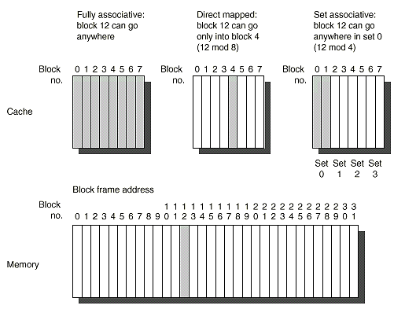
Cache Organization Example

Slide 40
Cache Organization Tradeoff
For a given cache size, there is a tradeoff between hit rate and complexity
If L = number of lines (blocks) in the cache, L = Cache Size / Block Size
How many places Name of Number of Sets for a block to go cache type
1 Direct Mapped L
n n-way associative L/n
L Fully Associative 1
Number of comparators needed to compare tags

Slide 41
Locating A Data Block in Cache
Each block in the cache has an address tag.
The tags of every cache block that might contain the required data are checked in parallel.
A valid bit is added to the tag to indicate whether this cache entry is valid or not.
The address from the CPU to the cache is divided into:
A block address, further divided into:
An index field to choose a block set in the cache.
(no index field when fully associative).
A tag field to search and match addresses in the selected set.
A block offset to select the data from the block.
Block Address
Block
Offset
Tag
Index

Slide 42
Address Field Sizes
Physical Address Generated by CPU
Block Address
Block
Offset
Tag
Index
Block offset size = log2(block size)
Index size = log2(Total number of blocks/associativity)
Tag size = address size - index size - offset size
Number of Sets
Mapping function:
Cache set or block frame number = Index =
= (Block Address) MOD (Number of Sets)

Slide 43
Locating A Data Block in Cache
Increasing associativity shrinks index, expands tag
Block index not needed for fully associative cache
Block Address
Block
Offset, m bits
Tag – r bits
Index – k bits
Tag to identify a unique block
2^{k} addressable blocks in the cache
2^{m} bytes in a block

Slide 44
Direct-Mapped Cache Example
Suppose we have a 16KB of data in a direct-mapped cache with 4 word blocks
Determine the size of the tag, index and offset fields if we’re using a 32-bit architecture
Offset
need to specify correct byte within a block
block contains 4 words = 16 bytes = 2⁴ bytes
need 4 bits to specify correct byte

Slide 45
Direct-Mapped Cache Example
Index: (~index into an “array of blocks”)
need to specify correct row in cache
cache contains 16 KB = 2¹⁴ bytes
block contains 2⁴ bytes (4 words)
# rows/cache =# blocks/cache (since there’s one block/row)
= bytes/cache bytes/row
= 2¹⁴ bytes/cache 2⁴ bytes/row
= 2¹⁰ rows/cache
need 10 bits to specify this many rows

Slide 46
Direct-Mapped Cache Example
Tag: use remaining bits as tag
tag length = mem addr length - offset - index = 32 - 4 - 10 bits = 18 bits
so tag is leftmost 18 bits of memory address

Slide 47
4KB Direct Mapped Cache Example
A
d
d
r
e
s
s
(
s
h
o
w
i
n
g
b
i
t
p
o
s
i
t
i
o
n
s
)
Index field
Tag field
3
1
3
0
1
3
1
2
1
1
2
1
0
o
B
y
t
e
f
f
s
e
t
H
i
t
2
0
1
0
D
a
t
a
T
a
g
1K = 1024 Blocks
Each block = one 32b word
Cache for a
2³² bytes = 4 GB
memory space
Mapping function:
Cache Block frame number =
(Block address) MOD (1024)
I
n
d
e
x
I
n
d
e
x
V
a
l
i
d
T
a
g
D
a
t
a
0
1
2
1
0
2
1
1
0
2
2
1
0
2
3
2
0
3
2
Block Address = 30 bits
Block offset
= 2 bits
Tag = 20 bits
Index = 10 bits

Slide 48
64KB Direct Mapped Cache Example
Tag field
A
d
d
r
e
s
s
(
s
h
o
w
i
n
g
b
i
t
p
o
s
i
t
i
o
n
s
)
4K= 4096 blocks
Each block = four words = 16 bytes
Can cache up to
2³² bytes = 4 GB
of memory
Index field
3
1
1
6
1
5
4
3
2
1
0
H
i
t
1
6
1
2
2
B
y
t
e
Word select
D
a
t
a
T
a
g
o
f
f
s
e
t
I
n
d
e
x
B
l
o
c
k
o
f
f
s
e
t
1
6
b
i
t
s
1
2
8
b
i
t
s
V
T
a
g
D
a
t
a
4
K
e
n
t
r
i
e
s
1
6
3
2
3
2
3
2
3
2
M
u
x
3
2
Block Address = 28 bits
Block offset
= 4 bits
Tag = 16 bits
Index = 12 bits
Mapping Function: Cache Block frame number = (Block address) MOD (4096)
Larger blocks take better advantage of spatial locality

Slide 49
Cache Organization: Set Associativity
O
n
e
-
w
a
y
s
e
t
a
s
s
o
c
i
a
t
i
v
e
(
d
i
r
e
c
t
m
a
p
p
e
d
)
B
l
o
c
k
T
a
g
D
a
t
a
0
T
w
o
-
w
a
y
s
e
t
a
s
s
o
c
i
a
t
i
v
e
1
2
S
e
t
T
a
g
D
a
t
a
T
a
g
D
a
t
a
3
0
4
1
5
2
6
3
7
F
o
u
r
-
w
a
y
s
e
t
a
s
s
o
c
i
a
t
i
v
e
S
e
t
T
a
g
D
a
t
a
T
a
g
D
a
t
a
T
a
g
D
a
t
a
T
a
g
D
a
t
a
0
1
E
i
g
h
t
-
w
a
y
s
e
t
a
s
s
o
c
i
a
t
i
v
e
(
f
u
l
l
y
a
s
s
o
c
i
a
t
i
v
e
)
T
a
g
D
a
t
a
T
a
g
D
a
t
a
T
a
g
D
a
t
a
T
a
g
D
a
t
a
T
a
g
D
a
t
a
T
a
g
D
a
t
a
T
a
g
D
a
t
a
T
a
g
D
a
t
a

Slide 50
Direct-Mapped Cache Design
32-bit architecture, 32-bit blocks, 8 blocks
ADDRESS
Block Address
Byte Offset (2-bit)
Block
Offset
Cache
Index (3-bit)
DATA
HIT
=1
Tag (27-bit)
Tag
Index
0x0000000
3
0
ADDR
CACHE SRAM
V
Tag
Data
1
0x00001C0
0xff083c2d
0
1
0x0000000
0x00000021
1
0x0000000
0x00000103
0
0
1
0
0x23F0210
0x00000009
DATA[59]
DATA[58:32]
DATA[31:0]
=
50

Slide 51
4KB Four-Way Set Associative Cache: MIPS Implementation Example
Tag
Field
A
d
d
r
e
s
s
3
1
3
0
1
2
1
1
1
0
9
8
3
2
1
0
Index
Field
1024 block frames
1 block = one 32b word
4-way set associative
256 sets
Cache for a
2³² bytes = 4 GB
memory space
2
2
8
I
n
d
e
x
V
T
a
g
D
a
t
a
V
T
a
g
D
a
t
a
V
T
a
g
D
a
t
a
V
T
a
g
D
a
t
a
0
1
2
2
5
3
2
5
4
2
5
5
2
2
3
2
Block Address = 30 bits
Tag = 22 bits
Index = 8 bits
Block offset
= 2 bits
4
-
t
o
-
1
m
u
l
t
i
p
l
e
x
o
r
H
i
t
D
a
t
a
Mapping Function: Cache Set Number = (Block address) MOD (256)
51

Slide 52
Fully Associative Cache Design
Key idea: set size of one block
1 comparator required for each block
No address decoding
Practical only for small caches due to hardware demands
tag in 11110111
data out 1111000011110000101011
=
tag 00011100
data 0000111100001111111101
=
=
tag 11110111
data 1111000011110000101011
tag 11110111
data 1111000011110000101011
=
tag 11111110
data 0000000000001111111100
=
tag 00000011
data 1110111100001110000001
=
tag 11100110
data 1111111111111111111111
52

Slide 53
Fully Associative
Fully Associative Cache with N block frames
0 bit for cache index
Compare the tags of all cache entries in parallel
Example: Block Size = 32 B blocks, we need N 27-bit comparators
31
4
0
Cache Tag (27 bits long)
Byte Select
Ex: 0x01
Cache Tag
Valid Bit
Cache Data
X
Byte 31
:
Byte 1
Byte 0
X
Byte 63
:
Byte 33
Byte 32
X
X
:
:
:
:
X
53
Notes:
53

Slide 54
Unified vs. Separate Level 1 Cache
Unified Level 1 Cache
A single level 1 cache is used for both instructions and data.
Separate instruction/data Level 1 caches (Harvard Memory Architecture):
The level 1 (L₁) cache is split into two caches, one for instructions (instruction cache, L₁ I-cache) and the other for data (data cache, L₁ D-cache).
Processor
Processor
Control
Control
Unified
Level
One
Cache
L₁
Datapath
L₁
I-cache
Registers
Datapath
Registers
L₁
D-cache
Unified Level 1 Cache
Separate Level 1 Caches
(Harvard Memory Architecture)
54

Slide 55
Why have separate caches?
Bandwidth: lets us access instructions and data in parallel (less structural hazards)
Most programs don’t modify their instructions
I-Cache can be simpler than D-Cache, since instruction references are never writes
Instruction stream has high locality of reference, can get higher hit rates with small cache
Data references never interfere with instruction references

Slide 56
Cache Replacement Policy
When a cache miss occurs the cache controller may have to select a block of cache data to be removed from a cache block frame and replaced with the requested data, such a block is usually selected by one of two methods (for direct mapped cache, there is only one choice):
Random:
Any block is randomly selected for replacement providing uniform allocation.
Simple to build in hardware.
The most widely used cache replacement strategy.
Least-recently used (LRU):
Accesses to blocks are recorded and the block replaced is the one that was not used for the longest period of time.
LRU is expensive to implement, as the number of blocks to be tracked increases, and is usually approximated.

Slide 57
LRU Policy
MRU
MRU-1
LRU+1
LRU
A
B
C
D
Access C
C
A
B
D
Access D
D
C
A
B
Access E
MISS, replacement
needed
E
D
C
A
Access C
C
E
D
A
Access G
MISS, replacement
needed
G
C
E
D
57
Notes:
57

Slide 58
Representative Miss Rates for Caches with Different Size, Associativity & Replacement Algorithm
Associativity: 2-way 4-way 8-way
Size LRU Random LRU Random LRU Random
16 KB 5.18% 5.69% 4.67% 5.29% 4.39% 4.96%
64 KB 1.88% 2.01% 1.54% 1.66% 1.39% 1.53%
256 KB 1.15% 1.17% 1.13% 1.13% 1.12% 1.12%

Slide 59
Cache and Memory Performance Average Memory Access Time (AMAT), Memory Stall cycles
The Average Memory Access Time (AMAT): The average number of cycles required to complete a memory access request by the CPU.
Memory stall cycles per memory access: The number of stall cycles added to CPU execution cycles for one memory access.
For an ideal memory: AMAT = 1 cycle, this results in zero memory stall cycles.
Memory stall cycles per memory access = AMAT -1
Memory stall cycles per instruction =
Memory stall cycles per memory access
x Number of memory accesses per instruction
= (AMAT -1 ) x ( 1 + fraction of loads/stores)
Instruction Fetch

Slide 60
Cache Performance Unified Memory Architecture
For a CPU with a single level (L1) of cache for both instructions and data and no stalls for cache hits:
Total CPU time = (CPU execution clock cycles +
Memory stall clock cycles) x clock cycle time
Memory stall clock cycles =
(Reads x Read miss rate x Read miss penalty) +
(Writes x Write miss rate x Write miss penalty)
If write and read miss penalties are the same:
Memory stall clock cycles = Memory accesses x Miss rate x Miss penalty
With ideal memory

Slide 61
Cache Performance Unified Memory Architecture
CPUtime = Instruction count x CPI x Clock cycle time
CPI_{execution} = CPI with ideal memory
CPI = CPI_{execution} + MEM Stall cycles per instruction
CPUtime = Instruction Count x (CPI_{execution} +
MEM Stall cycles per instruction) x Clock cycle time
MEM Stall cycles per instruction =
MEM accesses per instruction x Miss rate x Miss penalty
CPUtime = IC x (CPI_{execution} + MEM accesses per instruction x
Miss rate x Miss penalty) x Clock cycle time
Misses per instruction = Memory accesses per instruction x Miss rate
CPUtime = IC x (CPI_{execution} + Misses per instruction x Miss penalty) x
Clock cycle time

Slide 62
Memory Access Tree For Unified Level 1 Cache
CPU Memory Access
L1 Hit:
% = Hit Rate = H1
Access Time = 1
Stalls= H1 x 0 = 0
( No Stall)
L1 Miss:
% = (1- Hit rate) = (1-H1)
Access time = M + 1
Stall cycles per access = M x (1-H1)
L₁
AMAT = H1 x 1 + (1 -H1 ) x (M+ 1) = 1 + M x ( 1 -H1)
Stall Cycles Per Access = AMAT - 1 = M x (1 -H1)
M = Miss Penalty
H1 = Level 1 Hit Rate
1- H1 = Level 1 Miss Rate

Slide 63
Cache Impact On Performance: An Example
Assuming the following execution and cache parameters:
Cache miss penalty = 50 cycles
Normal instruction execution CPI ignoring memory stalls = 2.0 cycles
Miss rate = 2%
Average memory references/instruction = 1.33
CPU time = IC x [CPI _{execution} + Memory accesses/instruction x Miss rate x
Miss penalty ] x Clock cycle time
CPUtime _{with cache} = IC x (2.0 + (1.33 x 2% x 50)) x clock cycle time
= IC x 3.33 x Clock cycle time
Lower CPI _{execution} increases the impact of cache miss clock cycles

Slide 64
Cache Performance Harvard Memory Architecture
For a CPU with separate or split level one (L1) caches for
instructions and data (Harvard memory architecture) and no
stalls for cache hits:
CPUtime = Instruction count x CPI x Clock cycle time
CPI = CPI_{execution} + Mem Stall cycles per instruction
CPUtime = Instruction Count x (CPI_{execution} +
Mem Stall cycles per instruction) x Clock cycle time
Mem Stall cycles per instruction = Instruction Fetch Miss rate x Miss Penalty + Data Memory Accesses Per Instruction x Data Miss Rate x Miss Penalty

Slide 65
Memory Access Tree For Separate Level 1 Caches
CPU Memory Access
Instruction
Data
L₁
Instruction L1 Hit:
Access Time = 1
Stalls = 0
Instruction L1 Miss:
Access Time = M + 1
Stalls Per access:
%instructions x (1 - Instruction H1 ) x M
Data L1 Hit:
Access Time: 1
Stalls = 0
Data L1 Miss:
Access Time : M + 1
Stalls per access:
% data x (1 - Data H1 ) x M
Stall Cycles Per Access = % Instructions x ( 1 - Instruction H1 ) x M + % data x (1 - Data H1 ) x M
AMAT = 1 + Stall Cycles per access

Slide 66
Cache Write Strategies

Slide 67
Cache Read/Write Operations
Statistical data suggest that reads (including instruction fetches) dominate processor cache accesses (writes account for 25% of data cache traffic).
In cache reads, a block is read at the same time while the tag is being compared with the block address (searching). If the read is a hit the data is passed to the CPU, if a miss it ignores it.
In cache writes, modifying the block cannot begin until the tag is checked to see if the address is a hit.
Thus for cache writes, tag checking cannot take place in parallel, and only the specific data requested by the CPU can be modified.
Cache is classified according to the write and memory update strategy in place: write through, or write back.
67

Slide 68
Cache Write Strategies
Write Though: Data is written to both the cache block and the main memory.
The lower level always has fresh data; an important feature for I/O and multiprocessing.
Easier to implement than write back.
A write buffer is often used to reduce CPU write stall while data is written to memory.
Cache
Processor
DRAM
Write Buffer
68

Slide 69
Write Buffer for Write Through
Cache
Processor
DRAM
Write Buffer
A Write Buffer is needed between the Cache and Memory
Processor: writes data into the cache and the write buffer
Memory controller: write contents of the buffer to memory
Write buffer is just a FIFO queue:
Typical number of entries: 4
Works fine if: Store frequency (w.r.t. time) << 1 / DRAM write cycle
69
Notes:
69

Slide 70
Cache Write Strategies
Write back: Data is written or updated only to the cache block.
Writes occur at the speed of cache
The modified or dirty cache block is written to main memory later (e.g., when it’s being replaced from cache)
A status bit called a dirty bit, is used to indicate whether the block was modified while in cache; if not the block is not written to main memory.
Uses less memory bandwidth than write through.
70

Slide 71
Write misses
Index
V
Tag
Data
Address
Data
...
110
...
...
1101 0110
...
1
00010
123456
6378
71
If we try to write to an address that is not already contained in the cache; this is called a write miss.
Let’s say we want to store 21763 into Mem[1101 0110] but we find that address is not currently in the cache.
When we update Mem[1101 0110], should we also load it into the cache?

Slide 72
No write-allocate
With a no-write allocate policy, the write operation goes directly to main memory without affecting the cache.
This is good when data is written but not immediately used again, in which case there’s no point to load it into the cache yet.
Mem[1101 0110] = 21763
Index
V
Tag
Data
Address
Data
...
110
...
...
1101 0110
...
1
00010
123456
21763
72

Slide 73
Write Allocate
Mem[214] = 21763
Index
V
Tag
Data
Address
Data
...
110
...
...
1101 0110
...
1
11010
21763
21763
73
A write allocate strategy would instead load the newly written data into the cache.
If that data is needed again soon, it will be available in the cache.

Slide 74
Memory Access Tree, Unified L₁ Write Through, No Write Allocate, No Write Buffer
CPU Memory Access
Read
Write
L₁
L1 Read Hit:
Access Time = 1
Stalls = 0
L1 Read Miss:
Access Time = M + 1
Stalls Per access
% reads x (1 - H1 ) x M
L1 Write Hit:
Access Time: M +1
Stalls Per access:
% write x (H1 ) x M
L1 Write Miss:
Access Time : M + 1
Stalls per access:
% write x (1 - H1 ) x M
Stall Cycles Per Memory Access = % reads × (1 - H1 ) × M + % write × M
AMAT = 1 + % reads × (1 - H1 )× M + % write × M
74

Slide 75
Memory Access Tree Unified L₁ Write Back, With Write Allocate
CPU Memory Access
Read
Write
L₁
L1 Hit:
% read x H1
Access Time = 1
Stalls = 0
L1 Read Miss
L1 Write Hit:
% write x H1
Access Time = 1
Stalls = 0
L1 Write Miss
Clean
Access Time = M +1
Stall cycles = M x (1-H1 ) x
% reads x % clean
Dirty
Access Time = 2M +1
Stall cycles = 2M x (1-H1) x
%read x % dirty
Clean
Access Time = M +1
Stall cycles = M x (1 -H1) x
% write x % clean
Dirty
Access Time = 2M +1
Stall cycles = 2M x (1-H1) x
%write x % dirty
Stall Cycles Per Memory Access = (1-H1) × ( M × % clean + 2M × % dirty )
AMAT = 1 + Stall Cycles Per Memory Access
75

Slide 76
2 Levels of Cache: L₁, L₂
CPU
L₁ Cache
Hit Rate= H₁, Hit time = 1 cycle
(No Stall)
L₂ Cache
Hit Rate= H₂, Hit time = T₂ cycles
Main Memory
Memory access penalty, M
76

Slide 77
Miss Rates For Multi-Level Caches
Local Miss Rate: This rate is the number of misses in a cache level divided by the number of memory accesses to this level. Local Hit Rate = 1 - Local Miss Rate
Global Miss Rate: The number of misses in a cache level divided by the total number of memory accesses generated by the CPU.
Since level 1 receives all CPU memory accesses, for level 1:
Local Miss Rate = Global Miss Rate = 1 - H1
For level 2 since it only receives those accesses missed in level 1:
Local Miss Rate = Miss rate_{L2}= 1- H2
Global Miss Rate = Miss rate_{L1} x Miss rate_{L2}
= (1- H1) x (1 - H2)
77

Slide 78
2-Level Cache Performance Memory Access Tree
CPU Memory Access
L₁
L1 Hit:
Stalls= H1 x 0 = 0
(No Stall)
L1 Miss:
% = (1-H1)
L₂
L2 Hit:
(1-H1) x H2 x T2
L2 Miss:
Stalls= (1-H1)(1-H2) x M
Stall cycles per memory access = (1-H1) × H2 x T2 + (1-H1)(1-H2) × M
AMAT = 1 + (1-H1) × H2 × T2 + (1-H1)(1-H2) × M
T2: L2 cache hit time in cycles
78

Slide 79
2-Level Cache Performance
CPUtime = IC x (CPI_{execution} + Mem Stall cycles per instruction) x C
Mem Stall cycles per instruction = Mem accesses per instruction x Stall cycles per access
For a system with 2 levels of cache, assuming no penalty when found in L₁ cache:
Stall cycles per memory access =
[miss rate L₁] x [ Hit rate L₂ x Hit time L₂
+ Miss rate L₂ x Memory access penalty) ] =
(1-H1) x H2 x T2 + (1-H1)(1-H2) x M
L1 Miss, L2 Hit
L1 Miss, L2 Miss:
Must Access Main Memory
79

Slide 80
3 Levels of Cache
CPU
L1 Cache
Hit Rate= H₁, Hit time = 1 cycle
L2 Cache
Hit Rate= H₂, Hit time = T₂ cycles
L3 Cache
Hit Rate= H₃, Hit time = T₃
Main Memory
Memory access penalty, M
80

Slide 81
3-Level Cache Performance Memory Access Tree CPU Stall Cycles Per Memory Access
CPU Memory Access
L1 Hit:
Stalls= H1 x 0 = 0
( No Stall)
L1 Miss:
% = (1-H1)
L₁
L2 Hit:
(1-H1) x H2 x T2
L2 Miss:
% = (1-H1)(1-H2)
L₂
L₃
L3 Hit:
(1-H1) x (1-H2) x H3 x T3
L3 Miss:
(1-H1)(1-H2)(1-H3) x M
Stall cycles per memory access = (1-H1) x H2 x T2 + (1-H1) x (1-H2) x H3 x T3 + (1-H1)(1-H2) (1-H3)x M
AMAT = 1 + Stall cycles per memory access
81

Slide 82
3-Level Cache Performance
CPUtime = IC x (CPI_{execution} + Mem Stall cycles per instruction) x C
Mem Stall cycles per instruction = Mem accesses per instruction x Stall cycles per access
For a system with 3 levels of cache, assuming no penalty when data found in L₁ cache:
Stall cycles per memory access =
[miss rate L₁] x [ Hit rate L₂ x Hit time L₂
+ Miss rate L₂ x (Hit rate L3 x Hit time L₃
+ Miss rate L₃ x Memory access penalty) ] =
(1-H1) x H2 x T2 + (1-H1) x (1-H2) x H3 x T3
+ (1-H1)(1-H2) (1-H3)x M
L1 Miss, L2 Hit
L2 Miss, L3 Hit
L1 Miss, L2 Miss:
Must Access Main Memory
82

Slide 83
Reduce Miss Rate
83
Notes:
83

Slide 84
Reducing Misses (3 Cs)
Classifying Misses: 3 Cs
Compulsory—The first access to a block is not in the cache, so the block must be brought into the cache. These are also called cold start misses or first reference misses. (Misses even in infinite size cache)
Capacity—If the cache cannot contain all the blocks needed during the execution of a program, capacity misses will occur due to blocks being discarded and later retrieved. (Misses due to size of cache)
Conflict—If the block-placement strategy is not fully associative, conflict misses (in addition to compulsory and capacity misses) will occur because a block can be discarded and later retrieved if too many blocks map to its set. These are also called collision misses or interference misses. (Misses due to associativity and size of cache)
84
Notes:
84

Slide 85
3Cs Absolute Miss Rates
2:1 cache rule: The miss rate of a direct mapped cache of size N is about the same as a 2-way set associative cache of size N/2.
0.14
1-way
0.12
Conflict
2-way
0.1
4-way
0.08
Miss Rate per Type
8-way
0.06
Capacity
0.04
0.02
0
1
2
4
8
16
32
64
128
2:1 cache rule
Cache Size (KB)
Compulsory
85

Slide 86
3Cs Relative Miss Rate
100%
1-way
80%
Conflict
2-way
4-way
60%
8-way
Miss Rate per Type
40%
Capacity
20%
0%
1
2
4
8
16
32
64
128
Compulsory
Cache Size (KB)
86
Notes:
86

Slide 87
How to Reduce the 3 Cs Cache Misses?
Increase Block Size
Increase Associativity
Use a Victim Cache
Use a Pseudo Associative Cache
Hardware Prefetching
87
Notes:
87

Slide 88
1. Increase Block Size
One way to reduce the miss rate is to increase the block size
Take advantage of spatial locality
Reduce compulsory misses
However, larger blocks have disadvantages
May increase the miss penalty (need to get more data)
May increase hit time
May increase conflict misses (smaller number of block frames)
Increasing the block size can help, but don’t overdo it.
88

Slide 89
1. Reduce Misses via Larger Block Size
Cache Size (bytes)
25%
20%
1K
4K
15%
Miss
16K
Rate
10%
64K
5%
256K
0%
16
32
64
128
256
Block Size (bytes)
89
Notes:
89

Slide 90
2. Reduce Misses via Higher Associativity
90
Increasing associativity helps reduce conflict misses (8-way should be good enough)
2:1 Cache Rule:
The miss rate of a direct mapped cache of size N is about equal to the miss rate of a 2-way set associative cache of size N/2
Disadvantages of higher associativity
Need to do large number of comparisons
Need n-to-1 multiplexor for n-way set associative
Could increase hit time
Hit time for 2-way vs. 1-way external cache +10%, internal + 2%
Notes:
90

Slide 91
Example: Avg. Memory Access Time vs. Associativity
Example: assume CCT = 1.10 for 2-way, 1.12 for 4-way, 1.14 for 8-way vs. CCT=1 of direct mapped.
Cache Size Associativity
(KB) 1-way 2-way 4-way 8-way
1 7.65 6.60 6.22 5.44
2 5.90 4.90 4.62 4.09
4 4.60 3.95 3.57 3.19
8 3.30 3.00 2.87 2.59
16 2.45 2.20 2.12 2.04
32 2.00 1.80 1.77 1.79
64 1.70 1.60 1.57 1.59
128 1.50 1.45 1.42 1.44
(Red means memory access time not improved by higher associativity)
Does not take into account effect of slower clock on the rest of the program
91
Notes:
91

Slide 92
3. Reducing Misses via Victim Cache
Add a small fully associative victim cache to hold data discarded from the regular cache
When data not found in cache, check victim cache
4-entry victim cache removed 20% to 95% of conflicts for a 4 KB direct mapped data cache
Get access time of direct mapped with reduced miss rate
92
Notes:
92

Slide 93
3. Victim Cache
CPU
Address
Data Data
in out
=?
Tag
Data
Victim Cache
=?
Write buffer
Fully associative, small cache reduces conflict misses without impairing clock rate
Lower level memory
93

Slide 94
4. Reducing Misses via Pseudo-Associativity
How to combine fast hit time of direct mapped cache and the lower conflict misses of 2-way SA cache?
Divide cache: on a miss, check other half of cache to see if there, if so have a pseudo-hit (slow hit).
Usually check other half of cache by flipping the MSB of the index.
Drawbacks
CPU pipeline is hard if hit takes 1 or 2 cycles
Slightly more complex design
Hit Time
Pseudo Hit Time
Miss Penalty
94
Notes:
94

Slide 95
Pseudo Associative Cache
CPU
Address
Data Data
in out
Data
1
1
Tag
=?
3
2
2
=?
Write buffer
Lower level memory
95

Slide 96
5. Hardware Prefetching
Instruction Prefetching
Alpha 21064 fetches 2 blocks on a miss
Extra block placed in stream buffer
On miss check stream buffer
Works with data blocks too:
1 data stream buffer gets 25% misses from 4KB DM cache; 4 streams get 43%
For scientific programs: 8 streams got 50% to 70% of misses from two 64KB, 4-way set associative caches (one for instructions and one for data)
Prefetching relies on having extra memory bandwidth that can be used without penalty
96

Slide 97
Summary
3 Cs: Compulsory, Capacity, Conflict Misses
Reducing Miss Rate
1. Larger Block Size
2. Higher Associativity
3. Victim Cache
4. Pseudo-Associativity
5. HW Prefetching Instr, Data
97

Slide 98
Pros and cons – Re-visit cache design choices
Larger cache block size
Pros
Reduces miss rate
Cons
Increases miss penalty
Important factors deciding cache performance: hit time, miss rate, miss penalty
98

Slide 99
Pros and cons – Re-visit cache design choices
Bigger cache
Pros
Reduces miss rate
Cons
May increases hit time
My increase cost and power consumption
99

Slide 100
Pros and cons – Re-visit cache design choices
Higher associativity
Pros
Reduces miss rate
Cons
Increases hit time
100

Slide 101
Pros and cons – Re-visit cache design choices
Multiple levels of caches
Pros
Reduces miss penalty
Cons
Increases cost and power consumption
101

Slide 102
Multilevel Cache Design Considerations
Design considerations for L1 and L2 caches are very different
Primary cache should focus on minimizing hit time in support of a shorter clock cycle
Smaller cache with smaller block sizes
Secondary cache (s) should focus on reducing miss rate to reduce the penalty of long main memory access times
Larger cache with larger block sizes and/or higher associativity

Slide 103
Reducing Miss rate with programming
Examples:
cold cache, 4-byte words, 4-word cache blocks
j=0
i=0
int sumarraycols(int a[M][N])
{
int i, j, sum = 0;
for (j = 0; j < N; j++)
for (i = 0; i < M; i++)
sum += a[i][j];
return sum;
}
Miss rate =
～ 100%
j=0
i=0
int sumarrayrows(int a[M][N])
{
int i, j, sum = 0;
for (i = 0; i < M; i++)
for (j = 0; j < N; j++)
sum += a[i][j];
return sum;
}
Miss rate =
～1/N

Slide 104
Reducing Miss Penalty
104
Notes:
104

Slide 105
The cost of a cache miss
For a memory access, assume:
1 clock cycle to send address to memory
25 clock cycles for each DRAM access (clock cycle 2ns, 50 ns access time)
1 clock cycle to send each resulting data word
This actually depends on the bus speed
Miss access time (4-word block)
4 x (Address + access + sending data word)
4 x (1 + 25 + 1) = 108 = 108 cycles for each miss
105
Notes:
105

Slide 106
Memory Interleaving
4 bytes
4 bytes
Interleaving
Default
CPU
CPU
Begin accessing one word, and while waiting, start accessing other three words (pipelining)
Bus
Must finish accessing one word before starting the next access
Bus
Cache
Cache
Bus
(1+25+1)x4 = 108 cycles
1
25
1
1
25
1
1
25
1
Memory
1
25
1
30 cycles
Bus
Bus
Bus
Bus
Requires 4 separate memories, each 1/4 size
Memory₃
Memory₂
Memory₁
Memory₀
Interleaving works perfectly with caches
Spread out addresses among the memories
Sophisticated DRAMs provide support for this
106
Notes:
106

Slide 107
Cache Optimization
Six basic cache optimizations:
Larger block size
Reduces compulsory misses
Increases capacity and conflict misses, increases miss penalty
Larger total cache capacity to reduce miss rate
Increases hit time, increases power consumption
Higher associativity
Reduces conflict misses
Increases hit time, increases power consumption
Higher number of cache levels
Reduces overall memory access time
Giving priority to read misses over writes
Reduces miss penalty
Avoiding address translation in cache indexing
Reduces hit time

Slide 108
Ten Advanced Optimizations
1. Small and simple first level caches
Critical timing path:
addressing tag memory, then
comparing tags, then
selecting correct set
Direct-mapped caches can overlap tag compare and transmission of data
Lower associativity reduces power because fewer cache lines are accessed

Slide 109
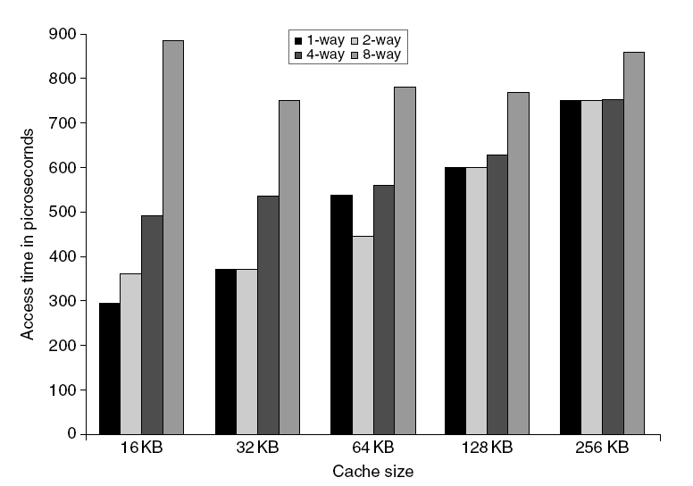
L1 Size and Associativity
Access time vs. size and associativity

Slide 110
Way Prediction
2. To improve hit time, predict the way to pre-set mux
Mis-prediction gives longer hit time
Prediction accuracy
> 90% for two-way
> 80% for four-way
I-cache has better accuracy than D-cache
First used on MIPS R10000 in mid-90s
Used on ARM Cortex-A8
Extend to predict block as well
“Way selection”
Increases mis-prediction penalty

Slide 111
Pipelining Cache
3. Pipeline cache access to improve bandwidth
Examples:
Pentium: 1 cycle
Pentium Pro – Pentium III: 2 cycles
Pentium 4 – Core i7: 4 cycles
Increases branch mis-prediction penalty
Makes it easier to increase associativity

Slide 112
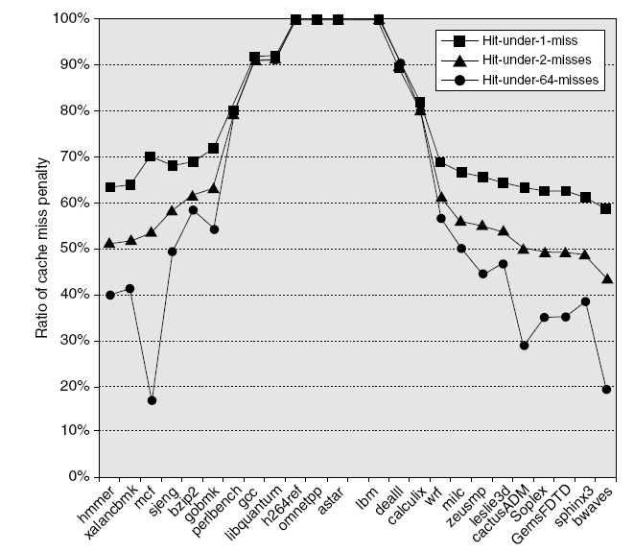
Nonblocking Caches
4. Allow hits before previous misses complete
“Hit under miss”
“Hit under multiple miss”
In general, processors can hide L1 miss penalty but not L2 miss penalty

Slide 113
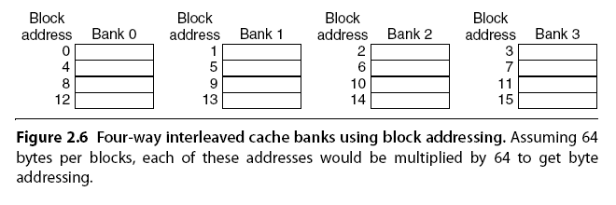
Multibanked Caches
5. Organize cache as independent banks to support simultaneous access
ARM Cortex-A8 supports 1-4 banks for L2
Intel i7 supports 4 banks for L1 and 8 banks for L2
Interleave banks according to block address

Slide 114
Critical Word First, Early Restart
6. Critical word first
Request missed word from memory first
Send it to the processor as soon as it arrives
Early restart
Request words in normal order
Send missed word to the processor as soon as it arrives
Effectiveness of these strategies depends on block size and likelihood of another access to the portion of the block that has not yet been fetched

Slide 115
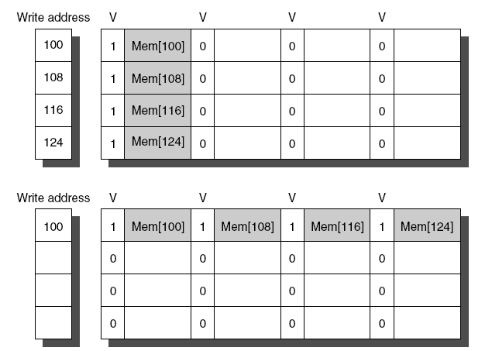
Merging Write Buffer
7. When storing to a block that is already pending in the write buffer, update write buffer (write merging)
Reduces stalls due to full write buffer
Do not apply to I/O addresses
No write merging
Write merging

Slide 116
Compiler Optimizations
8. Loop Interchange
Swap nested loops to access memory in sequential order
Blocking
Instead of accessing entire rows or columns, subdivide matrices into blocks
Improves locality if a block can fit in the cache

Slide 117
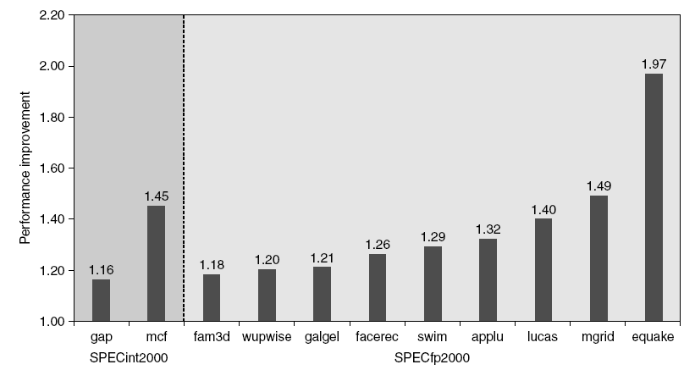
Hardware Prefetching
9. Fetch two blocks on miss (include next sequential block)
Pentium 4 Pre-fetching

Slide 118
Compiler Prefetching
10. Insert prefetch instructions before data is needed
Non-faulting: prefetch doesn’t cause exceptions
Register prefetch
Loads data into register
Cache prefetch
Loads data into cache
Combine with loop unrolling and software pipelining

Slide 119
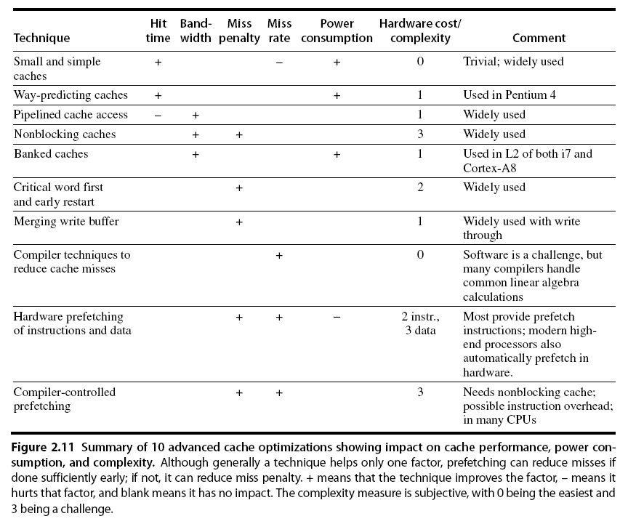
Summary

Slide 120
Virtual Memory
Originally invented to support program sizes larger than then-available physical memory
later on it finds applications in multi-programming and virtual machines
Virtual memory is as large as the address space allowed by the ISA…but
only a portion of the address space resides in physical memory at any given time
the rest is kept on disks and brought into physical memory as needed

Slide 121
Motivations for Virtual Memory
(1) Use Physical DRAM as a Cache for the Disk
Address space of a process (program) can exceed physical memory size
Sum of address spaces of multiple processes can exceed physical memory
(2) Simplify Memory Management
Multiple processes reside in main memory.
Each process with its own address space
Only “active” code and data are actually in memory
Allocate more memory to process as needed.

Slide 122
DRAM vs. SRAM as a “Cache”
DRAM vs. disk is more extreme than SRAM vs. DRAM
Access latencies:
DRAM ~10X slower than SRAM
Disk ~100,000X slower than DRAM
Design decisions made for DRAM caches driven by enormous cost of misses
SRAM
DRAM
Disk

Slide 123
Virtual Memory
Address translation
Program “sees” entire VM address space
Program is run in physical memory which is typically smaller than the address space
Pages of address space are swapped in/out of disk storage as needed
Strictly speaking VM is required to overcome limitation on the size of physical memory
but VM is extended in a natural way to support multiprogramming & memory protection
There are machines where the physical memory space is larger than the virtual memory space (e.g., PDP-11)
Address
translation
Physical memory
Disk
Virtual memory

Slide 124
Advantages of Virtual Memory
Abstraction of large and flat memory
program has a consistent view of a contiguous memory, even though physical memory is scrambled
Allows multiprogramming
relocation: allows the same program to run in any location in physical memory
Protection
different processes are protected from each other
different pages can have different behavior (read-only; user/supervisor)
kernel code/data protected from user programs
Sharing
can map same physical memory to multiple processes (shared memory)

Slide 125
How VM Works
On program startup
OS loads part of the program into RAM; this includes enough code to start execution
if program size exceeds allocated RAM space the remainder is maintained on disk
During execution
if program needs a code/data not resident in RAM, it fetches the segment from disk into RAM
if there is not enough room in RAM, some resident code/data is evicted from memory to make room
if evicted contents are “dirty”, they are written to disk

Slide 126
Address Translation

Slide 127
VA-to-PA Address Translation
Programs use virtual addresses (VA) for data & instructions
VA translated to physical addresses (PA)
Usually organized in pages (paging) or segments
Paging systems use a “page table” for the translation
Instruction/data fetched/updated in memory
Sw R1, 0(R4)
0x00
VA
PA
add R1, R2, R4
0x04
Virtual
address
0x00
0x04
Sub R8, R2, R1
0x08
Processor
0x04
0x00
BNEZ R5, 0x64
0x12
0x08
0x12
Main memory
0x12
Disk
Page table
Disk

Slide 128
Page Table
Memory organized in pages (similar to blocks in cache)
Page size is usually 4-8 Kbytes
31
12
11
0
Virtual address
Virtual page number
Page offset
Page table
23
12
11
0
Physical address
Physical page number
Page offset

Slide 129
VA to PA Translation
Page table maps the base address of virtual and physical page frames
Page offset need not be used in VA=>PA translation because virtual and physical block sizes are the same
Page frame
Page offset
Page
Table
Page offset
Physical address space
63
12
11
0
Virtual address space
Virtual page number
Page offset

Slide 130
Multiprogramming View of VM
Page table
base pointer 1
Each application has a separate page table
Page table contains an entry for each page
Page tables are identified by the base pointers maintained by OS for individual processes
1
VA 1
2
Program 1
3
Page table
base pointer 2
Page Table 1
VA 1
1
2
Program 2
3
4
Page table
base pointer 3
Page Table 2
VA 1
1
Physical Memory
Program 3
2
3
4
Page Table 3

Slide 131
Page Table Structure
Virtual page number <=> page table size
20 bits: ~1 million
31
12
11
0
Virtual page number
Page offset
Page offset <=> page size
12 bits: 4096 bytes
V
Physical page number
0x00000
0x00001
0x00002
0x00003
0x00004
0x00005
0x00006
0x00007
.
.
.
.
.
.
.
.
.
0xFFFFF
23
12
11
0
Physical address

Slide 132
Determining Page Table Size
Assume
32-bit virtual address
30-bit physical address
4 KB pages => 12 bit page offset
Each page table entry is one word (4 bytes)
How large is the page table?
Virtual page number = 32 - 12 = 20 bits
Number of entries = number of pages = 2^20
Total size = number of entries x bytes/entry
= 2^20 x 4 = 4 Mbytes
Each process running needs its own page table

Slide 133
Page Fault
How is it known whether the page is in memory?
Maintain a valid bit per page table entry
valid bit is set to INVALID if the page is not in memory
valid bit is set to VALID if the page is in memory
Page fault occurs when a page is not in memory
fault results in OS fetching the page from disk into DRAM
if DRAM is full, OS must evict a page (victim) to make room
if victim is dirty OS updates the page on disk before fetch
OS changes page table to reflect turnover
After a page fault and page-fetching, execution resumes at the instruction which caused the fault

Slide 134
Accelerating Virtual Memory Operations

Slide 135
VM => PM Translation
31
12
11
0
Virtual address
Virtual page number
Page offset
Page table
24
12
11
0
Physical address
Physical page number
Page offset
Each program memory reference requires two memory accesses: one for VM => PM mapping and one for actual data/instruction
must make page table lookup as fast as possible
Page table too big to keep in fast memory (SRAM) in its entirety
store page table in main memory
cache a portion of the page table in TLB (Translation Look-Aside Buffer)

Slide 136
Speeding Up Address Translation: Translation Lookaside Buffer (TLB)
TLB: A small and fast on-chip memory structure used for address translations.
If a virtual address is found in TLB (a TLB hit), the page table in main memory is not accessed.
Physical Page
Address
TLB (on-chip)
128-256 Entries
Virtual Page
Number
Valid
Tag
1
Physical Memory
1
1
1
128-256
TLB Entries
0
1
Physical Page
or Disk Address
Valid
1
1
Disk Storage
1
Page Table
(in main memory)
1
0
1
1
0
1
1
0
1

Slide 137
Translation Look-Aside Table (TLB)
TLB maintains a list of most-recently used pages
Similar to instruction & data cache
virtual address is used to index into the TLB
TLB entry contains physical address
takes ~ 1 clock cycle
What if VM=>PM lookup and data/instruction lookup takes more than 1 clock cycle?
To avoid TLB lookup, remember the last VM => PM translation
if same page is referenced, TLB lookup can be avoided
Processor
TLB
Memory

Slide 138
TLB / Cache Interaction
V
i
r
t
u
a
l
a
d
d
r
e
s
s
3
1
3
0
2
9
1
5
1
4
1
3
1
2
1
1
1
0
9
8
3
2
1
0
V
i
r
t
u
a
l
p
a
g
e
n
u
m
b
e
r
P
a
g
e
o
f
f
s
e
t
2
0
1
2
V
a
l
i
d
D
i
r
t
y
P
h
y
s
i
c
a
T
l
p
a
g
e
n
u
m
b
e
r
a
g
T
L
B
T
L
B
h
i
t
2
0
P
h
y
s
i
c
a
l
p
a
g
e
n
u
m
b
e
r
P
a
g
e
o
f
f
s
e
P
h
y
s
t
i
c
a
l
a
d
d
r
e
s
s
B
y
t
P
h
y
s
e
i
c
a
l
a
d
d
r
e
s
s
t
a
g
C
a
c
h
e
i
n
d
e
x
o
f
f
s
e
1
4
t
1
6
2
T
a
g
D
a
t
V
a
a
l
i
d
C
a
c
h
e
3
2
D
a
t
C
a
c
h
e
h
a
i
t

Slide 139
TLB and Context Switch
In multi-programming we need to use TLB for the active process
What to do with TLB at context switch?
Too costly to clear TLB on every context switch
Keep track of PTE in TLB per process using ASID

Slide 140
TLB Organization
Tag
Additional info per page
Dirty: page modified (if the page is swapped out, should the disk copy be updated?)
Valid: TLB entry valid
Used: Recently used or not (for selecting a page for eviction)
Access: Read/Write
ASID:Address Space ID

Slide 141
Associativity of VM
Cache miss penalty: 8-150 clock cycles
VM miss penalty: 1,000,000 - 10,000,000 clock cycles
Because of the high miss penalty, VM design minimizes miss rate by allowing full associativity for page placement

Slide 142
Write Strategies
Disk I/O slow (millions of clock cycles)
Always write-back; never write-through
Use dirty bit to decide whether to write disk before eviction
Smart disk controllers buffers writes
copy replaced page in buffer
read new page into main memory
write from buffer to disk

Slide 143
Virtual Machines
Supports isolation and security
Sharing a computer among many unrelated users
Enabled by raw speed of processors, making the overhead more acceptable
Allows different ISAs and operating systems to be presented to user programs
“System Virtual Machines”
SVM software is called “virtual machine monitor” or “hypervisor”
Individual virtual machines run under the monitor are called “guest VMs” or “guest OSes”

Slide 144
I/O Performance Measures
I/O bandwidth (throughput) – amount of information that can be input (output) and communicated across an interconnect (e.g., a bus) to the processor/memory (I/O device) per unit time
How much data can we move through the system in a certain time?
How many I/O operations can we do per unit time?
I/O response time (latency) – the total elapsed time to accomplish an input or output operation
An especially important performance metric in real-time systems
Many applications require both high throughput and short response times

Slide 145
Hard Disk Performance
Outer
Track
Inner
Track
Sector
Head
Arm
Controller
Spindle
Platter
Actuator
Disk Latency = Seek Time + Rotation Time + Transfer Time + Controller Overhead
Seek Time depends on the moving distance and moving speed of arms
Rotation Time depends on how fast the disk rotates and how far sector is from head
Transfer Time depends on data rate (bandwidth) of disk and size of request

Slide 146
Disk Access Time
I want
block X
block x
in memory
Disk platter
Disk access time =
Disk head
Seek time
+ Rotational delay
+ Transfer time
Disk arm
+ Other delays

Slide 147
Communication of I/O Devices and Processor
How does the processor command the I/O devices?
Special I/O instructions
Must specify both the device (port number) and the command
For example:
inp reg, port ; register←port
out port, reg ; port→register
Physical
address space
I/O address space
each device gets
one or more
addresses

Slide 148
Communication of I/O Devices and Processor
How does the processor command the I/O devices?
Memory-mapped I/O
Portions of the memory address space are assigned to I/O devices
Read and writes to those memory addresses are interpreted as commands to the I/O devices
Load/stores to the I/O address space can only be done by the OS
Physical address space
each device gets
one or more
addresses

Slide 149
Communication of I/O Devices and Processor
How does the I/O device communicate with the processor?
Polling – the processor periodically checks the status of an I/O device to determine its need for service
Processor is totally in control – it also does all the work
Can waste a lot of processor time due to speed differences
Interrupt-driven I/O – the I/O device issues an interrupt to the processor to indicate that it needs attention

Slide 150
Direct-Memory Access (DMA)
Interrupt-driven IO relieves the CPU from waiting for every IO event
But the CPU can still be bogged down if it is used in transferring IO data.
Typically blocks of bytes.
For high-bandwidth devices (like disks) interrupt-driven I/O would consume a lot of processor cycles

Slide 151
DMA
DMA – the I/O controller has the ability to transfer data directly to/from the memory without involving the processor

Slide 152
I/O Buses
Connect I/O devices (channels) to memory.
Many types of devices are connected to a bus.
Have a wide range of bandwidth requirements for the devices connected to a bus.
Typically follow a bus standard, e.g., PCI, SCSI.
Clocking schemes:
Synchronous: The bus includes a clock signal in the control lines and a fixed protocol for address and data relative to the clock
Asynchronous: The bus is self-timed and uses a handshaking protocol between the sender and receiver

Slide 153
RAID (Redundant Array of Inexpensive Disks)

Slide 154
RAID
To increase the availability and the performance (bandwidth) of a storage system, instead of a single disk, a set of disks (disk arrays) can be used.
Similar to memory interleaving, data can be spread among multiple disks (striping), allowing simultaneous access to the data, improving the throughput and latency besides availability.
However, the reliability of the system drops (n devices have 1/n the reliability of a single device).

Slide 155
Dependability Measures
Reliability: mean time to failure (MTTF)
Service interruption: mean time to repair (MTTR)
Mean time between failures
MTBF = MTTF + MTTR
Availability = MTTF / (MTTF + MTTR)
Improving Availability
Increase MTTF: fault avoidance, fault tolerance, fault forecasting
Reduce MTTR: improved tools and processes for diagnosis and repair

Slide 156
Array Reliability
Reliability of N disks = Reliability of 1 Disk ÷N
50,000 Hours ÷ 70 disks = 700 hours
Disk system Mean Time To Failure (MTTF): Drops from 6 years to 1 month!
Disks without redundancy are too unreliable to be useful!

Slide 157
RAID
A disk array’s availability can be improved by adding redundant disks:
If a single disk in the array fails, the lost information can be reconstructed from redundant information.
This leads to a technology known as RAID - Redundant Array of Inexpensive Disks.
Depending on the number of redundant disks and the redundancy scheme used, RAIDs are classified into levels.
At least 6 levels of RAID (0-5) are accepted by the industry.
Level 2 is not commercially available

Slide 158
RAID-0
stripe 0
stripe 1
stripe 2
stripe 3
stripe 4
stripe 5
stripe 6
stripe 7
stripe 8
stripe 9
stripe 10
stripe 11
stripe 12
stripe 13
stripe 14
stripe 15
Striped, non-redundant
Parallel access to multiple disks
Excellent data transfer rate
Excellent I/O request processing rate (for large stripes) if the controller supports independent Reads/Writes
Not fault tolerant (AID)
Typically used for applications requiring high performance for non-critical data (e.g., video streaming and editing)

Slide 159
RAID-1 - Mirroring
Called mirroring or shadowing, uses an extra disk (mirror) for each disk in the array
costly form of redundancy (but some FS, e.g., GFS, makes 3 copies)
Whenever data is written to one disk, the data is also written to the mirror: good for reads (lower latency), fair for writes
If a disk fails, the system goes to the mirror and gets the desired data.
Fast, but very expensive.
Typically used in system drives and critical files
Banking, insurance data
e-commerce servers
stripe 0
stripe 0
stripe 1
stripe 1
stripe 2
stripe 2
stripe 3
stripe 3

Slide 160
RAID-4 - Block-interleaved Parity
In RAID 3, every read or write needs to go to all disks since bits are interleaved among the disks.
Performance of RAID 3:
Only one request can be serviced at a time
Poor I/O request rate
Excellent data transfer rate
Typically used in large I/O request size applications, such as imaging or CAD
RAID 4: If we distribute the information block-interleaved, where a disk sector is a block, then for normal reads different reads can access different segments in parallel. Only if a disk fails will we need to access all the disks to recover the data.

Slide 161
RAID-4: Block Interleaved Parity
block 0
block 1
block 2
block 3
P(0-3)
block 4
block 5
block 6
block 7
P(4-7)
block 8
block 9
block 10
block 11
P(8-11)
block 12
block 13
block 14
block 15
P(12-15)
Allow for parallel access by multiple I/O requests
Doing multiple small reads is now faster than before.
A write, however, is a different story since we need to update the parity information for the block.
Large writes (full stripe), update the parity:
P’ = d0’ ⊕ d1’ ⊕ d2’ ⊕ d3’;
Small writes (eg. write on d0), update the parity:
P = d0 ⊕ d1 ⊕ d2 ⊕ d3
P’ = d0’ ⊕ d1 ⊕ d2 ⊕ d3 = d0’ ⊕ d0 ⊕ P;
However, writes are still very slow since parity disk is the bottleneck.

Slide 162
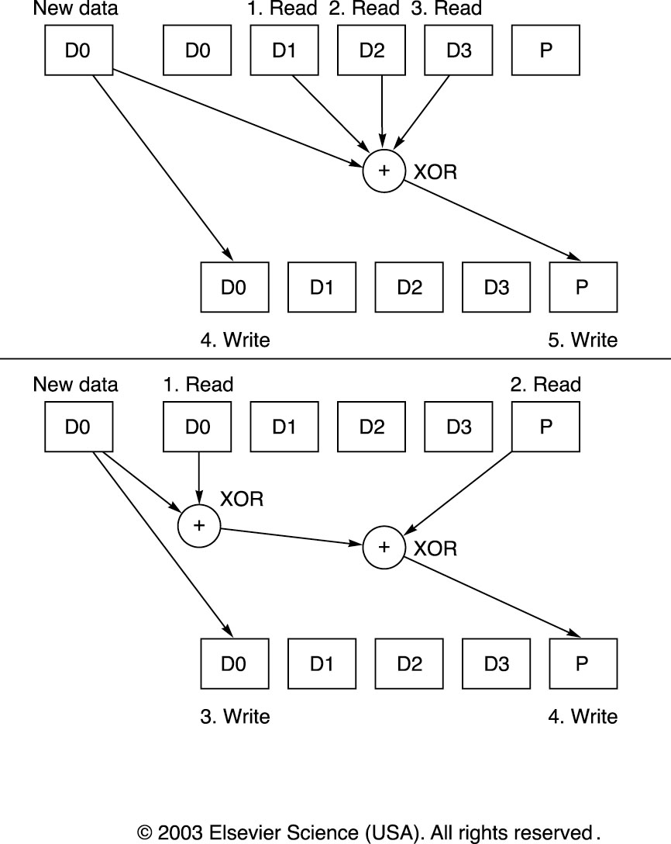
RAID-4: Small Writes

Slide 163
RAID-5 - Block-interleaved Distributed Parity
RAID 5 distributes the parity blocks among all the disks.
0
1
2
3
P0
4
5
6
P1
7
8
9
P2
10
11
12
P3
13
14
15
P4
16
17
18
19
20
21
22
23
P5
. . .
. . .
. . .
. . .
. . .
RAID 5
Why is this helpful?

Slide 164
RAID-5 - Block-interleaved Distributed Parity
This allows some writes to proceed in parallel
For example, writes to blocks 8 and 5 can occur simultaneously.

Slide 165
RAID-5 - Block-interleaved Distributed Parity
However, writes to blocks 8 and 11 cannot proceed in parallel.

Slide 166
Performance of RAID-5 - Block-interleaved Distributed Parity
Performance of RAID-5
I/O request rate: excellent for reads, good for writes
Data transfer rate: good for reads, good for writes
Typically used for high request rate, read-intensive data lookup
File and Application servers, Database servers, WWW, E-mail, and News servers, Intranet servers
Widely used.

Slide 167
RAID-6 – Row-Diagonal Parity
To handle 2 disk errors
In practice, another disk error can occur before the first problem disk is repaired
Use p-1 data disks, 1 row-parity disk, 1 diagonal-parity disk
If any two of the p+1 disks fail, data can still be recovered
Data Disk 0 | Data Disk 1 | Dada Disk 2 | Dada Disk 3 | Row Parity Disk | Diagonal Parity Disk
0 | 1 | 2 | 3 | 4 | 0
1 | 2 | 3 | 4 | 0 | 1
2 | 3 | 4 | 0 | 1 | 2
3 | 4 | 0 | 1 | 2 | 3

Slide 168
Dependability
Notes:
168

Slide 169
Definitions
Examples on why precise definitions so important for reliability
Is a programming mistake a fault, error, or failure?
Are we talking about the time it was designed or the time the program is run?
If the running program doesn’t exercise the mistake, is it still a fault/error/failure?
If an alpha particle hits a DRAM memory cell, is it a fault/error/failure if it doesn’t change the value?
Is it a fault/error/failure if the memory doesn’t access the changed bit?
Did a fault/error/failure still occur if the memory had error correction and delivered the corrected value to the CPU?

Slide 170
IFIP Standard terminology
Computer system dependability: quality of delivered service such that reliance can be justifiably placed on the service
Service is observed actual behavior as perceived by other system(s) interacting with this system’s users
Each module has ideal specified behavior, where service specification is agreed description of expected behavior
A system failure occurs when the actual behavior deviates from the specified behavior
failure occurred because an error, a defect in module
The cause of an error is a fault
When a fault occurs it creates a latent error, which becomes effective when it is activated
When error actually affects the delivered service, a failure occurs (time from error to failure is error latency)

Slide 171
Why multi-core ?
Difficult to make single-core clock frequencies even higher
Deeply pipelined circuits:
Heat problems
Clock problems
Efficiency (Stall) problems
Doubling issue rates above today’s 3-6 instructions per clock, say to 6 to 12 instructions, is extremely difficult
issue 3 or 4 data memory accesses per cycle,
rename and access more than 20 registers per cycle, and
fetch 12 to 24 instructions per cycle.
Many new applications are multithreaded
A general trend in computer architecture is to shift towards more parallelism through more processors or processor cores
Notes:
171

Slide 172
Thread-Level Parallelism (TLP)‏
This is parallelism on a more coarse scale
Server can serve each client in a separate thread (Web server, database server)‏
A computer game can do AI, graphics, and sound in three separate threads
Single-core superscalar processors cannot fully exploit TLP
Multi-core architectures are the next step in processor evolution: explicitly exploiting TLP
Notes:
172

Slide 173
Thread-Level Parallelism
Notes:
173

Slide 174
TLP
Thread-Level parallelism
Have multiple program counters
Uses MIMD model
Targeted for tightly-coupled shared-memory multiprocessors
For n processors, need n threads
Amount of computation assigned to each thread = grain size
Threads can be used for data-level parallelism, but the overheads may outweigh the benefit

Slide 175
How to exploit TLP?
Execute instructions from multiple threads on a single processor
Coarse-grain, fine-grain, SMT (Simultaneous Multi-Threading)
Execute multiple threads on multiple processors
“Anything that can be threaded today will map efficiently to multi-core”
Notes:
175

Slide 176
SMT – Simultaneous Multi-Threading
A variation on multithreading that uses the resources of a multiple-issue, dynamically scheduled processor (superscalar) to exploit both program ILP and thread-level parallelism (TLP)
With register renaming and dynamic scheduling, multiple instructions from independent threads can be issued in one cycle without regard to dependencies among them
Need separate rename tables (ROBs) for each thread
Need the capability to commit from multiple threads (i.e., from multiple ROBs) in one cycle
Notes:
176

Slide 177
TLP a 4-issue superscalar processor
Coarse MT
Fine MT
SMT
Issue slots
Thread A
Thread B
Time
Thread C
Thread D
Notes:
177

Slide 178
Without SMT, only a single thread can run at any given time
L1 D-Cache D-TLB
Integer
Floating Point
Schedulers
L2 Cache and Control
Uop queues
Rename/Alloc
BTB
Trace Cache
uCode ROM
Decoder
Bus
BTB and I-TLB
Thread 1: floating point
Notes:
178

Slide 179
Without SMT, only a single thread can run at any given time
L1 D-Cache D-TLB
Integer
Floating Point
Schedulers
L2 Cache and Control
Uop queues
Rename/Alloc
BTB
Trace Cache
uCode ROM
Decoder
Bus
BTB and I-TLB
Thread 2: integer operation
Notes:
179

Slide 180
SMT processor: both threads can run concurrently
L1 D-Cache D-TLB
Integer
Floating Point
Schedulers
L2 Cache and Control
Uop queues
Rename/Alloc
BTB
Trace Cache
uCode ROM
Decoder
Bus
BTB and I-TLB
Thread 2: integer operation
Thread 1: floating point
Notes:
180

Slide 181
But: Can’t simultaneously use the same functional unit
L1 D-Cache D-TLB
Integer
Floating Point
Schedulers
L2 Cache and Control
Uop queues
Rename/Alloc
BTB
Trace Cache
uCode ROM
Decoder
This scenario is impossible with SMT on a single core (assuming a single integer unit)‏
Bus
BTB and I-TLB
Thread 1
Thread 2
IMPOSSIBLE
Notes:
181

Slide 182
Multi-core: threads can run on separate cores
L1 D-Cache D-TLB
L1 D-Cache D-TLB
Integer
Floating Point
Integer
Floating Point
Schedulers
Schedulers
L2 Cache and Control
Uop queues
L2 Cache and Control
Uop queues
Rename/Alloc
Rename/Alloc
BTB
Trace Cache
uCode ROM
BTB
Trace Cache
uCode ROM
Decoder
Decoder
Bus
BTB and I-TLB
Bus
BTB and I-TLB
Thread 1
Thread 2
Notes:
182

Slide 183
Multi-core: threads can run on separate cores
L1 D-Cache D-TLB
L1 D-Cache D-TLB
Integer
Floating Point
Integer
Floating Point
Schedulers
Schedulers
L2 Cache and Control
Uop queues
L2 Cache and Control
Uop queues
Rename/Alloc
Rename/Alloc
BTB
Trace Cache
uCode ROM
BTB
Trace Cache
uCode ROM
Decoder
Decoder
Bus
BTB and I-TLB
Bus
BTB and I-TLB
Thread 3
Thread 4
Notes:
183

Slide 184
Combining Multi-core and SMT
Cores can be SMT-enabled (or not)‏
The different combinations:
Single-core, non-SMT: standard uniprocessor
Single-core, with SMT
Multi-core, non-SMT
Multi-core, with SMT
The number of SMT threads: 2, 4, or sometimes 8 simultaneous threads
Intel calls it “hyper-threading”
Notes:
184

Slide 185
SMT Dual-core: all four threads can run concurrently
L1 D-Cache D-TLB
L1 D-Cache D-TLB
Integer
Floating Point
Integer
Floating Point
Schedulers
Schedulers
L2 Cache and Control
Uop queues
L2 Cache and Control
Uop queues
Rename/Alloc
Rename/Alloc
BTB
Trace Cache
uCode ROM
BTB
Trace Cache
uCode ROM
Decoder
Decoder
Bus
BTB and I-TLB
Bus
BTB and I-TLB
Thread 1
Thread 3
Thread 2
Thread 4
Notes:
185

Slide 186
High-Performance Computing
Notes:
186

Slide 187
When Do We Need High Performance Computing?
Case1
To do a time-consuming operation in less time
I am an aircraft engineer
I need to run a simulation to test the stability of the wings at high speed
I’d rather have the result in 5 minutes than in 5 days so that I can complete the aircraft final design sooner.

Slide 188
When Do We Need High Performance Computing?
Case 2
To do a high number of operations per seconds
I am an engineer of Amazon.com
My Web server gets 10,000 hits per seconds
I’d like my Web server and my databases to handle 10,000 transactions per seconds so that customers do not experience bad delays

Slide 189
Multiprocessing
Multiprocessing (Parallel Processing): Concurrent execution of tasks (programs) using multiple computing, memory and interconnection resources.
Use multiple resources to solve problems faster
Provides an alternative to faster clock for performance
Assuming a doubling of effective processor performance every 2 years, 1024-Processor system (assuming linear performance gain) can get you the performance that it would take 20 years for a single-processor system to deliver
Using multiple processors to solve a single problem
Divide problem into many small pieces
Distribute these small problems to be solved by multiple processors simultaneously

Slide 190
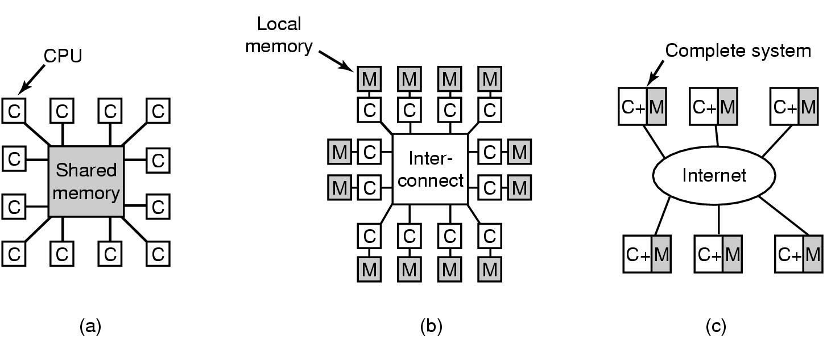
Multiprocessing
For the last 30+ years multiprocessing has been seen as the best way to produce orders of magnitude performance gains.
Double the number of processors, get (theoretically) double performance (less than 2 times the cost).
It turns out that the ability to develop and deliver software for multiprocessing systems induces impediment to wide adoption.

Slide 191
Performance Potential: Another View
Gustafson view
Parallel portion increases as the problem size increases
Serial time fixed (at s)
Parallel time proportional to problem size (true most of the time)
Gustafson’s Law: Speedup(N) = N - β(N-1)
N: number of processors, β : weight of non-parallelizable part
Old Serial: SSPPPPPP
6 processors: SSPPPPPP
PPPPPP
PPPPPP
PPPPPP
PPPPPP
PPPPPP
Hypothetical Serial:
SSPPPPPP PPPPPP PPPPPP PPPPPP PPPPPP PPPPPP
Speedup(6) = (8+5*6)/8 = 4.75
β =? in this calculation?
Speedup(N) = N(1- β) + β; Speedup'(∞) → ∞!!!!
This means we can achieve higher speedup by processing larger problems.

Slide 192
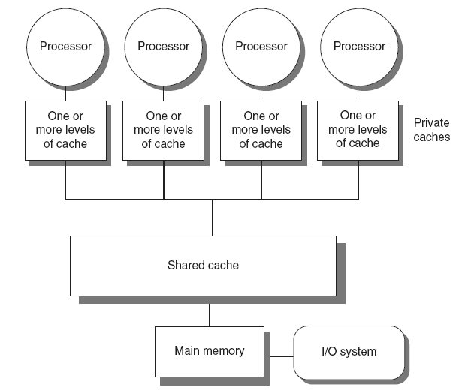
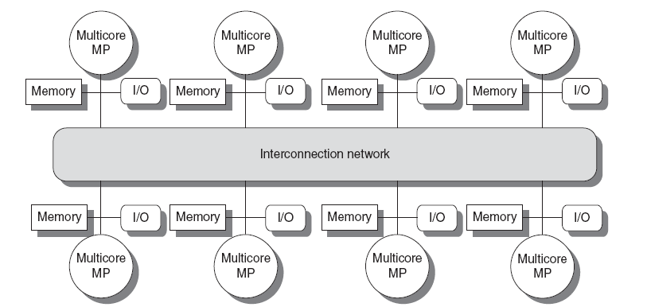
A Few Types
Symmetric multiprocessors (SMP)
Small number of cores
Share single memory with uniform memory latency
Distributed shared memory (DSM)
Memory distributed among processors
Non-uniform memory access/latency (NUMA)
Processors connected via direct (switched) and non-direct (multi-hop) interconnection networks

Slide 193
Flynn’s Taxonomy of Computing
SISD (Single Instruction, Single Data):
Typical uniprocessor systems that we’ve studied throughout this course.
Uniprocessor systems can time share and still be SISD.
SIMD (Single Instruction, Multiple Data):
Multiple processors simultaneously executing the same instruction on different data.
Specialized applications (e.g., image processing).
MIMD (Multiple Instruction, Multiple Data):
Multiple processors autonomously executing different instructions on different data.
Keep in mind that the processors are working together to solve a single problem.
This is a more general form of multiprocessing, and can be used in numerous applications

Slide 194
SIMD Systems
P
P
P
P
One control unit
Lockstep
All Ps do the same or nothing
M
M
M
M
P
P
P
P
M
M
M
M
P
P
P
P
M
M
M
M
Processor
Memory
P
P
P
P
M
M
M
M
von Neumann Computer
Some Interconnection Network

Slide 195
MIMD Architecture
Instruction
Stream A
Instruction
Stream B
Instruction
Stream C
Data Output
stream A
Data Input
stream A
Processor
A
Data Output
stream B
Data Input
stream B
Processor
B
Processor
C
Data Output
stream C
Data Input
stream C
Unlike SIMD, MIMD computer works asynchronously.
Shared memory (tightly coupled) MIMD
Distributed memory (loosely coupled) MIMD
195

Slide 196
MIMD Shared Memory Systems
M
M
M
M
Global Memory
Interconnection Networks
C
C
C
P
P
P
P
P
P
P
P
C
P
P
C
One global memory
Cache Coherence
All Ps have equal access to memory
P
C
P
C
M
M
M
M

Slide 197
Cache Coherent NUMA
M
M
M
M
C
C
C
C
P
P
P
P
Interconnection Network
Each P has part of the shared memory
Non uniform memory access

Slide 198
MIMD Distributed Memory Systems
M
M
M
M
P
P
P
P
Interconnection Networks
1110 1111
1010 1011
0110 0111
0010 0011
1100 1101
1000 1001
0100 0101
0000 0001
No shared memory
Message Passing
Topology
LAN/WAN

Slide 199
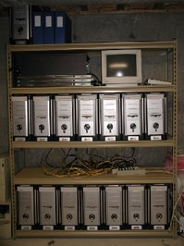
Cluster Architecture
Programming Environment
Middleware
OS
OS
OS
M
M
M
I/O
I/O
I/O
C
C
C
P
P
P
Interconnection Network
Home cluster

Slide 200


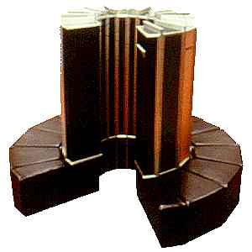

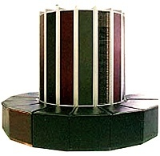
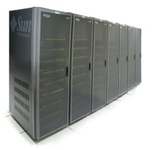

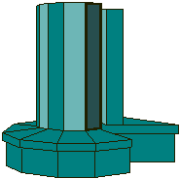
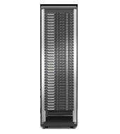
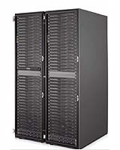
Grids
Geographically distributed platforms.
Internet
Dependable, consistent, pervasive, and inexpensive access to high end computing.

Slide 201
SIMD
Notes:
201

Slide 202
SIMD Parallel Computing
It can be a stand-alone multiprocessor
Or
Embedded in a single processor for specific applications (MMX)
202

Slide 203
SIMD Multiprocessing
Traditional vector computers are typical SIMD systems
In the late 80s and early 90s, many SIMD machines were commercially available (e.g., Connection machine has 64K ALUs, and MasPar has 16K ALUs)
GPU revives the SIMD computation, and is widely used in high-performance computers
SPMD—Single Program, Multiple Data
203

Slide 204
Cache Coherence
Notes:
204

Slide 205
Shared Memory Multiprocessor
Processor
Processor
Processor
Processor
Registers
Registers
Registers
Registers
Caches
Caches
Caches
Caches
Memory
Interconnect
Memory: centralized with Uniform Memory Access time (“uma”) and bus interconnect, I/O
Examples: Sun Enterprise 6000, SGI Challenge, Intel SystemPro
Disk & other IO
205
Notes:
205

Slide 206
Cache Coherence Problem
W: X = 17
R: X
P0
R: X
P1
P2
P3
$
X:17
$
$
$
X:42
X:42
MEM
X:42
Processor 3 does not see the value written by processor 0
206

Slide 207
Write Through does not help
W: X = 17
R: X
P0
R: X
P1
P2
P3
R: X
$
X:17
$
$
$
X:17
X:42
X:42
MEM
X:42
Processor 3 sees 42 in cache (does not get the correct value (17) from memory.
207

Slide 208
Why Don’t Processors Share Cache
Advantages
Cache placement identical to single cache
only one copy of any cached block
Disadvantages
Bandwidth limitation
P
1
P
n
Switch
(Interleaved)
First-level $
(Interleaved)
Main memory
Shared Cache
208
Notes:
208

Slide 209
Cache Coherence
Coherence
All reads by any processor return the most recently written value
Writes to the same location by any two processors are seen in the same order by all processors
Consistency
When a written value will be returned by a read
If a processor writes location A followed by location B, any processor that sees the new value of B must also see the new value of A

Slide 210
Enforcing Coherence
Coherent caches provide:
Migration: movement of data
Replication: multiple copies of data
Cache coherence protocols
Directory based
Sharing status of each block kept in one location
Snooping
Each core tracks sharing status of each block

Slide 211

Distributed Cache: Snoopy Cache-Coherence Protocols
State
Address
Data
Bus is a broadcast medium & caches know what they have
bus protocol: arbitration, command/addr, data
=> Every device observes every transaction
211

Slide 212
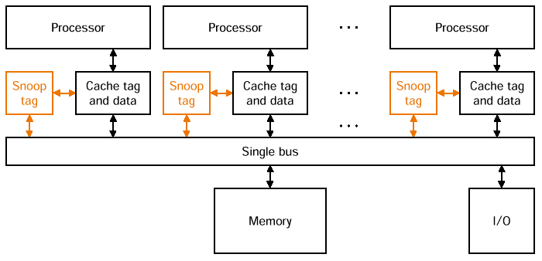
Snooping Cache Coherency
Cache Controller “snoops” all transactions on the shared bus
A transaction is a relevant transaction if it involves a cache block currently contained in this cache
take action to ensure coherence (invalidate, update, or supply value)
212

Slide 213
Hardware Cache Coherence
write-invalidate
write-update (also called distributed write)
invalidate -->
memory
X -> X’
X -> Inv
X -> Inv
P
P
. . . . .
P
memory
update -->
X -> X’
X -> X’
X -> X’
P
P
. . . . .
P

Slide 214
An Example Snoopy Protocol
Invalidation protocol, write-back cache
“invalidate” request on memory bus
Each cache block is in one state (track these):
Shared : multiple caches potentially have copies of the block; the block can be read
OR Modified : this cache has the only copy of the block; the block is writeable and dirty
OR Invalid : the block contains no valid data

Slide 215
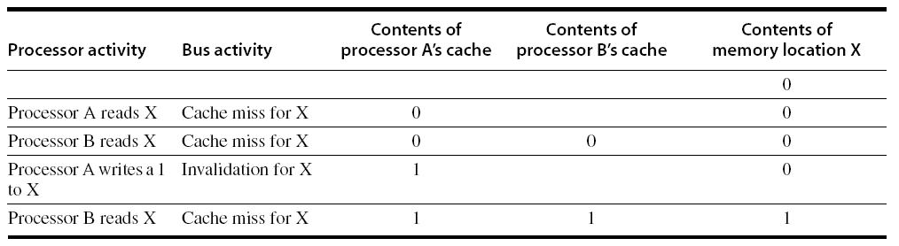
Snoopy Coherence Protocols
Write invalidate
On write, invalidate all other copies
Use bus itself to serialize
Write cannot complete until bus access is obtained
Write update
On write, update all copies

Slide 216
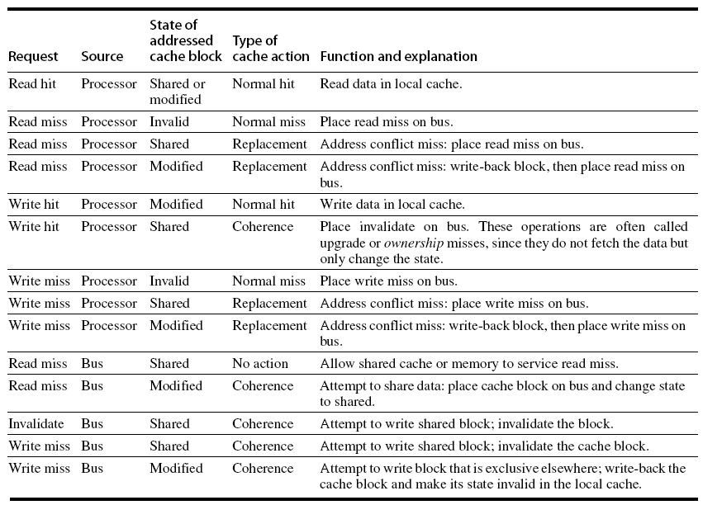
Snoopy Coherence Protocols

Slide 217
Snoopy-Cache State Machine
State machine for CPU requests for each cache block and for bus requests for each cache block
CPU: Read hit
Bus: Write miss
Bus: Invalidate
Shared
(read only)
Invalid
CPU: Read
Place read miss on bus
CPU: Write miss
Place Write Miss on bus
CPU: Read miss
Place read miss
on bus
CPU: read miss
Write back block, Place read miss on bus
Bus: Write miss
Write Back Block
Write Back
Block
CPU: Write hit Place invalidate on Bus
Bus:Read miss
CPU Write miss
Place Write Miss on Bus
Exclusive
(modified)
CPU: Write hit
CPU: Read hit
CPU: Write Miss
Write back data,
Place write miss on bus

Slide 218
Performance
Coherence influences cache miss rate
Coherence misses
True sharing misses
Write to shared block (transmission of invalidation)
Read an invalidated block
False sharing misses
Read an unmodified word in an invalidated block

Slide 219
Revisit: Coherency Solutions
Snooping Solution (Snoopy Bus):
Send all requests for data to all caches
Requires broadcast, works well with bus (natural broadcast medium)
Dominates for small scale machines (most of the market)
Directory-Based Schemes
Keep track of what is being shared in 1 centralized place (logically)
Send point-to-point requests to processors via network
Scales better than Snooping

Slide 220
Scalable Shared Memory Architectures
Used in IBM SP Multiprocessor
P
0
M
0
000
P
1
M
1
001
P
2
M
2
010
1
P
3
M
3
011
P
4
M
4
100
1
P
5
M
5
101
P
6
M
6
110
0
P
7
M
7
111
220

