Slide 1
COMP 4611 Design and Analysis of Computer Architectures http://course.cse.ust.hk/comp4611 Dr. GU Lin Department of Computer Science and Engineering The Hong Kong University of Science and Technology

Slide 2
Administrative Details
Instructor:
Dr. GU, Lin (the class of Tues., Thurs.)
Office #: 3562 (Lifts 25/26, 27/28)
Email:
Phone: 2358 6991
Office hours: Tuesdays: 16:30pm - 18:00pm
(or by appointments).
Teaching Assistants:
Arafet Ben Makhlouf, Zhiqiang Ma, Ke Hong

Slide 3
Administrative Details
Textbook
John L. Hennessy and David A. Patterson. Computer Architecture: A Quantitative Approach. Morgan Kaufman Publishers, 5th Edition, 2011. ISBN: 9780123838728.
Reference Book
David A. Patterson and John L. Hennessy. Computer Organization and Design: The Hardware/Software Interface, 4th Edition. Morgan Kaufmann Publishers, 2011. ISBN: 0123747503.
William Stallings. Computer Organization and Architecture: Designing for Performance, 8th Edition. Prentice Hall. ISBN: 0136073735.
Resources
Course web site: http://course.cse.ust.hk/comp4611
Class mailing lists: comp4611@cse.ust.hk, csta4611@cse.ust.hk (for TAs)
Information about lecture slides, office hours on course web site

Slide 4
Administrative Details
Tutorial sessions
Starts next week –
T1: Arafet Makhlouf
T2: Zhiqiang Ma
T3: Ke Hong
Schedule on course homepage
Grading Scheme
Homework: 30%.
Project: 15%.
Midterm: 20%.
Final Exam: 35%.

Slide 5
Project
The project will be based on simulation of computer architectures.
Uses SimpleScalar as the simulator
Requires C programming
The organization:
Group-based, up to 3 persons per group
Two tutorials cover materials related to the project

Slide 6
Breakdown of a Computing Problem
Problem
Algorithms
Programming in
High-Level Language
Compiler/Assembler/
Linker
Apps Trend
Instruction Set Architecture (ISA)‏
Target Machine
(one implementation)‏
Micro-architecture
System architecture
Functional units/
Data Path
Human Level
System Level
Architect’s
Territory
Gates Level
Design
RTL Level
Technology Trend
Logic Level
Circuit Level
Silicon Level
Transistors
Manufacturing
Notes:
6

Slide 7
Course Description and Goal
What will COMP 4611 give me?
Understanding of the internal design details of modern computers, their evolution, and trade-offs present at the hardware/software boundary.
Understanding of the interaction and design of the various components at hardware level (processor, memory, I/O) and the software level (operating system, compiler, instruction sets).
Intellectual preparation for dealing with a host of system design challenges.

Slide 8
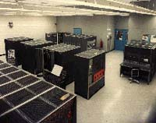
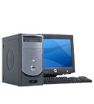
Course Description and Goal (cont’d)‏
What have been making computers faster and cheaper? And how to continue the innovations?
50 years of non-stop innovation – a technological miracle!
Compare computers and automobiles
The development of computers from the 1960’s to the 2010’s
 | Capacity (memory) | Speed (CPU) | Price
IBM7030 (Stretch)1961 | 128KB | 1.2 MIPS | US$13,500,000
i7 Desktop 2010 | 2GB (typical) | 2000+ MIPS | US$1,000

Slide 9
Course Description and Goal (cont’d)‏
Compare to computers and automobiles (cont’d)
What would a car be like if they had innovated like a computer?
 | Capacity (passengers) | Speed (KM/hour) | Price
A good car in the 1960’s | 5 | 100 | US$5,000
A car in the 2010’s had it developed like computers | 81920 | 166666 | US$0.29
This class tells you how computer scientists and engineers created such a technological miracle!

Slide 10
Course Description and Goal (cont’d)‏
To understand the design techniques, machine structures, technology factors and evaluation methods that will determine the form of computers in the 21st Century
Technology
Programming
Languages
Applications
Computer Architecture:
• Instruction Set Design
• Organization
• Hardware
Operating
Measurement &
Evaluation
Systems
History
Notes:
10

Slide 11
Course Description and Goal (cont’d)‏
Will I use the knowledge gained in this subject in my profession?
Remember
Few people design entire computers or entire instruction sets
But
Many computer engineers design computer components
Any successful computer engineer/architect needs to understand, in detail, all components of computers – in order to design any successful piece of hardware or software.

Slide 12
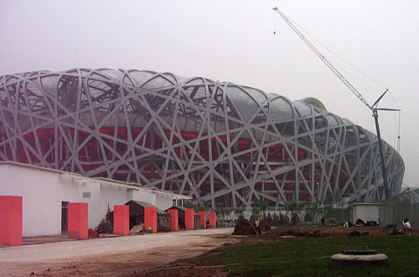
Computer Architecture in General
When we construct a building numerous practical considerations need to be taken into account:
Available materials
Worker skills
Budget
Space
Similarly, Computer Architecture is about working within constraints:
What will the market buy?
Cost/Performance
Tradeoffs in materials and processes
SOFTWARE

Slide 13
Computer Architecture
Related to computer architecture –
Instruction set architecture (ISA): The actual programmer-visible instruction set. Serves as the boundary between the software and hardware.
e.g., mov r2, r1 ( y = x; )
Implementation of a machine:
Organization: Includes the high-level aspects of a computer’s design such as: the memory system, the bus structure, the internal CPU unit which includes implementations of arithmetic, logic, branching, and data transfer operations.
Hardware: Refers to the specifics of the machine such as detailed logic design and packaging technology.

Slide 14
Three Computing Classes Today
Desktop/Laptop Computers
Personal computer and workstation: US$500 – 5K
Optimized for price-performance
Servers
Web server, file sever, computing sever: US$2K - 5M
Optimized for: availability, scalability, and throughput
Embedded Computers
Fastest growing and the most diverse space: US$1 - 10K
Microwaves, washing machines, palmtops, cell phones, etc.
Optimizations: price, power, specialized performance

Slide 15
Three Computing Classes Today
Feature | Desktop | Server | Embedded
Price of the system | $500-$5K | $2K-$5M e.g., Web server, file sever, computing sever | $1-$100K (including network routers at high end) e.g. Microwaves, washing machines, palmtops, cell phones, network processors
Price of the processor | $50-$500 | $200-$10K | $0.01 - $100
Sold per year | 250M | 6M | 500M (only 32-bit and 64-bit)
Critical system design issues | Price-performance, graphics performance | Throughput, availability, scalability | Price, power consumption, application-specific performance

Slide 16
Desktops/Laptops (Personal Computers)
Largest market in dollar terms
Spans low-end (<$500) to high-end (≈$5K) systems
Optimize price-performance
Performance measured in the number of calculations and graphic operations
Price is what matters to customers
Arena where the newest, highest-performance and cost-reduced microprocessors appear
Reasonably well characterized in terms of applications and benchmarking
What will a PC of 2015 do?
What will a PC of 2020 do?

Slide 17
Servers
Provide more reliable file and computing services (Web servers)‏
Key requirements
Availability – effectively provide service 24x7 (Yahoo!, Google, eBay)‏
Reliability
Scalability – server systems grow over time, so the ability to scale up the computing capacity is crucial
Performance – transactions per minute
Related category: clusters / supercomputers
Question: how many server-class computers are there at Google?

Slide 18
Embedded Computers
Fastest growing portion of the market
Computers as parts of other devices where their presence is not obviously visible
E.g., home appliances, printers, smart cards, cell phones, palmtops, set-top boxes, gaming consoles, network routers
Wide range of processing power and cost
≈$0.1 (8-bit, 16-bit processors), $10 (32-bit capable to execute 50M instructions per second), ≈$100-$200 (high-end video gaming consoles and network switches)‏
Requirements
Real-time performance requirement (e.g., time to process a video frame is limited)‏
Minimize memory requirements
Low power
SOCs (System-on-a-chip) combine processor cores and application-specific circuitry, DSP processors, network processors, ...

Slide 19
The Task of a Computer Designer
Evaluate Existing
Systems for
Bottlenecks
Implementation
Complexity
Benchmarks
Technology
Trends
Implement Next
Generation System
Simulate New
Designs and
Organizations
Workloads

Slide 20
Job Description of a Computer Architect
Make trade-off of performance, complexity, effectiveness, power, technology, cost, etc.
Understand application requirements
General purpose Desktop (Intel Pentium class, AMD Athlon)
Game and multimedia (PS3: STI’s Cell+Nvidia, Wii, Xbox 360)
Embedded and real-time (ARM, MIPS, XScale)
Online transactional processing (OLTP), data warehouse servers (Sun Fire T2000 (UltraSparc T1), IBM POWER (p690), Google Cluster)
Scientific (finite element analysis, protein folding, weather forecasts, defense related (IBM BlueGene, Cray T3D/T3E, IBM SP2))
Sometimes, there is no boundary …
New emphases
Power Efficiency, Availability, Reliability, Security

Slide 21
Levels of Abstraction
S/W and H/W consists of hierarchical layers of abstraction, each hides
details of lower layers from the above layer
The instruction set arch. abstracts the H/W and S/W interface and allows
many implementation of varying cost and performance to run the same S/W

Slide 22
Topics to be covered in this class
Fundamentals of Computer Architecture
Instruction Set Architecture
Pipelining & Instruction Level Parallelism
Memory Hierarchy
Input/Output and Storage Area Networks
Multi-cores and Multiprocessors

Slide 23
Computer Architecture Topics
Input/Output
and Storage
Disks and Tape
RAID
Emerging Technologies
Interleaving
DRAM
Memory
Hierarchy
Coherence,
Bandwidth,
Latency
L2 Cache
Cache Design
Block size,
Associativity
L1 Cache
Instruction Set Architecture
Addressing modes, formats
Processor
Design
Pipelining, Hazard Resolution,
Superscalar, Reordering, ILP
Branch Prediction, Speculation

Slide 24
Computer Architecture Topics
Multi-cores, Multiprocessors Networks and Interconnections
Shared Memory,
Message Passing
P
M
P
M
P
M
P
M
° ° °
S
Interconnection Network
Network Interfaces
Topologies, Routing, Bandwidth, Latency, Reliability

Slide 25
Multiprocessing within a chip: Many-Core
Many-core Era
Massively Parallel
Applications
100
Multi-core Era
Scalar and Parallel
Applications
nVIDIA Fermi: 512 cores
Intel predicts 100’s of cores on a chip in 2015
10
Increasing HW
threads
HT
1
2003
2005
2007
2009
2011
2013

Slide 26
Trends in Computer Architectures
Computer technology has been advancing at an alarming rate
You can buy a computer today that is more powerful than a supercomputer in the 1980s for 1/1000 the price.
These advances can be attributed to advances in technology as well as advances in computer design
Advances in technology (e.g., microelectronics, VLSI, packaging, etc) have been fairly steady
Advances in computer design (e.g., ISA, Cache, RAID, ILP, Multi-Cores, etc.) have a much bigger impact (This is the focus of this class).

Slide 27
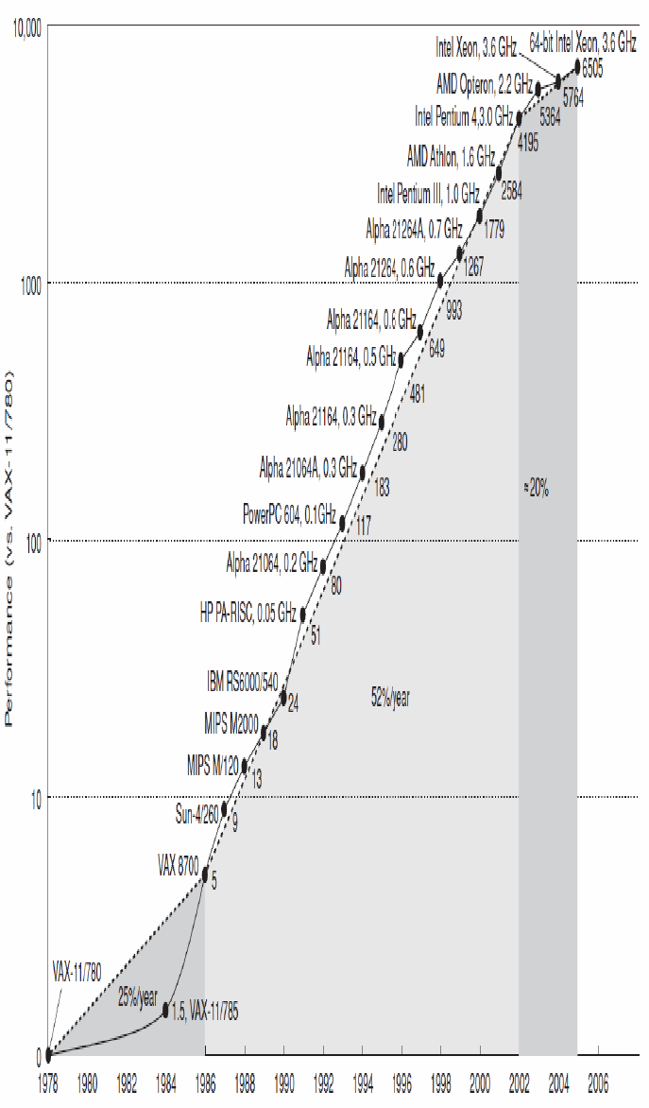
Processor Performance

Slide 28
Growth in processor performance
From Hennessy and Patterson, Computer Architecture: A Quantitative Approach, 4th edition, October, 2006
VAX : 25%/year 1978 to 1986
RISC + x86: 52%/year 1986 to 2002
RISC + x86: 20%/year 2002 to present

Slide 29
Trends in Technology
Processor technology followed closely Moore’s Law “Transistor density of chips doubles every 1.5-2.0 years”
As a consequence of Moore’s Law:
Processor speed doubles every 1.5-2.0 years
DRAM size doubles every 1.5-2.0 years
Etc.
These constitute a target that the computer industry aims for.
Will Moore’s Law continue?

Slide 30
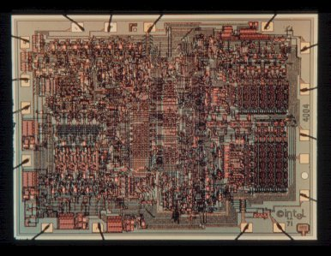
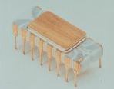
Intel 4004 Die Photo
Introduced in 1970
First microprocessor
2,250 transistors
12 mm²
108 KHz

Slide 31
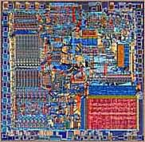
Intel 8086 Die Scan
Introduced in 1979
Basic architecture of the IA32 PC
29,000 transistors
33 mm²
5 MHz

Slide 32
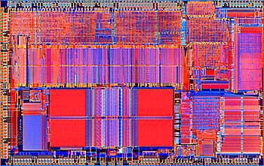
Intel 80486 Die Scan
Introduced in 1989
1st pipelined implementation of IA32
1,200,000 transistors
81 mm²
25 MHz

Slide 33
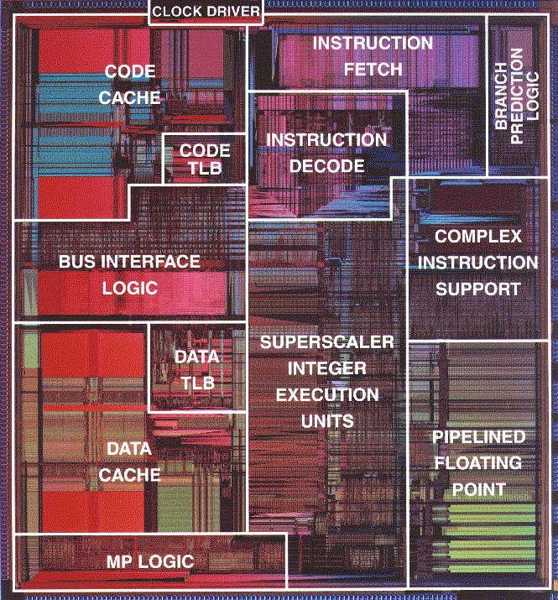
Pentium Die Photo
Introduced in 1993
1st superscalar implementation of IA32
3,100,000 transistors
296 mm²
60 MHz

Slide 34
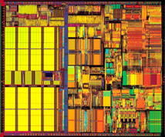
Pentium III
Introduced in 1999
9,500,000 transistors
125 mm²
450 MHz

Slide 35
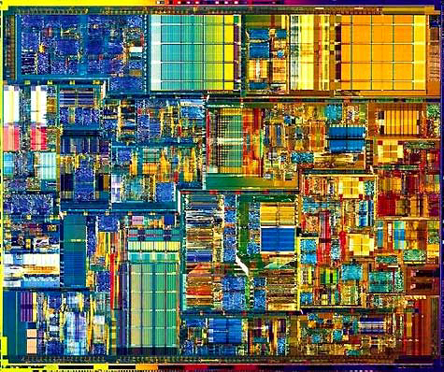
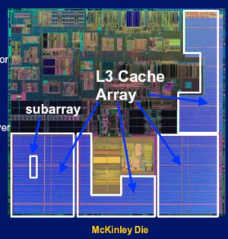
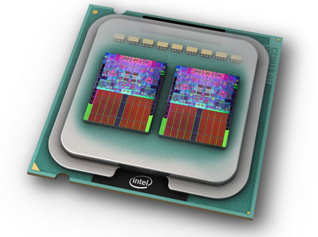
Pentium IV and Duo
Intel Itanium – 221M tr.
(2001)
Intel P4 – 55M tr (2001)
Intel Core 2 Extreme Quad-core 2x291M tr. (2006)

Slide 36
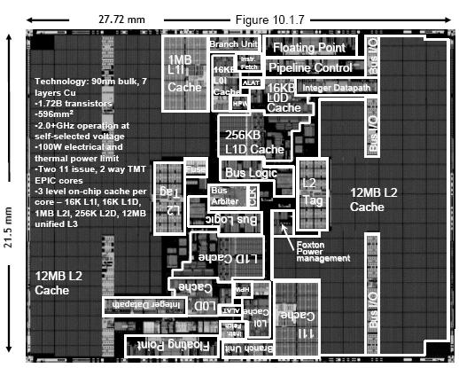
Dual-Core Itanium 2 (Montecito)

Slide 37
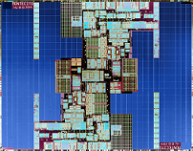
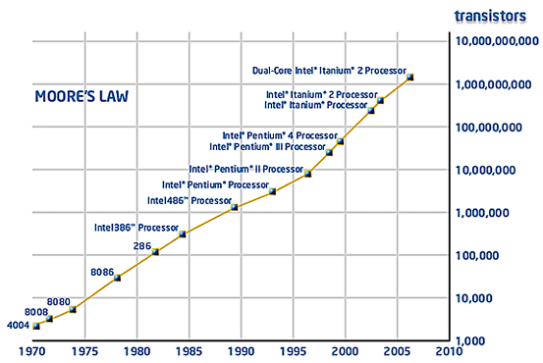
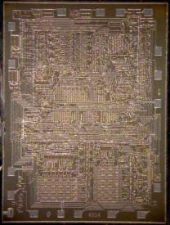
Moore’s Law
0.09 μm
596 mm²
1.7 billions
Montecito
10 μm
13.5mm²
42millions
Exponential growth
2,250
Transistor count will be doubled every 18 months
⎯ Gordon Moore, Intel co-founder

Slide 38
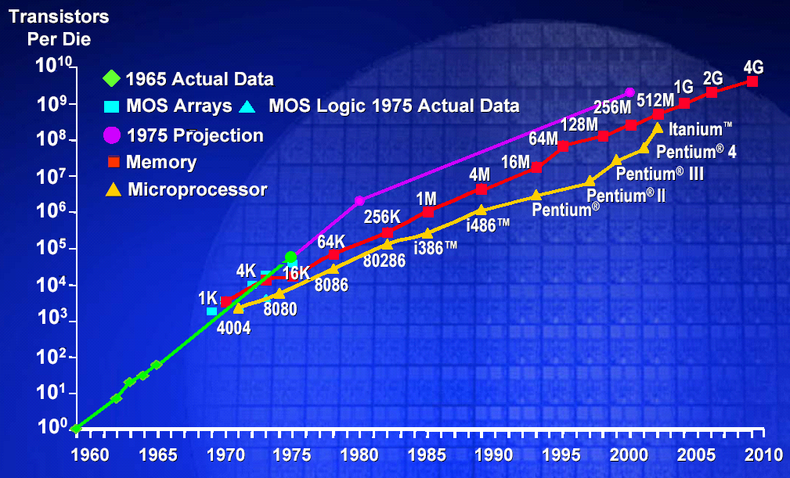
Memory Capacity (Single Chip DRAM)
year size(Mb) cyc time
1980 0.0625 250 ns
1983 0.25 220 ns
1986 1 190 ns
1989 4 165 ns
1992 16 145 ns
1996 64 120 ns
256 100 ns
2007 2G 52 ns
Moore’s Law for Memory: Transistor capacity increases by 4x every 3 years

Slide 39
MOORE’s LAW
Processor-DRAM Memory Gap (latency)
1000
µProc
50%/yr.
CPU
“Moore’s Law”
100
Processor-Memory
Performance Gap: (grows 50% / year)
Performance
10
DRAM
9%/yr.
(2X/10 yrs)
DRAM
1
1980
1981
1982
1983
1984
1985
1986
1987
1988
1989
1990
1991
1992
1993
1994
1995
1996
1997
1998
1999
2000
Notes:
Y-axis is performance
X-axis is time
Latency
Cliché:
Not e that x86 didn’t have cache on chip until 1989

Slide 40
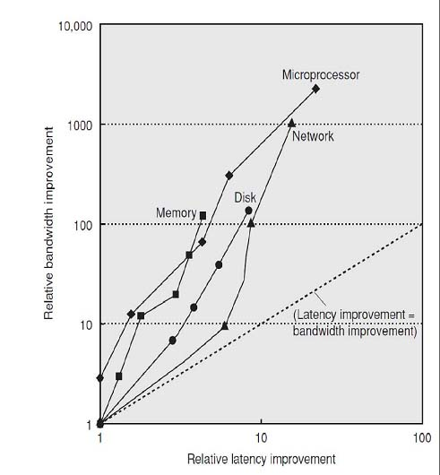
Latency vs. Performance (Throughput)
Notes:
Y-axis is performance
X-axis is time
Latency
Cliché:
Not e that x86 didn’t have cache on chip until 1989

Slide 41
Technology Trends
Capacity Speed (latency)
Logic 2x in 3 years 2x in 3 years
DRAM 4x in 3 years 2x in 10 years
Disk 4x in 3 years 2x in 10 years
Speed increases of memory and I/O have not kept pace with processor speed increases.
This phenomenon is extremely important in numerous processing/computing devices

Slide 42
Processor-Memory Gap: We need a balanced Computer System
Computer System
CPU
Chain: As strong as its
Weakest ring
[Clock Period,
CPI,
Instruction count]
Memory Bus
[Bandwidth]
Memory
Secondary
Storage
[Capacity,
Cycle Time]
[Capacity,
Data Rate]

Slide 43
Cost and Trends in Cost
Cost is an important factor in the design of any computer system (except may be supercomputers)
Cost changes over time
The learning curve and advances in technology lowers the manufacturing costs (Yield: the percentage of manufactured devices that survives the testing procedure).
High volume products lowers manufacturing costs (doubling the volume decreases cost by around 10%)
More rapid progress on the learning curve
Increases purchasing and manufacturing efficiency
Spreads development costs across more units
Commodity products decreases cost as well
Price is driven toward cost
Cost is driven down

Slide 44
Cost, Price, and Their Trends
Price – what you sell a good for
Cost – what you spent to produce it
Understanding cost
Learning curve principle – manufacturing costs decrease over time (even without major improvements in implementation technology)
Best measured by change in yield – the percentage of manufactured devices that survives the testing procedure
Volume (number of products manufactured)
doubling the volume decreases cost by around 10%)
decreases the time needed to get down the learning curve
decreases cost since it increases purchasing and manufacturing efficiency
Commodities – products sold by multiple vendors in large volumes which are essentially identical
Competition among suppliers lower cost

Slide 45
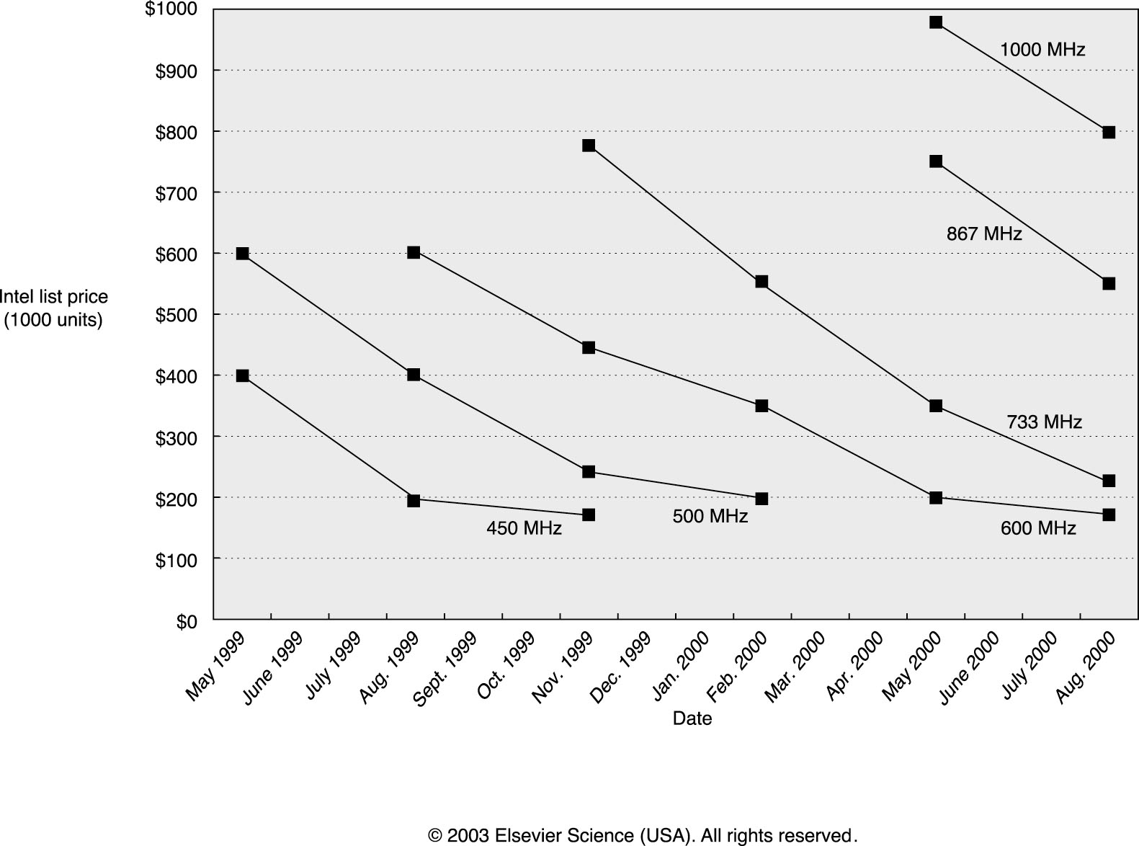
Processor Prices

Slide 46
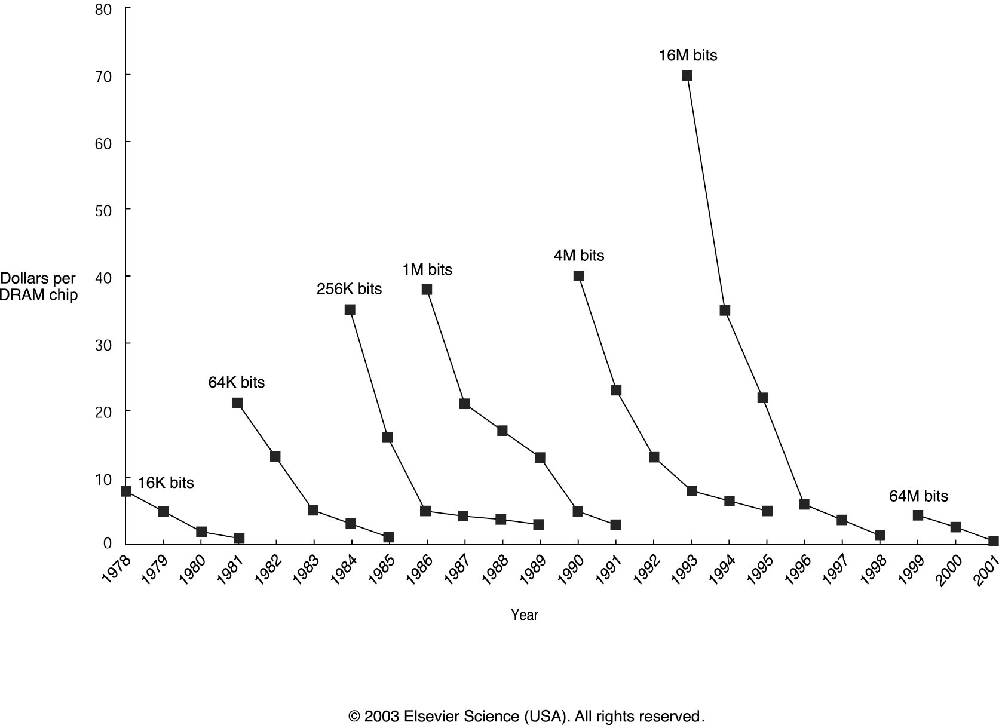
Memory Prices

Slide 47
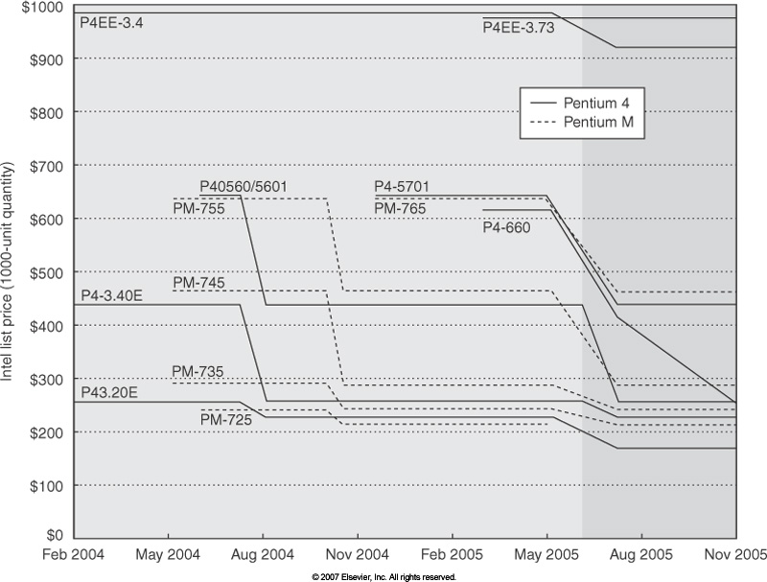
Trends in Cost: The Price of Pentium4 and PentiumM

Slide 48
Integrated Circuit Costs
Each copy of the integrated circuit appears in a die
Multiple dies are placed on each wafer
After fabrication, the individual dies are separated, tested, and packaged
Wafer
Die
Notes:
Multiple copies of an integrated circuit are fabricated on each wafer. If every copy ultimately works, then yield is 100%.

Slide 49
Wafer, Die, IC
Wafer
F F F F
F F F F F F
F F F F F F
F F F F F F
F F F F F F
F F F F
Processing
Slicing
IC
Die
F
Packaging
F

Slide 50
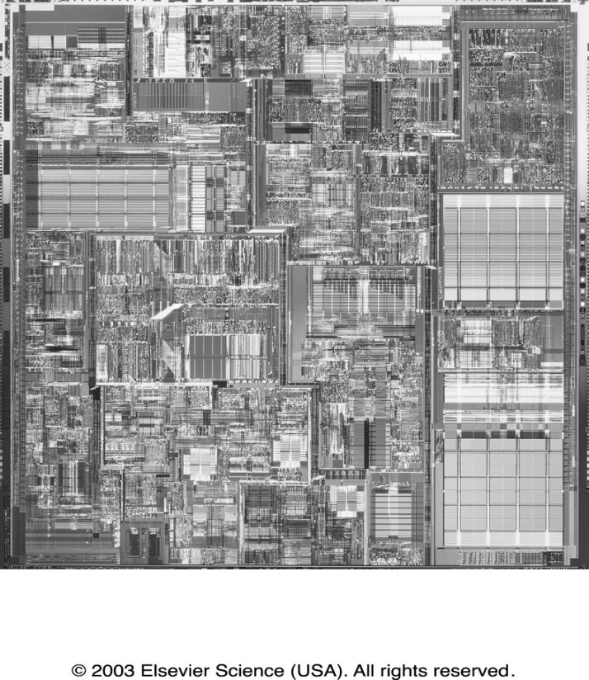
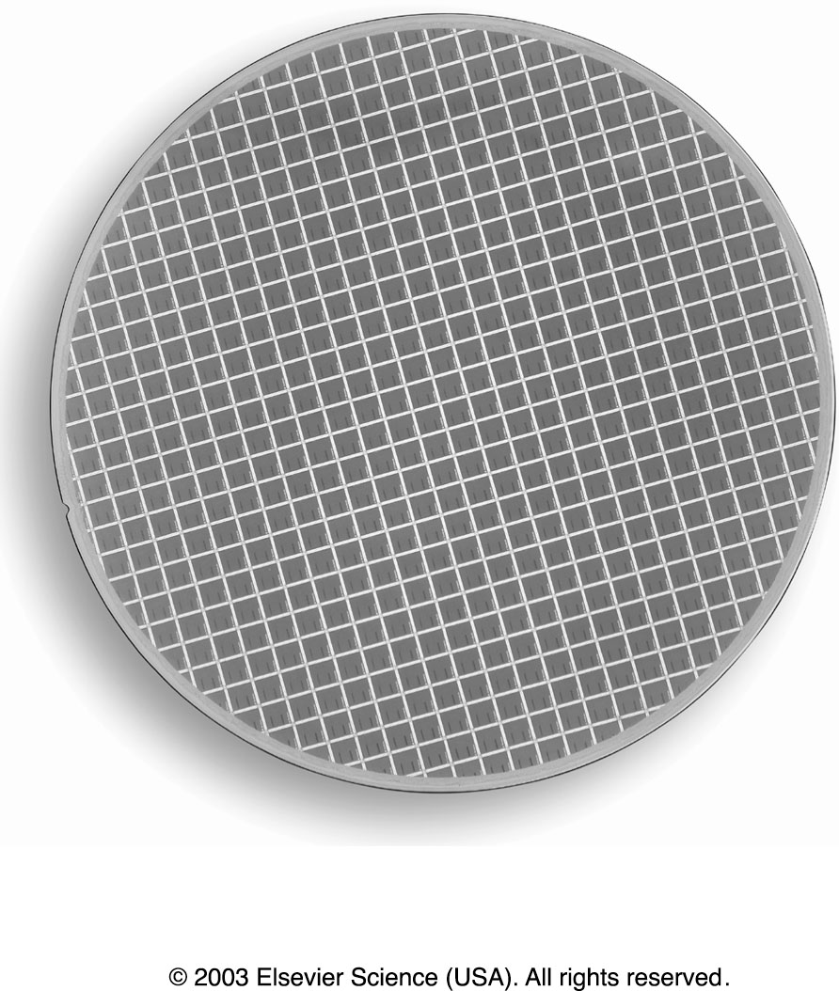
Integrated Circuit Costs
Die
Pentium 4 Processor
Wafer

Slide 51
Integrated Circuit Costs
IC Cost = Die Cost + Testing cost + Packaging Cost
Final Test Yield
Wafer
Die
Processing
Testing
Packaging
good dies
Yields =
Testing
processed dies

Slide 52
Integrated Circuit Costs
IC cost = Die cost + Testing cost + Packaging cost
Final test yield
Die cost = Wafer cost
Dies per Wafer x Die yield

Slide 53
Integrated Circuit Costs
IC cost = Die cost + Testing cost + Packaging cost
Final test yield
Die cost = Wafer cost
Dies per Wafer x Die yield
π ( Wafer_diameter/2)²
π ( Wafer_diameter )
Dies per Wafer =
1
Die Area
2 * Die Area
2

Slide 54
Example
Find the number of dies per 20-cm wafer for a die that is 1.0 cm on a side and a die that is 1.5cm on a side
Answer
270 dies
107 dies
π ( Wafer_diameter/2)²
π ( Wafer_diameter )
Dies per Wafer =
1
Die Area
2 * Die Area
2

Slide 55
Integrated Circuit Costs
− α
Defects per unit area * Die_Area
Die Yield =
Wafer Yield *
1+
α
Where α is a parameter inversely proportional to the number of mask
Levels, which is a measure of the manufacturing complexity.
For today’s CMOS process, good estimate is α = 3.0-4.0

Slide 56
Integrated Circuits Costs
Die Cost goes roughly with (die area)⁴
example :
defect density : 0.8 per cm²
α = 3.0
case 1: 1 cm x 1 cm
die yield = (1+(0.8x1)/3)⁻³ = 0.49
case 2: 1.5 cm x 1.5 cm
die yield = (1+(0.8x2.25)/3)⁻³ = 0.24
20-cm-diameter wafer with 3-4 metal layers : $3500
case 1 : 132 good 1-cm² dies, $27
case 2 : 25 good 2.25-cm² dies, $140

Slide 57
Other Costs
Die Test Cost = Test equipment Cost * Ave. Test Time
Die Yield
Packaging Cost: depends on pins, heat dissipation, beauty, ...
Chip | Die cost | Package |  |  | Test & assembly cost | Total
 |  | pins | type | cost
486DX2 | $12 | 168 | PGA | $11 | $12 | $35
Power PC 601 | $53 | 304 | QFP | $3 | $21 | $77
HP PA 7100 | $73 | 504 | PGA | $35 | $16 | $124
DEC Alpha | $149 | 431 | PGA | $30 | $23 | $202
Super SPARC | $272 | 293 | PGA | $20 | $34 | $326
Pentium | $417 | 273 | PGA | $19 | $37 | $473
QFP: Quad Flat Package
PGA: Pin Grid Array
BGA: Ball Grid Array

Slide 58
Cost/Price What is Relationship of Cost to Price?
Component Costs
List Price
Component
Cost
100%
100%

Slide 59
Cost/Price What is Relationship of Cost to Price?
Component Costs
Direct Costs (add 25% to 40% to component cost) Recurring costs: labor, purchasing, scrap, warranty
List Price
Direct Cost
20% to 28%
100%
Component
Cost
72% to 80%

Slide 60
Cost/Price What is Relationship of Cost to Price?
Component Costs
Direct Costs (add 25% to 40%) recurring costs: labor, purchasing, scrap, warranty
Gross Margin (add 82% to 186%) nonrecurring costs: R&D, marketing, sales, equipment maintenance, rental, financing cost, pretax profits, taxes
PC’s -- Lower gross margin
- Lower R&D expense
- Lower sales cost
Mail order, Phone order, retail store…
- Higher competition
Lower profit, volume sale,...
List Price
Gross
Margin
45% to 65%
100%
Direct Cost
10% to 11%
Gross margin varies depending on the products
High performance large systems vs Lower end machines
Component
Cost
25 % to 44%

Slide 61
Cost/Price What is Relationship of Cost to Price?
Component Costs
Direct Costs (add 25% to 40%) recurring costs: labor, purchasing, scrap, warranty
Gross Margin (add 82% to 186%) nonrecurring costs: R&D, marketing, sales,equipment maintenance, rental, financing cost, pretax profits, taxes
Average Discount to get List Price (add 33% to 66%):
volume discounts and/or retailer markup
List Price
Average
Discount
25% to 40%
Avg. Selling Price
Gross
Margin
34% to 39%
100%
Direct Cost
6% to 8%
Component
Cost
15% to 33%

Slide 62
Cost/Price What is Relationship of Cost to Price?
List
Price
Average
Discount
25~40%
ASP
Gross
Margin
Gross
Margin
45~65%
34~39%
Direct Cost
20~22%
Direct Cost
10~11%
Direct Cost
6~8%
Component
Cost
Component
Cost
72~80%
Component
Cost
Component
Cost
15~33%
100%
25~44%
+(25~40)%
+(82~186)%
+(33~66)%

Slide 63
Trends in Power in ICs
Power becomes a first-class architectural design constraint
Power Issues
How to bring it in and distribute around the chip? (many pins just for power supply and ground, interconnection layers for distribution)
How to remove the heat (dissipated power)
Why worry about power?
Battery life in portable and mobile platforms
Power consumption in desktops, server farms
Cooling costs, packaging costs, reliability, timing
Power density: 30 W/cm2 in Alpha 21364 (3x of typical hot plate)
Environment?
IT consumes a significant amount of energy
And performance!
Power and heating is limiting designers’ ability to improve performance of processors!
Unless you are huntry – http://www.youtube.com/watch?v=zrg8nJ0bsUk

Slide 64
Why worry about power? -- Power Dissipation
Lead microprocessors power continues to increase
100
P6
Pentium ®
10
286
486
Power (Watts)
8086
386
8085
1
8080
8008
4004
0.1
1971
1974
1978
1985
1992
2000
Year
Power delivery and dissipation will be prohibitive
Source: Borkar, De Intel®

Slide 65
Performance Evaluation of Computers

Slide 66
Metrics for Performance
The hardware performance is one major factor for the success of a computer system.
How to measure performance?
A computer user is typically interested in reducing the response time (execution time) - the time between the start and completion of an event.
A computer center manager is interested in increasing the throughput - the total amount of work done in a period of time.

Slide 67
An Example
Plane | DC to Paris [hour] | Top Speed [mph] | Passengers | Throughput [p/h]
Boeing 747 | 6.5 | 610 | 470 | 72 (=470/6.5)
Concorde | 3 | 1350 | 132 | 44 (=132/3)
Which has higher performance?
Time to deliver 1 passenger?
Concord is 6.5/3 = 2.2 times faster (120%)
Time to deliver 400 passengers?
Boeing is 72/44 = 1.6 times faster (60%)

Slide 68
Definition of Performance
We are most interested in response time
Performance [things/sec]
“X is n times faster than Y”
As faster means both increased performance and decreased execution time, to reduce confusion will use “improve performance” or “improve execution time”

Slide 69
Computer Performance Evaluation: Cycles Per Instruction (CPI) – CPU Performance
Sometimes, instead of using response time, we use CPU time to measure performance.
CPU time can also be divided into user CPU time (program) and system CPU time (OS).
The CPU time performance is probably the most accurate and fair measure of performance

Slide 70
Unix Times
Unix time command report:
90.7u 12.9s 2:39 65%
Which means
User CPU time is 90.7 seconds
System CPU time is 12.9 seconds
Elapsed time is 2 minutes and 39 seconds
Percentage of elapsed time that is CPU time is:

Slide 71
Cycles Per Instruction (CPI) – CPU Performance
Most computers run synchronously utilizing a CPU clock running at a constant clock rate:
where: Clock rate = 1 / clock cycle
A computer machine instruction is comprised of a number of elementary or micro-operations which vary in number and complexity depending on the instruction and the exact CPU organization and implementation.
A micro-operation is an elementary hardware operation that can be performed during one clock cycle.
This corresponds to one micro-instruction in microprogrammed CPUs.
Examples: register operations: shift, load, clear, increment, ALU operations: add, subtract, etc.
Thus a single machine instruction may take one (or less than one) or more cycles to complete termed as the Cycles Per Instruction (CPI).

Slide 72
CPU Performance Equation
CPU time = CPU clock cycles for a program X Clock cycle time
or:
CPU time = CPU clock cycles for a program / clock rate
CPI (clock cycles per instruction):
CPI = CPU clock cycles for a program / I
where I is the dynamic instruction count.

Slide 73
CPU Execution Time: The CPU Equation
Instruction count (I): A program is comprised of a number of instructions
Measured in: instructions/program
CPI: the average number of cycles for an instruction to be complete.
Measured in: cycles/instruction
Cycle time (C): CPU has a fixed clock cycle time. C = 1/clock rate
Measured in: seconds/cycle
CPU execution time is the product of the above three parameters as follows:
CPU Time = I x CPI x C
CPU time = Seconds = Instructions x Cycles x Seconds
Program Program Instruction Cycle

Slide 74
CPU Execution Time
For a given program and machine:
CPI = Total program execution cycles / Instructions count
CPU clock cycles = Instruction count x CPI
CPU execution time
= CPU clock cycles x Clock cycle
= Instruction count x CPI x Clock cycle
= I x CPI x C

Slide 75
CPU Execution Time: Example
A Program is running on a specific machine with the following parameters:
Total instruction count: 10,000,000 instructions
Average CPI for the program: 2.5 cycles/instruction.
CPU clock rate: 200 MHz.
What is the execution time for this program:
CPU time = Instruction count x CPI x Clock cycle
= 10,000,000 x 2.5 x 1 / clock rate
= 10,000,000 x 2.5 x 5x10⁻⁹
= .125 seconds
CPU time = Seconds = Instructions x Cycles x Seconds
Program Program Instruction Cycle

Slide 76
Factors Affecting CPU Performance
CPU time = Seconds = Instructions x Cycles x Seconds
Program Program Instruction Cycle
Instruction
Count I
CPI
Clock Cycle C
Program
X
X
Compiler
X
X
Instruction Set
Architecture (ISA)
X
X
Organization
X
X
Technology
X

Slide 77
Performance Comparison: Example
Using the same program with these changes:
A new compiler used: New instruction count 9,500,000
New CPI: 3.0
Faster CPU implementation: New clock rate = 300 MHZ
What is the speedup with the changes?
Speedup = (10,000,000 x 2.5 x 5x10⁻⁹) / (9,500,000 x 3 x 3.33x10⁻⁹ )
= .125 / .095 = 1.32
Speedup = Old Execution Time = I_{old} x CPI_{old} x Clock cycle_{old}
New Execution Time I_{new} x CPI_{new} x Clock Cycle_{new}

Slide 78
Metrics of Computer Performance
Application
Execution time: Target workload,
SPEC95, etc.
Programming
Language
Compiler
(millions) of Instructions per second – MIPS
(millions) of (F.P.) operations per second – MFLOP/s
ISA
Datapath
Control
Megabytes per second.
Function Units
Transistors
Wires
Pins
Cycles per second (clock rate).
Each metric has a purpose, and each can be misused.

Slide 79
Choosing Programs To Evaluate Performance
Levels of programs or benchmarks that could be used to evaluate performance:
Actual Target Workload: Full applications that run on the target machine.
Real Full Program-based Benchmarks:
Select a specific mix or suite of programs that are typical of targeted applications or workload (e.g SPEC95, SPEC CPU2000).
Small “Kernel” Benchmarks:
Key computationally-intensive pieces extracted from real programs.
Examples: Matrix factorization, FFT, tree search, etc.
Microbenchmarks:
Small, specially written programs to isolate a specific aspect of performance characteristics: Processing: integer, floating point, local memory, input/output, etc.

Slide 80
Types of Benchmarks
Pros
Cons
Very specific.
Non-portable.
Complex: Difficult
to run, or measure.
Representative
Actual Target Workload
Portable.
Widely used.
Measurements
useful in reality.
Full Application Benchmarks
Less representative
than actual workload.
Small “Kernel”
Benchmarks
Easy to “fool” by designing hardware to run them well.
Easy to run, early in the design cycle.
Peak performance results may be a long way from real application performance
Identify peak performance and potential bottlenecks.
Microbenchmarks

Slide 81
SPEC: Standard Performance Evaluation Corporation
The most popular and industry-standard set of CPU benchmarks.
SPECmarks, 1989:
10 programs yielding a single number (“SPECmarks”).
SPEC92, 1992:
SPECInt92 (6 integer programs) and SPECfp92 (14 floating point programs).
SPEC95, 1995:
SPECint95 (8 integer programs):
go, m88ksim, gcc, compress, li, ijpeg, perl, vortex
SPECfp95 (10 floating-point intensive programs):
tomcatv, swim, su2cor, hydro2d, mgrid, applu, turb3d, apsi, fppp, wave5
Performance relative to a Sun SuperSpark I (50 MHz) which is given a score of SPECint95 = SPECfp95 = 1

Slide 82
SPEC: Standard Performance Evaluation Corporation
SPEC CPU2000, 1999:
CINT2000 (11 integer programs). CFP2000 (14 floating-point intensive programs)
Performance relative to a Sun Ultra5_10 (300 MHz) which is given a score of SPECint2000 = SPECfp2000 = 100
SPEC CPU2006:
CINT2006 (12 integer programs). CFP2006 (17 floating-point intensive programs)
Performance relative to a Sun SPARC Enterprise M8000 which is given a score of SPECint2006 = 11.3 SPECfp2006 = 12.4

Slide 83
SPEC CPU2006 Programs
Benchmark Language Descriptions
400.Perlbench C Programming Language
401.bzip2 C Compression
403.Gcc C C Compiler
429.mcf C Combinatorial Optimization
445.gobmk C Artificial Intelligence: Go
456.Hmmer C Search Gene Sequence
458.sjeng C Artificial Intelligence: chess
462.libquantum C Physics / Quantum Computing
464.h264ref C Video Compression
471.omnetpp C++ Discrete Event Simulation
473.astar C++ Path-finding Algorithms
483.xalancbmk C++ XML Processing
CINT2006
(Integer)
Source: http://www.spec.org/osg/cpu2006/CINT2006/

Slide 84
SPEC CPU2006 Programs
Benchmark Language Descriptions
410.Bwaves Fortran Fluid Dynamics
416.Gamess Fortran Quantum Chemistry
433.Milc C Physics / Quantum Chromodynamics
434.Zeusmp Fortran Physics / CFD
435.Gromacs C, Fortran Biochemistry / Molecular Dynamics
436.cactusADM C, Fortran Physics / General
437.leslie3d Fortran Fluid Dynamics
444.Namd C++ Biology / Molecular Dynamics
447.dealII C++ Finite Element Analysis
450.Soplex C++ Linear Programming, Optimization
453.Povray C++ Image Ray-tracing
454.Calculix C, Fortran Structural Mechanics
459.GemsFDTD Fortran Computational Electromagnetics
465.Tonto Fortran Quantum Chemistry
470.Lbm C Fluid Dynamics
481.Wrf C, Fortran Weather
482.sphinx3 C Speech
CFP2006
(Floating
Point)
Source: http://www.spec.org/osg/cpu2006/CFP2006/

Slide 85
Top 20 SPEC CPU2006 Results (As of August 2007)
Top 20 SPECint2006
Top 20 SPECfp2006
# MHz Processor int peak int base MHz Processor fp peak fp base
3000 Core 2 Duo E6850 22.6 20.2 4700 POWER6 22.4 17.8
4700 POWER6 21.6 17.8 3000 Core 2 Duo E6850 19.3 18.7
3000 Xeon 5160 21.0 17.9 1600 Dual-Core Itanium 2 9050 18.1 17.3
3000 Xeon X5365 20.8 18.9 1600 Dual-Core Itanium 2 9040 17.8 17.0
2666 Core 2 Duo E6750 20.5 18.3 2666 Core 2 Duo E6750 17.7 17.1
2667 Core 2 Duo E6700 20.0 17.9 3000 Xeon 5160 17.7 17.1
2667 Core 2 Quad Q6700 19.7 17.6 3000 Opteron 2222 17.4 16.0
2666 Xeon X5355 19.1 17.3 2667 Core 2 Duo E6700 16.9 16.3
2666 Xeon 5150 19.1 17.3 2800 Opteron 2220 16.7 13.3
2666 Xeon X5355 18.9 17.2 3000 Xeon 5160 16.6 16.1
2667 Xeon X5355 18.6 16.8 2667 Xeon X5355 16.6 16.1
2933 Core 2 18.5 17.8 2667 Core 2 Quad Q6700 16.6 16.1
2400 Core 2 Quad Q6600 18.5 16.5 2666 Xeon X5355 16.6 16.1
2600 Core 2 Duo X7800 18.3 16.4 2933 Core 2 Extreme X6800 16.2 16.0
2667 Xeon 5150 17.6 16.6 2400 Core 2 Quad Q6600 16.0 15.4
2400 Core 2 Duo T7700 17.6 16.6 1400 Dual-Core Itanium 2 9020 15.9 15.2
2333 Xeon E5345 17.5 15.9 2667 Xeon 5150 15.9 15.5
2333 Xeon 5148 17.4 15.9 2333 Xeon E5345 15.4 14.9
2333 Xeon 5140 17.4 15.7 2600 Opteron 2218 15.4 12.5
2660 Xeon X5355 17.4 15.7 2400 Xeon X3220 15.3 15.1
Source: http://www.spec.org/cpu2006/results/cint2006.html

Slide 86
Top SPEC CPU2006 Results (CINT2006)
Hardware Vendor | System | Result | Base | # Cores | Published
Sun Microsystems | Sun Fire X2250 (Intel Xeon X5272 3.4GHz) | 28.5 | 23.6 | 4 | Sep-08
SGI | SGI Altix XE 250 (Intel Xeon X5272 3.4GHz) | 28.4 | 23.8 | 4 | Jun-08
Hewlett-Packard Company | ProLiant DL160 G5 (3.4 GHz, Intel Xeon X5272) | 28.4 | 23.6 | 4 | Jul-08
Dell Inc. | PowerEdge M600 (Intel Xeon X5460, 3.16 GHz) | 27.9 | 24.3 | 8 | Aug-08
Dell Inc. | PowerEdge 2900 III (Intel Xeon X5460, 3.16 GHz) | 27.7 | 24.2 | 8 | Aug-08

Slide 87
Top SPEC CPU2006 Results (Cfp2006)
Hardware Vendor | System | # Cores | Result | Base | Published
Fujitsu Limited | Fujitsu SPARC Enterprise M8000 | 64 | 28.8 | 25 | Aug-08
Sun Microsystems | Sun SPARC Enterprise M8000 | 64 | 28.8 | 25 | Aug-08
Hewlett-Packard Company | ProLiant DL160 G5 (3.4 GHz, Intel Xeon X5272) | 4 | 25.3 | 21.8 | Jul-08
SGI | SGI Altix XE 250 (Intel Xeon X5272 3.4GHz) | 4 | 25.3 | 21.9 | Jun-08
Sun Microsystems | Sun Fire X2250 (Intel Xeon X5272 3.4GHz) | 4 | 25.1 | 21.4 | Sep-08
IBM Corporation | IBM Power 595 (5.0 GHz, 1 core) | 1 | 24.9 | 20.1 | Apr-08

Slide 88
LINPACK: Benchmark for Supercomputers
LINPACK solves a dense system of linear equations – “This performance does not reflect the overall performance of a given system, as no single number ever can. It does, however, reflect the performance of a dedicated system for solving a dense system of linear equations.” – http://www.top500.org/project/linpack
Rank | Computer
1 | Sequoia - BlueGene/Q, Power BQC 16C 1.60 GHz, Custom IBM
2 | K computer, SPARC64 VIIIfx 2.0GHz, Tofu interconnect Fujitsu
3 | Mira - BlueGene/Q, Power BQC 16C 1.60GHz, Custom IBM
4 | SuperMUC - iDataPlex DX360M4, Xeon E5-2680 8C 2.70GHz, Infiniband FDR IBM
5 | Tianhe-1A - NUDT YH MPP, Xeon X5670 6C 2.93 GHz, NVIDIA 2050 NUDT
6 | Jaguar - Cray XK6, Opteron 6274 16C 2.200GHz, Cray Gemini interconnect, NVIDIA 2090 Cray Inc.
7 | Fermi - BlueGene/Q, Power BQC 16C 1.60GHz, Custom IBM
8 | JuQUEEN - BlueGene/Q, Power BQC 16C 1.60GHz, Custom IBM
9 | Curie thin nodes - Bullx B510, Xeon E5-2680 8C 2.700GHz, Infiniband QDR Bull
10 | Nebulae - Dawning TC3600 Blade System, Xeon X5650 6C 2.66GHz, Infiniband QDR, NVIDIA 2050 Dawning
List | Rank | Total Cores | Rmax (TFlops) | Rpeak (TFlops) | Power (kW)
06/2012 | 1 | 1572864 | 16324.8 | 20132.7 | 7890.00
11/2011 | 17 | 65536 | 690.2 | 838.9 | 340.50

Slide 89
Performance Evaluation Using Benchmarks
“For better or worse, benchmarks shape a field”
Good products created when we have:
Good benchmarks
Good ways to summarize performance
Given sales depend in big part on performance relative to competition, there is big investment in improving products as reported by performance summary
If benchmarks inadequate, then choose between improving product for real programs vs. improving product to get more sales; Sales almost always wins!

Slide 90
How to Summarize Performance
800
700
600
500
400
SPEC Perf
300
200
100
0
gcc
spice
doduc
nasa7
li
fpppp
epresso
eqntott
tomcatv
matrix300
Benchmark

Slide 91
Comparing and Summarizing Performance
Computer A Computer B Computer C
P1(secs) 1 10 20
P2(secs) 1,000 100 20
Total time(secs) 1,001 110 40
For program P1, A is 10 times faster than B,
For program P2, B is 10 times faster than A,
and so on...
The relative performance of computers is unclear with Total Execution Times

Slide 92
Summary Measure
1
n
n
Execution Time_{i}
i=1
Arithmetic Mean
Good, if programs are run equally in the workload

Slide 93
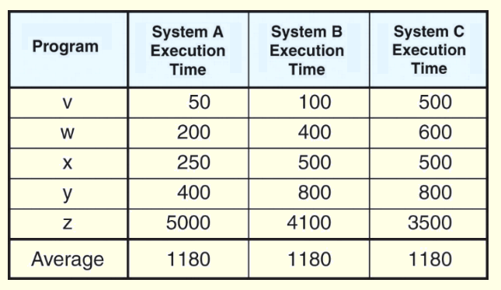
Arithmetic Mean
The arithmetic mean can be misleading if the data are skewed or scattered.
Consider the execution times given in the table below. The performance differences are hidden by the simple average.

Slide 94
Unequal Job Mix
Relative Performance
Weighted Execution Time
n
Weight_{i} x Execution Time_{i}
i=1
Weighted Arithmetic Mean
Normalized Execution Time to a reference machine
Arithmetic Mean
Geometric Mean
n
n
Execution Time Ratio_{i}
i=1
Normalized to the
reference machine

Slide 95
Weighted Arithmetic Mean
W(i)_{j} x Time_{j}
n
WAM(i) =
j=1
A B C W(1) W(2) W(3)
P1 (secs) 1.00 10.00 20.00 0.50 0.909 0.999
P2(secs) 1,000.00 100.00 20.00 0.50 0.091 0.001
WAM(1) 500.50 55.00 20.00
WAM(2) 91.91 18.19 20.00
WAM(3) 2.00 10.09 20.00
1.0 x 0.5 + 1,000 x 0.5

Slide 96
Normalized Execution Time
Geometric Mean = n
n
A B C
P1 1.00 10.00 20.00
P2 1,000.00 100.00 20.00
Execution time ratio_{i}
I=1
Normalized to A
Normalized to B
Normalized to C
A B C A B C A B C
P1 1.0 10.0 20.0 0.1 1.0 2.0 0.05 0.5 1.0
P2 1.0 0.1 0.02 10.0 1.0 0.2 50.0 5.0 1.0
Arithmetic mean 1.0 5.05 10.01 5.05 1.0 1.1 25.03 2.75 1.0
Geometric mean 1.0 1.0 0.63 1.0 1.0 0.63 1.58 1.58 1.0

Slide 97
Disadvantages of Arithmetic Mean
Performance varies depending on the reference machine
Normalized to A
Normalized to B
Normalized to C
A B C A B C A B C
P1
1.0 10.0 20.0 0.1 1.0 2.0 0.05 0.5 1.0
P2
1.0 0.1 0.02 10.0 1.0 0.2 50.0 5.0 1.0
1.0 5.05 10.01 5.05 1.0 1.1 25.03 2.75 1.0
Arithmetic mean
B is 5 times
slower than A
A is 5 times
slower than B
C is slowest
C is fastest

Slide 98
The Pros and Cons Of Geometric Means
Independent of running times of the individual programs
Independent of the reference machines
Do not predict execution time
the performance of A and B is the same : only true when P1 ran 100 times for every occurrence of P2
Computer A Computer B Computer C
P1(secs) 1 10 20
1(P1) x 100 + 1000(P2) x 1
= 10(P1) x 100 + 100(P2) x 1
P2(secs) 1,000 100 20
Total time(secs) 1,001 110 40
Normalized to A
Normalized to B
Normalized to C
A B C A B C A B C
P1 1.0 10.0 20.0 0.1 1.0 2.0 0.05 0.5 1.0
P2 1.0 0.1 0.02 10.0 1.0 0.2 50.0 5.0 1.0
Geometric mean 1.0 1.0 0.63 1.0 1.0 0.63 1.58 1.58 1.0

Slide 99
Geometric Mean
The real usefulness of the normalized geometric mean is that no matter which system is used as a reference, the ratio of the geometric means is consistent.
This is to say that the ratio of the geometric means for System A to System B, System B to System C, and System A to System C is the same no matter which machine is the reference machine.

Slide 100
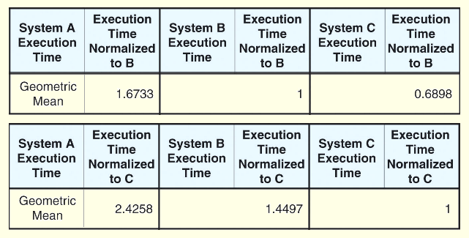
Geometric Mean
The results that we got when using System B and System C as reference machines are given below.
We find that 1.6733/1 = 2.4258/1.4497.

Slide 101
Geometric Mean
The inherent problem with using the geometric mean to demonstrate machine performance is that all execution times contribute equally to the result.
So shortening the execution time of a small program by 10% has the same effect as shortening the execution time of a large program by 10%.
Shorter programs are generally easier to optimize, but in the real world, we want to shorten the execution time of longer programs.
Also, if the geometric mean is not proportionate, a system giving a geometric mean 50% smaller than another is not necessarily twice as fast!

Slide 102
Measure Computer Performance: MIPS (Million Instructions Per Second)
For a specific program running on a specific computer, MIPS is a measure of millions of instructions executed per second:
MIPS = Instruction count / (Execution Time x 10⁶)
= Instruction count / (CPU clocks x Cycle time x 10⁶)
= (Instruction count x Clock rate) / (Instruction count x CPI x 10⁶)
= Clock rate / (CPI x 10⁶)
Shorter execution time usually means faster MIPS rating.

Slide 103
Computer Performance Measures : MIPS (Million Instructions Per Second)
Meaningless Indicator of Processor Speed
Problems:
No account for instruction set used.
Cannot be used to compare computers with different instruction sets.
Program-dependent: A single machine does not have a single MIPS rating.
A higher MIPS rating in some cases may not mean higher performance or better execution time. i.e. due to compiler design variations.

Slide 104
Compiler Variations, MIPS, Performance: An Example
For the machine with instruction classes:
For a given program two compilers produced the following instruction counts:
The machine is assumed to run at a clock rate of 100 MHz
Instruction class CPI
A 1
B 2
C 3
Instruction counts (in millions)
for each instruction class
Code from: A B C
Compiler 1 5 1 1
Compiler 2 10 1 1

Slide 105
Compiler Variations, MIPS, Performance: An Example (Continued)
MIPS = Clock rate / (CPI x 10⁶) = 100 MHz / (CPI x 10⁶)
CPI = CPU execution cycles / Instructions count
CPU time = Instruction count x CPI / Clock rate
For compiler 1:
CPI₁ = (5 x 1 + 1 x 2 + 1 x 3) / (5 + 1 + 1) = 10 / 7 = 1.43
MIP₁ = 100 / (1.428 x 10⁶) = 70.0
CPU time₁ = ((5 + 1 + 1) x 10⁶ x 1.43) / (100 x 10⁶) = 0.10 seconds
For compiler 2:
CPI₂ = (10 x 1 + 1 x 2 + 1 x 3) / (10 + 1 + 1) = 15 / 12 = 1.25
MIP₂ = 100 / (1.25 x 10⁶) = 80.0
CPU time₂ = ((10 + 1 + 1) x 10⁶ x 1.25) / (100 x 10⁶) = 0.15 seconds

Slide 106
Computer Performance Measures : MFOLPS (Million FLOating-Point Operations Per Second)
A floating-point operation is an addition, subtraction, multiplication, or division operation applied to numbers represented by a single or double precision floating-point representation.
MFLOPS, for a specific program running on a specific computer, is a measure of millions of floating point-operation (megaflops) per second:
MFLOPS = Number of floating-point operations / (Execution time x 10⁶ )

Slide 107
Computer Performance Measures : MFOLPS (Million FLOating-Point Operations Per Second)
A better comparison measure between different machines than MIPS.
Program-dependent: Different programs have different percentages of floating-point operations present. i.e compilers have no such operations and yield a MFLOPS rating of zero.
Dependent on the type of floating-point operations present in the program.

Slide 108
Quantitative Principles of Computer Design
Amdahl’s Law:
By Gene Amdahl, architect of IBM/360
The performance gain from improving some portion of a computer is calculated by:
Speedup = Performance for entire task using the enhancement
Performance for the entire task without using the enhancement
or Speedup = Execution time without the enhancement
Execution time for entire task using the enhancement

Slide 109
Performance Enhancement Calculations: Amdahl's Law
The performance enhancement possible due to a given design improvement is limited by the amount that the improved feature is used
Amdahl’s Law: Suppose that enhancement E accelerates a fraction F of the execution time by a factor S and the remainder of the time is unaffected then:
1
Speedup(E) = ----------------------
(1 - F) + F/S

Slide 110
Performance Enhancement Calculations: Amdahl's Law
Performance improvement or speedup due to enhancement E:
Execution Time without E Performance with E
Speedup(E) = -------------------------------------- = ---------------------
Execution Time with E Performance without E
E accelerates a fraction F of the execution time by a factor S, then:
Execution Time with E = ((1-F) + F/S) X Execution Time without E
Hence speedup is given by:
Execution Time without E 1
Speedup(E) = --------------------------------------------------------- = ----------------
((1 - F) + F/S) X Execution Time without E (1 - F) +F/S

Slide 111
Pictorial Depiction of Amdahl’s Law
Enhancement E accelerates fraction F of execution time by a factor of S
Before:
Execution Time without enhancement E:
Unaffected, fraction: (1- F)
Affected fraction: F
Unchanged
Unaffected, fraction: (1- F)
F/S
After:
Execution Time with enhancement E:
Execution Time without enhancement E 1
Speedup(E) = ------------------------------------------------------ = ------------------
Execution Time with enhancement E (1 - F) + F/S

Slide 112
Performance Enhancement Example
For the RISC machine with the following instruction mix:
Op Freq Cycles CPI(i) % Time
ALU 50% 1 .5 23%
Load 20% 5 1.0 45%
Store 10% 3 .3 14%
Branch 20% 2 .4 18%
CPI = 2.2

Slide 113
Performance Enhancement Example
If a CPU design enhancement improves the CPI of load instructions from 5 to 2, what is the resulting performance improvement from this enhancement:
Fraction enhanced = F = 45% or .45
Unaffected fraction = 100% - 45% = 55% or .55
Factor of enhancement = 5/2 = 2.5
Using Amdahl’s Law:
1 1
Speedup(E) = ------------------ = --------------------- = 1.37
(1 - F) + F/S .55 + .45/2.5

Slide 114
An Alternative Solution Using CPU Equation
If a CPU design enhancement improves the CPI of load instructions from 5 to 2, what is the resulting performance improvement from this enhancement:
Old CPI = 2.2
New CPI = .5 x 1 + .2 x 2 + .1 x 3 + .2 x 2 = 1.6
Original Execution Time Instruction count x old CPI x clock cycle
Speedup(E) = ------------------------------- = ----------------------------------------------------------
New Execution Time Instruction count x new CPI x clock cycle
old CPI 2.2
= ------------ = --------- = 1.37
new CPI 1.6
Which is the same speedup obtained from Amdahl’s Law in the first solution.

Slide 115
Performance Enhancement Example
A program runs in 100 seconds on a machine with multiply operations responsible for 80 seconds of this time. By how much must the speed of multiplication be improved to make the program four times faster?
100
Desired speedup = 4 = -----------------------------------------------------
Execution Time with enhancement
→ Execution time with enhancement = 25 seconds
25 seconds = (100 - 80 seconds) + 80 seconds / n
25 seconds = 20 seconds + 80 seconds / n
→ 5 = 80 seconds / n
→ n = 80/5 = 16
Hence multiplication should be 16 times faster to get a speedup of 4.

Slide 116
Performance Enhancement Example
For the previous example with a program running in 100 seconds on a machine with multiply operations responsible for 80 seconds of this time. By how much must the speed of multiplication be improved to make the program five times faster?
100
Desired speedup = 5 = -----------------------------------------------------
Execution Time with enhancement
→ Execution time with enhancement = 20 seconds
20 seconds = (100 - 80 seconds) + 80 seconds / n
20 seconds = 20 seconds + 80 seconds / n
→ 0 = 80 seconds / n
No amount of multiplication speed improvement can achieve this.

Slide 117
Another Amdahl’s Law Example
New CPU 10X faster
I/O-bound server, so 60% time waiting for I/O
Apparently, it’s human nature to be attracted by 10X faster, vs. keeping in perspective it’s just 1.6X faster

