Slide 1
COMP4611: Design and Analysis of Computer Architectures
Multiprocessors
Lin Gu CSE, HKUST

Slide 2

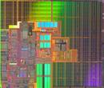

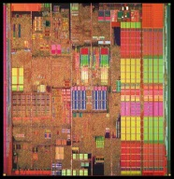
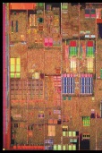

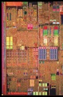

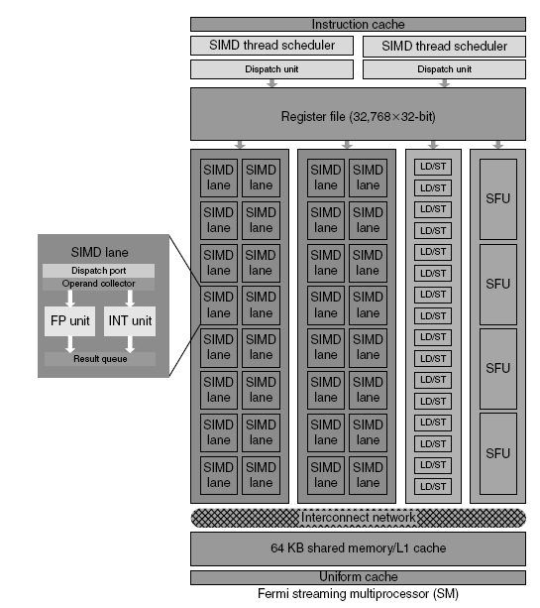
Multi-Core Technology
2004 2005 2007
Single Core Dual Core Multi-Core
Cache
4 or more cores
2X more
cores
+ Cache
Core
+ Cache
2 or more cores
Cache
+
Cache
Core
+ Cache
2010 Many Core

Slide 3
Multiprocessing within a chip: Many-Core
Many-core Era
Massively Parallel
Applications
100
Multi-core Era
Scalar and Parallel
Applications
Intel predicts 100’s of cores on a chip in 2015
10
Increasing HW
Threads
HT
1
2003
2005
2007
2009
2011
2013

Slide 4
Instruction-level parallelism
Parallelism at the machine-instruction level
The processor can re-order, pipeline instructions, split them into microinstructions, do aggressive branch prediction, etc.
Instruction-level parallelism enabled rapid increases in processor speeds over the last 15 years
Notes:
4

Slide 5
Why multi-core ?
Difficult to make single-core clock frequencies even higher
Deeply pipelined circuits:
Heat problems
Clock problems
Efficiency (Stall) problems
Doubling issue rates above today’s 3-6 instructions per clock, say to 6 to 12 instructions, is extremely difficult
issue 3 or 4 data memory accesses per cycle,
rename and access more than 20 registers per cycle, and
fetch 12 to 24 instructions per cycle.
Many new applications are multithreaded
A general trend in computer architecture is to shift towards more parallelism through more processors or processor cores
Notes:
5

Slide 6
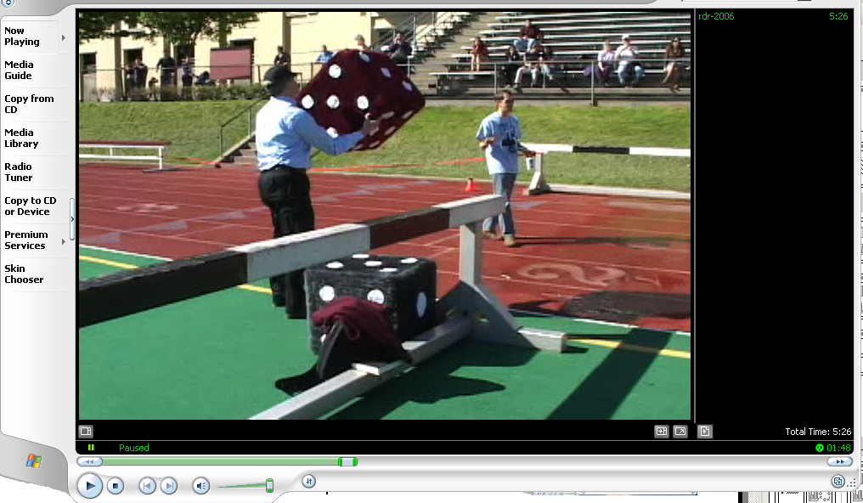
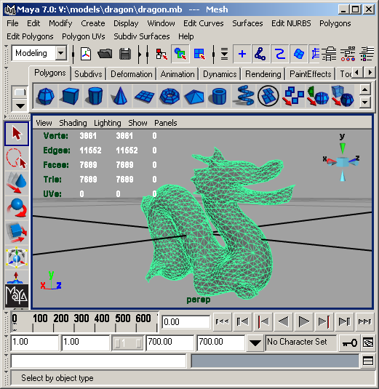
What applications benefit from multi-core?
Database servers
Web servers (Web commerce)‏
Multimedia applications
Scientific applications, CAD/CAM
In general, applications with Thread-level parallelism (as opposed to instruction-level parallelism)‏
Each can run on its own core
Notes:
6

Slide 7
Thread-level parallelism (TLP)‏
This is parallelism on a more coarse scale
Server can serve each client in a separate thread (Web server, database server)‏
A computer game can do AI, graphics, and sound in three separate threads
Single-core superscalar processors cannot fully exploit TLP
Multi-core architectures are the next step in processor evolution: explicitly exploiting TLP
Notes:
7

Slide 8
Thread-Level Parallelism
Notes:
8

Slide 9
Introduction
Thread-Level parallelism
Have multiple program counters
Uses MIMD model
Targeted for tightly-coupled shared-memory multiprocessors
For n processors, need n threads
Amount of computation assigned to each thread = grain size
Threads can be used for data-level parallelism, but the overheads may outweigh the benefit

Slide 10
How to exploit TLP?
Execute instructions from multiple threads on a single processor
Coarse-grain, fine-grain, SMT (Simultaneous Multi-Threading)
Execute multiple threads on multiple processors
“Anything that can be threaded today will map efficiently to multi-core”
Notes:
10

Slide 11
SMT – Simultaneous Multi-Threading
A variation on multithreading that uses the resources of a multiple-issue, dynamically scheduled processor (superscalar) to exploit both program ILP and thread-level parallelism (TLP)
With register renaming and dynamic scheduling, multiple instructions from independent threads can be issued in one cycle without regard to dependencies among them
Need separate rename tables (ROBs) for each thread
Need the capability to commit from multiple threads (i.e., from multiple ROBs) in one cycle
Notes:
11

Slide 12
TLP a 4-issue superscalar processor
Coarse MT
Fine MT
SMT
Issue slots
Thread A
Thread B
Time
Thread C
Thread D
Notes:
12

Slide 13
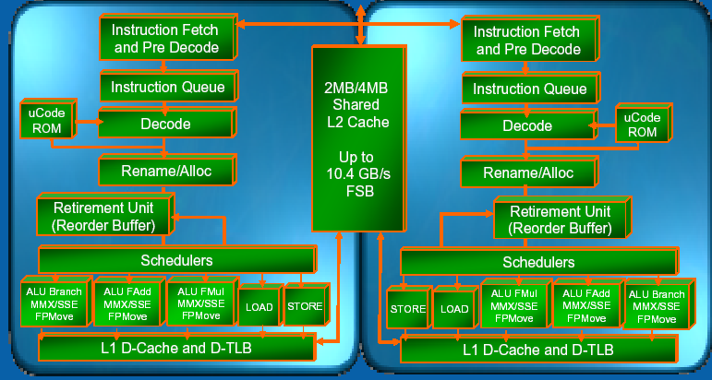
Core 2 Duo Microarchitecture
Notes:
13

Slide 14
Without SMT, only a single thread can run at any given time
L1 D-Cache D-TLB
Integer
Floating Point
Schedulers
L2 Cache and Control
Uop queues
Rename/Alloc
BTB
Trace Cache
uCode ROM
Decoder
Bus
BTB and I-TLB
Thread 1: floating point
Notes:
14

Slide 15
Without SMT, only a single thread can run at any given time
L1 D-Cache D-TLB
Integer
Floating Point
Schedulers
L2 Cache and Control
Uop queues
Rename/Alloc
BTB
Trace Cache
uCode ROM
Decoder
Bus
BTB and I-TLB
Thread 2: integer operation
Notes:
15

Slide 16
SMT processor: both threads can run concurrently
L1 D-Cache D-TLB
Integer
Floating Point
Schedulers
L2 Cache and Control
Uop queues
Rename/Alloc
BTB
Trace Cache
uCode ROM
Decoder
Bus
BTB and I-TLB
Thread 2: integer operation
Thread 1: floating point
Notes:
16

Slide 17
But: Can’t simultaneously use the same functional unit
L1 D-Cache D-TLB
Integer
Floating Point
Schedulers
L2 Cache and Control
Uop queues
Rename/Alloc
BTB
Trace Cache
uCode ROM
Decoder
This scenario is impossible with SMT on a single core (assuming a single integer unit)‏
Bus
BTB and I-TLB
Thread 1
Thread 2
IMPOSSIBLE
Notes:
17

Slide 18
Multi-core: threads can run on separate cores
L1 D-Cache D-TLB
L1 D-Cache D-TLB
Integer
Floating Point
Integer
Floating Point
Schedulers
Schedulers
L2 Cache and Control
Uop queues
L2 Cache and Control
Uop queues
Rename/Alloc
Rename/Alloc
BTB
Trace Cache
uCode ROM
BTB
Trace Cache
uCode ROM
Decoder
Decoder
Bus
BTB and I-TLB
Bus
BTB and I-TLB
Thread 1
Thread 2
Notes:
18

Slide 19
Multi-core: threads can run on separate cores
L1 D-Cache D-TLB
L1 D-Cache D-TLB
Integer
Floating Point
Integer
Floating Point
Schedulers
Schedulers
L2 Cache and Control
Uop queues
L2 Cache and Control
Uop queues
Rename/Alloc
Rename/Alloc
BTB
Trace Cache
uCode ROM
BTB
Trace Cache
uCode ROM
Decoder
Decoder
Bus
BTB and I-TLB
Bus
BTB and I-TLB
Thread 3
Thread 4
Notes:
19

Slide 20
Combining Multi-core and SMT
Cores can be SMT-enabled (or not)‏
The different combinations:
Single-core, non-SMT: standard uniprocessor
Single-core, with SMT
Multi-core, non-SMT
Multi-core, with SMT
The number of SMT threads: 2, 4, or sometimes 8 simultaneous threads
Intel calls them “hyper-threads”
Notes:
20

Slide 21
SMT Dual-core: all four threads can run concurrently
L1 D-Cache D-TLB
L1 D-Cache D-TLB
Integer
Floating Point
Integer
Floating Point
Schedulers
Schedulers
L2 Cache and Control
Uop queues
L2 Cache and Control
Uop queues
Rename/Alloc
Rename/Alloc
BTB
Trace Cache
uCode ROM
BTB
Trace Cache
uCode ROM
Decoder
Decoder
Bus
BTB and I-TLB
Bus
BTB and I-TLB
Thread 1
Thread 3
Thread 2
Thread 4
Notes:
21

Slide 22
High-Performance Computing
Notes:
22

Slide 23
Processor Performance
We have looked at various ways of increasing a single processor performance (Excluding VLSI techniques):
Pipelining
ILP
Superscalars
Out-of-order execution (Scoreboarding, Tomasulo)
VLIW
Cache (L1, L2, L3)
Interleaved memories
Compilers (Loop unrolling, branch prediction, etc.)
RAID
Etc …
However, quite often even the best microprocessors are not fast enough for certain applications !!!

Slide 24
Example: How far will ILP go?
Infinite resources and fetch bandwidth, perfect branch prediction and renaming

Slide 25
When Do We Need High Performance Computing?
Case1
To do a time-consuming operation in less time
I am an aircraft engineer
I need to run a simulation to test the stability of the wings at high speed
I’d rather have the result in 5 minutes than in 5 days so that I can complete the aircraft final design sooner.

Slide 26
When Do We Need High Performance Computing?
Case 2
To do a high number of operations per seconds
I am an engineer of Amazon.com
My Web server gets 10,000 hits per seconds
I’d like my Web server and my databases to handle 10,000 transactions per seconds so that customers do not experience bad delays
Amazon does “process” several GBytes of data per seconds

Slide 27
The need for High-Performance Computers some examples
Automotive design:
Major automotive companies use large systems (500+ CPUs) for:
CAD-CAM, crash testing, structural integrity and aerodynamics.
Savings: approx. $1 billion per company per year.
Semiconductor industry:
Semiconductor firms use large systems (500+ CPUs) for
device electronics simulation and logic validation
Savings: approx. $1 billion per company per year.
Airlines:
System-wide logistics optimization systems on parallel systems.
Savings: approx. $100 million per airline per year.

Slide 28
Grand Challenges
1 TB
100 GB
structural biology
10 GB
vehicle dynamics
pharmaceutical design
1 GB
48-hour
weather
72-hour
weather
Storage Requirements
chemical dynamics
100 MB
3D plasma modelling
2D airfoil
oil reservoir
modelling
10 MB
100 MFLOPS
1 GFLOPS
10 GFLOPS
100 GFLOPS
1 TFLOPS
Computational Performance Requirements

Slide 29

Weather Forecasting
Suppose the whole global atmosphere divided into cells of size 1 km × 1 km × 1 km to a height of 10 km (10 cells high) - about 5 × 10⁸ cells.
Suppose each cell calculation requires 200 floating point operations. In one time step, 10¹¹ floating point operations are necessary.
To forecast the weather over 7 days using 1-minute intervals, a computer operating at 1Gflops (10⁹ floating point operations/s) – similar to the Pentium 4 - takes 10⁶ seconds or over 10 days.
To perform calculation in 5 minutes requires a computer operating at 3.4 Tflops (3.4 × 10¹² floating point operations/sec).

Slide 30
Multiprocessing
Multiprocessing (Parallel Processing): Concurrent execution of tasks (programs) using multiple computing, memory and interconnection resources.
Use multiple resources to solve problems faster
Provides alternative to faster clock for performance
Assuming a doubling of effective processor performance every 2 years, 1024-Processor system (assuming linear performance gain) can get you the performance that it would take 20 years for a single-processor system to deliver
Using multiple processors to solve a single problem
Divide problem into many small pieces
Distribute these small problems to be solved by multiple processors simultaneously

Slide 31
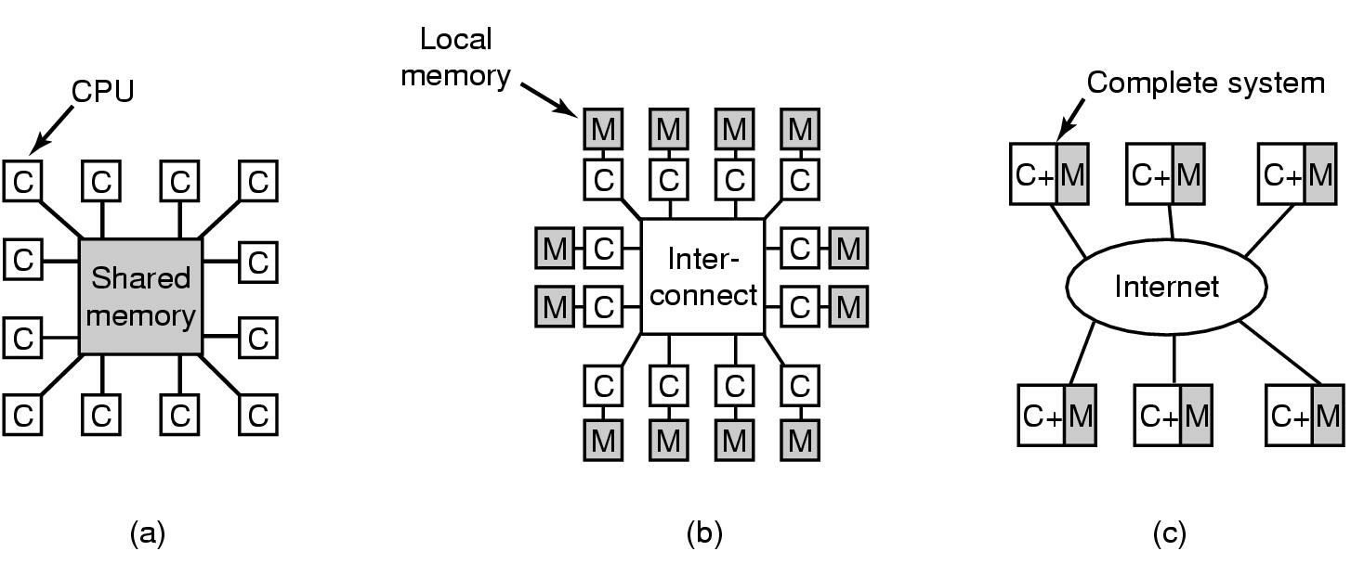
Multiprocessing
For the last 30+ years multiprocessing has been seen as the best way to produce orders of magnitude performance gains.
Double the number of processors, get (theoretically) double performance (less than 2 times the cost).
It turns out that the ability to develop and deliver software for multiprocessing systems induces impediment to wide adoption.

Slide 32
Amdahl’s Law
A parallel program has a sequential part (e.g., I/O) and a parallel part
T₁ = βT₁ + (1-β)T₁
T_{p} = βT₁ + (1-β)T₁ / p
Therefore:
Speedup(p) = 1 / (β + (1-β)/p)
= p / (β p + 1 - β)
≤ 1 / β
Example: if a code is 10% sequential (i.e., β = .10), the speedup will always be lower than 1 + 90/10 = 10, no matter how many processors are used!

Slide 33
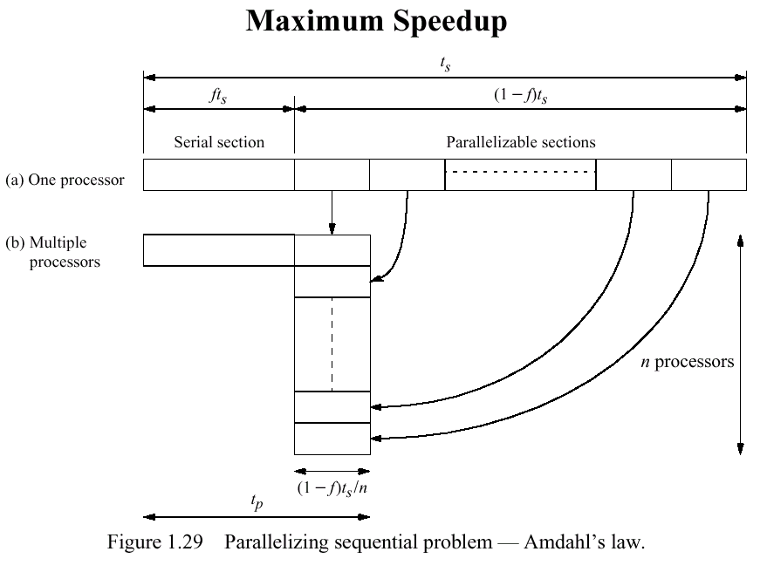

Slide 34
Performance Potential Using Multiple Processors
Amdahl's Law is pessimistic (in this case)
Let s be the serial part
Let p be the part that can be parallelized n ways
Serial: SSPPPPPP
6 processors: SSP
P
P
P
P
P
Speedup = 8/3 = 2.67
T(n) =
As n → ∞, T(n) →
Pessimistic
1
s+p/n
1
s

Slide 35
Amdahl’s Law
Speedup
25
20
15
1000 CPUs
16 CPUs
4 CPUs
10
5
0
10%
20%
30%
40%
50%
60%
70%
80%
90%
99%
% Serial

Slide 36
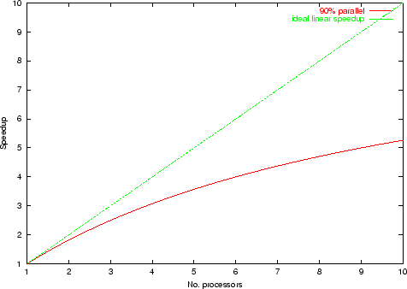
Example

Slide 37
Performance Potential: Another view
Gustafson view (more widely adopted for multiprocessors)
Parallel portion increases as the problem size increases
Serial time fixed (at s)
Parallel time proportional to problem size (true most of the time)
Gustafson’s Law: Speedup(N) = N - β(N-1)
N: number of processors, β : weight of non-parallelizable part
Old Serial: SSPPPPPP
6 processors: SSPPPPPP
PPPPPP
PPPPPP
PPPPPP
PPPPPP
PPPPPP
Hypothetical Serial:
SSPPPPPP PPPPPP PPPPPP PPPPPP PPPPPP PPPPPP
Speedup(6) = (8+5*6)/8 = 4.75
β =? in this calculation?
Speedup(N) = N(1- β) + β; Speedup'(∞) → ∞!!!!

Slide 38
Amdahl vs. Gustafson-Barsis
Speedup
100
80
Gustafson-Barsis
60
Amdhal
40
20
0
10%
20%
30%
40%
50%
60%
70%
80%
90%
99%
% Serial

Slide 39
TOP 5 Most computers in the world – must be multiprocessors
2008
Nov. 2012
No | Site Country | # of cores | Manufacturer, Model, Architecture | Rmax (TFlops)
1 | DOE/NNSA/LANL, USA | 129600 | IBM, BladeCenter QS22/LS21 Cluster, PowerXCell 8i 3.2 Ghz / Opteron DC 1.8 GHz , Voltaire Infiniband | 1105
2 | Oak Ridge National Laboratory, USA | 150152 | Cray XT5 QC 2.3 GHz | 1059
3 | NASA/Ames Research Center/NAS, USA | 51200 | SGI Altix ICE 8200EX, Xeon QC 3.0/2.66 GHz | 487
4 | DOE/NNSA/LLNL, USA | 212992 | IBM, eServer Blue Gene Solution | 478
5 | Argonne National Laboratory, USA | 163840 | IBM, Blue Gene/P Solution | 450
Site/Country/Year | # of cores | Manufacturer, Model, Architecture | Rmax (TFlops)
DOE/SC/Oak Ridge National Laboratory | 560640 | Titan - Cray XK7 , Opteron 6274 16C 2.200GHz, Cray Gemini interconnect, NVIDIA K20x | 17590
DOE/NNSA/LLNL | 1572864 | Sequoia - BlueGene/Q, Power BQC 16C 1.60 GHz | 16324
RIKEN Advanced Institute for Computational Science (AICS) | 705024 | K computer, SPARC64 VIIIfx 2.0GHz, Tofu interconnect | 10510
DOE/SC/Argonne National Laboratory | 786432 | Mira - BlueGene/Q, Power BQC 16C 1.60GHz | 8162
Forschungszentrum Juelich (FZJ) | 393216 | JUQUEEN - BlueGene/Q, Power BQC 16C 1.600GHz, Custom Interconnect | 4141
http://www.top500.org/

Slide 40
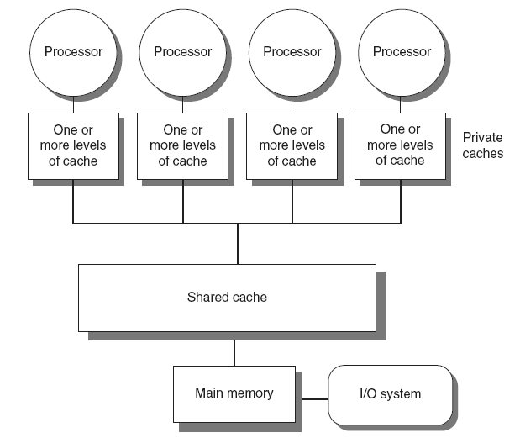
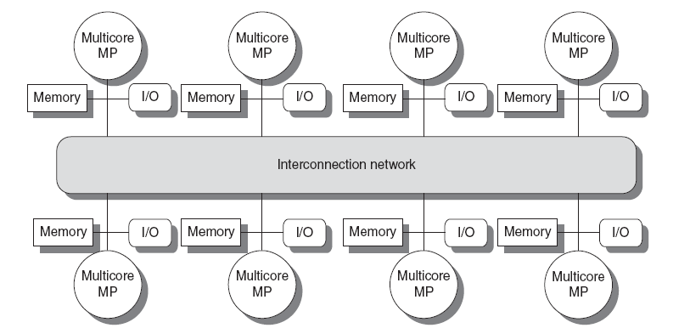
A Few Types
Symmetric multiprocessors (SMP)
Small number of cores
Share single memory with uniform memory latency
Distributed shared memory (DSM)
Memory distributed among processors
Non-uniform memory access/latency (NUMA)
Processors connected via direct (switched) and non-direct (multi-hop) interconnection networks

Slide 41
Flynn’s Taxonomy of Computing
SISD (Single Instruction, Single Data):
Typical uniprocessor systems that we’ve studied throughout this course.
Uniprocessor systems can time share and still be SISD.
SIMD (Single Instruction, Multiple Data):
Multiple processors simultaneously executing the same instruction on different data.
Specialized applications (e.g., image processing).
MIMD (Multiple Instruction, Multiple Data):
Multiple processors autonomously executing different instructions on different data.
Keep in mind that the processors are working together to solve a single problem.
This is a more general form of multiprocessing, and can be used in numerous applications

Slide 42
SIMD Systems
P
P
P
P
One control unit
Lockstep
All Ps do the same or nothing
M
M
M
M
P
P
P
P
M
M
M
M
P
P
P
P
M
M
M
M
Processor
Memory
P
P
P
P
M
M
M
M
von Neumann Computer
Some Interconnection Network

Slide 43
MIMD Architecture
Instruction
Stream A
Instruction
Stream B
Instruction
Stream C
Data Output
stream A
Data Input
stream A
Processor
A
Data Output
stream B
Data Input
stream B
Processor
B
Processor
C
Data Output
stream C
Data Input
stream C
Unlike SIMD, MIMD computer works asynchronously.
Shared memory (tightly coupled) MIMD
Distributed memory (loosely coupled) MIMD
43

Slide 44
MIMD Shared Memory Systems
M
M
M
M
Global Memory
Interconnection Networks
C
C
C
P
P
P
P
P
P
P
P
C
P
P
C
One global memory
Cache Coherence
All Ps have equal access to memory
P
C
P
C
M
M
M
M

Slide 45
Cache Coherent NUMA
M
M
M
M
C
C
C
C
P
P
P
P
Interconnection Network
Each P has part of the shared memory
Non uniform memory access

Slide 46
MIMD Distributed Memory Systems
M
M
M
M
P
P
P
P
Interconnection Networks
1110 1111
1010 1011
0110 0111
0010 0011
1100 1101
1000 1001
0100 0101
0000 0001
No shared memory
Message Passing
Topology
LAN/WAN

Slide 47
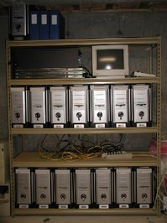
Cluster Architecture
Programming Environment
Middleware
OS
OS
OS
M
M
M
I/O
I/O
I/O
C
C
C
P
P
P
Interconnection Network
Home cluster

Slide 48


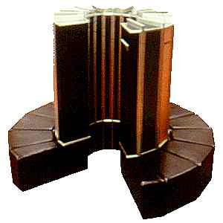

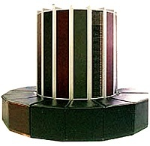
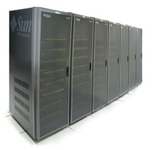


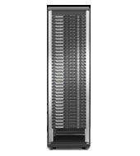
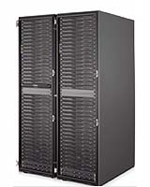
Grids
Geographically distributed platforms.
Internet
Dependable, consistent, pervasive, and inexpensive access to high end computing.

Slide 49
SIMD
Notes:
49

Slide 50
SIMD Parallel Computing
It can be a stand-alone multiprocessor
Or
Embedded in a single processor for specific applications (MMX)
50

Slide 51
SIMD Applications
Database, image processing, and signal processing.
Image processing maps very naturally onto SIMD systems.
Each processor (Execution unit) performs operations on a single pixel or neighborhood of pixels.
The operations performed are fairly straightforward and simple.
Data could be streamed into the system and operated on in real-time or close to real-time.
51

Slide 52
SIMD Operations
Image processing on SIMD systems.
Sequential pixel operations take a very long time to perform.
A 512x512 image would require 262,144 iterations through a sequential loop with each loop executing 10 instructions. That translates to 2,621,440 clock cycles (if each instruction is a single cycle) plus loop overhead.
Each pixel is operated on
sequentially one after
another.
512x512 image
52

Slide 53
SIMD Operations
Image processing on SIMD systems.
On a SIMD system with 64x64 processors (e.g., very simple ALUs) the same operations would take 640 cycles, where each processor operates on an 8x8 set of pixels plus loop overhead.
Each processor operates on
an 8x8 set of pixels in
parallel.
Speedup due to parallelism:
2,621,440/640 = 4096 =
64x64 (number of proc.)
loop overhead ignored.
512x512 image
53

Slide 54
SIMD Operations
Image processing on SIMD systems.
On a SIMD system with 512x512 processors (which is not unreasonable on SIMD machines) the same operation would take 10 cycles.
Each processor operates on
a single pixel in parallel.
Speedup due to parallelism:
2,621,440/10 = 262,144 =
512x512 (number of proc.)!
512x512 image
Notice no loop overhead!
54

Slide 55
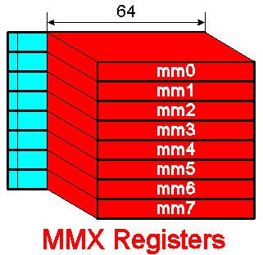
Pentium MMX MultiMedia eXtentions
57 new instructions
Eight 64-bit wide MMX registers
First available in 1997
Supported on:
Intel Pentium-MMX, Pentium II, Pentium III, Pentium IV
AMD K6, K6-2, K6-3, K7 (and later)
Cyrix M2, MMX-enhanced MediaGX, Jalapeno (and later)
Gives a large speedup in many multimedia applications
55

Slide 56
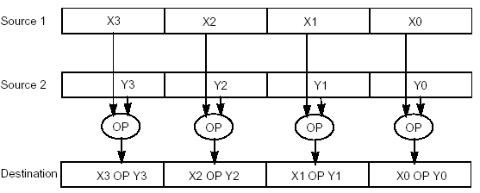
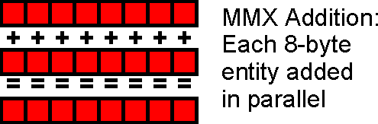
MMX SIMD Operations
Example: consider an image pixel data represented as bytes.
with MMX, eight of these pixels can be packed together in a 64-bit quantity and moved into an MMX register
MMX instruction performs the arithmetic or logical operation on all eight elements in parallel
PADD(B/W/D): Addition
PADDB MM1, MM2
adds 64-bit contents of MM2 to MM1,
byte-by-byte any carries generated
are dropped, e.g., byte A0h + 70h = 10h
PSUB(B/W/D): Subtraction
56

Slide 57

MMX: Image Dissolve Using Alpha Blending
Example: MMX instructions speed up image composition
A flower will dissolve a swan
Alpha (a standard scheme) determines the intensity of the flower
The full intensity, the flower’s 8-bit alpha value is FFh, or 255
The equation below calculates each pixel:
Result_pixel =Flower_pixel *(alpha/255) + Swan_pixel * [1-(alpha/255)]
For alpha 230, the resulting pixel is 90% flower and 10% swan
57

Slide 58
SIMD Multiprocessing
Traditional vector computers are typical SIMD systems
In the late 80s and early 90s, many SIMD machines were commercially available (e.g., Connection machine has 64K ALUs, and MasPar has 16K ALUs)
GPU revives the SIMD computation, and is widely used in high-performance computers
SPMD—Single Program, Multiple Data
58

Slide 59
Cache Coherence
Notes:
59

Slide 60
Shared Memory Multiprocessor
Processor
Processor
Processor
Processor
Registers
Registers
Registers
Registers
Caches
Caches
Caches
Caches
Memory
Interconnect
Memory: centralized with Uniform Memory Access time (“uma”) and bus interconnect, I/O
Examples: Sun Enterprise 6000, SGI Challenge, Intel SystemPro
Disk & other IO
60
Notes:
60

Slide 61
Shared Memory Programming Model
Processor
Memory
System
Process
Process
load(X)
store(X)
X
Shared variable
61

Slide 62
Shared Memory Model
Virtual address spaces for a collection of processes communicating via shared addresses
Machine physical address space
Pn private
Load
Common physical addresses
Store
Shared portion of address space
P2 private
P1 private
Private portion of address space
P0 private
62

Slide 63
Cache Coherence Problem
W: X = 17
R: X
P0
R: X
P1
P2
P3
$
X:17
$
$
$
X:42
X:42
MEM
X:42
Processor 3 does not see the value written by processor 0
63

Slide 64
Write Through does not help
W: X = 17
R: X
P0
R: X
P1
P2
P3
R: X
$
X:17
$
$
$
X:17
X:42
X:42
MEM
X:42
Processor 3 sees 42 in cache (does not get the correct value (17) from memory.
64

Slide 65
Why Don’t Processors Share Cache
Advantages
Cache placement identical to single cache
only one copy of any cached block
Disadvantages
Bandwidth limitation
P
1
P
n
Switch
(Interleaved)
First-level $
(Interleaved)
Main memory
Shared Cache
65
Notes:
65

Slide 66
Cache Coherence
Coherence
All reads by any processor must return the most recently written value
Writes to the same location by any two processors are seen in the same order by all processors
Consistency
When a written value will be returned by a read
If a processor writes location A followed by location B, any processor that sees the new value of B must also see the new value of A

Slide 67
Enforcing Coherence
Coherent caches provide:
Migration: movement of data
Replication: multiple copies of data
Cache coherence protocols
Directory based
Sharing status of each block kept in one location
Snooping
Each core tracks sharing status of each block

Slide 68

Distributed Cache: Snoopy Cache-Coherence Protocols
State
Address
Data
Bus is a broadcast medium & caches know what they have
bus protocol: arbitration, command/addr, data
=> Every device observes every transaction
68

Slide 69
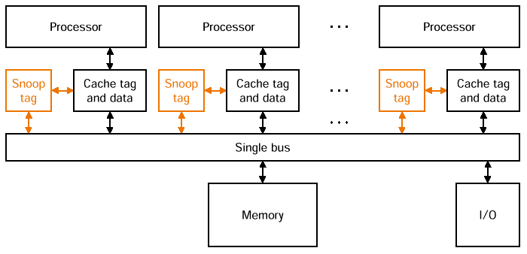
Snooping Cache Coherency
Cache Controller “snoops” all transactions on the shared bus
A transaction is a relevant transaction if it involves a cache block currently contained in this cache
take action to ensure coherence (invalidate, update, or supply value)
69

Slide 70
Hardware Cache Coherence
write-invalidate
write-update (also called distributed write)
invalidate -->
memory
X -> X’
X -> Inv
X -> Inv
P
P
. . . . .
P
memory
update -->
X -> X’
X -> X’
X -> X’
P
P
. . . . .
P

Slide 71
An Example Snoopy Protocol
Invalidation protocol, write-back cache
“invalidate” request on memory bus
Each cache block is in one state (track these):
Shared : multiple caches potentially have copies of the block; the block can be read
OR Modified : this cache has the only copy of the block; the block is writeable and dirty
OR Invalid : the block contains no valid data

Slide 72
An Example Snoopy Protocol
Source Request State of block Cache action Function and explanation
CPU | Read hit | Shared, modified | Normal hit | Read hit in cache
CPU | Read miss | Invalid | Normal miss | Place read miss on bus
CPU | Read miss | Shared | Replacement | Place read miss on bus
CPU | Read miss | Modified | Replacement | Write back block, then place read miss on bus

Slide 73
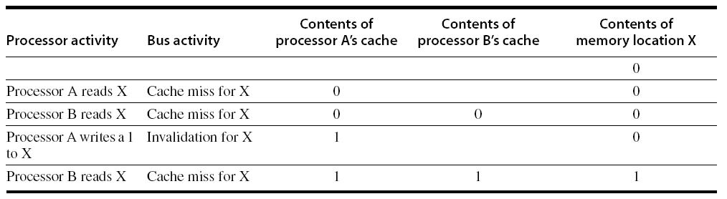
Snoopy Coherence Protocols
Write invalidate
On write, invalidate all other copies
Use bus itself to serialize
Write cannot complete until bus access is obtained
Write update
On write, update all copies

Slide 74
An Example Snoopy Protocol
Source Request State of block Cache action Function and explanation
CPU | Write hit | Modified | Normal hit | Write data in cache
CPU | Write hit | Shared | Coherence | Place invalidate on bus
CPU | Write miss | Invalid | Normal miss | Place write miss on bus
CPU | Write miss | Shared | Replacement | Place write miss on bus
CPU | Write miss | Modified | Replacement | Write back block, then place write miss on bus

Slide 75
An Example Snoopy Protocol
Source Request State of block Cache action Function and explanation
Bus | Read miss | Shared | No action | Allow memory to service the miss
Bus | Read miss | Modified | Coherence | Place cache block on bus
Bus | Invalidate | Shared | Coherence | Invalidate the block
Bus | Write miss | Shared | Coherence | Invalidate the block
Bus | Write miss | Modified | Replacement | Write back block, invalidate the block

Slide 76
Snoopy Coherence Protocols
Locating an item when a read miss occurs
In write-back cache, the updated value must be sent to the requesting processor
Cache lines marked as shared or exclusive/modified
Only writes to shared lines need an invalidate broadcast
After this, the line is marked as exclusive

Slide 77
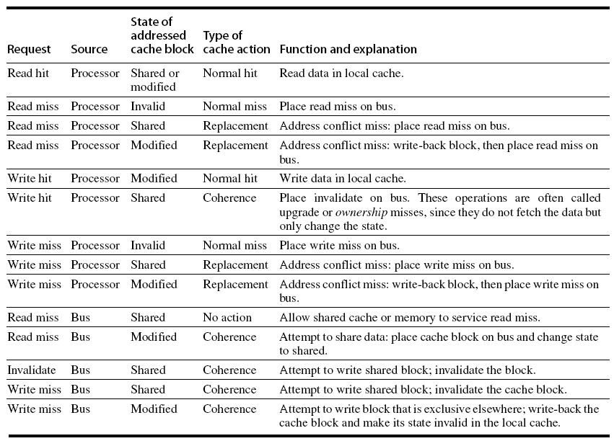
Snoopy Coherence Protocols

Slide 78
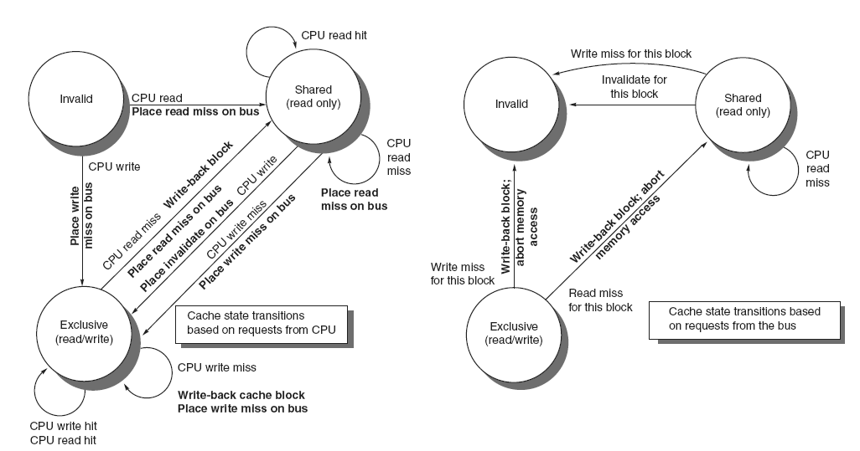
Snoopy Coherence Protocols

Slide 79
Snoopy-Cache State Machine
State machine for CPU requests for each cache block and for bus requests for each cache block
CPU: Read hit
Bus: Write miss
Bus: Invalidate
Shared
(read only)
Invalid
CPU: Read
Place read miss on bus
CPU: Write miss
Place Write Miss on bus
CPU: Read miss
Place read miss
on bus
CPU: read miss
Write back block, Place read miss on bus
Bus: Write miss
Write Back Block
Write Back
Block
CPU: Write hit Place invalidate on Bus
Bus:Read miss
CPU Write miss
Place Write Miss on Bus
Exclusive
(modified)
CPU: Write hit
CPU: Read hit
CPU: Write Miss
Write back data,
Place write miss on bus

Slide 80
Snoopy Coherence Protocols
Complications for the basic MSI protocol:
Operations are not atomic
E.g. detect miss, acquire bus, receive a response
Creates possibility of deadlock and races
One solution: processor that sends invalidate can hold bus until other processors receive the invalidate
Extensions:
Add exclusive state to indicate clean block in only one cache (MESI protocol)
Prevents needing to write invalidate on a write
Owned state

Slide 81
Performance
Coherence influences cache miss rate
Coherence misses
True sharing misses
Write to shared block (transmission of invalidation)
Read an invalidated block
False sharing misses
Read an unmodified word in an invalidated block

Slide 82
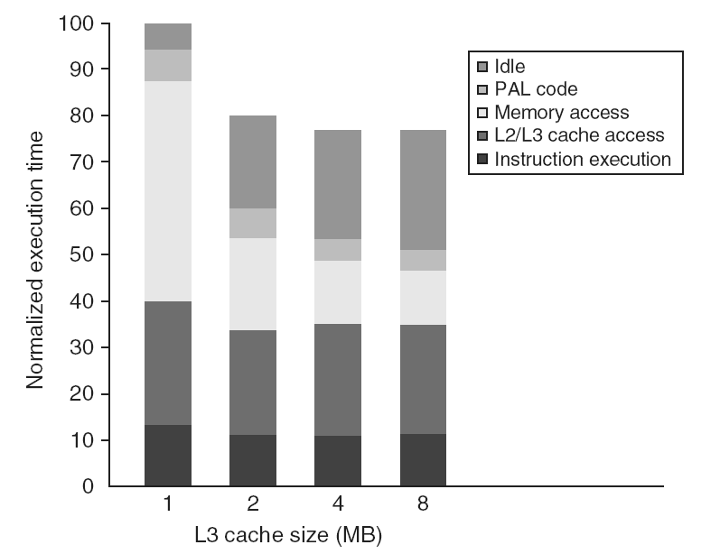
Performance Study: Commercial Workload

Slide 83
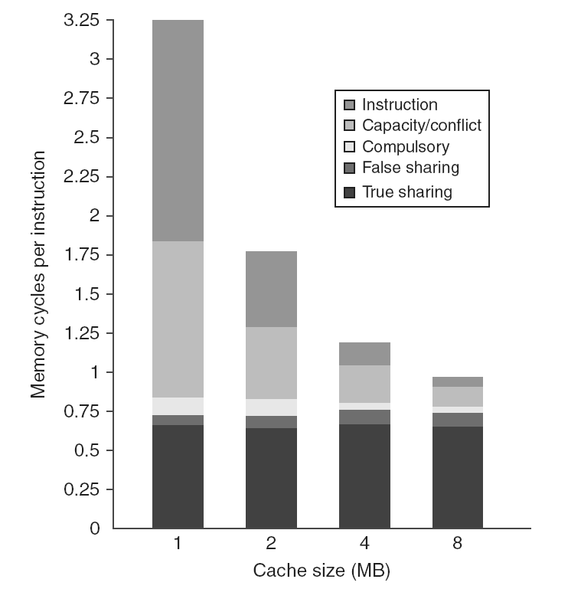
Performance Study: Commercial Workload

Slide 84
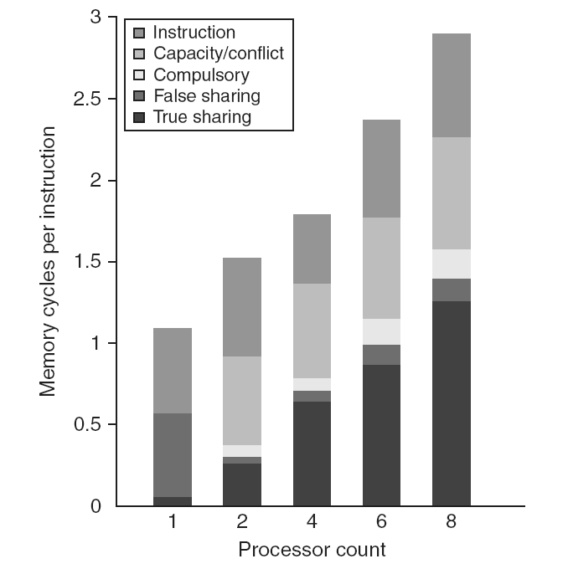
Performance Study: Commercial Workload

Slide 85
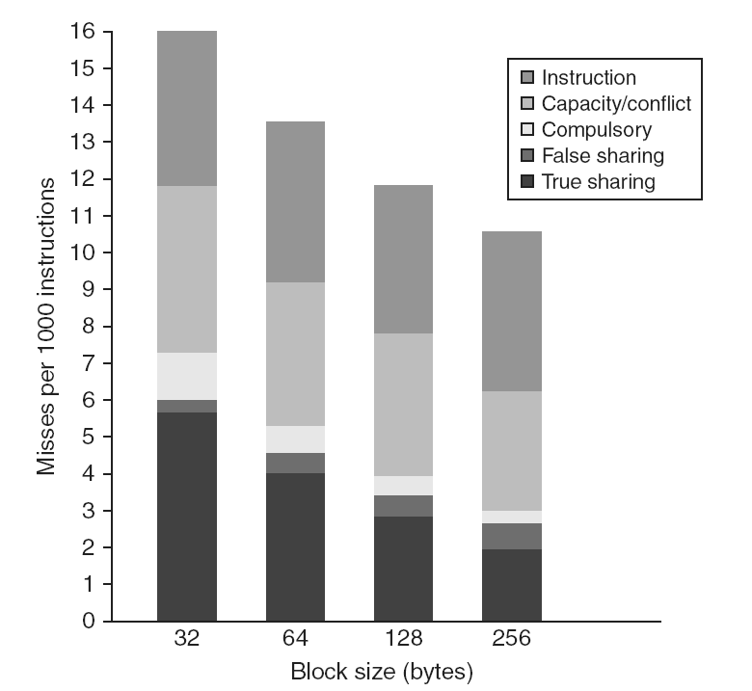
Performance Study: Commercial Workload

Slide 86
Revisit: Coherency Solutions
Snooping Solution (Snoopy Bus):
Send all requests for data to all caches
Requires broadcast, works well with bus (natural broadcast medium)
Dominates for small scale machines (most of the market)
Directory-Based Schemes
Keep track of what is being shared in 1 centralized place (logically)
Send point-to-point requests to processors via network
Scales better than Snooping

Slide 87
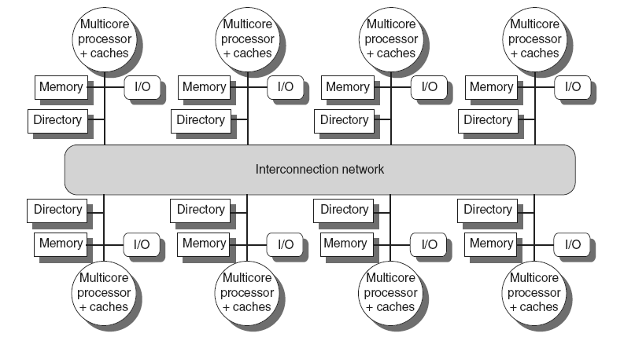
Directory Protocols
Directory keeps track of every block
Which caches have each block
Dirty status of each block
Implement in shared L3 cache
Keep bit vector of size = # cores for each block in L3
Not scalable beyond shared L3
Implement in a distributed fashion:

Slide 88
Directory Protocols
For each block, maintain state:
Shared
One or more nodes have the block cached, value in memory is up-to-date
Set of node IDs
Uncached
Modified
Exactly one node has a copy of the cache block, value in memory is out-of-date
Owner node ID
Directory maintains block states and sends invalidation messages

Slide 89
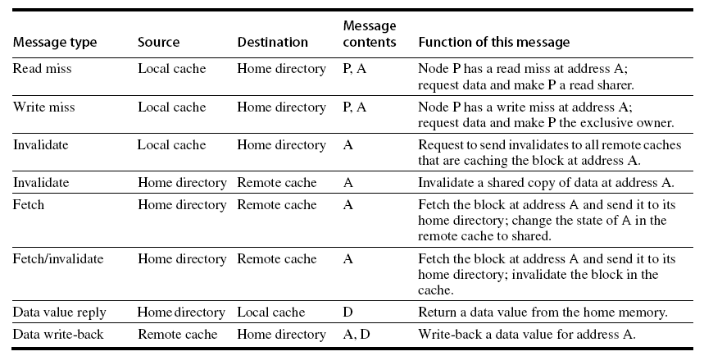
Messages

Slide 90
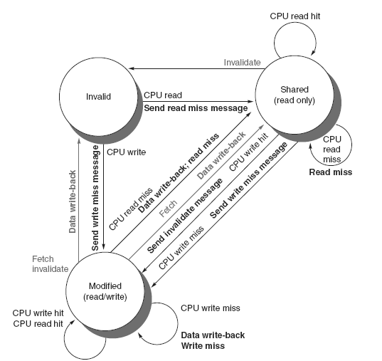
Directory Protocols

Slide 91
Directory Protocols
For uncached block:
Read miss
Requesting node is sent the requested data and is made the only sharing node, block is now shared
Write miss
The requesting node is sent the requested data and becomes the sharing node, block is now exclusive
For shared block:
Read miss
The requesting node is sent the requested data from memory, node is added to sharing set
Write miss
The requesting node is sent the value, all nodes in the sharing set are sent invalidate messages, sharing set only contains requesting node, block is now exclusive

Slide 92
Directory Protocols
For exclusive block:
Read miss
The owner is sent a data fetch message, block becomes shared, owner sends data to the directory, data written back to memory, sharers set contains old owner and requestor
Data write back
Block becomes uncached, sharer set is empty
Write miss
Message is sent to old owner to invalidate and send the value to the directory, requestor becomes new owner, block remains exclusive

Slide 93
Synchronization
Basic building blocks:
Atomic exchange
Swaps register with memory location
Test-and-set
Sets under condition
Fetch-and-increment
Reads original value from memory and increments it in memory
Requires memory read and write in uninterruptable instruction
load linked/store conditional
If the contents of the memory location specified by the load linked are changed before the store conditional to the same address, the store conditional fails

Slide 94
Implementing Locks
Spin lock
If no coherence:
DADDUI R2,R0,#1
lockit: EXCH R2,0(R1) ;atomic exchange
BNEZ R2,lockit ;already locked?
If coherence:
lockit: LD R2,0(R1) ;load of lock
BNEZ R2,lockit ;not available-spin
DADDUI R2,R0,#1 ;load locked value
EXCH R2,0(R1) ;swap
BNEZ R2,lockit ;branch if lock wasn’t 0

Slide 95
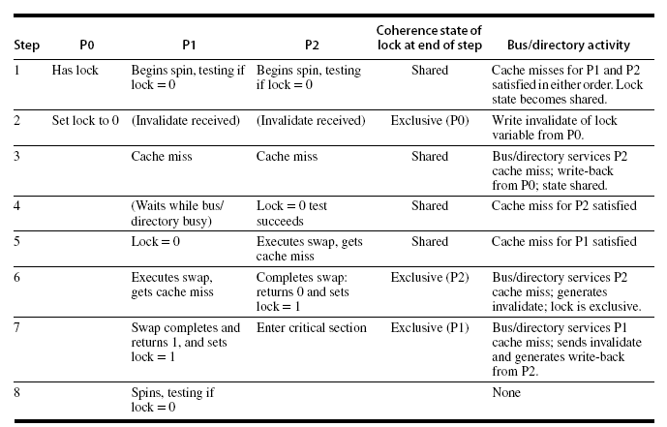
Implementing Locks
Advantage of this scheme: reduces memory traffic

Slide 96
Models of Memory Consistency
Processor 1:
A=0
…
A=1
if (B==0) …
Processor 2:
B=0
…
B=1
if (A==0) …
Should be impossible for both if-statements to be evaluated as true
Delayed write invalidate?
Sequential consistency:
Result of execution should be the same as long as:
Accesses on each processor were kept in order
Accesses on different processors were arbitrarily interleaved

Slide 97
Implementing Locks
To implement, delay completion of all memory accesses until all invalidations caused by the access are completed
Reduces performance!
Alternatives:
Program-enforced synchronization to force write on processor to occur before read on the other processor
Requires synchronization object for A and another for B
“Unlock” after write
“Lock” after read

Slide 98
Relaxed Consistency Models
Rules:
X → Y
Operation X must complete before operation Y is done
Sequential consistency requires:
R → W, R → R, W → R, W → W
Relax W → R
“Total store ordering”
Relax W → W
“Partial store order”
Relax R → W and R → R
“Weak ordering” and “release consistency”

Slide 99
Relaxed Consistency Models
Consistency model is multiprocessor specific
Programmers will often implement explicit synchronization
Speculation gives much of the performance advantage of relaxed models with sequential consistency
Basic idea: if an invalidation arrives for a result that has not been committed, use speculation recovery

Slide 100
Interconnect
Notes:
100

Slide 101
Limits of Bus-Based Shared Memory
Assume:
1 GHz processor
=> 4 GB/s inst BW per processor (32-bit)
=> 1.2 GB/s data BW at 30% load-store
Suppose 98% inst hit rate and 95% data hit rate
=> 80 MB/s inst BW per processor
=> 60 MB/s data BW per processor
140 MB/s combined BW
Assuming 1 GB/s bus bandwidth
∴ 8 processors will saturate the memory bus
I/O
MEM
° ° °
MEM
140 MB/s
° ° °
cache
cache
5.2 GB/s
PROC
PROC
101
Notes:
101

Slide 102
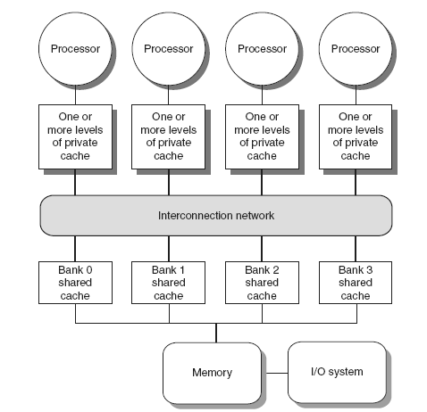
Coherence Protocols: Extensions
Shared memory bus and snooping bandwidth is bottleneck for scaling symmetric multiprocessors
Duplicating tags
Place directory in outermost cache
Use crossbars or point-to-point networks with banked memory

Slide 103
Coherence Protocols
AMD Opteron:
Memory directly connected to each multicore chip in NUMA-like organization
Implement coherence protocol using point-to-point links
Use explicit acknowledgements to order operations

Slide 104
Scalable Shared Memory Architectures Crossbar Switch
Used in SUN entreprise 10000
Mem
Mem
Mem
Mem
Cache
Cache
I/O
I/O
P
P
104

Slide 105
Scalable Shared Memory Architectures
Used in IBM SP Multiprocessor
P
0
M
0
000
P
1
M
1
001
P
2
M
2
010
1
P
3
M
3
011
P
4
M
4
100
1
P
5
M
5
101
P
6
M
6
110
0
P
7
M
7
111
105

Slide 106
Approaches to Building Parallel Machines
P
1
P
n
Scale
Switch
P
1
P
n
(Interleaved)
$
First-level $
$
Inter
connection network
(Interleaved)
Main memory
Mem
Mem
Shared Cache
P
1
P
n
Mem
$
Mem
$
Inter
connection network
Distributed Memory
106

Slide 107
Scales of Multiprocessors
Small size multiprocessors ( < 10 processors)
Use shared memory with shared bus
Not expensive
Commercially available, and highly used as small servers
Medium size multiprocessors ( < 64 processors)
Use shared memory with crossbar switch
Commercially available
Used as high-end servers and computing engines
Large size multiprocessors ( > 64 processors)
Use distributed memory with custom-made interconnection network
Very powerful computing machines
Extremely expensive

