Slide 1
Comp4611 Tutorial 2
Instruction Set Architecture
(ISA)
Sept. 24, 26, 28 2012

Slide 2
Computer Architecture
Instruction set architecture (ISA)
  The actual programmer-visible instruction set and serving as the boundary between the software and hardware.
Organization
  Includes the high-level aspects of a computer’s design such as: The memory system, the bus structure, and the internal CPU unit.
Hardware
  Refers to the specifics of the machine such as detailed logic design and packaging technology.

Slide 3
Instruction Set Architecture
“Instruction Set Architecture is the structure of a computer that a machine language programmer (or a compiler) must understand to write a correct (timing independent) program for that machine.”
IBM, Introducing the IBM 360 (1964)
The ISA defines:
  Operations that the processor can execute
  Data Transfer mechanisms + how to access data
  Control Mechanisms (branch, jump, etc)
  “Contract” between programmer/compiler and hardware

Slide 4
More About ISA
Example
  Intel 80x86 family use the similar ISA. The later generation has the ISA covering that of the former generation.
Benefit
  Old software can be used on the new hardware and vice versa (backwards compatibility).
Requirement
  ISA can provide convenient functionality to higher level (software view).
  ISA should permit efficient implementation at lower level (hardware view).

Slide 5
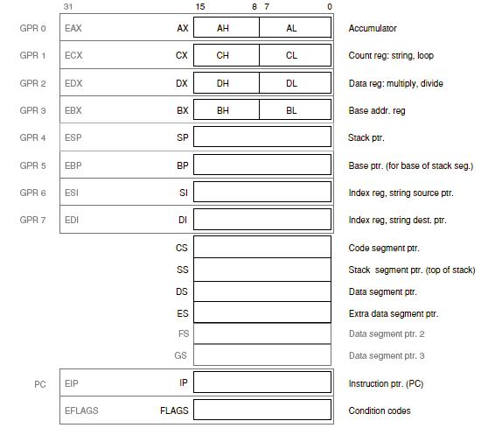
Review of 80x86 Registers (IA-32)

Slide 6
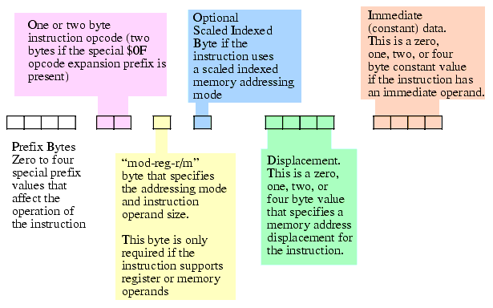
80x86 Instruction Encoding
Hybrid length

Slide 7
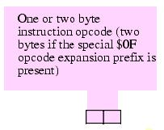
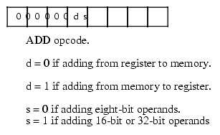
80x86 Operation Code (opcode)
The 80x86 supports two basic opcode sizes
  Standard one-byte opcode
  Or two-byte opcode
    Consisting of a $0F opcode expansion prefix byte and a second byte specifying the actual instruction.
  Provides for up to 512 different instruction classes
    Although the 80x86 does not yet use them all
In reality, certain bits in opcode may used for non-instruction-class purposes
  i.e. ‘s’ bit specifies the size of the operand, ‘d’ specifies the direction of the transfer
Expandability
0 | 0 | 0 | 0 | 0 | 0 | d | s

Slide 8
Move on: IA-64
Incompatible to IA-32
Adopted in Intel Itanium® processor family
A full 64-bit address space
Large directly accessible registers
128-bit encoding that has room for three instructions
Instruction bits to communicate information from the compiler to the hardware
Trade-offs runtime and compilation time
New ways of prediction

Slide 9
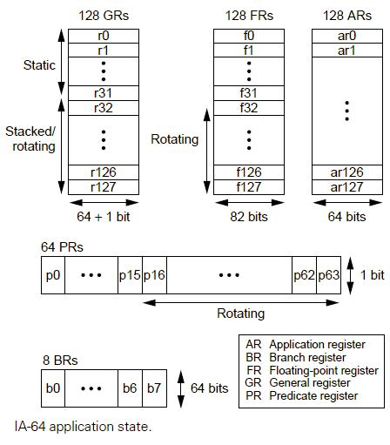
IA-64 registers
128 65-bit general registers
128 82-bit floating-point registers
128 64-bit special-purpose application registers
8 64-bit branch registers
64 one-bit predicate registers

Slide 10
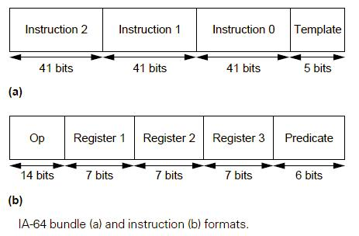
IA-64 instruction formats
IA-64 passes the burden of parallelism-hunting back to the compiler. The compiler takes all of your sequential code, examines it for dependencies, shuffles it around, then packs it into 128-bit "bundles" which can safely be executed in parallel. Each 128-bit bundle contains three instructions and a set of template bits.

Slide 11
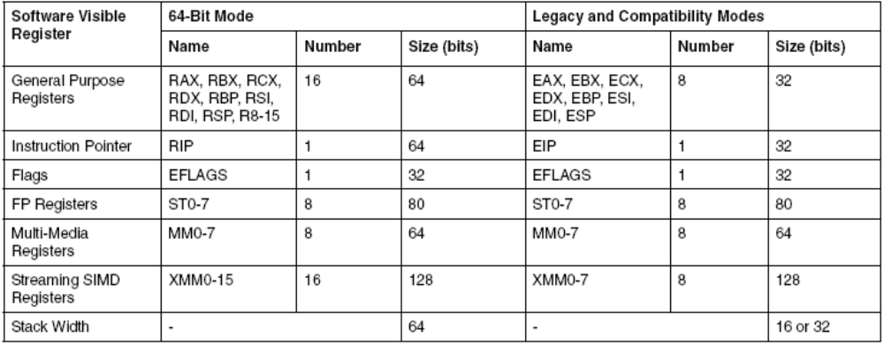
Move on: Intel® EM64T
Enhancement to IA-32 architecture
Legacy Mode : 32-bit O/S and 32-bit applications
Compatibility Mode : 64-bit O/S and 32-bit applications
64-bit Mode : 64-bit O/S and 64-bit applications

Slide 12
Intel® IA-64 vs Intel® EM64T
Is Intel® EM64T the same technology used in the Itanium® 2 processor?
No.
Intel® EM64T is an extension to Intel's processors based on the IA-32 architecture.
The Itanium processor family is based on the EPIC architecture.
These are two separate families of processors, based on two different architectures.
The Itanium processor family is specifically designed for the most demanding mission-critical applications.

Slide 13
The evolvement of ISA:
Practical Example: Multimedia ISAs
Motivation:
  Demand (or to be created by Intel) of multimedia/ graphics/ communication processing
Observation:
  The common processing involve repetitive integer and FP operations
  In original x86 architecture, those operations require a large number of instructions
Solution:
  Intel tries to design a new instruction set to speedup the operations
  Put those operations into a single hardware instruction (also known as vector operations)

Slide 14
Move on
Intel MMX (’97)
  MultiMedia eXtensions, a set of instructions built into Intel microprocessors and other x86-compatible microprocessors to handle many common multimedia operations.
SSE (‘99)
  Streaming SIMD Extensions is introduced in Pentium III series processors to enable the performance of 3D and video applications. SSE
  Added 70 new instructions.
SSE2 (‘01)
  An extension to the basic SSE instruction set to solve the pipeline problem of issuing FPU (float process unit) and SSE instructions at the same time.
  Added 144 new instructions to SSE.
SSE3 (‘04)
  The third iteration of the SSE instruction set for the IA-32 architecture.
  Capability to work horizontally in a register.

Slide 15
Intel® Pentium® 4 with SSE3
13 new streaming instructions that will increase the performance
  Added instructions that add and subtract the multiple values stored within a single register. These instructions simplify the implementation of a number of DSP and 3D operations.
  A new instruction that convert floating point values to integers without having to change the global rounding mode, thus avoiding costly pipeline stalls.

Slide 16
Intel® Core™ Microarchitecture
http://www.youtube.com/watch?v=4BDfi_sdnFc
Wide Dynamic Execution
  Deliver more instructions per clock cycle
  Allow each core to fetch, dispatch, execute and retire up to four full instructions simultaneously
  improving execution and energy efficiency
Intelligent Power Capability
  Intelligently turns on only the subsystem that are required
  → reduce power consumption

Slide 17
Intel® Core™ Microarchitecture
Advanced Smart Cache
  Each execution core can access data from the faster, more efficient cache subsystem
  improves processor efficiency and performance
Smart Memory Access
  Load or pre-fetch data in advance
Advanced Digital Media Boost
  The 128-bit SSE instructions are now issued at a throughput rate of one per clock cycle
  → accelerating a broad range of applications, including video, speech and image, photo processing, encryption, financial, engineering and scientific applications.

Slide 18
ISA and uArchitecture
Both Intel and AMD adopt 80x86 ISA
  Interoperability of programs
Different in performance as the underlying microarchitectures are different
  Optimization issue for different CPUs

Slide 19
Intel 64/x86-64
The x86-64 architecture is a 64-bit superset of the 32-bit x86 ISA
x86-64 was designed by AMD who named it AMD64
It has been cloned by Intel under the name Intel 64
The vendor-neutral names x86-64 or x64
All instructions in the x86 instruction set can be executed by x86-64 CPUs

Slide 20
Intel 64/x86-64
Intel 64/x86-64 should not be confused with the Intel Itanium architecture known as IA-64 which is not compatible at native instruction set level x86-64
Intel 64 is Intel's implementation of x86-64.
Used in newer versions of Pentium 4, Celeron D, Xeon and Pentium Dual-Core processors, the Atom D510, N450, N550, N2600 and N2800 and in all versions of the Pentium Extreme Edition, Core 2, Core i7, Core i5, and Core i3 processors.

Slide 21
Intel 64/x86-64
Additional registers
  The number of named registers is increased from 8 (i.e. eax, ebx, ecx, edx, ebp, esp, esi, edi) to 16
Larger virtual address space
  Current models can address up to 256 terabytes
  Expandable in the future to 16 exabytes
  Compared to just 4 gigabytes for 32-bit x86

