Slide 1
Comp4611 Tutorial 3
Pipelining and Data Hazards
Oct. 3, 5, 8 2012

Slide 2
Outline
Pipelining
What is Data Hazards ?
Data Hazard Detection
Data Hazard Solutions
Data Hazard Example

Slide 3
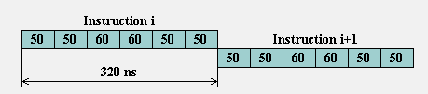
Pipelining Exercise
Consider a nonpipelined machine with 6 execution stages of lengths 50 ns, 50 ns, 60 ns, 60 ns, 50 ns, and 50 ns.
  Find the instruction latency on this machine.
  How much time does it take to execute 100 instructions ?
Solution:
Instruction latency = 50+50+60+60+50+50= 320 ns
Time to execute 100 instructions = 100*320 = 32000 ns

Slide 4
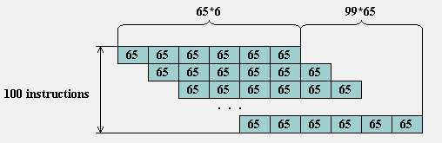
Pipelining Exercise
Suppose we introduce pipelining on this machine. Assume that when pipelining is introducing, the clock skew adds 5 ns of overhead to each execution stage.
  What is the instruction latency on the pipelined machine ?
  How much time does it take to execute 100 instructions ?
Solution:
Note: the length of the pipe stages must all be the same.
Length of pipelined stage = MAX (lengths of unpipelined stages) + overhead = 60 + 5 = 65 ns
Instruction latency = 65*6 = 390 ns
Time to execute 100 instructions = 65*6 + 65*99 = 6825 ns
Notes:
Gl: when introducing pipelining → when pipelining is introduced

Slide 5
Pipelining Exercise
What is the speedup obtained from pipelining?
Speedup is the ratio of the average instruction time without pipelining to the average instruction time with pipelining.
(here we do not consider any stalls introduced by different types of hazards which we will look at in the next section)
Solution:
Speedup = Old Execution Time / New Execution Time
= 32000 / 6825
= 4.69

Slide 6

Basic MIPS Integer Datapath
ADD
4
ADD
PC
<<2
ADDR
RD
Instruction
I
Instruction
32
16
32
5
5
5
Memory
RN1
RN2
WN
Taken?
Register File
RD1
ALU
WD
RD2
M
U
ADDR
X
Data
E
Memory
RD
M
16
X
32
U
T
WD
X
N
D

Slide 7
Pipelining in MIPS
Question: What happens if we break execution into multiple cycles?
Answer: in the best case, we can start executing a new instruction on each clock cycle - this is pipelining
Pipelining stages:
  IF: Instruction Fetch
  ID: Instruction Decode
  EX: Execute / Address Calculation
  MEM: Memory Access (read / write)
  WB: Write Back (results into register file)

Slide 8
Basic MIPS Processor
ADD
4
ADD
PC
<<2
ADDR
RD
Instruction
I
Instruction
32
16
32
5
5
5
Taken?
Memory
RN1
RN2
WN
Register File
RD1
ALU
WD
RD2
M
U
ADDR
X
Data
E
Memory
RD
M
16
X
32
U
T
WD
X
N
D
IF
Instruction Fetch
ID
Instruction Decode
EX
Execute/ Address Calc.
MEM
Memory Access
WB
Write Back

Slide 9
Simple MIPS Pipelined
Integer Instruction Processing
Clock Number Time in clock cycles →
Instruction N° 1 2 3 4 5 6 7 8 9
Instruction I IF ID EX MEM WB
Instruction I+1 IF ID EX MEM WB
Instruction I+2 IF ID EX MEM WB
Instruction I+3 IF ID EX MEM WB
Instruction I +4 IF ID EX MEM WB
Time to fill the pipeline
MIPS Pipeline Stages:
IF = Instruction Fetch
ID = Instruction Decode
EX = Execution
MEM = Memory Access
WB = Write Back
Last instruction
I+4 completed
First instruction
I completed

Slide 10
Pipelining Hazards
Hazards prevent next instruction from executing during its designated clock cycle
  Structural hazards
    Caused by hardware resource conflicts
  Data hazards
    Arise when an instruction depends on the results of a previous instruction
  Control hazards
    Caused by change of control (e.g. jump)

Slide 11
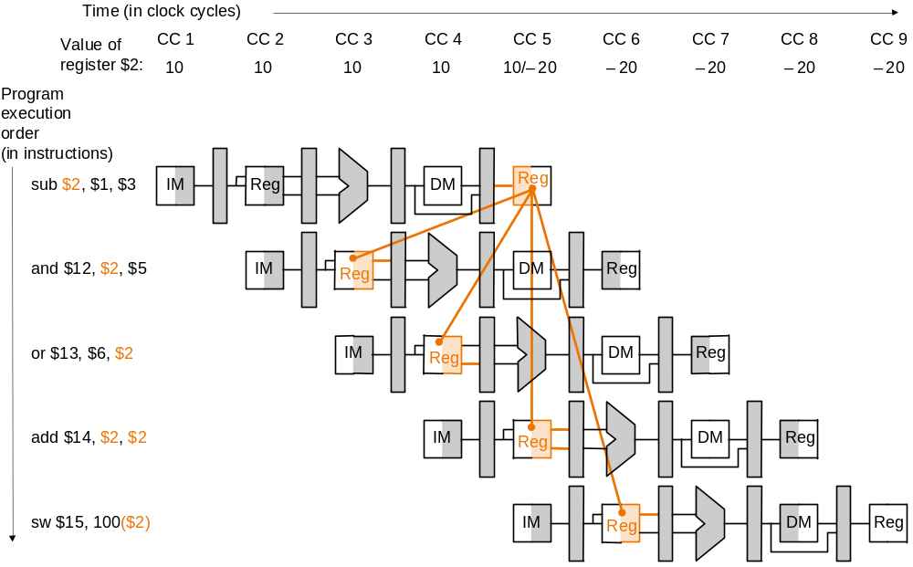
Data Hazards
Data hazards occur when data is used before it is ready
The use of the result of the SUB instruction in the next three instructions causes a data hazard, since the register $2 is not written until after those instructions read it.

Slide 12
Data Hazards
Read After Write (RAW)
Instr_{J} tries to read operand before Instr_{I} writes it
Caused by a “Dependence” (in compiler nomenclature).
This hazard results from an actual need for communication.
Execution Order is:
Instr_{I}
Instr_{J}
I: add r1,r2,r3
J: sub r4,r1,r3

Slide 13
Data Hazards
Write After Read (WAR)
Instr_{J} tries to write operand before Instr_{I} reads i
  Gets wrong operand
Called an “Anti-Dependence” by compiler writers.
This results from reuse of the name “r1”.
Can this data hazard happen in MIPS 5 stage pipeline ?
Execution Order is:
Instr_{I}
Instr_{J}
I: sub r4,r1,r3
J: add r1,r2,r3
K: mul r6,r1,r7

Slide 14
Data Hazards
Write After Write (WAW)
Instr_{J} tries to write operand before Instr_{I} writes it
  Leaves wrong result ( Instr_{I} not Instr_{J} )
Called an “Output-Dependence” by compiler writers.
This also results from the reuse of name “r1”.
Can’t happen in MIPS 5 stage pipeline because:
  All instructions take 5 stages, and
  Writes are always in stage 5
Will see WAR and WAW later in more complicated pipes
Execution Order is:
Instr_{I}
Instr_{J}
I: sub r1,r4,r3
J: add r1,r2,r3
K: mul r6,r1,r7

Slide 15
Data Hazards Solutions
Solutions for Data Hazards
  Stalling
    Add bubbles
  Forwarding
    Connect new value directly to next stage
  Reordering

Slide 16
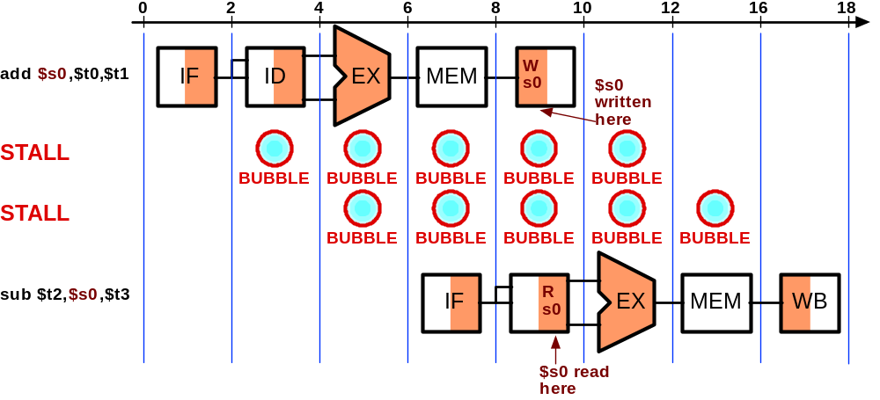
Data Hazard - Stalling

Slide 17
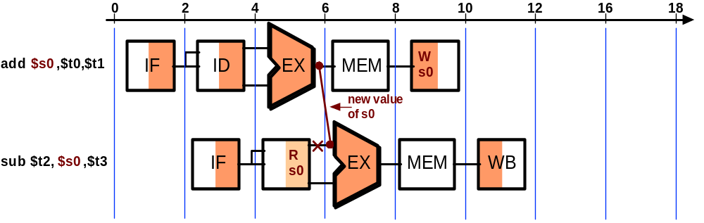
Data Hazards - Forwarding
Key idea: connect new value directly to next stage
Still read s0, but ignore in favor of new result
Problem: what about load instructions?

Slide 18
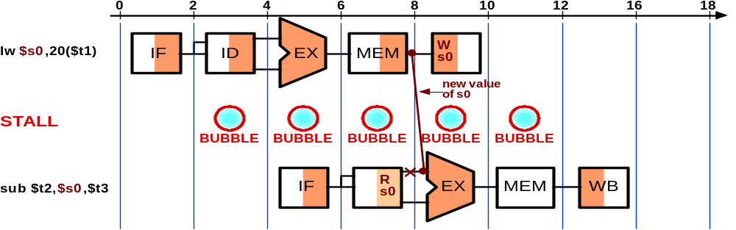
Data Hazards - Forwarding
STALL still required for load - data avail. after MEM
MIPS architecture calls this delayed load, initial implementations required compiler to deal with this

Slide 19
Data Hazards - Reordering
Assuming we have data forwarding, what are the hazards in this code ?
    lw $t0, 0($t1)
    lw $t2, 4($t1)
    add $s3, $t2, $s4
    add $s5, $t0, $s6
Reorder instructions to remove hazard:
    lw $t0, 0($t1)
    lw $t2, 4($t1)
    add $s5, $t0, $s6
    add $s3, $t2, $s4

Slide 20
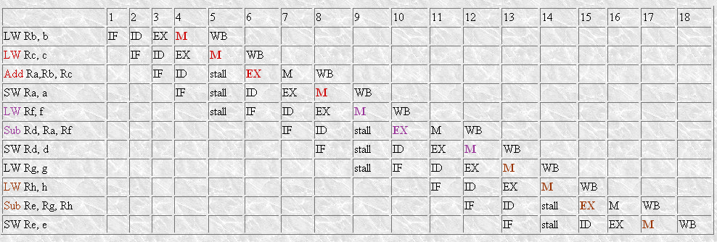
Data Hazards Example
For the following sequence of statements:
a = b + c d = a – f e = g - h
One solution would look like this:

Slide 21
Data Hazards Example
Observation:
  In time steps 4, 5, and 6, there are two forwards from the Data memory unit to the ALU in the EX stage of the Add instruction.
  So also the case in time steps 13, 14, and 15.
  The hardware to implement this forwarding will need two Load Memory Data places to store the output of data memory.
  Note that for the SW instructions, the register value is needed at the input of Data memory.

Slide 22
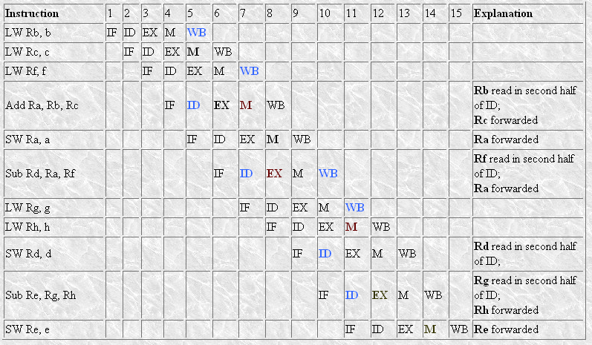
Data Hazards Example
The better solution with compiler assist is given below:
(Rather than just allow the pipeline to stall, the compiler could avoid these stalls by rearranging the code sequence to eliminate the hazards.)
Notes:
Gl: is the grammar right in “Rather than just allow”?
try to schedule the pipeline to avoid → avoid

