Slide 1
SimpleScalar Tutorial
COMP4611 Tutorial 5
Oct 15th-19th

Slide 2
Outline
Introduction to SimpleScalar
SimpleScalar installation and practice
PISA objdump installation and practice
Instruction count and CPI calculation

Slide 3
What is SimpleScalar
A tool set for users to build applications that simulate real programs running on a range of modern processors and systems
SimpleScalar tool set includes a set of sample simulators to simulate different operations of processors (i.e. branch prediction)

Slide 4
Install Cygwin
We will run SimpleScalar on Cygwin
Go to http://cygwin.com/install.html to install Cygwin
ftp.iij.ad.jp(ftp) as a recommended mirror site
Select Category (the default) package installation option
Make sure gcc, make, wget, tar are installed

Slide 5
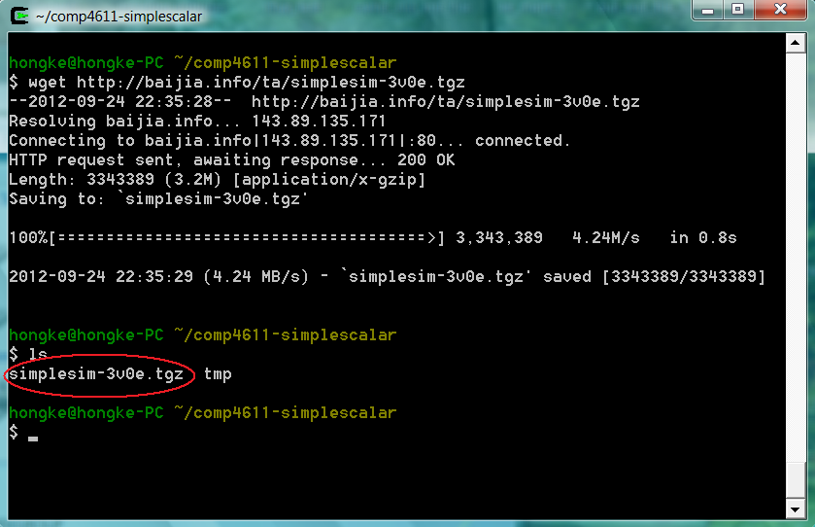
Where to get SimpleScalar
Open Cygwin to download SimpleScalar:
$ wget http://baijia.info/ta/simplesim-3v0e.tgz

Slide 6
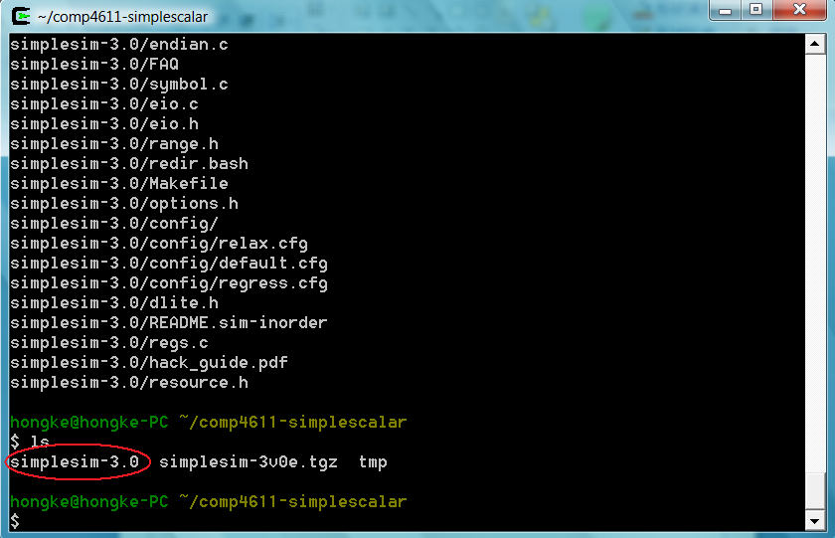
Where to get SimpleScalar
Extract the SimpleScalar package:
$ tar –xzvf simplesim-3v0e.tgz

Slide 7
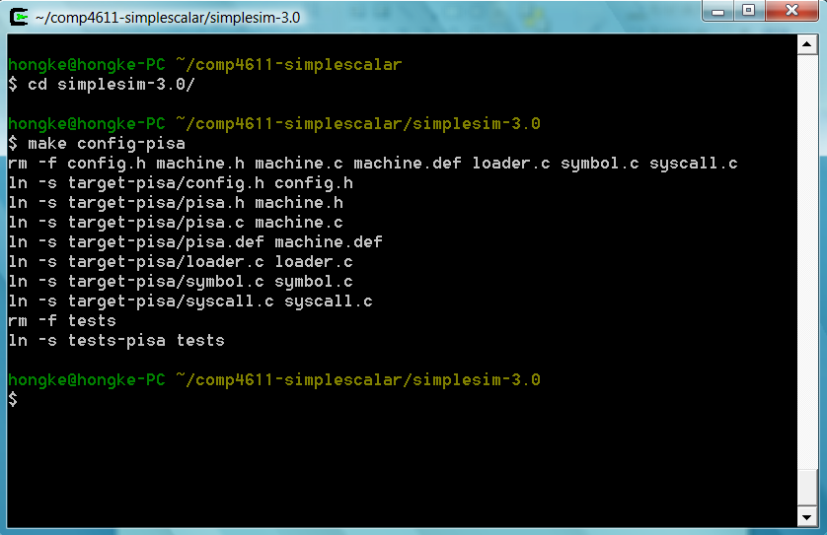
How to install SimpleScalar
Configure the installation target:
$ cd simplesim-3.0/
$ make config-pisa

Slide 8
What is PISA and Alpha
SimpleScalar can simulate programs in Alpha or PISA binary
PISA (Portable ISA) instruction set is a simple MIPS-like instruction set
Alpha ISA is a 64-bit RISC ISA

Slide 9
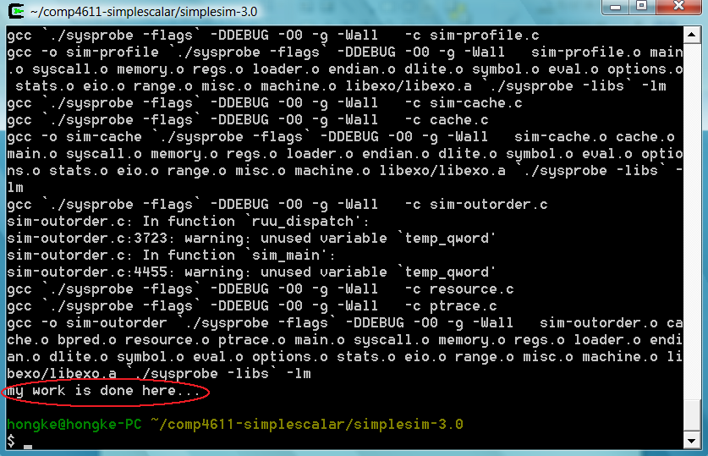
How to install SimpleScalar
Compile the source code of SimpleScalar:
$ make

Slide 10
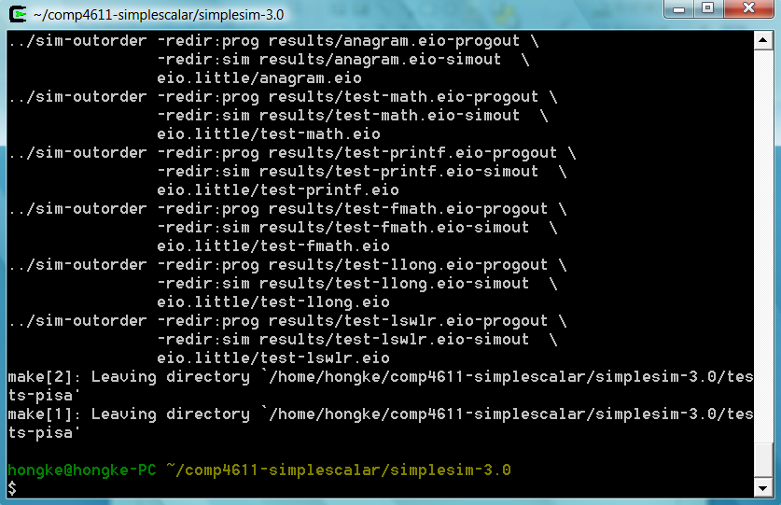
How to verify SimpleScalar works
Verify if the installation is successful:
$ make sim-tests

Slide 11
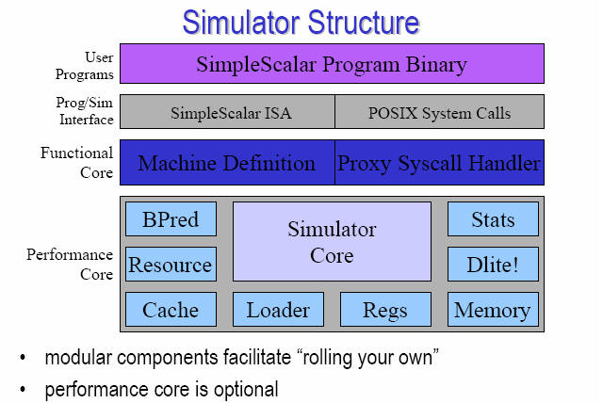
Structure of SimpleScalar
Where to get SimpleScalar program binary?

Slide 12
Exercise
How to install SimpleScalar for Alpha binary?
Clean the previous installation for PISA binary
$ cd simplesim-3.0
$ make clean
Configure the installation target:
$ make config-alpha
Compile the source code
Verify the installation

Slide 13
Benchmark on SimpleScalar
Download some benchmark programs at http://www.eecs.umich.edu/~taustin/eecs573_public/instruct-progs.tar.gz
Extract the benchmark package:
$ tar –xzvf instruct-progs.tar.gz
$ mv benchmarks simplesim-3.0/
$ cd simplesim-3.0
$ ls benchmarks/

Slide 14
Benchmark on SimpleScalar
Run GCC Alpha binary on SimpleScalar
$ cd benchmarks
$ ../sim-safe cc1.alpha -O 1stmt.i
Compare the simulation result:
$ diff 1stmt.s 1stmt.s.ref
simulator program
Alpha binary
Input file

Slide 15
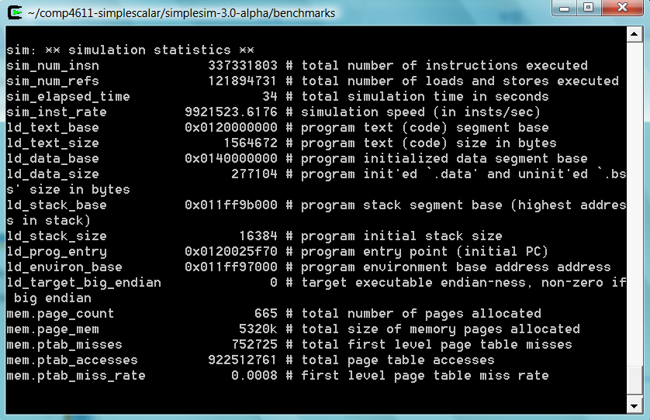
Simulation Summary

Slide 16
Benchmark on SimpleScalar
Run GO Alpha binary on SimpleScalar
$ cd benchmarks
$ ../sim-safe go.alpha 50 9 2stone9.in > OUT
Compare the simulation result:
$ diff OUT go.out

Slide 17
Introduction to PISA objdump
A tool for disassembling PISA binary code into PISA assembly code
Manual of objdump available at http://sourceware.org/binutils/docs/binutils/objdump.html

Slide 18
Install PISA objdump and gcc
Download objdump and gcc for PISA at http://www.eecg.toronto.edu/~moshovos/ACA06/files/ss-gcc.usrlocal.tar.bz
Install objdump and gcc for PISA:
$ tar –cvjf ss-gcc.usrlocal.tar.bz
$ tar –xvjf ss-gcc.usrlocal.tar.bz
$ mv usr/local/ss /usr/local
$ cd usr/loca/bin
$ ls ss-gcc ss-objdump

Slide 19
PISA objdump Demo
A simple C program – hello.c
int main()
{
int i, a;
a = 2;
for (i = 0; i < 1000; i++)
a++;
}

Slide 20
PISA objdump Demo
Compile hello.c into PISA binary code – hello
$ ./ss-gcc -o hello hello.c
Disassemble hello into PISA assembly code – hello.asm
$ ./ss-objdump -d hello > hello.asm
$ less hello.asm

Slide 21
PISA assembly of main()
004001f0 <main> addiu/00 $sp[29],$sp[29],-32
004001f8 <main+8> sw/00 $ra[31],28($sp[29])
00400200 <main+10> sw/00 $s8[30],24($sp[29])
00400208 <main+18> addu/00 $s8[30],$zero[0],$sp[29]
00400210 <main+20> jal/00 00400468 <__main>
00400218 <main+28> addiu/00 $v0[2],$zero[0],2
00400220 <main+30> sw/00 $v0[2],20($s8[30])
00400228 <main+38> sw/00 $zero[0],16($s8[30])
00400230 <main+40> lw/00 $v0[2],16($s8[30])
00400238 <main+48> slti/00 $v1[3],$v0[2],1000
00400240 <main+50> bne/00 $v1[3],$zero[0],00400250 <main+60>
00400248 <main+58> j/00 00400298 <main+a8>
00400250 <main+60> lw/00 $v1[3],20($s8[30])

Slide 22
PISA assembly of main()
00400258 <main+68> addiu/00 $v0[2],$v1[3],1
00400260 <main+70> addu/00 $v1[3],$zero[0],$v0[2]
00400268 <main+78> sw/00 $v1[3],20($s8[30])
00400270 <main+80> lw/00 $v1[3],16($s8[30])
00400278 <main+88> addiu/00 $v0[2],$v1[3],1
00400280 <main+90> addu/00 $v1[3],$zero[0],$v0[2]
00400288 <main+98> sw/00 $v1[3],16($s8[30])
00400290 <main+a0> j/00 00400230 <main+40>
00400298 <main+a8> addu/00 $sp[29],$zero[0],$s8[30]
004002a0 <main+b0> lw/00 $ra[31],28($sp[29])
004002a8 <main+b8> lw/00 $s8[30],24($sp[29])
004002b0 <main+c0> addiu/00 $sp[29],$sp[29],32
004002b8 <main+c8> jr/00 $ra[31]

Slide 23
hello on SimpleScalar
Simulate hello binary on SimpleScalar
$ cp hello ~/simplesim-3.0
$ cd ~/simplesim-3.0
$ ./sim-safe –v hello &> hello.ss
$ less hello.ss
$ cat hello.ss | grep ‘bne’ | wc
$ cat hello.ss | grep ‘j/’ | wc

Slide 24
Instruction Statistics
Static instruction statistics is the statistics about the program’s binary code (i.e. how many instructions are there in the program)
Dynamic instruction statistics is the statistics of the dynamic instruction flow fetched and executed by the processor

Slide 25
Instruction Statistics of hello
What is the static instruction count in main() of hello?
What is one instruction that is executed most frequently by processors in main() of hello?

Slide 26
Calculate CPI of hello
For a given program, CPI = Total program execution cycles / Instruction count
Is Instruction count equal to static or dynamic instruction count?
How to get Total program execution cycles? (Hint: SimpleScalar summary)

Slide 27
References
SimpleScalar LLC: www.simplescalar.com
Setting up Cygwin: cygwin.com/cygwin-ug-net/setup-net.html
Introduction to SimpleScalar: www.ecs.umass.edu/ece/koren/architecture/Simplescalar/SimpleScalar_introduction.htm
GCC port for SimpleScalar: www.eecg.toronto.edu/~moshovos/ACA06
GNU objdump: sourceware.org/binutils/docs/binutils/objdump.html

