Slide 1

COMP4611 Tutorial 6
Instruction Level Parallelism

Slide 2
Instruction Level Parallelism
Definition
  An implementation technique whereby multiple instructions are overlapped in execution
Two separate approaches to exploiting ILP
  Hardware support to help discover and exploit the parallelism dynamically
  Software technology to find parallelism statically

Slide 3
Instruction Level Parallelism
Few possibilities in a basic block
  A straight-line code sequence
    no branches in except to the entry
    no branches out except at the exit
  Blocks are small (6-7 instructions)
  Instructions are likely to depend upon one another
Goal: Exploit ILP across multiple basic blocks
  Example: loop-level parallelism
    for (i = 1000; i > 0; i=i-1)
    x[i] = x[i] + s;

Slide 4
Basic Scheduling
Sequential MIPS Assembly Code
Loop: LD F0, 0(R1)
ADDD F4, F0, F2
SD 0(R1), F4
SUBI R1, R1, #8
BNEZ R1, Loop
for (i = 1000; i > 0; i=i-1)
x[i] = x[i] + s;
Pipelined execution:
Loop: LD F0, 0(R1) 1
stall 2
ADDD F4, F0, F2 3
stall 4
stall 5
SD 0(R1), F4 6
SUBI R1, R1, #8 7
stall 8
BNEZ R1, Loop 9
stall 10
Scheduled pipelined execution:
Loop: LD F0, 0(R1) 1 SUBI R1, R1, #8 2
ADDD F4, F0, F2 3
stall 4
BNEZ R1, Loop 5
SD 8(R1), F4 6
Data dependency

Slide 5
Loop Unrolling
Loop: LD F0, 0(R1)
ADDD F4, F0, F2
SD 0(R1), F4
SUBI R1, R1, #8
BEQZ R1, Exit
LD F6, 0(R1)
ADDD F8, F6, F2
SD 0(R1), F8
SUBI R1, R1, #8
BEQZ R1, Exit
LD F10, 0(R1)
ADDD F12, F10, F2
SD 0(R1), F12
SUBI R1, R1, #8
BEQZ R1, Exit
LD F14, 0(R1)
ADDD F16, F14, F2
SD 0(R1), F16
SUBI R1, R1, #8
BNEZ R1, Loop
Exit:
Pros:
- Larger basic block
- More scope for
scheduling
- Eliminating
dependencies
Cons:
- Increases code size
Comment:
- Often a precursor
step for other
optimizations
Definition:
Replicates
the loop body
multiple times
Use different registers
to avoid unnecessary
constraints

Slide 6

Possible hazards – Data hazard
RAW (read after write)
  j tries to read a source before
  i writes it, so j incorrectly gets
  the old value.
WAW (write after write)
  j tries to write an operand
  before it is written by i
WAR (write after read)
  j tries to write a destination
  before it is read by i, and i
  incorrectly gets the new value.
  Longer operation latency
  more frequent stalls
Happen when
write in more than one pipe stage
one instruction proceed when
previous one is stalled
Happen when instructions
are reordered

Slide 7
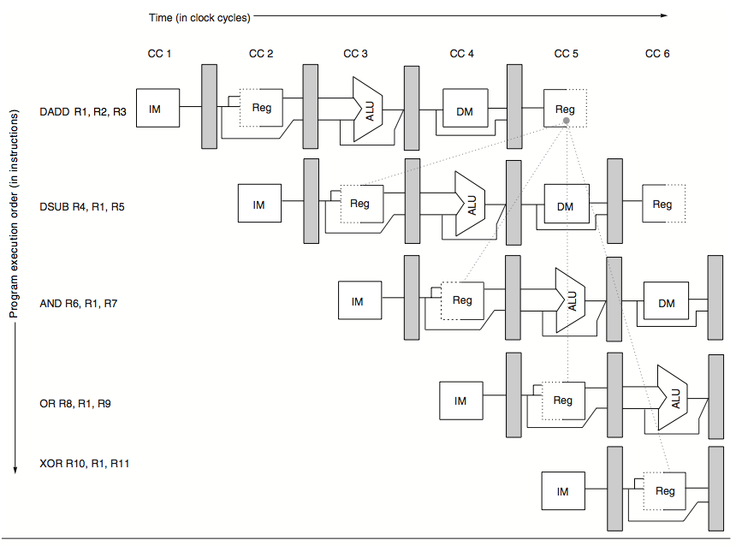
Possible hazards – Data hazard

Slide 8
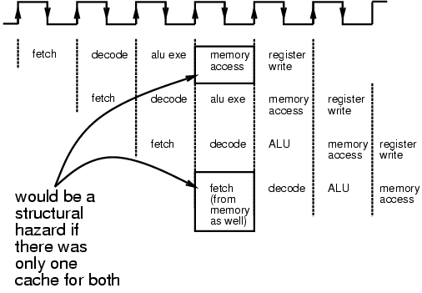


Possible hazards – Structural hazard
Structural hazard
  Resource conflicts for some
  combination of instructions
Happen when the overlapped
execution of instructions requires
to use the same functional unit.

Slide 9
Possible hazards – Control hazard
Control hazard
  A control hazard is when we need to find the destination of a branch, and can’t fetch any new instructions until we know that destination.
  A branch is either taken or not taken
  Taken: PC<=PC+4+immediate
  Not Taken: PC<=PC+4

Slide 10
Example 1
Consider a machine with multi-cycle functional units that is an extension of the 5 stage pipeline machine (IF ID EX MEM WB).
Integer operations have 1 EX stage, FP Add has 3 EX stages and FP multiply has 8 EX stages.
Each FP unit is pipelined and the pipeline supports full forwarding.
All other stages in the pipeline complete in one cycle. Branches are resolved in the ID stage.
For WAW hazards, assume that they are resolved through stalls and not through aborting the first instruction.
List all of the hazards that cause stalls in the following code segment and explain why they occur.

Slide 11
Example 1
Loop : 1) L.D F2, 0(R1)
2) L.D F3, 8(R1)
3) L.D F4, 16(R1)
4) L.D F5, 24(R1)
5) MUL.D F7, F4, F3
6) MUL.D F9, F3, F2
7) ADD.D F6, F7, F5
8) ADD.D F8, F4, F5
9) S.D F6, 16(R1)
10) S.D F8, 24(R1)
11) DADDI R1, R1, -32
12) BNEZ R1, loop
RAW hazard
on F7
RAW hazard
on R1

Slide 12
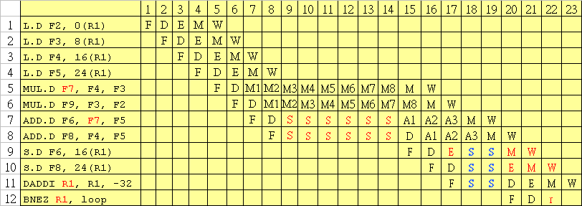
Example 1
line 7 RAW hazard on F7
line 12 RAW hazard on R1
Structural hazard
for M

Slide 13
Exercise
The following loop is a dot product:
  foo: L.D F0, 0(R1) ;load X[i]
  L.D F4, 0(R2) ;load Y[i]
  MUL.D F0, F0, F4 ;multiply X[i]*Y[i]
  ADD.D F2, F0, F2 ;add sum=sum+X[i]*Y[i]
  ADDUI R1, R1, #-8 ;decrement X index
  ADDUI R2, R2, #-8 ;decrement Y index
  BNEZ R1, foo ;loop if not done
Assume
  the pipeline latencies from Table 1,
  a 1-cycle delay branch.
  a single-issue pipeline.
  the running sum in F2 is initially 0.
  despite the fact that the loop is not parallel, it can be scheduled with no delays.

Slide 14
Table 1
Instruction producing result | Instruction using result | Latency in clock cycles
FP ALU op | FP ALU op | 3
FP ALU op | Store double | 2 (ignore the structural hazard)
Load double | FP ALU op | 1
Load double | Store double | 0
Integer op | Integer op | 0

Slide 15
Exercise (cont.)
Unroll the loop a sufficient number of times to schedule it without any delays. Show the delay after eliminating any unnecessary branch maintenance instructions.
Hint: an scheduling of the code is needed

Slide 16
Exercise: Data Dependency
  L.D F0, 0(R1)
  L.D F4, 0(R2)
  stall
  MUL.D F0, F0, F4
  stall
  stall
  stall
  ADD.D F2, F0, F2
  ADDUI R1, R1, #-8
  ADDUI R2, R2, #-8
  BNEZ R1, foo
  stall
1 clock cycle
3 clock cycles

Slide 17
Unrolling Twice
  L.D F0, 0(R1)
  L.D F4, 0(R2)
  stall
  MUL.D F0, F0, F4
  Stall
  Stall
  stall
  ADD.D F2, F0, F2
  ADDUI R1, R1, #-8
  ADDUI R2, R2, #-8
  BNEZ R1, foo
  stall
  L.D F6, -8(R1)
  L.D F8, -8(R2)
  stall
  MUL.D F6, F6, F8
  Stall
  Stall
  Stall
  ADD.D F2, F6 , F2
  ADDUI R1, R1, #-16
  ADDUI R2, R2, #-16
Using
different registers

Slide 18
New method
Solution
  - Calculate the partial sum for even and odd elements separately
  - Combine the result in the end. ( F2, F10 )
Foo:
  L.D F0, 0(R1)
  L.D F6, -8(R1)
  L.D F4, 0(R2)
  L.D F8, -8(R2)
  MUL.D F0, F0, F4
  MUL.D F6, F6, F8
  ADDUI R1, R1, #-16
  ADDUI R2, R2, #-16
  ADD.D F2, F0, F2
  BNEZ R1, foo
  ADD.D F10, F6, F10
  ADD.D F2, F2, F10
Loop body takes 11 cycles
Bar:

Slide 19
Dynamic Scheduling
Advantages
  Enables handling some cases when dependencies are unknown at compile time
  Allows code that was compiled with one pipeline in mind to run efficiently on a different pipeline
  Allows Out-of-order execution, Out-of-order completion
DIVD F0, F2, F4
ADDD F10, F0, F8 (stall)
SUBD F12, F8, F14 (have to wait)

Slide 20
Tomasulo Algorithm
Designed to overcome long memory access and floating point delays.
RAW hazards are avoided by executing an instruction only when its operands are available.
WAR and WAW hazards arised from name dependencies, are eliminated by register renaming.
Registers in instructions are replaced by values or pointers to reservation stations.
The Common Data Bus (CDB) is used to bypass the registers and pass the results from the reservation stations directly to the functional units.

Slide 21
Tomasulo Organization
From Mem
FP Op
Queue
FP Registers
Load Buffers
Load1
Load2
Load3
Load4
Load5
Load6
Store
Buffers
Add1
Add2
Add3
Mult1
Mult2
Reservation
Stations
To Mem
FP adders
FP multipliers
Common Data Bus (CDB)

Slide 22
Reservation Station Components
Busy: Indicates reservation station or FU is busy
Op: Operation to perform in the unit (e.g., + or –)
Vj, Vk: Value of Source operands
Qj, Qk: Reservation stations producing source registers (value to be written)
  Note: Qj,Qk=0 => ready
A: effective address

Slide 23
Three Stages of Tomasulo Algorithm
Issue —get instruction from FP Op Queue
  If reservation station free (no structural hazard),
  control issues the instruction & sends operands (renames registers).
Execute —operate on operands (EX)
  When both operands ready then execute;
  if not ready, watch CDB for result
Write result —finish execution (WB)
  Write on CDB to all awaiting units; mark reservation station available

Slide 24
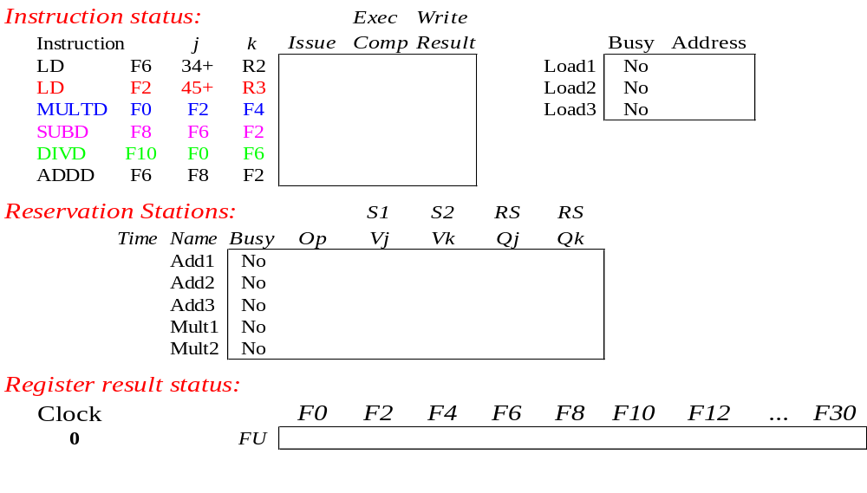
Tomasulo Example (Cycle 0)
FP Latency: Add = 2 cycles, Multiply = 10, Divide = 40
Load takes 2 cycles in execution stage
Notes:
Reference: http://bwrc.eecs.berkeley.edu/Classes/CS152/lectures/lec17-tomasulo.ppt

Slide 25
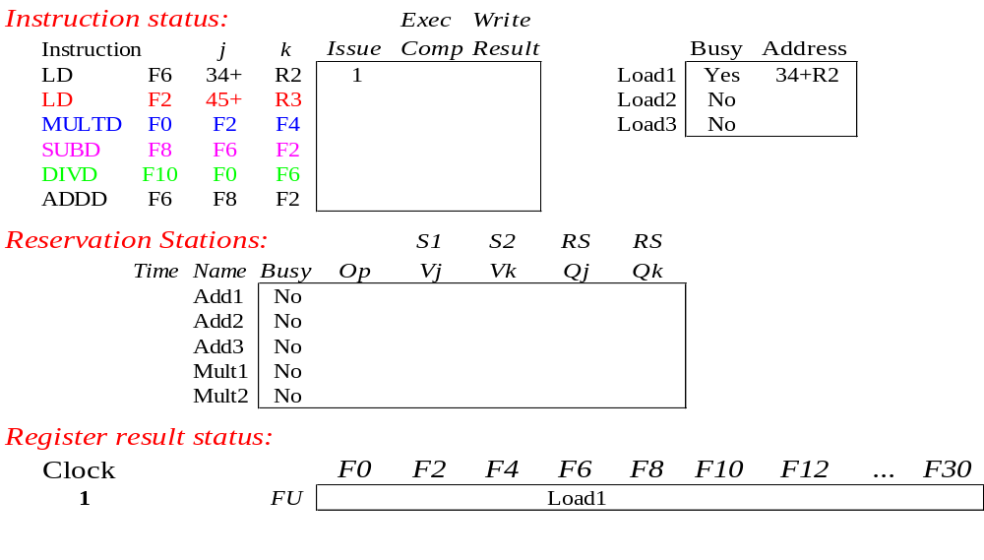
Tomasulo Example (Cycle 1)
FP Latency: Add = 2 cycles, Multiply = 10, Divide = 40
Load takes 2 cycles in execution stage
Notes:
Reference: http://bwrc.eecs.berkeley.edu/Classes/CS152/lectures/lec17-tomasulo.ppt

Slide 26
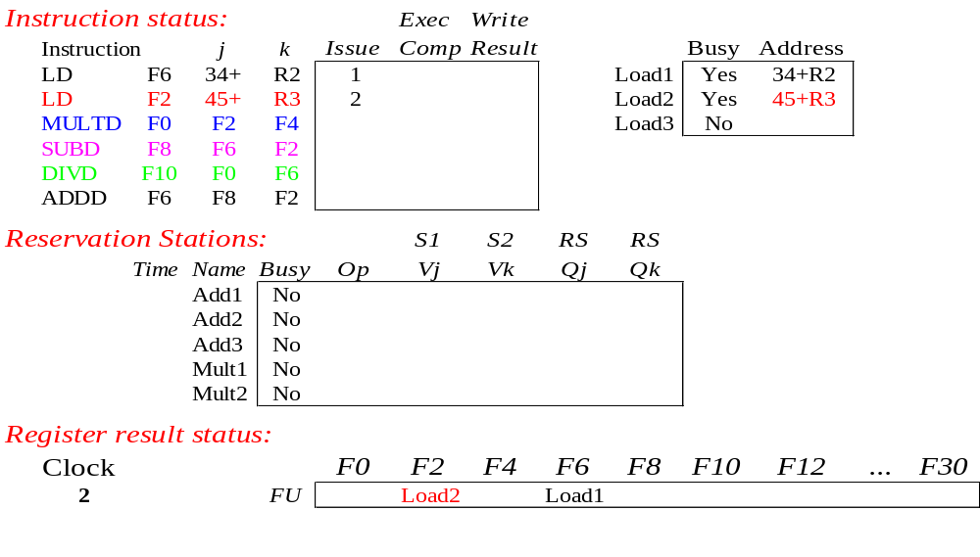
Tomasulo Example (Cycle 2)
FP Latency: Add = 2 cycles, Multiply = 10, Divide = 40
Load takes 2 cycles in execution stage

Slide 27
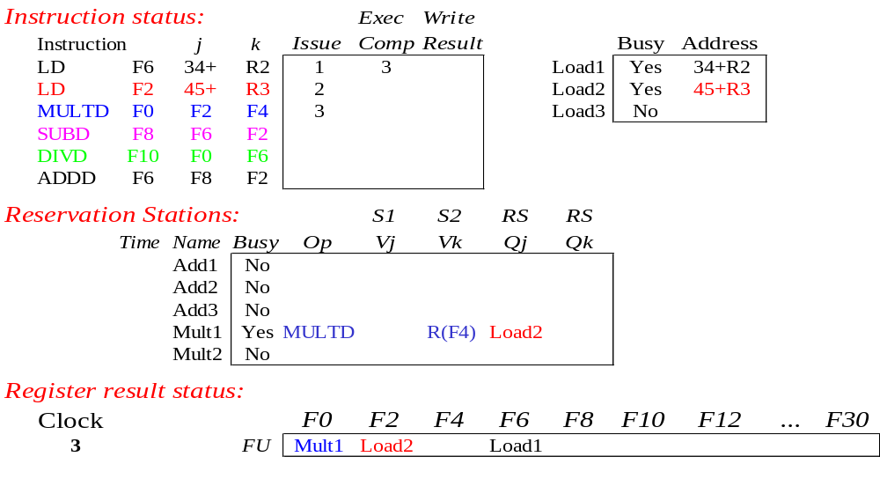
Tomasulo Example (Cycle 3)
FP Latency: Add = 2 cycles, Multiply = 10, Divide = 40
Load takes 2 cycles in execution stage

Slide 28
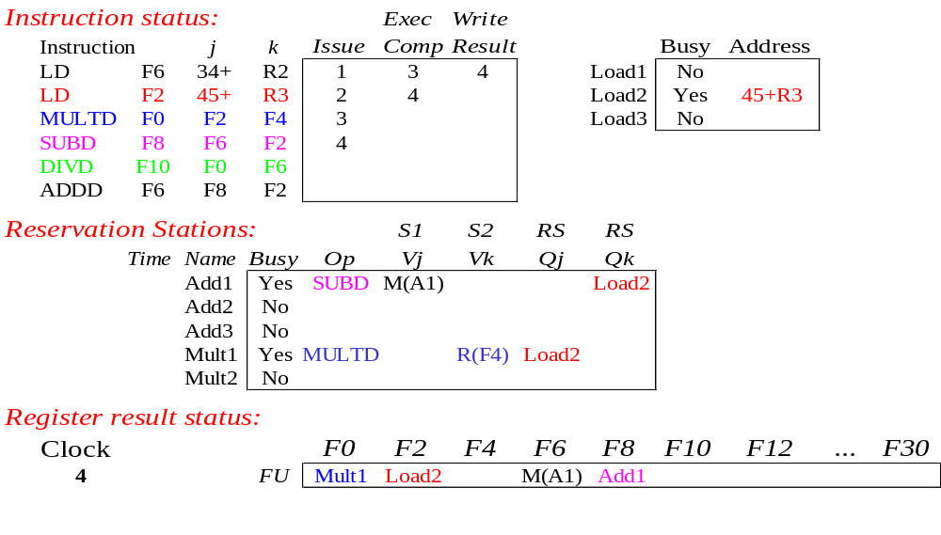
Tomasulo Example (Cycle 4)
FP Latency: Add = 2 cycles, Multiply = 10, Divide = 40
Load takes 2 cycles in execution stage

Slide 29
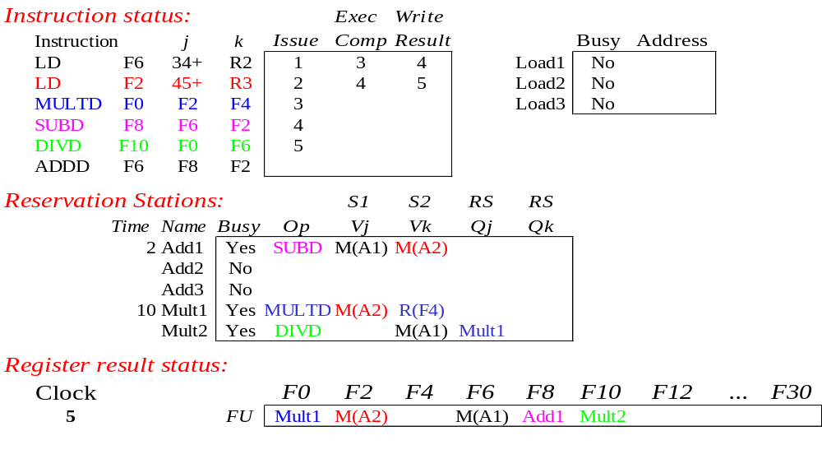
Tomasulo Example (Cycle 5)
FP Latency: Add = 2 cycles, Multiply = 10, Divide = 40
Load takes 2 cycles in execution stage

Slide 30
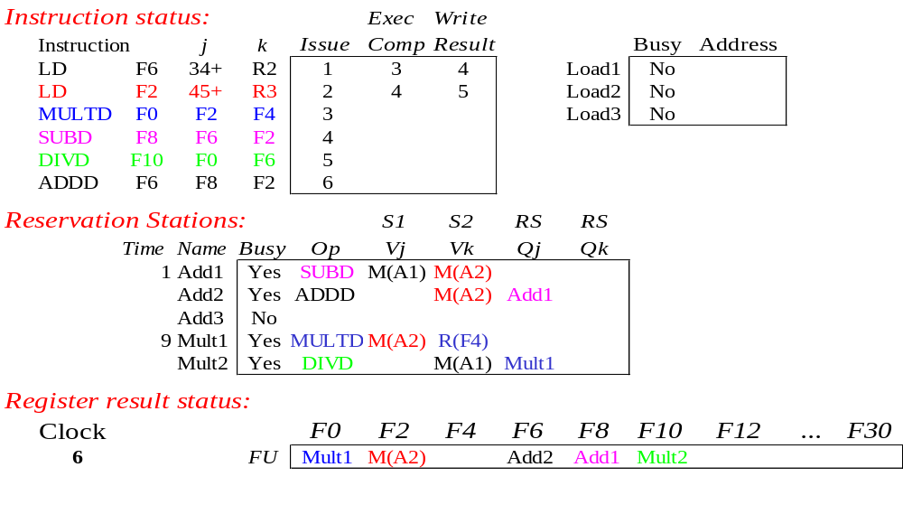
Tomasulo Example (Cycle 6)
FP Latency: Add = 2 cycles, Multiply = 10, Divide = 40
Load takes 2 cycles in execution stage

Slide 31

Tomasulo Example (Cycle 7)
FP Latency: Add = 2 cycles, Multiply = 10, Divide = 40
Load takes 2 cycles in execution stage

Slide 32
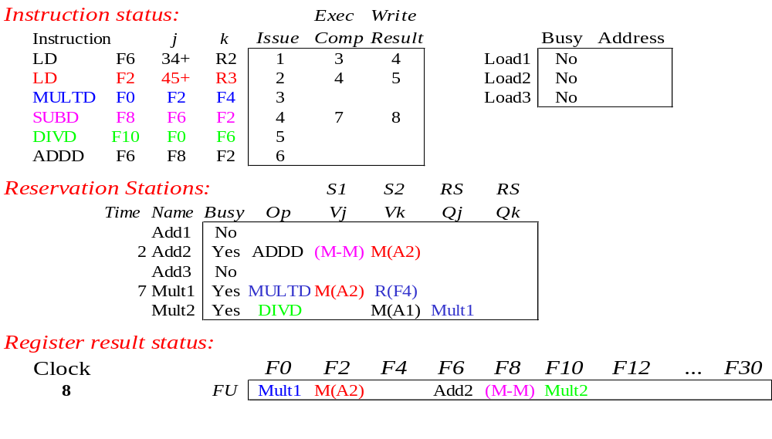
Tomasulo Example (Cycle 8)
FP Latency: Add = 2 cycles, Multiply = 10, Divide = 40
Load takes 2 cycles in execution stage

Slide 33

Tomasulo Example (Cycle 10)
FP Latency: Add = 2 cycles, Multiply = 10, Divide = 40
Load takes 2 cycles in execution stage

Slide 34
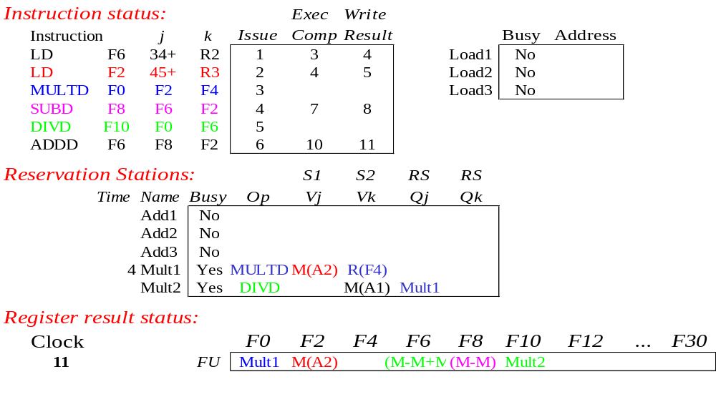
Tomasulo Example (Cycle 11)
FP Latency: Add = 2 cycles, Multiply = 10, Divide = 40
Load takes 2 cycles in execution stage

Slide 35
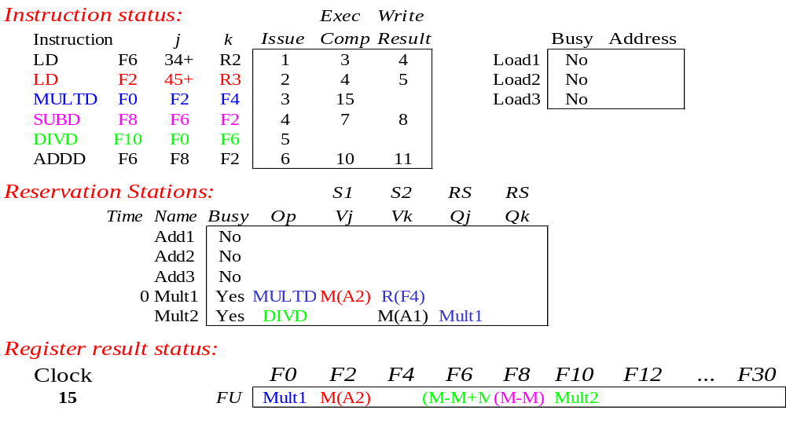
Tomasulo Example (Cycle 15)
FP Latency: Add = 2 cycles, Multiply = 10, Divide = 40
Load takes 2 cycles in execution stage

Slide 36
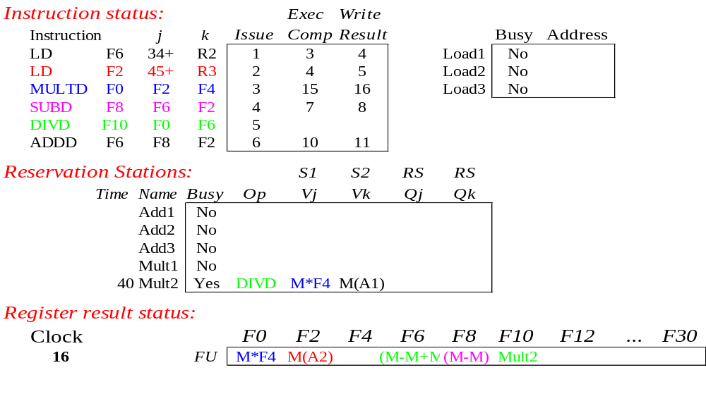
Tomasulo Example (Cycle 16)
FP Latency: Add = 2 cycles, Multiply = 10, Divide = 40
Load takes 2 cycles in execution stage

Slide 37
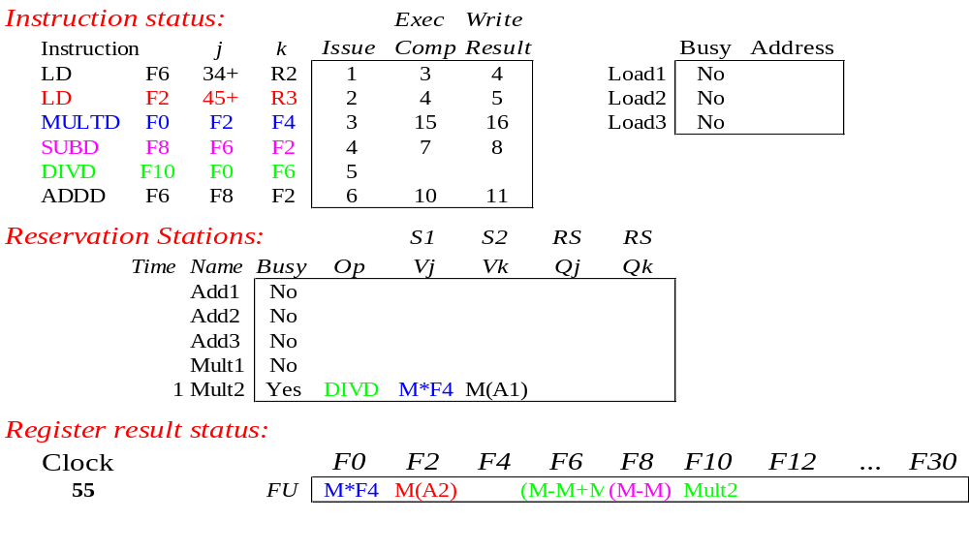
Tomasulo Example (Cycle 55)
FP Latency: Add = 2 cycles, Multiply = 10, Divide = 40
Load takes 2 cycles in execution stage

Slide 38
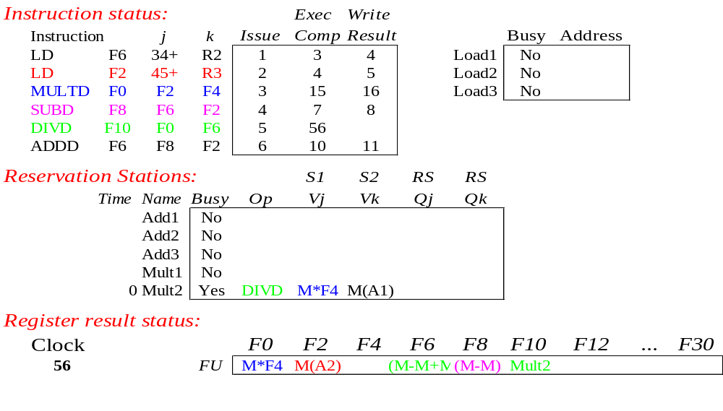
Tomasulo Example (Cycle 56)
FP Latency: Add = 2 cycles, Multiply = 10, Divide = 40
Load takes 2 cycles in execution stage

Slide 39
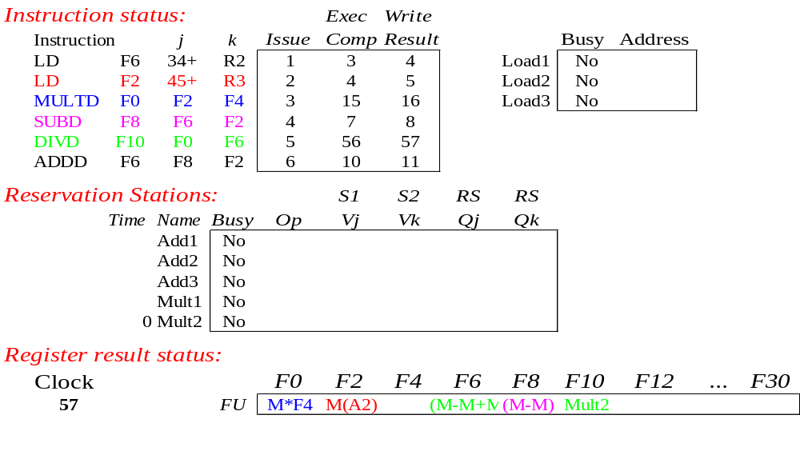
Tomasulo Example (Cycle 57)
FP Latency: Add = 2 cycles, Multiply = 10, Divide = 40
Load takes 2 cycles in execution stage
  In-order issue,
  Out-of-order execute and commit

