Slide 1
Gaze Tracking Using Webcam
Faculty Advisor
Professor Jiebo Luo
University of Rochester
Computer Science Department
Presenter
Phyo Thiha
University of Rochester
Computer Science Department

Slide 2

Project’s Goal

Slide 3
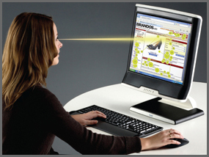
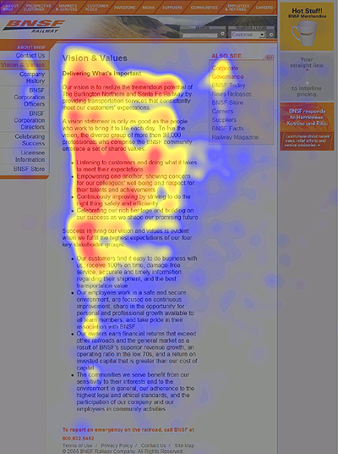
Motivation
Web Usability Testing
Image Credit: http://www.interactivevideo.com
Image Credit: http://www.useit.com

Slide 4
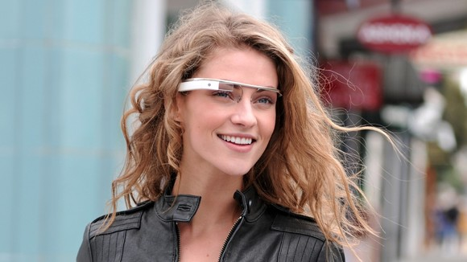
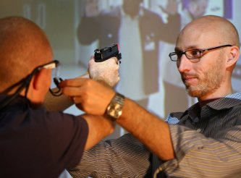
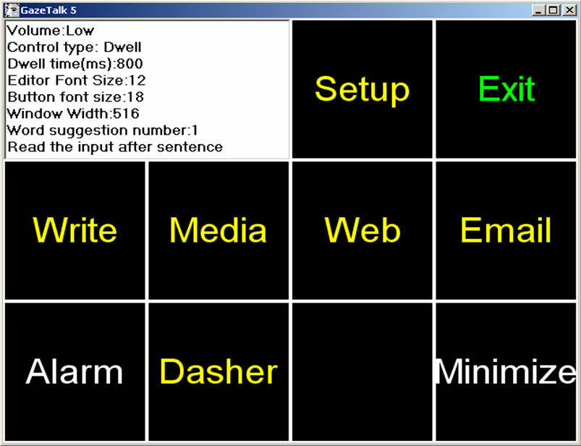
Other Usages
Google’s Project Glass
Military/Police Training
Image Credit: http://www.techradar.com
Image Credit: http://www.mtu.edu
Gaze-based Text Entry
Image Credit: http://www.gazegroup.org

Slide 5
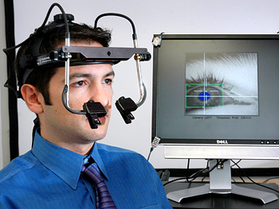
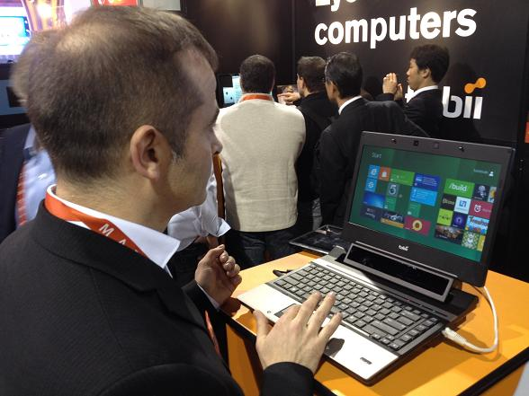
Different Approaches
Head-mounted
Infrared
Image Credit: http://facelab.uwaterloo.ca
Image Credit: http://www.newscientist.com
Notes:
Require special equipment. And a bit annoying for user (constrains the user). But good accuracy.

Slide 6
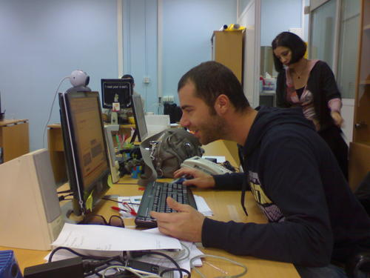
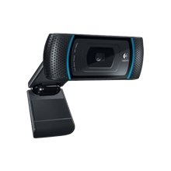
My Approach
Webcam-based tracking
Logitech HD Pro C910
Resolution: 1280x720
Cost: $61

Slide 7
Existing Applications
Coxlab <https://github.com/coxlab/eyetracker>
ITU Gaze Tracker <http://www.gazegroup.org>
Opengazer <http://www.inference.phy.cam.ac.uk/opengazer/>
TrackEye
<http://www.codeproject.com/Articles/26897/TrackEye-Real-Time-Tracking-Of-Human-Eyes-Using-a>
Notes:
A lot of commercial apps out there, but almost all of them requires you to wear head mounted gear or comes with expensive suite. The ones with web cam are rarely commercialized (probably due to their limited accuracy). There are a few freely available ones out there, but most of them aren’t open source and the ones that are open source are poorly documented and very hard to build. Toiled with that for about a week and a half.

Slide 8
Main Dependencies
SimpleCV <http://simplecv.org/>
PyBrain <http://pybrain.org/>
Orange <http://orange.biolab.si/>
Pylab <http://www.scipy.org/PyLab>
SciPy/NumPy <http://numpy.scipy.org/>
Notes:
Main ones. What each of them are. Why choose – open source and pretty well known with active support groups

Slide 9
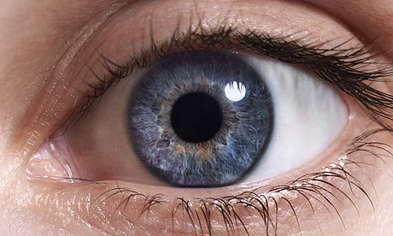
Human Eye
Iris
Glint
Pupil

Slide 10
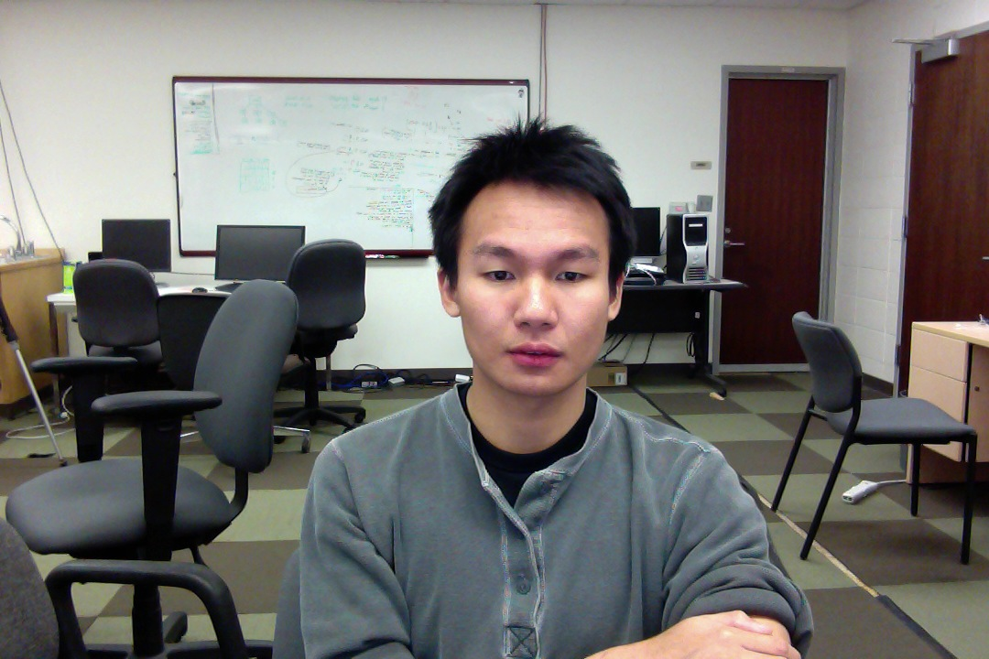
Finding the Eyes

Slide 11
Finding the Eyes
Find the face

Slide 12
Finding the Eyes
Find the eyes
Notes:
That’s cheaper

Slide 13
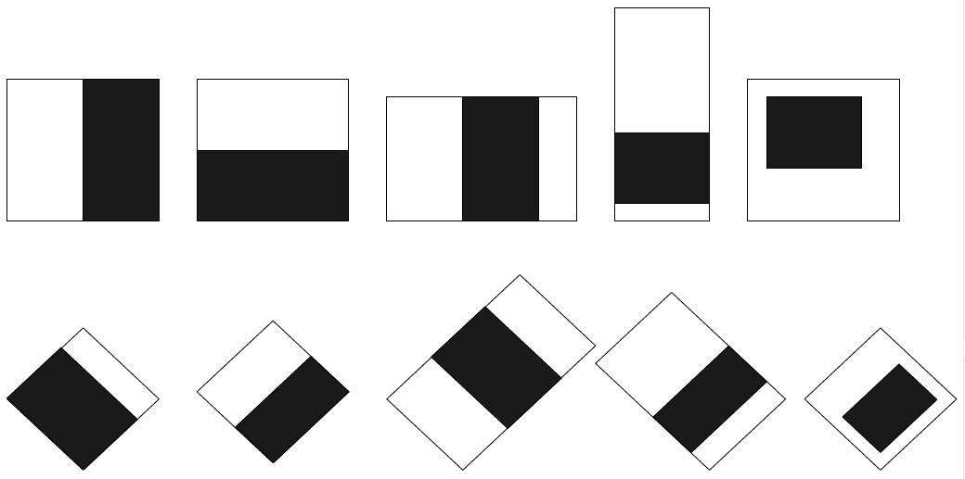
How did I Find the Face and the Eyes?
Haar-like Features
Viola-Jones’ Cascade Architecture

Slide 14
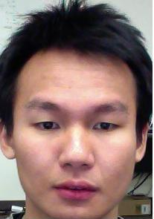
After Finding Both Eyes
Notes:
Take the left-third of the box

Slide 15
After Finding Both Eyes
Only the Left Eye is Used
Notes:
Because it’s redundant to be searching for both eyes since if your eyes are staring at a place, both eyes should be pointing in that direction unless you have some sort of anormaly

Slide 16
Left Eye is Extracted
Notes:
After much experimentation and hacking, I found a way to reliably exract the blob of the Iris. NOT the glint though because unfortunately the resolution is too poor (and the picture is too small) to detect the glint reliably. The left eye images are 25x20px.

Slide 17
Blob Extraction To Obtain Iris
Notes:
Hue Distance, I tried.

Slide 18
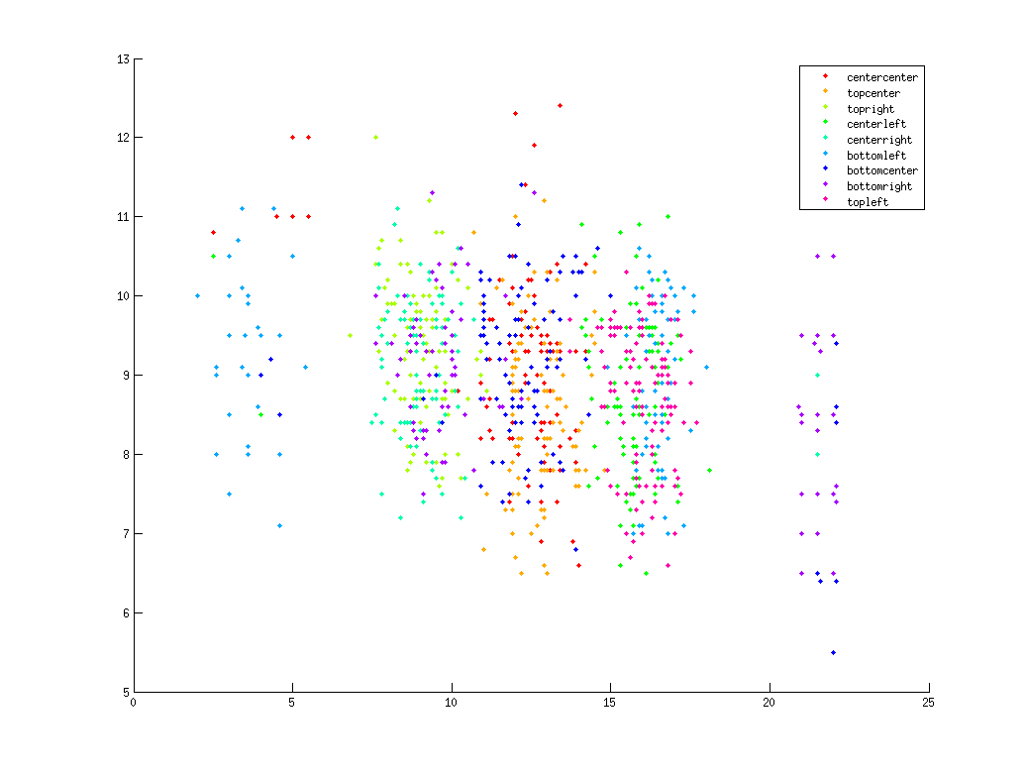
Centroid of the Iris
X vs Y

Slide 19
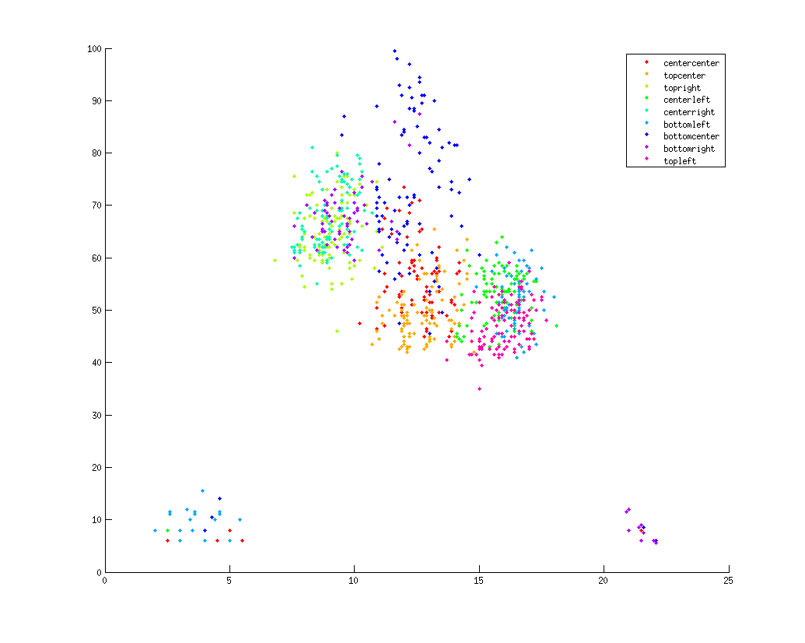
X vs. Area of the Iris

Slide 20
Machine Learning to the Rescue!
Support Vector Machines (SVM)
K-Nearest Neighbors (KNN)
Feed-Forward Neural Network (FNN)

Slide 21
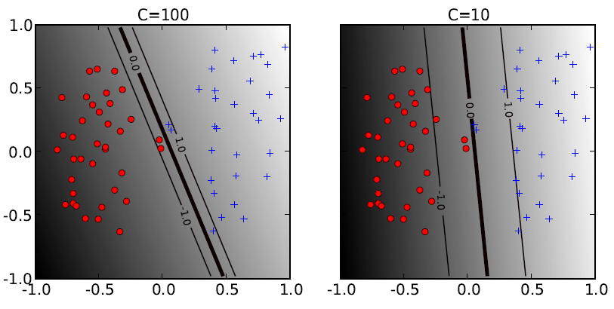
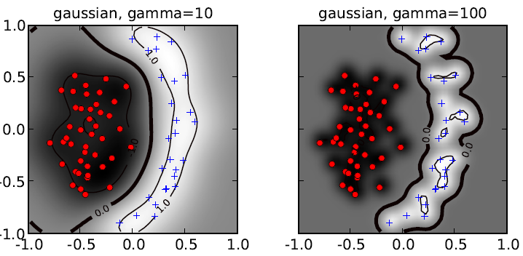
Support Vector Machines (SVM)
Binary Image as Input
Kernels – RBF, Linear, Poly, Sigmoid
Parameters – c, gamma, coefficient

Slide 22
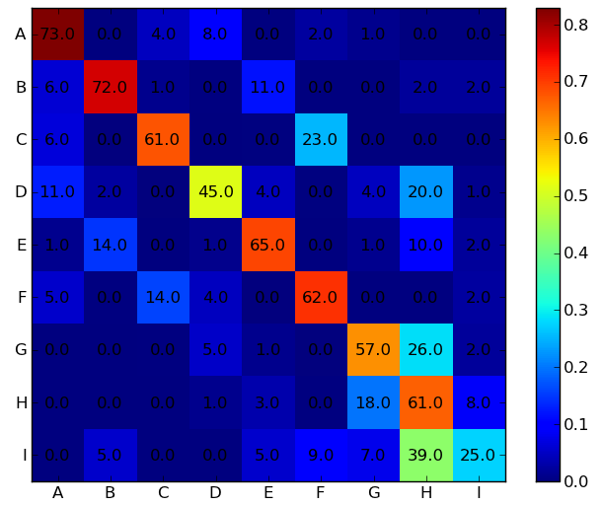
Best SVM Result
Polynomial of Degree 5
Coefficient ~40
Accuracy ~65%
Notes:
The bigger the polynomial, the better. But only up to 5. Beyond that is very little advantage with large overhead in computation time. One classifier was trained for about two hours with a degree of 9

Slide 23
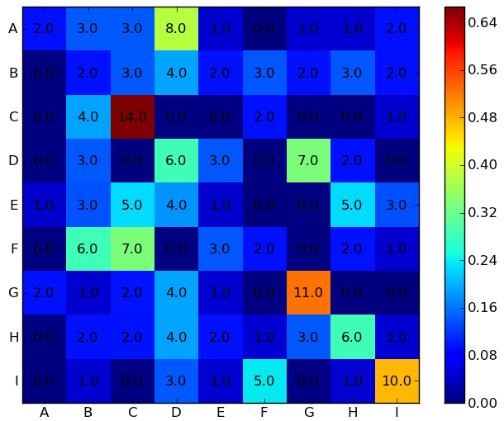
K-Nearest Neighbors
Distance Metrics – Hamming, Manhattan, Euclidean
Accuracy ~20%
Notes:
Bad because features that I was feeding to the network were just array of binary values representing each image.

Slide 24
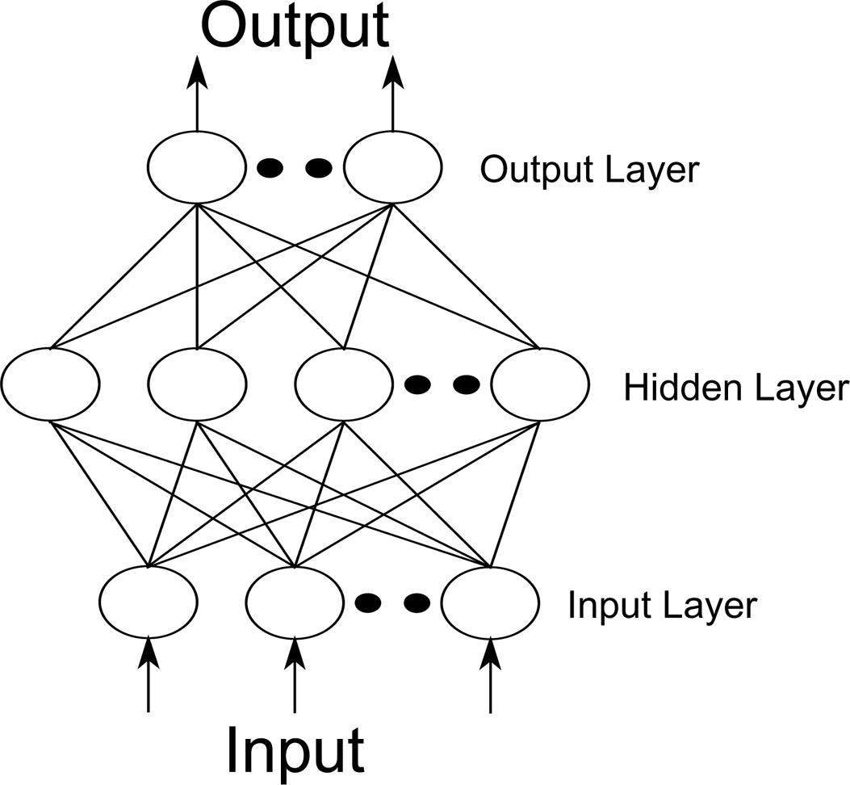
Feed-Forward Neural Network
Backpropagation
Input → Binary Img.
Hidden → 40
Output → 9
Max. Iteration → 80
Image Credit: http://www.emeraldinsight.com

Slide 25
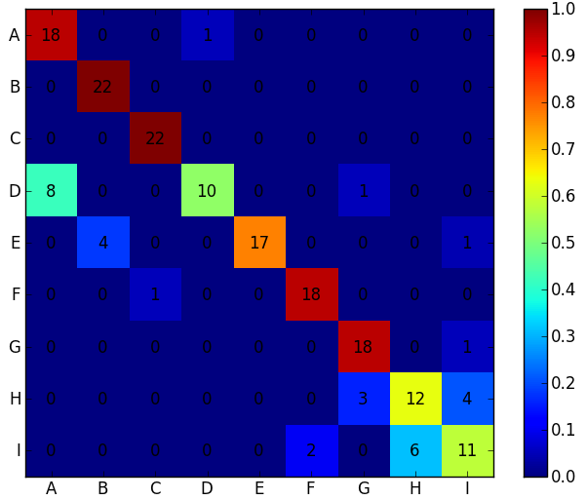
Best Neural Network Result
Accuracy ~80%

Slide 26
Evaluation
Requires Training
Dependent on Screen Size
Effect of Lighting
Simple Approach
Somewhat Robust to Head Movmnt.
Room for Improvement
Notes:
Lacks Smooth Transitioning between frames
Low Cost.

Slide 27
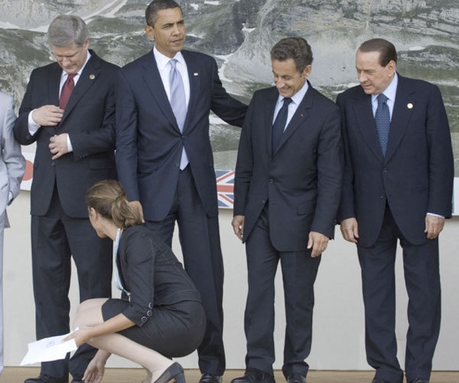
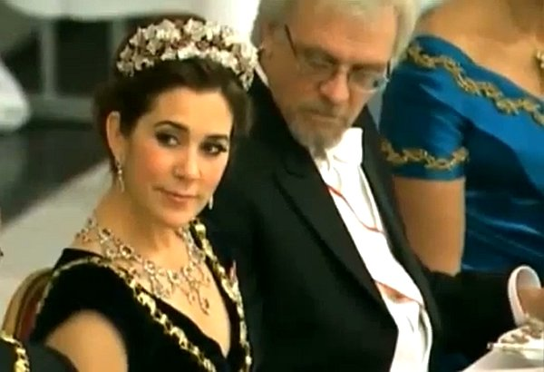
What’s Next?
Image Credit: http://www.huffingtonpost.com
Image Credit: http://dailypicksandflicks.com

Slide 28
THANKS
Open-Source Community
and
YOU
Code @
<github.com/plartoo>
Notes:
And Professor Luo

