Slide 1
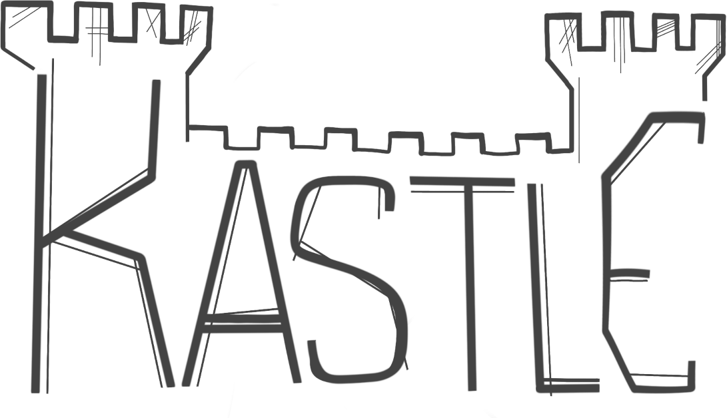
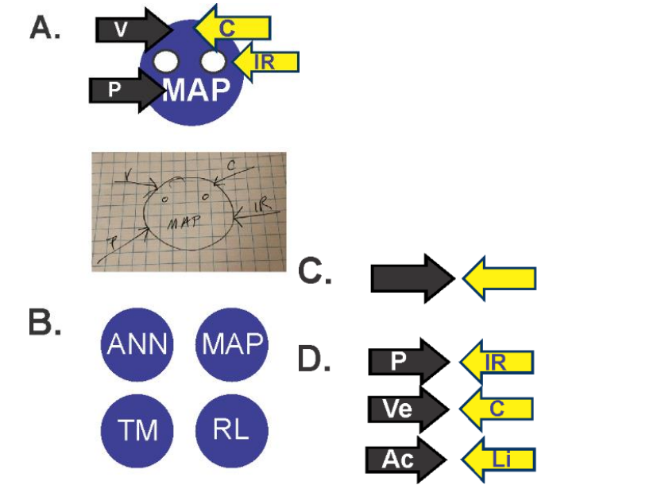
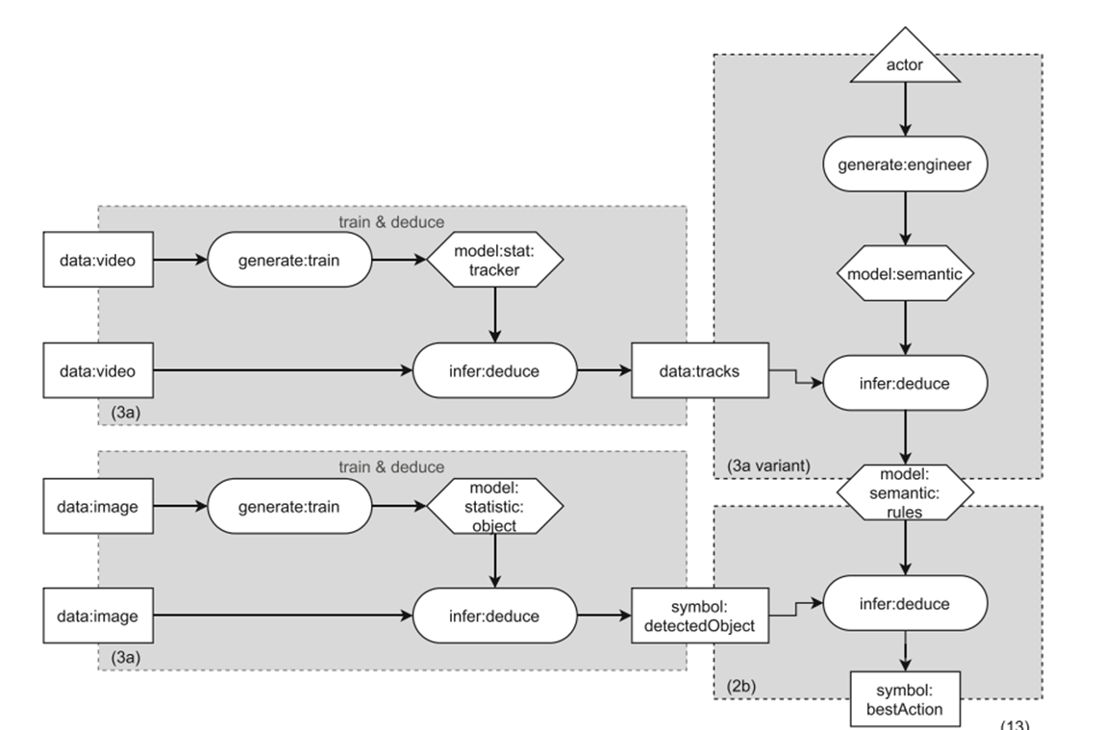
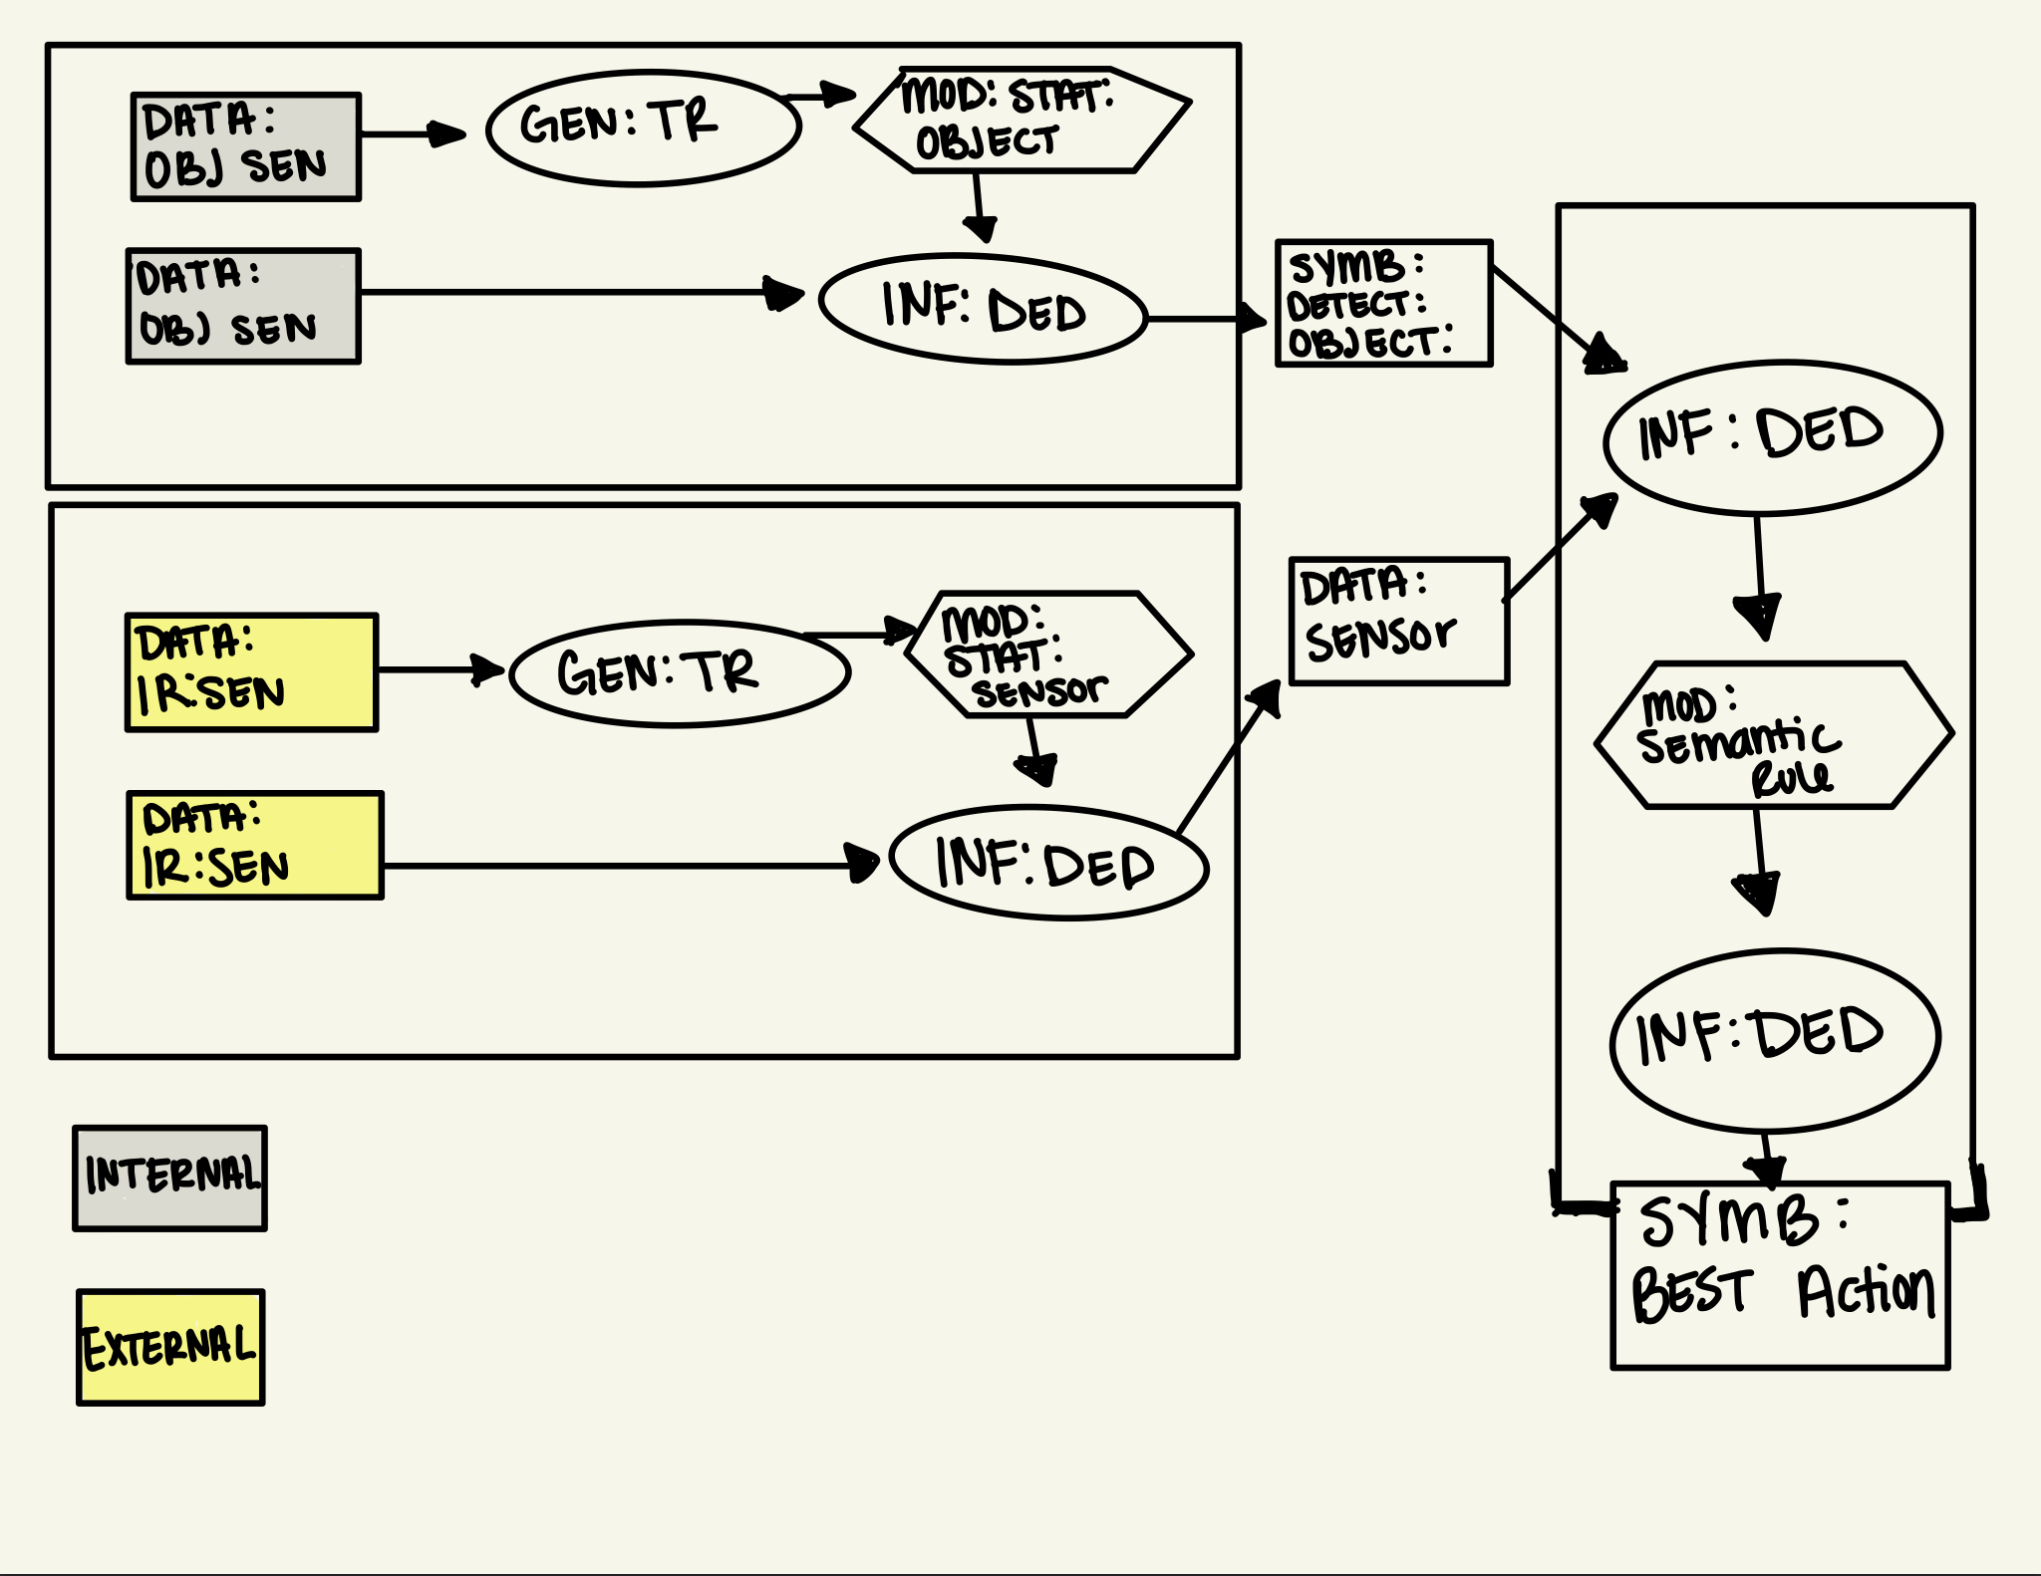
Symbols to Represent AI Systems
Alexis Ellis, Dr. Subhashini Ganapathy , Dr. Salehi Hugh, Dr. Cogan Shimizu
{ ellis.177@wright.edu, subhashini.Ganapathy@wright.edu, hugh.Salehi@wright.edu, cogan.Shimizu@wright.edu,}
Wright State University; College of Engineering and Computer Science.
Introduction
Preliminary Work
AI is rapidly integrating in various domains causing communication and comprehension of these systems to be strained between users.
A need to visual represent AI systems to open the “Black Box” phenomenon is becoming ever more present.
These representations need to be generalizable to capture familiar and obscure AI systems while remaining understandable to all users.
Why Use Symbols?
Breakdown complex frameworks
Symbols have the potential to be universally understood. [1]
Symbols have been used for a significant portion of human history. [2]
Humans are good at learning and using symbols.
Figure 1. Applied AI Symbol examples [3].
Figure 2. Robot Use Case Boxology [4].
Future Work
Develop a visual framework using semantic and composable glyphs (i.e., visual symbols) that will communicate AI systems
Provide a real-world application of our framework using a use case.
Evaluating out framework through expert opinion, user studies, and tool development.
References
[1] Joy Lo, Chih-Wei, Huey-Wen Yien, and I-Ping Chen. “How Universal Are Universal Symbols? An Estimation of Cross-Cultural Adoption of Universal Healthcare Symbols.” HERD: Health Environments Research & Design Journal 9, no. 3 (April 1, 2016): 116–34. https://doi.org/10.1177/1937586715616360.
[2] Sassoon, Rosemary, and Albertine Gaur. Signs, Symbols and Icons: Pre-History to the Computer Age. Intellect Books, 1997
[3] Hawkes, Teresa D., and Trevor J. Bihl. “Symbols to Represent AI Systems.” In NAECON 2021-IEEE National Aerospace and Electronics Conference, 61–68. IEEE, 2021.
[5] Bekkum, Michael van, Maaike de Boer, Frank van Harmelen, André Meyer-Vitali, and Annette ten Teije. “Modular Design Patterns for Hybrid Learning and Reasoning Systems: A Taxonomy, Patterns and Use Cases.” Applied Intelligence 51, no. 9 (2021): 6528–46.
Figure 3. Combination of Roomba use case and Boxology
This research is being supported by the Defense Associated Graduate Student Innovators (DAGSI) under RY23-8.
Notes:
We asked…
We did…
We observed…
We conclude….
Result slide> bold the best parts
Add highlighted box to tables to draw the attention to it
Always come back to the question in your results
Alexis: Design choices, how to evaluate effectiveness of system symbol representation - Supporting XAISubjective human studies (surveying) for simple testing, not fitted for Roomba (robotics)

