Slide 1

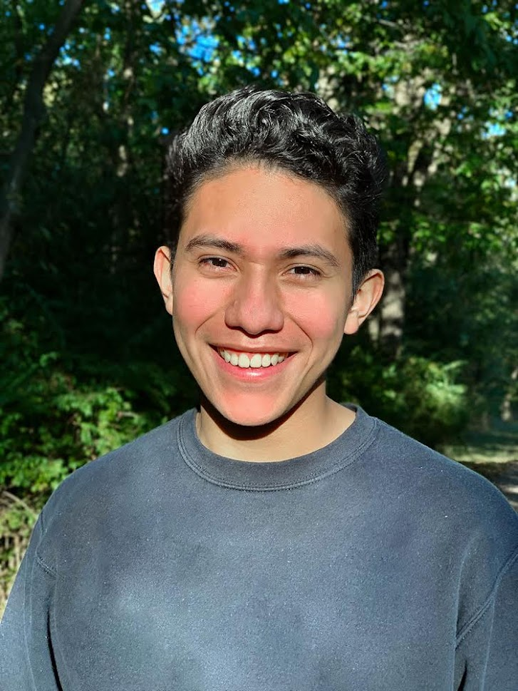
About Me!
Home
For Fun
Goals
Chris
de Leon
Web Designer
Let’s Chat!
Notes:
Home/Landing Page

Slide 2
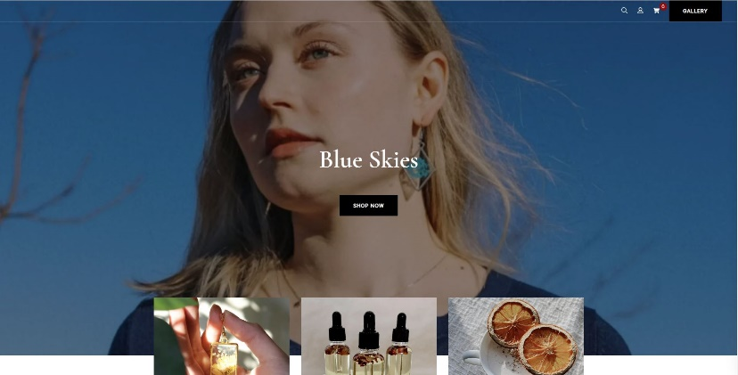
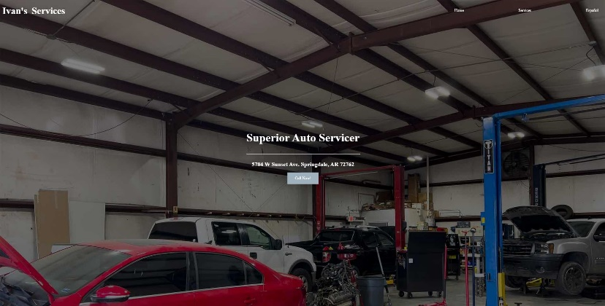
I’m the designer for Blue Skies SGF, a small business local to Springfield. The idea behind this design was to capture the notes of nature and organics that the brand represents. Feel free to give their site a visit.
About Me
I’m just a guy with a love for web design.
Here are some projects I’ve been working on
I’m the designer for Ivan’s Service, a mechanic shop local to Springdale, AR. This client required a basic website that displayed their services to reach more clients via SEO
Notes:
2nd viewport of Home page

Slide 3

Get in Touch With Me!
I’d love to work with you ☺
Name:
Email:
Message:
Submit
Notes:
3rd and final viewport of home page

Slide 4

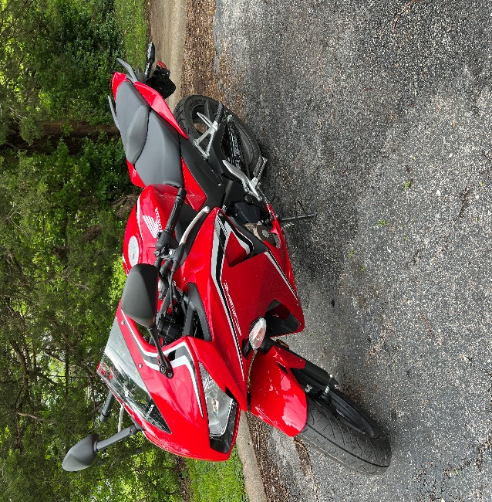

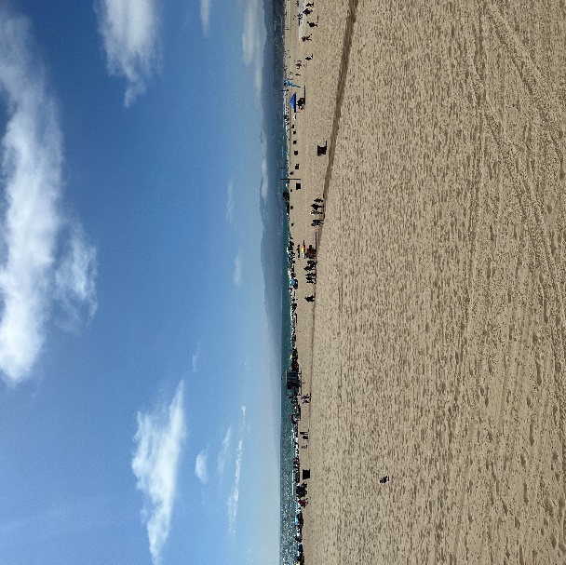
What do I do for Fun?
I enjoy traveling around the United States. Pictured above is Santa Monica Beach, CA.
I enjoy coding and creating unique websites.
I enjoy riding my motorcycle.
Notes:
For Fun Page

Slide 5

Goals
So far I have taken a couple programming/coding classes such as Web Site Development I and Intro to Computer Programming. I took these courses in partial fulfillment of the Associate of Science in Computer Science degree offered at OTC. Initially, going to school had not crossed my mind. I took a year’s worth of classes at a different college and I soon realized that what I was studying wasn’t really what I wanted for myself. Not too long after, I got into coding and I enjoyed doing it. Without having anyone to ask me or force me to do it, I started small projects. I figured that if this is something I truly enjoy then going to college for it would be worthwhile.
I am taking this particular class because my favorite of all things programming/coding related is website design. In Web Site Development I, I enjoyed every project we were assigned with completing and working on other things than the ones that caught my attention helped me direct my practice in areas that I’m not very strong in. I believe this class will further enhance my web site development skills and I’m excited to add more projects to my repertoire.
Feel free to reach out to me with any questions!
Notes:
Goals

