Slide 1
UX Scenario Document File Version 4.4
Samsung TV Seller Office
IPTV Nova Plus
Smart TV Media Player Application (Tizen)
Submission Date | 2026 / 11 / 02
App Ver. | 1.0.2
App Developer | Name: Christian Montano E-mail: christian.montano.0712@gmail.com

Slide 2
Samsung Internal Use Only
Table of Contents
Samsung TV Seller Office
1. Basic Information
2. Document History
3. Page Description (Guideline)
4. Detailed Login Information & Test Accounts
5. Main Page Description (Dashboard)
6. Sub Page Description (Live TV & VOD Movies/Series)
7. Paid Content (Not Applicable)
8. In-App Ad (Not Applicable)
9. Appendix (QA Notes & Samsung Remote Controls)
2

Slide 3
Samsung Internal Use Only
1. Basic Information
Samsung TV Seller Office
Category / Items | Input (By Developer) | Example / Standards
App Title | IPTV Nova Plus | Media Player Application
Category | Entertainment | Entertainment / Life
File Type | Web (Tizen IPK) | Web / Native App
Optimized Resolution | 1920*1080 (Full HD / UHD) | 1920*1080
Service Area Information | Global (All Available Countries) | Global / Selected Regions
App Service Language | English, Spanish | English, Spanish
Geo-IP Block | No | Yes / No
SDK Version | Tizen 3.0 to Tizen 24 | Tizen 3.0+
In-App Ad | Not Applicable (No Ads) | Banner / AVOD / None
Paid Content | Not Applicable (Free Standalone App) | Transaction / Subscription / None
Sound | Audio Tracks & Live Video Streams | BGM / Sound Effect / Stream Audio
3

Slide 4
Samsung Internal Use Only
2. Document History
Samsung TV Seller Office
No. | Sent Date | Version | File Name | Contents
1 | 02.11.2026 | 1.0.0 | UX Scenario IPTV Nova Plus | Initial submission draft
2 | 02.11.2026 | 1.0.2 | UX Scenario IPTV Nova Plus | Official QA submission with Demo Mode & Hi-Res Icons
4

Slide 5
Samsung Internal Use Only
3. Page Description (Navigation Guidelines)
Samsung TV Seller Office
• Samsung TV Remote & TV D-Pad Controls:
The app features full spatial 4-way D-Pad navigation (Up, Down, Left, Right) with clear visual focus borders on all interactive elements.
• OK Button (Enter):
Selects channels, opens categories, triggers video playback, and confirms modal dialogs.
• BACK Button:
Returns to the previous screen (from Player to Dashboard, from Dashboard to Account Manager). Handles Samsung Tizen history API cleanly without exiting unexpectedly.
• Multi-Account Management:
Users can register multiple Xtream Codes playlists and switch between profiles effortlessly.
• One-Click Demo Environment:
For rapid QA evaluation, the app provides a 'Probar en MODO DEMO' button requiring no external servers or complex configuration.
5

Slide 6
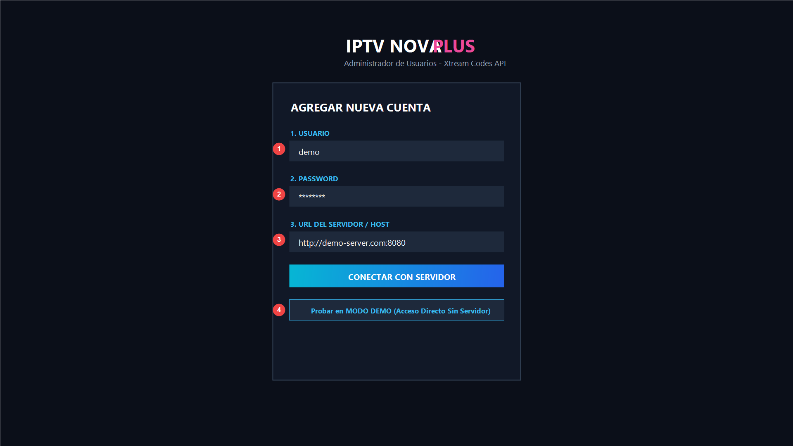
Samsung Internal Use Only
4. Detailed Login Information & Test Account
Samsung TV Seller Office
1 | Input field: Usuario (Username)
2 | Input field: Contraseña (Password)
3 | Input field: URL del Servidor / Host
4 | One-Click: 'Probar en MODO DEMO' (Test Mode)
TEST CREDENTIALS FOR Samsung QA:
• Method A (Recommended): Simply click the button 'Probar en MODO DEMO' [4] to log in instantly with legal test streams.
• Method B (Manual Input):
User: demo
Password: demo
Server: demo
6

Slide 7
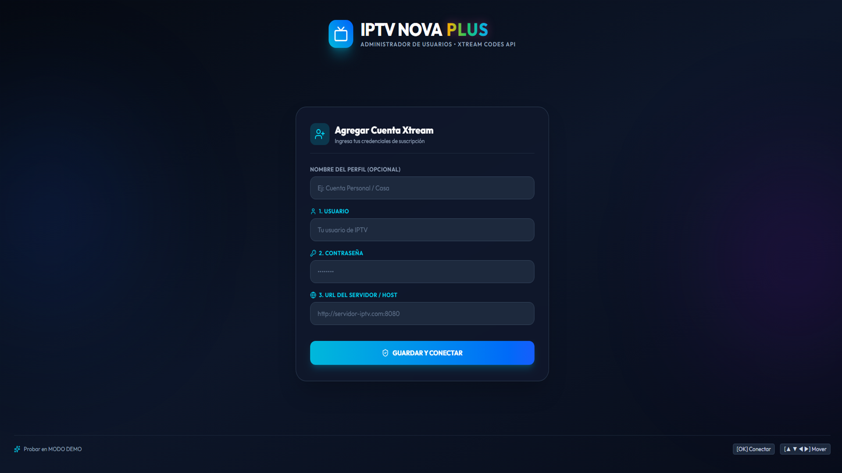
Samsung Internal Use Only
5. Main Page Description (Dashboard)
Samsung TV Seller Office
1 | App Logo & Active User Profile / Expiration Date
2 | LIVE TV Card: Access live television channels
3 | MOVIES Card: Browse VOD film catalog & YouTube trailers
4 | SERIES Card: Browse seasons and episodes
5 | Quick Access Bar: Favorites, Profile, Change Account, Settings
6 | Parental Control: PIN protected (+18) content (Default: 0000)
7

Slide 8
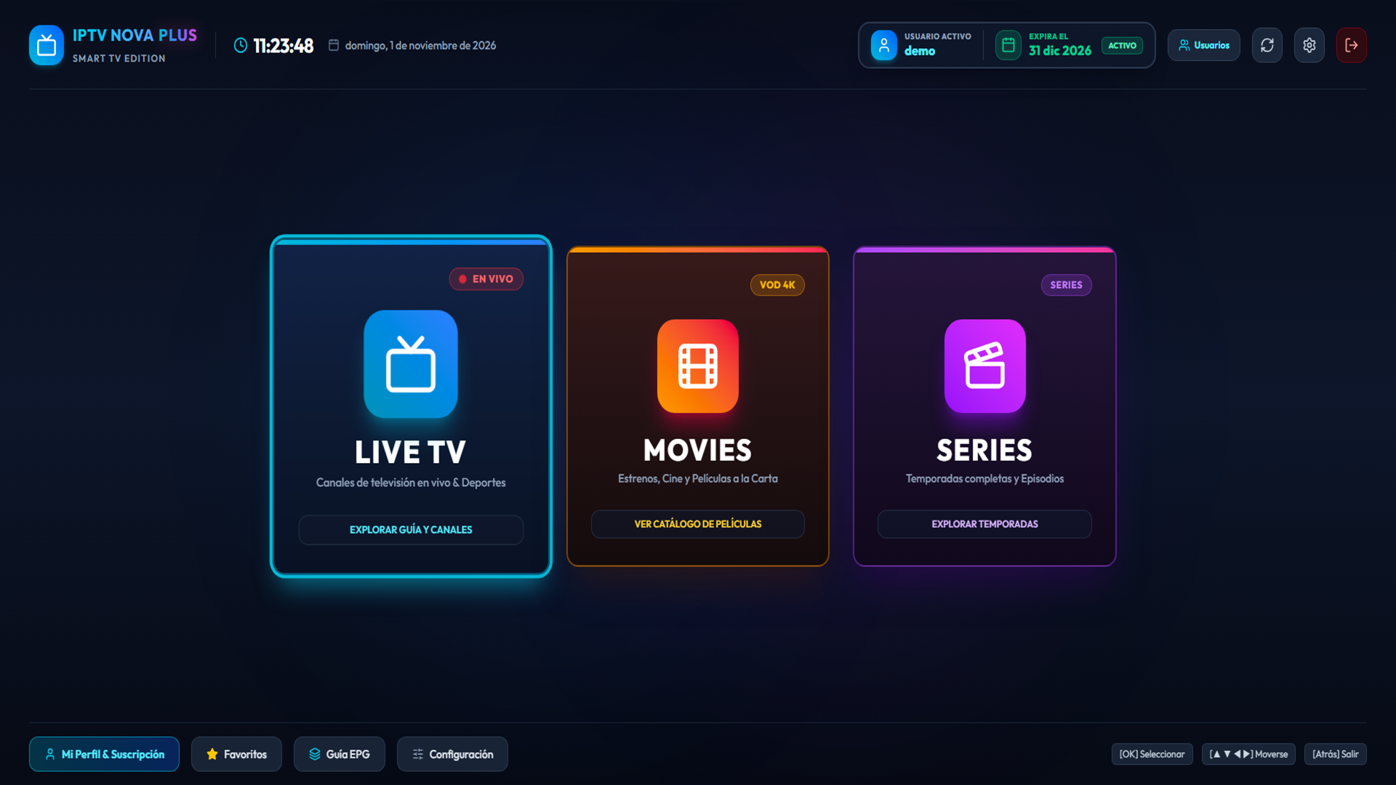
Samsung Internal Use Only
6. Sub Page Description (Live TV Channels)
Samsung TV Seller Office
1 | Category Sidebar: Sports, News, Movies, Kids, etc.
2 | Channel List: Real-time channel list with active selection
3 | Built-in Player Preview: High-definition HLS/MPEG-TS video
4 | Player Gear Menu: Switch audio language, subtitles & aspect ratio
5 | Favorites: One-click favorite channel bookmarking
8

Slide 9
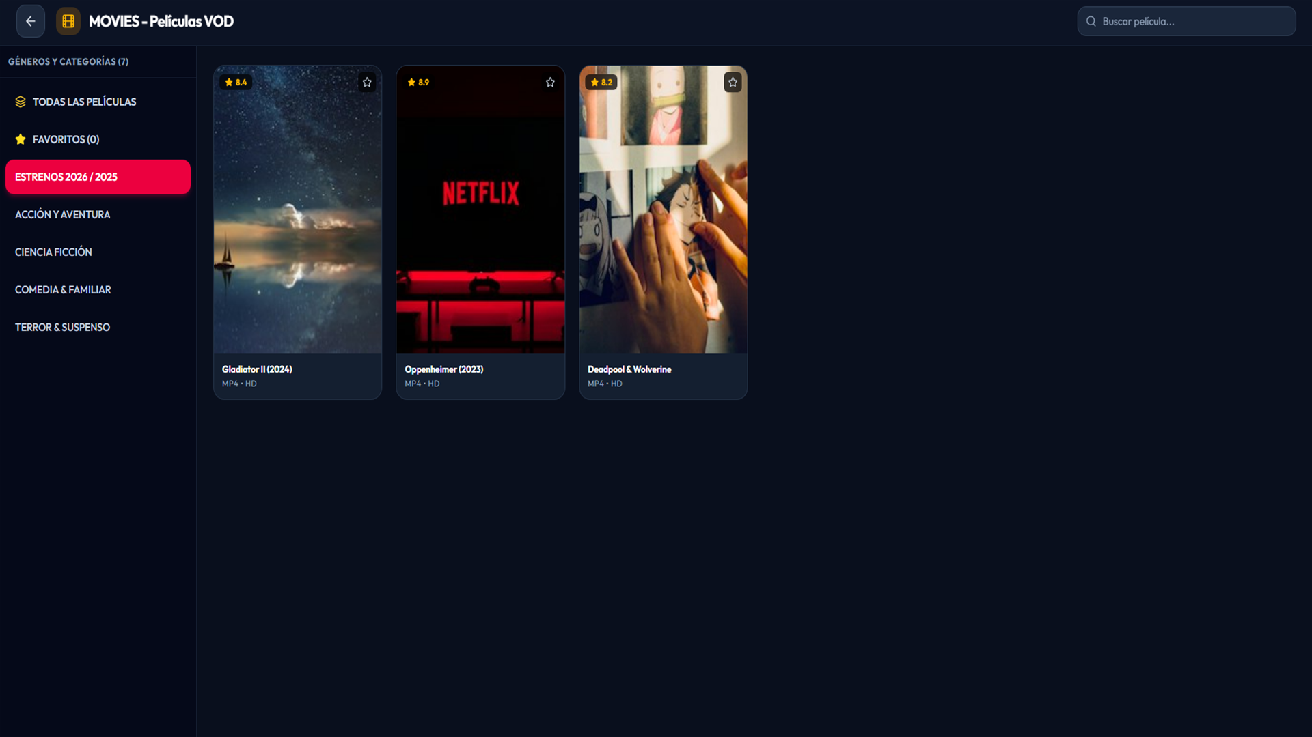
Samsung Internal Use Only
6. Sub Page Description (VOD Movies & Series)
Samsung TV Seller Office
1 | VOD Catalog Grid: High-res movie posters and series covers
2 | Movie Synopsis: Detailed plot summary, release year, genre
3 | Official Trailers: Plays YouTube trailers directly on TV
4 | Playback Controls: Play Movie, resume playback, track selection
5 | Parental Lock: PIN prompt before opening adult categories
9

Slide 10
Samsung Internal Use Only
7. Paid Content (Not Applicable)
Samsung TV Seller Office
NOT APPLICABLE (NO PAID CONTENT)
• IPTV Nova Plus is completely FREE of charge.
• There is NO in-app purchasing mechanism, NO Tizen Pay integration, and NO paid subscriptions.
• The application is purely a client media player for playlists provided voluntarily by the user.
10

Slide 11
Samsung Internal Use Only
8. In-App Ad (Not Applicable)
Samsung TV Seller Office
NOT APPLICABLE (NO IN-APP ADS)
• The application does NOT contain any banner advertisements.
• The application does NOT contain any video ads (AVOD) or popups.
• No third-party ad networks or tracking SDKs are utilized.
11

Slide 12
Samsung Internal Use Only
[Appendix] Notes for Samsung QA Reviewers
Samsung TV Seller Office
1. Fast Track Testing (Demo Mode):
On initial app launch, click 'Probar en MODO DEMO' at the bottom of the account screen. This instantly loads standard test streams (HLS 1080p legal content) allowing immediate verification of video, audio tracks, and UI navigation without external network constraints.
2. Parental Control Verification:
Adult / XXX categories are locked by default. The default PIN code is 0000. It can be changed in the Settings screen.
3. Remote Control Compatibility:
The application fully adheres to Samsung Tizen Smart TV guidelines: spatial D-Pad navigation, OK button triggers, and standard TV Back key returns to the previous view without abrupt exit.
4. Zero Personal Data Collection:
Account credentials and favorites are stored strictly in HTML5 LocalStorage on the TV. No user data is transmitted to third-party tracking servers.
5. Developer Contact:
Developer: Christian Montano | Email: christian.montano.0712@gmail.com | Thank you for reviewing IPTV Nova Plus.
12

