Slide 1
THR3028(R) Visual Studio Code The most useful (and underused!) tips and tricks
Chris Dias
Principal Program Manager

Slide 2
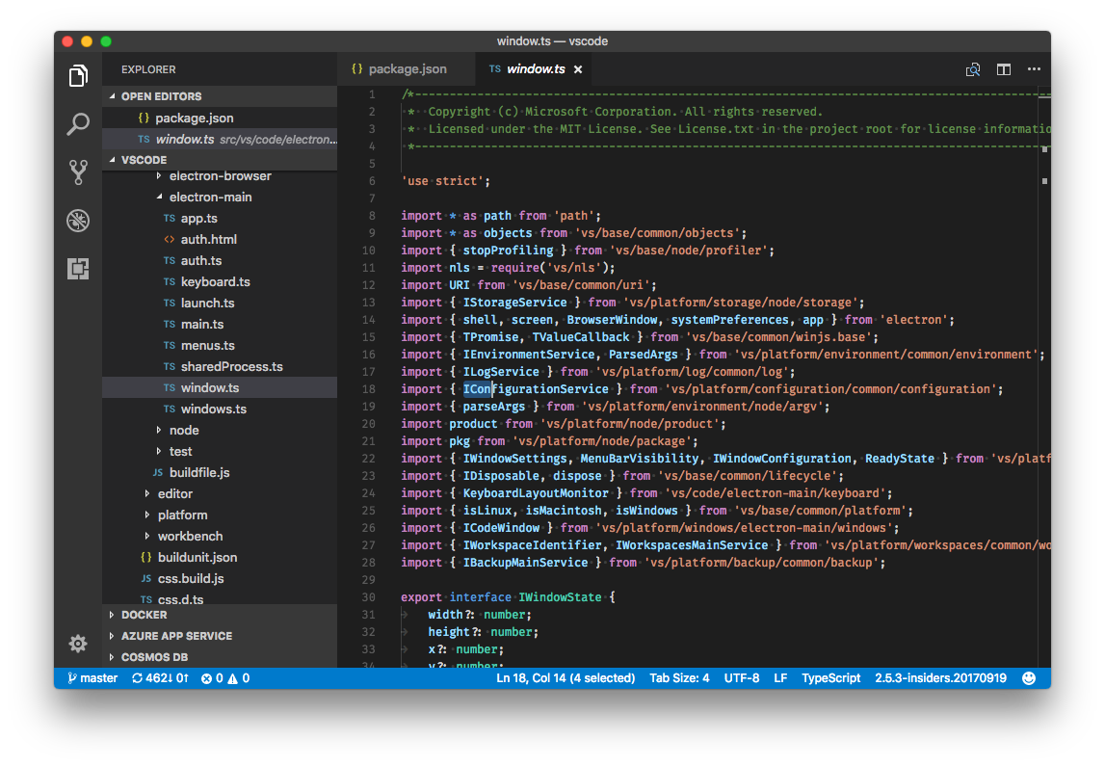
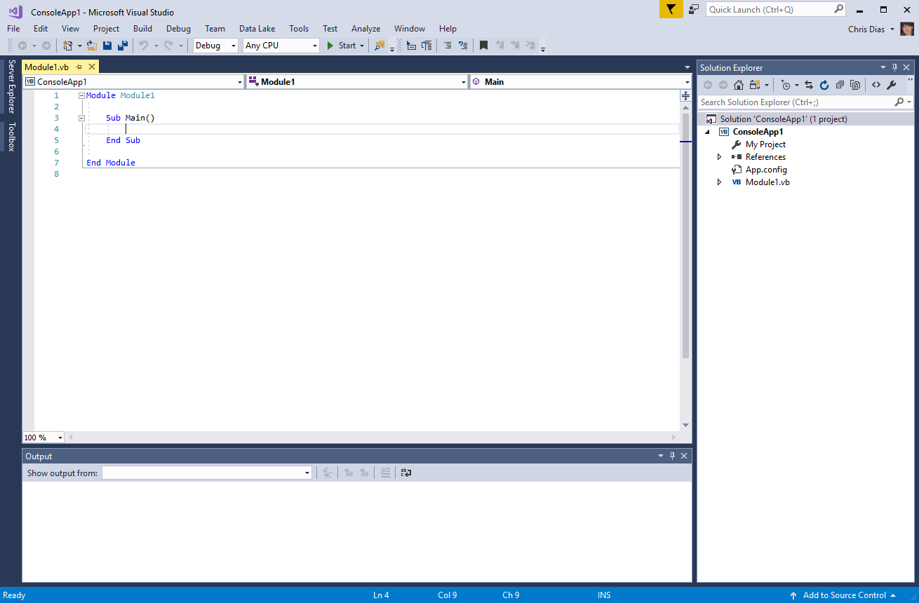

Slide 3
Setup
Customization
Keyboard shortcuts
Editing, Code Navigation
Search
Tasks
Debugging
Terminal
Source Code Control
Extensions

Slide 4
Thanks!
Follow us @code
https://code.visualstudio.com
https://github.com/microsoft/vscode
https://github.com/microsoft/vscode-tips-and-tricks

Slide 5
Resources for Microsoft employees
Can’t find the image that you have in mind for your presentation? The Media Acquisitions team can help you find and license imagery through our stock photography providers. You will also find imagery and information via these links:
Mediaacq
Microsoft Brand Central
Presentation guidelines
Microsoft photography
Microsoft illustrations
www.superstock.com/
www.gettyimages.com/creativeimages/royaltyfree
www.corbisimages.com/stock-photo/royalty-free
There are agreements in place with these providers.
For information on the use of third-party copyrighted content please contact visit this site.
Notes:
Even more resources can be found at the links on this slide!

Slide 6

Please evaluate this session Your feedback is important to us!
This slide is required. Do NOT delete or alter the slide.
The slide will be replaced onsite through Silver Fox Productions with an updated QR code.
From your PC or Tablet visit MyIgnite at http://myignite.microsoft.com
From your phone download and use the Ignite Mobile App by scanning the QR code above or visiting https://aka.ms/ignite.mobileapp

