Slide 1
THR3028(R) Visual Studio Code The most useful (and underused!) tips and tricks
Chris Dias
Principal Program Manager

Slide 2
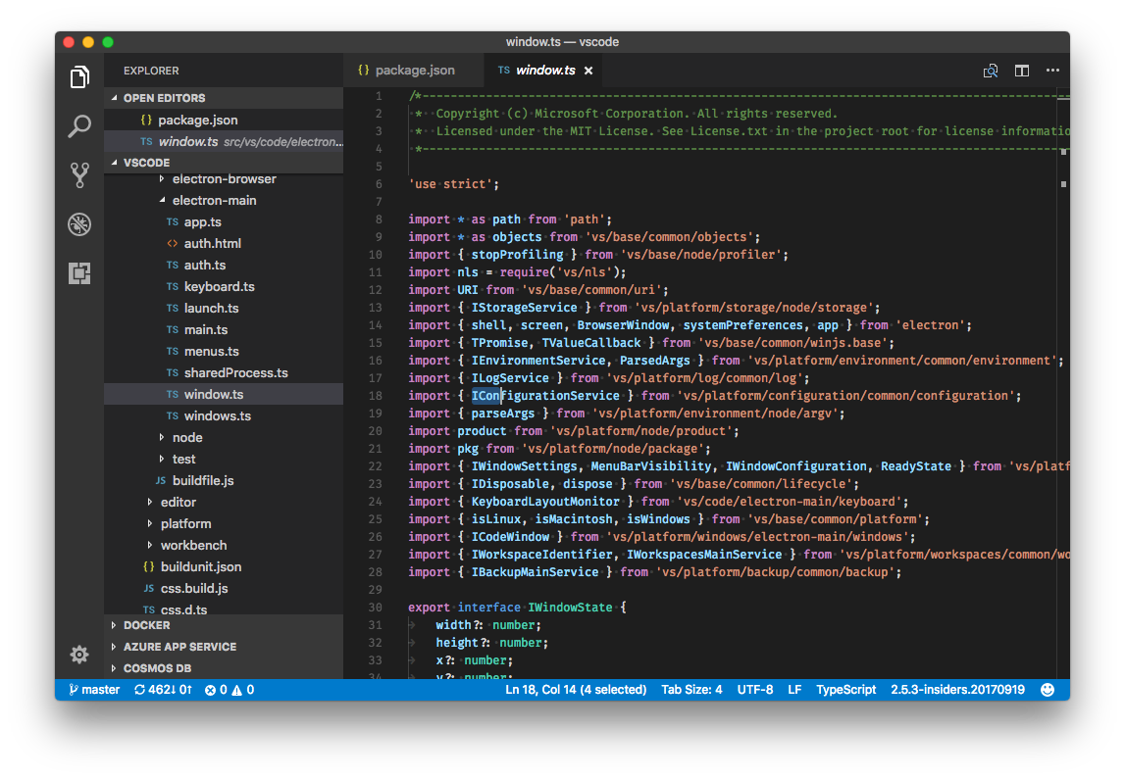
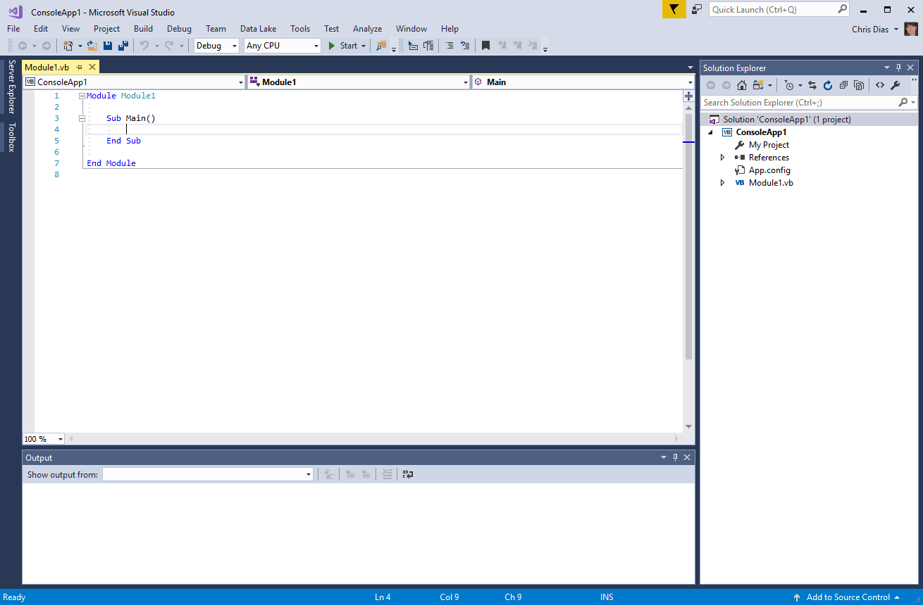
This talk is about VS CODE, not the VS IDE!!
This…
Not This!
(So… it’s OK to leave)

Slide 3
Tips and Tricks…
Setup
Customization
Keyboard shortcuts
Editing and Code Navigation
Code Style and Correctness
Debugging
Tasks
Integrated Terminal
Source Code Control
Extensions, Marketplace
More at https://github.com/Microsoft/vscode-tips-and-tricks.git

Slide 4
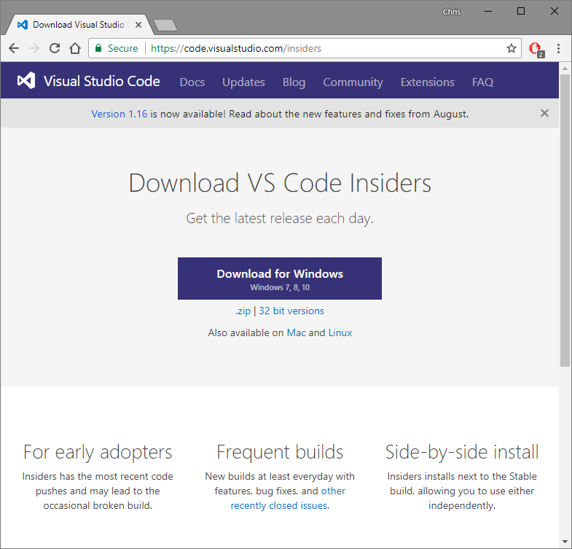
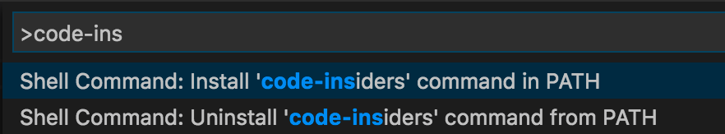
Setup
Get the Insiders build
Exact same builds we use
Releases daily, installs side by side
Early access to new features
Update on your schedule
Add shortcut to PATH
Launch in 9+ Languages

Slide 5
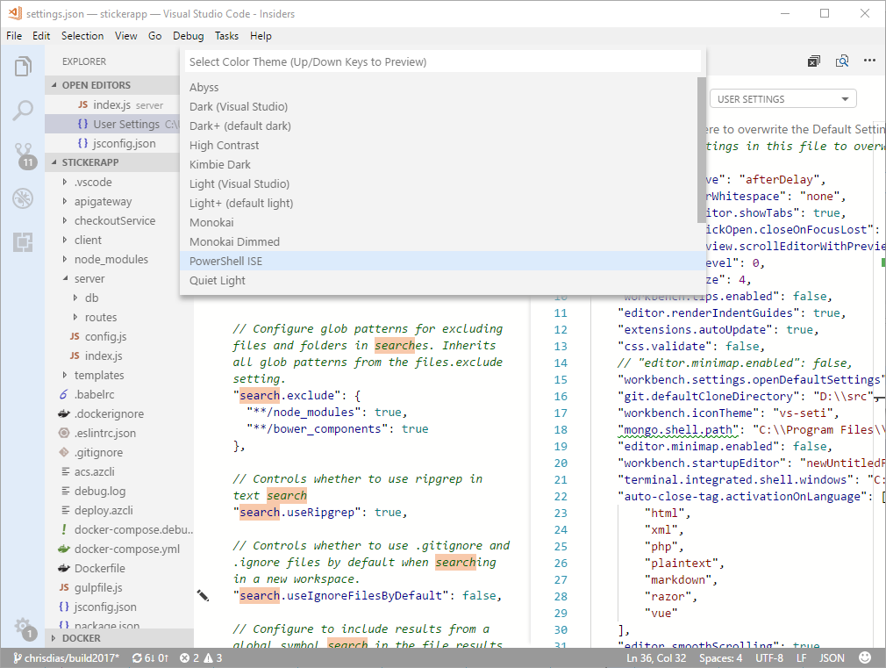
Customization – Make it Yours
Themes, Icons
Settings – CMD+,
IntelliSense, validation
User, Workspace settings
My favorites
AutoSave
Font ligatures
Workbench tips
Remove files/folders from explorer
…

Slide 6
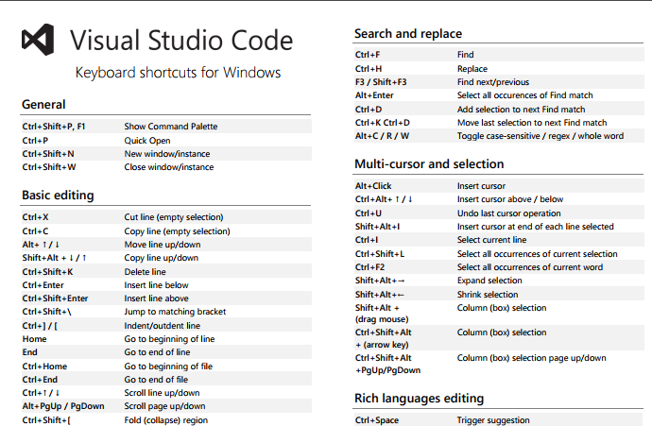
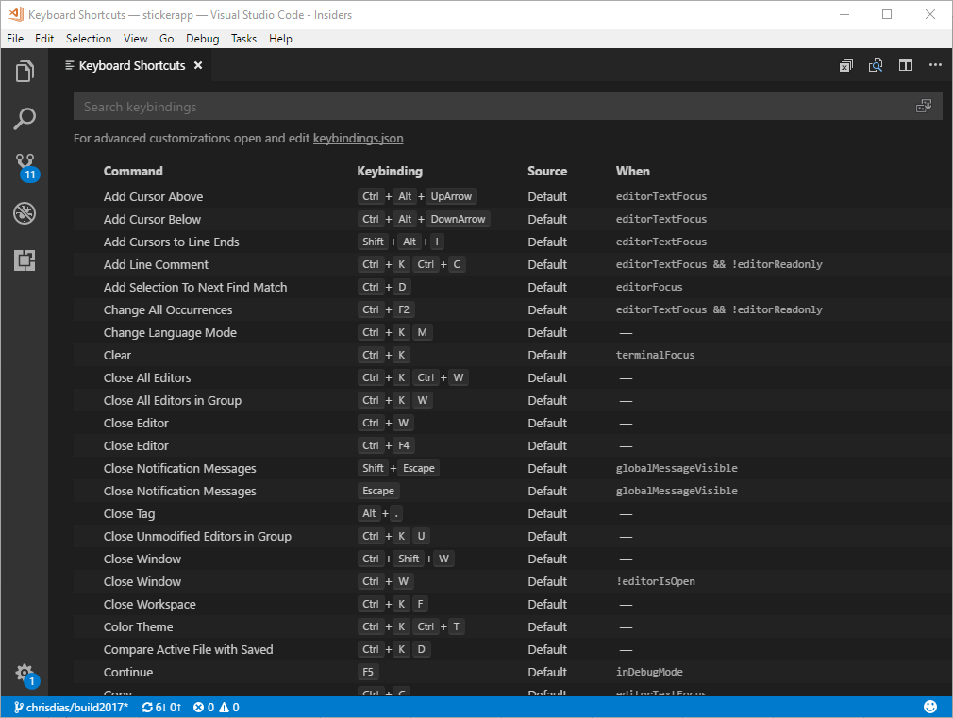
Keyboard Shortcuts
Help | Keyboard Shortcut Reference
Keymap Extensions
Sublime, VIM, Atom, …
Customize shortcuts
Quick Outline
The “when” clause
Resolve conflicts
Advanced Customization

Slide 7
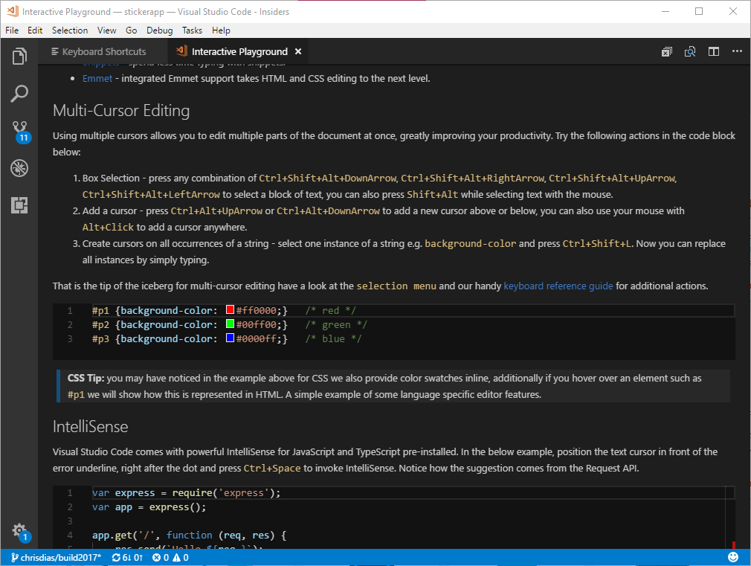
Navigation and Editing
Remember one thing: F1
Navigate: CMD+P, Right Arrow to open files
Switch Project: CMD+R
Outline: CMD+SHIFT+O
Help | Interactive Editor Playground
Multi Cursor, Line Actions, Snippets, more…
Emmet Cheat Sheet: https://docs.emmet.io/cheat-sheet/
My Favorites
Multi Cursors: CMD+D, CMD+SHIFT+L
GoTo Definition: CMD+Click, Go Back: ALT+Left Arrow
Peek: ALT+F12
Navigate Errors and Warnings: F8

Slide 8
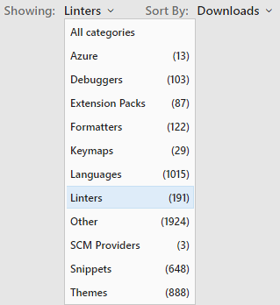
Code Style and Correctness
If you do JavaScript, remember a second thing: TypeScript!
JavaScript type checking: @ts-check, jsconfig.json
Linters enforce style
ESLint plus 190 more …
Lightbulbs
Formatters make it readable
XML is my favorite, 121 more in Marketplace

Slide 9
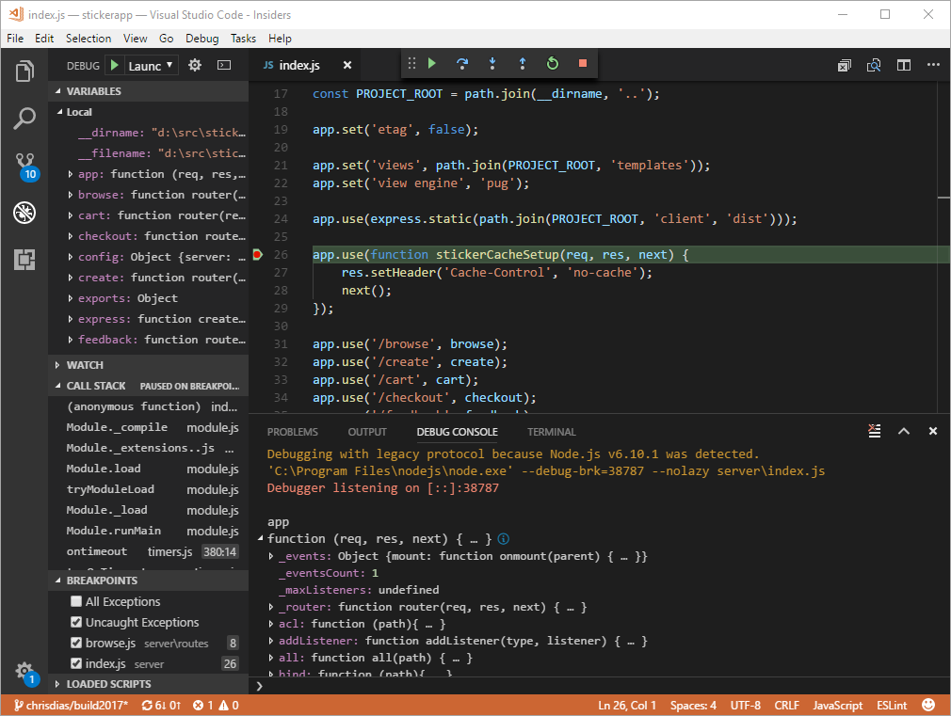
Debugging
Single file debugging
Client, Server Debugging
launch.json
Debug Console, REPL
Inline debug values
Docker debugging
Recipes

Slide 10
Tasks
Automate the grunt work
Pre-Launch tasks when debugging
Problem Matchers

Slide 11
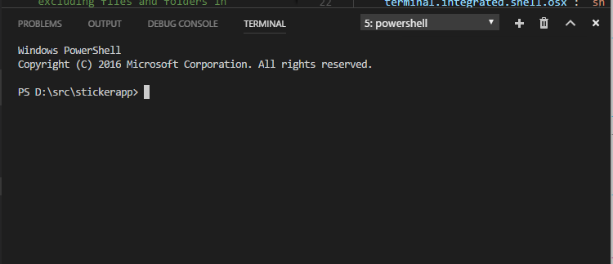
Integrated Terminal
Pick it
"terminal.integrated.shell.osx " : "zsh",
"terminal.integrated.shell.windows”: "C:\\windows\\system32\\cmd.exe"
Customize it
"terminal.integrated.cursorStyle": "block",
"terminal.integrated.cursorBlinking": true
Name it
F1, Terminal: Rename
Run selected text in it
Set up a key binding

Slide 12
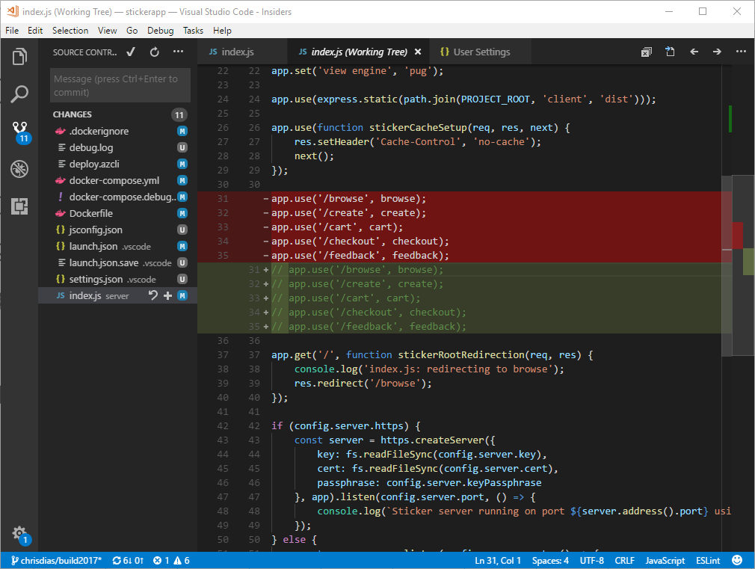
Source Code Control
Git Stash
Branching
Diff: side by side, inline, accessible
Partial Git commits
Additional SCC providers
Git lens extension
Ben's configuration

Slide 13
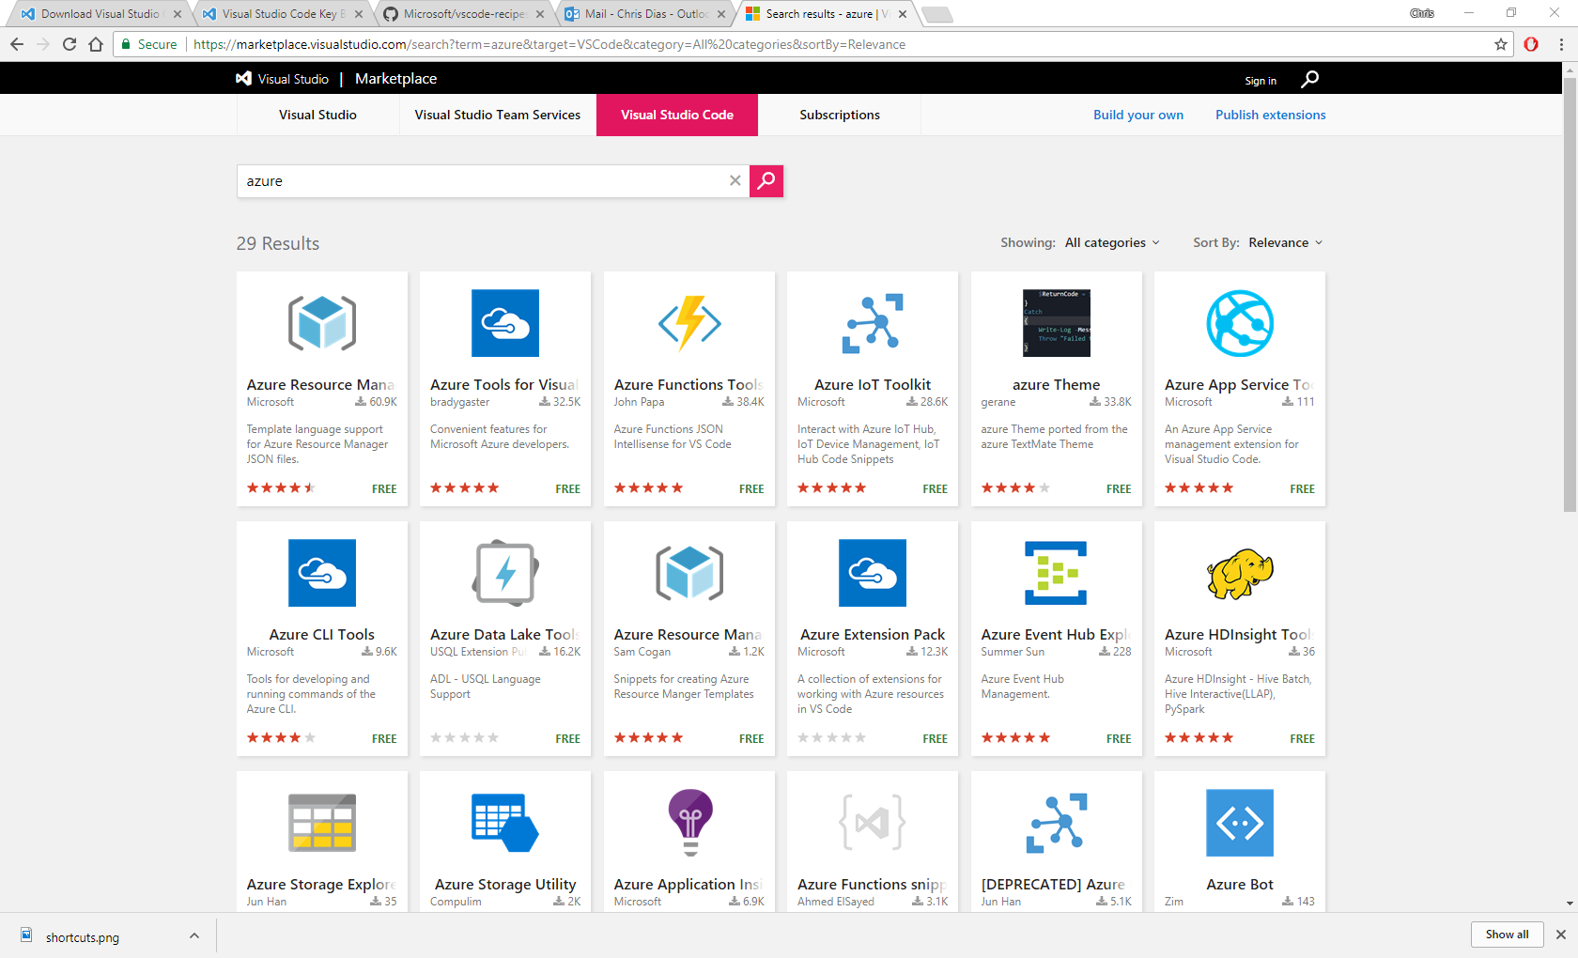
Extensions and the Marketplace
Single click install
List of cool extensions…
Explosion thing
Open new workspace here extension (mine)
Close all (Ben's) https://marketplace.visualstudio.com/items?itemName=benjpas.close-all

Slide 14
#HappyCoding!
Follow us @code
Learn: https://code.visualstudio.com/docs
Insiders: https://code.visualstudio.com/insiders
Contribute: https://github.com/microsoft/vscode
Tips: https://github.com/microsoft/vscode-tips-and-tricks

Slide 15

Please evaluate this session Your feedback is important to us!
This slide is required. Do NOT delete or alter the slide.
The slide will be replaced onsite through Silver Fox Productions with an updated QR code.
From your PC or Tablet visit MyIgnite at http://myignite.microsoft.com
From your phone download and use the Ignite Mobile App by scanning the QR code above or visiting https://aka.ms/ignite.mobileapp

Slide 17
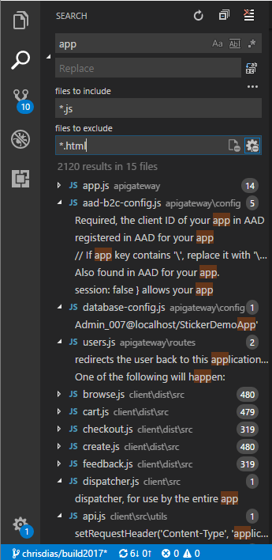
Search
Advanced options
Include, exclude files
Settings
Ignore files
Remove from results

