Slide 1

THR3028R: Visual Studio Code The most useful (and underused!) tips and tricks
Chris Dias
Principal Program Manager
VS Code

Slide 2
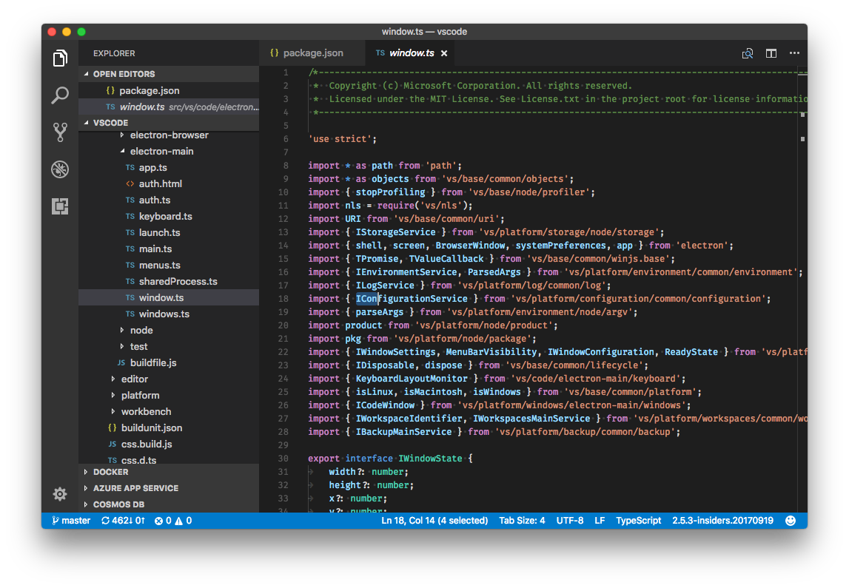
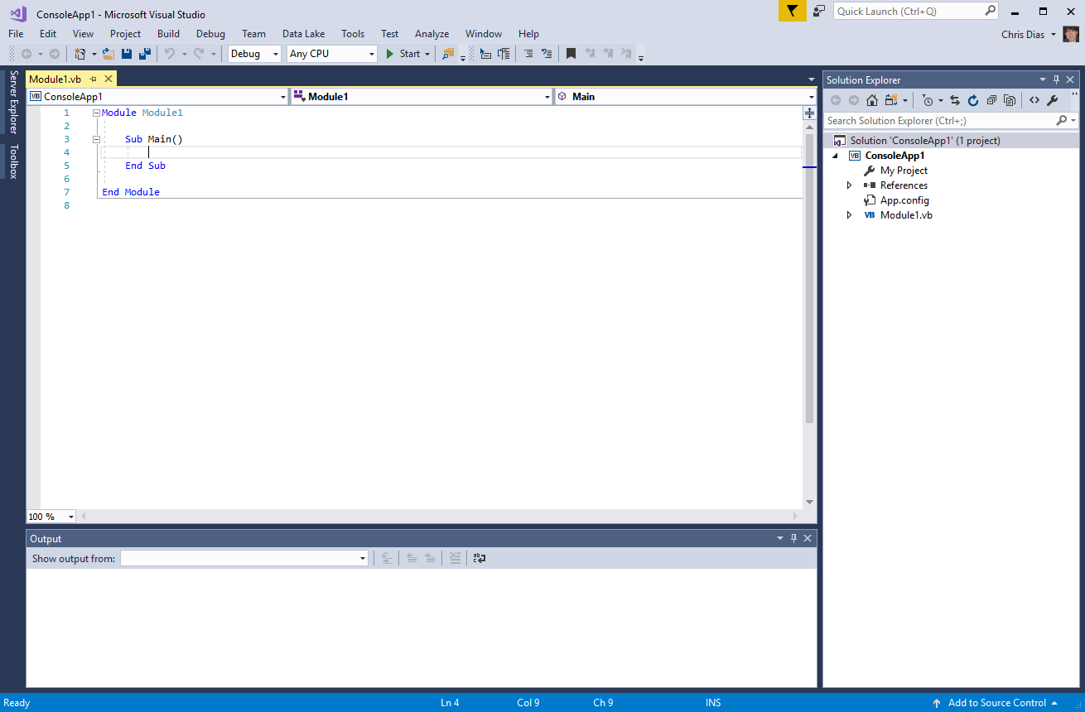
This talk is about VS CODE, not the VS IDE!!
This…
Not This!
(So… it’s OK to leave)

Slide 3
Tips and Tricks…
Setup
Customization
Keyboard shortcuts
Editing and Code Navigation
Code Style and Correctness
Debugging
Tasks
Integrated Terminal
Source Code Control
Extensions, Marketplace
More at https://github.com/Microsoft/vscode-tips-and-tricks.git

Slide 4
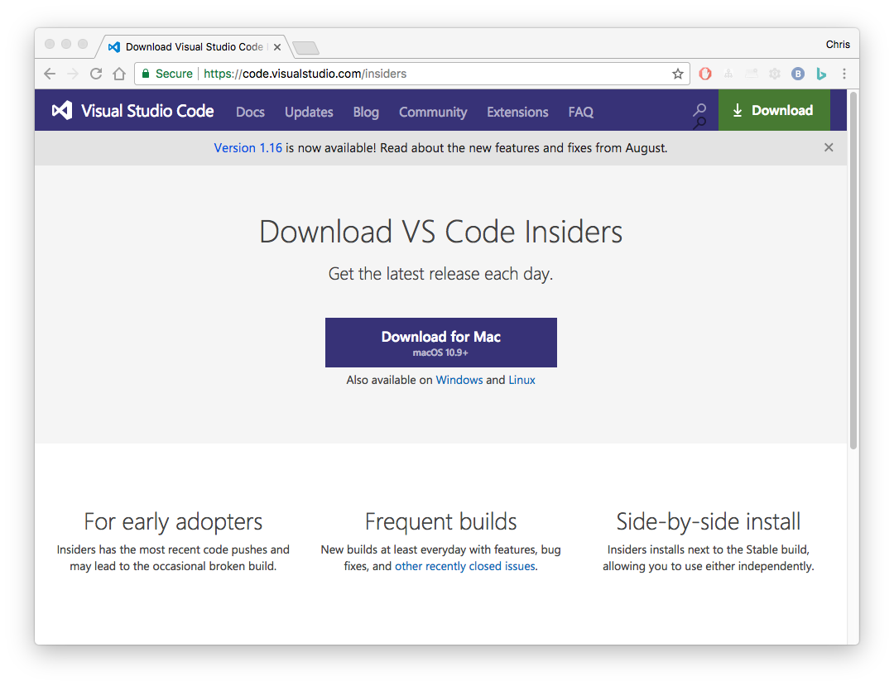
Setup
Get the Insiders build!
Exact same builds we use
Early access to new features
Launch in 9+ Languages
code --locale en-US
F1 >Configure Language
Add shortcut to PATH
F1 >Shell Command…

Slide 5
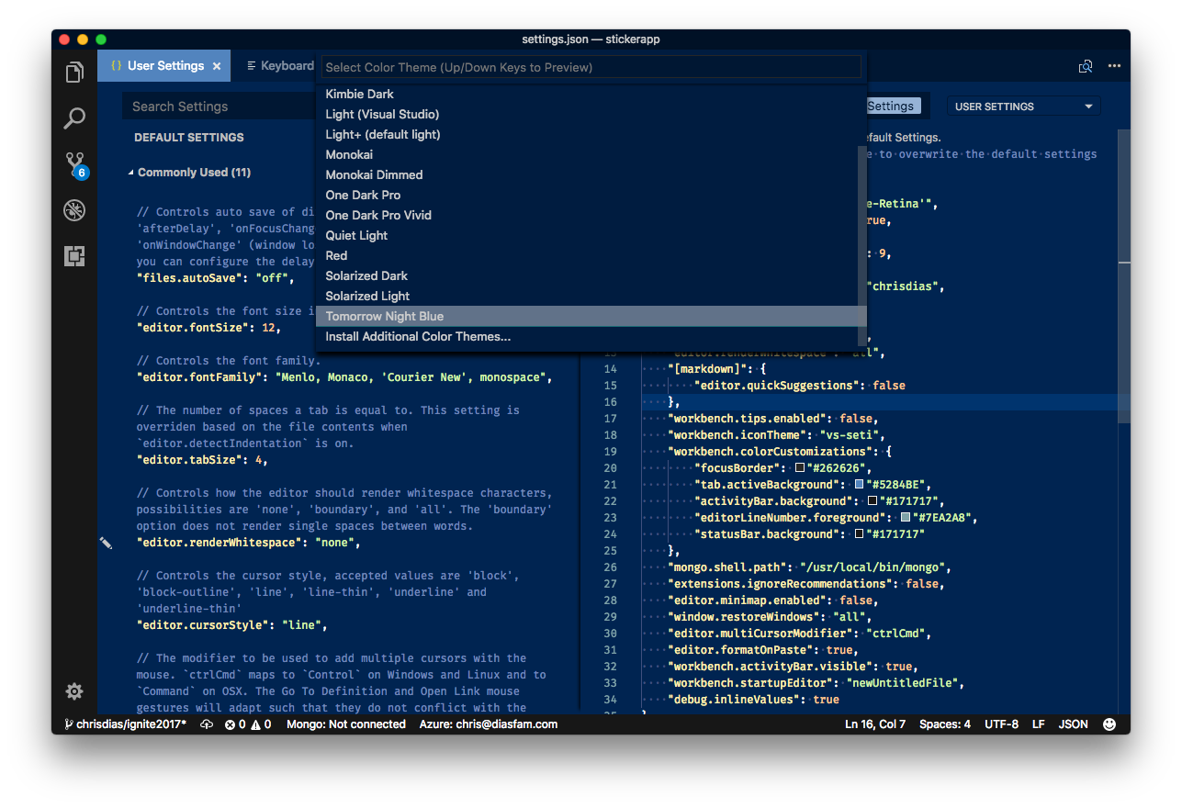

Customization – Make it Yours
890+ Themes, Icons
Settings: CMD+,
IntelliSense, validation
User, Workspace settings
Fun favorites
AutoSave
Font ligatures
Workbench tips

Slide 6
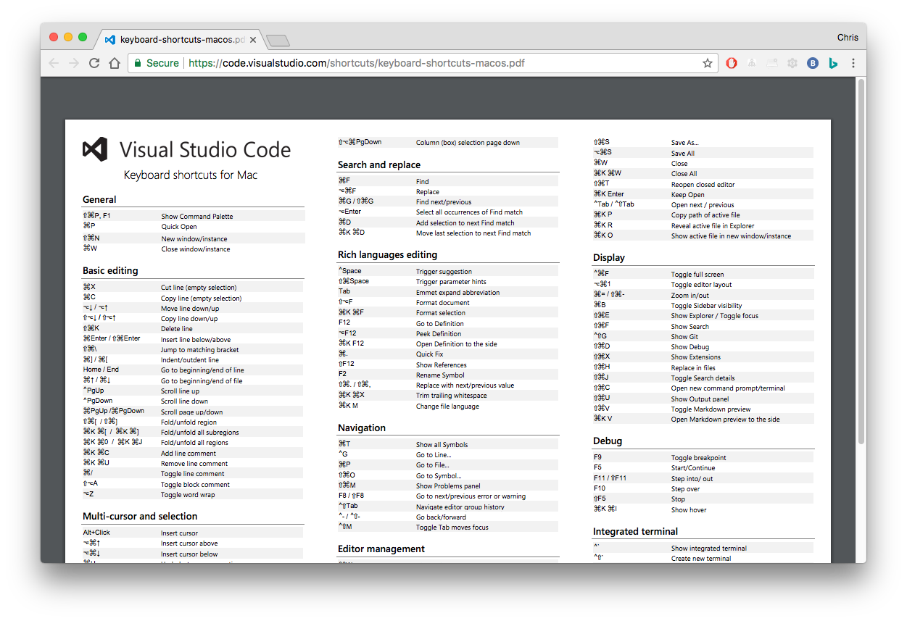
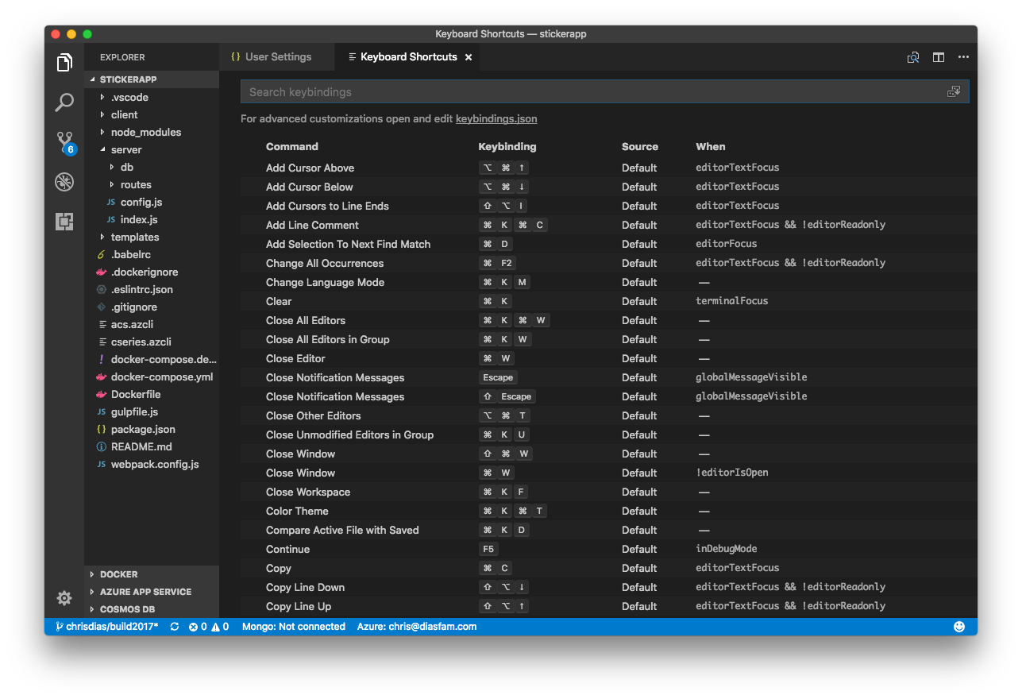
Keyboard Shortcuts
Help | Keyboard Shortcut Reference
Customize shortcuts
Editor, show conflicts
Quick Outline in keybindings.json
The when clause
Keymap Extensions
Sublime, VIM, Atom, …
Advanced Customization

Slide 7
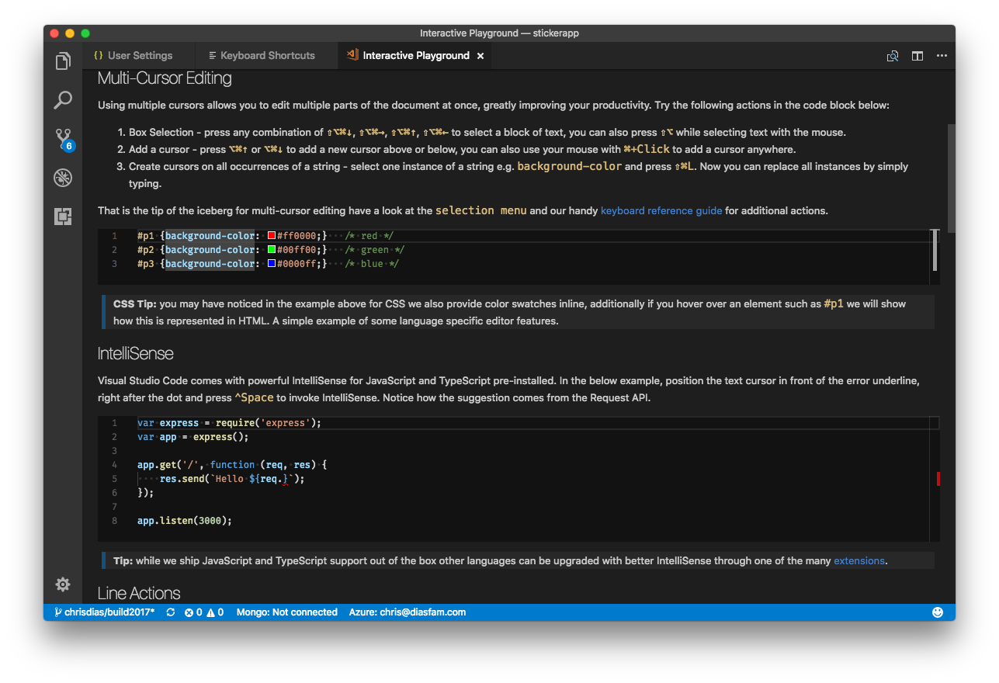
Navigation and Editing
Remember one thing: F1
Navigate workspaces: CTRL+R
Navigate files: CMD+P, Right Arrow open files
Navigate within files: CMD+SHIFT+O
Help | Interactive Editor Playground
Multi Cursor, Line Actions, Snippets, more…
Emmet Cheat Sheet
My Favorites
Multi Cursors: CMD+D, CMD+SHIFT+L
GoTo Definition: CMD+Click, Go Back: ALT+Left Arrow
Peek: ALT+F12
Errors and Warnings: F8

Slide 8

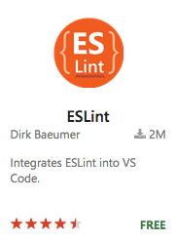
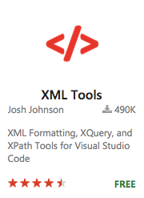
Code Style and Correctness
If you do JavaScript, remember a second thing: TypeScript!
Type checking JS: @ts-check, jsconfig.json
Linters enforce style
ESLint plus 190 more …
Lightbulbs
Formatters make it readable
XML is my favorite, 121 more in Marketplace
"editor.formatOnPaste": true

Slide 9
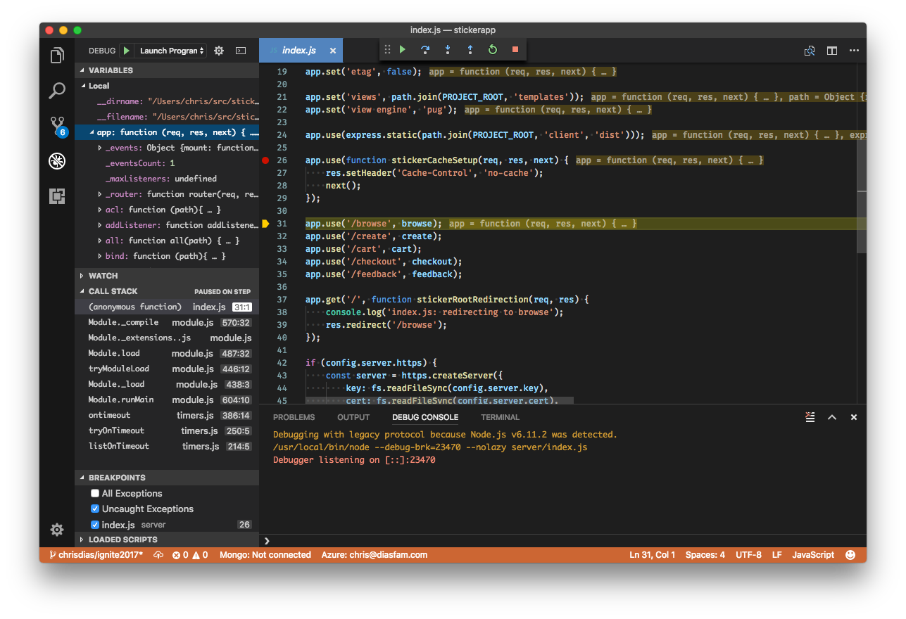
Debugging
Single file debugging
Client, server debugging
Debug console, REPL
Inline debug values
Attach to Docker
Recipes

Slide 10
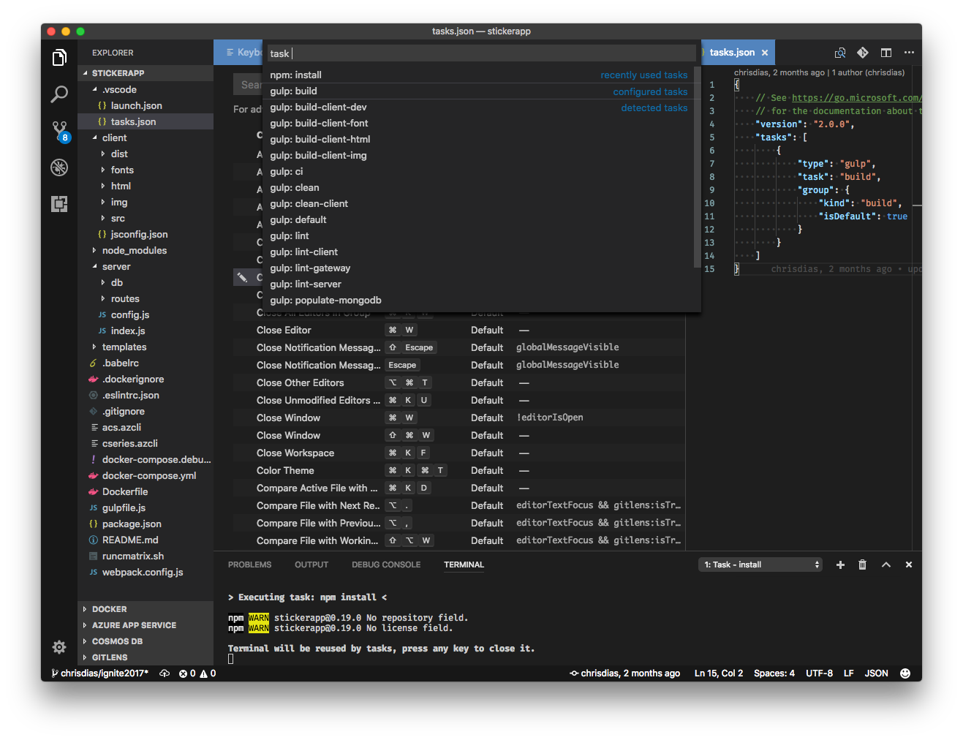
Tasks
F1, “task” auto-detects tasks
npm, grunt, gulp by default
Customize with tasks.json
Bind task to keyboard shortcuts
Debug preLaunchTask
Problem Matchers

Slide 11
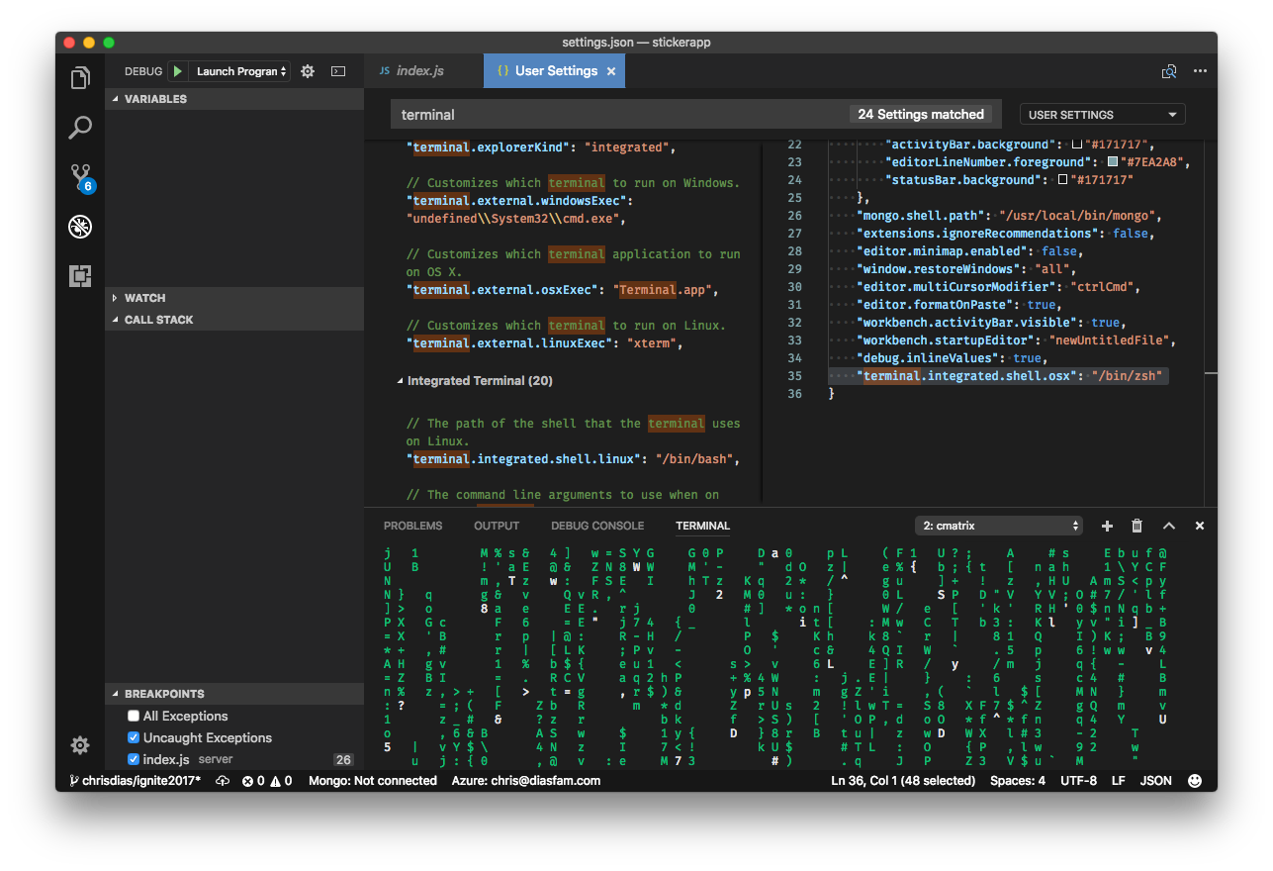
Integrated Terminal
Pick it
"terminal.integrated.shell.osx": ”/bin/zsh"
Customize it
"terminal.integrated.cursorStyle": "block"
Name it
F1, Terminal: Rename
F1 > Run file or selected text

Slide 12
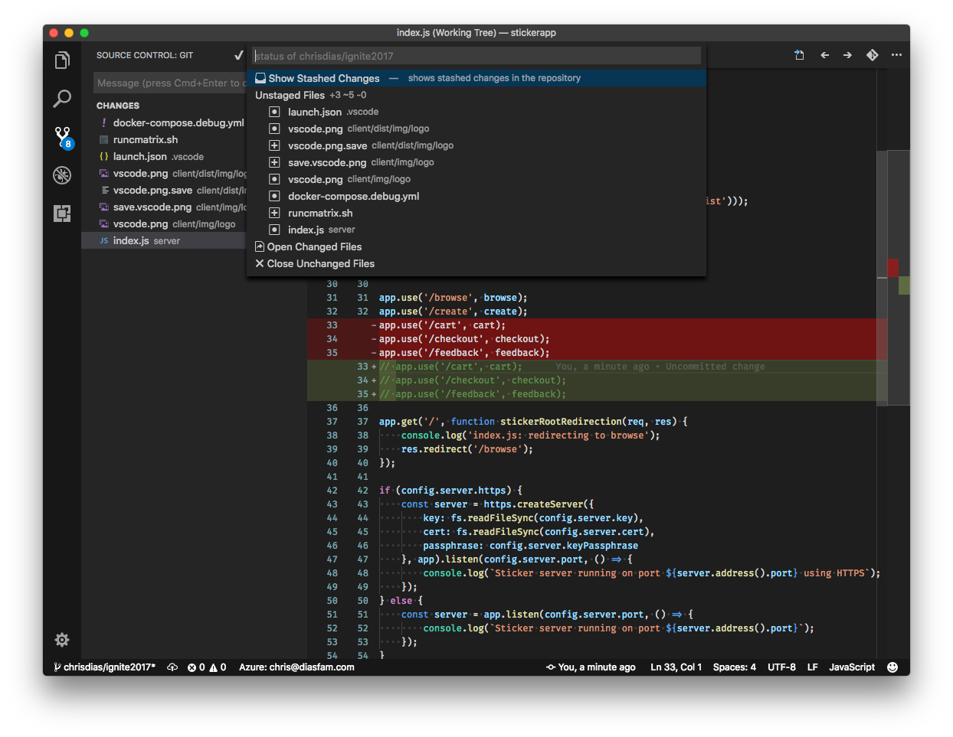
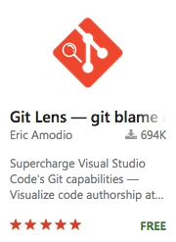
Source Code Control
Multiple Providers
Git, Hg, VSTS, Perforce
Diff
Side by side, inline, accessible
git config --global core.editor code
Easy branching, staging, stashing, and partial commits

Slide 13
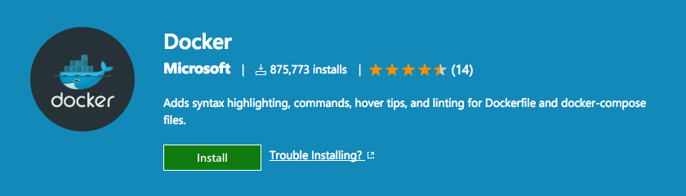
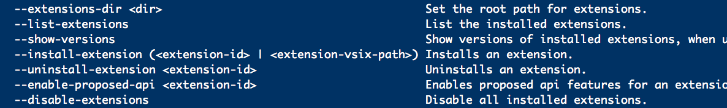
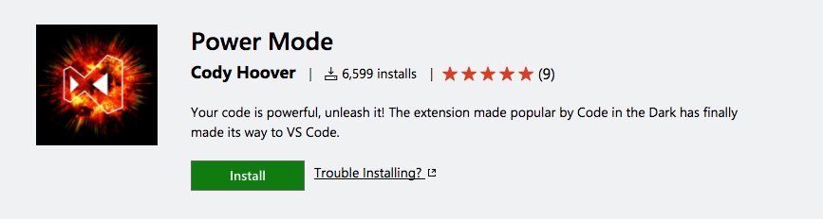
Extensions and the Marketplace
Easy to create!
npm install –g generator-code
yo code
Single click install
Manage with code CLI
Fun extensions
Open Folder, Close All, NPM Validation
And of course… Power Mode

Slide 14
#HappyCoding!
Follow us @code
Learn: https://code.visualstudio.com/docs
Insiders: https://code.visualstudio.com/insiders
Contribute: https://github.com/microsoft/vscode
Tips: https://github.com/microsoft/vscode-tips-and-tricks

Slide 15

Please evaluate this session Your feedback is important to us!
This slide is required. Do NOT delete or alter the slide.
The slide will be replaced onsite through Silver Fox Productions with an updated QR code.
From your PC or Tablet visit MyIgnite at http://myignite.microsoft.com
From your phone download and use the Ignite Mobile App by scanning the QR code above or visiting https://aka.ms/ignite.mobileapp

