Slide 2



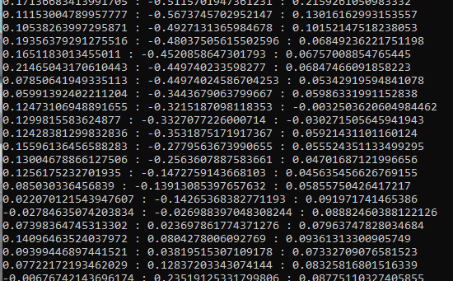


solution
injest
query
Embed into vectors
embedder
Embed into a vector
Store in DB
Query db for matches
Query vector
Chroma
Documents
Shove selected matches and query into llm
LLM
Display to user

Slide 3
DB info
demo db took ~2 minutes to injest all documents
  17 AI linked in articles
  353 Wikipedia chemistry and science links
  4 Wikipedia frog links
  57606 vectors

Slide 4
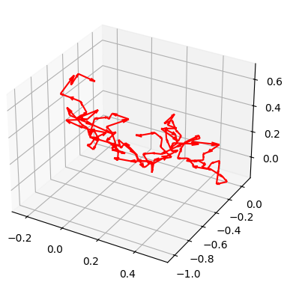
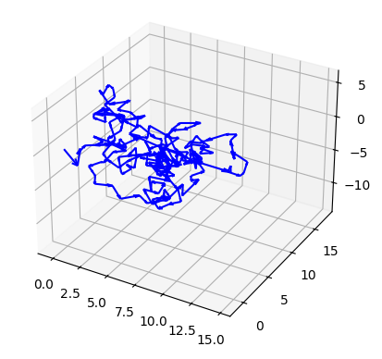
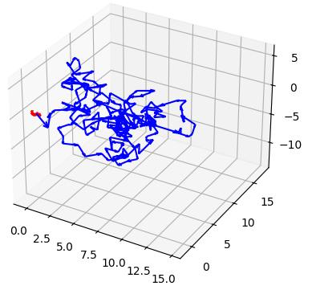
Embedding encoding
“What is ai” nomic text
“What is ai” both
“What is ai” gpt4

Slide 5
Tech used
Langchain
  Mit license
  Company in sf
  Tools to build llm applications
Chroma
  apache 2.0 license
  Based in SF
  Vecor db used to store data for llms

Slide 6
costs
Openai pricing
  Vector storage $.10 per gb per day
  Tokens 1million $0.75 to $225
  Embeddings 1 million $0.02 to $0.13

Slide 8

injest
query
Embed into vectors
embedder
Chroma
LLM

