Slide 1
Weather app
Christopher helland
Features:
Input a city and state, output current weather using OpenWeatherMap API
Shows some unit conversions

Slide 2

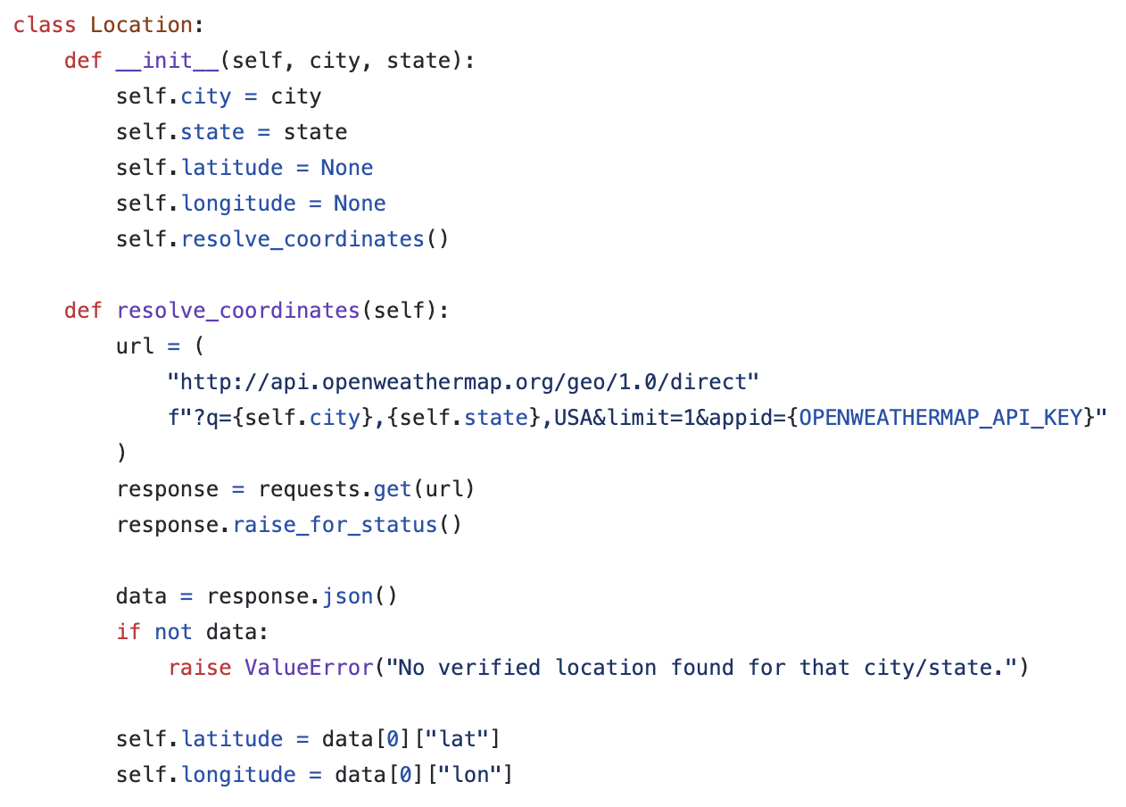

Slide 3
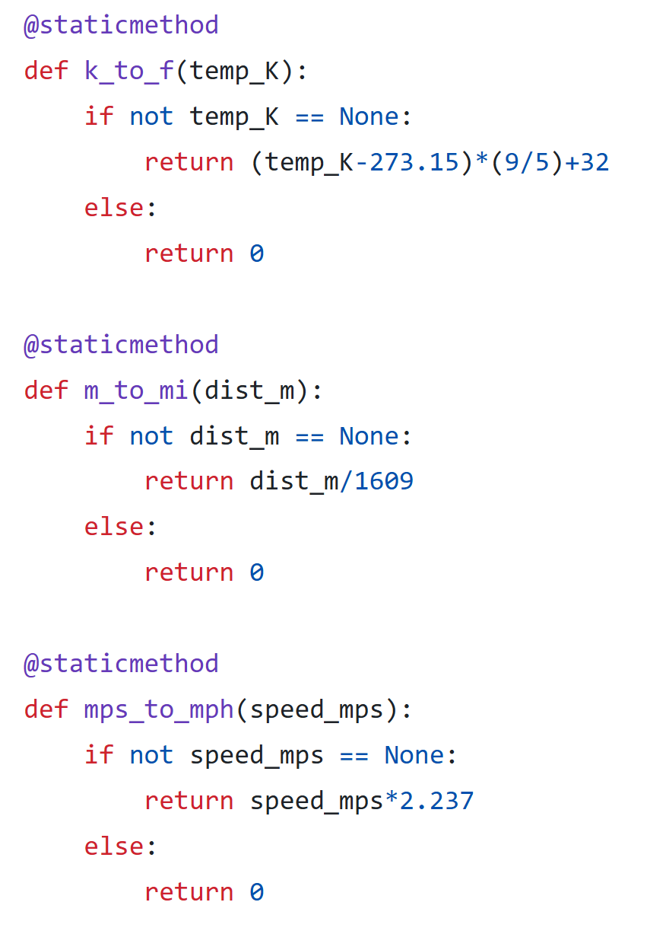
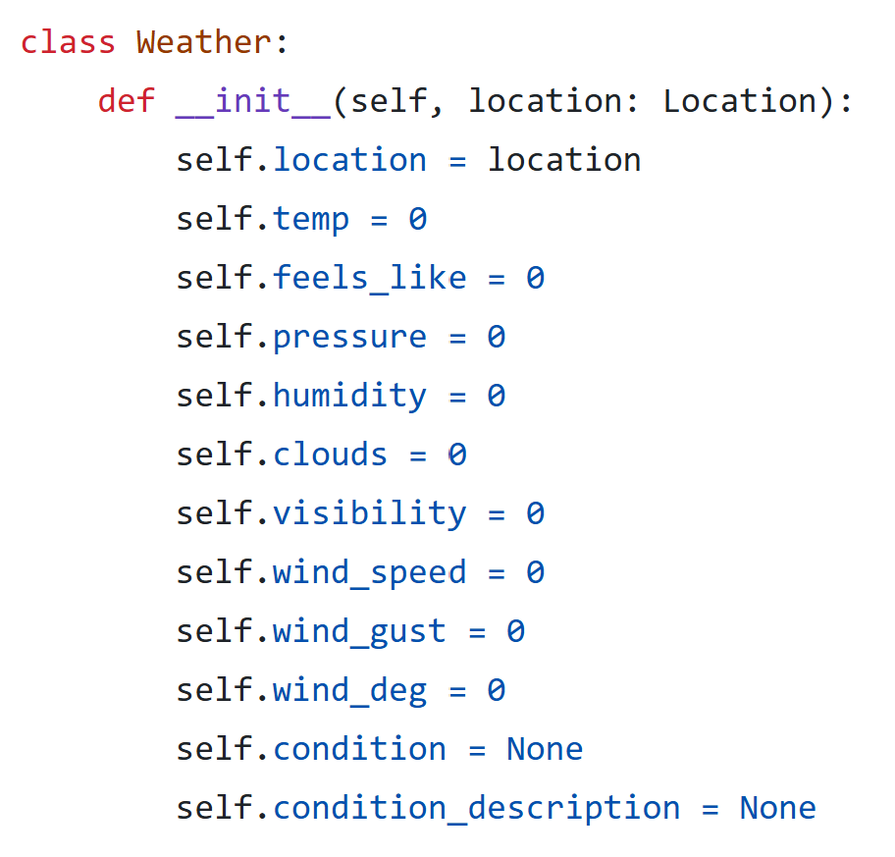

Slide 4
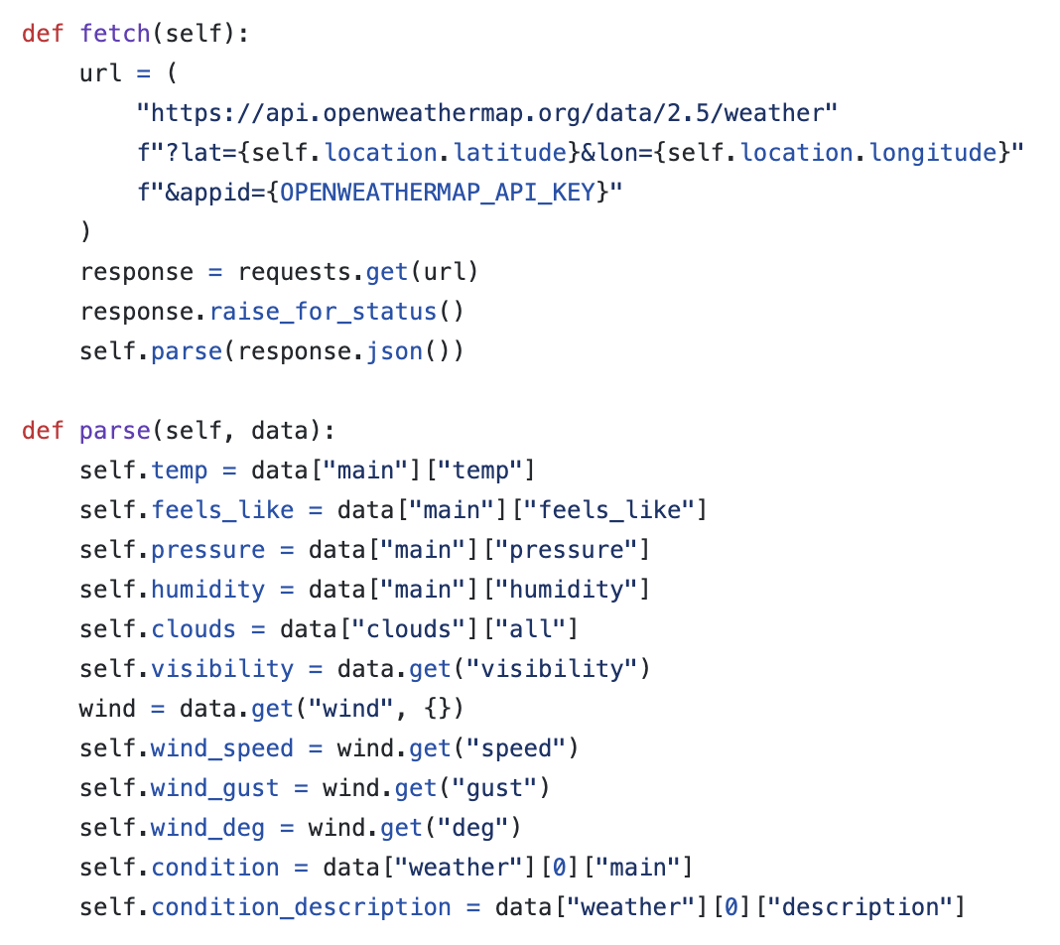

Slide 5
