Slide 1

remix and other development tools
Debugging Smart Contract
github.com/ethereum/remix
yann@ethereum.org

Slide 2

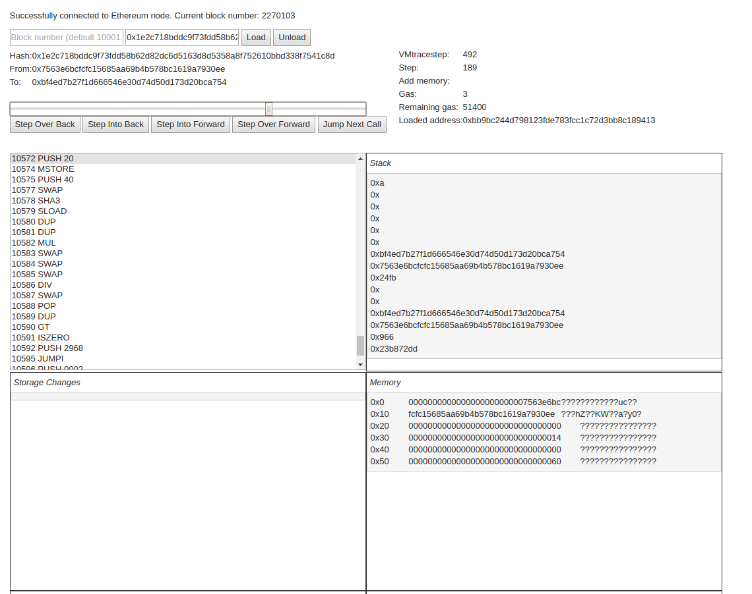
remix and other development tools
Smart contract debugging
    VM
    Solidity
JavaScript / npm / node
Easily Integrable and will benefit all other tools developed by the community

Slide 3
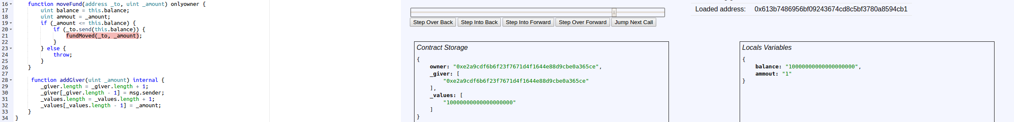
remix and other development tools
Source code debugging
Breakpoint manager
Tracker
  Contract storage
  Locals variables
Extends any Solidity/Text Editor
That can deal with a JavaScript module

Slide 4
remix and other development tools
Remix integration in Browser solidity

Slide 5

remix and other development tools
Testrpc
Dapple
Truffle
Etherscan
Ethercamp
Ethereum Studio
Mist
Metamask
...
Remix available as NPM module ...

Slide 6
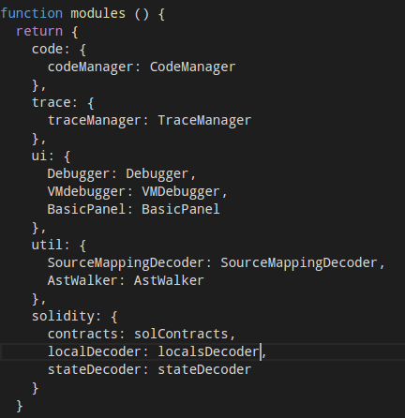
remix and other development tools
… and provide “low level” tools
That anyone can use to extend tools, imagine new use cases.

Slide 7
remix and other development tools
Integration in progress:
Metamask
Mist
Etherscan
Browser solidity (as a full featured IDE)

Slide 8
remix and other development tools
Concrete objectives to keep in mind:
Debug transactions that are already committed (source code)
Easily integrable in any apps that needs transactions inspection either
for development purpose or whatever else
Provide “low level” API that aim to extend other apps
  AstWalker
  TraceManager
  SourceLocationTracker
  ...

Slide 9
remix and other development tools
What's next
Commit Storage / Local Tracker
Breakpoint manager
Scenario builder
Ethereumjs-vm full integration
Mist full integration
(a lot of) documentations :)
Ensure performance
Extend Browser solidity
      Github integration
      Directory structure
      Static analysis
      Smart contract unit testing

Slide 10
remix and other development tools
Follow, contribute, propose !
github.com/ethereum/remix
github.com/ethereum/browser-solidity
gitter.im/ethereum/remix
gitter.im/ethereum/cpp-ethereum
gitter.im/ethereum/cpp-ethereum-development
ethereum.github.io/browser-solidity
ethereum.github.io/remix

