Slide 1
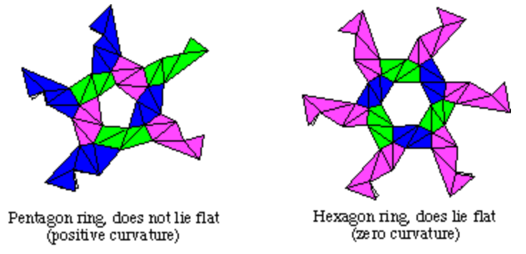

http://kahuna.merrimack.edu/~thull/phzig/phzig.html

Slide 2
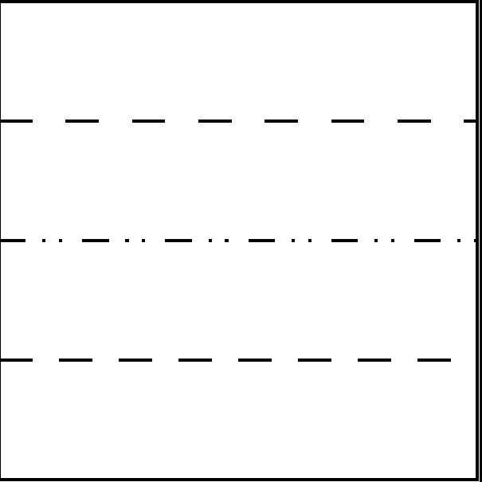
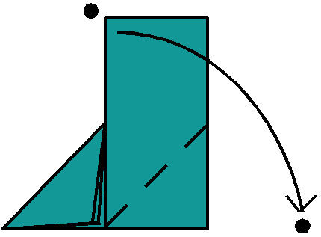
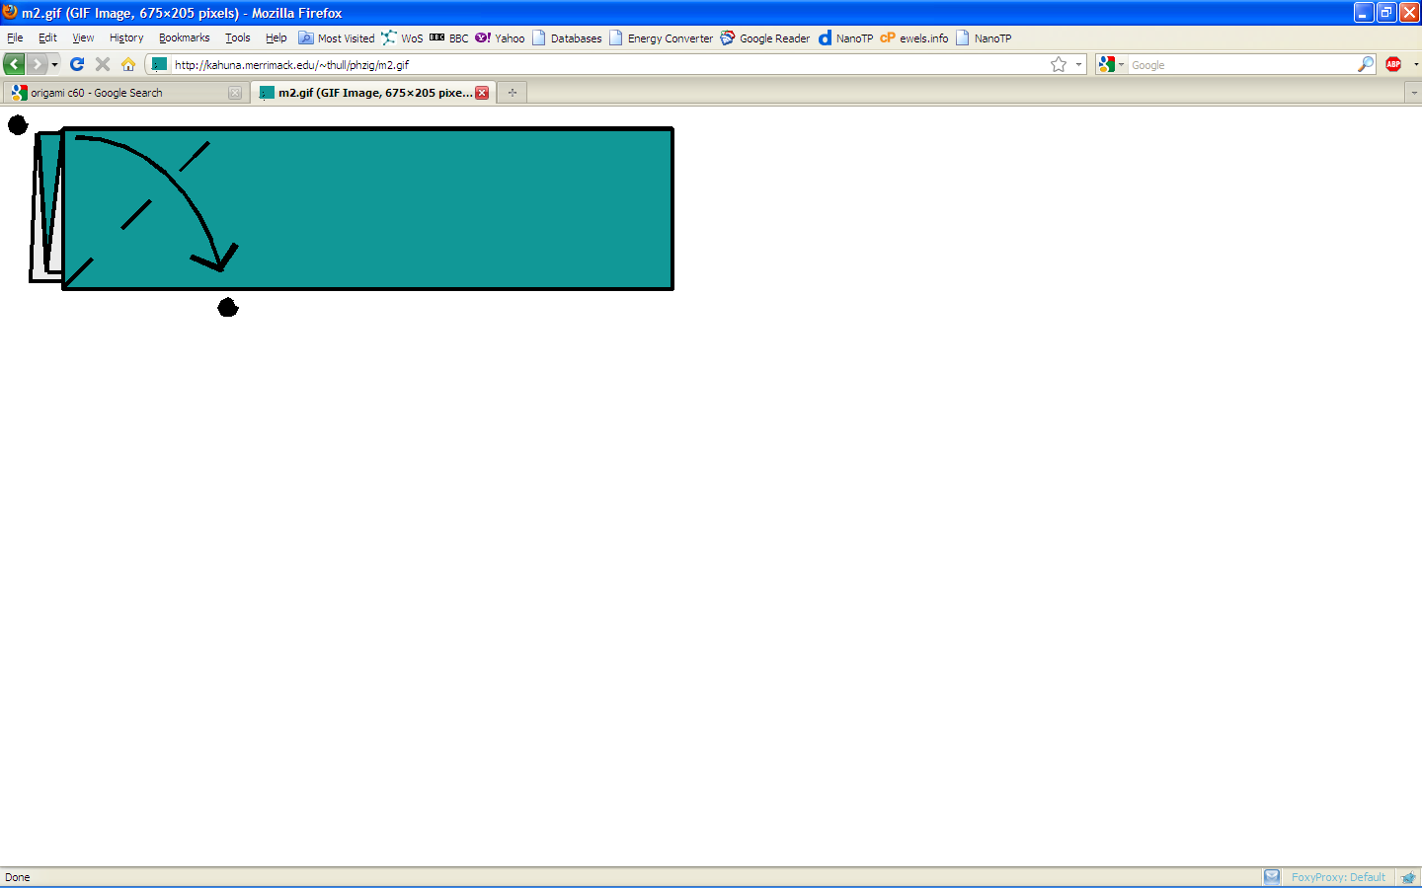
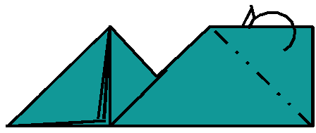
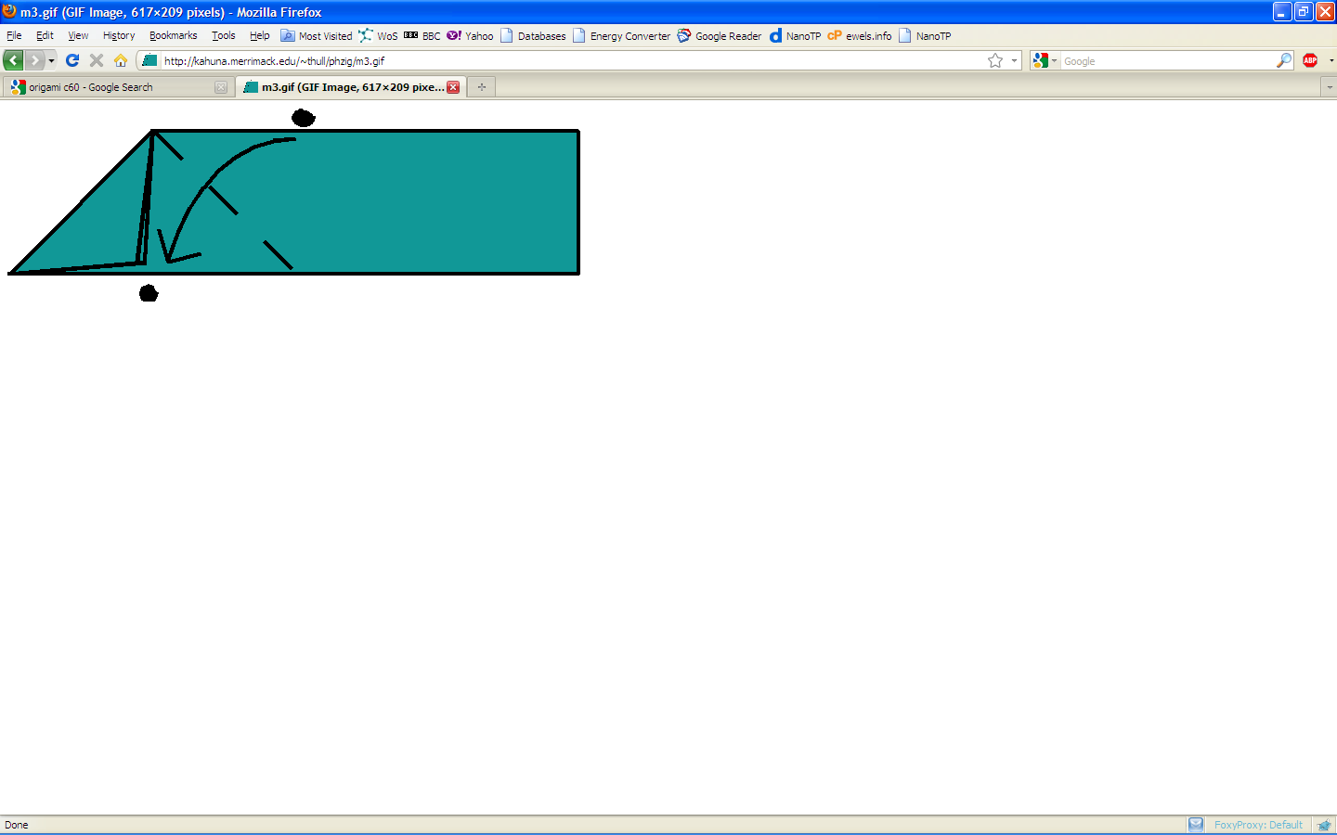
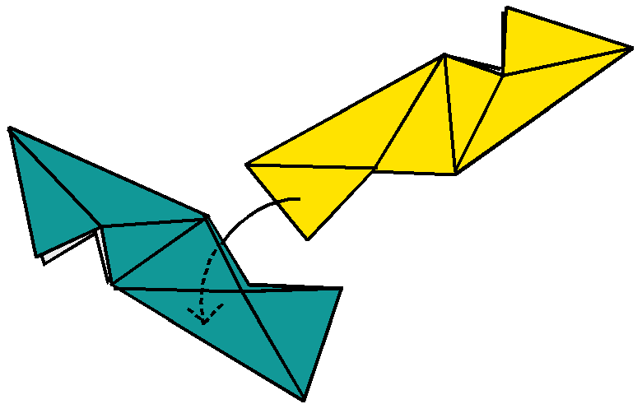
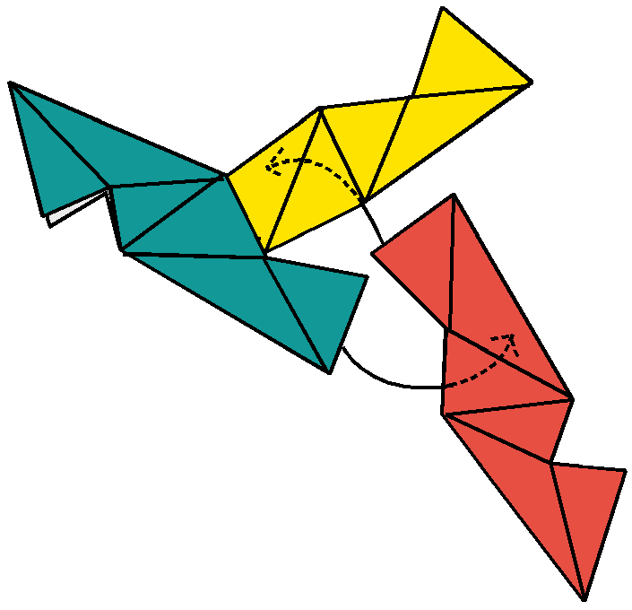
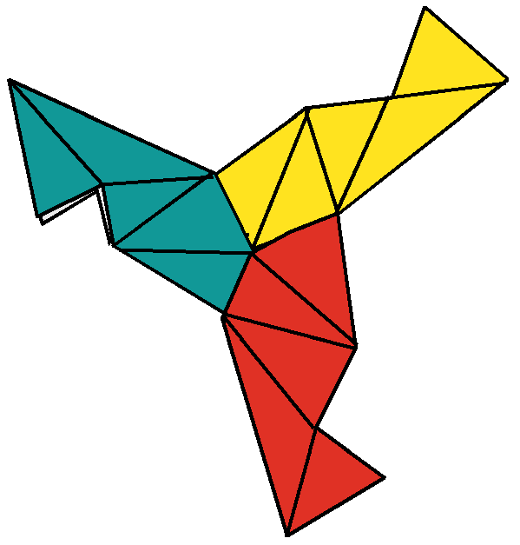
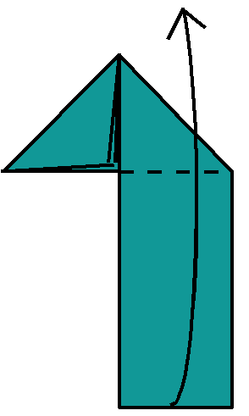
Take a square piece of paper and fold it ‘up-down-up-down’ into four.
(5) Fold the strip down to the right
(2) Fold the top left corner down.
(6) Fold the upper right
corner behind, and your unit is finished!
(3) Fold the right end of the strip down to meet the folded edges.
(4) Now fold the strip up, so the bottom is straight.
Slide the end of one unit into the side of another, as shown. The flap should go in between the
layers of paper, and crease lines should line up.
It takes three units to make a corner. Slide the third unit into the second
unit, and slide the first into the third.
This is what you should see.

