Slide 1
URTIC Cold Detection: mid-term result and plan
Christoph Feldkircher, Ming Yuan Lee, Akshat Chouksey
ML4Health SS26, Technical University of Munich
16 June 2026
Feldkircher, Lee, Chouksey | ML4Health SS26, TUM | URTIC Cold Detection
Notes:
We submitted our system to the ComParE 2017 Cold task. It scored UAR 0.62 on the hidden test, below what our own validation predicted. I will cover what we used, what went wrong, why, and what we change next.

Slide 2
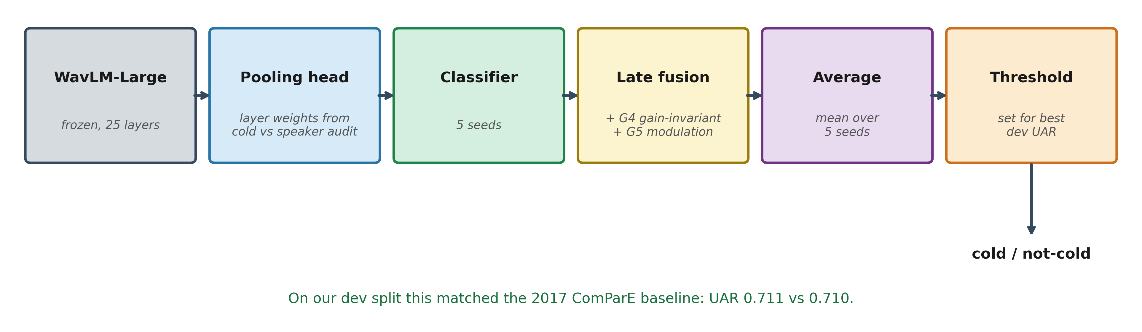
What we used
Feldkircher, Lee, Chouksey | ML4Health SS26, TUM | URTIC Cold Detection
Notes:
We rebuilt the 2017 late fusion with a modern backbone. Frozen WavLM with audit-weighted pooling, two handcrafted groups fused on top, five seeds averaged, one threshold tuned on a dev split. On that split we matched the published baseline.

Slide 3
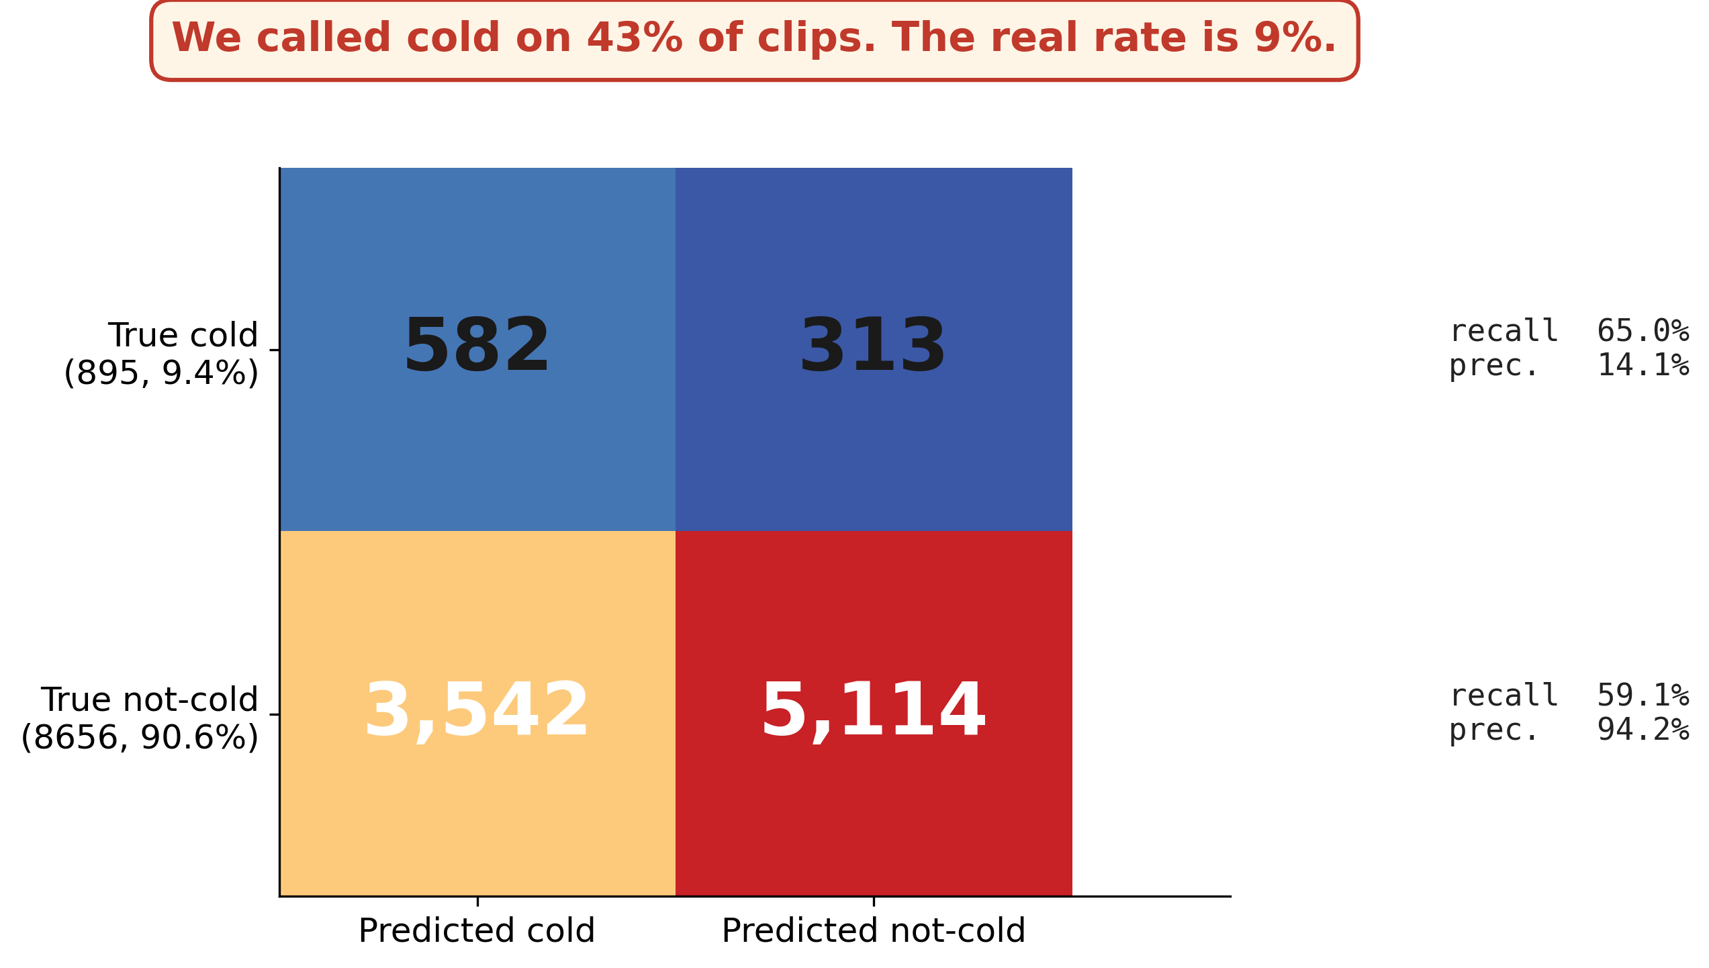
What went wrong
Feldkircher, Lee, Chouksey | ML4Health SS26, TUM | URTIC Cold Detection
Notes:
On the hidden test we got 0.62. Our own validation said 0.69, and the result sits below every dev fold we measured. Precision on cold is 14 percent. We checked the run five ways and it is byte for byte correct, so this is not a bug. It is a generalization gap.

Slide 4
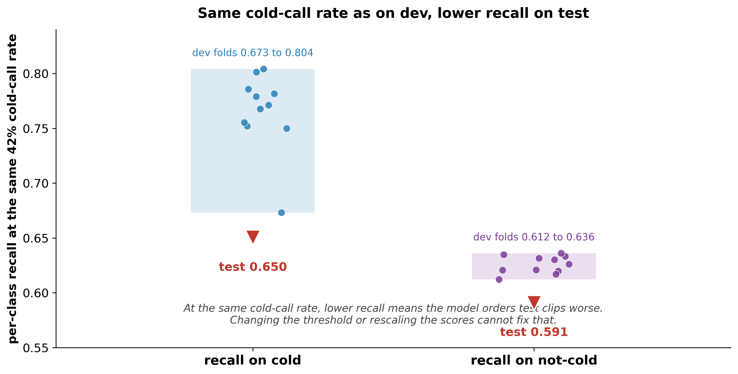
The problem is the ranking, not the threshold
Feldkircher, Lee, Chouksey | ML4Health SS26, TUM | URTIC Cold Detection
Notes:
The easy story is that we call cold too often. But at our threshold the cold-call rate is about 42 percent on dev too, so the rate is matched. Hold it matched and look at recall: on test it is below every dev fold, on both classes. At a fixed call rate that is a ranking loss, and no threshold change fixes a ranking loss.

Slide 5
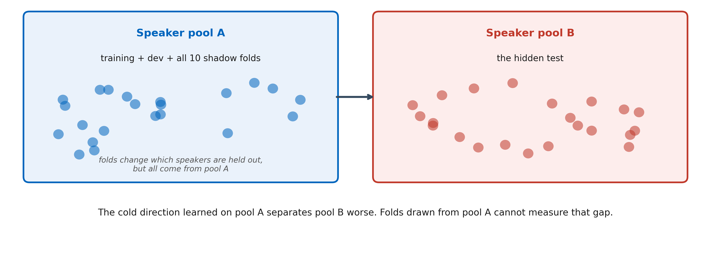
Why our dev folds did not catch it
Feldkircher, Lee, Chouksey | ML4Health SS26, TUM | URTIC Cold Detection
Notes:
Our folds are speaker-disjoint, but they all come from one speaker pool. The hidden test is a different population. The cold direction we learned leans on speaker traits from our pool and transfers worse. Folds drawn from the same pool cannot measure that gap.

Slide 6
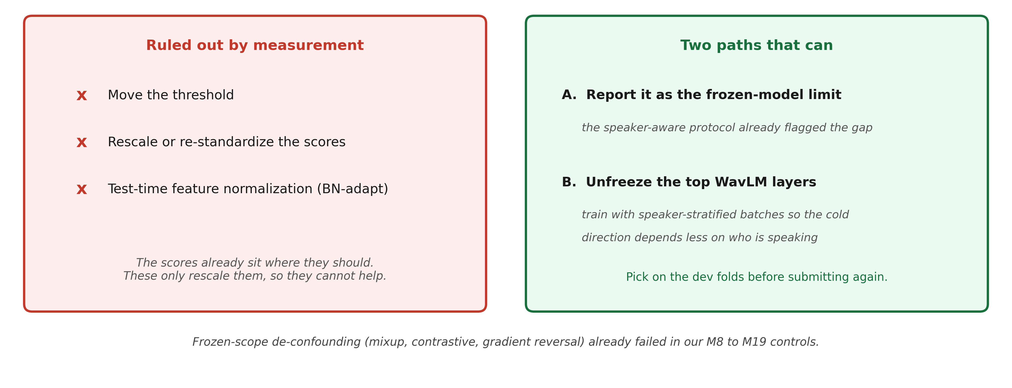
What we change next
Feldkircher, Lee, Chouksey | ML4Health SS26, TUM | URTIC Cold Detection
Notes:
We ruled out the cheap fixes by measurement. Two real options. One, report this as the ceiling of a frozen backbone, which our protocol already flagged. Two, unfreeze the top layers and train with speaker-stratified batches so the cold cue depends less on who is talking. We pick on the dev folds first.

Slide 7
References
Schuller et al. The INTERSPEECH 2017 Computational Paralinguistics Challenge: Addressee, Cold and Snoring. Interspeech 2017.
Chen et al. WavLM: Large-Scale Self-Supervised Pre-Training for Full Stack Speech Processing. IEEE JSTSP, 2022.
Yang et al. SUPERB: Speech processing Universal PERformance Benchmark. Interspeech 2021.
Coppock, Jones, Kiskin, Schuller. COVID-19 detection from audio: seven grains of salt. Lancet Digital Health, 2021.
Feldkircher, Lee, Chouksey | ML4Health SS26, TUM | URTIC Cold Detection
Notes:
References for the baseline, the backbone, the frozen-representation paradigm, and the speaker-confound point.

