Slide 1
 | The A-maize-ing-trio (DE results using our counts table) |  |  | Springer et al
 | Mo17 | B73 | Oh43 | Mo17 | B73 | Oh43
Cold | 4,271 | 4,437 | 4,313 | 5,309 | 4,819 | 4,668
Heat | 5,252 | 5,727 | 930 | 5,310 | 5,114 | 5,438
Salt | 1,791 | 2,646 | 1,944 | 5,118 | 5,986 | 5,712
UV | 1,785 | 1,535 | 1,924 | 4,120 | 3,823 | 4,555
Total DE genes (non redundant) | 10,857 |  |  | Not provided

Slide 2
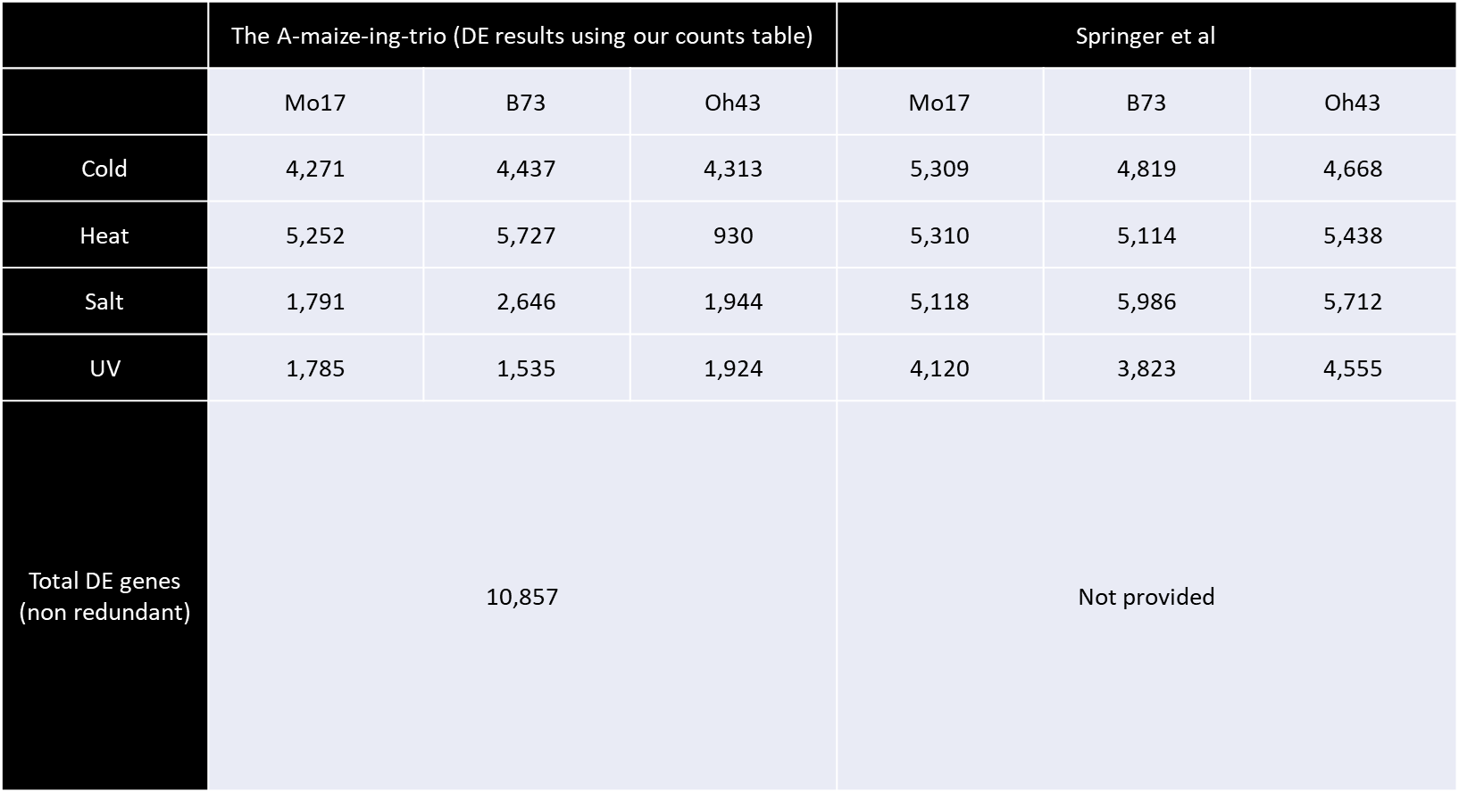

Slide 3
 | The A-maize-ing-trio (DE results using authors count table) |  |  | Springer et al
 | Mo17 | B73 | Oh43 | Mo17 | B73 | Oh43
Cold | 2,579 | 2,211 | 2,461 | 5,309 | 4,819 | 4,668
Heat | 3,106 | 3,614 | 634 | 5,310 | 5,114 | 5,438
Salt | 2,084 | 3,105 | 2,335 | 5,118 | 5,986 | 5,712
UV | 2,244 | 1,710 | 2,296 | 4,120 | 3,823 | 4,555
Total DE genes (non redundant) | 7,502 |  |  | Not provided

Slide 4


